Slide 1
Finding an Edge
Creating a Moat around an Investment Process
Notes:
Thanks to Dave, the students, and Texas Lutheran for having me.
Quick question: who here knows what investors mean when they talk about Moats?
We hopefully all understand why its important to talk about competitive advantage in the context of a business. But for those of you who want to make a career of stock picking, as I have, its important to understand how you can create competitive advantages for a firm and for an investment process.
So I’m going to talk today about how an investment manager can create a competitive advantage in an investment process. One that is difficult to replicate, and one that creates returns above a benchmark index over extended periods.

Slide 2
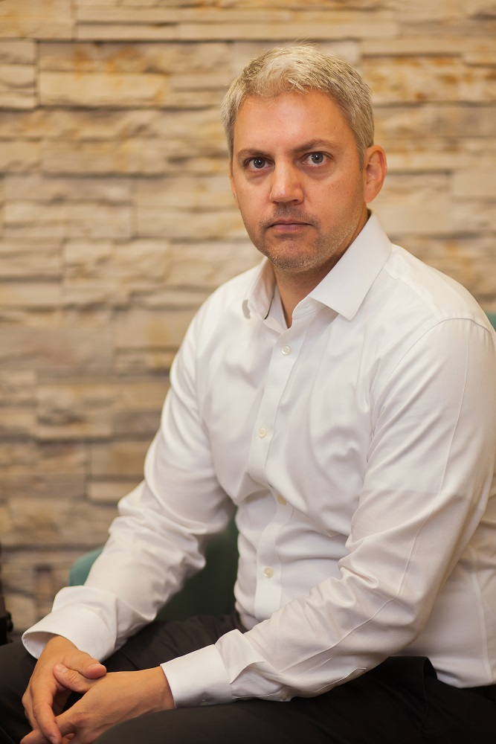
Brian T. Bares, CFA
Bares Capital Management, Inc.
Research Analyst
AUM: $2.7 Billion
Three concentrated strategies:
Micro Cap (closed)
Small Cap (closed)
Mid/Large Cap (open)
*as of 2/28/2018
Notes:
So who am I and why am I qualified to talk about this subject?
Our firm is an institutional investment manager. We have three concentrated strategies that total about $3 billion across the organization. And we have two major differentiators. First, we are highly concentrated in the portfolios that we run (typically between 8-12 names) and we rely heavily on the qualitative sourcing and vetting of ideas. So if you take two key principles away from today, remember that we are concentrated and qualitative.
Not only do we embrace these two principles because we believe that they will increase our chances to put up market-beating performance numbers, but we also happen to believe that there are structural reasons why others aren’t willing to embrace what we do, which creates a competitive advantage, or moat, around our business.

Slide 3
My Story
Notes:
My story actual starts here in the great state of Nebraska

Slide 4
U. Nebraska Grad
Boutique Small-Cap Manager
Bares Capital
Math 1995 (Lincoln, NE)
1997-2000 (Austin, TX)
2000-Present (Austin, TX)
Notes:
Truncated professional history
Grew to love Buffett.
Studied mathematics in Lincoln. Came from an entrepreneurial family.
Followed a girl to Austin after college. Married a different one.
Talked my way into a job at a small-cap value manager in Austin. Did everything from compliance to ops, built the trading desk, and eventually worked my way onto the portfolio management team. Got my CFA. It was my total immersion apprenticeship. We were highly diversified and quantitative in our approach. Today we are the exact opposite.

Slide 5

World Headquarters in June 2000
Startup Capital: $21,195.14
Notes:
When you think about the investment management industry, You wouldn’t think of it as one with high barriers to entry. One component of a moat is having some barrier to keep competitive pressures at bay.
This slide makes it clear that if I could get to $3B in managed assets from a standing start, that the business likely has some commodity characteristics.

Slide 6
Barriers to Entry in Investment Management are not Financial
Notes:
Barriers are not financial
Investment Management industry is unique.
Barriers are not obvious.

Slide 7
Real Barriers to Entry:
Track Record (3-5 years)
Categorization (Morningstar “Style Boxes”)
Youth and Inexperience (I was 27 years old)
Lack of a Team
Assets Under Management (Chicken-and-Egg Problem)
Notes:
The real barriers to entry are:
Successful track record
An investment strategy that “fits” what investors are looking for
Industry experience
Broad team both in research and operations
-but this all leads to a phrase I call the Chicken and Egg Problem. YOU NEED THE ASSETS TO DEVELOP THESE CHECKBOXES, BUT YOU NEED TO CHECK THE BOXES TO GET THE ASSETS.
So I approached the business with eye toward differentiation and a ton of hard work in an attempt to surmount these challenges.

Slide 8
Bares Capital from $40,000 to $2.7 Billion
We avoided:
Individuals
Mutual Funds
Grew AUM with Institutional Clients
Notes:
Structurally, I chose an interesting path. One that is nonobvious.
We decided to go after institutional money as early as possible.
I thought that managing individual money was more about managing investor psychology than managing money. It also didn’t scale as well.
I thought that the world didn’t need another mutual fund. 40 act funds are a regulatory nightmare and they have much higher breakeven points than institutional separate accounts.
I had also made the decision to limit the capital in our strategies, which effectively capped our potential compensation. That isn’t a great model for a 40 act fund.
My goal was to run very concentrated portfolios for institutions where we were a small allocation in a larger, more diversified portfolio. We could attract a small group of clients that were long term, and restrict our size to maintain investment flexibility and focus on investment performance.

Slide 9
WHAT MAKES US DIFFERENT
Concentrated
10 stock portfolios
~60% in top 5
Low turnover
Qualitative
No computer screening
Lots of field work
Unique Ideas
Notes:
The two main structural differentiators for us are our level of concentration and, importantly, our focus on qualitative factors. We do our own work and its traditional shoe leather field research.

Slide 10
We Do Things The Hard Way
Concentrated
10 stock portfolios
Incentives
More AUM
More Diversity
Larger Mkt Caps
= More Mgmt Fees!
Qualitative
No computer screening
Easy Path
Computer screens
Idea trading w/ peers
Sell side ideas
= Unsustainable!
Notes:
We have opted to avoid the easy path in our firm.
Our concentration runs counter to our economic incentives. If we were concerned primarily with our own profitability, we would diversify, gather more assets in our existing strategies that are closed and have good performance, and earn more management fees. But we feel strongly that this path would jeopardize our potential for outperformance.
Furthermore, by choosing to follow an investment process that is primarily qualitative in nature, we can’t take computer screening shortcuts, we can’t trade our ideas with friends or accept ideas from the sell side, and we have to do our own hard work.

Slide 11
Building a Moat around an Investment Process
Notes:
OK – so we talked at a high level about our firm, lets now get into the meat of the presentation. How do we structure an investment process that is hard for other investors to replicate.

Slide 12
INVERTING THE CONCEPT:
HOW TO INSURE MEDIOCRITY
An undifferentiated investment process is:
Easy to execute
Reliant on “industry standard” tools
Excessively Diversified
  “Hugging the benchmark”
  Increased fee-based AUM
Susceptible to Outside Influence
Trading ideas with other managers (Social Proof)
Sell side stock pitches
Notes:
Well, lets start by inverting the exercise.
How would we build an investment process that was totally average and destined for mediocrity?
We would make it
EASY TO EXECUTE
We would have all of the inputs come from
INDUSTRY STANDARD TOOLS (BLOOMBERG, FACTSET, AND OTHER COMPUTER SCREENING AND ANALYTICAL TOOLS)
We would construct a portfolio that hugged the benchmark to insure no clients ever deviated too much from average, this would appeal to risk-averse consultants, boards of large pension funds who are not investment people, and to internal staff who don’t want career volatility. It would also have the convenient byproduct of increasing fee paying AUM to make the manager more profitable.
And finally, we would have no original investment intellectual property. We would trade ideas with our friends and talk a lot to Wall Street and have them sell us their best ideas.
Sound like any firms that you have heard of? If you are nodding yes, its because its most of them.

Slide 13
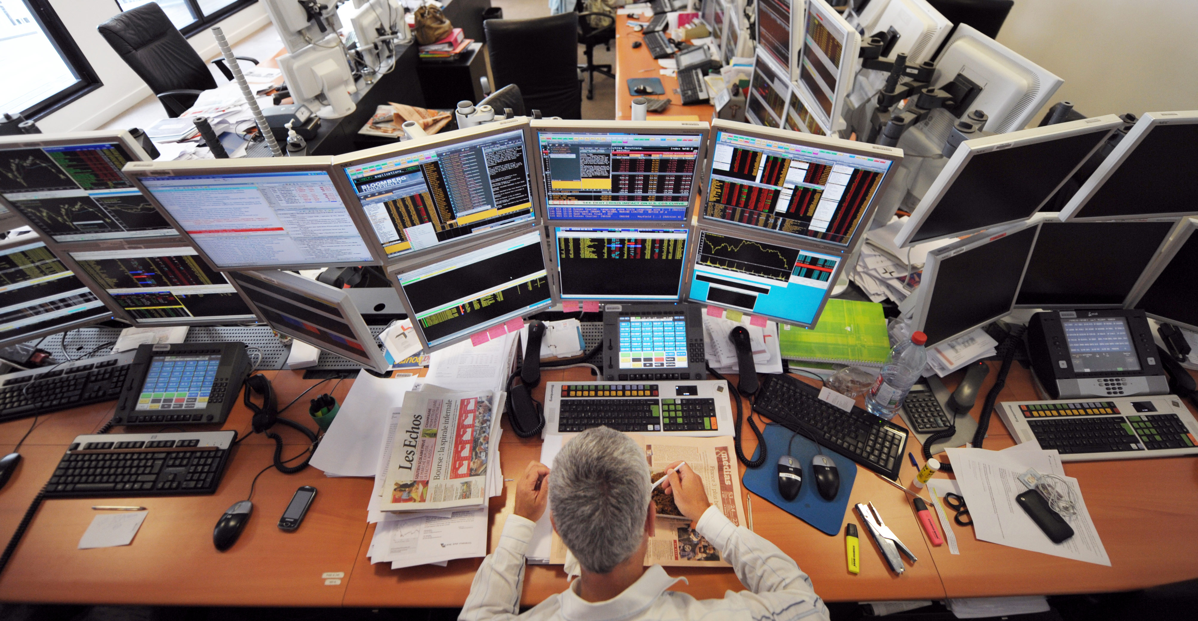
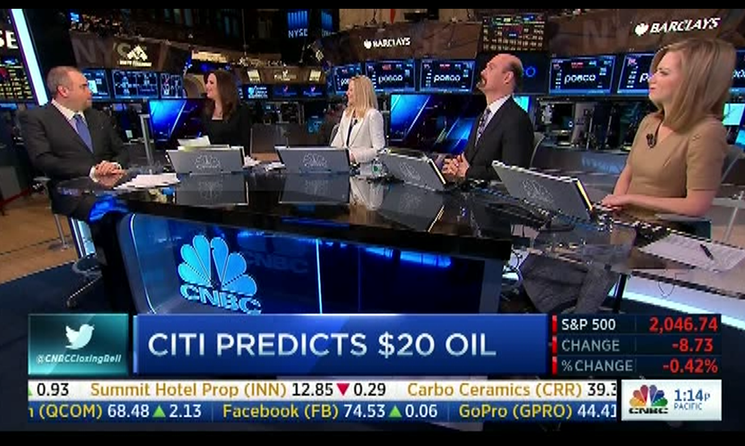
Typical “No Moat” Process
Standard Tools
Mechanistic Process
Step 3
Step 2
Step 1
Outside Influence
Notes:
So here we have a manager with his six screen display, with Bloomberg, probably a trade execution window, so he generates a bunch of fees for his broker, who in turn sells him ideas. He’s constantly on the phone talking to his peers, but not people at the companies he owns.
He probably follows some mechanistic process, where his clients feel artificially comfortable that human bias and emotion are minimized. And he ends up with hundreds of investments so that his clients pay active fees but get passive results.
And here we have the blare of the Fast Money crowd inciting his receptive brain into acting more than he should.

Slide 14
INVESTORS ALSO WANT REPEATABILITY
Is sharing ideas repeatable?
Relying on “one-off” macro calls?
(e.g. The Big Short)
Guessing Next Quarter’s Earnings?
Outsourcing idea generation?
Notes:
So as a follow on to this, people who allocate capital to managers like us want some repeatability in an investment process.
But think about some of the more famous investors we heard about in the last 10 years or so. Do the guys in the Big Short have a formal process? I’m not taking anything away from them at all, but was their success a one-off occurrence? Can they continue to find the next big macro call with anything close to reliability?
What about managers who share ideas, or who guess next quarter’s earnings, or who rely on third parties or the sell side to give them their next money maker? Can an allocator have any faith in the repeatability of these processes?

Slide 15
Building a Differentiated Process
Notes:
So lets talk about what makes a differentiated process and how to make it repeatable

Slide 16
IDEA GENERATION – TWO OPTIONS
QUANTITIVE
Pros:
Repeatable
May be unique (for a while)
Easy to execute
Cons:
Misplaced confidence
Subject to competitive arbitrage
Tends to be backward looking
QUALITATIVE
Pros:
Can be repeatable
Unique ideas
Incorporates non-financial analysis
Cons:
Hard to communicate
Difficult to execute
Requires cummulative experience
Need to do the hard work yourself
Notes:
If you are a common stockpicker, the way I see it, you have two general paths to building a formalized investment process.
You can build a quantitative process, where you have repeatability with your screens. You may think you have a unique recipe of factors that have backtested well. And best of all, its easy to execute. No divas on your team demanding large salaries for thinking they are the next Warren Buffett, just a computer running your process.
The downside is that there is artificial confidence in the results of a process simply because its quantitative. And the worst part is that when a quant strategy stops working, you can’t tell until its too late. Usually someone else is committing significant capital to something similar, and competitive arbitrage nullifies everyone’s advantage.
Finally, everything you know about a business is in its past, everything that determines the value of a business is in its future. Quant strategies are notoriously reliant on backward looking accounting stats
[WESTERN DIGITAL EXAMPLE]
If you take a more qualitative route, you can formalize a set of characteristics you are looking for, and attempt to convince your investors that you have something repeatable. Your ideas are more likely to be unique as they will be reliant on assessing harder to guage non-financial factors like capital allocation or competitive advantage. The hard part is that they are difficult to articulate to investors, they are even harder to execute since you need a team. And it takes time to accumulate relevant experience. In short, you need to do the hard work yourself. And its human nature not to want to do this.

Slide 17
IDEA GENERATION – TWO OPTIONS
QUANTITIVE
Pros:
Repeatable
May be unique (for a while)
Easy to execute
Cons:
Misplaced confidence
Subject to competitive arbitrage
Tends to be backward looking
QUALITATIVE
Pros:
Can be repeatable
Unique ideas
Incorporates non-financial analysis
Cons:
Hard to communicate
Difficult to execute
Requires cummulative experience
Need to do the hard work yourself
Notes:
As you may have already guessed, we have opted to pursue the qualitative path. We put in the hours, hired the people, convinced allocators to come along for the ride, and committed to a formalized process.

Slide 18
OUR FUNDAMENTAL PREMISE
Stock Price
Per-Share Business Value
Notes:
Our qualitative process starts with a simple premise – stock prices follow internal compounding of business value per share. If you want stock price outperformance, you need to be looking for above average compounding of business value.
Micro economics teaches us that above average results usually can’t result from average businesses. Why? Because everyone earns their cost of capital over a cycle.
If you own a dry cleaner, and are earning excess economic returns, I’m going to open one across the street and compete with you on price until we both earn our cost of capital over a cycle. That is, unless one of us has a unique competitive advantage.

Slide 19
EXCEPTIONAL STOCK PRICE PERFORMANCE
MUST COME FROM EXCEPTIONAL PER-SHARE COMPOUNDING OF BUSINESS VALUE
ABSENT:
MULTIPLE EXPANSION/CONTRACTION
DISTRIBUTIONS AND DIVIDENDS
GIVEN A LONG ENOUGH TIME HORIZON
Notes:
So in short – if you remove multiple expansions and contractions, distributions and dividends, and you are long term investor, exceptional stock price performance is driven by exceptional compounding of business value.
How do you get exceptional compounding of business value over sustained periods?

Slide 20
EXCEPTIONAL STOCK PRICE PERFORMANCE
MUST COME FROM EXCEPTIONAL PER-SHARE COMPOUNDING OF BUSINESS VALUE
ABSENT:
MULTIPLE EXPANSION/CONTRACTION
DISTRIBUTIONS AND DIVIDENDS
GIVEN A LONG ENOUGH TIME HORIZON
BOTTOM LINE
EXCEPTIONAL COMPOUNDING OF BUSINESS VALUE COMES FROM THREE SOURCES
Notes:
You get it from three sources.

Slide 21
RESEARCH FOCUS
Moat
Management
Unappreciated
Growth
Notes:
Moats (competitive advantage)
Management (exceptional capital allocators and operators)
Unappreciated sources of growth (embedded call options, long runways)

Slide 22
RESEARCH FOCUS
Moat
Management
Unappreciated Growth
THESE FACTORS ARE QUALITATIVE
Notes:
Note that the identification of these factors is a qualitative exercise
The results of high scores in these areas is quantitative excellence, but the money is made in the identification of these factors before the results have been posted.

Slide 23
A MOAT AROUND AN INVESTMENT PROCESS
TEAM
Staffed team of research analysts with ample field travel budget
FOCUS
Study qualitative differentiation among moats, management teams, and underappreciated areas of growth
DISCIPLINE
Cap assets under management to insure strategy success and concentrate in best ideas
Notes:
So what have we done to build the moat around our qualitative investment process?
We have a dedicated team of 11 analysts who are empowered to chase down ideas.
We have a focus on those qualitative factors we mentioned
And we have the discipline to execute and not follow our economic incentives into situations of over diversity.

Slide 24
A MOAT AROUND AN INVESTMENT PROCESS
TEAM
Staffed team of research analysts with ample field travel budget
FOCUS
Study qualitative differentiation among moats, management teams, and underappreciated areas of growth
DISCIPLINE
Cap assets under management to insure strategy success and concentrate in best ideas
Cumulative knowledge will widen the moat over time
Notes:
A final note is that the longer you do this, the better your cumulative knowledge becomes, which should help to wide the moat over time.

Slide 25
Bares Capital Productivity and Selectivity
 | Last 3 Years
Office-Based Research | 1,495
Ideas Ruled Out | 722
Total Team Site Visits | 567
Presentations | 59
Portfolio Additions | 6
Notes:
Here is an example of our own productivity over the last 3 years.
In rough numbers, we have looked at 1500 companies closely, we ruled out over 700, we have performed almost 600 site visits as a team and that has resulted in 60 formal idea presentations to our team, which in turn added 6 names to our strategies.
This slide is designed to highlight the selectivity of our process.
This is hard for “two guys and a Bloomberg terminal” to replicate.

Slide 26
MOAT ≠ EDGE
Differentiation may not lead to outperformance
Notes:
I thought that I’d make the distinction between a moat and an investment edge.
Just because an investment process is hard to replicate, doesn’t necessarily mean that it will produce good results. A good process should be rooted in sound investment principles and should be designed to produce a unique take on an idea. In industry parlance, a “variant perception”

Slide 27
What is an Investment Edge?
My Definition:
Repeatable Sourcing of Variant Perception that Leads to Sustained Outperformance
Sources of Variant Perception:
Informational
Analytical
Behavioral
Notes:
My definition of an investment edge is
A repeatable sourcing of variant perception that leads to sustained outperformance
The unique take or variant perception can come from three areas:
You can have an informational advantage
You can have an analytical advantage
You can have an advantage based on systematic behavioral bias

Slide 28
What is an Investment Edge?
My Definition:
Repeatable Sourcing of Variant Perception that Leads to Sustained Outperformance
Sources of Variant Perception:
Informational
Analytical
Behavioral
Rare
True informational advantages are usually illegal
More common in small market caps
Hard to repeat
Notes:
Informational advantages are rare. Even in our microcap strategy, we almost never come across a real informational edge. One where material value of a company is totally missed by all market participants. For example, an undervalued piece of real estate on the books of a business. Even where you find this, its hard to make an informational edge a repeatable source of outperformance.

Slide 29
What is an Investment Edge?
My Definition:
Repeatable Sourcing of Variant Perception that Leads to Sustained Outperformance
Sources of Variant Perception:
Informational
Analytical
Behavioral
More Common
Analyzing public information differently than other investors
May be quantitative or qualitative
Can be a repeatable edge
Notes:
Analytical edges are the most common. Here you are taking public information and analyzing it in a unique or unusual way.

Slide 30
What is an Investment Edge?
My Definition:
Repeatable Sourcing of Variant Perception that Leads to Sustained Outperformance
Sources of Variant Perception:
Informational
Analytical
Behavioral
Very Common
Markets overreact
Investors are overconfident
Loss avoidance trumps rationality
Decisions are made on anchor prices
Hard to implement in practice
Notes:
Behavioral bias is prevalent in the stock market, but despite it being systematic, its actually very difficult to implement in practice, at least in my experience. You can talk about loss aversion, anchoring, overconfidence, and other biases, but its just hard to confidently make trades based on these factors. Perhaps some managers are successful with it, but I’ve been around the business for almost 20 years and met many of my peers in institutional money management. I rarely see anyone claim this a core part of their investment advantage.

Slide 31
Two Pillars of a Successful Investment Process
Building a differentiated investment process that is hard to replicate
Creating repeatable sources of variant perception that should lead to outperformance
Notes:
So in summary there are two ideas that are important to building a moat around a process that produces repeatable outperformance.

Slide 32
Two Pillars of a Successful Investment Process
Building a differentiated investment process that is hard to replicate
MOAT
Creating repeatable sources of variant perception that should lead to outperformance
EDGE
Notes:
There is the differentiated approach that is hopefully difficult to replicate, and there is the repeatable source of variant perception.
So you have to chose how you are going to structure your process if you decide to make a career out of running money. But smart allocators are going to demand to see some repeatable edge that is difficult for other managers to replicate.

Slide 33
Thanks!
ANY QUESTIONS?
You can reach me at
bbares@barescapital.com

