Slide 1
Bulldog Investment Company
Valuation

Slide 2
Why is Valuation so Important?
If you don’t know what your buying, then you aren’t investing
“Price is what you pay, value is what you get” – Warren Buffett

Slide 3
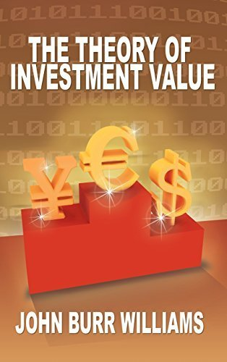
Intrinsic Value
Since the 1930’s, it has been widely accepted that the correct way to value an asset is via the present value of future cash flows
Published in 1938 by John Williams as a PhD thesis
“In theory there is no difference between theory and practice.
In practice there is” – Yogi Berra

Slide 4
Valuation is an Art, Not a Science
There are many widely accepted valuation methods:
Discounted cash flow
Normalized earnings
Asset-based valuation
Liquidation value
Sum of the parts
Dividend growth model
Precedent transactions
Historical multiples

Slide 5
Why Use the Discounted Cash Flow Model?
Focus on determining intrinsic value
Long term oriented
Independent of market conditions
Accounts for business fundamentals
Margin of safety

Slide 6
Challenges to Using the Discounted Cash Flow Model
3 Main Problems:
Estimating cash flows
Determining an appropriate discount rate
Determining an appropriate multiple for terminal value

Slide 7
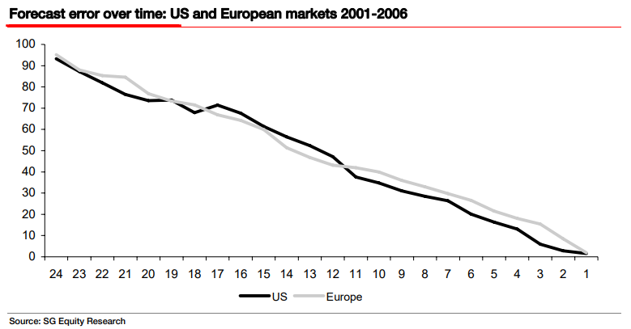
Estimating Cash Flows
Easier if business is:
Understand
Predictable
Consistent
Inaccuracy
Time in Months

Slide 8
Which Would You Rather Forecast?

Slide 9
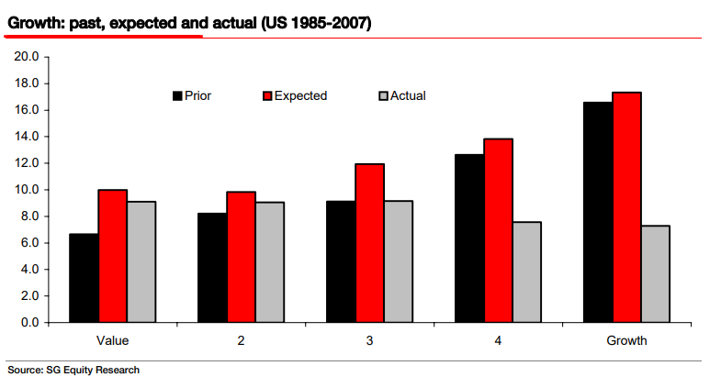
Estimating Cash Flows – Accuracy By Equity Style

Slide 10
Determining a Discount Rate
Methods of Determining:
Weighted average cost of capital (WACC)
Cost of equity (CAPM)
Hurdle rate (subjective)
Historical rate of market return

Slide 11
Determining an Exit Multiple
*Key to determining terminal value (2nd stage of the DCF)
1st Stage: estimating cash flow/ earnings for 5-10 years
2nd stage: determine multiple for final year of earnings
  Math: cash flow or earnings in final year (X) exit multiple, discounted to present value
What will investors be willing to pay for those earnings in the final year?
  The market is forward looking, the past isn’t always indicative of the future

Slide 12
Considerations When Determining Exit Multiple
What are the current growth expectations? What could the business grow at in 5-10 years?
What is the historical trading range (multiples) for the business? How does that change as expectations of growth change?
Does the business have a long runway for growth?
Does the business have a competitive advantage?
Does the business trade at a premium or a discount to the broader market?
What expectations are built in into the stock?

Slide 13
Give Yourself Room For Error
Slight changes in the inputs can yield vastly different results
“The three most important words in investing are margin of safety.” – Warren Buffett
At least 20%

Slide 14
KISS – Keep It Simple Stupid
You would rather be roughly right than precisely wrong
Think in probabilities and range of outcomes
Get as many reps as you can
Reverse DCF
  Eliminate the hassle of determining growth rates
  Much easier than traditional DCF

Slide 15
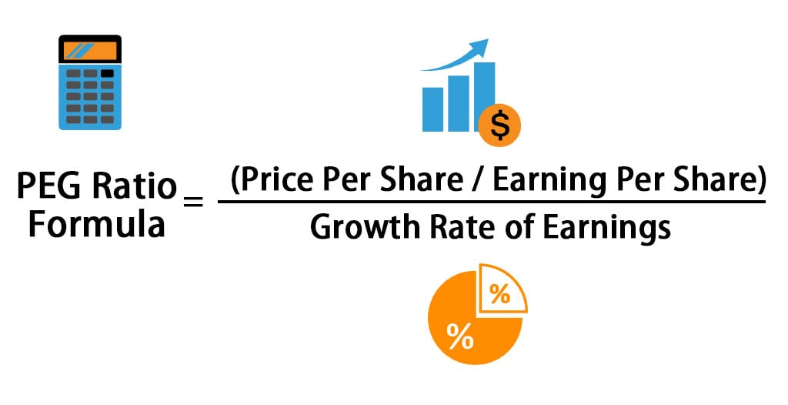
Why use the PEG Ratio?
Just another tool, it is not a thesis driver
The Market is Forward Looking
TTM PE is backwards looking
PE alone can be misleading
PEG normalizes valuation by incorporating growth rates
Useful for making comparisons with industry peers
Limitations:
Relies on speculative growth estimates
Works best for predictable and consistent companies

