Slide 1

Bulldog Investment Company
The Simple Investment Checklist
By: Luis Green and Jon Zahradka

Slide 2

Research can be overwhelming if you
Do things last minute
Do not know what you are looking for
Do not have a process
Do not know the right sources of info
Is there a solution?

Slide 3
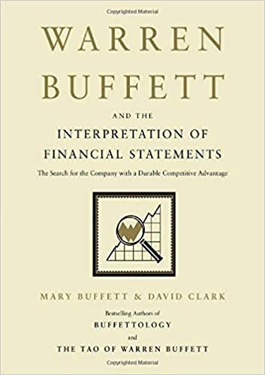



The Simple Investment Checklist

Slide 4

#1 Numbers
The numbers tell a story
Interpretations of financial statements
Is the company improving or getting worse?
Is it predictable and consistent?
Is it worth doing a deeper dive?
#s =

Slide 5
#2 What Does The Company Do?
In your own words answer
What does the company do?
What products or services does it sell?
What industry are they in?
How do they make money?
GO Straight to the annual report
10-k company annual report
Under business overview
And Management Discussion & Analysis

Slide 6
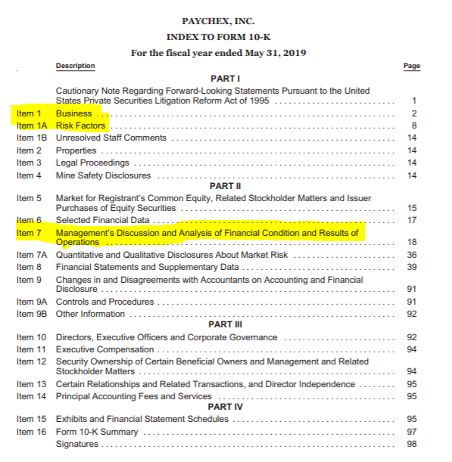

Slide 7
#3 Company Breakdown
Breakdown The Company
By business segment
By product, by service
By geography
And as a percentage of revenue
Is this good or bad?
Annual Report 10-k

Slide 8
#4 Company Overview
How did they get to where they are?
Company History
How it was founded, by who, and why?
Acquisition and divestiture history
Product and service introductions
How has the company changed over time?
Where to find it
Annual Report 10-k
Company Website
Investor presentations
Search for articles
Watch videos Make it simple
Create a timeline, and put image to words

Slide 9


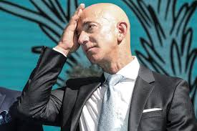
#5 Management
Who is the management team?
What is their experience?
How have they allocated capital?
Do they have skin in the game?
Sources
Annual Report 10-k
Company website
Watch interviews

Slide 10

#6 Risk Factors
Annual report 10-k
Base on what you have learned
Use your own judgement
Analyst reports

Slide 11

#7 Competitors
Who are they?
Time series analysis
Financial comparison
Based on the numbers
Is this a good industry?

Slide 12

#8 Moat Analysis
Does the company have a moat?
Switching Costs
Network Effect
Efficient Scale, Cost Advantages
Intangible Assets
Is it a Wide moat or is it Narrow moat?

Slide 13

#9 Growth Opportunities
Where the business is heading?
10-K annual report
Earnings transcript
Management investor presentations

Slide 14

#10 Valuation
Value Bands
Discounted Cash Flow (DCF)

Slide 15
#11 Conclusion
Buy
Do not buy
What is your overall conclusion?
What were the pross and cons?
What price would you pay for the company?
% of portfolio?
Limit Order
Put Option

