Slide 1
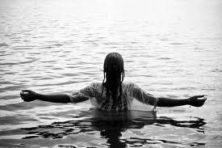
BAPTISM in Jesus’ name!

Slide 2
About Baptism
The word baptism comes from the Greek word “baptisma” which means “immersion or submersion”.
Its listed in the scripture about 23 along with the word baptized about 51 times.
Historically, baptism was once a common and mandatory practice of most religions even pagans.
Mainly, as symbolic or ritualistic act of cleansing.
Today the practice, though still performed in some religions, has greatly declined amongst some faiths.

Slide 3
About Baptism cont’d?
A number of religious organizations no longer require or have done away with baptism as a necessity for salvation but this teaching and belief is contrary to the scriptures.
The bible teaches us that baptism in Jesus name is done for the remission of sins; not as an act of physically rinsing or cleansing the skin but a spiritual act in response to your belief of the word of God and the power of Jesus’ name. The bible also says we are buried with Christ through baptism and thus rise to walk in the newness of life with him…..let see what the bible says…..

Slide 4
Baptism is essential to salvation
He that believeth and is baptized shall be saved; but he that believeth not shall be damned. (mark 16:16)
Jesus answered Verily, verily I say unto thee, except a man be born of water and of the spirit, he cannot enter into the kingdom of God. (John 3:5)
Then Peter said unto them repent and be baptized every one of you in the name of Jesus Christ, for the remission of sins, and ye shall receive the gift of the holy ghost. (Acts 2:38) [ref #2]

Slide 5
The purpose of baptism
The like figure where unto even baptism doth also now save us (not the putting away of the filth of the flesh, but the answer of a good conscience toward God) by the resurrection of Jesus Christ. (1 Peter 3:20-21)
Know ye not that so many of us as were baptized in Jesus Christ, have put on Christ?
Therefore we are buried with him by baptism into death: that like as Christ was raised up from the dead by the glory of the Father even so we also should walk in newness of life. [read on] ( Romans 6:4)

Slide 6
Baptism should be done by immersion
And Jesus when he was baptized went up straightway out of the water………(Matt 3:16)
And it came to pass in those days that Jesus came from Nazareth of Galilee and was baptized of John in Jordan.
And John also was baptizing in Aenon near to Salim, because there was much water there: and they came and were baptized. (John 3:23)
And he commanded the chariot to stand still : and they went down both into the water both Philip and the eunuch; and he baptized him. (acts 8:38) [recap]

Slide 7
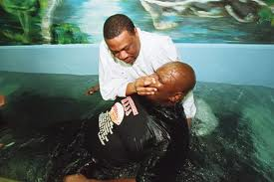
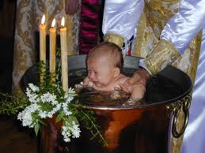
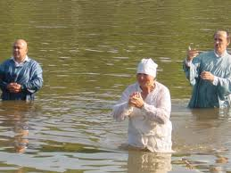
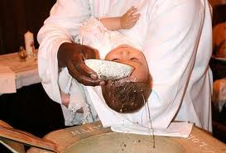
Neither sprinkling nor infant baptism are biblically instructed
Biblically accurate
Biblically inaccurate

Slide 8
Baptism must be done in Jesus’ name!
Repent and be baptized every one of you in the name of Jesus Christ for the remission of sins and ye shall receive the gift of the Holy Ghost. (acts 2:38)
When they heard this they were baptized in the name of the Lord Jesus (acts 19:5) [recap]
Now when the apostles which were at Jerusalem heard that Samaria had received the word, they sent unto them Peter and John: 15 -who when they were come down, prayed for them that they might receive the Holy Ghost: 16-(for as of yet he was fallen upon none of them: only they had been baptized in the name of the Lord Jesus.) [Acts 8:14-16]

Slide 9
Baptism in Jesus name cont’d
And that repentance and remission of sins should be preached in his name among all nations, beginning at Jerusalem. (Luke 24:47)
But when they believed Philip preaching the kingdom of God and the name of Jesus Christ, they were baptized both men and women. (Acts 8:12)
And whatsoever ye do in word or in deed, do all in the name of the Lord Jesus, giving thanks to God and the Father by Him. (Col 3:17)
Neither is there salvation in any other for there is none other name under heaven given among men, whereby we must be saved. (Acts 4:12)

Slide 10
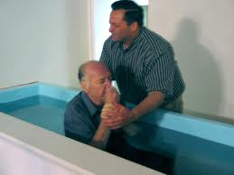
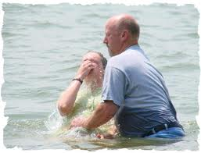
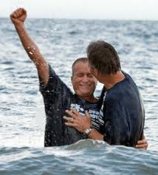
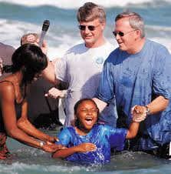
Born of the Water!
Baptism is essential to salvation
Baptism must be by immersion
Baptism must be in Jesus’ Name
Many have been baptized in the name of Jesus Christ for the remission of sins; from the time of the apostles in the early church, and still today.
It was the eunuch in the book of Acts after hearing the word of God, that believed the gospel and asked the imperative, life changing question:
“See here is water, what doth hinder me to be baptized?”
WHAT DOTH HIDER YOU?

Slide 11
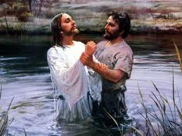
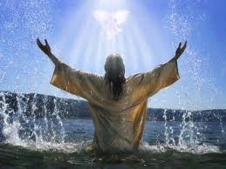
Jesus did it for our example…let’s follow Christ!

Slide 12

APOSTOLIC HOUSE OF PRAYER INC.
Pastor Damien Fields &
Minister T. I. Fields

