Slide 1
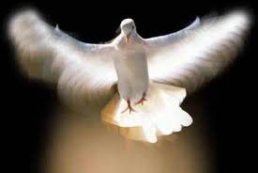
The Baptism of the Holy Ghost

Slide 2
WHAT IS THE BAPTISM OF THE HOLYGHOST?
IS THE HOLY GHOST ESSENTIAL FOR SALVATION?
HOW DO YOU RECEIVE THE HOLY GHOST?

Slide 3
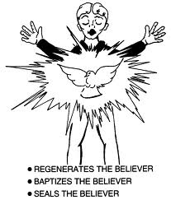
What is the HolyGohst?
The Holy Ghost is the Spirit of God dwelling within the life and body of a believer.
The Holy Ghost is the only seal that identifies us in the earth realm as the sons of God.
The Holy Ghost is also a necessary element for inheriting eternal life…without the Spirit dwelling within, we cannot go with Him when He comes.

Slide 4
The Holy Ghost is essential!
But ye are not in the flesh but in the Spirit, if so be that the Spirit of God dwell in you. Now if any man have not the Spirit of Christ, he his none of His. (Rom 8:9) [ref. John 3:6]
The Spirit beareth witness with our Spirit, that we are the children of God. (Rom 8:16)
Jesus answered Verily verily, I say unto thee, Except a man be born of water and of the Spirit he cannot enter in to the kingdom of God. (John 3:5)

Slide 5
The Holy Ghost is essential cont’d
He that believeth on me as the scripture hath said, out of his belly shall flow rivers of living water. (But this spake He of the Spirit, which they that believe on him should receive: for the Holy Ghost was not yet given; because that Jesus was not yet glorified.) [John 7:38-39]
But if the Spirit of Him that raised Jesus from the dead dwell in you, he that raised up Christ from the dead shall also quicken your mortal bodies by his Spirit that dwelleth in you. (Rom 8:11)

Slide 6
The Holy Ghost is For you!
Then Peter said unto them, Repent and be baptized everyone of you in the name of Jesus Christ for the for the remission of sins and ye shall receive the gift of the Holy Ghost.
For the promise is unto YOU and to your children and unto all that are afar off, even as many as the Lord our God shall call. (Acts 2: 38-39)

Slide 7
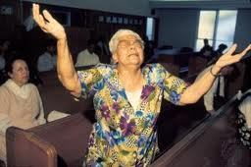
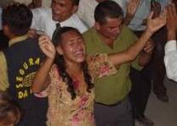
How do you receive the Holy Ghost?

Slide 8
How do you receive the Holy Ghost?
If ye then being evil, know how to give good gifts unto your children: how much more shall your heavenly Father give the Holy Spirit to them that ask him? (Luke 11:13)
And it shall come to pass in the last days saith God, I will pour out of my Spirit upon all flesh: and your sons and your daughters shall prophesy and your young men shall see visions and your old men shall dream dreams: (Acts 2:17)
And when Paul had laid his hands upon them, the Holy Ghost came on them: and they spake with tongues and prophesied. (Acts 19:6)

Slide 9
How do you receive the Holy Ghost cont’d
But as many as received him, to them gave he power to become the sons of God, even to them that believe on his name: (John 1:12)
He said unto them, Have ye received the Holy Ghost since ye believed? And they said unto him, We have not so much as heard whether there be any Holy Ghost. (Acts 19:2)
He that believeth on me, as the scripture hath said, out of his belly shall flow rivers of living water.(John 7:38)
(But this spake he of the Spirit, which they that believe on him should receive: for the Holy Ghost was not yet given; because that Jesus was not yet glorified. (7:39)

Slide 10
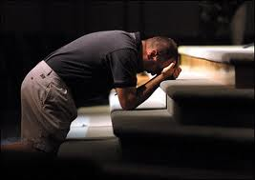
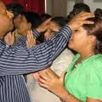
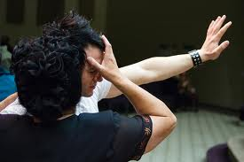
How do you receive the Holy Ghost?
THE BIBLE SAYS WE MUST ASK FOR THE HOLY GHOST.
THE BIBLE TELLS US THAT GOD POURS OUT HIS SPIRIT UPON US .
MANY RECEIVE THE HOLY GHOST BY THE LAYING ON OF HANDS.
THE HOLY GHOST IS A GIFT THAT IF WE BELIEVE, WE SHALL RECEIVE.
BLESSED ARE THEY THAT DO HUNGER AND THIRST AFTER RIGHTEOUSNESS, FOR THEY SHALL BE FILLED. (MATT 5:6)

Slide 11
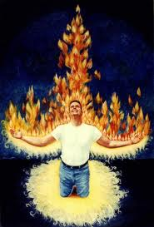
What are the signs of receiving the Holy Ghost?

Slide 12
What are the signs of receiving the Holy Ghost?
I indeed baptize you with water unto repentance: but he that cometh after me is mightier than I, whose shoes I am not worthy to bear: he shall baptize you with the Holy Ghost and with fire: (Matt 3:11)
While Peter yet spake these words, the Holy Ghost fell on all them which heard the word.
And they of the circumcision which believed were astonished as many as came with Peter because that on the Gentiles also was poured out the gift of the Holy Ghost.
For they heard them speak with tongues and magnify God…. (Acts 10:44-46)

Slide 13
Signs of receiving the Holy Ghost cont’d
And they were all filled with the Holy Ghost and began to speak with tongues as the Spirit gave them the utterance. (acts 2:4)
And these signs shall follow them that believe; In my name shall they cast out devils; they shall speak with new tongues. ( Mark 16:17)
For with stammering lips and another tongue will he speak to this people. (Isaiah 28:11)
And when Paul laid his hands upon them, the Holy Ghost came on them; and they spake with new tongues and prophesied. (Acts 19:6)

Slide 14
What is the purpose and benefit of having the Holy Ghost?
But ye shall receive power after that the Holy Ghost is come upon you: and ye shall be witnesses unto me both in Jerusalem and in all Judaea and in Samaria and unto the uttermost part of the earth. (Acts1:8)
For by one Spirit are we baptized into one body whether we be Jews or Gentiles, whether we be bond or free; and have been all made to drink into one Spirit.(1 cor 12:13)
But the comforter which is the Holy Ghost, whom the Father will send in my name, he shall teach you all things and bring all things to your remembrance whatsoever I have said unto you. (John 14:26)

Slide 15
Purpose and benefits of the Holy Ghost cont’d
For the Holy Ghost shall teach you in that same hour what ye ought to say. (Luke 12:12)
Howbeit when he, the Spirit of truth is come, he will guide you into all truth:…(John 14:26)
Likewise the Spirit also helpeth our infirmities: for we know not what we should pray for as we ought: but the Spirit maketh intercession for us with groanings which cannot be uttered. (Rom 8:26)

Slide 16
Purpose and benefits of the Holy Ghost cont’d
For ye have not received the spirit of bondage again to fear; but ye have received the Spirit of adoption whereby we cry abba, Father. (Rom 8:15)
For as many as are led by the Spirit of God, they are the sons of God. (Rom 8:14)
And because ye are sons God hath sent forth the Spirit of His son into your hearts crying Abba, Father. (Gal 4:6)

Slide 17
Purpose and benefit of the Holy Ghost cont’d
The Spirit itself beareth witness with our spirit, that we are the children of God: (Rom 8 :16)
And if children, then heirs; heirs of God and joint heirs with Christ; if so be that we suffer with him, that we may be also glorified together. (Rom 8:17)
But as many as received him, to them gave he power to become the sons of God, even to them that believe on his name: (John 1:12)

Slide 18
Purpose and benefits of the Holy Ghost cont’d
Jesus answered Verily verily, I say unto thee, Except a man be born of water and of the Spirit, he cannot enter into the kingdom of God. (John 3:5)
That which is born of the flesh is flesh; and that which is born of the Spirit is spirit.(John 3:6)
It is the Spirit that quickeneth; the flesh profiteth nothing: the words that I speak unto you, they are spirit, and they are life. John 6:63

Slide 19
Purpose and benefits of the Holy Ghost cont’d
Now this I say, brethren, that flesh and blood cannot inherit the kingdom of God; neither doth corruption inherit incorruption. (1 cor 15:50)
But if the Spirit of him that raised up Jesus from the dead dwell in you, he that raised up Christ from the dead shall also quicken your mortal bodies by his Spirit that dwelleth in you. (Rom 8:11)
For this corruptible must put on incorruption, and this mortal must put on immortality. (1 cor 15:53)

Slide 20
Purpose and benefit of the Holy Ghost cont’d
Behold, I shew you a mystery; We shall not all sleep, but we shall all be changed, (1 cor 15:51)
In a moment, in the twinkling of an eye, at the last trump: for the trumpet shall sound, and the dead shall be raised incorruptible, and we shall be changed. (1 cor 15:52)
For this corruptible must put on incorruption, and this mortal must put on immortality. (1 Cor 15:53)

Slide 21
Purpose and benefits of the Holy Ghost cont’d
So when this corruptible shall have put on incorruption, and this mortal shall have put on immortality, then shall be brought to pass the saying that is written, Death is swallowed up in victory.(1 Cor 15:54)
O death, where is thy sting? O grave, where is thy victory? (1 Cor 15:55)
But thanks be to God, which giveth us the victory through our Lord Jesus Christ. (15:57)

Slide 22

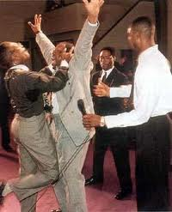
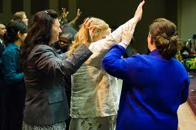
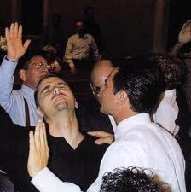
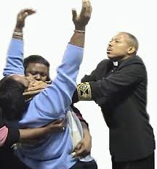
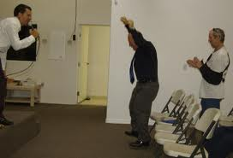
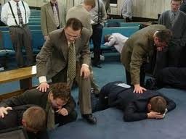

Slide 23

APOSTOLIC HOUSE OF PRAYER INC.
Pastor Damien Fields &
Minister T.I. Fields

