Slide 1
Sonship vs servanthood
T.I Fields 11/2/2017

Slide 2
Introduction
The topic of Sonship is as important as the topic of Submission.
The concepts of Sonship vs Servanthood & Submission vs Rebellion WILL change your life if you chose to hear, receive and apply it.
In it the Lord reveals the purpose and process of the Kingdom.
HERE ARE THE SCRIPTURES:

Slide 3
PURPOSE REVEALED
God is the KING of Kings & LORD or Lords.
We are His children, in His Kingdom.
Like any King He wants His sons to one day rule & reign (bride)
This Kingdom life is all about Rulership & inheritance.
In other words Blessing & Revival, equipment & authority
Many people complain about the fact that they haven’t gotten this or that from God but the issue isn’t whether He has something for you, it’s more about when He can release it to you.
LETS LOOK AT THE SCRIPTURE

Slide 4
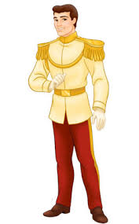
SONSHIP VS SERVANTHOOD

Slide 5
Identity & Purpose
Rom 8:28 And we know that all things work together for good to them that love God, to them who are called according to His PURPOSE=SONSHIP.
1 John 3:2- Beloved NOW are we the SONS of GOD!....
John 1:12- But as many as received HIM to them gave He power to become the SONS of God,…(Rom 8:9 &15)
Rom 8:29 For whom He did foreknow, He also did predestinate to be conformed to the image of His dear Son;….

Slide 6
IDENTITY-WHO ARE YOU?
Rom 8:16- The Spirit itself beareth witness with our spirit, that we are the children of GOD. (ref v. 14)
17 And if children then HEIRS and JOINT HEIRS with Christ; if so be that we suffer with Him, that we may be GLORIFIED together. (coronation) ( suffering is the right of passage so to speak. No cross - no crown) the glorification is in the suffering.

Slide 7
HEIRS: Inheritance & blessing
Now that we recognize God’s calling of Sonship and realize that we are Sons and heirs & joint heirs with Christ Jesus. Let’s look further.
Definition; Heir: One who receives or is entitled to inheritance, riches, property rank, title or office, from an ancestor, predecessor or parent; “heir to a throne”
say “IM ENTITLED TO THIS” (but it comes with maturity!)
There are things that belong to you within the plan of God for your life. Time to receive what God truly has instore for you.

Slide 8
HEIRS (cont’d)
God is our King and He ultimately wants us as His sons & heirs to His throne, to both receive our inheritance and to rule. Just as in the natural.
In addition to that, all that the king has, the son gains access to, at the appointed time. Inheritance is never a question, there’s no question about provision, it comes with the territory. You won’t find a newly appointed king, wondering if he will eat or if he has clean garments. It’s a given!
Think of it in terms of a TRUST FUND ( can HE trust you with the fund?)
Question isn’t about ownership…its about maturity & timing!

Slide 9
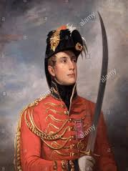
Rulers & Lords ( conclude later)
In addition to inheritance which is significant of blessing, favor, equipment, provision etc. God wants us to become rulers.
Ruler: One who governs, who’s gives the charge.
Lord: one who’s in control, in action of a Master, one with authority

Slide 10
RULERS (notes cont’d)
This position is imperative mainly because we can’t do anything in the Kingdom or in the spirit realm without authority and governing power. THIS IS ABOUT REVIVAL & KINGDOM VICTORY!
If we are going to have revival, we need those operating in authority, if we are going to have victory. : SCRIPTURES
We Wrestle not against flesh and blood but against principalities, powers, rulers of the darkness..( Eph 6:12)
For the weapons of our warfare are not carnal but mighty through God (2 Cor 10:2-6)
THIS IS ABOUT TRUE REVIVAL- There’s Spiritual Battle to be fought and won.

Slide 11
READY TO REIGN
Calling us to rule to reign, execute judgement, give the charge, stand in authority and dominion.
As the bride of Christ we are called to partner Reign with Him.
Esther was being prepared to rule and reign with her King Ahasueras. He needed a Queen. No princess Brides!
Her preparation was by her obedience to the Eunuch.
Ultimately Esther did reign beside the king after finishing her process of preparation. He offered her half of the Kingdom. She could ask what she will and it shall be done ( John 14-15)

Slide 12
Authority & Dominion
This will be addressed in a segment entitled Kingdom Strategy.
Warfare
Weapons
Armor
Strategy*
Rules of engagement

Slide 13
GOD’S PROBLEM : OUR IMMAURITY
Scripture:
GALATIANS 4:1- “Now I say that the heir as long as he is a child differeth nothing from a servant, though he BE LORD of ALL.
V2. But is under tutors and governors until the time appointed of the father.”
Even though you’re his child, if you still act like a child you won’t receive all that He’s destined for you….until the time is right.
The Child is no different in authority, than the servant.

Slide 14
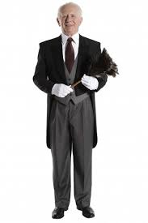
HEIR/CHILD = SERVANT

Slide 15
Revelation on immaturity
The Lord said He cannot hand off glory and power to a child. It will be dangerous for the child and detrimental to the kingdom.
Cant give inheritance, Glory or power to the immature.
So if you are wondering “why I don’t have this or that?”
God is patiently and faithfully waiting for you to grow up!
To be ready , to be prepared, to be mature, in order to receive.

Slide 16
MASTERY
Scripts:
Entangleth himself
When I was a child- 1
Double minded man…2 minds
Let us move on…(from basic principles)
Mastery of concepts
Check your progress report..

Slide 17
ANSWER: Growth up!
1 Pet 2:2 “As new born babes desire the sincere milk of the word that ye may grow thereby.”
Heb 5:12-14 “For when for the time ye ought to be teachers, ye have need that one teach you again which be the first principles of the oracles of God, and are become such as have need of milk and not of strong meat.
13 For everyone that useth milk is unskillful in the word of righteousness: for he is a babe. (minimal knowledge & practice)
14 But strong meat belongeth to them that are of full age, who by reason of use have their senses exercised to discern both G & E.

Slide 18
WHAT’s YOUR GENO TYPE?
Types of sons:
These were out of control, undisciplined sons
Esua: sold his inheritance, birthright and blessing. Devalued it.
Prodigal: squandered his inheritance
Sampson: stubborn, hardheaded & unreceptive

Slide 19
Immature Sons ( handling)
The above were different types of sons. They lacked self control, discipline, obedience.
They did what they wanted, when they wanted. They lived life according to their desires an appetites ….but it cost them dearly.
This takes us further in the topic of self Mastery but looks at it from the view of self control. The areas we want to look at:
Rebellion, submission, teachability, correctability, humility.
All these will affect your growth, elevtion , graduation and authority…..which ultimately affects our progress, Lordship, inheritance

Slide 20
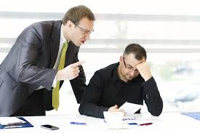
THE WISE WILL RECEIVE…..Prov 1:5
BLESSING
CORRECTION

Slide 21
BLESSING & CORRECTION
It is just as important to receive correction as it is blessing. The key to walking in full authority is first walking in full submission.
We can’t have one without the other.
The Best leaders first made the best followers

Slide 22
SCRIPTURE
The scripture says:
Abase shall be exalted
Humble yourself under the mighty hand: 1 Pet 5:5 &6
That ye may be partakers of His 1 pet 4:13
Even with the forward.
Glory resteth 1 pet 4:14
What is God trying to do right now! From resisters to receiver’s…for the GLORY
( resist the proud but giveth grace)

Slide 23
Rebellion
God is trying to get rebellion out of you. The very depth of you.
That’s why He’s calling you to obedience.
Some of us hate to be corrected , instructed, bossed around
But God is using that to poke, pin point , highlight so HE can up root, dig up and destroy the rebellious, prideful natures in you.
He is trying to fid your stubbornness, your defensiveness, your rebuttals , your fighting back-ness. Etc.. Because its resists and it doesn’t receive .

Slide 24
Rebellion within
For stubbornness is as the sin of witchcraft 1 Sam 15:23
He that Resisteth the power Rom 13:1&2
One who stays stubborn Prov 29:1
God has found resistance within us in various ways. He’s poking at it to highlight it & get rid of it! You have to love His way more than your own way to defeat it!
So Correction wont be grievous. Ps 119: 165 (read)

Slide 25
CHASTENING CONSTRUCTING
Heb 12:5 – “… My SON despise not the chastening of the Lord, nor faint when thou art rebuked of HIM:
For who the Lord LOVETH HE chasteneth and scourgeth every SON who he recieveth.
Recive the engrafted word that is able to save your soul!
BE THE GOOD SON!...RECIEVE YE THE WORD OF THE LORD!
Not talkin bout sippin koolaide, but instead being a sponge and absorbing the word of GOD.

Slide 26
CONSTRUCTIVE CRITICISM
There’s a power and blessing of correction.
It qualifies you as a Son. Leads you deeper into Sonship & closer 2 inheritance.
Wise will hear and increase learning.
Constructive criticism, He building and forming you .
How you approach the word of instruction from now on….
How you receive the word ….will determine what you receive.
Your response to the word or correction is everything!
Mule like spirit, stubbornness, kicking against the pricks, yes but…
2 Tim 3:16,17- All scripture….
LEARN TO TAKE CORRECTION AS CONSTRUCTIVE CRITISM & ADMONITION.

Slide 27
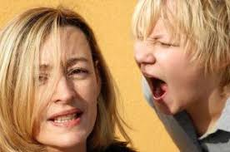
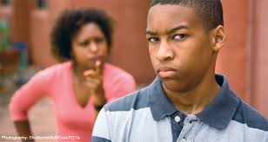
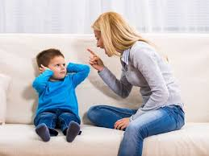
Are you a receiver or a resister?
Responding Resister
Action Resister
Silent Resister
EXPRESS IT?
DISPLAY IT?
INTERNALIZE IT?

Slide 28
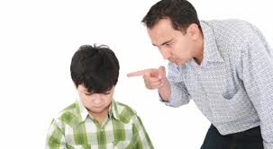
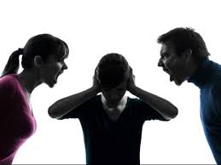
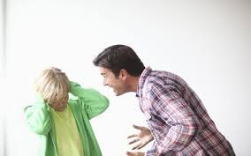
There is a way with God…Parents

Slide 29
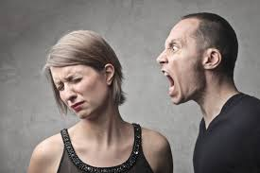
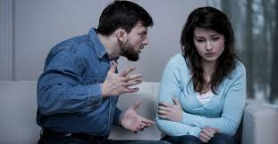
There is A way with God…Husbands
Shouter/Yeller
Aggressor
Blamer/ Shamer

Slide 30
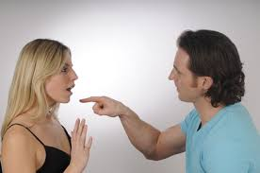
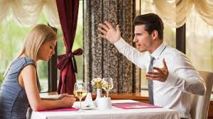
Husbands… there is a way with God

Slide 31
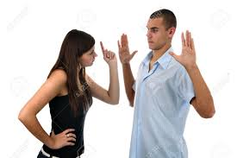
There is a way with God…Wives
Belittler
Reactor
Rejector
Dominant, insulting,
Aggression, bullying, sassing
Silent treatment, manipulation

Slide 32
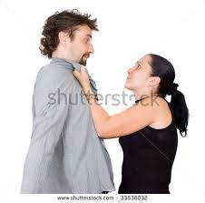
There is a better way…wives
annoyed
stressed
scared

Slide 33
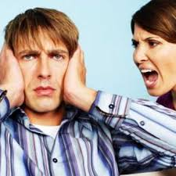
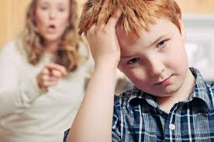
Do our words hurt? Are you in God’s order?

Slide 34
Order in His Court! Order in His House!
Eph 5:23,5:28,33 Col 3:19, 1 Cor 7:3,
Husbands love your wives
Eph 5:24, 25, Col 3:18, 1 Pet 3:1,5,7
Wives submit to your husbands
Eph 6: , 1 Tim 3:12, Titus 1:6
Children obey your parents
Col 3:22, Eph 6:5, 1 Pet 2:18
Servants obey your masters

Slide 35
Works Both ways/ Ebb & Flow
HERE’S HOW: SUBMISSION- for this is thank worthy…even with the froward
RESISTER….RECIEVER
HERE’S HOW: MASTERS
Punished us After their own pleasure
Even though your in charge there is a way to take charge
Even though you’re the leader , there is a way to lead.
You too have a master in heaven

Slide 36
1 PETER 4:1
Even with the forward 1 PET 2:18-24 (V15*)
submission
Order in His Courts!

Slide 37
RECEIVE THE GLORY

Slide 38
BABES IN CHRIST-CARNALITY
And I, brethren, could not speak unto you as unto spiritual, but as unto carnal, even as unto babes in Christ.
² I have fed you with milk, and not with meat: for hitherto ye were not able to bear it, neither yet now are ye able.
³ For ye are yet carnal: for whereas there is among you envying, and strife, and divisions, are ye not carnal, and walk as men?

Slide 39
GOAL: MATURITY & MASTERY
A BIG SIGN OF MATURITY IS SELF CONTROL & MASTERY.
KIDS OR NOVICE INDIVIDUALS DON’T HAVE THIS.
ARE YOU A BABY & A NEWBY?
OR A SKILLFULL ADULT?
RECEPTIVENESS TO THE WORD..TEACHABLE SPIRIT!
EPH 4:13 UNTO A PERFECT MAN, UNTO THE MEASURE OF THE STATURE OF THE FULLNESS OF CHRIST

Slide 40
MATURITY & MASTERY
Got to be Old enough, mature enough, have self control and be wise and constrained.
A ruler that lacks self control will be a problem!!!
It doesn’t matter what you have or what you’ve done if you lack these , you’re lacking!
“HE THAT RULETH HIS SPIRIT IS BETTER THAN HE THAT TAKETH A CITY!”
( PROVERBS 16:32)

Slide 41
WHAT ARE OUR GOALS IN CHRIST?
GROWTH-STATURE CHRIST-BY EATING & PRACTICING THE WORD
MASTERY- LIVING THE WORD
SELF CONTROL/DISCIPLINE- CONTROLING THE TONGUE
FINDING PURPOSE.

Slide 42
Self Control : The Tongue
James 3:2 For in many things we OFFEND all. If any man OFFEND NOT in WORD, the same is a perfect man and able also to bridle the whole body.
Bit & Bridle
Jam 3:3* Behold we put bits in the horses mouth
Ps 32:9 Be not as the horse, which hath no understanding whose mouth must be held in with bit and bridle, [ fences, borders, blocks, ropes, sippy cups, etc] lest they come near unto thee. (evil/sin) lack of self control requires more controls & limits. With maturity comes common sense. You can be trusted with more.

Slide 43
Self control: THE TONGUE
Not what goeth into a man that defileth him ( Matt 15:11)/
James 3:6- the tongue defiles the whole body.
Defile the temple him shall god destroy
Conversation = actions/ deportations ( 1 pet 3 & James 3)
Prov 21:23 : whoso keepeth his mouth and his tongue keepeth his soul from troubles. ( if you watch mouth you can save yourself a lot of trouble)

Slide 44
Offense & Defense
Great peace have they which love thy law and NOTHING shall offend them. ( live by, believe, trust in etc.)
Easily offended – sign you need more of the word.
Defensive –offended- ( lash back or recoil)
Fill your heart and mind with the word...there’s a word for it!

Slide 45
Self Control-Tongue The Heart
Prov 4:23 Keep your heart with all diligence for out of it..
Luke 6:45 Out of the abundance of the heart the MOUTH speaks.
Prov 16:23- The HEART of the wise teacheth his MOUTH
Phil 4:7*- keeping power

Slide 46
Protect Your Spirit!
It’s part of who you are inside that gives off an aroma
He that ruleth his spirit IS GREATER than he that taketh a city.
(innerself, your inner person, presence and aura
Your personality
The spirit of a man will sustain his infirmity
Bears witness with your spirit the we are the sons of man
The spirit of man knoweth the spirit of man

Slide 47
Monitor Your Mind
What’s in your heart will affect your mouth but it’s your MIND that effects your heart…So you’ve got to get your mind right!
Let this mind be in you which was also in Christ Jesus
For with the mind we serve God.

Slide 48
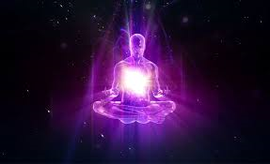
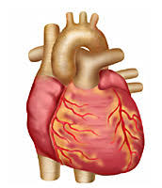
THE PATH
MIND
SPIRIT
HEART
MOUTH

Slide 49
Exposure
Movies
Music
Eyes are the window to the soul.
Environment, practices & people.***
What you surround yourself with, will affect you, get into you and ultimately come out of you. It can defile and corrupt you. (Matt 15:11)
Evil communication corrupts good manners! 1Cor 15:33

Slide 50
CHANGE!
WHEN I WAS A CHILD, I SPAKE AS A CHILD BUT NOW THAT I AM A MAN, I HAVE PUT AWAY CHILDISH THINGS.
1 COR 13:11

Slide 51
TIME TO CHANGE!
…LET US LAY ASIDE EVERY WEIGHT AND THE SIN WHICH DOTH SO EASILY BESET US…
Everything/Everyone that we know holds us back or keeps us doing wrong, we need to begin to lay them aside. There are things we know are toxic to our spirit, our minds and our heart. We must begin the process of personal vetting. Examining ourselves & beginning to identify these things or people, one by one and begin to work on cleaning things up and getting better according to the word of God.

Slide 52
ASK YOURSELF… What about me needs to be changed?
Attitudes
Mindsets
Bad habits
Personality
Language
Reactions
Emotional responses

Slide 53
The Word can be applied in all areas of life.
Personal
Marriage
Parenting
Family
Friendship
Colleagues
Brethren
Finances

Slide 54
How to Apply the Word of God ?
First Start to read.
Don’t know where to start?: 3 paths (personal, planned, prompted)
Personal- Reading based on personal interest/need.
Planned- There are bible plans that one can follow .
Prompted- When the Spirit of God nudges you to specifically read something.

Slide 55
How to apply the word of God
Once you’ve started reading, your job is to now start applying!
The power and effectiveness of the word is found in practicing it.
In this, the presence and Life of God comes alive in your life. You become like Him as you practice His way.
This is where maturity & wisdom begin to grow & form in you. You will become a better person, internally & therefore, externally.

Slide 56
Books to begin with….
Psalms-Deals with day to day emotions, feelings and circumstances.
Proverbs- How to deport yourself in life. How to respond in all situations.
Matt-Miracles done by Jesus, experiences of people, End Time Prophecy.
John-The Life and words of Jesus Christ
Revelation-End Times.

Slide 57
Follow the Leader
It is very important that you have a man of God in your life. That you can go to for spiritual guidance
Paul said : Follow me as I follows Christ
watch for your soul!
Thogh their many “church
Pray and ask the Lord to lead you to the right church with a good spiritual leader that is of himn
How can they hear without a preacher?
How can he preach except he be sent?
You need a real God called ( not self appointed ) Man of God I your life. Who is walking in spirit and in God’s truth. So your life will be lead and guided by the spirit. God bless you as you seek the Lord!

Slide 58
Join a church
Forsake not the assembling of your selves.**
Oh how beautiful it is for brethren to dell together in unity.
Body of Christ.
Same mind , same heart, same direction.
Not just any church…a biblical church, that believes and teaches the full truth of the word of God. Led by the spirit.
When you come together scriptures

Slide 59
RISE TO WALK IN NEW LIFE!
New Year… NEW YOU!

Slide 60
To continue your walk with God:
Visit ahopnc.com
#John 3:16 &17
#John 3:1-7
#acts2:38

