Slide 1



Withdrawal Technique and Reducing Adenoma Miss Rate
Morteza Shafazand
Karolinska University Hospital/ Sweden

Slide 2

Agenda
Is it important to detect adenomas?
Are we good enough at detection?
How to imoprove our detection rate?

Slide 3
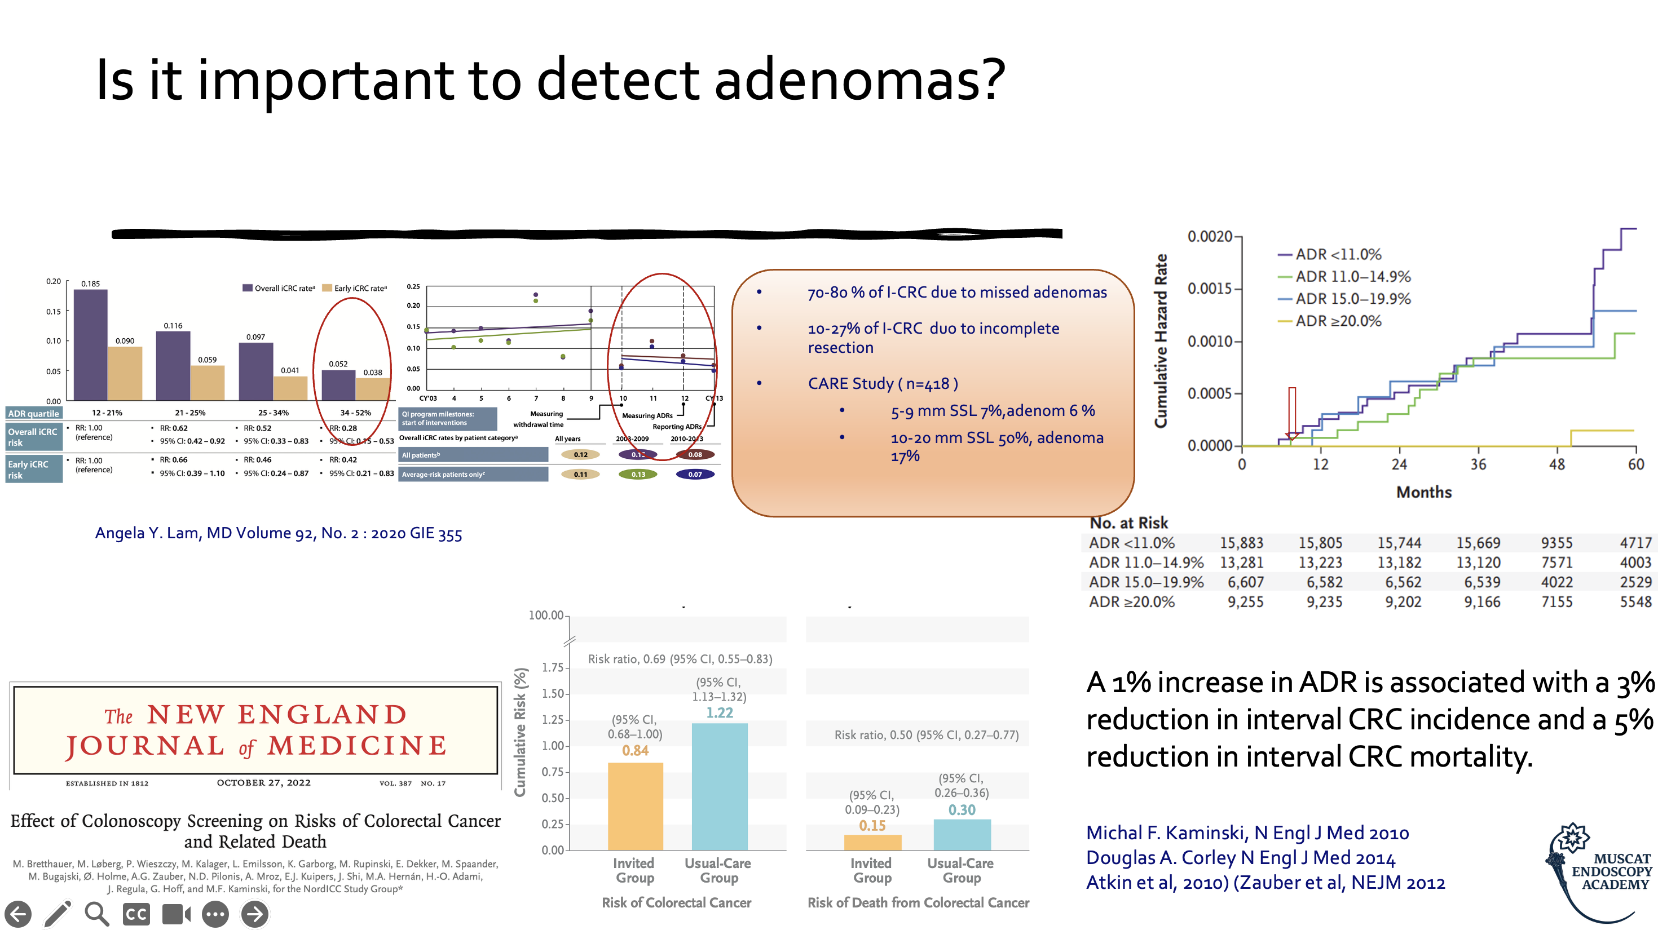

Slide 4
Are we good enough at detection?
Adenoma Miss Rate (AMR) 22% (van Rijn et al, 2006)
Advanced Adenoma Miss Rate (AAMR) 11% (Heresbach et al. Endoscopy 2008)
Post Colonoscopy Colorectal cancer (PCCRC) in Sweden 8% (A.Forsberg et al. 2017)

Slide 5
Why do we miss adenomas?
Bad bowel preparation
Not good intubation technique (CIT, discomfort)
Short withdrawal time
Flat and depressed lesions
Proximal folds and flexures.
(Gralnek IM. 2015)

Slide 6
How to imoprove ADR?
Good bowel preparation
High-quality colonoscopy technique
New technology
Other interventions

Slide 7
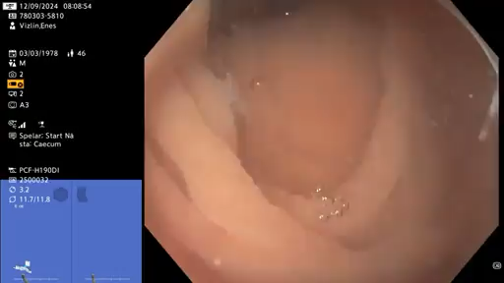
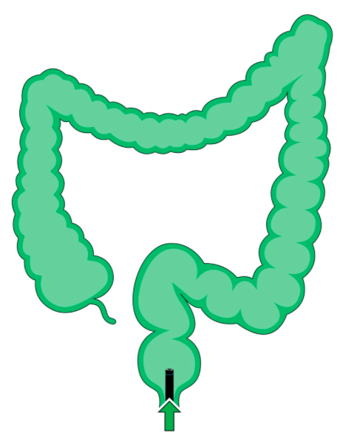
High-quality colonoscopy technique
Water-assisted colonoscopy, WAC (WI vs WE)
Absolute increase of ADR (6 v 10 %)
Withdrawal time WT (6 vs 9 min)
Absolute increase of ADR (9 %)
Second look in the right colon (Retroflex vs Repeated forward view)
Absolute increase of ADR (10-17 %)
Position changes
Absolute increase of (7 %)
RL
LL
S
S/LL
S/RL
RL
S/RL
LL

Slide 8
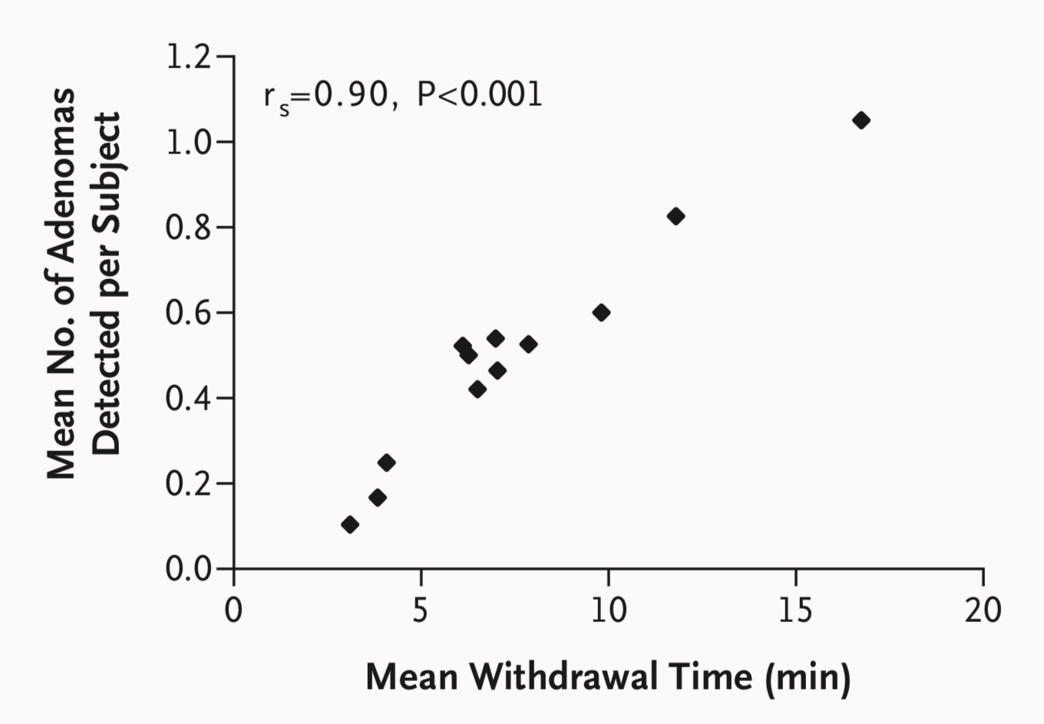
Withdrawal Time and ADR
Barclay, et al. N Engl J Med 2006; 355:2533-2541

Slide 9
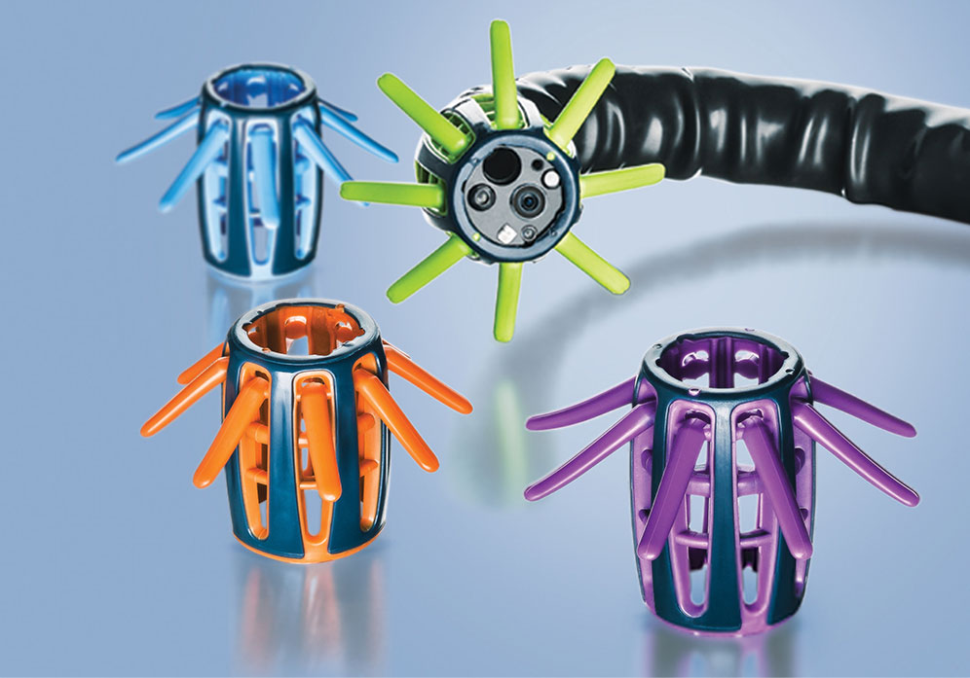
New technology
Distal CAP, (EndoCap vs Endocuff vs Endorings)
Absolute increase of ADR (5-11 %)
IEE, NBI vs Chromoendoscopy. vs WLI
Absolute increase of (5-18 %)
AI/CAD (GI Genius (Medtronic) · CAD EYE (Fujifilm) · ENDO-AID CADe (Olympus) · Discovery (PENTAX Medical) · Magentiq Eye (CADe) · EndoBRAIN (CADx—Japan))
Absolute increase of ADR (15 %)
Notes:
Narrow-band imaging with 190 colonoscopes is superior to white-light colonoscopy
Distal attachment use for high performence vs low performance

Slide 10
Other interventions
Structured endoscopist training
Absolute increase of ADR (20-26 %)
Buscopan
Absolute increase of ADR (0 %)
Simethicon ( 400-1200 mg )
Absolute increase of ADR (???)
Other present observers / assistant
Absolute increase of (19 %)
Notes:
This meta-analysis found no significant impact of Hyoscine on polyp and adenoma detection when used during colonoscopy. 2018
Focused educational interventions improve ADR by 20 to 26 percentage points.

Slide 11
Take home message
Good bowel prep.
High-quality colonoscopy technique (Structured endoscopist training)
WT not shorter than 6 min.
Change focus from symptom to lesion
Using some new technology/devices (Distal CAP, AI)

Slide 12

Thank You for your attention Visit our online platform and learn more
www.muscatendoscopyacademy.com

