Slide 1
Gastrointestinal Bleeding and Hemostatic Techniques
Presented by: Mr Khalid Abaadi & Sahana Raju

Slide 2
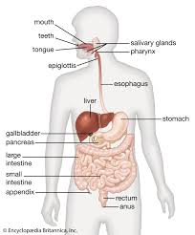
INTRODUCTION
Gastrointestinal bleeding describes every form of hemorrhage in the GI track, from the pharynx to the rectum.

Slide 3
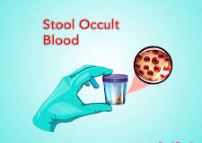
TYPES OF GI BLEEDING
Acute Bleed-
Is sudden & sever onset of bleeding which requires medical emergency.
Chronic Bleed-
Bleeding that on and off over a long period.
Occult Bleed-
Bleeding is not visible but evident with microscopic analysis.

Slide 4
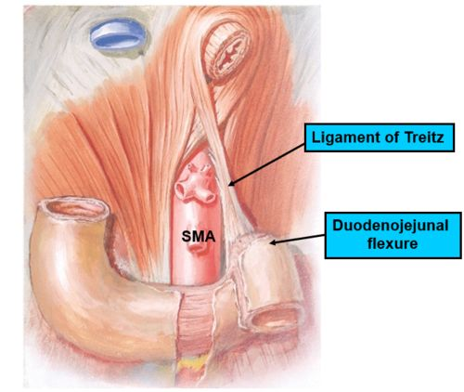
CLASSIFICATION OF GI BLEEDING
1.Upper GI bleed :
Proximal to the Ligament of Treitz
70% of GI bleeds are upper GI track.
2. Lower GI bleed:
Distal to the Ligament of Treitz
30% of cases.

Slide 5
CAUSES- UGI BLEED
Mallory weiss tear due to increased abdominal pressure(vomiting)
Varices -Oesophageal or Gastric
Oesophagitis
Peptic ulcer disease (PUD)
Vascular malformation
Dieulofoy’s lesion (vascular abnormality)
Gastroduodenal erosion
GAVE -(Gastric Antral Vascular Ectasia)
Malignant lesions

Slide 6
RISK FACTORS
Prolonged use of Non Steroidal Anti Inflammatory Drugs (NSAIDs),
Aspirin, anticoagulants
H/O Peptic Ulcer Disease
H.Pylori infection
Increased age
Coexisting illness like Liver disease
Other factors are- heavy alcohol use, Chronic Kidney Disease, smoking etc

Slide 7
SIGNS & SYMPTOMS
Hematemesis-bright red or Coffee ground
Melena
SOB
Abdominal pain
Syncope
Orthostatic changes of BP, HR
Pale skin
Epigastric Pain
Weight loss

Slide 8

LOWER GI BLEED

Slide 9
CAUSES OF BLEED
Diverticulitis
Hemorrhoids
Colorectal Neoplasia
Post Polypectomy
Solitary Rectal Ulcer
Radiation Proctitis
Ulcerative Colitis

Slide 10
SIGNS & SYMPTOMS
Bloody diarrhea
Febrile episode
Dehydration
Hypotension
Abdominal cramp/pain

Slide 11
DIAGNOSTIC TOOLS
Gastroscopy
Colonoscopy
Single/Double Balloon Enteroscopy
Video Capsule Endoscopy

Slide 12
ENDOSCOPIC METHODS FOR HEMOSTASIS
Injection Method- Saline, Epinephrine, N-butyl-2 cyanoacrylate (Glue)
Thermal Methods-Heater Probes, APC, Bi-polar Coagulation Probe
Mechanical Method –Hemoclips, Banding, Over the scope clips
Topical Hemostatic Agents- Sprays(Hemospray)
Combination therapy is widely used

Slide 13
ENDOSCOPY UNIT PREPARATION
Injections, injectors
Machanical Hemostatic devices
Electro surgical unit (Cautery) with accessories
Supporting apparatuses- like water jet, suction apparatus, CO2 insufflators
Crash cart

Slide 14
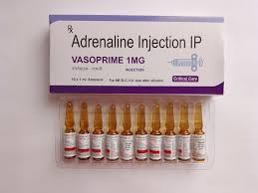
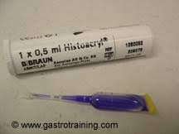
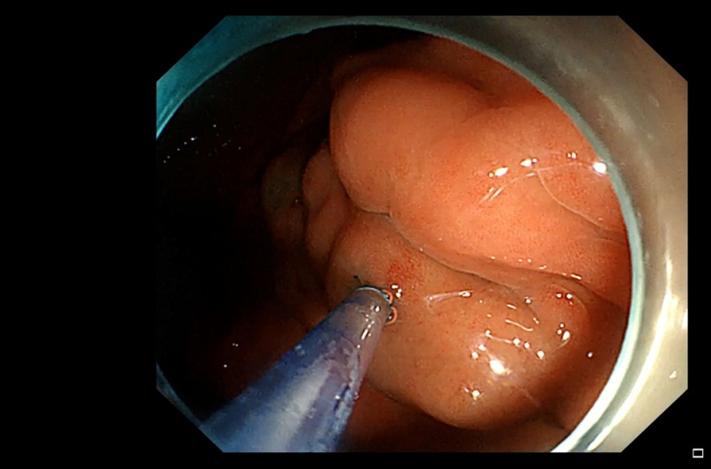
ENDOSCOPIC SCLEROTHERAPY
Saline, Epinephrine injection (1:10,000)
Tissue adhesive (Glue) injections are used in Fundal Varices.

Slide 15
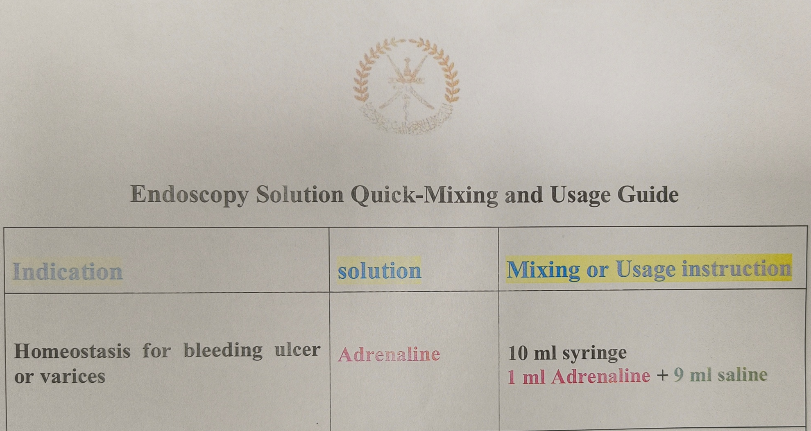
Conti..

Slide 16
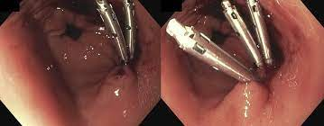
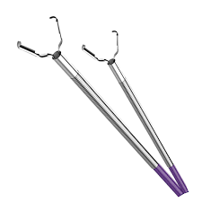
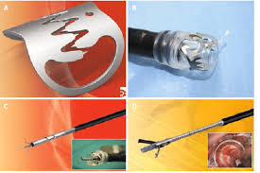
METALLIC HEMOCLIPS
Multiple clips are applied
to seal the vessel.
The clips typically remains
in the place for several days
before detaching on their
own.

Slide 17
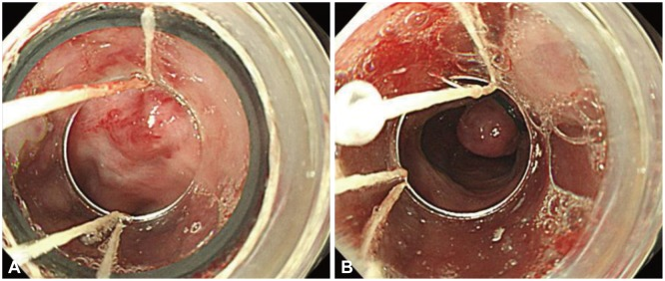

ENDOSCOPIC BAND LIGATION(EBL)
A rubber band is placed over a varix which subsequently undergoes thrombosis,healing and fibrosis.

Slide 18
COMPLICATION OF GI BLEED TREATMENT
Aspiration pneumonia
Perforation
Rebleeding
Infection due to weakened immune system
Reaction to the medication

Slide 19

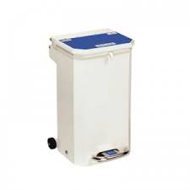
POST PROCEDURE REQUIREMENTS
Proper segregation of waste –Infectious(YELLOW) & Non Infectious(BLACK)

Slide 20
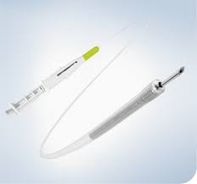
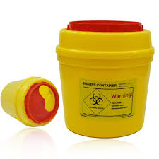
Sclerotherapy Needles/Injectors must be disposed in designated sharp container to avoid NSIs.

Slide 21
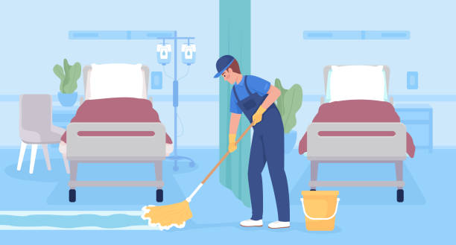

Decontamination of the procedure room and equipments before the next patient in.

Slide 22
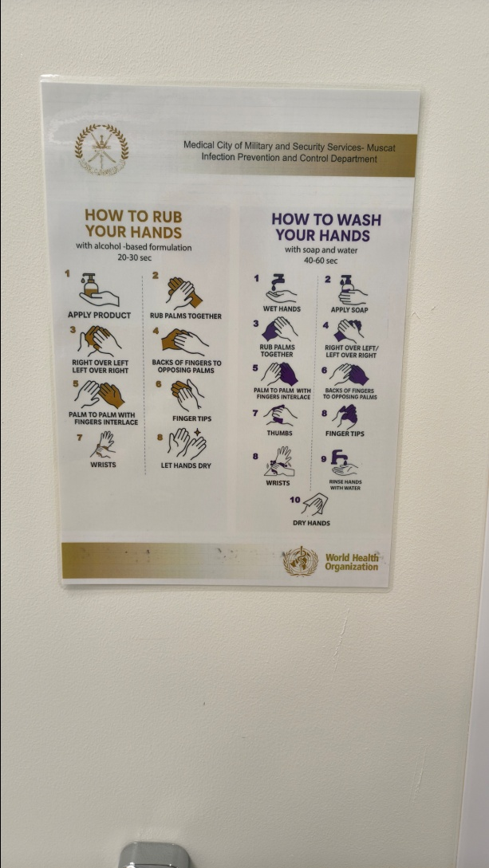
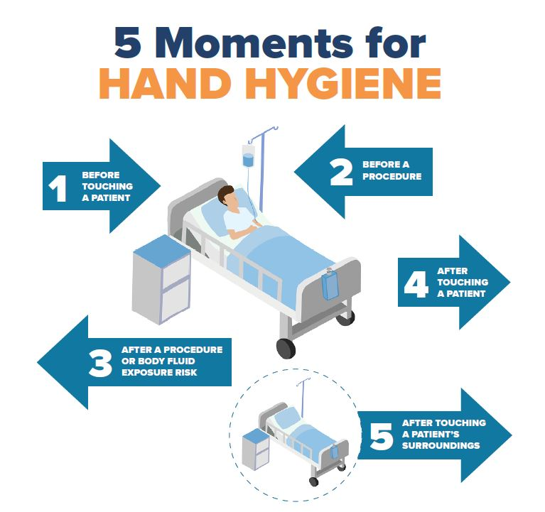
Strict adherence to the Hand hygiene technique & 5 movements as per CDC.

Slide 23


Accurate documentation of the event in EMR, patient file and In Log book.

Slide 24
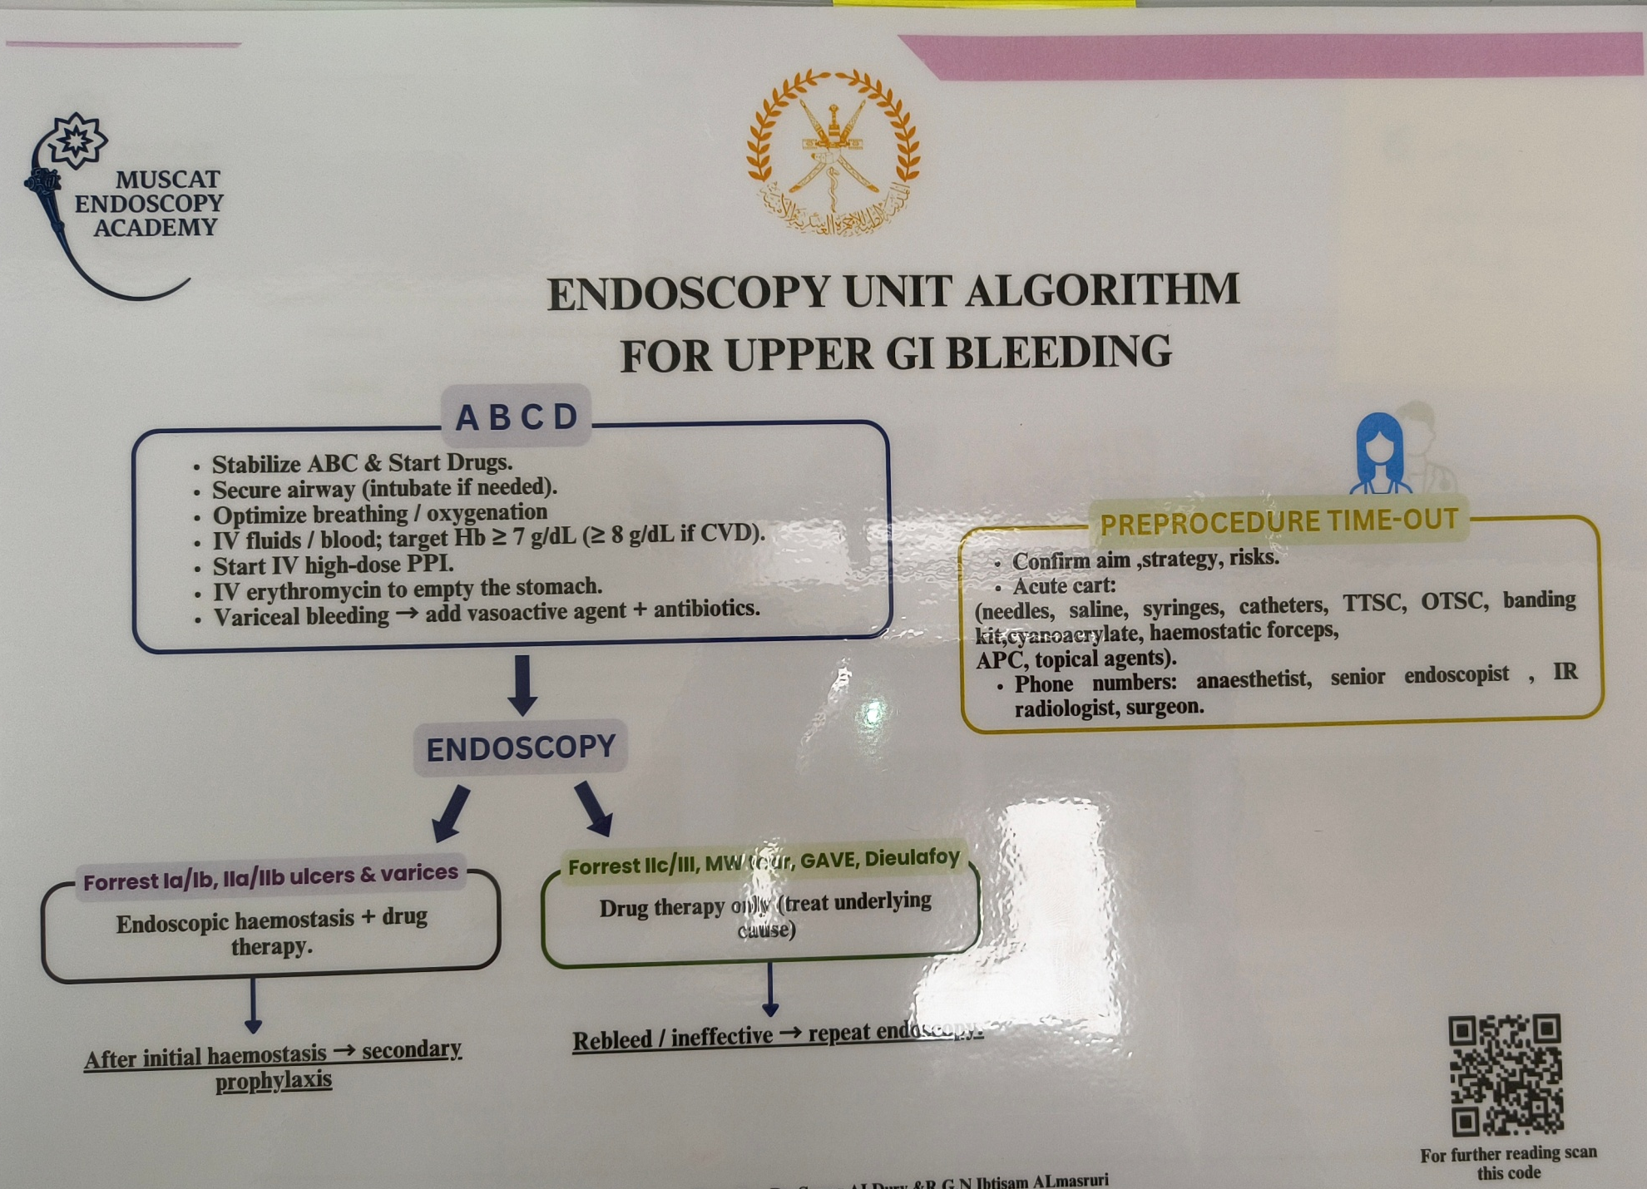

Slide 25

BE ALERT
EXPECT
THE
UNEXPECTED

Slide 26


