Slide 1



Why Colonoscopy Hurts — and How to Prevent It
Samer Al-Dury
21.1.2026

Slide 2

Why colonoscopy sometimes hurts
Most painful colonoscopies are not painful because of the patient — but because of what the scope is doing inside the patient.

Slide 3
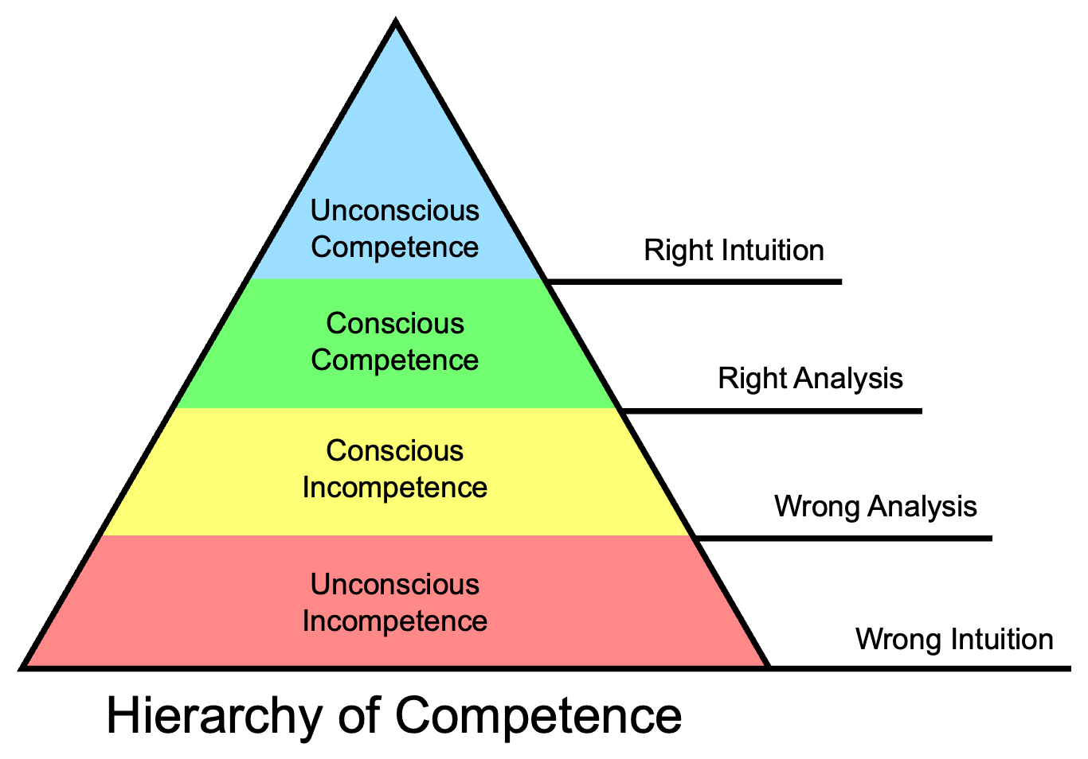
The competence hierarchy
Notes:
1. Unconscious Incompetence
“I don’t know that I’m causing pain.”
What this looks like in colonoscopy
Endoscopist keeps pushing despite resistance
Increasing gas to “see better”
Patient shows discomfort but is sedated
Assumes pain = anxious patient or poor tolerance
Typical endoscopy scenario
Sigmoid loop forms early
Scope advances on the screen but the patient complains
Operator says: “Almost there” and pushes more
Teaching point
Pain is happening, but the operator doesn’t recognize why.
--------
2. Conscious Incompetence
“Something feels wrong — but I don’t know how to fix it.”
What this looks like
Operator senses resistance
Advancement feels difficult
Unsure whether to push, withdraw, or change position
Starts asking for more sedation
Typical endoscopy scenario
Transverse colon with repeated looping
Scope slides back when pushing
Cecum feels “far away”
Operator hesitates and becomes tense
Teaching point
This is the most uncomfortable learning stage, but also the most important one.
Key phrase you can say:
“If you’ve reached this stage, you’re already improving.”
------------
3. Conscious Competence
“I know what to do — but I must think about it.”
What this looks like
Actively watching scope behavior
Recognizes loop formation early
Uses withdrawal to shorten
Changes patient position intentionally
Communicates with nurses
Typical endoscopy scenario
Sigmoid loop begins to form
Operator withdraws, rotates, re-advances
Applies targeted abdominal pressure
Progress resumes with less discomfort
Teaching point
Technique is correct — but requires focus and mental effort.
Say this:
“This is where most good endoscopists live for years.”
----------------------
4. Unconscious Competence
“It feels easy — and the patient is comfortable.”
What this looks like
Smooth insertion
Minimal gas use
Rare need for external pressure
Patient often surprised it’s over
Operator feels calm and unhurried
Typical endoscopy scenario
Long colon, but minimal looping
Advancement is slow but steady
Withdrawal quality remains high
Cecum reached without struggle
Teaching point
Comfort is no longer a goal — it’s the default outcome.
Powerful line to use:
“The best colonoscopy often feels uneventful.”

Slide 4
What patients actually feel
Key sensations patients report:
Cramping
Pressure
Sharp pain during looping
Post-procedure bloating
Important message:
Pain is dynamic, not constant
It usually correlates with specific maneuvers

Slide 5
The 3 main causes of pain
Loop formation
Excess insufflation
Poor torque and scope control
Notes:
Say explicitly:
“Sedation masks pain — it does not prevent injury or discomfort.”

Slide 6
Loop formation – the main culprit
Loops stretch the mesentery
Pain often occurs before the loop is visible externally
Common loop sites:
sigmoid
transverse colon
Notes:
Key takeaway:
If you feel resistance, pain is already coming

Slide 7
Insufflation and overdistension
Gas distends the bowel → discomfort
Over-insufflation worsens loops
Water-based techniques reduce both
Notes:
Phrase to use:
“If you need more gas to see, you probably need less gas to advance.”

Slide 8
Scope control and body mechanics
This is where many endoscopists fail
Excess pushing instead of torque
Poor hand position
Not using withdrawal to advance

Slide 9
Preventing pain: the core principles
Introduce a preventive mindset:
Anticipate loops early
Advance with minimal distension
Shorten before pushing
Change patient position proactively
Communicate with nursing staff

Slide 10
Role of team communication
Nurses detect discomfort early
Abdominal pressure matters
Position changes are powerful
Notes:
Say this clearly:
“A silent room during a painful colonoscopy is a dangerous room.”

Slide 11
When pain is a warning sign
Pain may indicate:
Excessive looping
Poor scope alignment
Risk of perforation
Notes:
Key message:
Pain is feedback — not something to ignore or sedate away.

Slide 12
When to stop, reset or change strategy
Withdraw and shorten
Switch technique
Change position
Ask for help
Abort if needed

Slide 13
What we will practice today
Loop prevention and reduction
Gentle insertion strategies
Controlled insufflation
Decision-making during resistance
Comfort-first thinking

Slide 14
Take home message
Pain is predictable
Loops cause pain — not speed
Less gas, more thinking
Comfort improves completion and quality
Good colonoscopy feels boring — and that’s good
If your colonoscopies are painful, your patients will remember — but so will you, if you’re willing to listen.”

Slide 15
References
1. Ahmed JF, et al. Causes of intraprocedural discomfort in colonoscopy: a review and practical tips. *BMJ Open Gastroenterol*. 2024;11(6):e001561.
2. Sinonquel P, et al. Painless colonoscopy: fact or fiction? *Dig Dis Sci*. 2024;69(6):2047–2065.
3. Kay CL, et al. Colonoscopy pain management: A Bayesian network meta-analysis of randomized trials. *Gastroenterology*. 2025;168(2):289–301.
4. Choy MC, et al. Diagnostic ileocolonoscopy: getting the basics right. *Frontline Gastroenterol*. 2020;11(6):484–491.
5. Rutter CM, et al. Mechanical analysis of insertion problems and pain during colonoscopy. *Endoscopy*. 2013;45(2):109–119.
6. Corley DA, et al. Quality of colonoscopy in practice. *Gastrointest Endosc Clin N Am*. 2023;33(3):433–447.
7. Sharma S, et al. Risk factors associated with painful colonoscopy: A retrospective analysis. *Gut*. 2012;62(Suppl 1):A158.
8. Barclay RL, et al. Colonoscopic withdrawal times and adenoma detection during screening colonoscopy. *N Engl J Med*. 2006;355(24):2533–2541.

Slide 16

Thank You for your attention Visit our online platform and learn more
www.muscatendoscopyacademy.com

