Slide 1


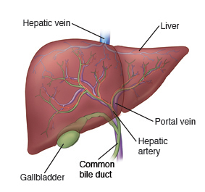
Cirrhosis and portal hypertension
Done by:
G/5 Zainab ALBalushi
G/7 Noora ALZadjali

Slide 2
content
Definition
Causes
Symptoms
Pre-Endoscopy Nursing Management for Liver Cirrhosis Patients
Portal hypertension (definition,causes,clinical manifestation, complication, diagnosis, treatment)
Clinical Implications of Cirrhosis for Endoscopic Procedures
Article review

Slide 3
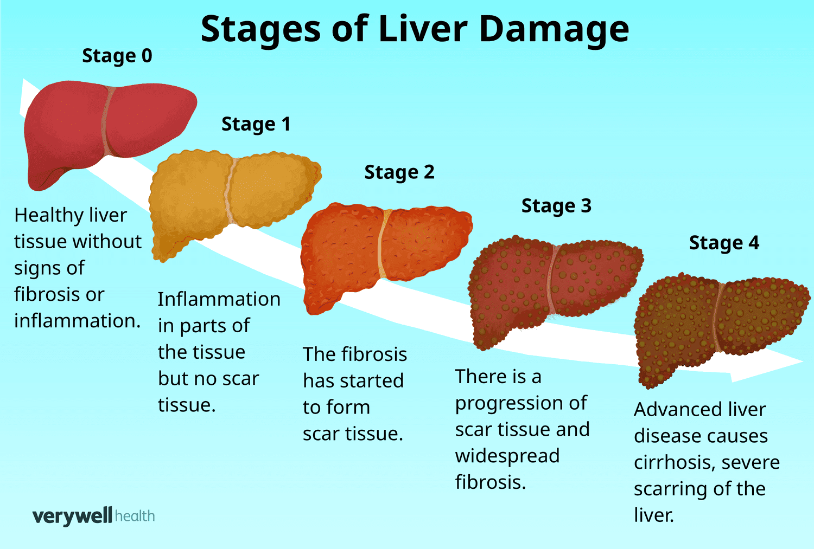
definition

Slide 4
causes
Alcoholic liver cirrhosis
liver cirrhosis and hepatitis
Liver cirrhosis and fatty liver ((NAFLD) ): obesity – 20 per cent of people with obesity have fatty liver disease
high blood cholesterol and triglycerides
type 2 diabetes.

Slide 5
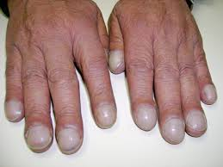
symptoms
Extreme tiredness.
Easily bleeding or bruising.
Loss of appetite / nausea / weight loss
Edema in the legs, feet or ankles
Itchy skin.
Yellow discoloration in the skin and eyes, called jaundice.
Fluid buildup in the belly, called ascites
Spiderlike blood vessels on the skin.
Redness in the palms of the hands.
Clubbing of the fingers.

Slide 6
Pre-Endoscopy Nursing Management for Liver Cirrhosis Patients

Slide 7
1. Comprehensive Patient Assessment- Medical History:
Confirm cirrhosis, past variceal bleeding, encephalopathy, ascites, coagulopathy.
- Vital Signs: Monitor BP, HR, RR, SpO2, temperature.
- Neurological Status: Watch for hepatic encephalopathy signs (confusion, disorientation).
Bleeding Risk: Review platelet count, INR, PT, PTT.
Medications: beta-blockers, lactulose, diuretics, anticoagulants

Slide 8
2. Patient Preparation- Fasting
Ensure NPO status for 6-8 hours.
Bowel Prep: Administer cleansing agents if colonoscopy planned.
IV Access: Establish reliable IV line.
Sedation Assessment: Evaluate liver function to adjust sedation.
Consent: Verify and document informed consent
Notes:
Colonoscopy: screen colorecteal cancer for those planned going for liver trasplant

Slide 9
3. Laboratory and Imaging Review
Lab Tests: Review CBC, LFTs, coagulation, renal function, ammonia
Imaging: Check ultrasound/CT/MRI findings (e.g., ascites)
Notes:
Nodular service , smaller size

Slide 10
4. Medication Management
Withhold or adjust medications (e.g., anticoagulants).
Administer prophylactic antibiotics if risk of variceal bleeding.
Initiate octreotide/vasopressin as needed
Notes:
Octreotide is used for the treatment of growth hormone producing tumors (

Slide 11
5. Psychosocial Support
Provide reassurance and emotional support.
Educate patient on procedure and expected outcomes.-
Involve caregivers if patient has altered

Slide 12
6. Emergency Preparation
Ensure availability of emergency equipment: suction, oxygen, crash cart.
Be prepared for complications: bleeding, aspiration, sedation effects

Slide 13
Portal hypertension

Slide 14
DEFINITION
Portal hypertension is defined as the elevation of the hepatic venous pressure gradient to >5mmhg.
Clinically significant portal hypertension is present when gradient exceeds 10mmhg
Risk of variceal bleeding increase beyond a gradient of 12 mmhg.

Slide 15
ANATOMY OF PORTAL VENOUS SYSTEM
Portal vein is formed by the union of the superior mesenteric vein and the splenic vein
just posterior to the head of pancreas at the level of second lumbar vertebra
Portal blood flow is about 1000 to 1200 ml/min

Slide 16
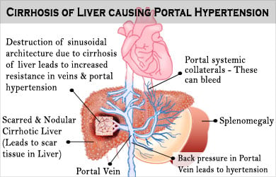

Slide 17
Causes
Pre-hepatic :
1-portal vein thrombosis
2-splenic vein thrombosis
3-massive spleenomegaly
Intra-hepatic
1-cirrhosis
2-schistosomiasis
3-congenital hepatic fibrosis

Slide 18
Post-hepatic
1-budd chiari symptoms
2-right heart failure
3-congenital pericarditis

Slide 19
CLINICAL MANIFESTATION
Splenomegaly
Esophageal varices
Gastric varices
Ascites
Hemorrhoids
Hepatic encephalopaty
Caput medusae

Slide 20
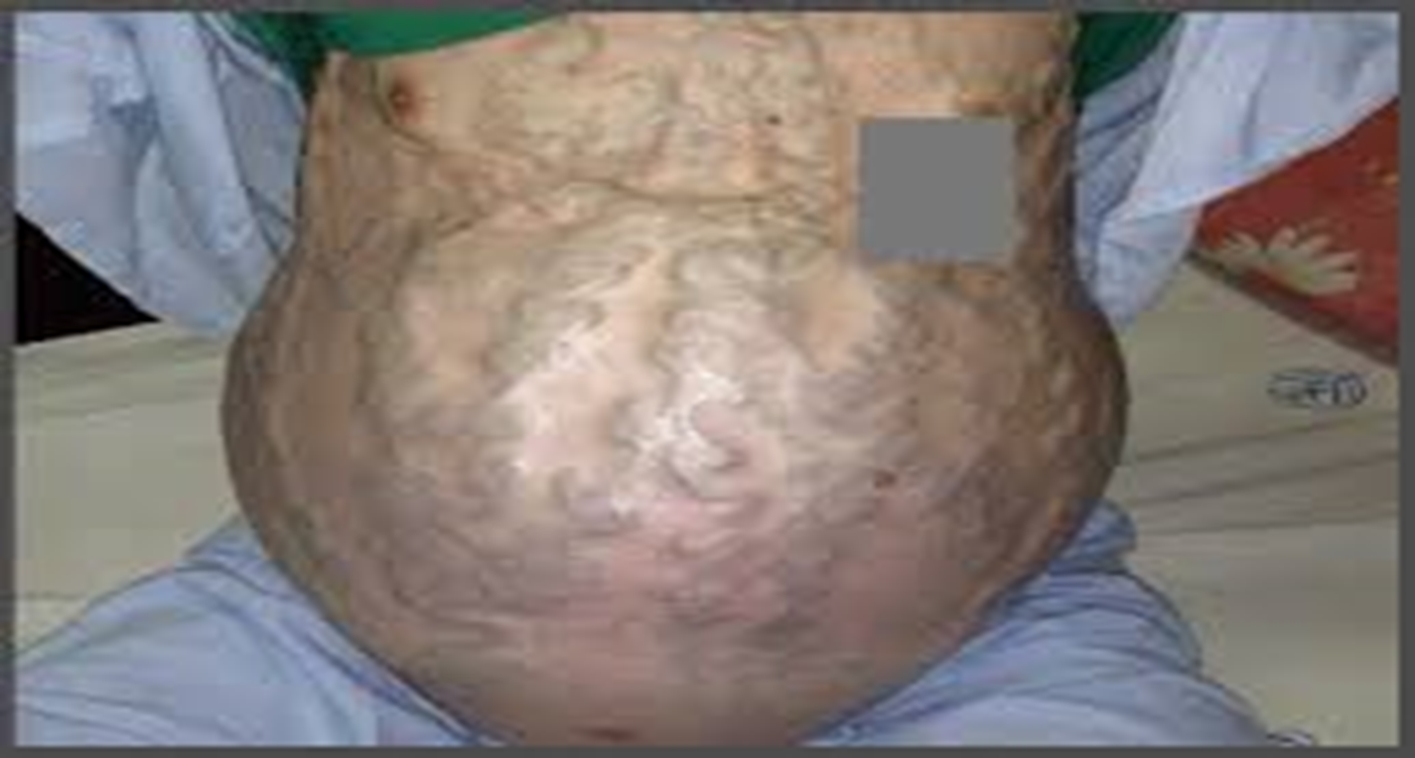
Caput medusae: enlarged and visibly dilation veins around the umbilicus.
Its occurs when blood flow through the liver blocked, due to portal hypertension.

Slide 21
COMPLICATIONS
Ascites
GI bleeding
Hypersplenism
Low blood oxygen
Kidney failure
Mild cognitive impairment
Iron deficiency anemia

Slide 22
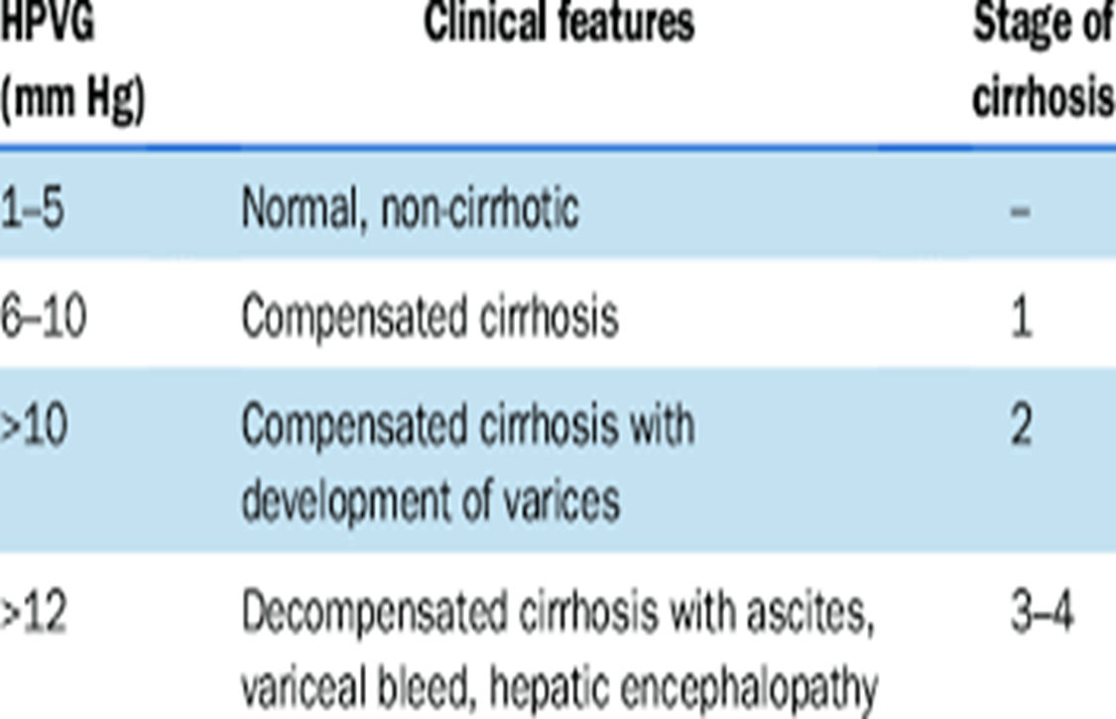

Slide 23
DIAGNOSIS
Blood tests: comprehensive metabolic panel can show signs of kidney and liver dysfunction.
CBC show if spleen has become overactive in removing WBC or platelets.
Ultrasound: proceed images of blood moving through veins. Identify obstructions and abnormal widening or narrowing

Slide 24
TREATMENT
Endoscopy: sclerotherapy, banding
Medication: beta-blocker are used as secondary measure to
Prevent recurrent variceal bleeding.
Propanolol or nadolol is effective in reducing portal venous pressure.
Administration of these drugs at doses that reduce the heart rate by 25% has been shown to be effective in the primary prevention of variceal bleeding

Slide 25
Liver transplantation
Non-surgecal (TIPS)
Surgecal (distal splenorenal shunt)

Slide 26
Clinical Implications of Cirrhosis for Endoscopic Procedures
Proper assessment and preparation are crucial to minimize risk and ensure safe outcomes.

Slide 27
Complication | Implication | Management
Coagulopathy | Bleeding risk | Check INR, Platelets, FFP/platelet transfusion
Varices | Risk of rupture | Gentle technique, band ligation if needed
Encephalopathy | Sedation risk | Minimal sedation, monitor neuro status
Ascites | Procedural difficulty, infection risk | Aseptic technique, antibiotics

Slide 28
Cardiopulmonary | Sedation risk | Cardiac eval, O2 monitoring
Drug Metabolism | Drug sensitivity | Lower doses, short-acting agents
Infection | peritonitis, sepsis risk | Prophylactic antibiotics
Mucosal Fragility | Poor healing | Avoid unnecessary biopsies

Slide 29
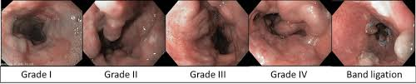
Esophageal banding
a medical procedure that uses small elastic bands to close off enlarged veins (varices) in the esophagus, often caused by liver disease
How long do esophageal varices bands last???
Notes:
For grade 2 or higher
5-7 days
Ulcer may occur

Slide 30
Immediate post-procedure care
Fasting: Do not eat or drink anything for about 2 hours after the procedure.
Clear liquids: After the initial fasting period, start with sips of water or other clear liquids before moving on to soft foods.
Soft foods: Stick to soft foods like pudding, soup, mashed potatoes, and porridge for the first few days or until your throat feels better.
Sore throat: A sore throat is common for 24-48 hours and can be helped by lozenges or gargling with warm, salt water.
Sedation: For the first 24 hours, do not drive, operate heavy machinery, make important decisions, or take sedatives.
Rest: Rest for the remainder of the day and avoid strenuous activity for at least 24 hours or as advised by your doctor.

Slide 31
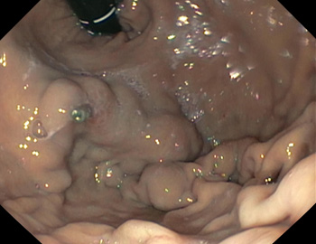
Fundal varices
endoscopic cyanoacrylate (CA) injection: The tissue adhesive, such as N-butyl-2-cyanoacrylate (NBC), is injected directly into the varix to seal it off.
https://www.youtube.com/watch?v=tQhYmFYMWHI

Slide 32
ARTICLE
ENDOSCOPIC MANAGEMENT OF PORTAL HYPERTENSION
Summary key of concepts and guidelines
(al-busafi et al.;pmc3398621)

Slide 33
BACKGROUND
MOST COMMON CAUSE: LIVER CIRRHOSIS
HVPG>12MMHG INCREASE RISK OF VARICEAL BLEEDING
DEVELOPMENT OF VARICES MARKS DISEASE PROGRESSION

Slide 34
ROLE OF ENDOSCOPY
UPPER GI ENDOSCOPY= GOLD STANDARD FOR VARICES DIAGNOSIS
ASSESSES VARICEAL SIZE, RED WALE SIGNS, BLEEDING RISK
EUS CAN EVALUATE COLLATERAL VESSELS BUT NOT FIRST LINE

Slide 35
ENDOSCOPIC THERAPY:PRIMARY PROPHTLAXIS
INDICATED FOR MEDIUM/LARGE VARICES
NON-SELECTIVE BETA-BLOCKER(NSBB)
ENDOSCOPIC VARICEAL LIGATION (EVL)
COMBINATION THERAPY IN SELECTED PATIENTS

Slide 36
ENDOSCOPIC THERAPY:ACUTE BLEEDING
EARLY ENDOSCOPY (WITHIN 12HRS) IS ESSENTIAL
EVL OR SCLEROTHERAPY TO CONTROL BLEEDING
START VASOACTIVE DRUGS AND ANTIBIOTICS

Slide 37
SECONDARY PROPHYLAXIS
AFTER FIRST variceal bleed
nsbb+evl is recommended
Reduces re-bleeding and improves survival

Slide 38
Varices by location
Esophageal varices: evl preferred over injection therapy
Gastric varices: glue injection (cyanoacrylate), coil placement, tips is needed

Slide 39
Other considerations
Good endoscopic technique improves visualization and safety
Capsule endoscopy is promising but not replacement
Ectopic varices require individualized managment

Slide 40
Surveillance recommendations
No varices: repeat endoscopy every 2-3 years
Small varices: repeat every 1-2 years
Large varices or high- risk: start prophylaxis (evl or nsbb)
Endoscopy must be combined with medical/interventional therapy

Slide 41
Conclusion
Endoscopy plays a central role in variceal management
Evl=standard for esophageal varices
Glue injection and advanced methods for gastric varices
Ongoing surveillance and combination therapy are key

Slide 42

The end….

