Slide 1



Colonoscopy Without Pain
Welcome, Course overview & Safety briefing
Samer Al-Dury
21-22.1.2026
Endoscopy Unit, Medical City For Military & Security Services,
Muscat - Oman
Notes:
Warm welcome to Muscat and to the Endoscopy Unit
Acknowledge international and local faculty
Thank participants for committing two intensive days
Set expectations: interactive, practical, honest
“This is not a course about gadgets — it’s about judgment, technique, and patient comfort.”

Slide 2



Slide 3
Why pain-free colonoscopy matters
Colonoscopy discomfort remains common worldwide
Pain leads to:
  incomplete exams
  poor patient experience
  avoidance of follow-up
Most pain is operator-related, not patient-related
Notes:
👉 Comfort is a skill, not luck.

Slide 4
Symposium structure
3 principles:
Gentle before fast
Think before pushing
Comfort is a team outcome
Notes:
Explain briefly:
We prioritize how you insert, not just reaching the cecum
Nurses are not assistants — they are partners
Technology supports thinking, it doesn’t replace it

Slide 5
Learning objectives
Insertion techniques & loop control
Understanding anatomy and scope position
Managing difficult colons safely
Withdrawal technique & quality
Live cases + structured debriefs
Simulator-based skills refinement
Notes:
⚠️ Say explicitly:
“Live cases will vary — we focus on principles, not perfect anatomy.”

Slide 6
NOT a learning objective
❌ Not a competition
❌ Not about rushing procedures
❌ Not about showing off difficult cases
❌ Not about one ‘right’ technique
✔️ It is about:
decision-making
recognizing limits
knowing when to stop or change strategy

Slide 7
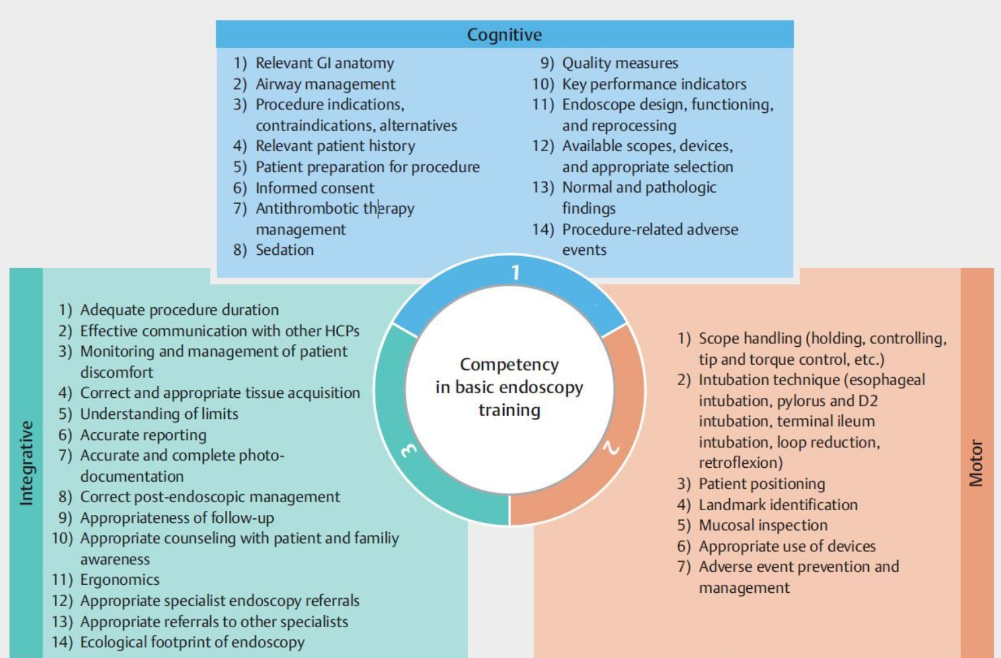

Slide 8
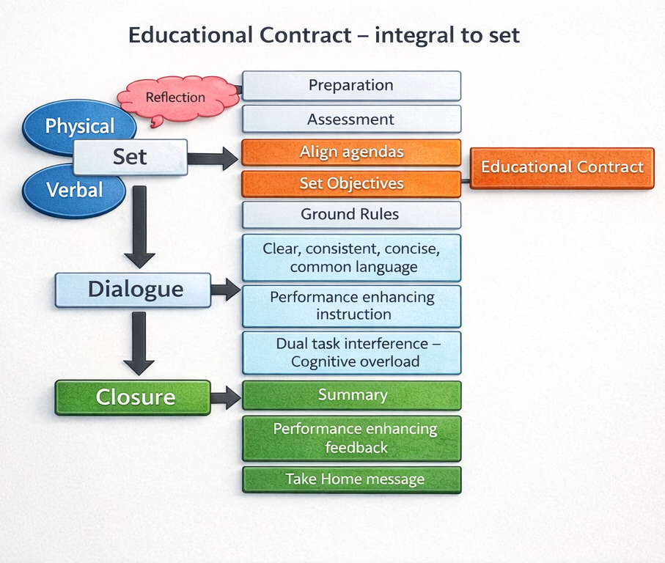

Slide 9
Important reminders
Patient Safety First
All live cases are routine, elective colonoscopies
Standard hospital consent and sedation protocols
Faculty may take over at any time
Patient comfort overrides teaching at all times
Notes:
Say this clearly:
“If comfort or safety is compromised, teaching stops.”

Slide 10
Roles during procedures
One trainee
One trainer
One moderator
Open discussion encouraged
Questions are welcome — but timing matters
Rules:
No interruptions during critical moments
Debrief happens immediately after each case

Slide 11
Getting the most out of the 2 days
Be honest about your struggles
Ask why, not just how
Try techniques during simulator blocks
Observe body language, hand position, and pacing
Notes:
Encourage humility:
“If you’re already perfect, this course won’t help you.”

Slide 12

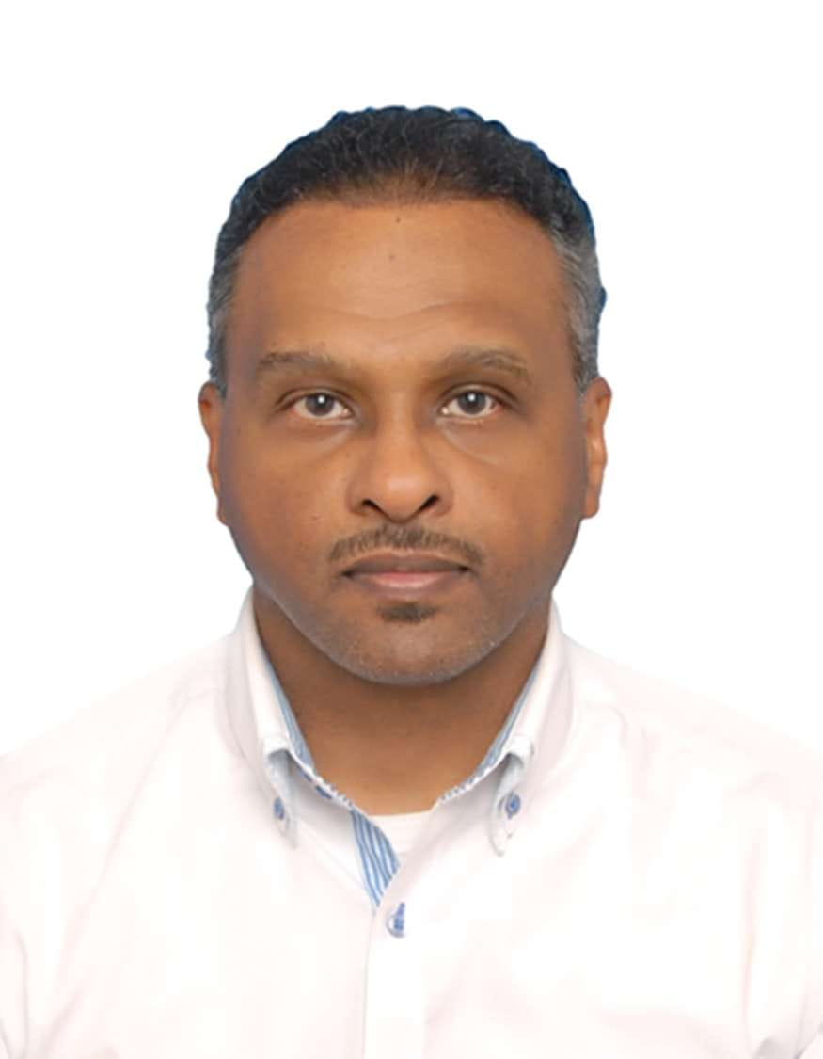
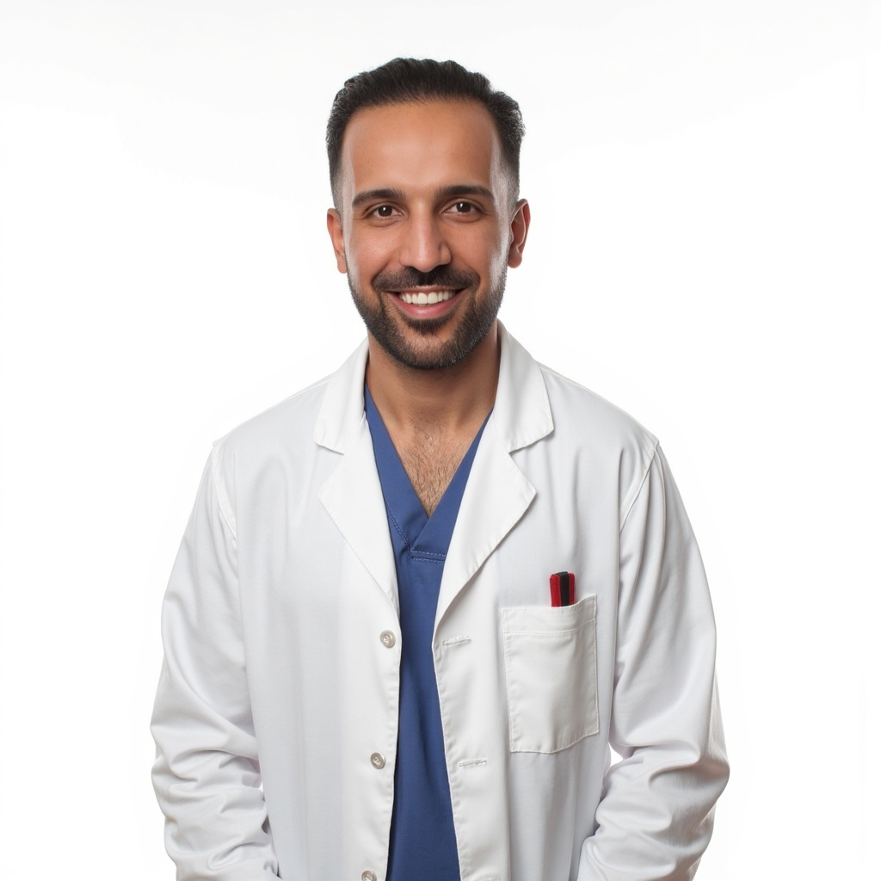
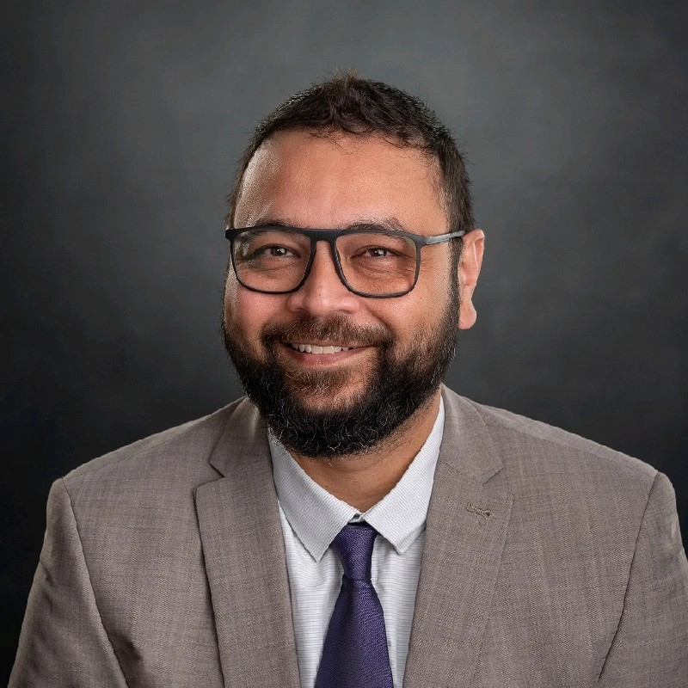
Faculty
Dr Morteza Shafazand – Sweden
Dr Mohammed (Adnan) Khan – UK / Muscat
Dr Faiz Ibrahim – UK / Muscat
Dr Samer Al-Dury – Sweden / Muscat

Slide 13
Ground rules
Respect patients, staff, and colleagues
Confidentiality of cases
Phones on silent during live cases and in classroom
Learning > ego

Slide 14
References
1. American College of Gastroenterology, American Society for Gastrointestinal Endoscopy. Quality indicators for colonoscopy. *American Journal of Gastroenterology*. 2024;119(9):1701–1723.
2. Corley DA, et al. Adenoma detection rates and risk of colorectal cancer and death. *New England Journal of Medicine*. 2014;370(26):2541–2548.
3. Barclay RL, et al. Colonoscopic withdrawal times and adenoma detection during screening colonoscopy. *New England Journal of Medicine*. 2006;355(24):2533–2541.
4. Ismail FW, et al. Exploring endoscopic competence in gastroenterology training: A simulation-based assessment. *Clinical Gastroenterology and Hepatology*. 2024;22(1):123–134.
5. ASGE Standards of Practice Committee. Infection control during gastrointestinal endoscopy. *Gastrointestinal Endoscopy*. 2018;88(2):327–337.
6. American College of Gastroenterology. Guidelines for credentialing and privileging for gastrointestinal endoscopy. *American Journal of Gastroenterology*. 2017;112(7):1015–1026.
7. Ericsson KA. Deliberate practice and the acquisition and maintenance of expert performance in medicine and related domains. *Academic Medicine*. 2015;90(11):1471–1486.
8. Ahmed JF, et al. Causes of intraprocedural discomfort in colonoscopy. *Gastrointestinal Endoscopy*. 2024;100(4):567–578.
9. Kay CL, et al. Traditional and novel colonoscopy quality metrics. *Gastroenterology*. 2025;168(2):289–301.
10. Pagani W, et al. Digital platforms, virtual reality, and augmented reality in endoscopy training. *Endoscopy*. 2025;57(5):420–435.

Slide 15

Thank You for your attention
Visit our online platform and learn more
www.muscatendoscopyacademy.com

