Slide 1
Varied Kinds of PARTS!
Helping your own system be ready for anything!!

Slide 2
General Assumptions
Each Person’s System is Unique!
How Each Person Experiences their Parts is Unique
Parts May Change Over Time in Presentation, Embodiment, and/or Communication
Curiosity of the Therapist helps Clients be Curious

Slide 3


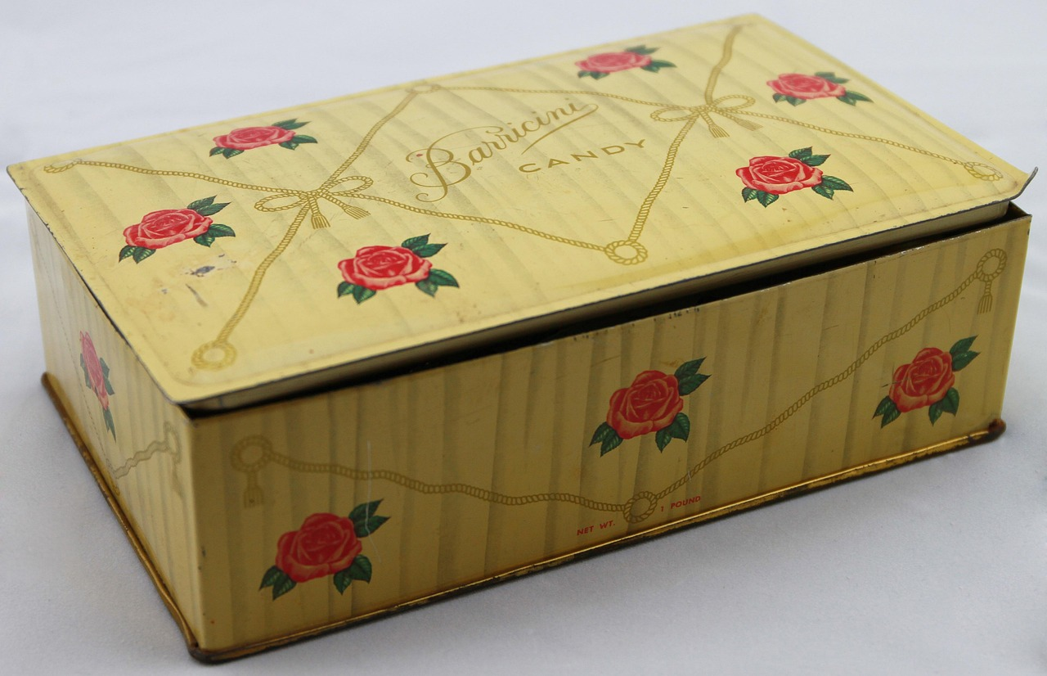


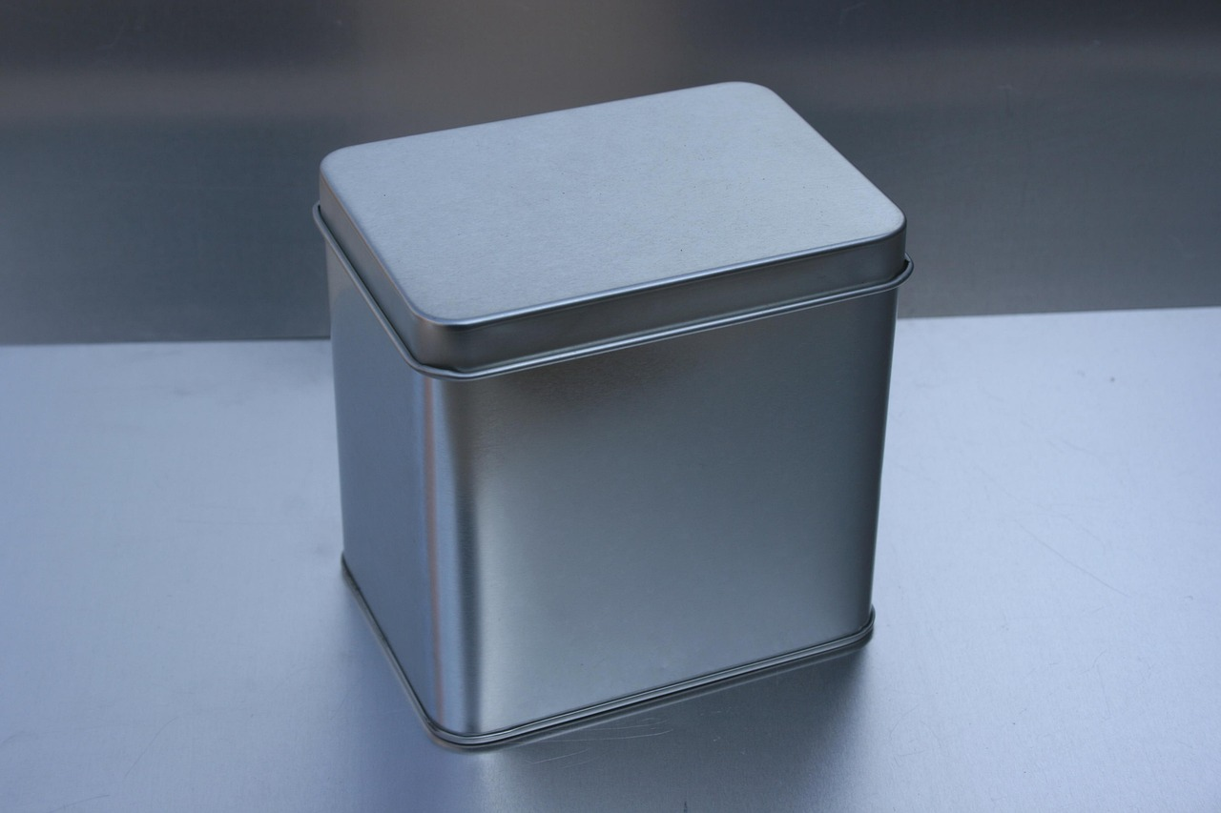
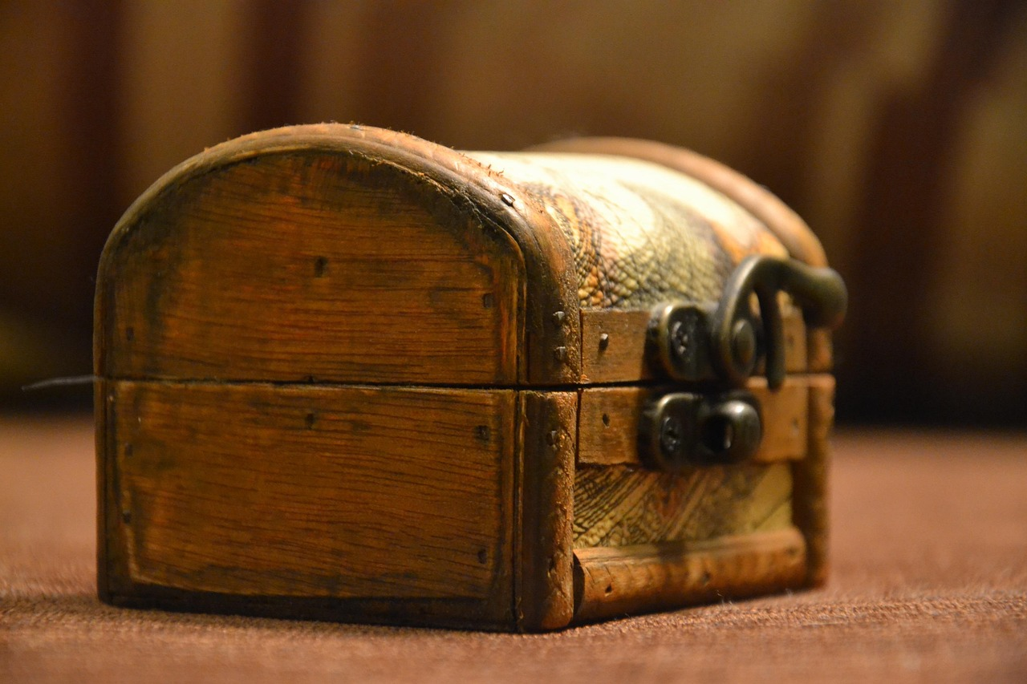

Slide 4







Slide 5







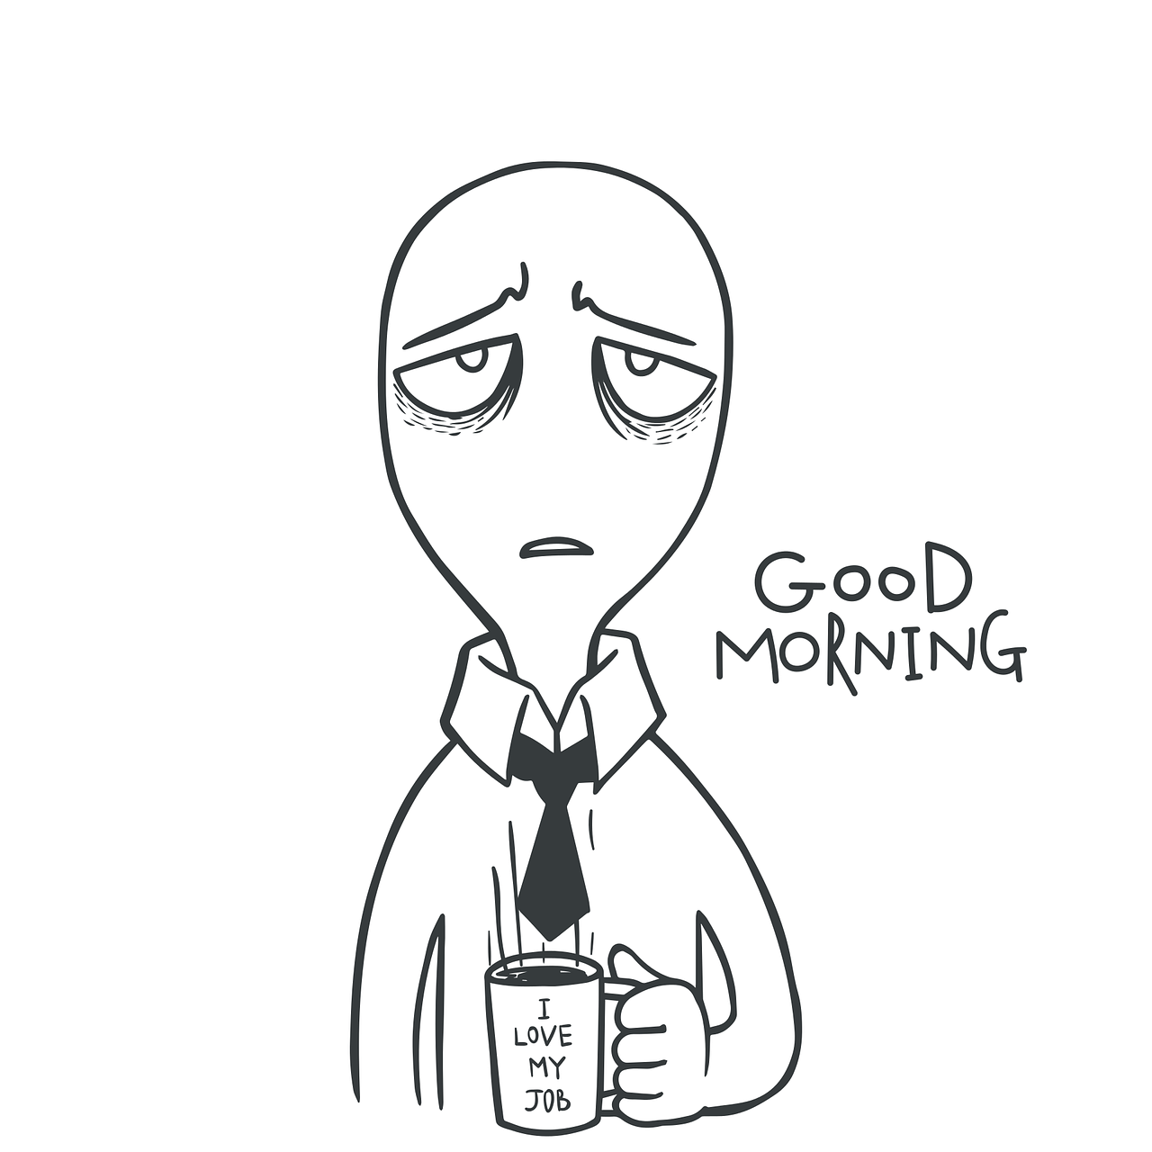

Slide 6
Complexity Varies
Perceptions may be More Simplistic because:
  Therapist/Client needs to Get more Curious, Stay with it
  Part needs to Gain Trust, share more with Self
  Part may be Younger in age, less complex with less maturity
  Neglect, Poverty, or other Lack can impact parts

Slide 7
Change happens!
Parts Evolve as Time is spent Relating/Connecting with them
  i.e. Child part Appears to be Dead, Springs Up Alive!
  i.e. Adult part Appears to be Dead, Revives with patient Witnessing, Unburdening
  i.e. Parts takes one Shape/Form, then Another, then Another
  i.e. Part shows up in one Place, then a Different Place

Slide 8
IFS: Theory & Process
Multiplicity is Normal: For us, and for our Parts!
  i.e. We have Parts & Self, Parts have Parts & Self, and those Parts have Parts & Self……
Some Parts will show Multiple Inner Dimensions, others Not
Being in Relationship allows Parts and Self to Develop Over Time

Slide 9
What if Client says,
“Nothing is Happening”
Most Clients will notice SOMETHING, even if it is THINKING that they are not noticing anything!
Being PATIENT and CURIOUS allows more to come out, come into awareness

Slide 10
What if Client says,
“I Don’t Know”
Use IMPLICIT DIRECT ACCESS if needed to talk for a bit more, then return to inner focus when there seems to be an entry point
Show You get it: IFS may feel opposite to “talk therapy”; the IFS Process might prompt mild discomfort to terror
Education: Client might need more Explanation first, simple reminder of IFS goals/process/safety
Patience! Help Client (and You!) to find Calm, Curious, Patient Presence

Slide 11
Final Thoughts:
Always BE CURIOUS!
Remember to SLOW DOWN
If You or your Client are unclear, ASK more Curious Questions
Support the unfolding Relationship Process of CONNECTEDNESS!

Slide 12


Thank you!
Kelly Loy, LMFT, LCPC

