Slide 1
Neurodivergent clients
Utilizing a neuro-inclusive IFS approach

Slide 2
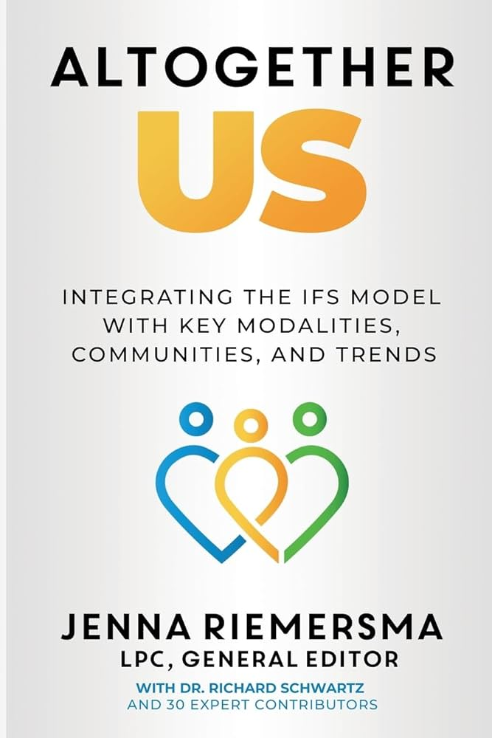
All information taken from the following book:
Pages 315-360
Altogether Us: Integrating the IFS Model with Key Modalities, Communities, and Trends, Chapter: Embodying IFS with Neurodivergent Clients by Candice Christiansen, Med, CMHC and Meg Martinez-Dettamanti, MS, CMHC and edited by Jenna Riemersma

Slide 3
Ideas for offering a Neuro-Inclusive IFS Approach

Slide 4
Focus on yourself, first
Explore your own individual, legacy, and cultural burdens related to implicit bias, judgment, and stereotypes against Neurodifferent individuals.
Work to un-blend from parts with extreme beliefs and provide unburdening when needed.
Acknowledge ruptures, apologize and work to repair.
Strive to be Self-led.

Slide 5
Use Curiosity with neuro-different clients around their sensory, learning, and internal needs
  What does your client need to feel safe?
    Explore accommodations to help client and their parts feel comfortable.
    Mirror client’s words and language.
    Address sensory issues such as lights, sounds, smells, tastes, internal and external sensations at beginning of and throughout session.
    Possible needs of client might include dimming lights, averting or closing eyes, rocking back and forth, bouncing fidgeting, wiggling, getting up and standing, walking, stretching, and using a weighted or soft blanket.
    Encourage self-stimulating behaviors such as stimming, if needed.

Slide 6
Help client distinguish between traits of Neurodifference (hardware) and their burdened parts (“software”) (“software virus”)
Hardware: Traits related to neurodifferences
Software: Parts- managers and firefighters
Software Virus- Burdens held by exiles.

Slide 7
Common Neurodifferent Traits (“Hardware”) that May Impact Internal Family Systems
•Rejection sensitivity or Rejection Sensitivity Dsyphoria.
•Sensory sensitivity
•Autonomic Nervous System Meltdowns.
•Autonomic Nervous System Shutdowns.
•Emotional empathy
•Alexithymia
•“Rigid” thinking
•Concrete thinking
•Hyper-focus
•Anxiety.
•Distraction

Slide 8
Common Protector Parts in Manager-Roles (“Software”)
•Social Masking Parts
•Insecure or Judging Parts
•People Pleasing Parts
•Prover Parts
•Perfectionist Parts
•Comparing Parts
•Ruminating Parts
•Compliant Parts
•Loyal Parts
•Advocate Parts
•Entertaining or “Funny” Parts

Slide 9
Common Protector Parts in Firefighter Roles (“Software”)
•Depressed Parts
•Dissociating Parts
•Angry or “Emotional Outburst” Parts
•Distracting Parts
•Sleepy Parts
•Raging or Angry Parts
•Defender Parts
•Justice Parts
•Lone Wolf Parts
•Parts that Engage in Addictive Processes
•Suicidal Parts

Slide 10
Common Burdens of Exiled Parts (“Software Virus”)
•Burden of Shame
•Burden of Anxiety
•Burden of Emotional Overwhelm
•Burden of Defectiveness
•Burden of Fear of Failure
•Burden of Loneliness
•Burden of Fear of Dangerous People
•Burden of Fear of Being Ostracized

Slide 11
Be Creative when Working with Parts
Ask how information is learned_ visual, auditory, and/or kinesthetic.
Utilize client’s traits, likes and learning style to create an individual plan.
Some ideas for parts recognition and mapping might include visually imagining parts, using visual arts or music to depict parts, matching parts to pictures or objects, using figurines, or through bodily sensations.

Slide 12
Mapping technique/strategies for Neurodifferent Learning Style – Visual
•Visual (imaginative or artistic) : Encourage clients to draw, paint, sculpt, etc
* Visual (concrete): Premade visual aids such as nesting dolls, finger puppets, play therapy figurines, parts cards, genograms, or even photographs can be helpful. Example: A creative client once used a video game to create electronic human versions of their parts distinct from their ND traits.*

Slide 13
Mapping technique/strategies for Neurodifferent Learning Style – Auditory
•Encourage clients to explore sound, silence, and music as a way to name and distinguish their ND traits and their parts. Example: Some clients with “auditory stims” may use a specific sound to regulate their nervous nervous system and choose songs or music to represent their parts.

Slide 14
Mapping technique/strategies for Neurodifferent Learning Style – Kinesthetic (preference for tactile stimming or need for movement to learn)
•Suggest that clients move around the room or demonstrate their parts and ND traits with body postures or facial expressions. Examples: A client who was a drummer demonstrated an angry part through drumming on his thighs while another client sat on their hands to represent a “masking” manager part. One client shared, “My ADH brain feels like a laser when I’m focused on my interests and a flood light when I’m in crowded spaces; my manager parts try to control the laser and a part shames me when the flood light turns on”

Slide 15

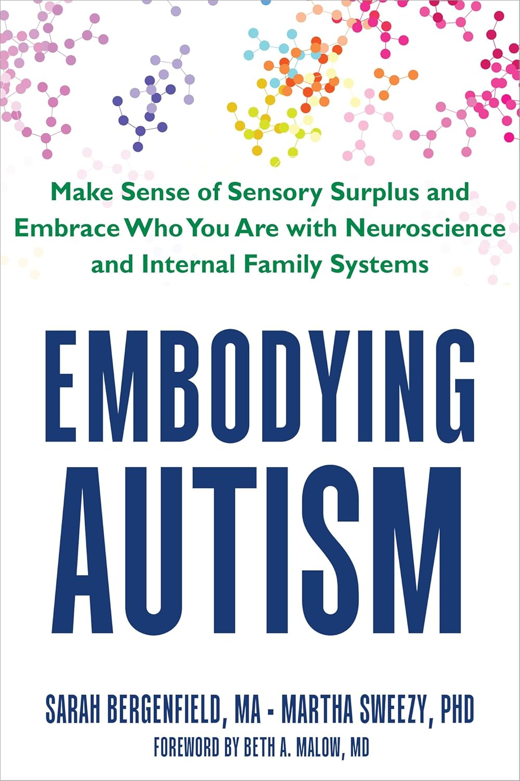
Resources available soon
IFS Integration: A Comprehensive Guide to Applying Internal Family Systems Across Modalities, Populations, and Clinical Presentations by Jenna Riemersma; To be released Nov. 2025
(previously published as Altogether US)
Embodying Autism: Make Sense of Sensory Surplus and Embrace Who You Are with Neuroscience and Internal Family Systems by Sarah Bergenfield MA (Author), Martha Sweezy PhD (Author), Beth Ann Malow MD (Foreword);
To be released January 2026

