Slide 1

Z O N e s of
Regulation

Slide 2
Training Purpose
Children in foster care often struggle with emotional regulation due to trauma.
This training helps foster parents understand the Zones of Regulation, recognize trauma-based stress responses, and support children in building self-regulation skills safely and effectively.

Slide 3
Learning Objectives
Understand emotional regulation and how trauma affects it
1
Identify the four Zones of Regulation
2
Recognize trauma-based behaviors within each zone
3
Respond supportively without escalating behavior
4
Teach children regulation skills over time
5

Slide 4
Module 1: Regulation & Trauma Basics

Slide 5

What is emotional regulation?
Emotional regulation is the ability to:
Recognize feelings
Manage emotional responses
Return to a calm, organized state

Slide 6
Trauma Impact
Keep a child’s brain in survival mode
Reduce impulse control
Increase emotional intensity
Delay regulation skills
Trauma can:
👉 Children may not yet have the skills to calm themselves.

Slide 7
Module 2
Introduction to Zones of Regulation

Slide 8
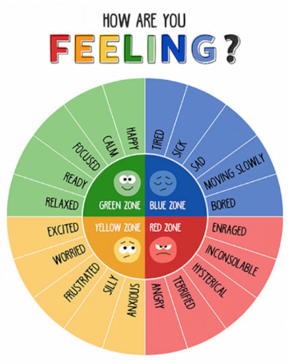
The 4 Zones
Blue Zone
Green Zone
Yellow Zone
Red Zone

Slide 9
It is important to remember that all zones are normal.
The goal is not to “stay green,” but to recognize and manage zones safely.

Slide 10
Module 3
Trauma & the Zones

Slide 11
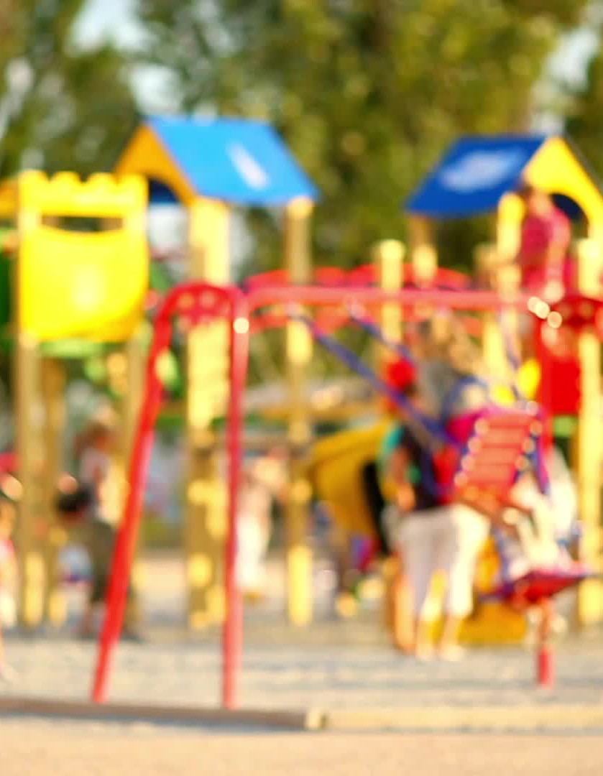
Children with trauma may:
Spend more time in Yellow or Red
Move quickly between zones
Have fewer coping strategies
Misinterpret neutral situations as threats

Slide 12
Important Shift
Instead of asking:
Ask:
“Why are they acting this way?”
“What zone are they in, and what do they need?”

Slide 13
Module 4
How Foster Parents Should Respond by Zone

Slide 14
Blue Zone
(Low Energy)
✔ Offer comfort and connection
✔ Reduce demands
✔ Check physical needs (sleep, illness)
❌ Avoid shaming (“Snap out of it”)

Slide 15
Green Zone
👉 This is the best time to teach.
(Regulated)
✔ Teach skills
✔ Practice coping tools
✔ Praise effort and awareness

Slide 16

Yellow Zone (Escalating)
✔ Validate feelings
✔ Offer choices
✔ Prompt calming strategies
✔ Reduce stimulation
❌ Avoid lectures or power struggles

Slide 17
Red Zone
(crisis)
✔ Focus on safety
✔ Stay calm and present
✔ Reduce language
✔ Give space if needed
❌ Do NOT:
Argue
Threaten
Punish
Demand explanations
📌 Regulation comes before correction.

Slide 18

Module 5
Teaching Regulation Skills

Slide 19
Children learn regulation over time, not in crisis.

Slide 20
Helpful Tools
Deep breathing
Sensory tools (stress ball, music)
Movement breaks
Visual charts
Calm spaces (not isolation)
Predictable routines
Teach children:
✔ How to name their zone
✔ What helps them move toward regulation

Slide 21
Module 6
Practical Foster Care Examples

Slide 22

Example 1:
Child explodes after school → Likely Yellow/Red
✔ Response: Snack, quiet time, reduced demands
Example 2:
Child shuts down after a visit → Likely Blue
✔ Response: Comfort, connection, reassurance
Example 3:
Child calm at bedtime → Green
✔ Response: Practice coping skills, reflect on the day

Slide 23
Module 7
Key Takeaways

Slide 24

Zones describe states, not behavior choices
Trauma makes regulation harder
Foster parents help children borrow calm
Teaching happens in Green, not Red
Progress is gradual and uneven

Slide 25

Important Reminders for Foster Parents
Zones are not discipline tools
Never punish a child for being in a zone
Use consistent language across caregivers
Partner with caseworkers and therapists
Ask for help when behaviors escalate

