Slide 1
The Patrol Method
A Short Presentation for Parents
Original Document by Bill Nelson
Salt River District
Grand Canyon Council

Slide 2
Welcome to Boy Scouting!
The Aims of Boy Scouting
  Character Development
  Citizenship Training
  Mental and Physical Fitness
Notes:
Whether you have just crossed over with your son from Cub Scouts or just joined Boy Scouts, we appreciate your enthusiasm and encourage your participation in the troop.
The three aims of Boy Scouting are character development, citizenship training, and mental and physical fitness. Everything we do is in support of those three aims.

Slide 3
Scouting: A Learning Environment
Scouting offers an environment that grants young men opportunities to lead, to learn, and to explore.
During their Boy Scout experience you should expect the boys to become more confident, more skilled and better prepared for life as they grow into manhood.
Notes:
Scouting offers an environment that grants young men opportunities to lead, to learn, and to explore.
During their Boy Scout experience you should expect the boys to become more confident, more skilled and better prepared for life as they grow into manhood.

Slide 4
Scouting: A Learning Environment
Boy Scouts have many opportunities to learn skills of leadership, of the outdoors, and of life.
Each boy decides what he will learn and how quickly he will do it.
As he progresses, the value of his achievements will be reinforces through recognition
  advancement in the Scouting’s ranks, positions of leadership in the troop, and accomplishments during outdoor adventures.

Slide 5
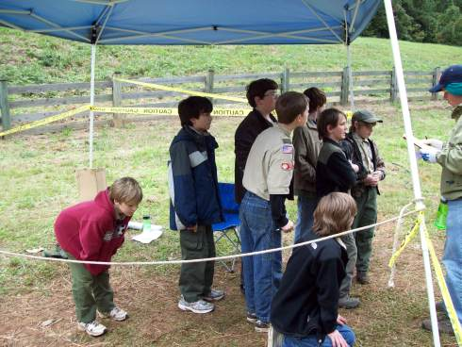
Difference to Cub Scouting
One very important difference between Boy Scouting and Cub Scouting is that in Boy Scouting we concentrate on Leadership Development.
In order to teach leadership, we let the boys lead.
Meeting and activity planning and operation are left up to the boys with adult mentoring

Slide 6
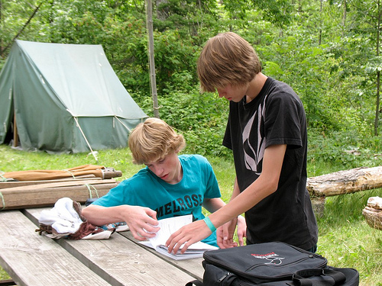
Patrol Method
This method of teaching boys how to lead is called the Patrol Method
It is so important to Boy Scouting that it is firmly established as one of the Eight Methods of Scouting

Slide 7
The Methods of Boy Scouting
The Ideals
The Patrol Method
The Outdoors
Advancement
Association with Adults
Personal Growth
Leadership Development
The Uniform
Notes:
The Patrol Method is one of the 8 methods of Scouting. It has been said that it is the most important method. The Patrol Method also supports the 6th and 7th methods of Scouting: Personal Growth and Leadership Development

Slide 8
Differences from Cub Scouting
Cub Scout Den
Den Leader – Adult
In charge of everything that happens in the den
Boy Scout Patrol
Patrol Leader – Youth
A Patrol Leader has real authority and genuine responsibilities. Much of the success and happiness of four to ten other boys depend directly on him.

Slide 9
Differences from Cub Scouting
Troop Operations
Senior Patrol Leader – Youth
Works with Patrol Leader Council (youth committee) to make sure troop runs smoothly
Scoutmaster is mentor, teacher and guide
Pack Operations
Cubmaster – Adult
Works with adult Den Leaders, committee chair and adult committee members to make sure pack runs smoothly

Slide 10
Differences from Cub Scouting
Troop Meeting
Organized by youth
Everything that happens is controlled by them
Adults supervise to watch out for safety concerns and to mentor the leaders afterwards
Since the youth are learning how to lead, meetings can look very unplanned (and may be)
Pack Meeting
Organized by Cubmaster and other adults
Everything that happens is controlled by adults
Usually run very smoothly

Slide 11
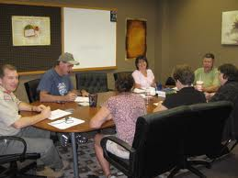
Adult Troop Committee
We have adults helping in the committee:
  Supporting the Scoutmaster in delivering a quality troop program
  Handling troop administration

Slide 12
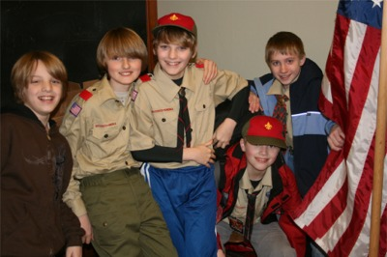
Boy-Led Troops Are Not Perfect
The boys often make mistakes and the meetings are seldom as smooth as adult run meetings
But the boys do learn how to lead via this method

Slide 13
Adult Run Troops
Opposite of Boy Run Troops
Some signs of an adult run troop:
  All scouts are dressed perfectly
  Meeting agenda is complete and posted weeks in advance of troop meetings
  Adults making lots of announcements
  Adults stand with scouts or in front of scouts during activities.
  Troop focuses solely on advancement
  Troop focuses solely on outings

Slide 14
What Can I Look for in a Boy Lead Troop?
SM and adults are seen in the background and not heard
Adults are separated from the troop activities but are ever watchful for safety and harassment
The SPL is the leader of the meeting
The SPL runs the Patrol Leaders’ Council and takes ownership of the troop calendar
Patrols have meetings and outings on their own

Slide 15
Why is Boy Run So Important?
Boys don’t learn leadership skills in adult run troops
Boys don’t take ownership in adult run troops
Boys often lose interest in adult run troops and leave
Boys often don’t have fun in adult run troops. They are too much like school.

Slide 16
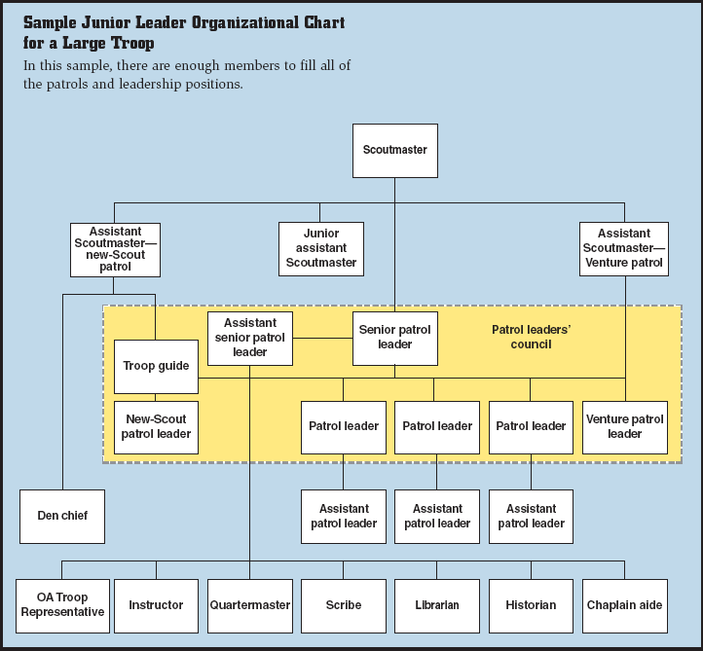
Boy Scout Troop Structure
Notes:
The senior patrol leader (SPL) assumes the most leadership responsibility of any Scout in the troop.
The SPL is in charge of all Troop Meetings and Troop Activities
The SPL and the Patrol Leaders (together called the PLC) plan all troop calendars, troop activities and troop meetings.

Slide 17
Scoutmaster’s Role
Trains the Jr. Leaders
Mentors them
Acts as safety officer
Provides encouragement
Helps to set goals for the troop and for individual Jr. Leaders

Slide 18
Chain of Command
Scouts should go to their Patrol Leader with questions.
Patrol Leaders should go to the Senior Patrol Leader with questions
Senior Patrol Leader should go to the Scoutmaster with questions

Slide 19
General Rule #1
Don’t do anything a Scout can do

Slide 20
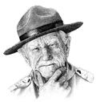

How the Patrol Method Works
"Train 'em, trust 'em, and let 'em lead!”

Slide 21
Where to Get More Information
Online training under the Boy Scout tab at www.myscouting.org

