Slide 1

World Class PCB Solutions
HUADING GROUP CO LTD

Slide 2
01
Company Profile
02
Key Milestones
03
Corparation Organization
Corporate
04
Certificates
05
Global Operations
06
Manufacturing Sites Overview
07
Corporate Business Update

Slide 3
Company Profile
Found: | March,2003
Registered： | HK$100,000,000,00=US$13,000,000,00
Operation: | P.R.CHINA
Production Capacity: | 200,000M2/Month
Employees: | 4600
2023 Revenues | US$196 Million

Slide 4
Key Milestones
1976 | Single-sided PCB Factory Started Full Production
1982 | Double-sided PCB Factory Started Full Production
1988 | Multilayer PCB Factory Started Full Production
1990 | A Member of CPCA=China Printed Circuit Association Since CPCA Establishment in June,1990. Plant started Building Automative PCB
2000 | Director of China Printed Circuit Association
2003 | Flex PCB Factory Started Full Production,Including Rigid Flex PCB Plant Started Building HDI Huading Group Established
2006 | Metal-cored(Aluminium-cored)PCB Factory Started Full Production,Plant started Anvlaver Production
2007 | Become An IPC member
2011 | Ranked #88 Among The World Top PCB Manufactures
2012 | Executive Director of China Printed Circuit Association Among 671 Officially Registered Member In P.R.China
2013 | Ranked #91 Among The World Top PCB Manufactures
2015 | Ranked #82 Among The World Top PCB Manufactures
2017 | Ranked #89 Among The World Top PCB Manufactures
2018 2019 | Ranked #96 Among The World Top PCB Manufactures Ranked #87 Among The World Top PCB Manufactures
2020 | Ranked #85 Among The World Top PCB Manufactures
2024 | Huading-inversted PCB Factory Is About To Be Listed On The U.S.A. Stock Market

Slide 5
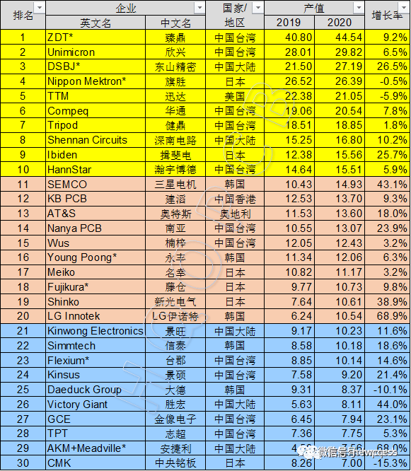

Slide 6
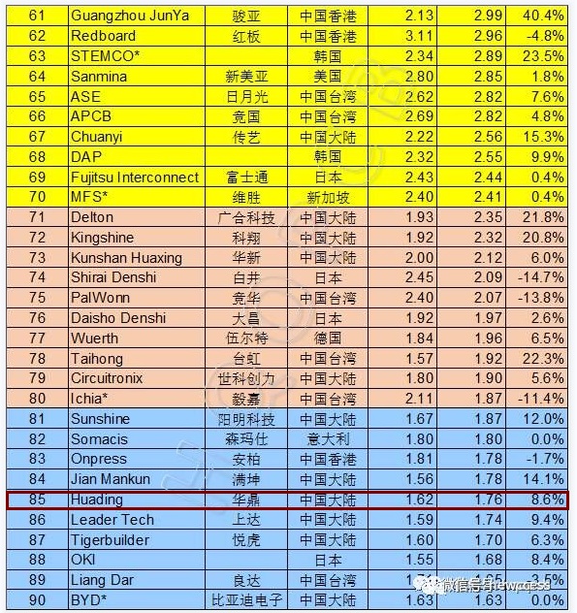

Slide 7
Certificates
 | Multilayer | DE.S.＆S.S
UL | approved | approved
ISO 9001 | approved | approved
IATF 16949 | approved | approved
QC 080000 | approved | approved
OHSAS 18001 | approved | approved
ISO 45001 | approved | approved
ISO 13485 | approved | approved

Slide 8
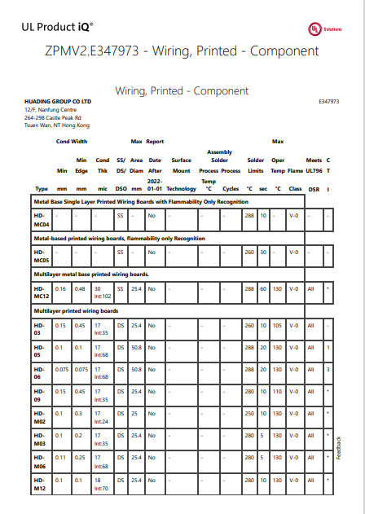
UL Product iQ

Slide 9
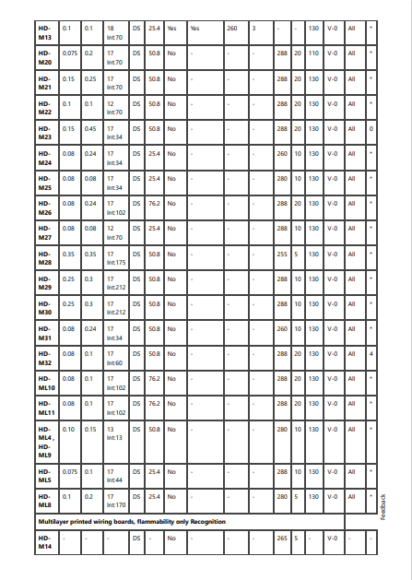
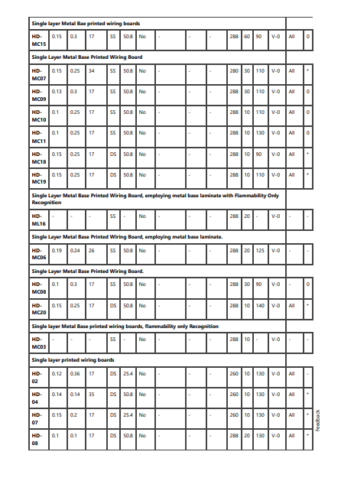

Slide 10
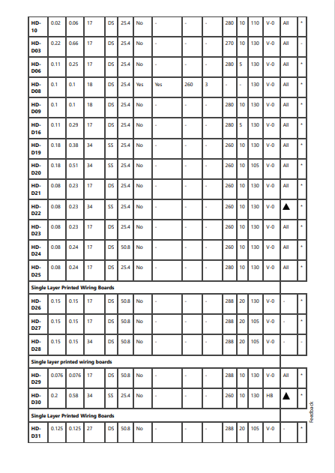
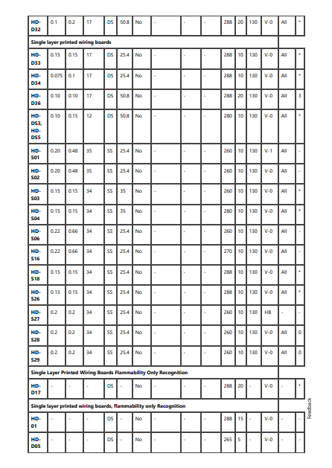

Slide 11
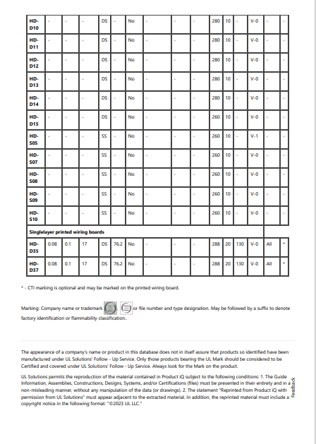

Slide 13
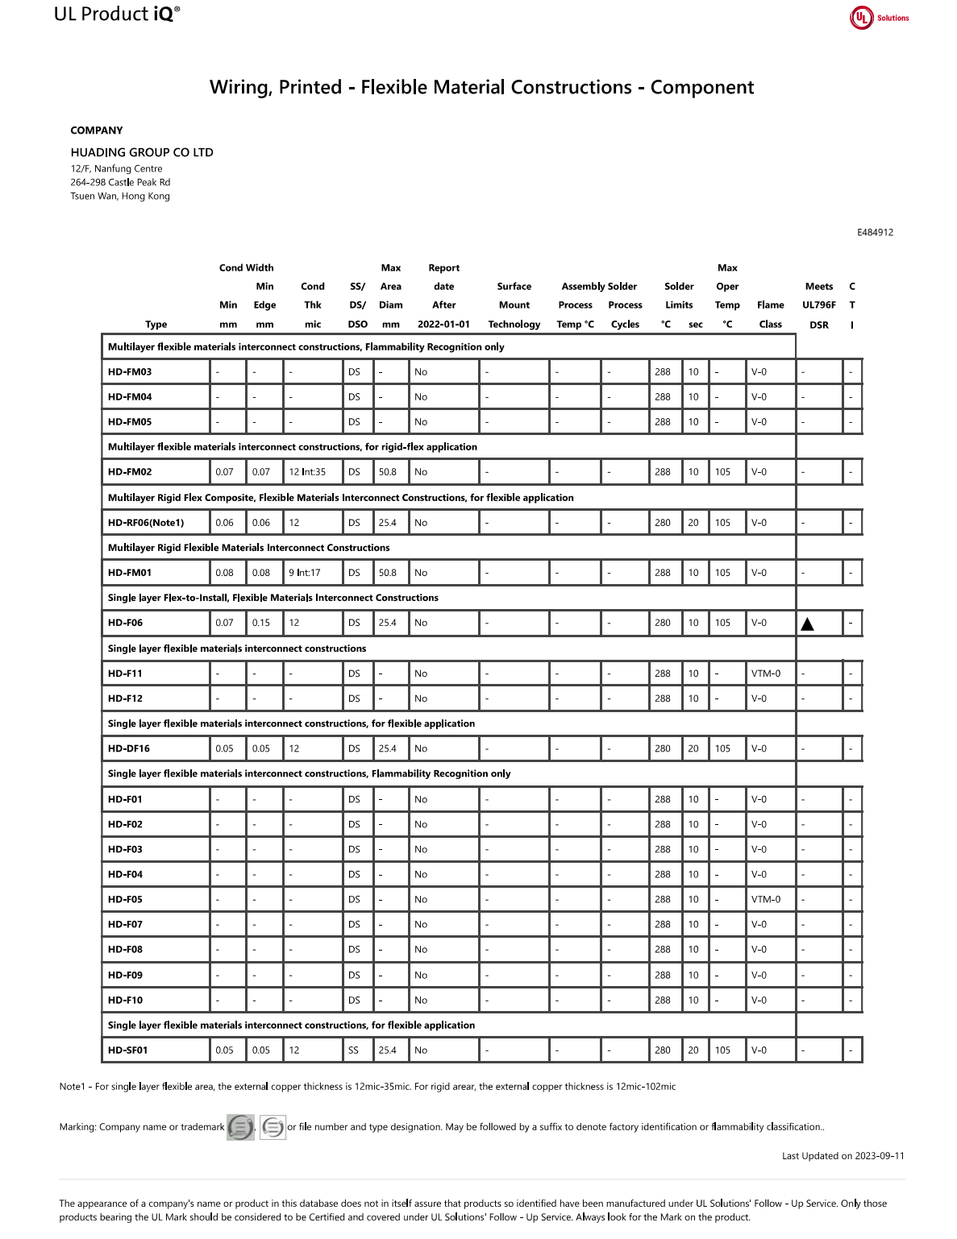

Slide 14
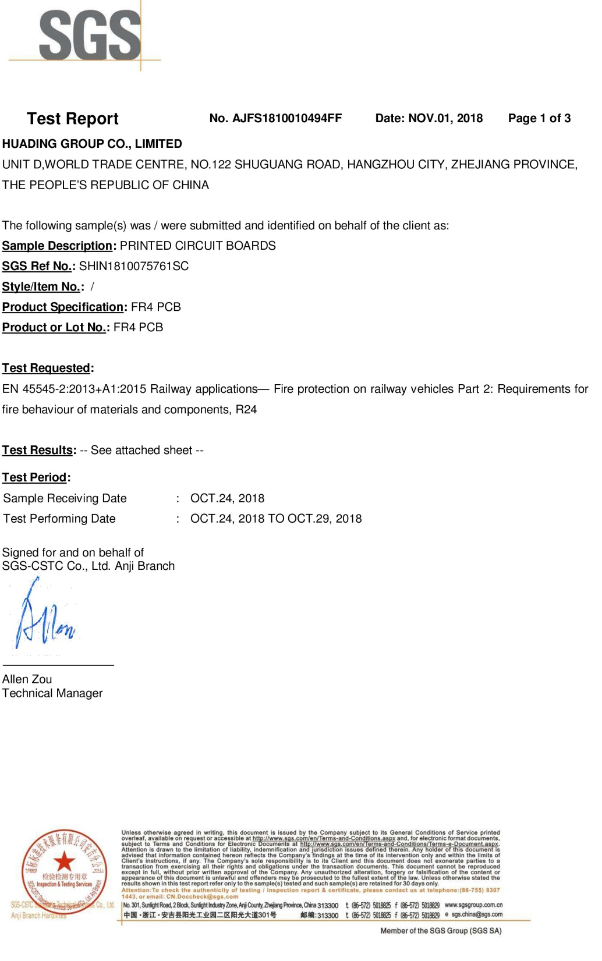
High-Speed Railway PCB
Application Certificate

Slide 15
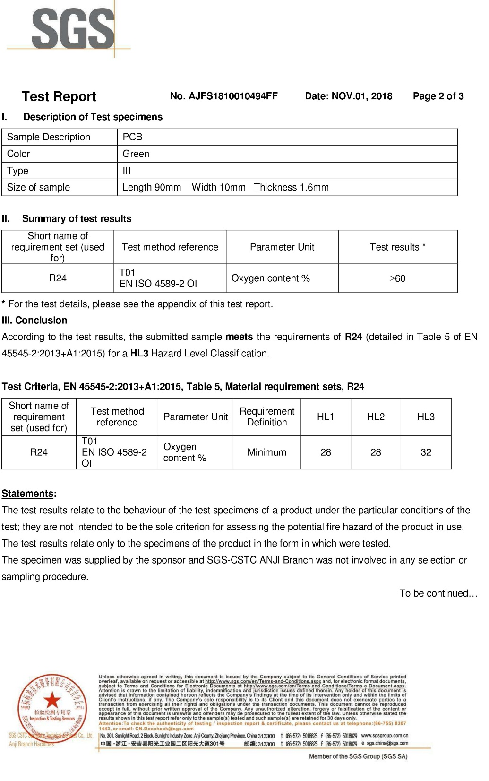
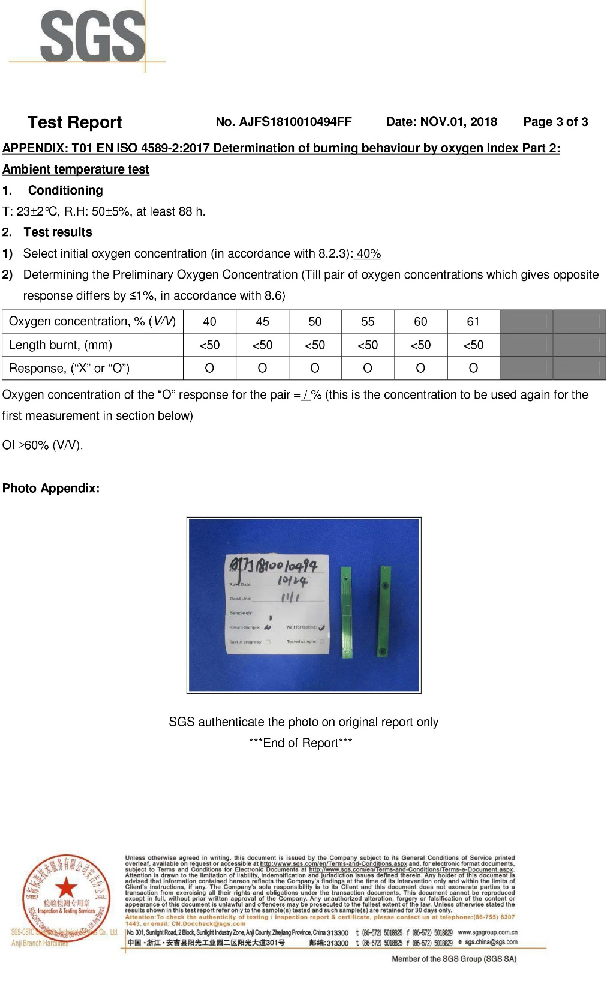

Slide 16
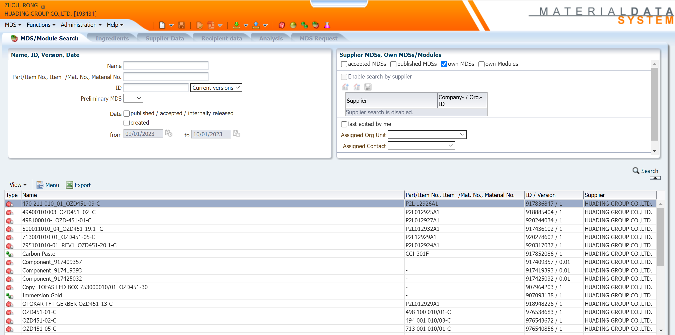
IMDS Global PCB Data For Automative Applications

Slide 17
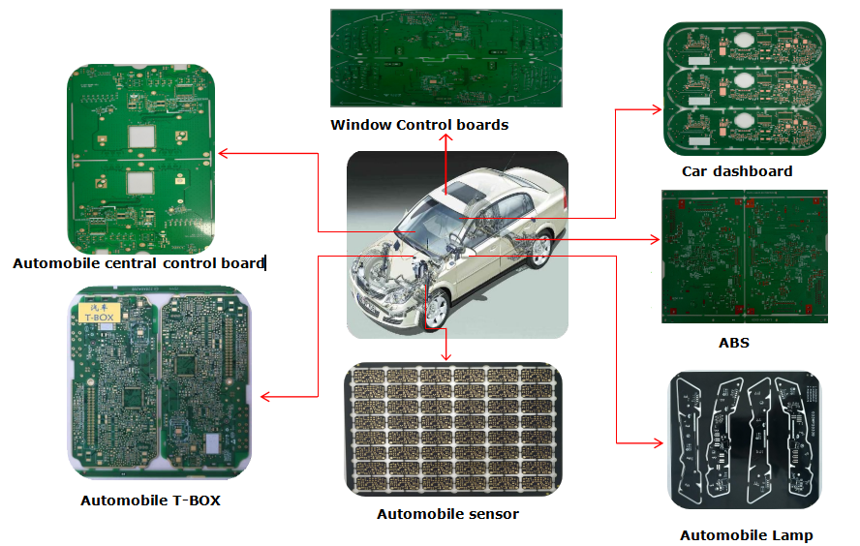
Application field of automobile products
Product description:
Automotive PC boards are used in the audio and instrumentation systems of the car and its other applications as well. Because it is related to the life safety of the passengers, it is necessary to pursue zero functional defects, and it is not allowed to make up the copper tracks.
Main process features:
① Quality requirements "zero defect";
② Supplementary lines and track gaps are not allowed;
③ Manufacture and QC control in accordance with the IPC Class 3 standards and requirements;
④ Board particles and other contamination are not allowed on PCB surface;
⑤ Keep production records for more than 10 years;
⑥ Long-term use in severe environments, such as high-speed operation, high and low temperature, humidity, strong vibration, wear resistance, etc.
Technology features: Automative boards
Specifications: automotive PCBs, the minimum hole copper is 25um, and external lines are not allowed to be repaired
Finished board thickness: 1.6+/-0.1mm
Copper thickness: 70um
Surface Treatment: Immersion Gold Finish (ENIG)

Slide 18
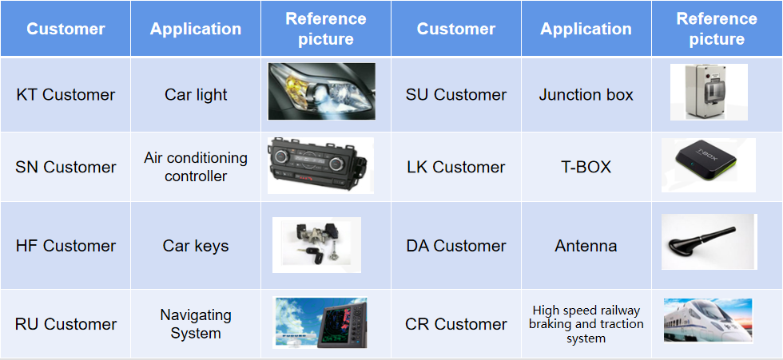
Application examples of vehicle related products

Slide 19
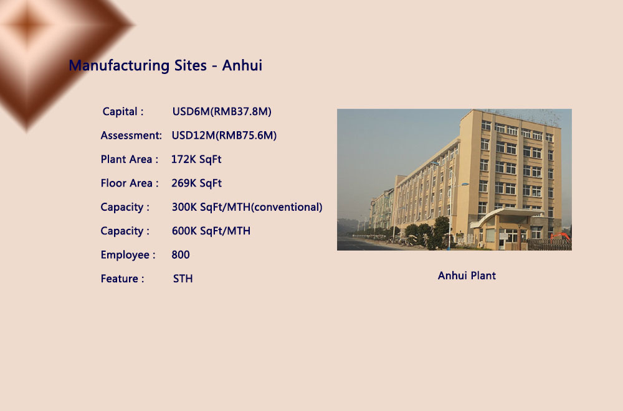

Slide 20
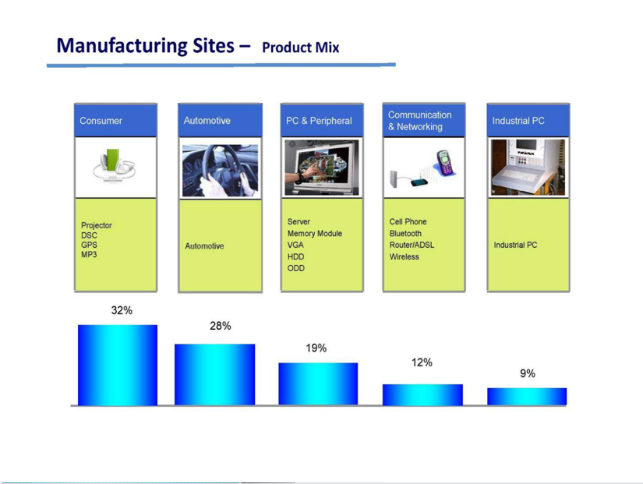

Slide 21
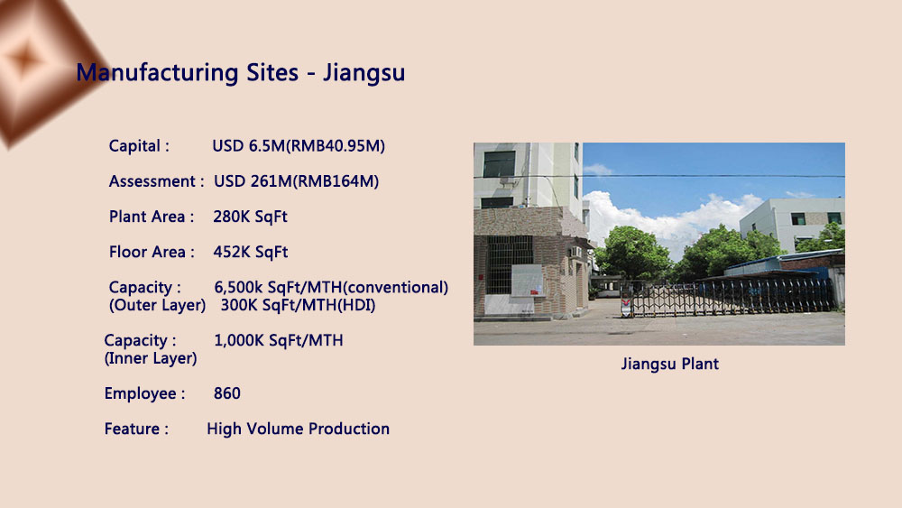

Slide 22
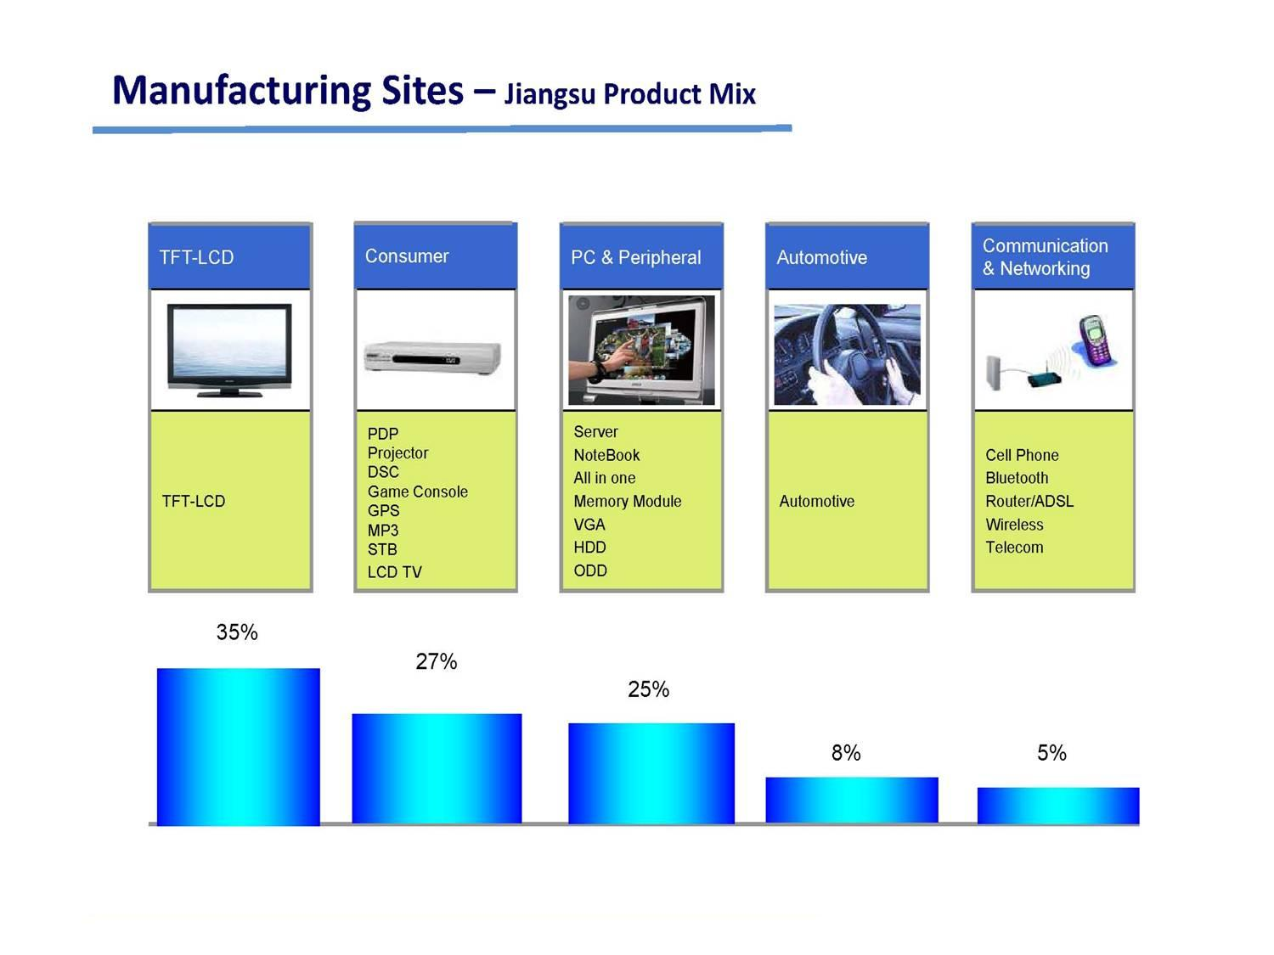

Slide 23
Technology Overview

Slide 24
PCB Finish
 | Anhui | Jiangsu
HASL | available | available
Lead-Free HASL | available | available
OSP | available | available
Immersion Silver | available | available
Immersion Tin | available | available
ENIG(Selective ENIG) | available | available
Hard Gold/Soft Gold | available | available
Gold Finger | available | available

Slide 25
Technical Roadmap
Unit: mil | 2018 | 2019 | 2020 | 2021 | 2022 | 2023
Build Up Structure | Any Layer/ 10 Layers | Any Layer/ 12 Layers | Any Layer/ 14 Layers | Any Layer/ 16 Layers | Any Layer/ 18 Layers | Any Layer/ 20 Layers
PCB Thickness (min./max.) | 16/128 | 14/128 | 12/128 | 12/130 | 12/130 | 12/130
Min.IL-core Thickness | 2 | 2 | 1.8 | 1.6 | 1.6 | 1.6
Min.Line Width/space-inner Layer | 2.4/2.4 | 2.2/2.2 | 2/2 | 1.8/1.8 | 1.6/1.6 | 1.6/1.6
Min.Line Width/space-Outer Layer | 2.4/2.4 | 2.2/2.2 | 2/2 | 1.8/1.8 | 1.6/1.6 | 1.6/1.6
Min.Laser Via/pad | 6/10 | 5/9 | 4/8 | 3/6 | 3/6 | 3/6
BAG/Ball Pitch | 18 | 16 | 14 | 12 | 12 | 12
Min. S/M Clearance(mm) | 1.5 | 1.4 | 1.3 | 1.2 | 1.0 | 1.0
SMD (Define Pad) | 6 | 6 | 5 | 5 | 5 | 5
Impendance | +/-8% | +/-7% | +/-7% | +/-7% | +/-6% | +/-6%
 | Material/Innovation
Material | Low DK, Low DF, Low CTE, Metal Core, Thin Dielectric, Ceramin(High Frequency)
Innovation | Filling Copper Vias, Capped Vias, Flex With Flying Leads, Embedded Copper Coins, Heat Sinks, Planar Transformer, Burried Componets

Slide 26

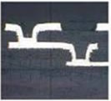
HDI Capability Overview
Description |  |  | 2018 | 2019 | 2020 | 2021 | 2022 | 2023
Copper Filled Via / Stagger Via |  | Min. Via Diameter (mil) | 4 | 3 | 2.8 | 2.8 | 2.4 | 2.4
 |  | Min.L1 Capture Pad(mil) | D+5 | D+4 | D+3.2 | D+3.2 | D+2.4 | D+2.4
 |  | Min.L2 Capture Pad(mil) | D+5 | D+4 | D+3.2 | D+3.2 | D+2.4 | D+2.4
 |  | Min.L3 Capture Pad(mil) | D+5 | D+4 | D+3.2 | D+3.2 | D+2.4 | D+2.4
 |  | Aspect Ratio | 0.8 | 1.0 | 1.0 | 1.2 | 1.2 | 1.2

Slide 27
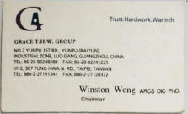
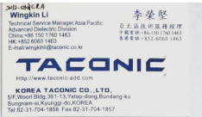
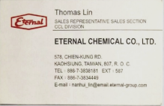
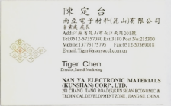
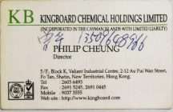
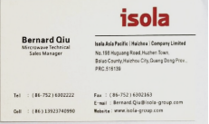
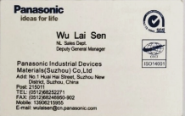
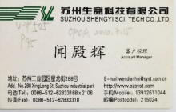
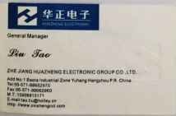
Partners (suppliers)

Slide 28




















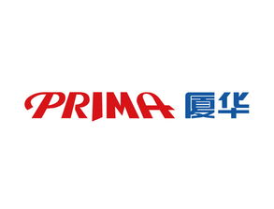
Main Customers
World Class PCB Solutions

Slide 29
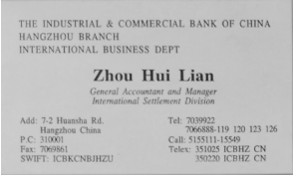
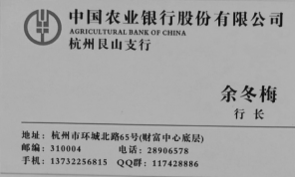
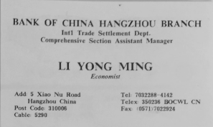
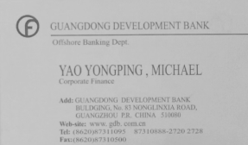
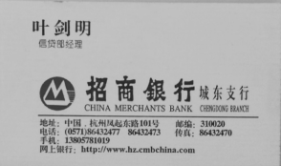
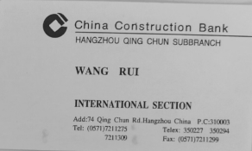
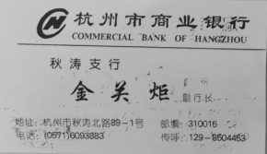
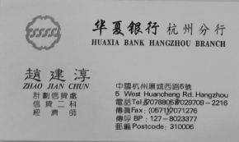
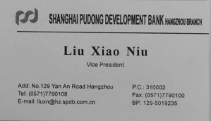
Partnership Bank

Slide 30









感谢
THANK YOU
http://www.szkmpcb.com

