Slide 1

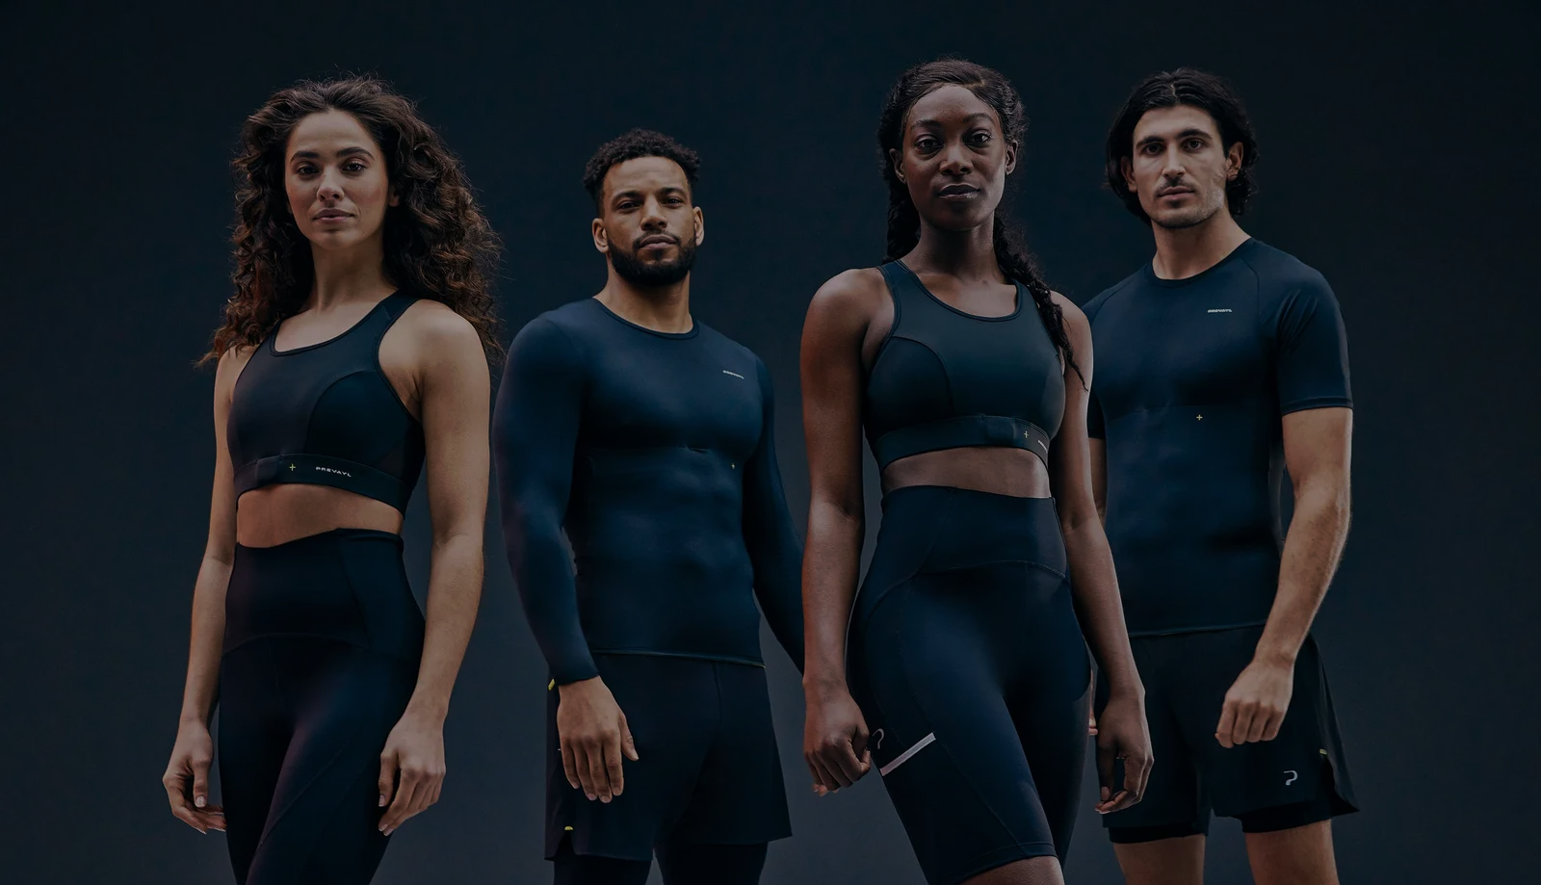
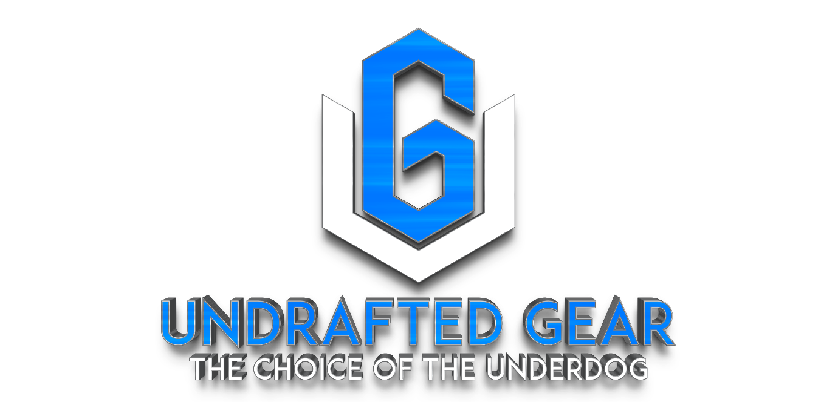



UNDRAFTED GEAR INC.
PITCH DECK PRESENTATION
www.undraftedgear.com
1+ (951) 807-1382 USA
undraftedgear@gmail.com

Slide 2
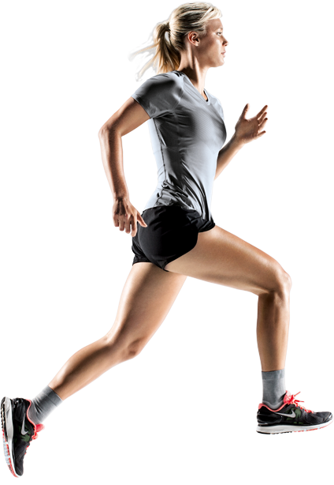

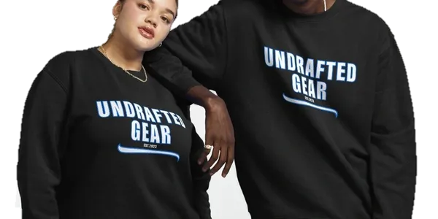
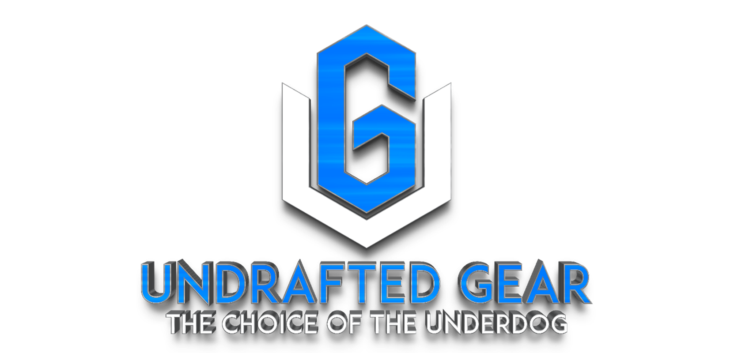
WELCOME TO UNDRAFTED GEAR INC.
Undrafted Gear Inc. is a development company based in California that is focused on creating a new line of high-end sports apparel. They are also introducing a new crypto token called the UGCT (Undrafted Gear Crypto Token) that will be used for transactions on a blockchain platform that is yet to be determined. The UGCT token will also be used to purchase Undrafted Gear apparel and can be invested and traded in the cryptocurrency market. Initially, Undrafted Gear will operate as an online sportswear company. Undrafted Gear Inc. is a development company based in California that specializes in creating a new line of high-end sports apparel. The company has a unique approach to its business model by incorporating a new crypto token called the UGCT (Undrafted Gear Crypto Token) that will be used for transactions on a blockchain platform. The blockchain platform where the UGCT token will be used is yet to be determined.

Slide 3
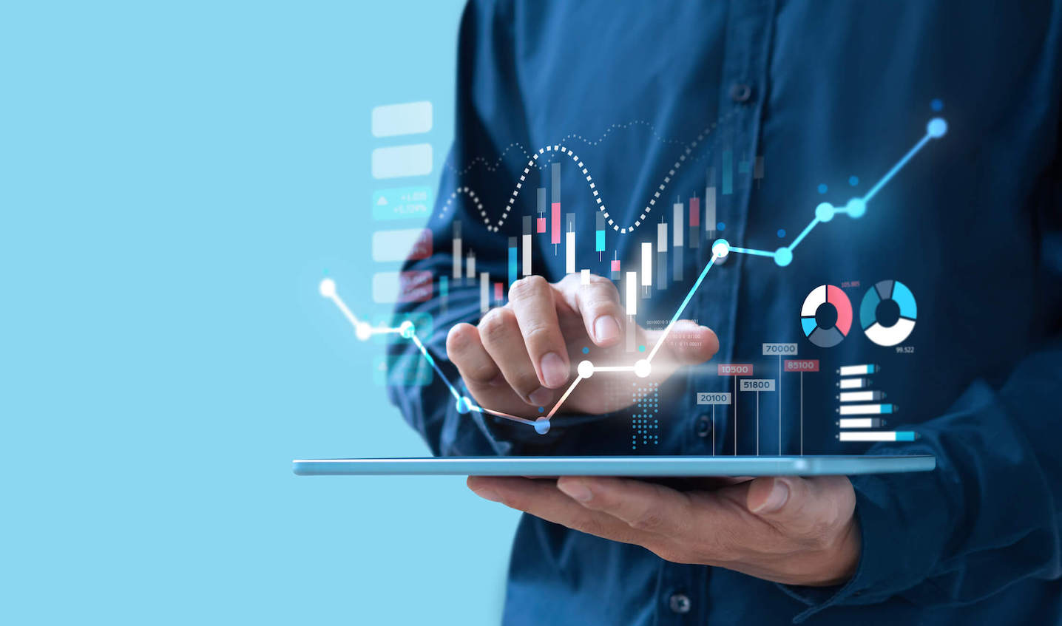
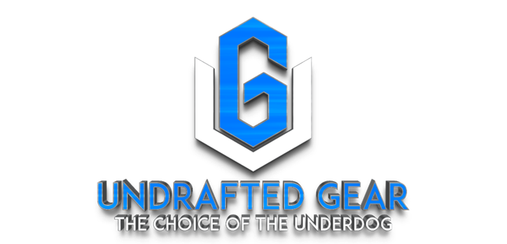
OUR MARKET OPPORTUNITY
The global sportswear market was valued at USD 425.37 billion in 2022 and is expected to reach USD 635.69 billion by 2028, growing at a CAGR of 6.93%. Increasing participation of athletes in sports activities, awareness of fitness & and wellness, and athleisure trends all contribute to the adoption of sportswear. Moreover, the growth of the manufacturing industry also contributes to the expansion of the sportswear market. Facilities owners concentrate on producing and delivering products to their clients at a faster, cheaper, and higher quality rate and for efficient production cycles, which minimizes operational costs and waste.

Slide 4
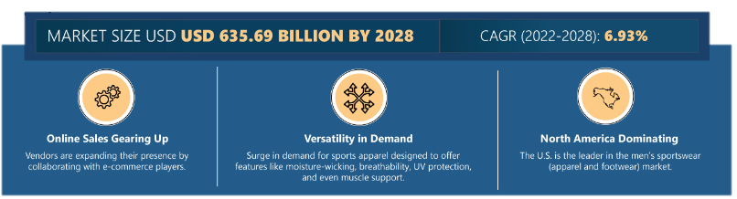
MARKET OVERVIEW
The Global Sportswear Industry
The global sportswear market was valued at USD 425.37 billion in 2022 and is expected to reach USD 635.69 billion by 2028, growing at a CAGR of 6.93%.
Source: https://www.arizton.com/market-reports/sportswear-market-size-analysis#:~:text=MARKET%20OUTLOOK,at%20a%20CAGR%20of%206.93%25

Slide 5
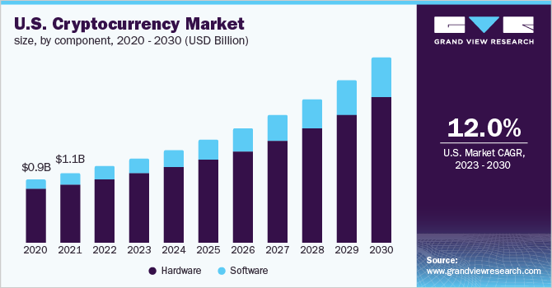
MARKET OVERVIEW
THE Global Cryptocurrency Market
The global cryptocurrency market size was valued at USD 4.67 billion in 2022 and is expected to expand at a compound annual growth rate (CAGR) of 12.5% from 2023 to 2030.
Source:https://www.grandviewresearch.com/industry-analysis/cryptocurrency-market-report

Slide 6
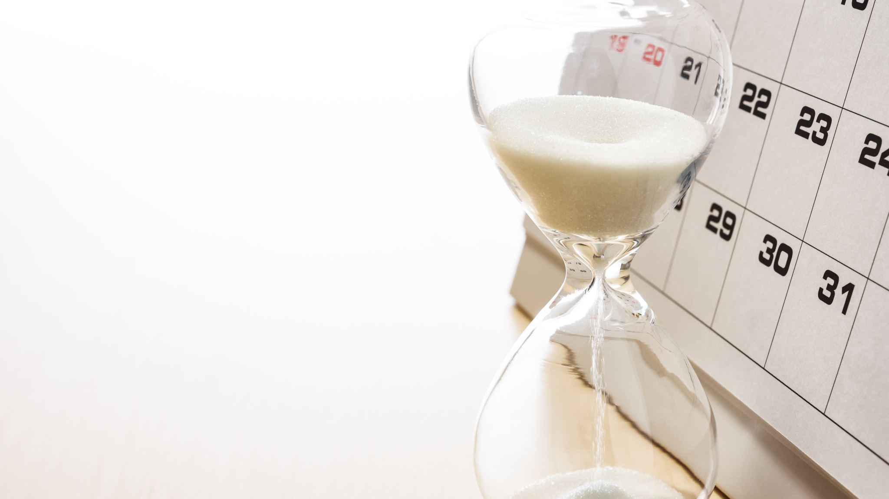
OUR MISSION AT UNDRAFTED GEAR INC.
“Undrafted Gear, the choice of the underdog.”
To provide the sportswear industry with the first investable clothing line within the cryptocurrency realm, while marketing an undeniably catchy, attractive, and comfortable brand of sportswear.

Slide 7
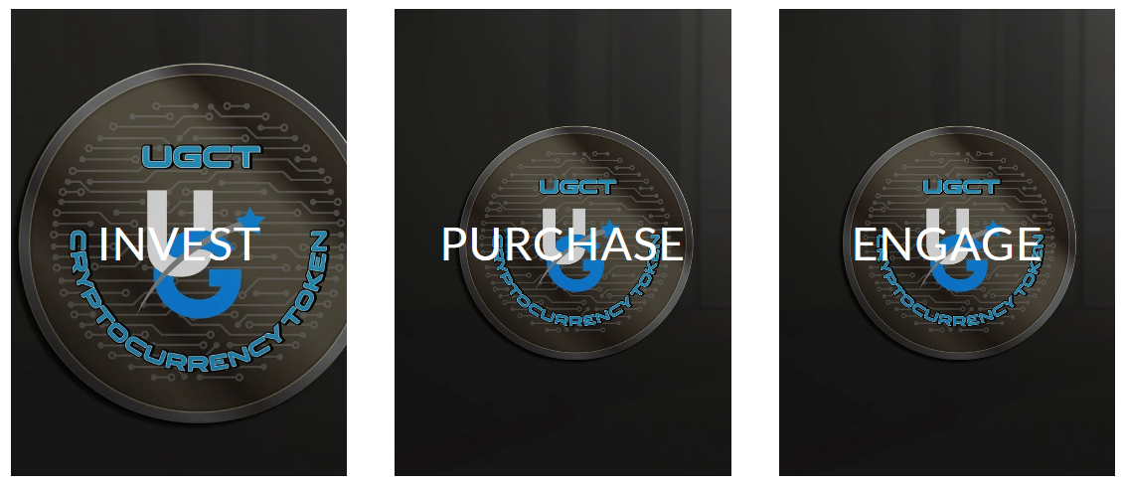
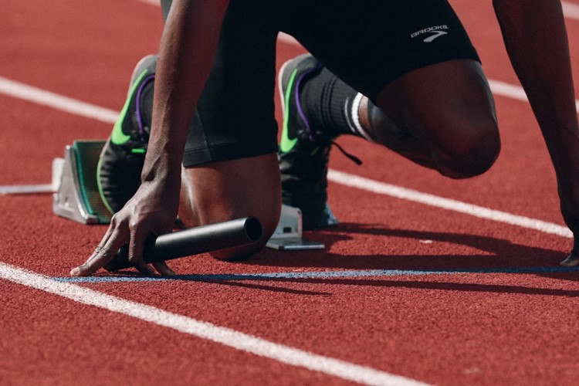
OUR SERVICES
Undrafted Gear is not just another sportswear brand. It represents the indomitable spirit of resilience and determination. Undrafted Gear embodies the philosophy of surpassing perceived limitations to achieve excellence in every aspect of life. Our product range is designed to boost performance, style, and comfort for athletes, fitness enthusiasts, and people leading active lifestyles. We offer a comprehensive selection of premium sportswear and athleisure products, including a diverse range of apparel and gear. Our products are carefully crafted using cutting-edge technologies and the finest materials to meet the needs of modern athletes.
Presentation is a public speaking activity that
aims to convey a message or information. The
things conveyed can be in the form of ideas,
ideas, programs, products, or services and are
usually carried out in a discussion or forum.
A good presentation must contain at least
three important aspects which include
opening, content and conclusion.

Slide 8
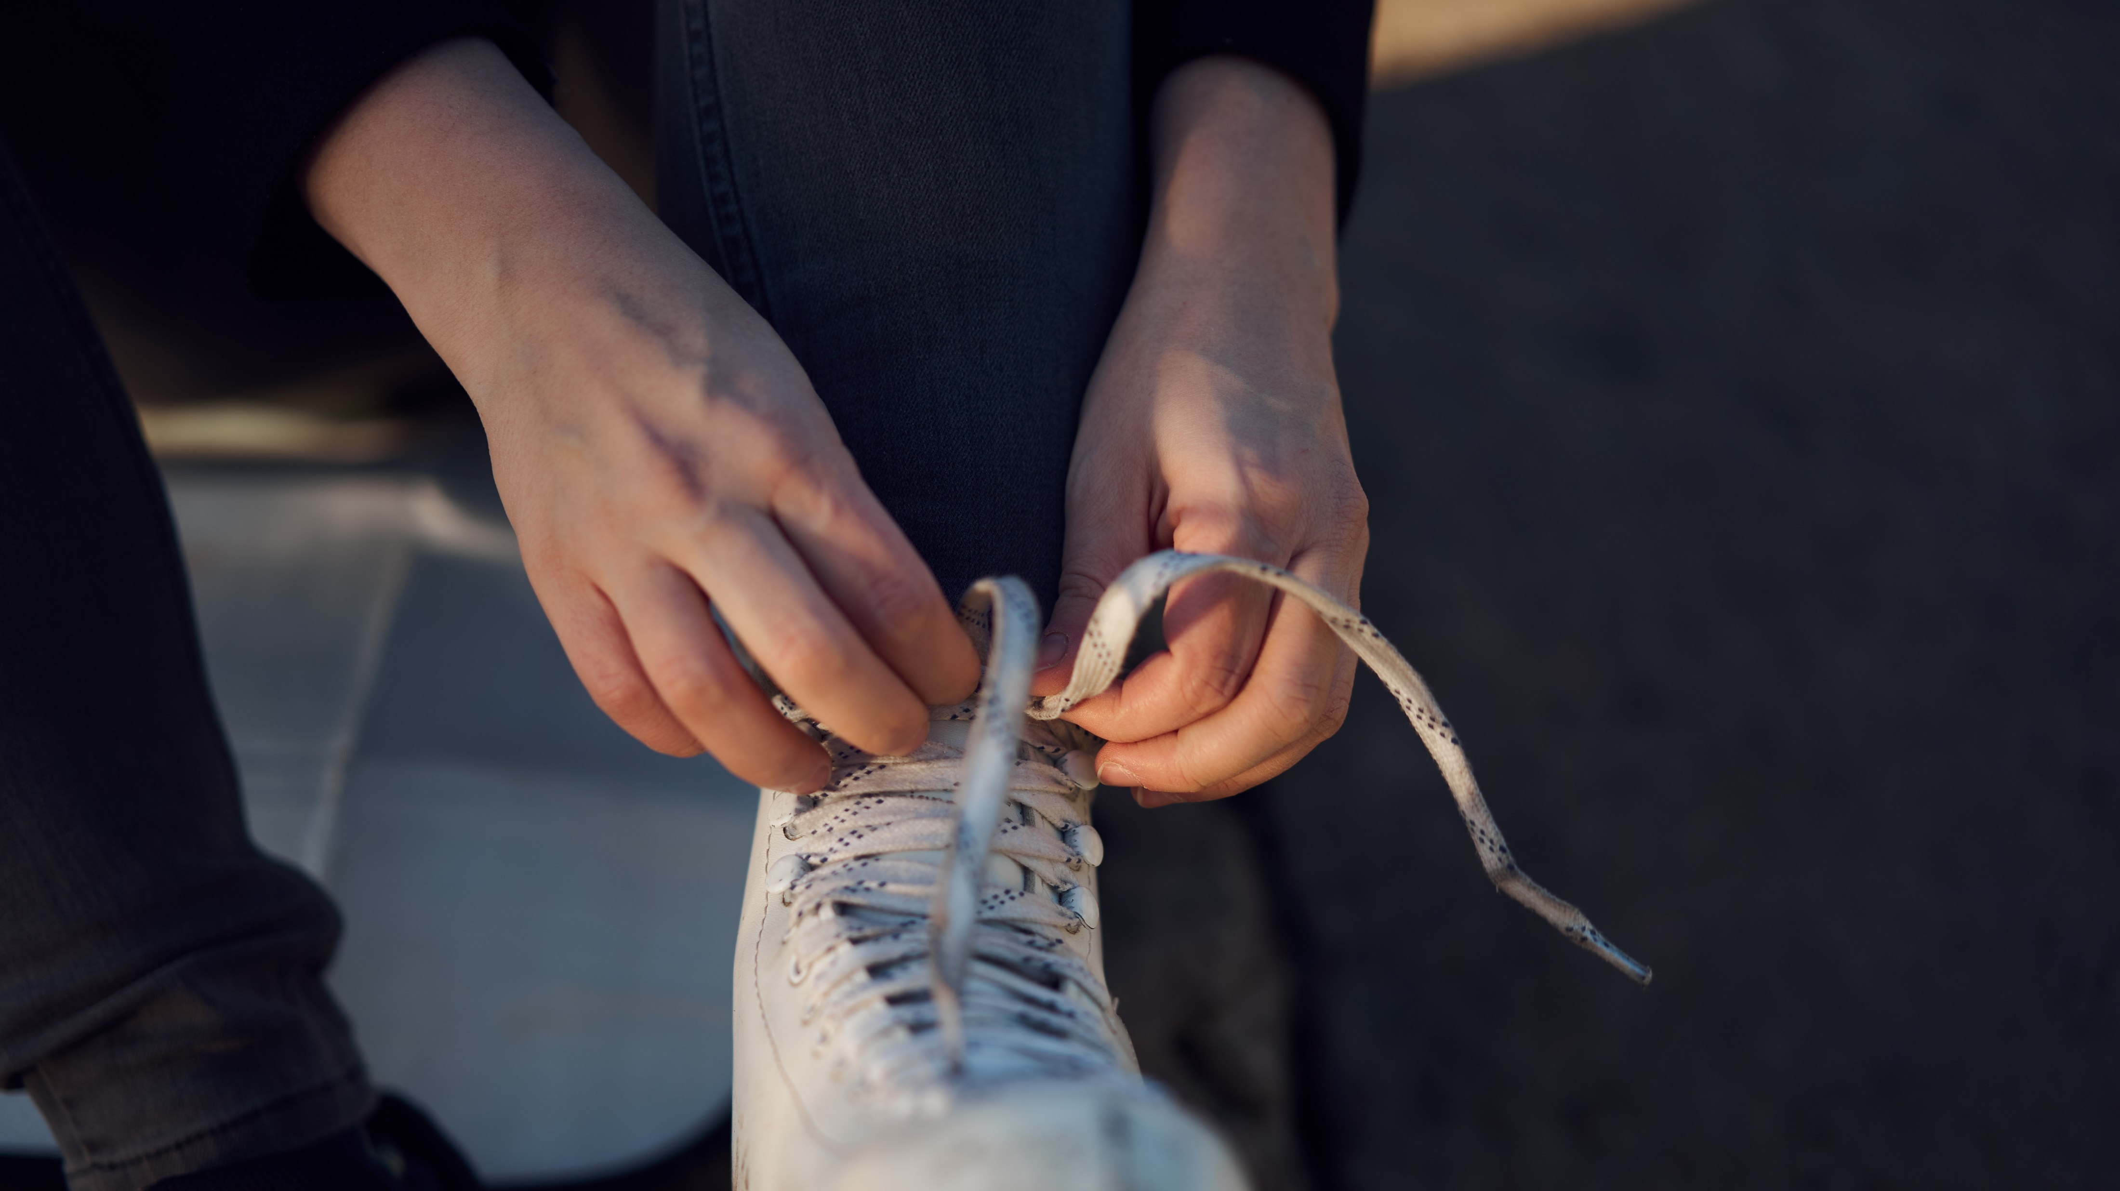





OUR OFFERINGS
At Undrafted Gear, we pride ourselves on designing high-quality products that cater to the needs of active individuals. We use only the best materials and the latest technology to create sportswear that is both comfortable and durable, while also being stylish and performance-driven.
Sportswear Apparel: Our core offerings will include a comprehensive line of sportswear apparel, meticulously crafted to enhance performance and comfort.
Footwear:
Undrafted Gear will also offer a range of athletic footwear designed to support your active lifestyle.
Accessories:
In addition to apparel and footwear, Undrafted Gear will provide a selection of accessories to complement your athletic endeavors.
UGCT Integration:
As pioneers in the integration of cryptocurrency, Undrafted Gear will introduce the Undrafted Gear Crypto Token (UGCT).
Limited Edition Collections: To keep our offerings fresh and exciting, Undrafted Gear will periodically release limited edition collections inspired by the latest trends, events, and collaborations.

Slide 9
SWOT ANALYSIS
S
W
O
T
STRENGTHS
WEAKNESSES
OPPORTUNITIES
THREATS
Unique Value Proposition: Undrafted Gear offers a novel combination of high-quality sportswear and cryptocurrency integration. Innovative Brand Concept: The integration of the Undrafted Gear Crypto Token (UGCT) offers customers the opportunity to invest in cryptocurrency. Strategic Partnerships: Collaborations with professional athletes as brand ambassadors enhance Undrafted Gear's credibility and visibility in the sports industry. Focus on Customer Engagement: Undrafted Gear prioritizes community building and customer engagement through social media, events, and loyalty programs, fostering a loyal customer base and driving brand advocacy.
Brand Awareness: As a new entrant in the market, Undrafted Gear may face challenges in building brand awareness and gaining traction among consumers. Cryptocurrency Volatility: The integration of cryptocurrency introduces potential risks associated with market volatility. Limited Product Range: Initially focusing on sportswear and cryptocurrency, Undrafted Gear may have a limited product range compared to traditional sportswear brands.
Expansion into New Markets: Undrafted Gear has the opportunity to expand its product offerings beyond sportswear and cryptocurrency. Global Market Reach: With an online-focused business model, Undrafted Gear can leverage digital channels to reach a global audience. Continued Cryptocurrency Adoption: As cryptocurrency becomes increasingly mainstream, Undrafted Gear can capitalize on growing consumer interest and adoption of digital currencies.
Competitive Pressure: Undrafted Gear faces intense competition from established sportswear brands and emerging players in both the sportswear and cryptocurrency industries. Regulatory Uncertainty: Regulatory changes and government interventions in the cryptocurrency market could impact the legality, stability, and acceptance of the Undrafted Gear Crypto Token (UGCT), potentially undermining investor confidence and brand reputation.

Slide 10
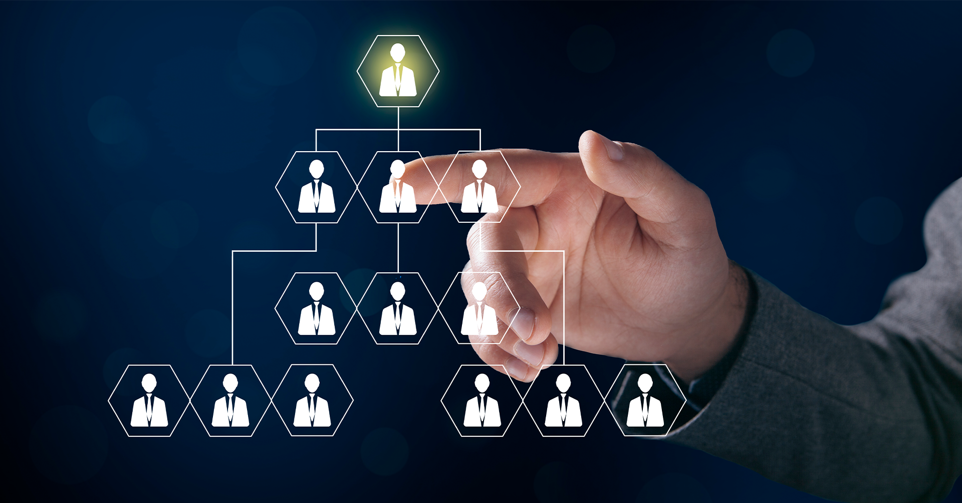
COMPANY MANAGMENT
Stephen (Steve) Butler – Founder
Undrafted Gear owes much of its success to Steve Butler, a man with a diverse set of skills and experiences. As a former law enforcement officer and lifelong sports enthusiast, Steve brings a unique perspective to the table. He is not only a visionary leader, but also an entrepreneur with a keen sense of strategy. With his unwavering commitment to excellence, Steve sets the tone for the entire organization. He inspires his team to be innovative, creative, and ambitious. Thanks to his leadership, Undrafted Gear has become a trusted brand that delivers quality products and exceptional customer service.

Slide 11

PARTNERSHIP & COLLABORATION
Undrafted Gear is a sports apparel company that is poised to experience robust revenue growth in the coming years. Based on market research, it is projected that the global sports apparel market will reach a size of USD 218 billion by 2024. Additionally, the athletic apparel revenue is forecasted to reach USD 315 billion, indicating a significant opportunity for growth.
Undrafted Gear’s innovative approach to sports apparel, combined with the integration of cryptocurrency, positions us to capture a significant market share and expand our revenue. Our focus on sustainability, quality, and trendsetting designs will differentiate us from the competition. Moreover, at Undrafted Gear, we understand the importance of collaboration in achieving financial success. That is why we are committed to seeking strategic partnerships with complementary brands, distribution channels, and technology providers. These partnerships will enable us to enhance our product offerings, expand our reach, and drive revenue growth.
In conclusion, Undrafted Gear is ready to take on the sports apparel industry with its innovative approach and commitment to collaboration. With a projected global sports apparel market size expected to reach USD 218 billion in 2024 and athletic apparel revenue forecasted to reach USD 315 billion, we believe that our brand is well-positioned to experience exponential growth in the coming years.

Slide 12
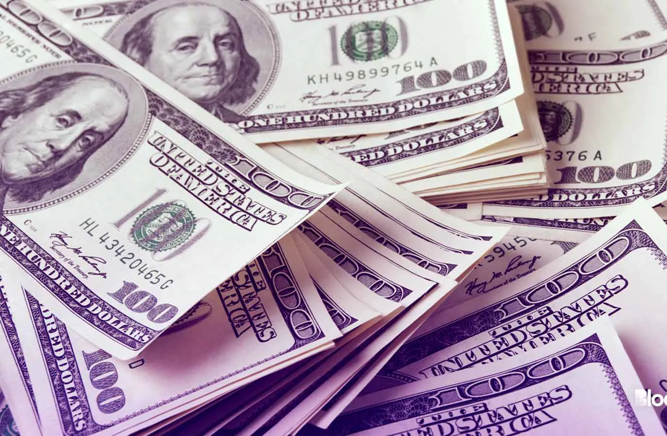
FINANCIAL REQUIREMENT
Undrafted Gear recognizes the importance of securing adequate financial resources to successfully launch its debut line of sportswear and accompanying initiatives. To achieve this, the company estimates a total projected startup cost ranging from $120,000 to $150,000.
These funds will be allocated for,
Product Development
Recruitment and Management
Crypto Currency Integration
Website Development
Shipment and Delivery
Marketing and Promotion

Slide 13
FINANCIAL SUMMARY
 | 2024 | 2025 | 2026
Income | $ 2,180,000 | $ 2,834,000 | $ 4,109,300
Cost of Sales | $ 654,000 | $ 793,520 | $ 1,027,325
Gross Profit | $ 1,526,000 | $ 2,040,480 | $ 3,081,975
Total Expenses | $ 698,600 | $ 773,730 | $ 907,689
Profit Before Taxes | $ 827,400 | $ 1,266,750 | $ 2,174,287
Total Taxes | $ 73,142 | $ 111,981 | $ 192,207
Net Profit | $ 754,258 | $ 1,154,769 | $ 1,982,080
Net Profit Margin | 35% | 41% | 48%

Slide 14

JOIN WITH US!
We are a sustainable business seeking a partner(s) to help us raise funds. Our market expansion can be local or global, and it will benefit both parties involved. We cordially invite you to negotiate a business relationship with us and request your assistance to make our efforts productive. We would be delighted to have you with us.

Slide 15
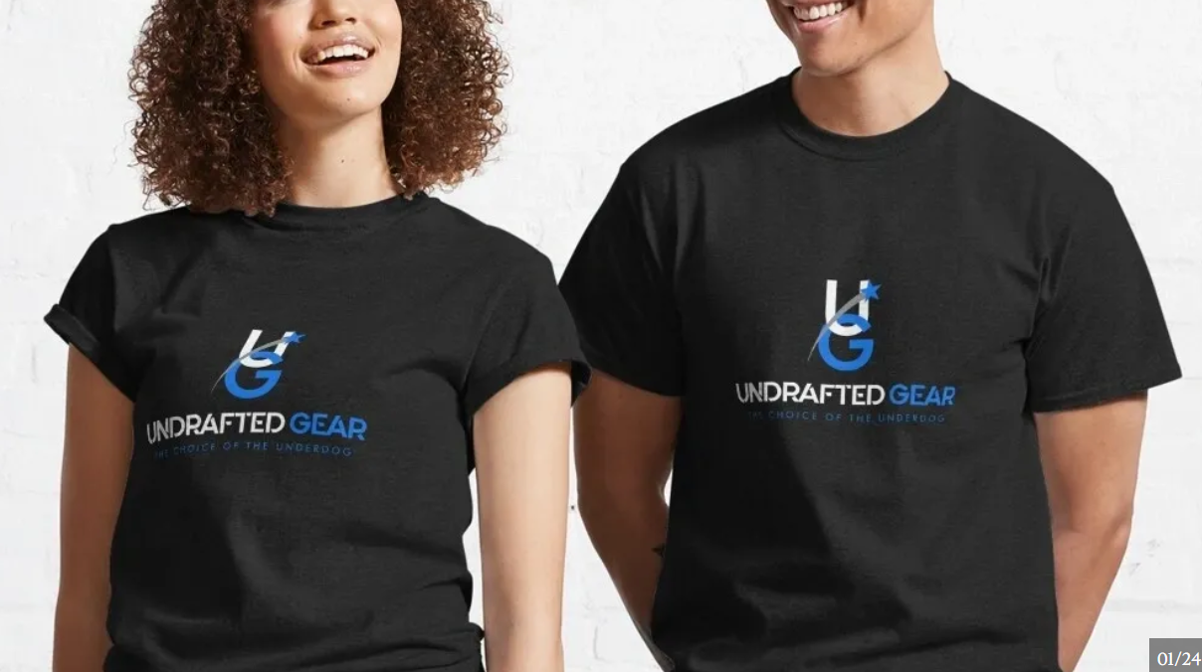
THANK YOU
FOR YOUR ATTENTION

