Slide 1

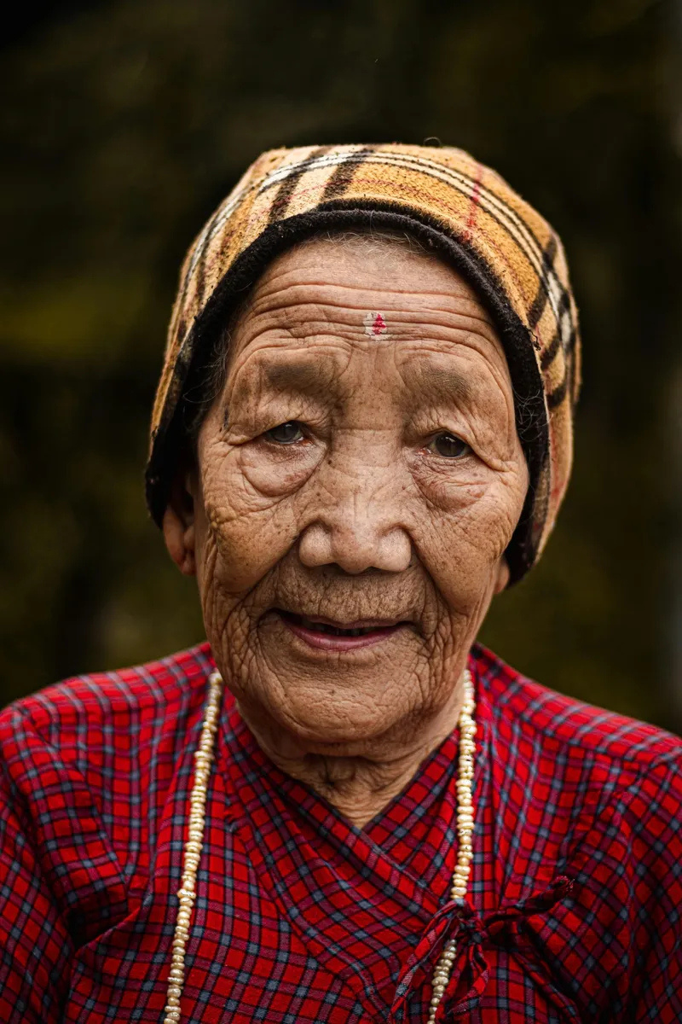
A Global Awakening
Empathy, Science, and
Our Shared Human Origins
THE MOVEMENT: SANITY IN HUMANITY
Copyright © 2025 iambernie.com All Rights Reserved.

Slide 2

We Are
One Family
We are all part of the same human family. Every single person on Earth today is, at minimum, your 15th to 50th cousin. That’s not opinion, it’s genetics. Science tells us we all descend from the same original mother. As we spread across continents, nature did what nature does best, it diversified us.
Copyright © 2025 iambernie.com All Rights Reserved.

Slide 3
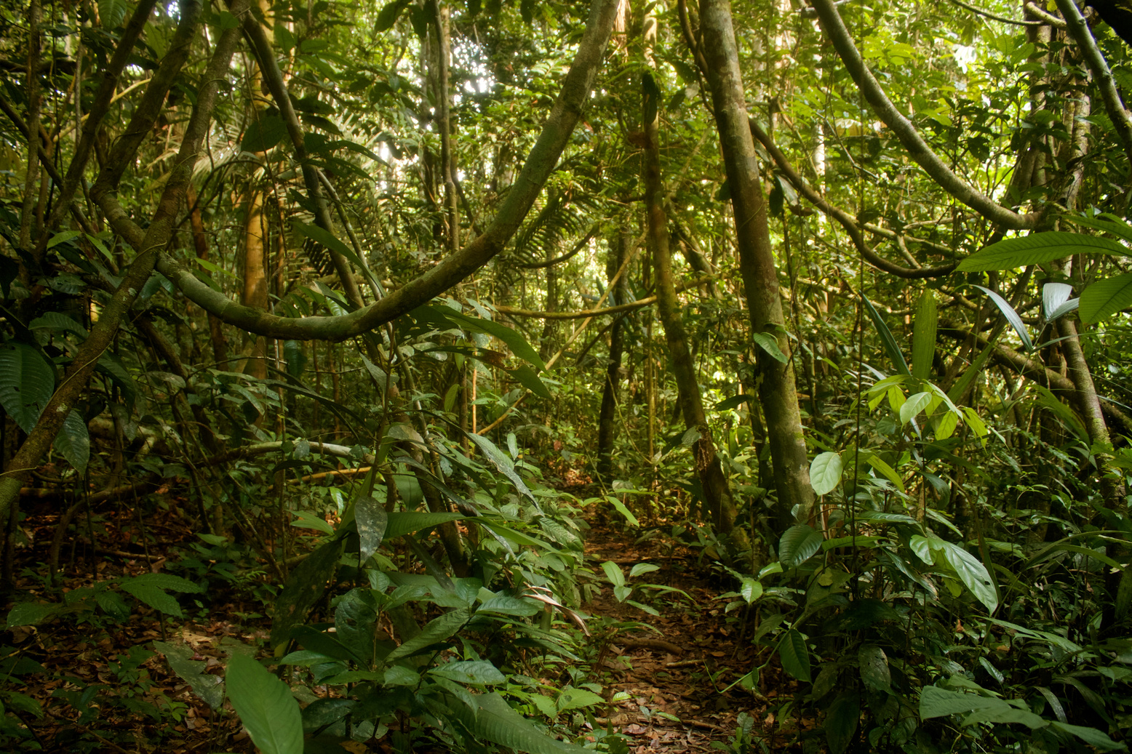
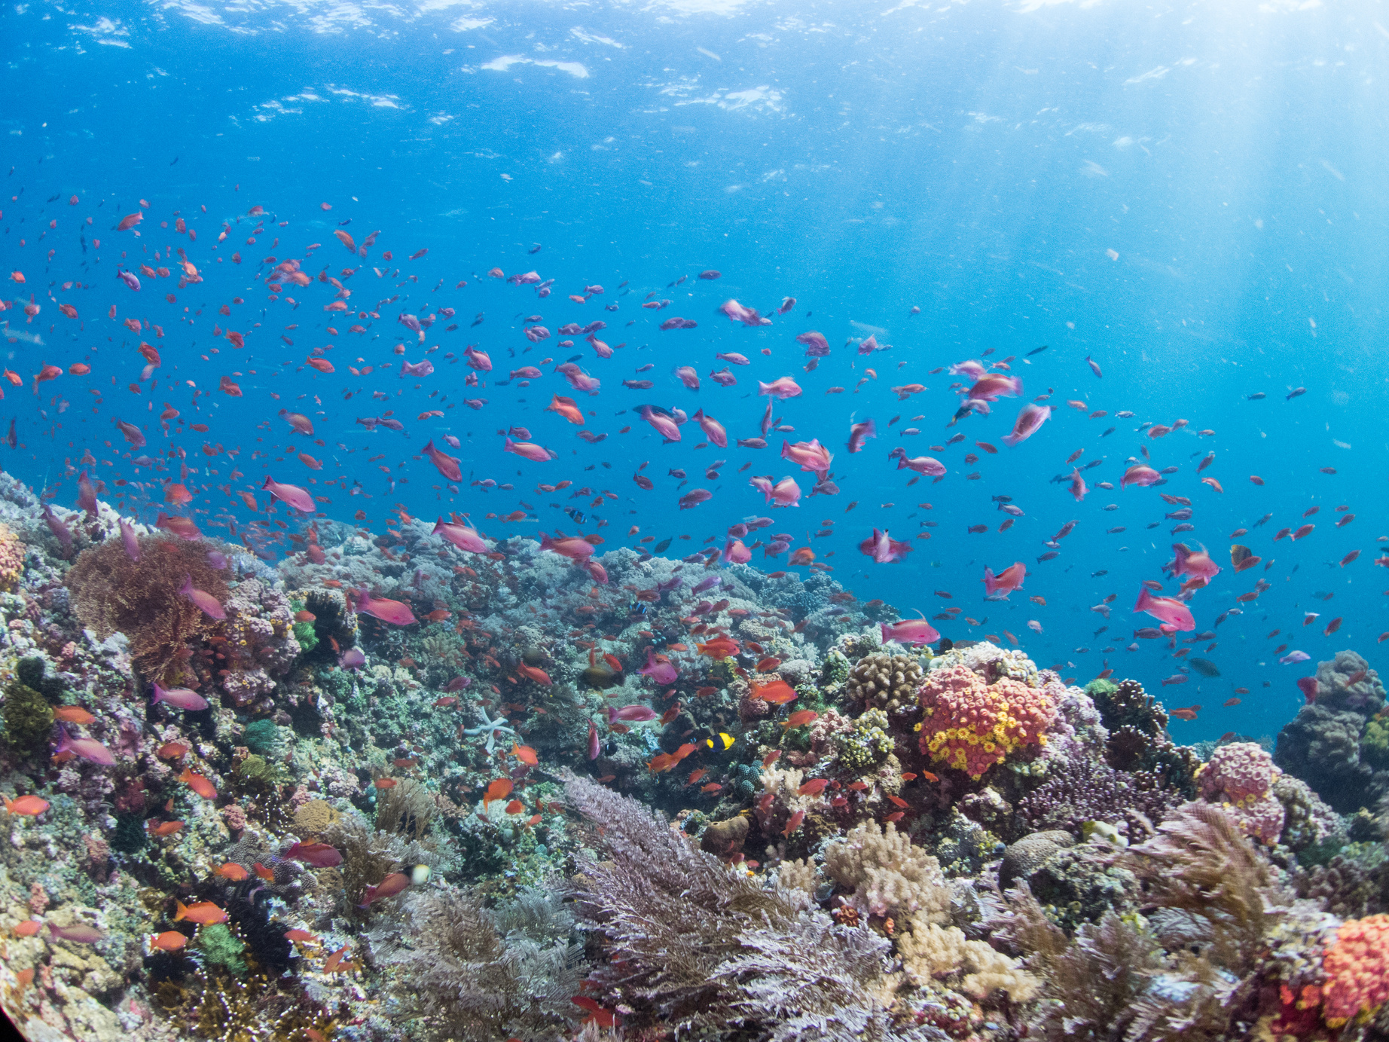


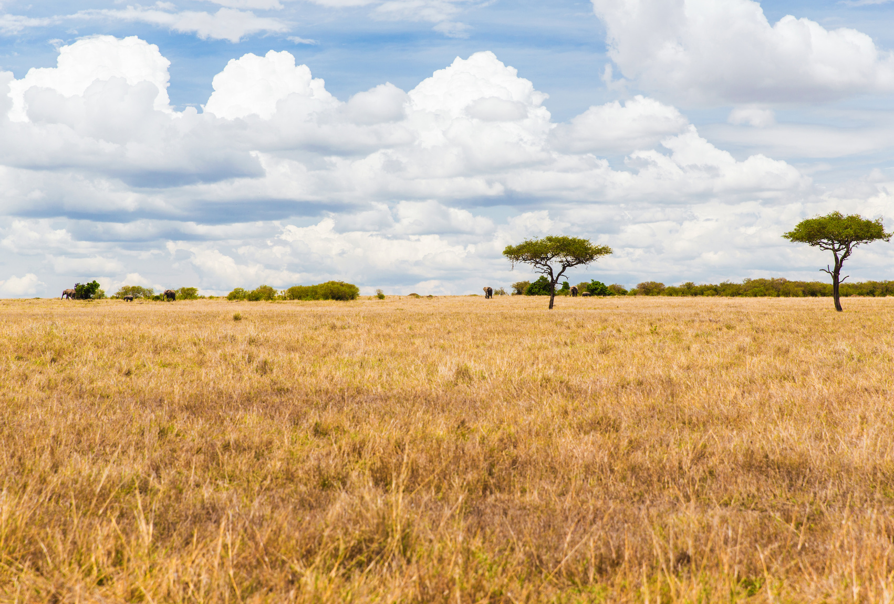

Celebrating Nature's Diversity
Diversity enriches our world, reminding us of the beauty in variety across ecosystems and humanity.
Nature thrives on diversity, showcasing the beauty of various species and their unique roles in the ecosystem.
Copyright © 2025 iambernie.com All Rights Reserved.

Slide 4
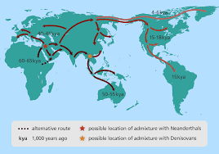
Variety is the Seasoning
of Life on Earth
Ten million species roam this Earth in every color, shape, and size imaginable, and humanity is no exception. Our skin tones, languages, and customs are beautiful branches from the same ancestral root. We are not separate races. We are one species, one family. When we all meet, it’s a family reunion.
And yet, we forget.
Copyright © 2025 iambernie.com All Rights Reserved.

Slide 5
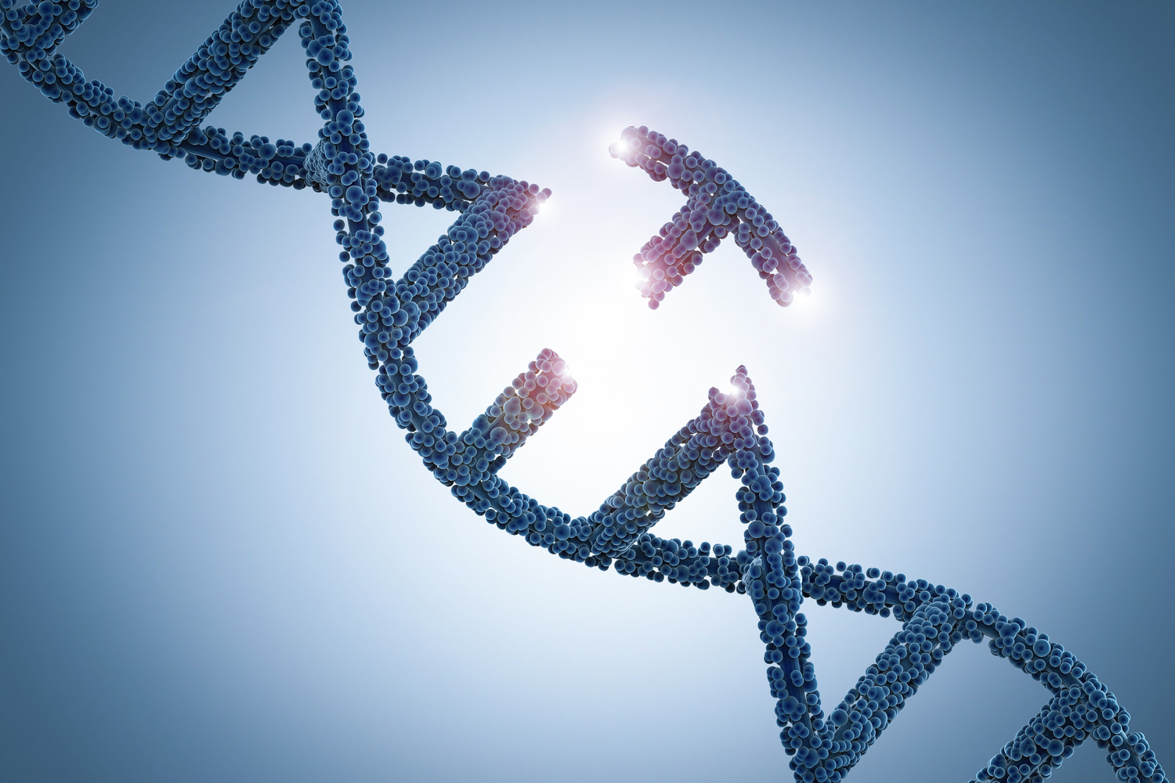
Our Genetic
Connections
Understanding our genetic connections as one human family
We share over 99% of our DNA, making us more alike than different, highlighting our shared heritage and connection to each other.
Embracing our shared humanity through empathy and understanding
By recognizing our common roots, we can foster a sense of belonging and compassion, paving the way for unity in a divided world.
Copyright © 2025 iambernie.com All Rights Reserved.

Slide 6

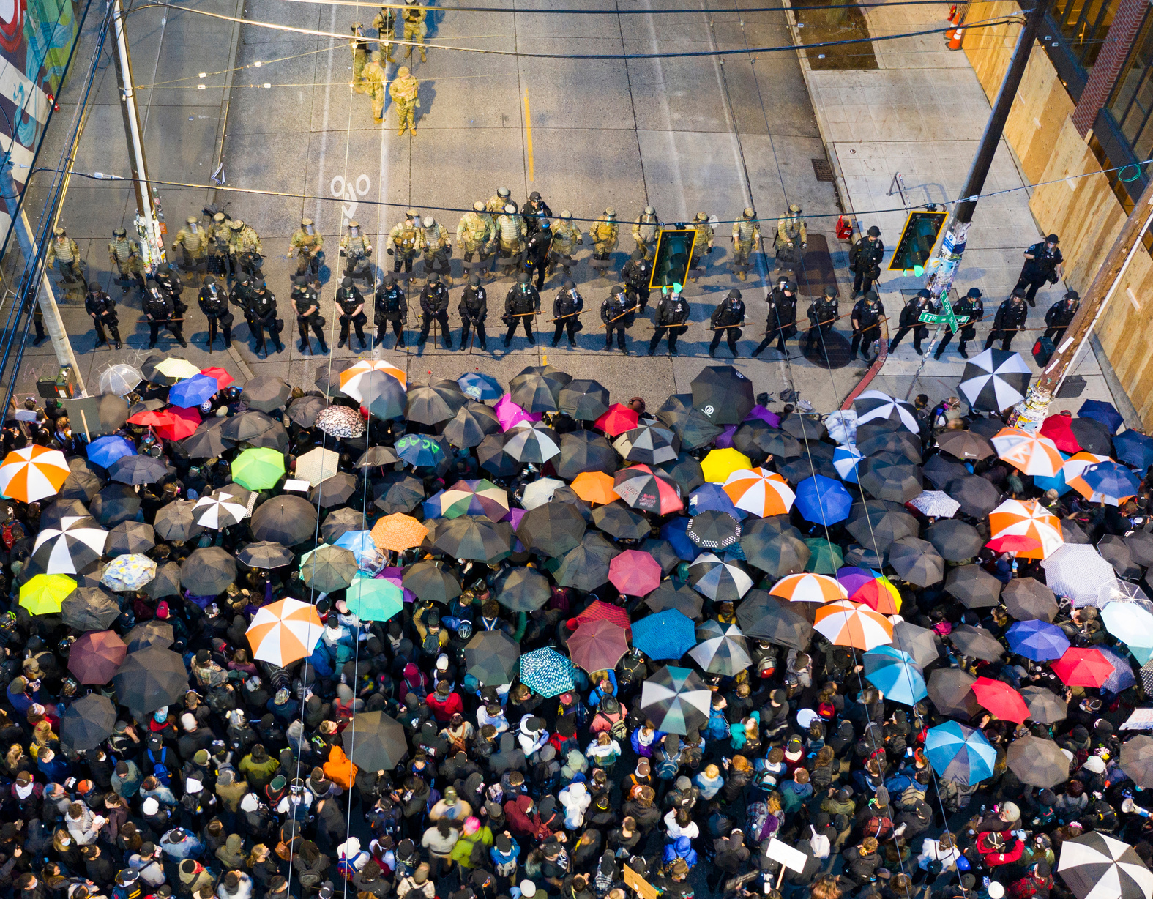
Insecurity often breeds fear, leading to division and hate among communities. This disconnect undermines our shared humanity and reinforces barriers, making it crucial to foster empathy and connection to combat these negative emotions.
Insecurity and Division
Fear
Drives a wedge between communities
Insecurity
Fuels a sense of separation and distrust
Hatred
Emerges from misunderstanding and fearfulness
Division
Creates barriers, hindering our progress together
Copyright © 2025 iambernie.com All Rights Reserved.

Slide 7
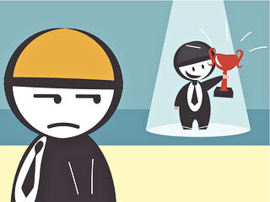
Insecurity Can Lead
to Hate
Insecurity, envy, and fear of the unfamiliar fuel gossip, bigotry, and eventually, hate. When false leaders seize that fear, they manipulate it. They build mobs, spread disinformation, and turn people against their own cousins. Hatred spreads like cancer, indiscriminately, destructively, and inevitably leading to suffering, guilt, and collapse.
We’ve been too quick to conform. Too eager to follow party lines or ideologies without asking questions.
Copyright © 2025 iambernie.com All Rights Reserved.

Slide 8
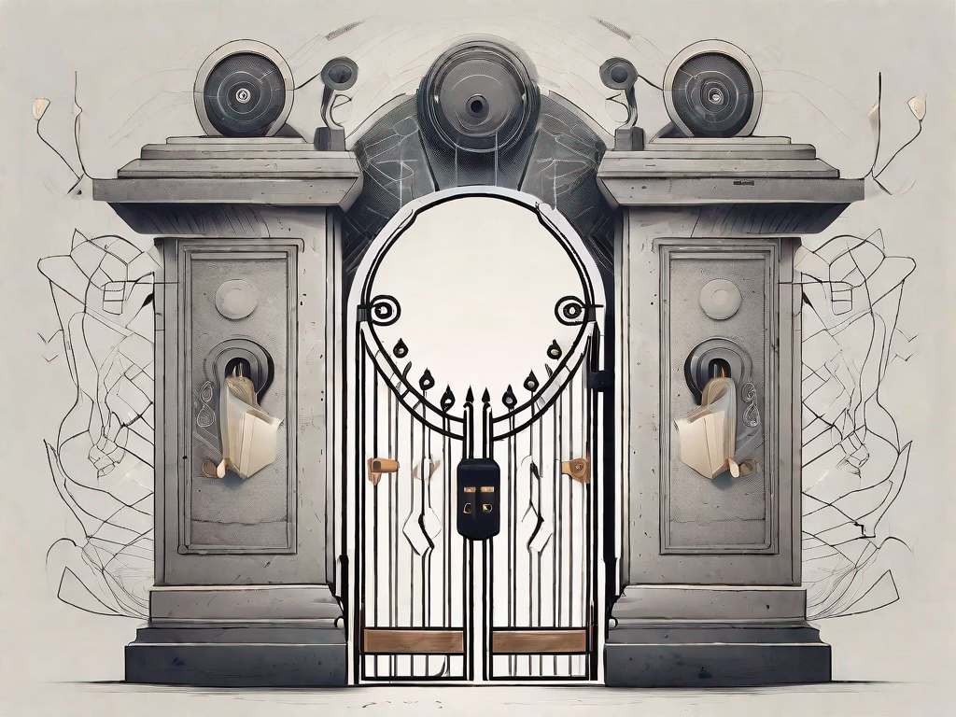
Gatekeeper
We forget: We are the gatekeepers of our own minds.
What we accept, absorb, and repeat becomes the language of our conscience, or the weapon of
our undoing.
We must reclaim our moral compass, resist blaming others for our discomforts, and stop justifying hate and violence as a byproduct of allegiance or ideology.
Blind obedience is not a virtue.
Critical thought is.
Copyright © 2025 iambernie.com All Rights Reserved.

Slide 9
The Importance of Critical Thought Today
Critical thinking is essential for fostering informed and engaged citizens worldwide.
Percentage of people lacking critical thinking skills
Percentage of leaders valuing critical thought
75%
60%
This limits their ability to analyze information effectively.
Effective leadership relies on sound
reasoning and ethical decision-making.
Copyright © 2025 iambernie.com All Rights Reserved.

Slide 10
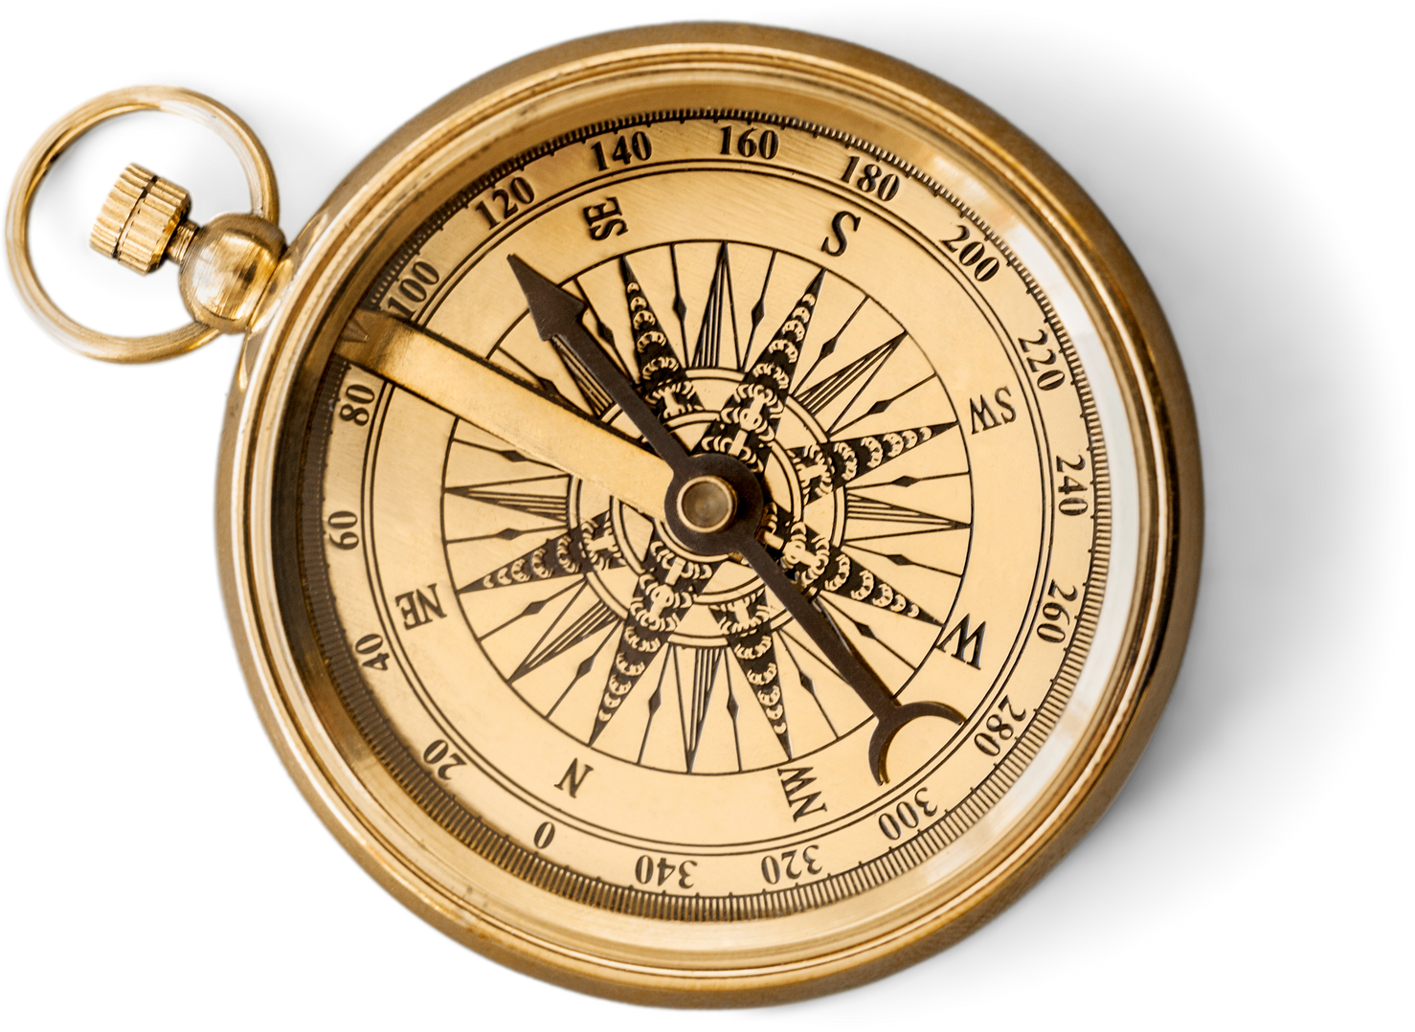
Reclaiming our
Moral Compass
Critical thought is essential for navigating through uncertainty and finding clarity.
Copyright © 2025 iambernie.com All Rights Reserved.

Slide 11

Pillars of Moral Fortitude
The five habits that you’ll use in every discussion and activity:
  Emotional Composure: Practice pausing and settling your emotions when you feel attacked, so you can choose a calm, constructive response.
  Empathy Inquiry: Replace confrontation with genuine listening: invite, “tell me more,” to disarm hostility and open dialogue.
  Empathic Perspective: Acknowledge your blind spots and be ready to admit when you might be wrong. Humility fosters mutual understanding.
  Courageous Consistency: Moral courage isn’t a one-off. Deliberately rehearse these skills so they become your default way of engaging.
  Purpose Alignment: Constantly check your motive: are you solving the problem or seeking moral superiority? Align with the former for healthier outcomes.
Copyright © 2025 iambernie.com All Rights Reserved.

Slide 12
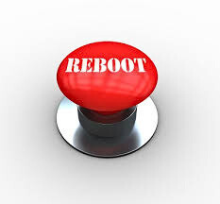
But all is not lost
We can reboot humanity.
Introducing: Sanity in Humanity
A global movement to reawaken our sense of connection, empathy, and shared purpose.
Copyright © 2025 iambernie.com All Rights Reserved.

Slide 13
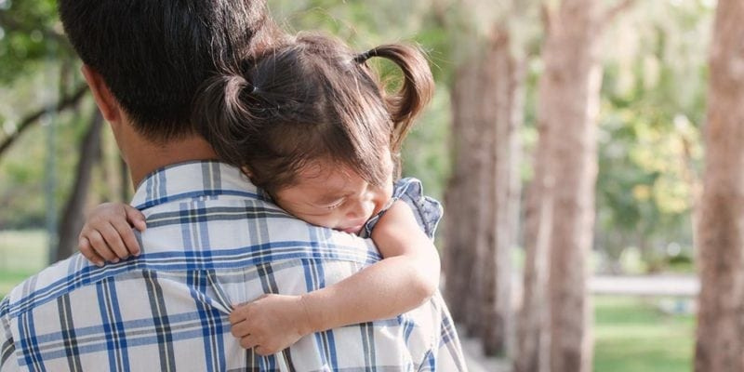
Security
At our core, we all want the same things:
  To feel safe.
  To feel valued.
  To feel that we matter.
And the truth is, we are happiest as individuals and as societies when we are acknowledged and respected.
Copyright © 2025 iambernie.com All Rights Reserved.

Slide 14
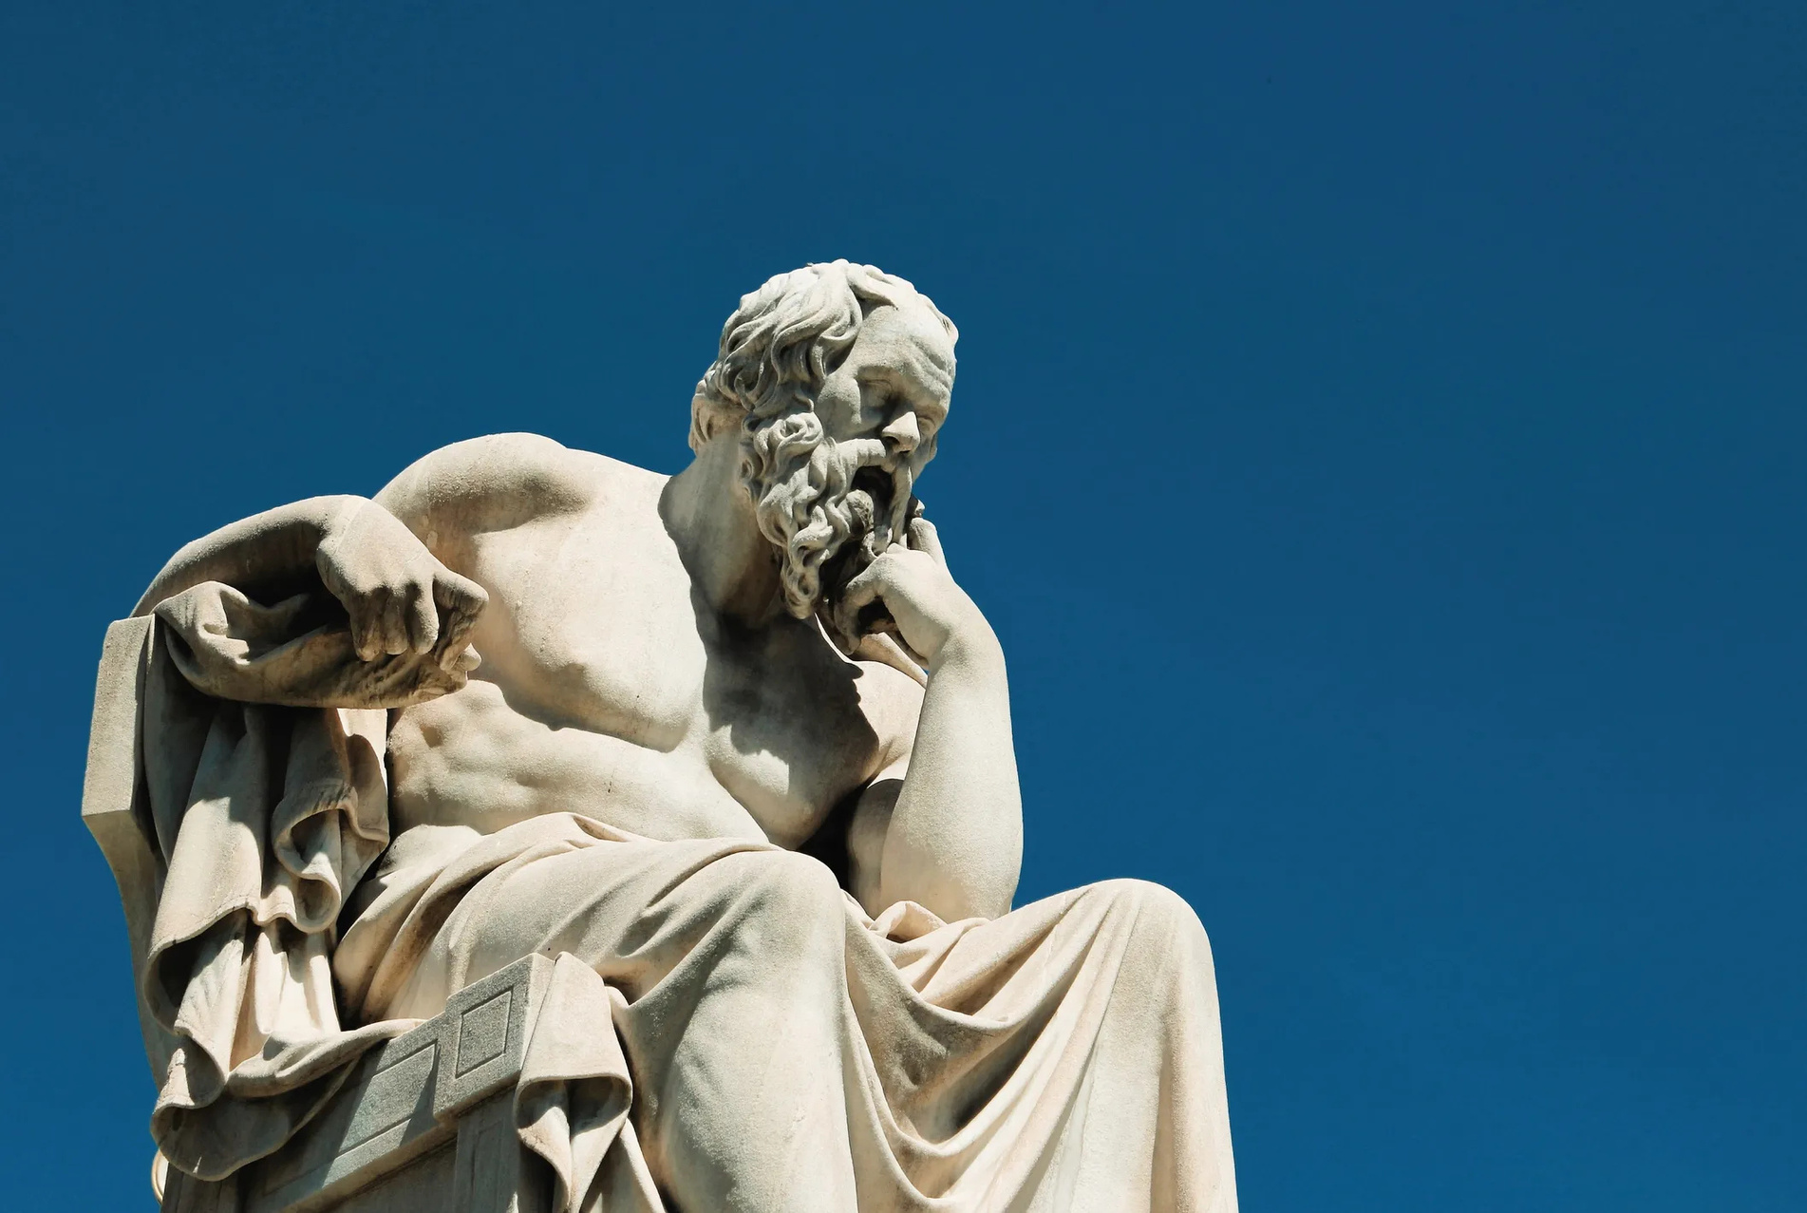
Wise & Honest Leadership
We need a new kind of leadership. Not the loudest voice in the room, but the wisest.
  True leadership doesn’t control,
it validates.
  It respects every person’s identity, heritage, and struggle.
  It stands up for those who are belittled, even when it’s hard.
  It shows gratitude, takes accountability, and uplifts others with courage and compassion.
Copyright © 2025 iambernie.com All Rights Reserved.

Slide 15
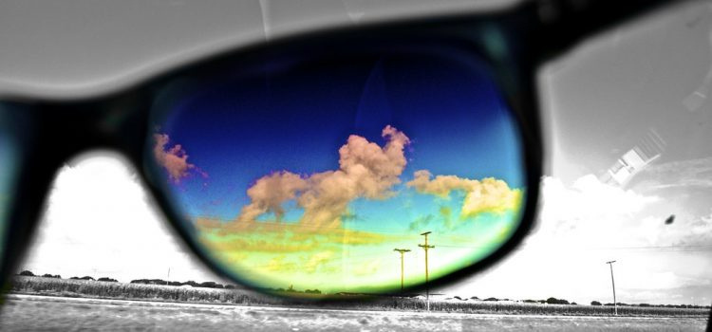
A New Perspective
We must remember: we are cousins.
We don’t have to like every cousin, but we should see them as family.
From that truth and point of view, our worldview changes.
Copyright © 2025 iambernie.com All Rights Reserved.

Slide 16
Humanity Needs Remembering,
Not Fixing
Shared Goals
Working together for common vision
Respectful Dialogue
Listening to understand different perspectives
Collective Action
Joining forces for impactful change
As we embrace our shared origins, we can foster understanding and create a brighter future together.
Empathy First
Fostering compassion to bridge divides
Copyright © 2025 iambernie.com All Rights Reserved.

Slide 17


Seeing Each Other as Family
Shared experiences and common values
Embracing our diverse backgrounds and stories
Unity through empathy and understanding
Illustrating our interconnectedness as one human family
Copyright © 2025 iambernie.com All Rights Reserved.

Slide 18
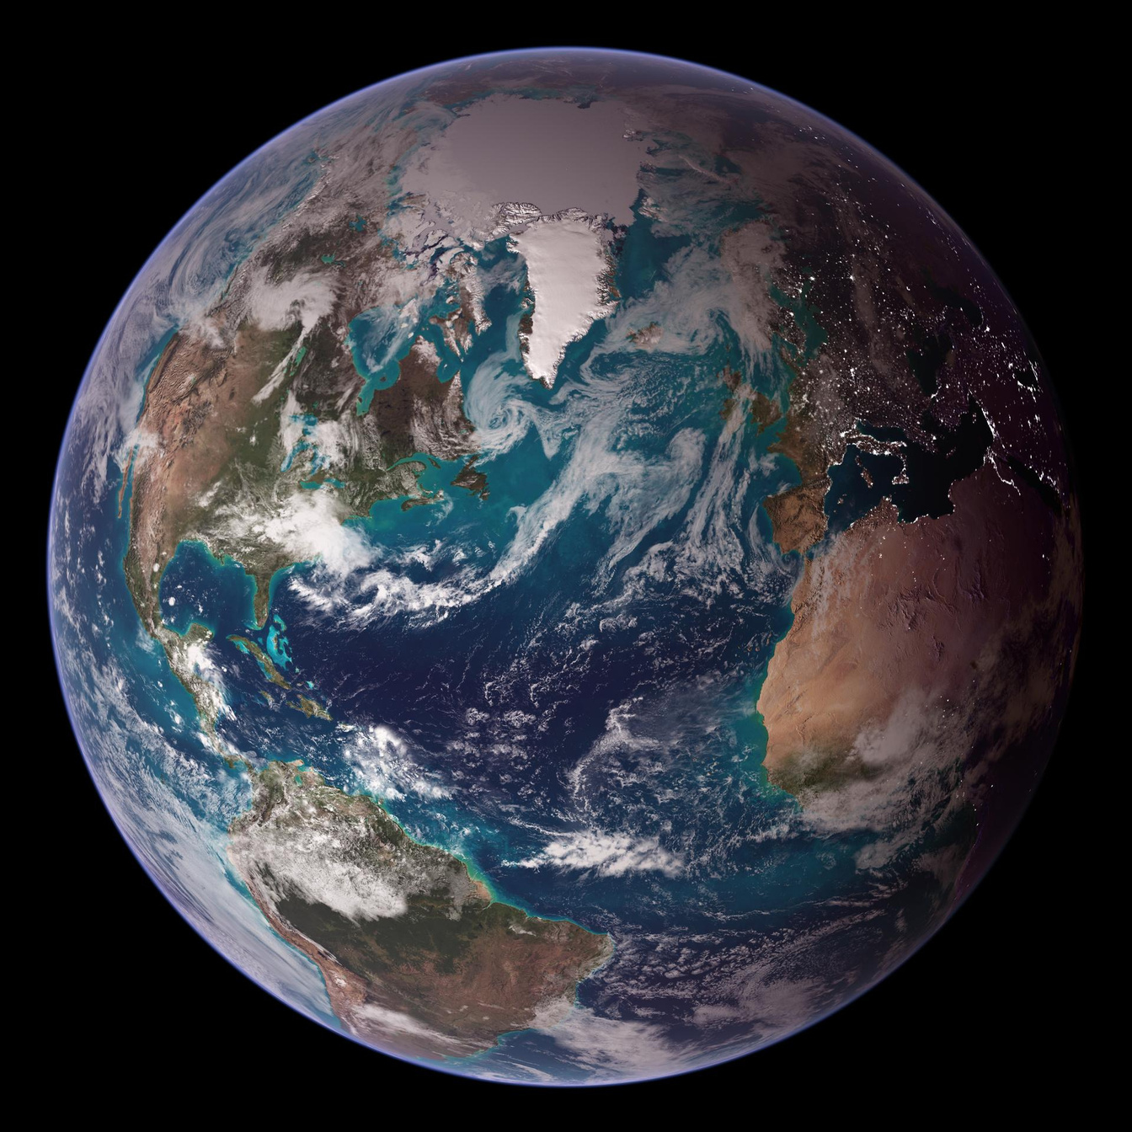
The Bigger Picture
We’re all clinging to the same cooled crust of a fiery planet hurtling through space.
We’ve spent too long fighting over imaginary lines and manufactured differences.
It's time to stop playing in the mud and start building something better, together.
Copyright © 2025 iambernie.com All Rights Reserved.

Slide 19
Building a better future through unity
and collaboration
Shared Goals
Working together for common vision
Respectful Dialogue
Listening to understand different perspectives
Collective Action
Joining forces for impactful change
Empathy First
Fostering compassion to bridge divides
Copyright © 2025 iambernie.com All Rights Reserved.

Slide 20
Inclusivity
Sanity in
Humanity
Embrace diverse perspectives for unity.
Empathy
Understand others' feelings to foster connection.
The importance of guidance that respects and validates everyone through Wise and Honest Leadership.
Integrity
Lead with honesty and moral principles.
Vision
Inspire a shared future for all.
Copyright © 2025 iambernie.com All Rights Reserved.

Slide 21


Call to Action: Embrace Our Humanity
01
02
03
Reframe Perspectives
Build a Future
Stand Against Disrespect
Shift your viewpoint to foster understanding.
Collaborate to nurture a more inclusive world.
Challenge negativity and uphold our shared values.
Copyright © 2025 iambernie.com All Rights Reserved.

Slide 22
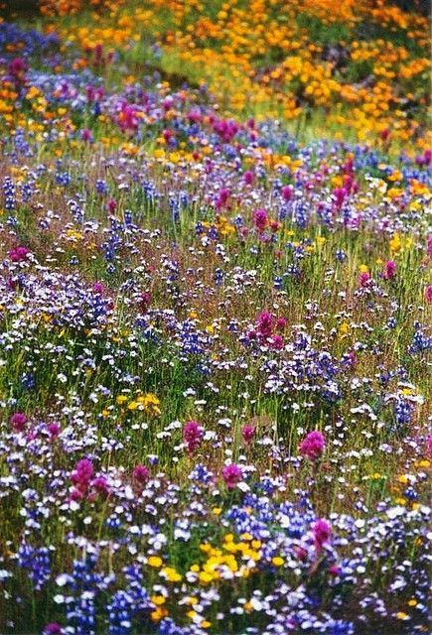
In Review:
  Reframe how we see each other, not as enemies, but as kin.
  Stand up when others are disrespected.
  Question ideologies that divide, dominate, or dehumanize.
  Be thoughtful about what enters our hearts and minds.
  Be upstanders who reject silence in the face of cruelty.
  Be problem solvers who know that patience, compassion, and persistence can outlast hate.
  Be builders of a future that honors every person’s place in this shared home.
Copyright © 2025 iambernie.com All Rights Reserved.

Slide 23
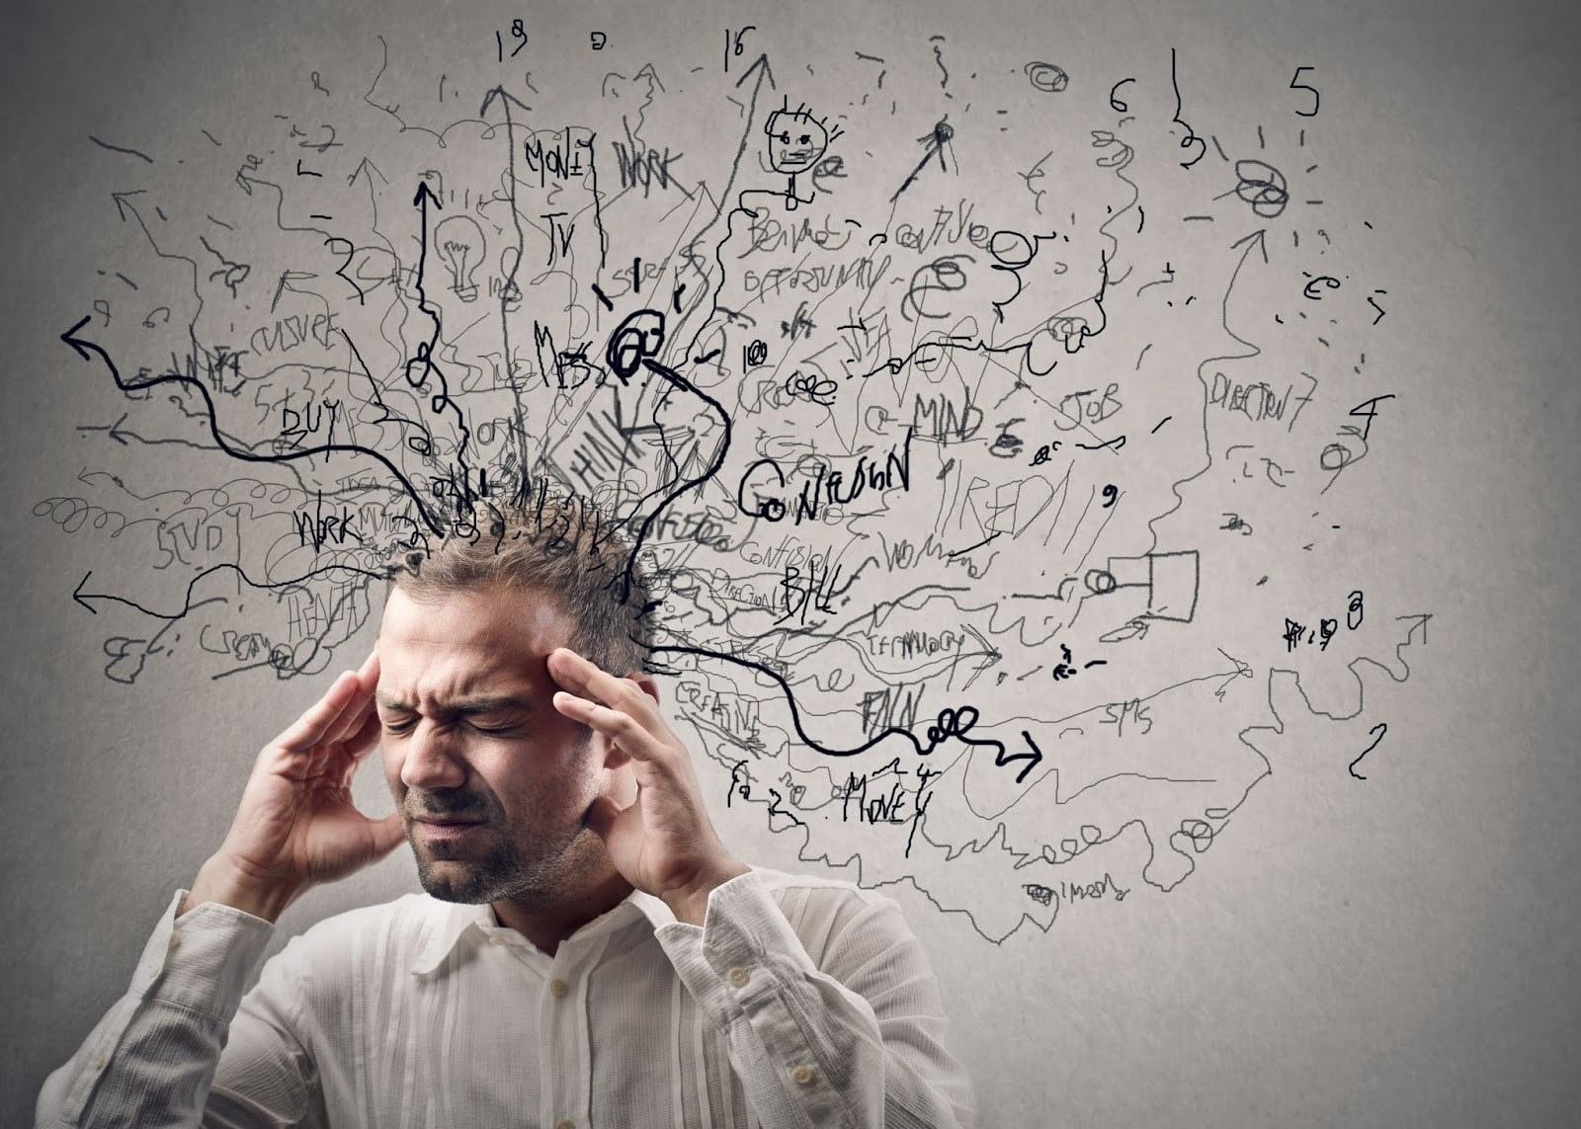
Distractions from Our Common Origin
We are not broken.
We are distracted.
And we are overdue for a perspective shift.
Copyright © 2025 iambernie.com All Rights Reserved.

Slide 24
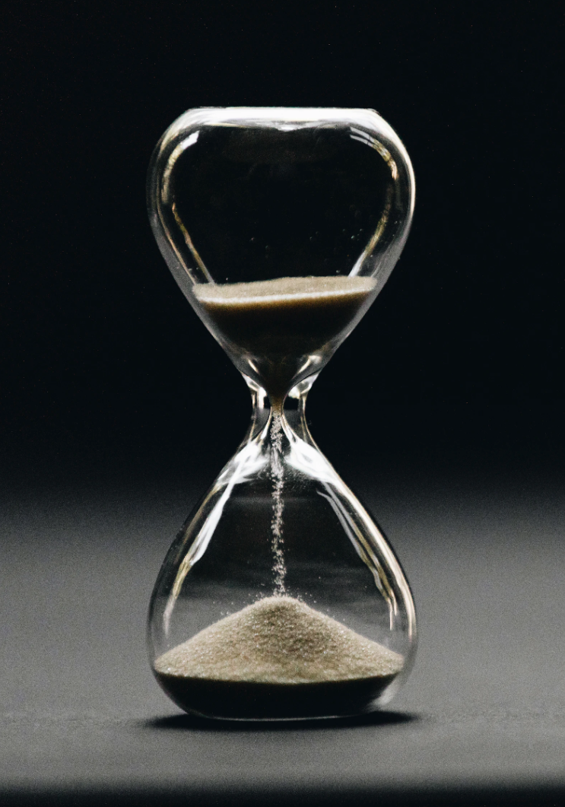
Urgency!
The reboot starts now.
Sanity in Humanity.
Because we can do better.
And we must — for ourselves, and for the generations to come.

Slide 25
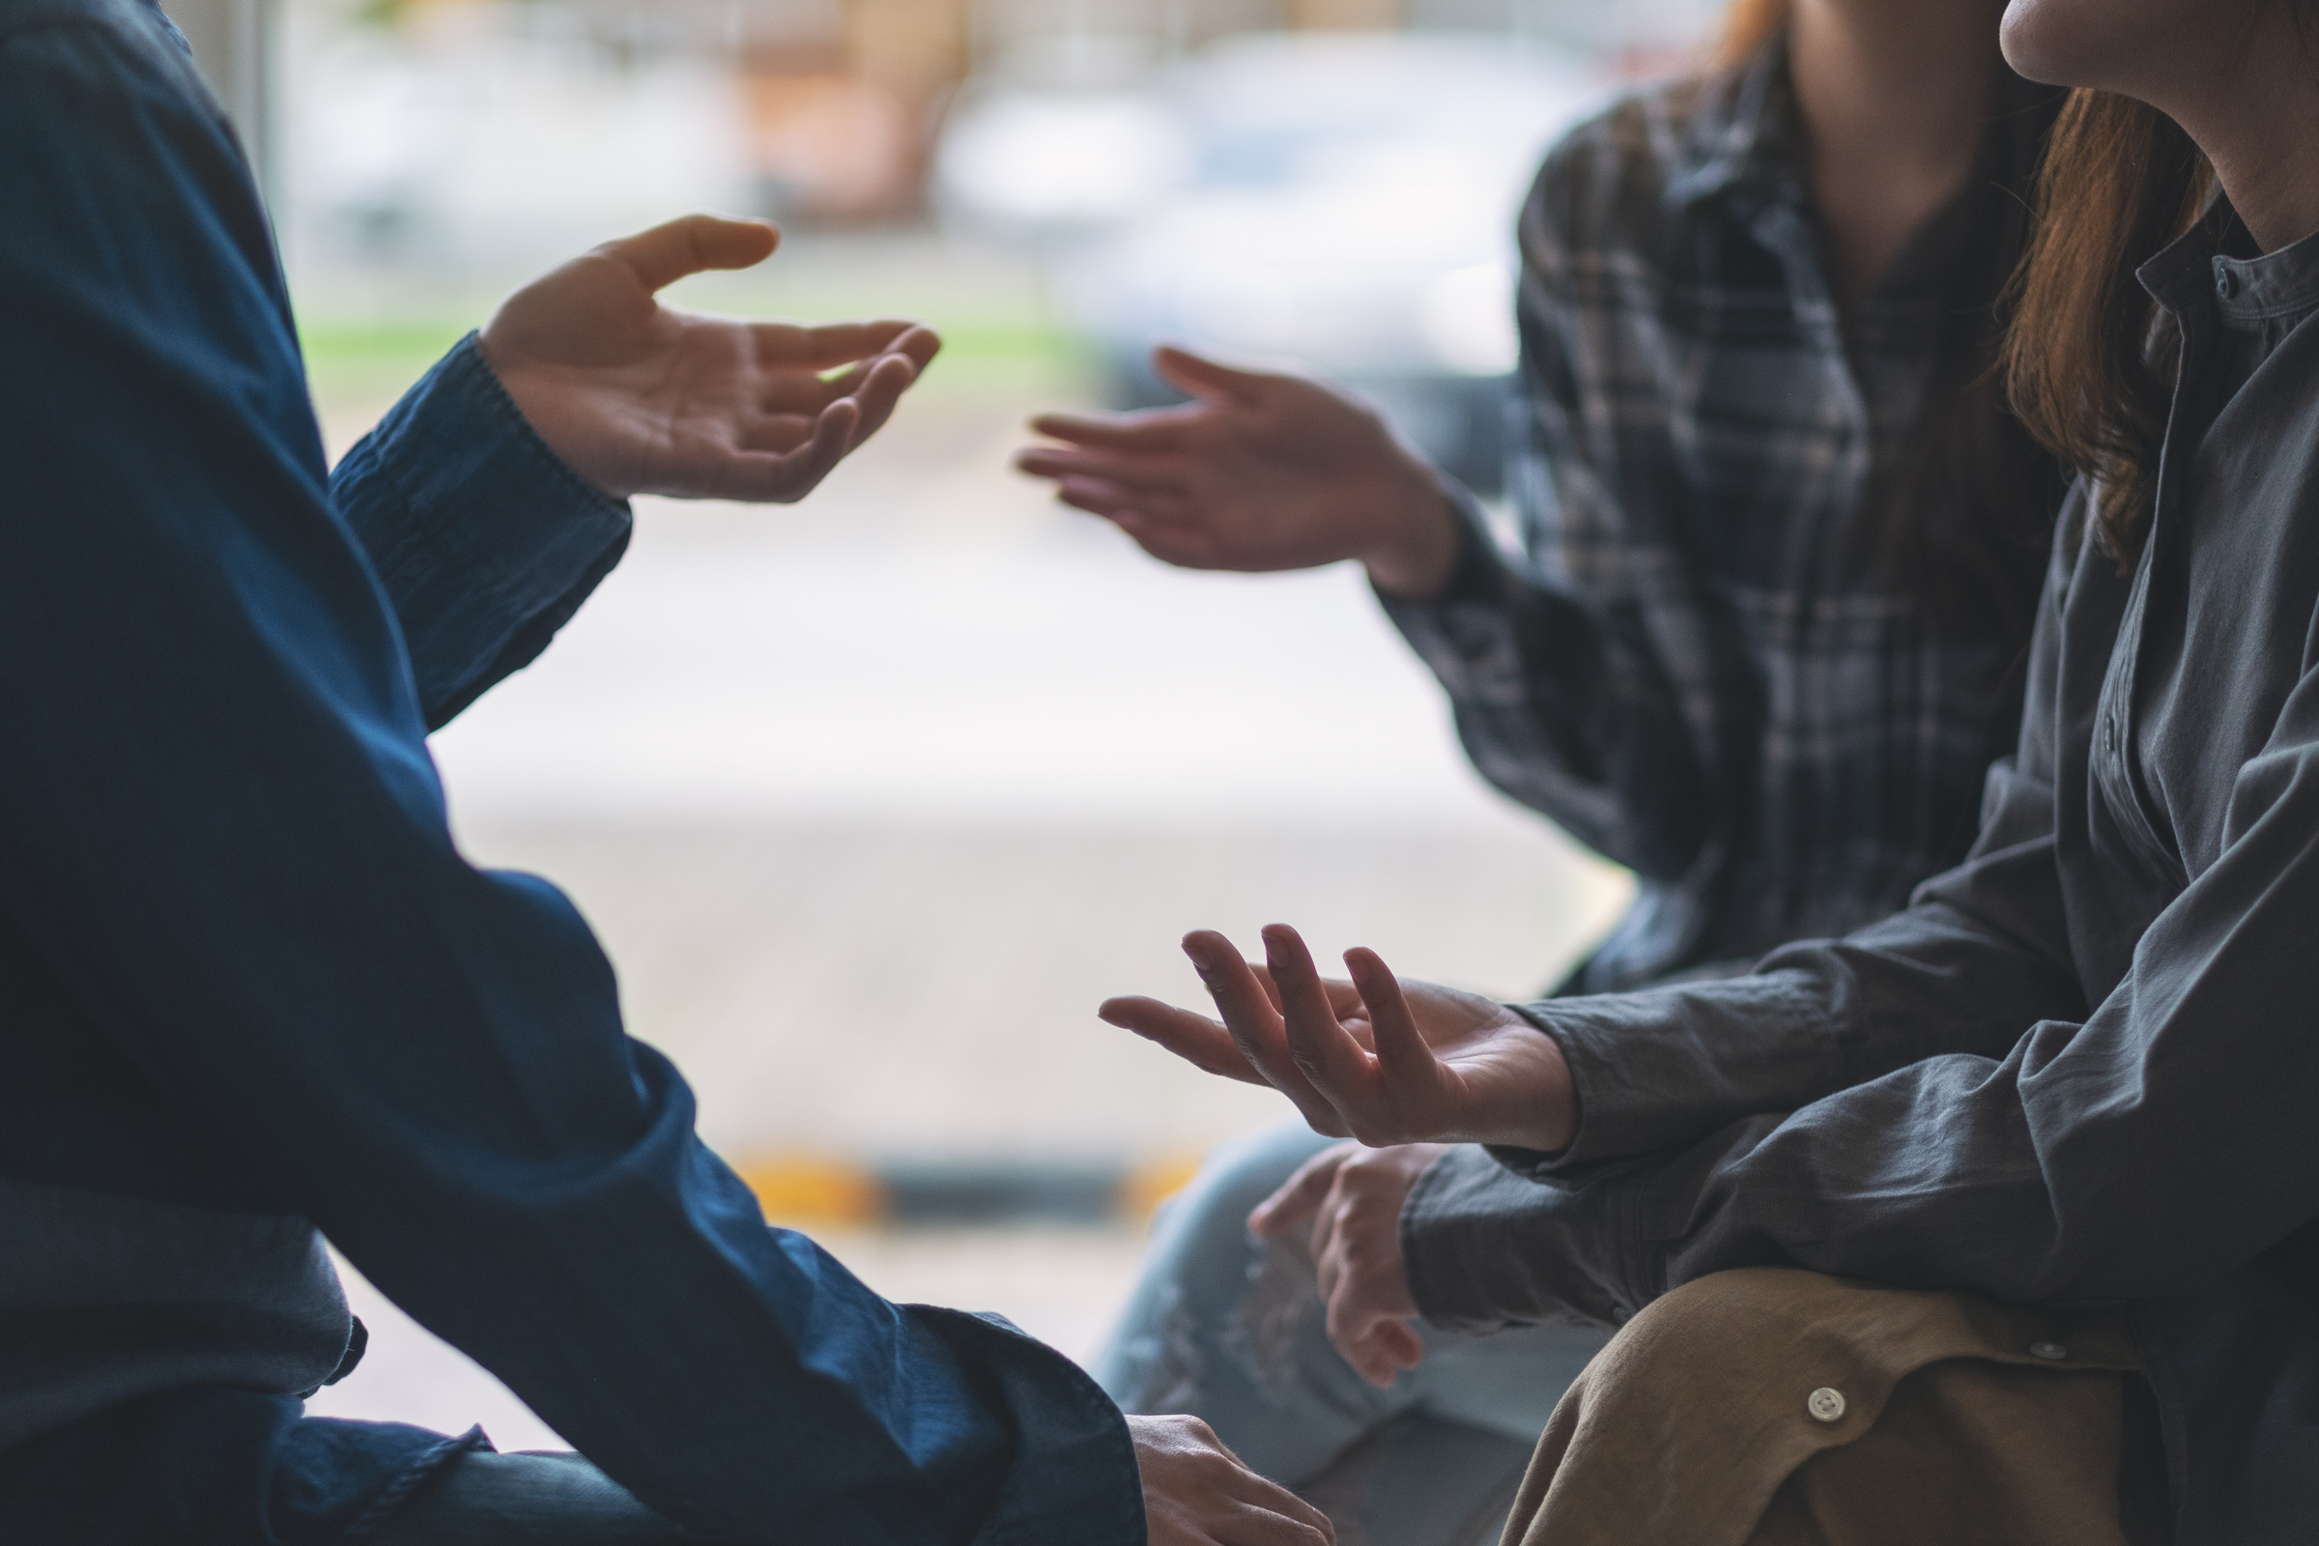
Learn more...
Email
iambernie2025@gmailcom
Website
iambernie.com
Copyright © 2025 iambernie.com All Rights Reserved.

