Slide 1
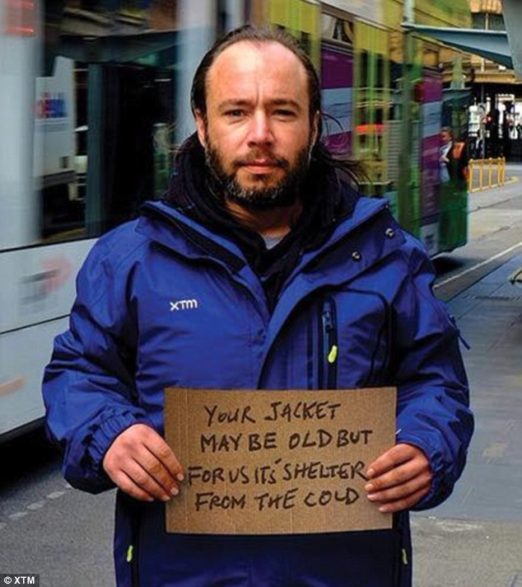


Lincoln City warming shelter
Who we are and what we do

Slide 2

“Make a career out of humanity…it will enrich your spirit as nothing else can. It will give you that rare sense of nobility that can only spring from love and selflessly helping your fellow man…you will make a greater person of yourself, a greater nation of your country, and a finer world to live in.”
Martin Luther King Jr.
1929 - 1968

Slide 3

Lincoln City Warming Shelter Mission
Lincoln City Warming Shelter(s) are operated by a coalition of people representing non profits, faith based communities, and regular citizens providing warming shelter(s) in the Lincoln City and surrounding areas during temperatures 39 degrees and below from December 1st through March 1st.

Slide 4
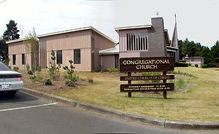
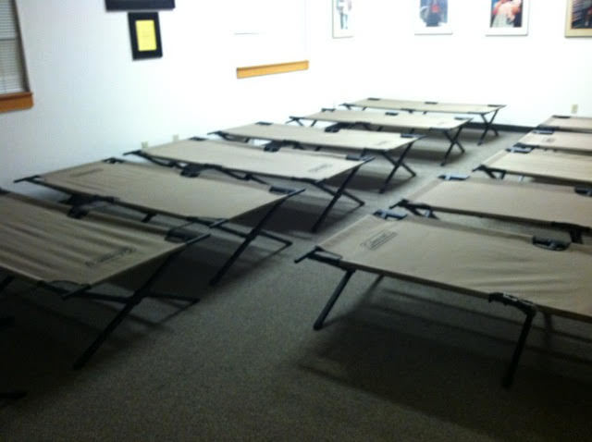
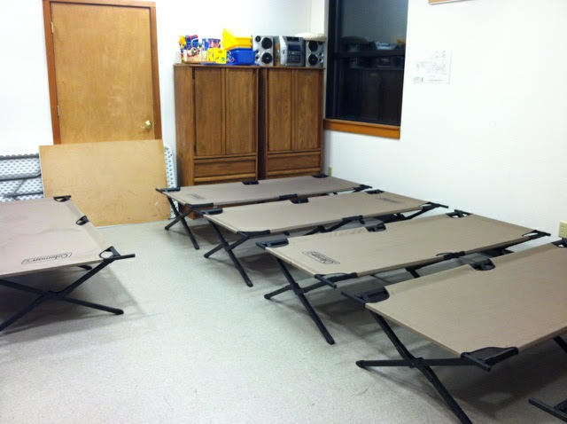
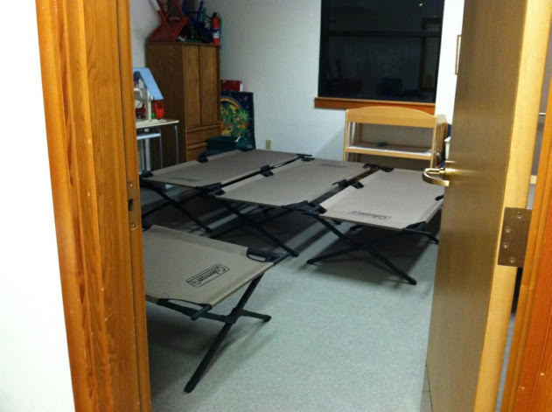
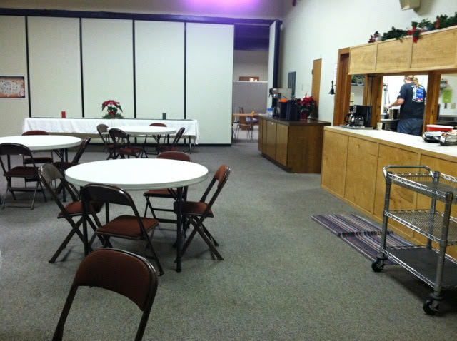
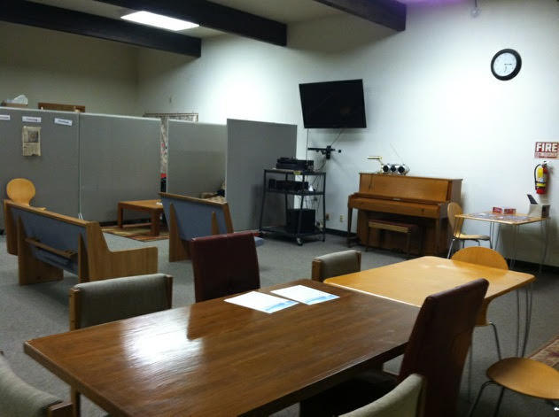
Singles Shelter
Congregational Church
Singles Men Room 1
Singles Men Room 2
Singles Women Room
Kitchen & Dining Room
Hang out spot w/ movies

Slide 5
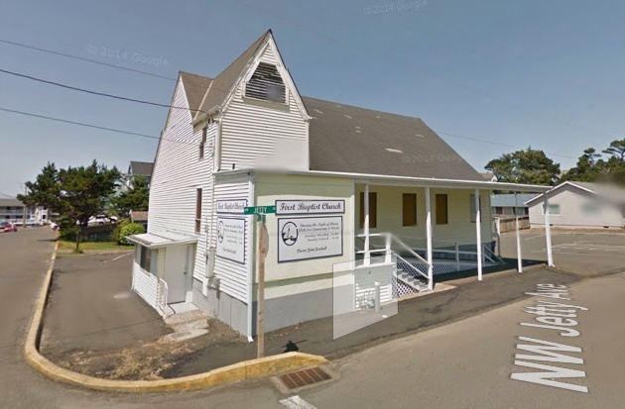
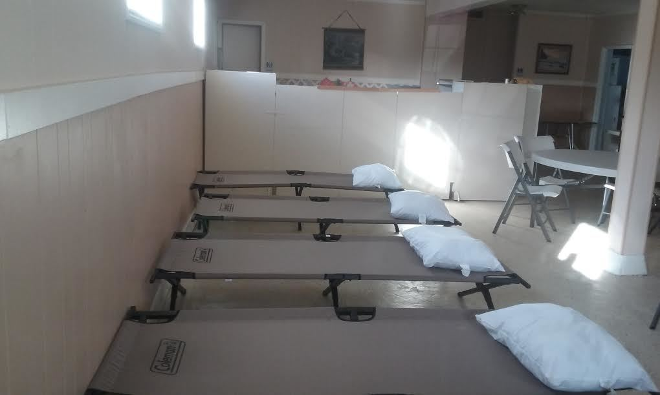
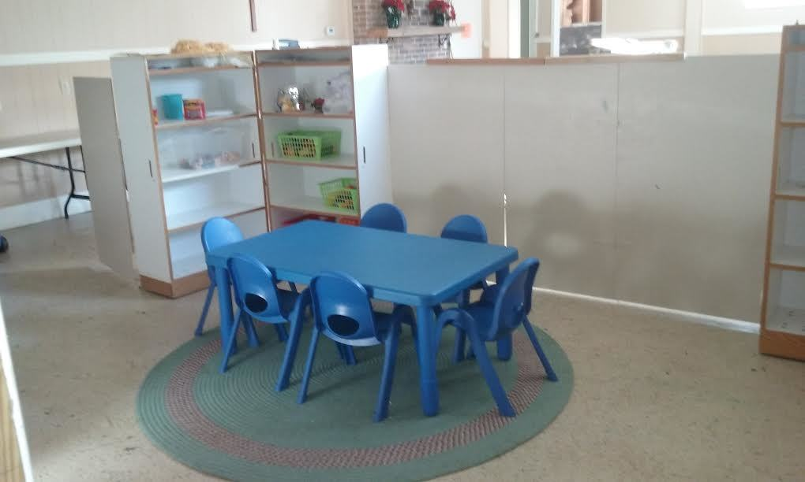
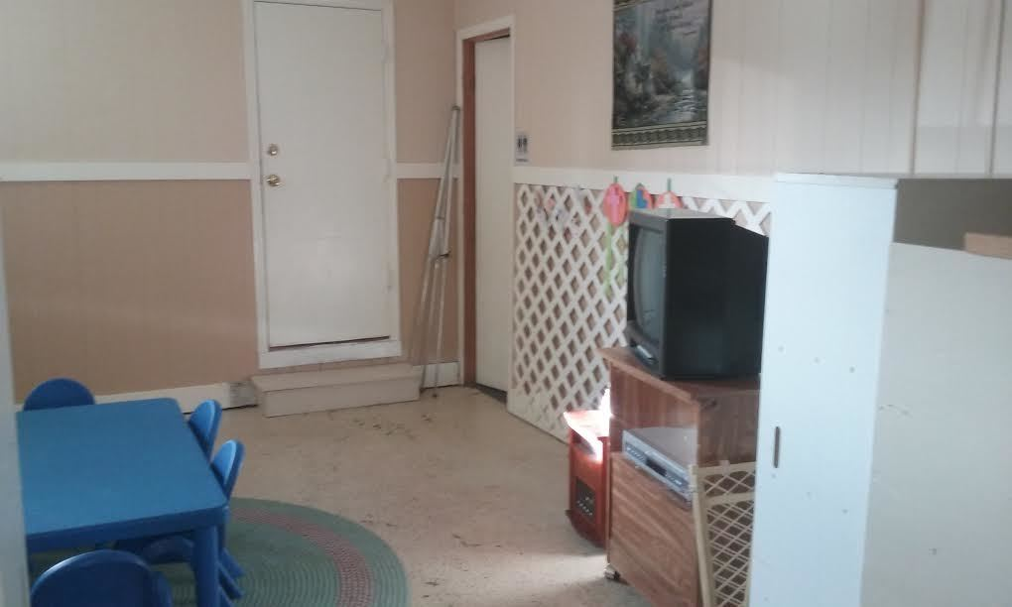
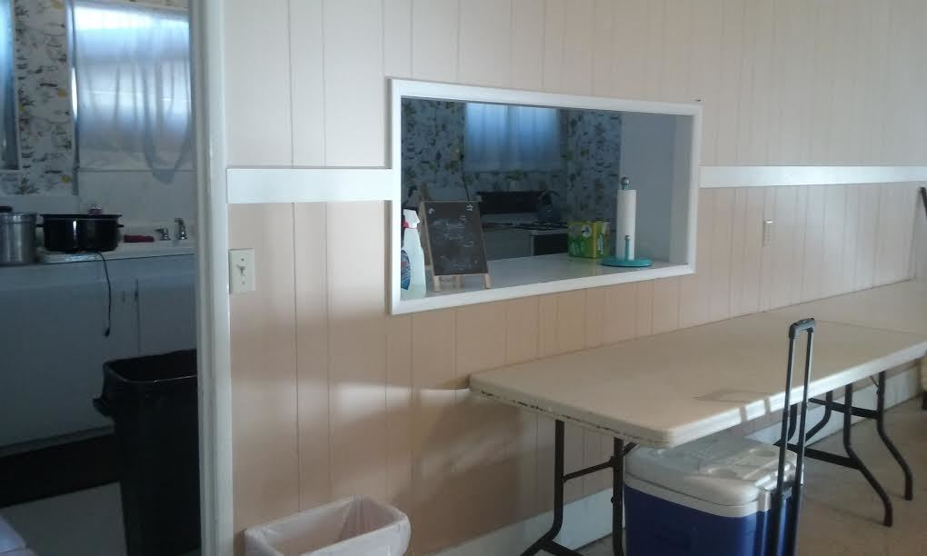
Family Shelter
First Baptist Church
Family sleeping space
Children’s area
Movies for the kids
Kitchen

Slide 6
Notification Process Protocol
1. Operations Manager looks at www.weather.gov (NOAA) to
Determine if the temperature
during the night time low will reach 39 degrees or below. (7 days prior)
2. Host sites are notified (7 days prior)
3. Volunteer Coordinators notified (7 days prior)
4. Volunteers are notified (3 to 7 days prior)
5. Facebook and other Social Media pages notified. (7 days prior)
6. Police Station and hospital notified (day of shelter opening.)

Slide 7
Shelter Operations
4:00pm (Families) First Baptist Church – Doors Open
6:00pm (Singles) Congregational Church – Doors Open
6:00pm – 7:30pm – A warm dinner provided with coffee or water bottle
7:30pm – 10:00pm – There is a T.V and DVD available at both locations as well as decks of cards and board games
10:00pm – Lights out and shelter doors close. No one enters the shelter unless escorted by a police officer
6:00am – Lights on, everyone wakes up
6:30am – 7:30am – Breakfast with coffee or water bottle, resources handed out, i.e. bus tickets, shower vouchers, laundry vouchers
8:00am –close Shelters

Slide 8
Supplies available to Shelter Guests
Clothes
Pants, shirts, warm jackets, hats, gloves, scarfs, interview pieces, socks
Shoes
Gently used (sometimes new) athletic shoes, boots for men & women
Toiletries
Feminine Products
Pads and tampons
Shampoo, Conditioner, lotion, body soap, toothbrush, toothpaste, razors
Emergency Mylar blankets
These blankets retain 90% of body heat and are waterproof
Emergency Mylar tents
These tents retain 90% of body heat and are given solely to pet owners
Bus tickets
Shower Vouchers
To get to and from the shelter as well as making court appearances
Includes a towel, this is the most important resource as it restores dignity
Laundry Vouchers
∙Laundry vouchers can be redeemed at Posh Wash Laundry mat in Lincoln City

Slide 9
When people are given basic things like the ability to take a shower, wear clean clothes, and groom themselves, they are able to face society and get back on their feet. Expecting a homeless person to function in society without rehabilitation is comparable to handing someone a raw steak without a way to cook it. Crazy right? Take a moment and think about that…

Slide 10
Statistics
Homeless Population
Resources
Volunteers
Total people we helped during 2016-17 season: 127
Locals helped: 31
Transients helped: 96
Men helped: 91
Women helped: 32
Children helped: 4
Veterans helped: 12
Native American people helped: 13 African American people helped: 4
Hispanic people helped: 6
Shower vouchers given: 204
Bus tickets given: 467
Laundry Vouchers given: 48
Mylar tents for pet owners: 7
Volunteers: 68
Volunteer Hours: 3,073.20

Slide 11
Do to the strain on the host locations, we were unable to open the shelters at 50 degrees and below as well as unable to open during hazardous stormy weather conditions. Both of which pose a medical emergency threat of hypothermia for our homeless population…

Slide 12
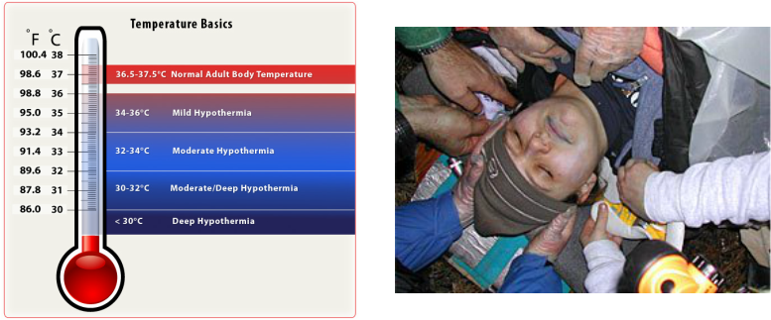
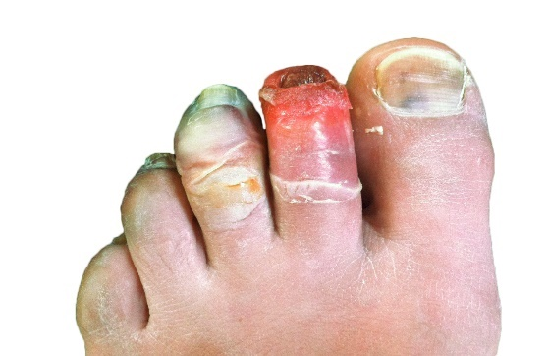
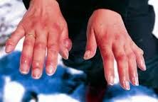
Hypothermia
Hypothermia – The condition of having an abnormally low body temperature, typically one that is dangerously low.
Causes of Hypothermia:
Exposure to cold air, water, wind or rain – Your body temperature can drop to a low level at temperatures of 50 degrees and below or higher in wet & windy weather or if you are in 60-70 degree water.
Other causes – Certain medical conditions such as diabetes, and thyroid conditions, some medications, severe trauma, or using drugs and / or alcohol.

Slide 13
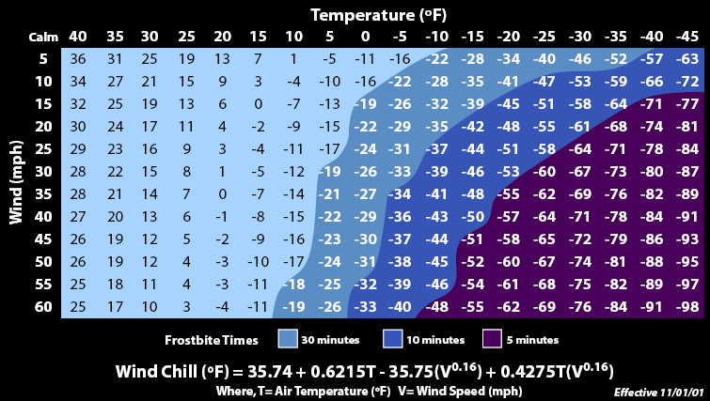
Wind Chill Factor
Wind-Chill ( Wind-Chill Factor) - is the perceived decrease in air temperature felt by the body on exposed skin due to the flow of air.
A surface loses heat through conduction, convection and radiation. The rate of convection depends both on the difference in temperature between the surface and the fluid surrounding it and the velocity of that fluid with respect to the surface. The faster the wind speed, the more the surface cools. In other words, the air “feels” colder than it is because of the chilling effect of the wind on the skin. In extreme conditions, this will increase the risk of adverse effects such as frost-bite

Slide 14
2016 months and their lows
Causes of Hypothermia: Exposure to cold air, water, wind or rain - your body temperature can drop to a low level at temperatures of 50 degrees and below, or higher in wet and windy weather or if you are in 60 to 70 degree water.
January 2016:
Potential days open: 29
July 2016:
Potential days open: 10
Total Number of days we would have been open: 251
Number of actual days open: 13
This means that in the 2016 season, for 238 days, our entire homeless population was in emergency medical status at risk of hypothermia. This does not include the wind-chill factor.
If we were open addressing the posing medical emergency due to hypothermia, we would be open every single month for no less than 10 days per month.
According to these facts, we have hypothermia risk temperatures year-round. We are in desperate need of a year-round emergency shelter to address this issue and save lives.
February 2016:
Potential days open: 24
August 2016:
Potential days open: 11
March 2016:
Potential days open: 29
September 2016:
Potential days open: 18
April 2016:
Potential days open: 26
October 2016:
Potential days open: 11
May 2016:
Potential days open: 22
November 2016:
Potential days open: 22
June 2016:
Potential days open: 19
December 2016:
Potential days open: 31

Slide 15
With our area being a hypothermia risk pretty much year round, that brings another factor into play…Depression…Would you be able to get out of depression if you were freezing all the time and homeless?

Slide 16
Suicide Facts
Suicide is the 2nd leading cause of death in Oregon
Psychological, behavioral, and health problems co-occur and are known to increase suicide risk. Approximately, 70% of suicide victims had a diagnosed mental disorder, alcohol and/ or substance use problems, or depressed mood at time of death.
Lincoln and Tillamook Counties have a higher than state average suicide rate
Approximately 25% of suicides that occurred in Oregon were Veterans
In 2012, the age-adjusted suicide rate among Oregonians was 17.7 per 100,000, which is 42% higher than the national average

Slide 17
What we do is not just a mission for our homeless population, it is also a mission for our volunteers who suffer in silence from depression. Currently, 11.4% of the population in Lincoln County live with depression…

Slide 18

Benefits of Volunteering
Being a volunteer has lots of benefits. It can bring meaning and purpose to your life, while increasing your self-esteem and wellbeing. Volunteering also relieves stress, and alleviates symptoms of depression. As well as having a positive impact on your community, volunteering can improve your relationships too.
Volunteering can:
Give you a sense of achievement and purpose
Help you feel part of the community
Help you feel better about yourself by improving your self-esteem and confidence
Help you share your skills, learn new skills and create better work-life balance
Help combat stress, loneliness, social isolation and depression
Help you meet new people, which can help you feel more needed and valued

Slide 19
Where do we go from here?
Step 1
Find a different location for LCWS
Step 2
Turn LCWS into a year-round emergency shelter program
Step 3
Opening Criteria: When temps reach 50 & below or hazardous stormy weather

Slide 20
How do we stay open for all these potential days??
Year- Round Emergency Shelter
Opening Criteria: 50 degrees and below and hazardous weather conditions
Paid Staff
Community Volunteers
Shelter- Guest Volunteers

Slide 21
Emergency Shelter Facility Must Have:
Commercial Kitchen
Showers / or the capability to put in showers.
Separate areas or the ability to create separate areas for Men, Women, and Families.
Enough room in each separate area for 20 people.
A location within the city limits, so that guests can get to work and use public transit.

Slide 22
LC Emergency Shelter Guidelines
All shelter guests must sign in upon arrival providing their name and birth date (and showing some form of identification should they have it and/ or provide emergency contacts.
No smoking on the grounds of the emergency warming shelter site, or within the building. Should they wish to leave and smoke after 10:00pm, advise them that they cannot be readmitted that same night.
After 10:00pm, no one may leave and come back to the shelter once they are signed in for the night. If they choose to leave, they will not be able to return until the next opening day.
No one will be admitted to the shelter after 10:00pm, for security reasons, unless escorted by emergency personnel because of threatening health issues.
No alcohol or drugs are permitted in the shelters. Should someone arrive noticeably intoxicated, they will be given an opportunity to immediately go to bed and sleep it off or will be asked to leave.
No pets or comfort/companion animals are allowed at the shelter site; only trained service animals are allowed, if the animal does not cause problems in the shelter.
No weapons of any kind or size are permitted in the shelters. Should they come to the shelter with a weapon, regardless of size, they are asked to surrender it and place it in a marked container, retain in a safe location, and return to the guest upon departure the next morning.
As a shelter guest, conflict is disrespectful and will not be tolerated. If they demonstrate an unwillingness to abide by shelter policies while a guest, they may be asked to leave.
The Shelter operates from 6:00pm to 8:00am. At 8:00am, the shelter is closed and all guests must depart the shelter site.

Slide 23
The Approximate Cost to run a program like this
1. Food: $100.00 per day open X approx. 250 days = $25,000.00 per year
2. Laundry: $45.00 per 7 days = $1,620.00 per year
3. Transportation: $2.00 per person X 20 people X 250 days = $10,000.00 per year
4. Advertising: approx. $2,000.00 per year
5. Admin Costs: approx. $2,500.00 per year
6. Supplies: approx. $5,000.00 per year
7. Trash: approx. $1,200.00 per year
8. Wages: approx. $286,560.00 per year
9. Building Rent/Lease: approx. $24,000.00 per year
10. Utilities: approx. $6,000.00 per year
_____________________________________________________________________________________
Total Approx. Cost: $363, 880.00 (PER YEAR)

Slide 24
You think those are high numbers? Check this out…

Slide 25
Hospital Costs
Jail Costs
Samaritan treats approximately 180 homeless people every year.
Half of those people visit more than once, and of that number, 45% of them are chronic users.
Emergency room treatment costs the hospital approximately $14,500.00 for a typical homeless person, and averages $44,800.00 for chronic users
80% of Emergency room visits made by people struggling with homelessness is for an illness that could have been treated with PREVENTATIVE CARE.
This year, we helped 127 different people
If we took the 180 people and spit that in half, we would have 90 people. This is what it would look like to pay for them.
45 regular people X $14,500.00 = $652,500.00
45 Chronic Users X $44,800.00 = $2,016,000.00
________________________________________
Total Cost (PER YEAR): $2,668,500.00
People who are homeless spend more time in jail or prison, which is tremendously costly to the state and locality. Often, time served is a result of laws disproportionately affecting the homeless population, including regulations against loitering, sleeping in cars, and begging.
According to a University of Texas two-year survey of homeless individuals, each person cost the tax payers $14,480.00 (PER YEAR), primarily for OVERNIGHT jail.
A typical cost of a prison bed in a state or federal prison is $20,000.00 (PER YEAR)
We helped 127 different people this year which is a far cry from the entire homeless population that we have in Lincoln City alone. Let’s be fair and say that 63 homeless people went to jail, which is half of the people we helped.
63 people X $14,480.00 = $912,240.00 (PER YEAR)
Hospital Costs PER YEAR: approx. $2,668,500.00 + Jail Costs PER YEAR: approx. $912,240.00 = $3, 580,740.00
Cost to run Year-Round Emergency Shelter (approx. 250 days a year): approx. $363,880.00
If we took the total cost for ONE year with Hospital & Jail costs combined, we could run our Shelter for 9 Years

Slide 26
Doesn’t seem so bad now does it? Seems like a pretty reasonable budget if we can run our Shelter for 9 solid years with the same amount of money it takes to pay for Hospital and Jail costs every year……So why haven’t we done this yet??

Slide 27

“ You must be the change you wish to see in the world.”
Mahatma Gandhi
1869 - 1943

Slide 28
Research Sources
1. https://en.wikipedia.org/wiki/Wind_chill
2. http://www.accuweather.com/en/us/lincoln-city-or/97367/month/340213?monyr=3/01/2016
3.http://www.Public.health.oregon.gov/DiseaseConditions/InjuryFatalityData/Documents/NVDRS/Suicide%20in%20Oregon%202015%20report.pdf
4. http://www.mindhealthconnect.org.au/benefits-of-volunteering
5.https://www.google.com/search?q=pictures+of+people+volunteering&source=lnms&tbm=isch&sa=X&ved=0ahUKEwja49u7gNTSAhUMpJQKHdeCCj4Q_AUIBigB&biw=1310&bih=611#imgrc=-gya3wztNENZfM:
6. http://www.endhomelessness.org/pages/cost_of_homelessness
7. http://www.greendoors.org/facts/cost.php
8. http://www.lincolncitywarmingshelter.com/our-history
9. http://www.lincolncitywarmingshelter.com/stats-reviews-success-stories
10. Lincoln City Warming Shelter Operations Manual

