Slide 1

Lincoln City Warming Shelter
2 phase approach to a permanent home

Slide 2
Lincoln City Warming Shelter Mission:
Providing warmth to those who need it when it is needed most…
Lincoln City Warming Shelter is a tax deductible, nonprofit agency providing the homeless in Lincoln City a warm safe location to sleep overnight during hypothermic risk temperatures.
Lincoln City Warming Shelter is in Phase 1 of our expansion project providing food, shelter, resources, and social services on-site to the homeless in Lincoln City and surrounding areas for a three month block from mid November through March.

Slide 3
Hypothermia & Wind chill
Hypothermia: When the body’s temperature drops abnormally low, typically one that is dangerously low. Causes of hypothermia are exposure to cold air, wind or rain. The body temperature can drop to a dangerously low level at outside temperatures of 50 degrees and below, in wet windy weather or in 60-70 degree precipitation.
Wind Chill: the perceived decrease in air temperature felt by the body on exposed skin due to the flow of air. The faster the wind speed, the more the surface cools. In extreme conditions, this will increase the risk of adverse effects such as frost-bite, and hypothermia.
Samaritan North Lincoln Hospital: In 2016, 10 unduplicated homeless individuals were treated and released for hypothermia with an additional 9 unduplicated homeless individuals who were hospitalized owing hypothermia. This cost SNLH approximately $548,200.00
Samaritan Pacific Communities Hospital: In 2016, 12 unduplicated homeless individuals were treated and released for hypothermia with an additional 5 unduplicated homeless individuals who were hospitalized owing hypothermia. This cost SPCH approximately $398,000.00

Slide 4
The Need for Services
Season 2016/ 2017 Stats
Number of Cots Occupied: 779 Number of nights open: 47
Number of un-duplicated individuals: 135 Number of meals served: 2,344
Number of shower vouchers given: 204 Number of bus tickets given: 467
Number of laundry vouchers given: 48 Number of tents to pet owners: 7
Number of meals given to pets: 21

Slide 5
Phase 1
For the winter season of 2017/18, Lincoln City Warming Shelter will be at the Old Taft Fire
House located at 1207 SE 48th Place, in Taft of Lincoln City moving us away from using a host location which gives us the opportunity provide more services to the homeless.
What the new changes look like:
Host Location:
Only available
Certain hours, temp trigger, 39
Volunteer led
No paid positions, no Director
Shower Vchs
Laundry Vchs
For shelter guests
Volunteers
Only community volunteers
No onsite social services
Rented Facility
Available 24/7, open for three month block.
Paid Director
One Full time paid Director
Inhouse Shower
Inhouse Laundry
For shelter
guests
Shelter Guest Volunteers, comm Volunteers, court ordered volunteers
Services
Resource counseling, job search, resume, referrals

Slide 6
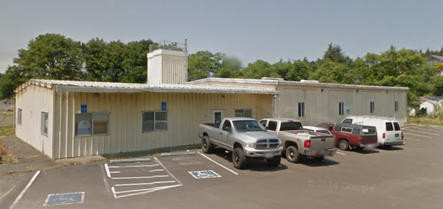
Season 2017/18 at a Glimpse
Morning at the Shelter
6 a.m. – Lights on for the day
Between 6 a.m. – 8 a.m. – Women’s shower time (limit 10 mins per person)
7 a.m. – Breakfast
8 a.m. – Shelter closes, shelter guests provided with sack lunches to go.
Between 8 a.m. – 9 a.m. clean up / breakdown cots by shelter guests who have previously signed up and have written approval by Shelter Manager.
Day Center (led by LCHS)
10 a.m. – 10:45 a.m. – Job search, resume and cover letter building
11 a.m. – 3 p.m. – Resource Counseling
4:15 p.m. – 5 p.m. – Assistance with signing up for food stamps, OHP and TANF is possible
Night at Shelter Continued…
6 p.m. – Shelter opens
6:30 p.m. – Dinner
Between 7:30 – 9:30 p.m. – Men’s Shower time (limit 10 mins per person)
Between 7:30 – 9:30 p.m. – “Hang out time” movie, coloring, cards, etc,,
10 p.m. – Lights out, everyone must be signed in. No one leaves the shelter after this time, and if they do, they cannot come back in unless escorted by a Police Officer or when it is light’s on the next morning.
Night at the Shelter
Between 5 p.m. – 6 p.m. set up cots by shelter guests who have previously signed up and have been approved by Shelter Manager.

Slide 7
Supplies & Services available to Guests
Warm Dinner, Breakfast, and cold sack lunch
Dinner, breakfast and lunch for pet owners as well as dog food for their dogs.
Dry clothing
Rain ponchos
Toiletries
Feminine Products
Emergency Mylar Blankets
Emergency Mylar tents for animal companions
Lockers
On-site shower
On-site laundry
Bus tickets
Resource Counseling
Assistance with Job search & resume building
Assistance with obtaining benefits such as food stamps and Oregon Health Plan
Assistance with referrals to Drug Counseling services, 12 step programs and Mental Health services.
On-site Crisis Counselor – (during shelter hours)

Slide 8
Donation Drop Sites
Beachtown Charities, open Thursday, Friday and Saturday from 11am to 4pm. Year round.
Warming Shelter, during the open season Monday – Friday from 11am to 3pm

Slide 9
Volunteer Opportunities
For questions about Volunteer Opportunities or fulfilling community service hours, please contact Sharon Padilla, 541-992-5748 or e-mail at forestlady2680@gmail.com

Slide 10
What is needed?
Financial Support. We have received a donation of a pre-fabricated 2-story building that needs to be put on a lot and built. That building is Phase 2 of our expansion project and will become the future permanent home for LCWS.

Slide 11
Different ways to donate

Slide 12
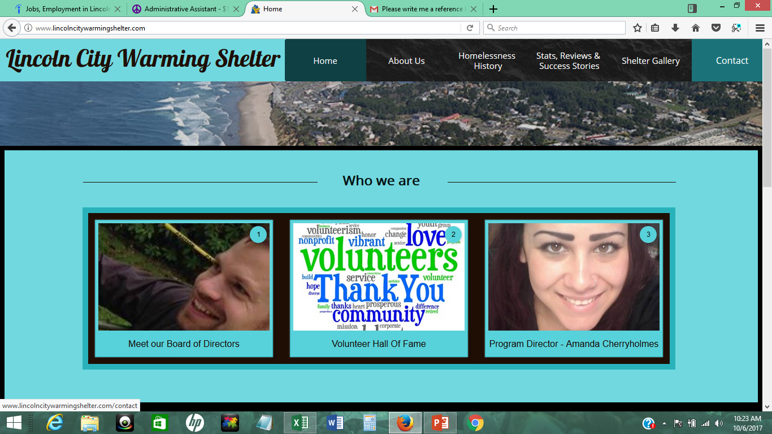
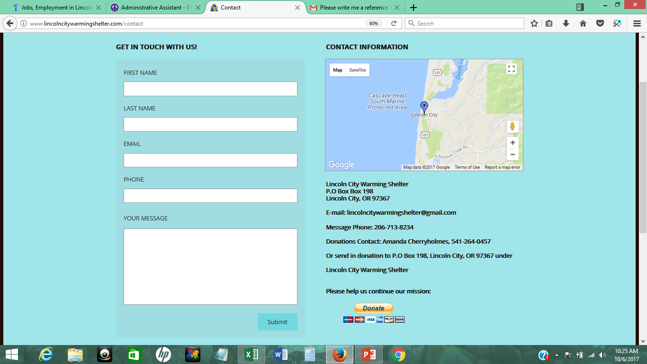
Online
www.lincolncitywarmingshelter.com
Click on Contact Page
Click on yellow donate button which will lead you to payment window

Slide 13
In Person
Keep updated on local festivals and which vendors will be present. The next scheduled vendor booth will be at the Cultural Center in November at Giving Tuesday. We are set up with PayPal Here which gives us the ability to take credit card donations at whatever capacity and the funds go directly into the Warming Shelter bank account for us to run our program. The equipment is portable and connects via Bluetooth to an app on my smart phone and sends receipts to the donors via e-mail. This gives us the ability to take credit card donations in person whenever and wherever we are located.

Slide 14
Through the Mail
You can send us donations to us at P.O Box 198, Lincoln City, OR 97367. If you are sending a check, please make it payable to Lincoln City Warming Shelter.

Slide 15
We need YOUR help to succeed.

