Slide 1


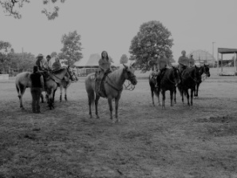
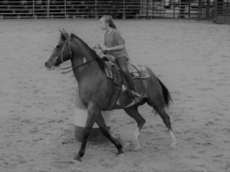
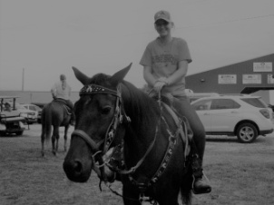
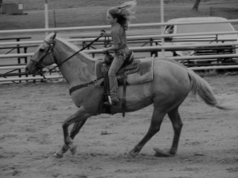
2020 ALL YOUTH SHOW
June 24, 2020
Sign up no later than June 2, 2020
Start Time – 6:00 PM
Enter through Track/Livestock Gate only
Rider age as of January 1, 2020
Youth - 11 & Under Junior - 12-18
1. Youth Flag 6. Junior Figure 8
2. Junior Flag 7. Youth Poles
3. Youth Barrels 8. Junior Poles
4. Junior Barrels 9. Mystery Class
5. Youth Figure 8 10. Mystery Class
(Time permitting)
$15.00 per horse/rider combo - No more than two horses per rider
Sign up by June 2nd by e-mail **.
Include rider’s name, age, phone number and T-shirt size.
(T-Shirt for first 20 paid entrees.)
Negative Coggins Required
No riding off club grounds
Jeans and boots required
No use of whips/bats/crops ahead of horse’s shoulder
Inappropriate behavior is cause for expulsion
Tail ribbon for horses that kick
Chairperson’s decision is final
Meramec Community Fair and the Sullivan Saddle Club are not responsible for accidents, injuries, or losses to spectators, exhibitors or equine
** For more information or to register
Mary Loomis at 573-732-4757, m.loomis.remember@gmail.com or
Myra Modglin at 314-852-8908, mymy@centurytel.net .
You can also visit us online at www.sullivansaddleclubsite.com or facebook.com/SullivanSaddleClub

