Slide 2
Climate Decode Guide to Climate Neutral Events

Slide 3
Table of Contents
01
Introduction to Climate-Neutral Events 1.1 Importance of Climate-Neutral Events
02
Planning for Climate-Neutral Events
2.1 Initial Assessment
2.2 Stakeholders Engagement
03
Carbon Footprint Calculation
3.1 Data Collection
3.2 Emission Categorization
04
Strategies for Reducing Emissions
05
Offsetting Carbon Emissions
06
Communication and Reporting
07
Post-Event Evaluation
08
Conclusion and References

Slide 4
01 Introduction to Climate-Neutral Events
Climate-neutral events are those organized with the goal of minimizing and offsetting the greenhouse gas (GHG) emissions they produce. This involves calculating the event's carbon footprint, reducing emissions wherever possible, and compensating for the remaining emissions through carbon offset projects.

Slide 5
Importance:
In India, where the events industry is rapidly growing, there is an increasing need to address these impacts. By adopting climate-neutral practices, event organizers can contribute ;
To significantly impact energy use, waste, and transportation, necessitating sustainable practices.
Adopting climate-neutral practices helps combat climate change and aligns with India's sustainability goals.
Implementing these practices boosts the event's reputation and supports broader environmental objectives.
Objective:
This guidebook is designed to help event organizers in India plan and execute climate-neutral events. The goal is to provide practical steps and strategies to reduce the carbon footprint of events, promote sustainability, and support India’s broader environmental objectives.

Slide 6
Planning for Climate-Neutral Events
Initial Assessment
Stakeholder Engagement
Assess key areas of environmental concern such as energy usage (lighting, venue power), waste generation (plastic, food waste), and transportation (participant travel, event logistics).
Establish specific and measurable targets for reducing the event's carbon footprint, including minimizing energy use, limiting waste, and promoting eco-friendly transport options.
Engage stakeholders—such as venue managers, sponsors, suppliers, and participants—early in the planning process to align them with your sustainability goals.
Clearly communicate the event's climate-neutral goals to all parties involved.
Encourage suppliers to offer sustainable products and services, and raise awareness among participants about the importance of minimizing their own carbon impact.

Slide 7
Carbon Footprint Calculation
Data Collection:
Gather data on energy usage, transportation, catering, and waste.
Use carbon footprint calculators or hire experts to estimate emissions.
Emission Categories:
Scope 1: Direct Emissions
On- site energy generation (e.g., diesel generators at the venue)
Company- Owned vehicles used for event logistics
Scope 2: Indirect Emissions from Energy
Electricity used to power the venue (lighting, air conditioning, audio-visual equipment).
Heating and Cooling systems at the event site.
Scope 3: Other Indirect Emissions
Transportation: Participant travel (flight, taxies, public transport) and shipping of materials.
Catering: Food production, transportation and waste management
Materials: Production and disposal of event materials (décor, promotional items, giveaways.)
Waste Management: Emissions from the waste disposal process like recycling or landfilling.

Slide 8
Strategies for Reducing Emissions

Slide 9
Strategies for Reducing Emissions
Venue Selection:
Choose energy-efficient venues with green certifications (e.g., LEED).
Opt for locations accessible by public transport to reduce travel emissions..
Sustainable Catering:
Offer plant-based menu options.
Source food locally and seasonally to minimize food miles.
Reduce food waste with careful planning and portion control..
Energy Management:
Utilize renewable energy sources where possible.
Implement energy-saving measures like LED lighting and smart thermostats.
Waste Reduction:
Encourage the use of reusable materials.
Set up clear recycling stations.
Minimize single-use plastics.

Slide 10
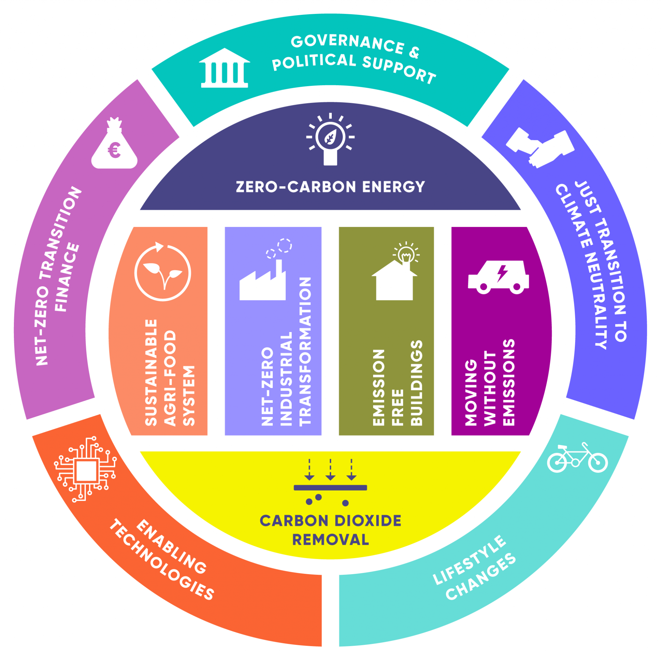
Offsetting Carbon Emissions
Empowering India’s Events with Carbon Neutrality
Understanding Off-sets:
Identify credible options to offset on source and
carbon offset projects (e.g., reforestation, renewable energy).
Purchasing Offsets:
Guide on how to purchase offsets to cover the emissions that can’t be reduced.
Highlight the importance of transparency and third-party verification of offset projects.

Slide 11
Communication and Reporting
Key aspects of carbon neutral events
Transparency
Share the event’s sustainability goals and achievements with participants.
Provide updates on the steps taken to reduce the event's carbon footprint.
Reporting
Compile a report on the event’s carbon footprint and the measures taken.
Highlight successes and areas for improvement in future events.

Slide 12
Post-Event Evaluation
Feedback Collection:
Gather feedback from participants on the event’s sustainability practices.
Use insights to refine future event planning.
Review Outcomes:
Analyze the effectiveness of the climate-neutral strategies implemented.
Compare the actual carbon footprint against the projected targets.

Slide 13
SUPPORT SUSTAINABLE DECARBONIZATION
Conclusion and Key Takeaways

Slide 14
References

