Slide 1
6:05PM SLT | 13:35PM CET
ENVIRONMENTAL SUSTAINABILITY
India's Carbon Credit Trading Scheme
Exploring India's Efforts to Reduce Greenhouse Gas Emissions through Carbon Credit Trading

Slide 2
Table of Contents
01
02
Global Carbon Market and India's Commitment
Overview of India's Carbon Credit Trading Scheme (CCTS)
1.1 Global Carbon Markets
2.1 Institutional Framework and Key Stakeholders
1.2 India's Commitment to Combat Climate Change
2.2 Compliance and Voluntary Mechanisms
1.3 India's Experience in carbon Markets
03
04
Article 6 of Paris Agreement
Conclusion and Key Takeaways
3.1. Understanding 6.2 & 6.4 mechanism in Indian.
Summarizing the key findings and learnings from India's CCTS for a sustainable future and global climate goals.

Slide 3
01
Global Carbon Market and India's Commitment
1.1 Global Carbon Markets
1.2 India's Commitment to Combat Climate Change
1.3 India's Experience in carbon Markets

Slide 4
MECHANISMS FOR CARBON OFFSETTING
Global Carbon Markets
Compliance Mechanisms in Carbon Pricing
Compliance Carbon Market was valued at USD 101.4 billion in 2023 and is set to grow at a 14.7% CAGR between 2024 and 2032. key tools managed by governments to regulate carbon emissions are a. Emissions Trading Systems (ETS) b. Output based Pricing scheme c. Carbon taxation
Voluntary Mechanisms for Carbon Offsetting
Independent standards and NGOs enable entities which have set their voluntary science based climate targets offset emissions by purchasing carbon credits. The global voluntary carbon market was valued at US$2,004.85 million in 2021 and is expected to reach 17.11 billion by 2027.

Slide 5
India's Commitment to Combat Climate Change
India's Pledge to Combat Climate Change
2021
At COP26 in Glasgow, India announces its "Panchamrit" strategy, which includes:
2002
a. Reaching 500 GW of non-fossil fuel energy capacity by 2030.
b. Meet 50% of its energy requirements from renewable energy by 2030.
Ratifies the Kyoto Protocol, committing to reduce greenhouse gas emissions.
c. Reducing the carbon intensity of its economy to less than 45% by 2030. and achieving net-zero carbon emissions by 2070.
01
02
03
04
1992
2015
India signs the United Nations Framework Convention on Climate Change (UNFCCC).
Submits Intended Nationally Determined Contributions (INDCs) ahead of COP21, committing to reduce emissions intensity by 33-35% by 2030 (from 2005 levels) and increase the share of non-fossil fuel-based energy to 40% of installed capacity by 2030.

Slide 6
India's Commitment to Combat Climate Change
India's Pledge to Combat Climate Change
2021
At COP26 in Glasgow, India announces its "Panchamrit" strategy, which includes:
a. Reaching 500 GW of non-fossil fuel energy capacity by 2030.
b. Meet 50% of its energy requirements from renewable energy by 2030.
c. Reducing the carbon intensity of its economy to less than 45% by 2030. and achieving net-zero carbon emissions by 2070.
04
05
2015
2022
Submits Intended Nationally Determined Contributions (INDCs) ahead of COP21, committing to reduce emissions intensity by 33-35% by 2030 (from 2005 levels) and increase the share of non-fossil fuel-based energy to 40% of installed capacity by 2030.
India's updated Nationally Determined Contribution (NDC) is submitted, reaffirming and expanding its climate targets under the Paris Agreement.

Slide 7
India’s Experience in Carbon Markets
01
Early Adoption of Clean Development Mechanism (CDM)
India's early adoption of the Clean Development Mechanism (CDM) under the Kyoto Protocol led to significant achievements in emission reductions and sustainable development. CDM allows developed countries to invest in emission reduction projects in developing nations, earning Certified Emission Reduction (CER) credits, promoting technology transfer, and meeting GHG targets cost-effectively.
02
Transition to Energy Efficiency-Based Targets
PAT Scheme: The Perform Achieve and Trade (PAT) scheme is a key program under the National Mission for Enhanced Energy Efficiency (NMEEE), targeting energy-intensive sectors to reduce specific energy consumption.
Energy Saving Certificates (ESCerts) to overachieving energy consumers, with trading facilitated through platforms like IEX and PXIl

Slide 8
Overview of India's Carbon Credit Trading Scheme (CCTS)

Slide 9
Overview of India's Carbon Credit Trading Scheme (CCTS)
Understanding the Significance and Mechanisms of CCTS in India
Ambitious Climate Goals
India's CCTS is aligned with the nation's aggressive targets to combat climate change and reduce greenhouse gas emissions.
Support for Emission Reduction Actions
The CCTS aims to assist organizations by providing a framework to price and incentivize additional efforts in reducing GHG emissions.
Compliance Mechanism
The Compliance mechanism within CCTS ensures that entities adhere to emission regulations and standards set by the scheme.
Offset Mechanism
The Offset mechanism allows organizations to compensate for their emissions by investing in eco-friendly projects, fostering sustainability.

Slide 10
INDIA'S CARBON CREDIT TRADING SCHEME (CCTS)
Regulatory Framework
Empowering India's Carbon Credit Trading Scheme
Amendments in the Energy Conservation (Amendment) Act, 2022
Empowerment of Central Government bodies for Carbon Trading Scheme

Slide 11
OVERVIEW OF INDIA'S CARBON CREDIT TRADING SCHEME (CCTS)
Key Features of Compliance Mechanism
Key aspects of India's Carbon Credit Trading Scheme (CCTS)
Transition from Perform Achieve and Trade (PAT) Scheme
The PAT Scheme will gradually shift towards this compliance mechanism, indicating a significant policy shift.
Government-Set GHG Emission Intensity Targets
The government establishes targets for greenhouse gas emission intensity, aiming to control environmental impact.
Eligibility for Carbon Credit Certificates
Entities achieving GHG emission reductions below the set targets can earn Carbon Credit Certificates.
Mandatory Program for Energy Intensive Industries
The scheme mandates participation for industries with high energy consumption to regulate their GHG emissions.

Slide 12
OVERVIEW OF INDIA'S CARBON CREDIT TRADING SCHEME (CCTS)
Sectors for Gradual Transition
Identifying Key Sectors for India's Carbon Credit Trading Scheme (CCTS)
01
02
03
04
05
Aluminium Industry
Chlor Alkali Industry
Cement Sector
Fertilizer Industry
Iron & Steel Production
77 million tons of CO2
9.2 million tons of CO2
164 million metric tons of CO2
25 million tons of CO2
135.420 million tons CO2.

Slide 13
OVERVIEW OF INDIA'S CARBON CREDIT TRADING SCHEME (CCTS)
Key Features of Voluntary Mechanism
Highlighting Key Aspects of India's Carbon Credit Trading Scheme (CCTS)
01
02
03
04
For non-obligated entities
Entities can register projects for GHG emission reduction, removal, or avoidance
Eligible projects receive Carbon Credit Certificates
Enables mitigation from sectors not covered under compliance mechanism

Slide 14
Phase II Sectors
Phase II will expand the scheme to include sectors like Fugitive Emissions, Construction, Solvent use, and Carbon capture and storage, enhancing the coverage and impact of the initiative.
OVERVIEW OF INDIA'S CCTS
Phased Inclusion of Sectors
Implementing a Strategic Approach to Sector Integration in India's Carbon Credit Trading Scheme
Phase I Sectors
In Phase I, key sectors such as Energy, Industries, Agriculture, Waste handling, Forestry, and Transport will be included to kickstart the carbon credit trading scheme.

Slide 15
OVERVIEW OF INDIA'S CCTS
Key Stakeholders
01
National Steering Committee for Indian Carbon Market (NSCICM)
02
Understanding the Key Players in Indian Carbon Market Initiatives
Bureau of Energy Efficiency (BEE)
NSCICM plays a vital role in formulating policies and strategies for carbon market development in India, ensuring coordination among stakeholders.
BEE focuses on energy efficiency and sustainable development, promoting clean development mechanisms and carbon trading initiatives.
03
Grid Controller of India (GCI)
GCI oversees the efficient management of the national power grid, crucial for integrating renewable energy sources and regulating carbon emissions.
04
Central Electricity Regulatory Commission (CERC)
CERC plays a regulatory role in ensuring fair trade practices, grid connectivity for renewable energy projects, and compliance with carbon market regulations.

Slide 16
OVERVIEW OF INDIA'S CARBON CREDIT TRADING SCHEME (CCTS)
National Steering Committee for Indian Carbon Market (NSCICM)
Ensuring Effective Oversight and Regulation of India's Carbon Market Initiatives
01
04
Oversees the Functioning of the Indian Carbon Market - NSCICM plays a crucial role in supervising and managing the operations of the Indian Carbon Market to ensure compliance and efficiency.
Monitoring Market Functions - The committee actively monitors and evaluates the functions and performance of the Indian carbon market to identify areas for improvement and ensure alignment with set objectives.
02
03
Chaired by Key Officials - Chaired by the Secretary of the Ministry of Power and co-chaired by the Secretary of the MoEFCC, ensuring high-level leadership and coordination.
Recommendations and Guidelines - NSCICM is responsible for recommending essential procedures, rules, regulations, and targets to enhance the effectiveness and transparency.

Slide 17
OVERVIEW OF INDIA'S CARBON CREDIT TRADING SCHEME
Bureau of Energy Efficiency (BEE)
Key Responsibilities of BEE in India's Carbon Credit Trading Scheme (CCTS)
Administrator for the scheme
The BEE oversees the implementation and management of the carbon credit trading scheme, ensuring adherence to established guidelines and regulations.
Identifies sectors and potential for GHG emission reduction
BEE conducts thorough assessments to identify industries and sectors with the potential for significant greenhouse gas emission reduction, thereby contributing to environmental sustainability.

Slide 18
OVERVIEW OF INDIA'S CARBON CREDIT TRADING SCHEME (CCTS)
Grid Controller of India (GCI)
Key Functions of the Grid Controller of India (GCI) in India's Carbon Credit Trading Scheme (CCTS)
Registry Operator for the ICM
Established:1998 under the Central Electricity Regulatory Commission (CERC)
Chaired by a government-appointed Chairperson
Key Functions under CCTS
1.
To enable registration of entities
2.
To keep accounts of various types of carbon credits issued against each entities
3.
To facilitate transactions of credits on the trading platform
4.
To function as Meta registry for the country and maintain secure database with all security protocols as approved by NSC-ICM.****
To function as Meta registry for the country and maintain secure database with all security protocols as approved by NSC-ICM.

Slide 19
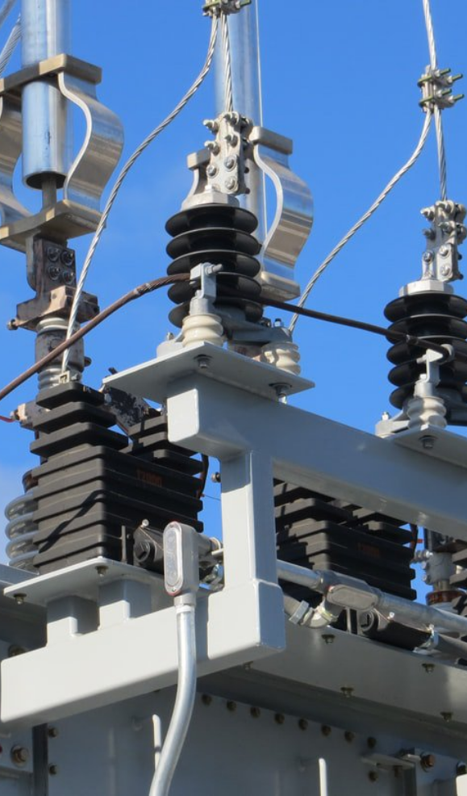
OVERVIEW OF INDIA'S CARBON CREDIT TRADING SCHEME (CCTS)
Central Electricity Regulatory Commission (CERC)
Regulating Power Trading in India's Carbon Credit Trading Scheme (CCTS)
Regulator for ICM Trading
01
Market Oversight and Corrective Actions
Approval of Power Exchange Regulations
03
02

Slide 20
Article 6 of Paris Agreement

Slide 21
Article 6 of the Paris Agreement
Understanding the Key Aspects of International Cooperation on Climate Change in India
01
02
03
What Article 6
Article 6.2
Article 6.4
Article 6 regulates voluntary cooperation among Parties to promote mitigation ambition and sustainable development to facilitate international cooperation on climate change through market and non-market approaches. It aims to help countries achieve their Nationally Determined Contributions (NDCs) efficiently and cost-effectively.

Slide 22
Article 6 of the Paris Agreement
Understanding the Key Aspects of International Cooperation on Climate Change in India
01
02
03
What Article 6
Article 6.2
Article 6.4
Provides an accounting framework for international cooperation. Facilitates linking emissions trading schemes between countries. Allows international transfer of carbon credits (Countries can participate in international carbon markets by trading ITMOs through a decentralized cooperative approach.)

Slide 23
Article 6 of the Paris Agreement
Understanding the Key Aspects of International Cooperation on Climate Change in India
02
03
What Article 6
Article 6.2
Article 6.4
It establishes a central UN mechanism to trade credits from specific emissions reduction projects. Enables countries to finance clean energy projects in other countries. Provides credit for emissions reductions to the financing country.

Slide 24
Article 6.2 and 6.4 Mechanism
Renewable energy with storage (only stored component)-
01
Solar thermal power,
India's Article 6.2 and 6.4 Whitelist Sectors
02
Off- shore wind,
03
Tidal energy,
04
Ocean Thermal Energy,
05
Ocean Salt Gradient Energy,
06
Ocean Wave Energy
07
Ocean Current Energy,
08
High Voltage Direct Current Transmission in conjunction with the renewal energy projects

Slide 25
Article 6.2 and 6.4 Mechanism
India's Article 6.2 and 6.4 Whitelist Sectors
Clean fuels-
01
Green Hydrogen
02
Compressed bio-gas
03
Emerging mobility solutions like fuel cells and Sustainable Aviation Fuel

Slide 26
Article 6.2 and 6.4 Mechanism
India's Article 6.2 and 6.4 Whitelist Sectors
01
Other Innovations-
High end technology for energy efficiency
Best available technologies for process improvement in hard to abate sectors
02
Alternate Materials-
Green Ammonia
03
Removal Activities
Carbon Capture Utilization and Storage

Slide 27
SUPPORT SUSTAINABLE DECARBONIZATION
Conclusion and Key Takeaways
Take action now to support India's commitment to reduce GHG emissions and achieve sustainable decarbonization through the Carbon Credit Trading Scheme.
India’s Carbon Credit Trading Scheme aligns with ambitious climate goals.
India’s Carbon Credit Trading Scheme aligns with ambitious climate goals.
Transition from PAT Scheme to broader compliance mechanisms.
Phased sector inclusion, starting with energy and agriculture.
Key stakeholders: BEE and Grid Controller of India.
Article 6 of Paris Agreement enables international carbon credit transfers.
Rapid growth in global carbon markets; India’s active participation.

Slide 28
References
01
https://www.csis.org/analysis/voluntary-carbon-markets-review-global-initiatives-and-evolving-models
02
https://www.gminsights.com/industry-analysis/compliance-carbon-credit-market
03
https://www.ceew.in/publications/how-can-india-achieve-low-carbon-sustainable-aluminium-production-and-reduce-carbon-footprint
04
https://pib.gov.in/PressReleaseIframePage.aspx?PRID=1900216
05
https://beeindia.gov.in/en/programmes/carbon-market

