Slide 1




Partners

Slide 2

Opening Remarks
Martha Donato
President
MAD Event Management

Slide 3



Thank you to our Host and Venue ​

Slide 4


Thank you to our Partners​

Slide 5










Thank you to our Generous Sponsors

Slide 6
Thank you to our Advisory Board Members​
Mark Bogdansky, Auto Care Association
Glenda Brungardt, The Exhibitor Advocate
Marsha Flanagan, IAEE
Larry Grossenbacher, CSI Worldwide
Kai Hattendorf, UFI
Susanne Hennigers, Messe Munich
Lori Jenks, Access Intelligence
Julie Kagy, ESCA
Claude Molinari, Visit Detroit
Vincent Polito, SISO
Jason Popp, Moss
Laura Purdy, Exhibition Place
Jeff Quade, GES
Janice Rogers, Diversified Communications
John Schreiber, LVCVA
Phil Stone, Plural Strategy
Steve Walker, MGM

Slide 7
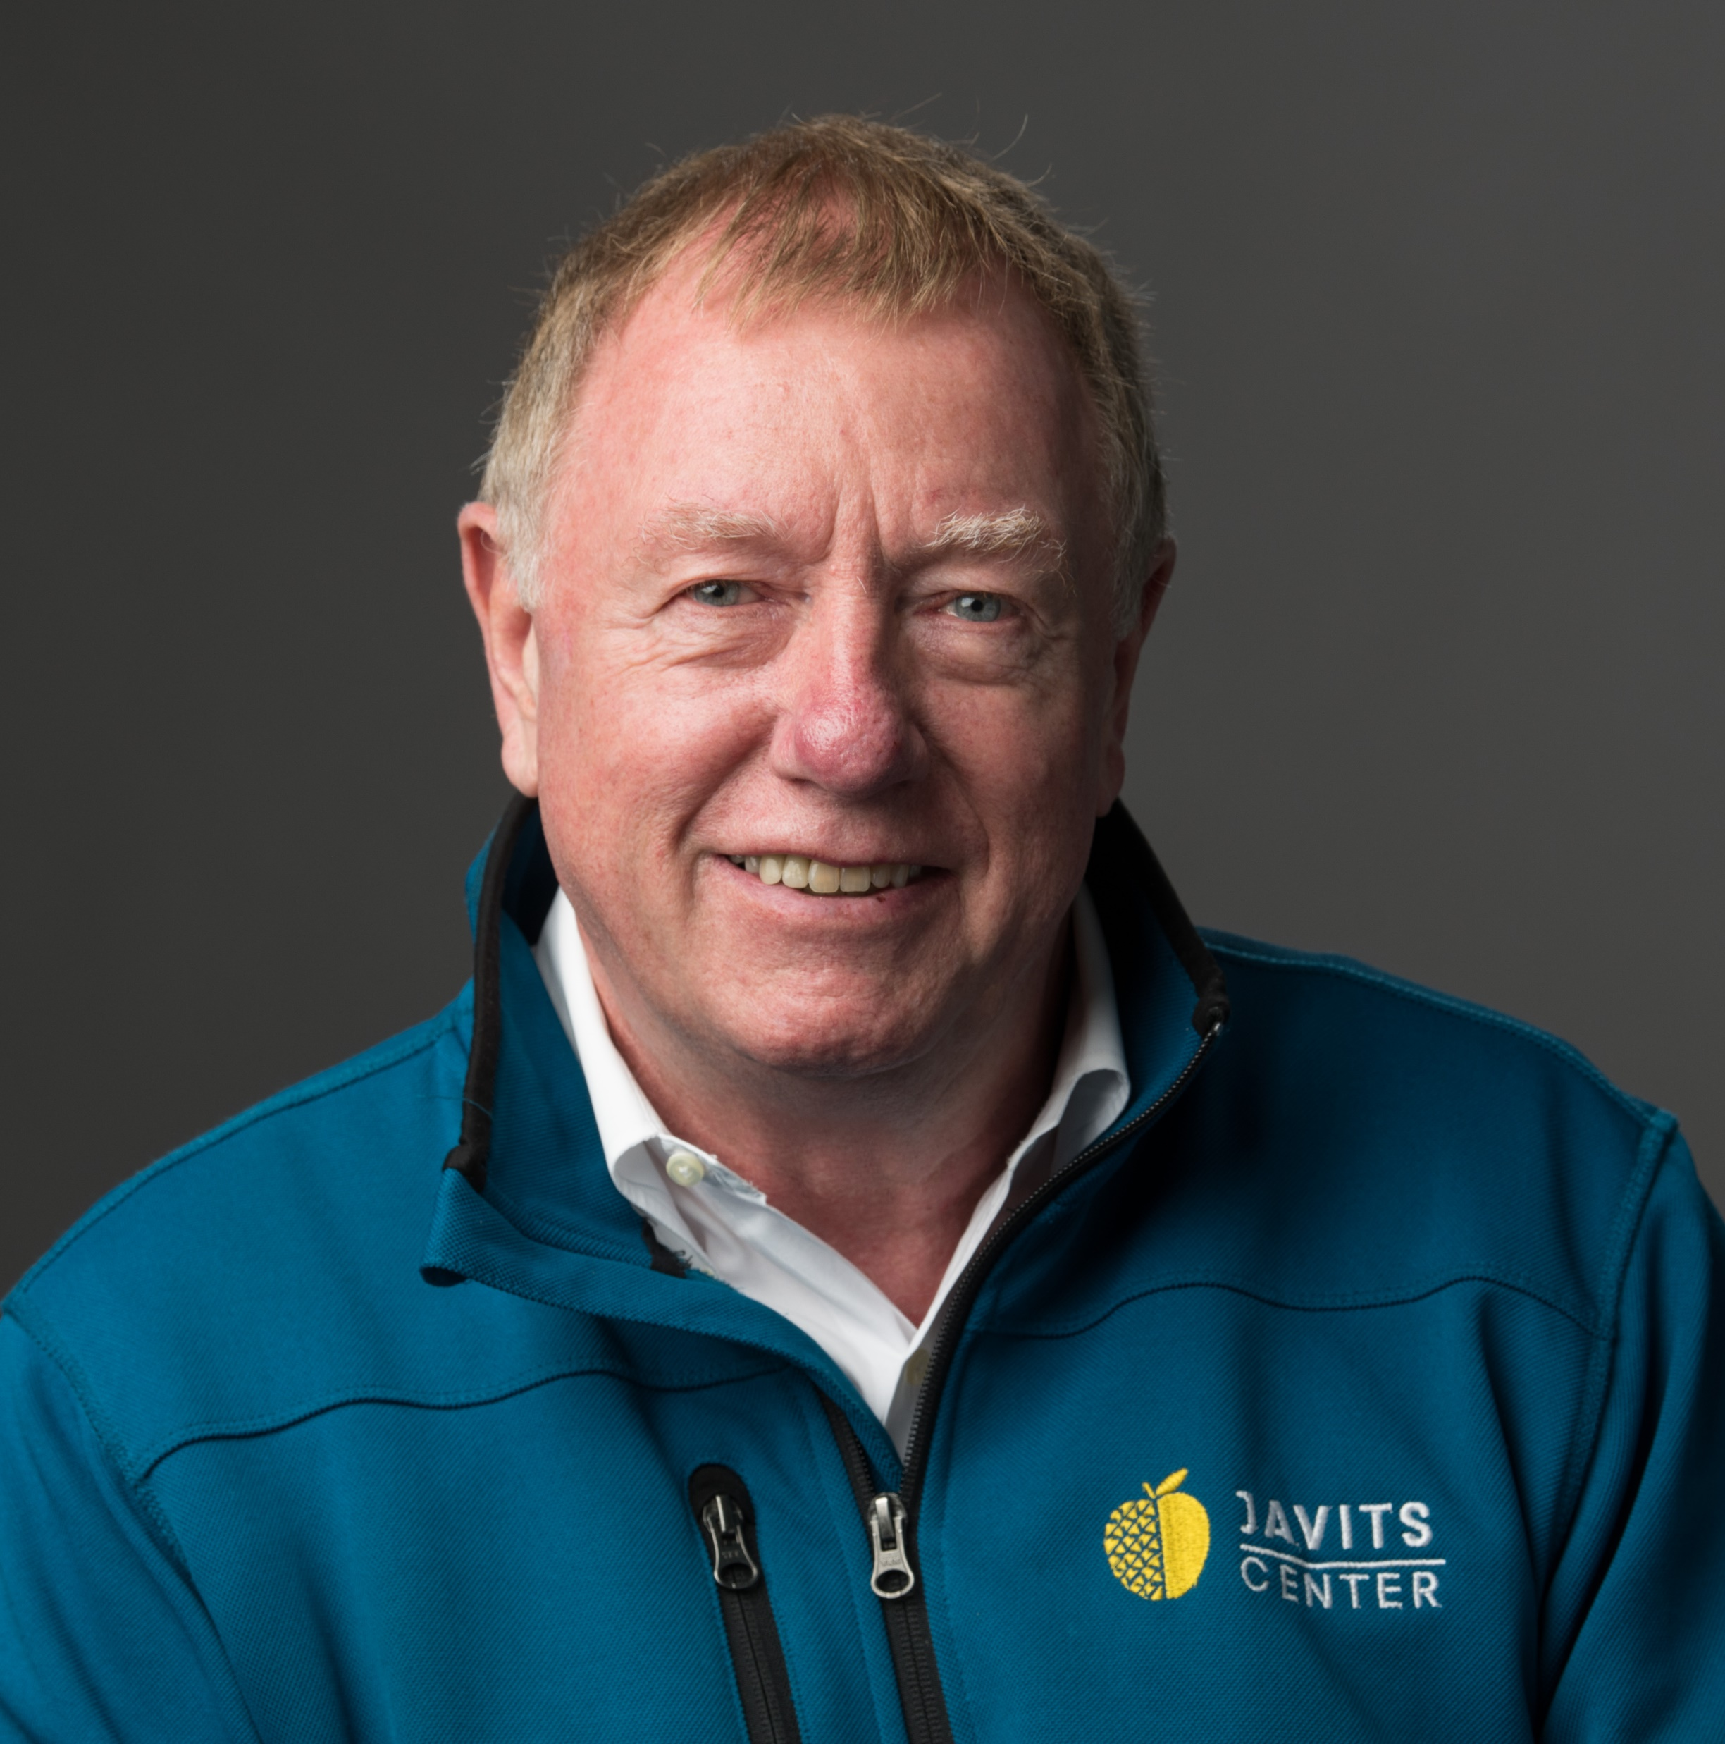

Zero Award 2024
Alan Steele,
CEO
JACOB K. JAVITS CONVENTION CENTER
For his unwavering dedication and leadership in advancing sustainability within the exhibition industry.

Slide 8
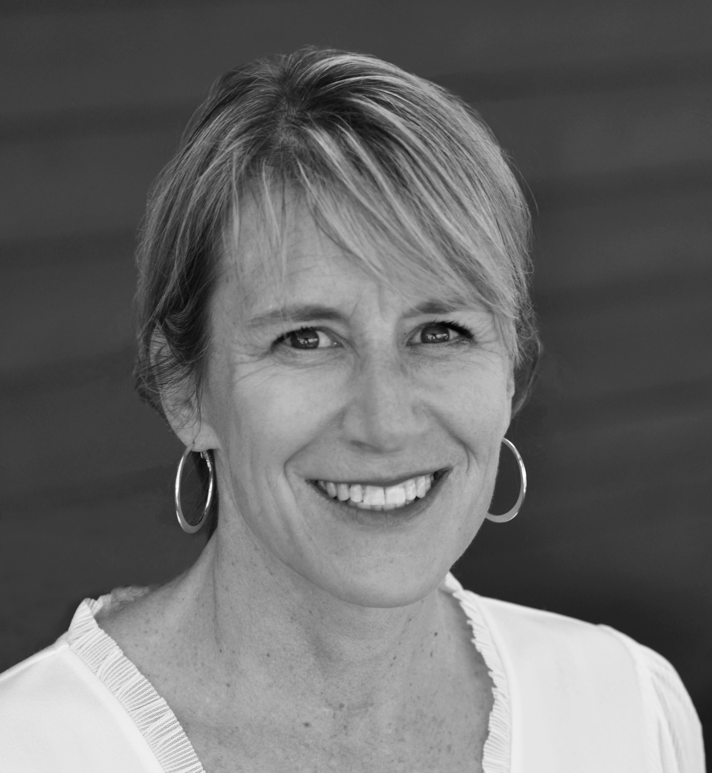
Opening Keynote:
Navigating the Evolving Travel Landscape
1:30 PM - 1:50 PM
Susan Austin
Principle, Consulting
AMERICAN EXPRESS GLOBAL BUSINESS TRAVEL
Susan Austin leads the Green Compass (tm) ecosystem, at AmexGBT, helping clients and partners navigate sustainability initiatives and achieve carbon reduction goals through innovative solutions.

Slide 9

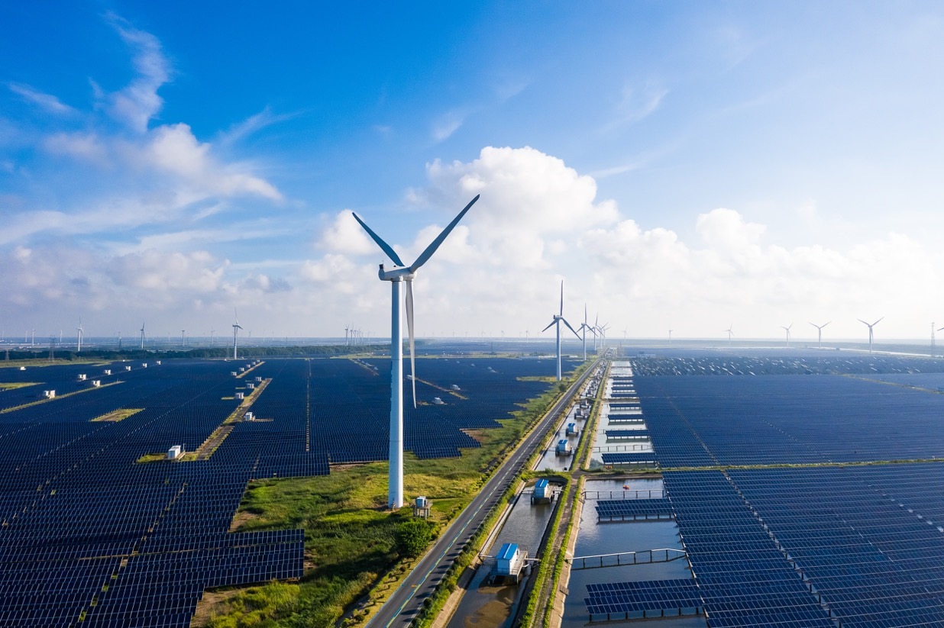
Sustainability and Navigating the Evolving Travel Landscape
Susan Austin, Principal
September 24, 2024

Slide 10
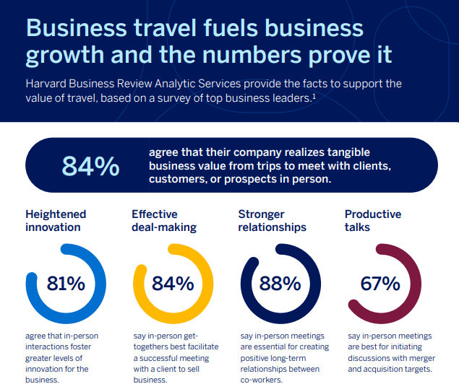
Travel is a force for good

Slide 11
Environmental Strategy
FIVE elements
TRACK & REPORT
INFLUENCE
CHOICE
PROCURE GREEN
COMPENSATE
CARBON
DRIVE TO NET-ZERO
AVIATION

Slide 12
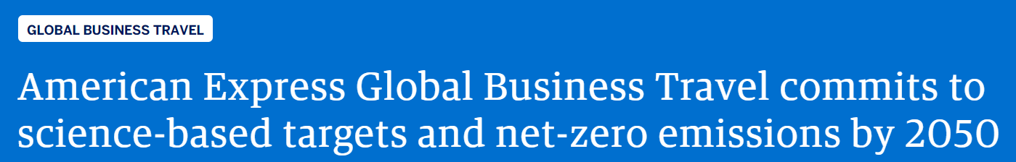
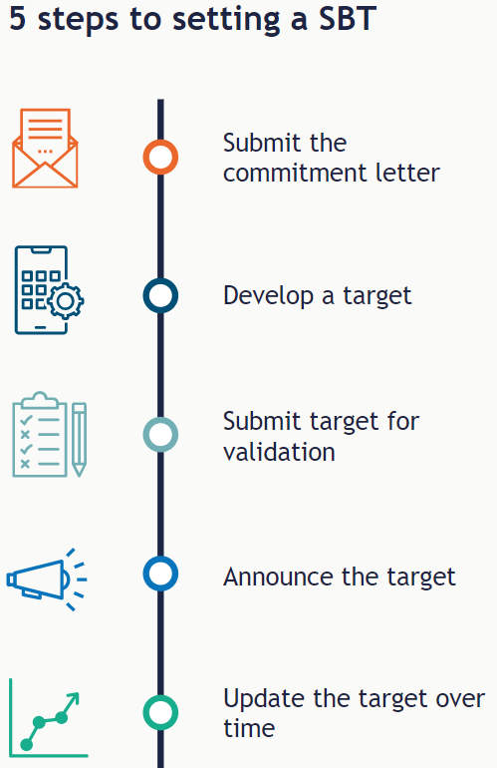

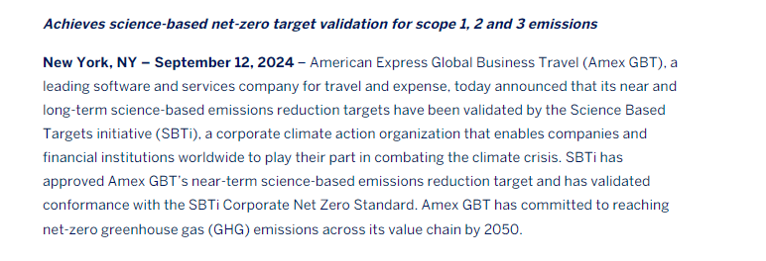
Science-Based and Net-Zero Targets
  YE2021, GBT committed to the science-based targets initiative (SBTi) reaffirming its previously announced net-zero target by 2050
  Throughout 2022, GBT performed an emissions assessment across all scopes with expert consultants
  Sep 12, 2024: GBT validation by SBTi!
GBT is here
Full press release here
Source: https://sciencebasedtargets.org/
Notes:
TALK TRACK
The Science Based Targets initiative (SBTi) drives ambitious climate action in the private sector by enabling companies to set science-based emissions reduction targets. See SBTi “About Us” section: https://sciencebasedtargets.org/about-us
See GBT press release https://www.amexglobalbusinesstravel.com/press-room/american-express-global-business-travel-commits-to-science-based-targets-and-net-zero-emissions-by-2050/
November 16, 2021 – American Express Global Business Travel (GBT) today announced that it is committing to set science-based targets as an interim step on its journey to net-zero emissions globally by 2050.
GBT will follow the Science Based Targets initiative (SBTi) methodology to establish emissions reduction goals for its global operations and supply chain over the next two years. For science-based and net-zero targets, GBT is working to limit global warming to avoid the most catastrophic threats of climate change as set out by the Paris Agreement. GBT joins SBTi together with more than 2,000 companies representing more than 20% of global market capitalization (in excess of USD 20 trillion)¹.
Paul Abbott, GBT’s CEO, said: “GBT is committed to reducing emissions in line with climate science because we recognize that economic and social progress are inextricably bound with environmental sustainability. By committing to set science-based targets, GBT is building on the momentum of COP26 and the International Air Transport Association (IATA) net-zero resolution, which represents nearly 300 airlines including all our preferred partners. We invite the global travel ecosystem to challenge business-as-usual by taking climate leadership and investing in a more sustainable future.”
GBT has been carbon neutral for its own travel since 2019, one of the first global travel management companies to offset 100% of its own travel emissions. To help achieve its science-based and net-zero targets, GBT will incorporate sustainable aviation fuel (SAF) into its strategy for reducing its own corporate travel emissions. GBT is already working to scale SAF throughout the aviation value chain through its collaboration with Shell Aviation, combining the buying power of airlines and GBT’s corporate business travel customers.
Si-Yeon Kim, GBT’s Chief Risk & Compliance Officer and Executive Chair of Environmental, Social, and Governance (ESG) said: “While GBT enables clients and travelers, we are also accelerating our own decarbonization journey. Formally committing to the SBTi is an important milestone, underlining our determination to achieve net-zero emissions by 2050 or earlier.”

Slide 13


Advocacy
Net Zero with Sustainable aviation fuel (SAF)
Our Commitment to a Sustainable Future
Amex GBT signed the World Economic Forum Clean Skies for Tomorrow ambition statement to achieve 10% SAF by 2030.¹
This requires a collaborative approach from all parts
of the aviation ecosystem.
1 https://www.weforum.org/cleanskies/ambition-statement

Slide 14

SAF: What are the benefits?
SAFs can reduce
carbon emissions by
SAFs can reduce
carbon emissions by
80%
80%
on a lifecycle basis in comparison to fossil-based fuels.¹
in comparison to using
fossil-based fuels.
Source: IATA
1 iata.org/en/programs/environment/sustainable-aviation-fuels/
Notes:
https://www.iata.org/en/programs/environment/sustainable-aviation-fuels/

Slide 15
It’s Time!

Slide 16
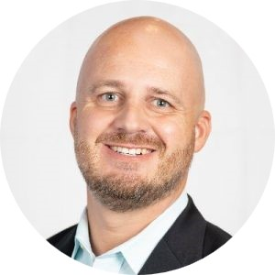
State of Legislation Snapshot Report
1:50 PM - 2:00 PM
Tommy Goodwin
Vice President
ECA
Tommy Goodwin is Vice President for the Exhibitions & Conferences Alliance, a coalition of leading professional, industry, and labor associations that comprise the unified advocacy voice of the business events industry.

Slide 17
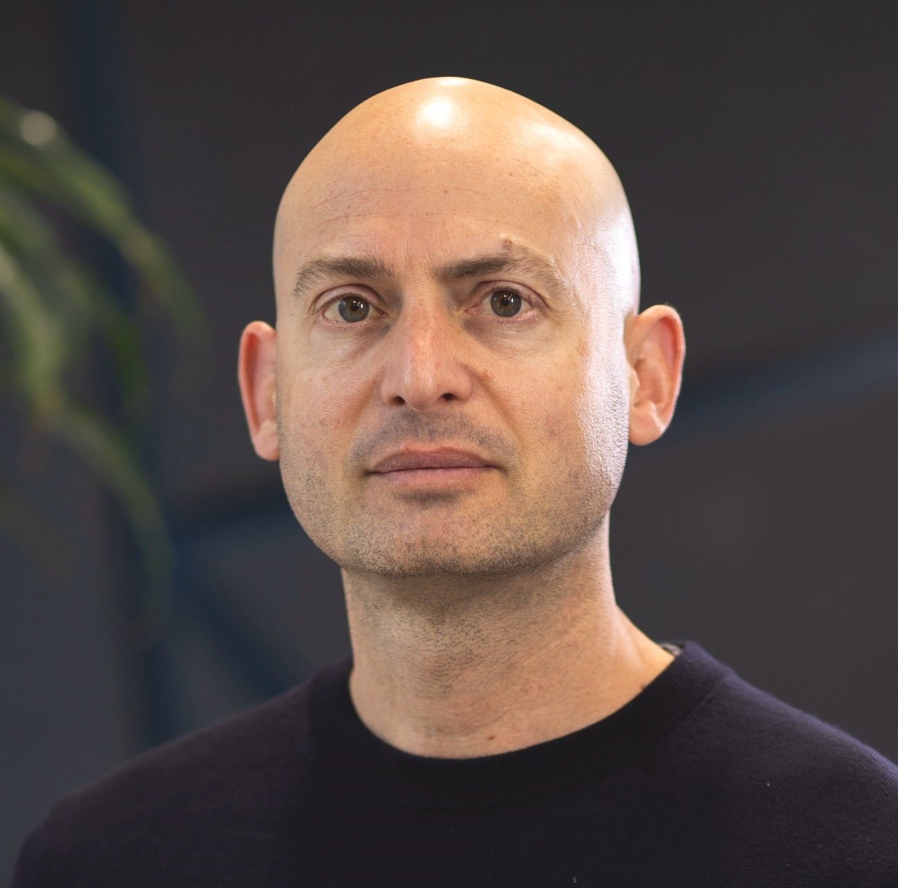
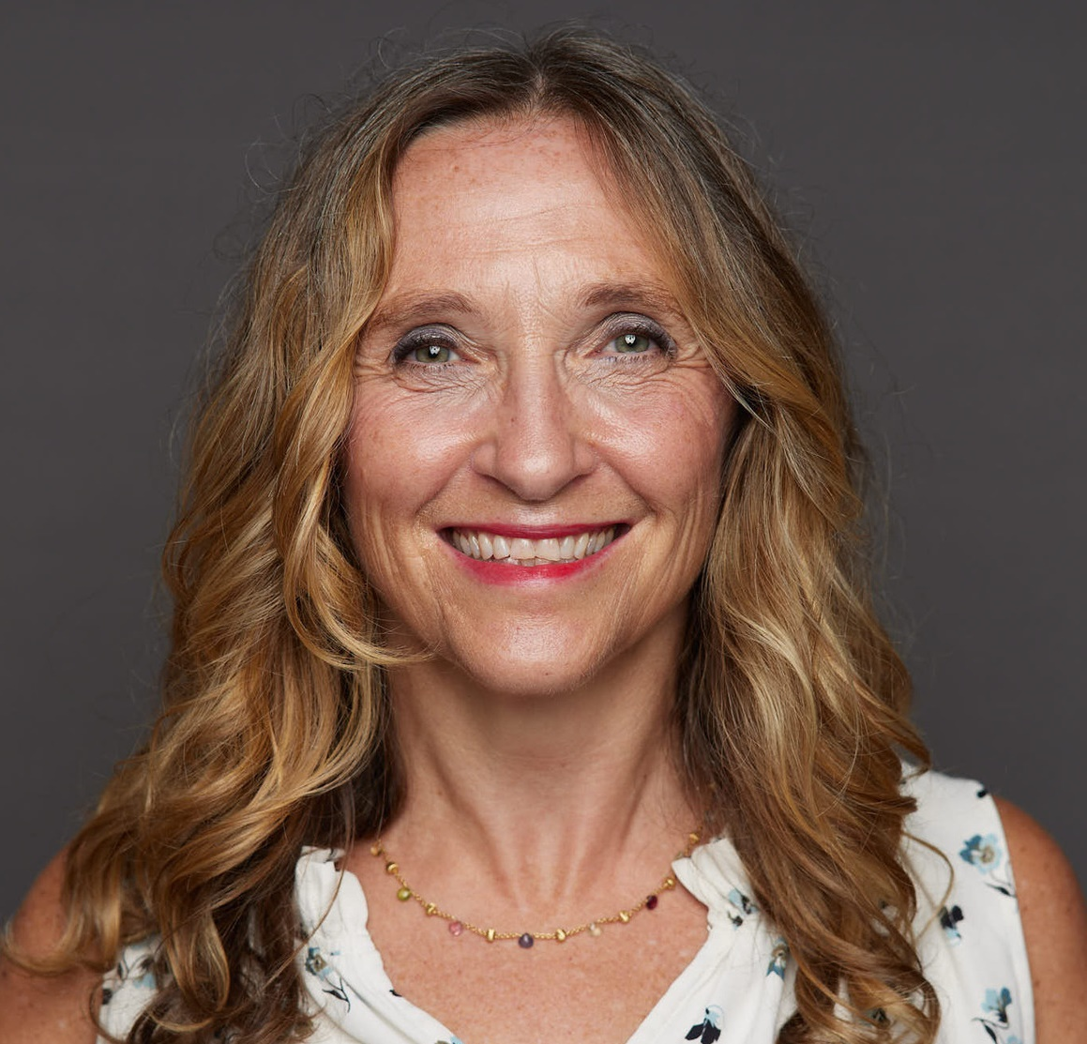
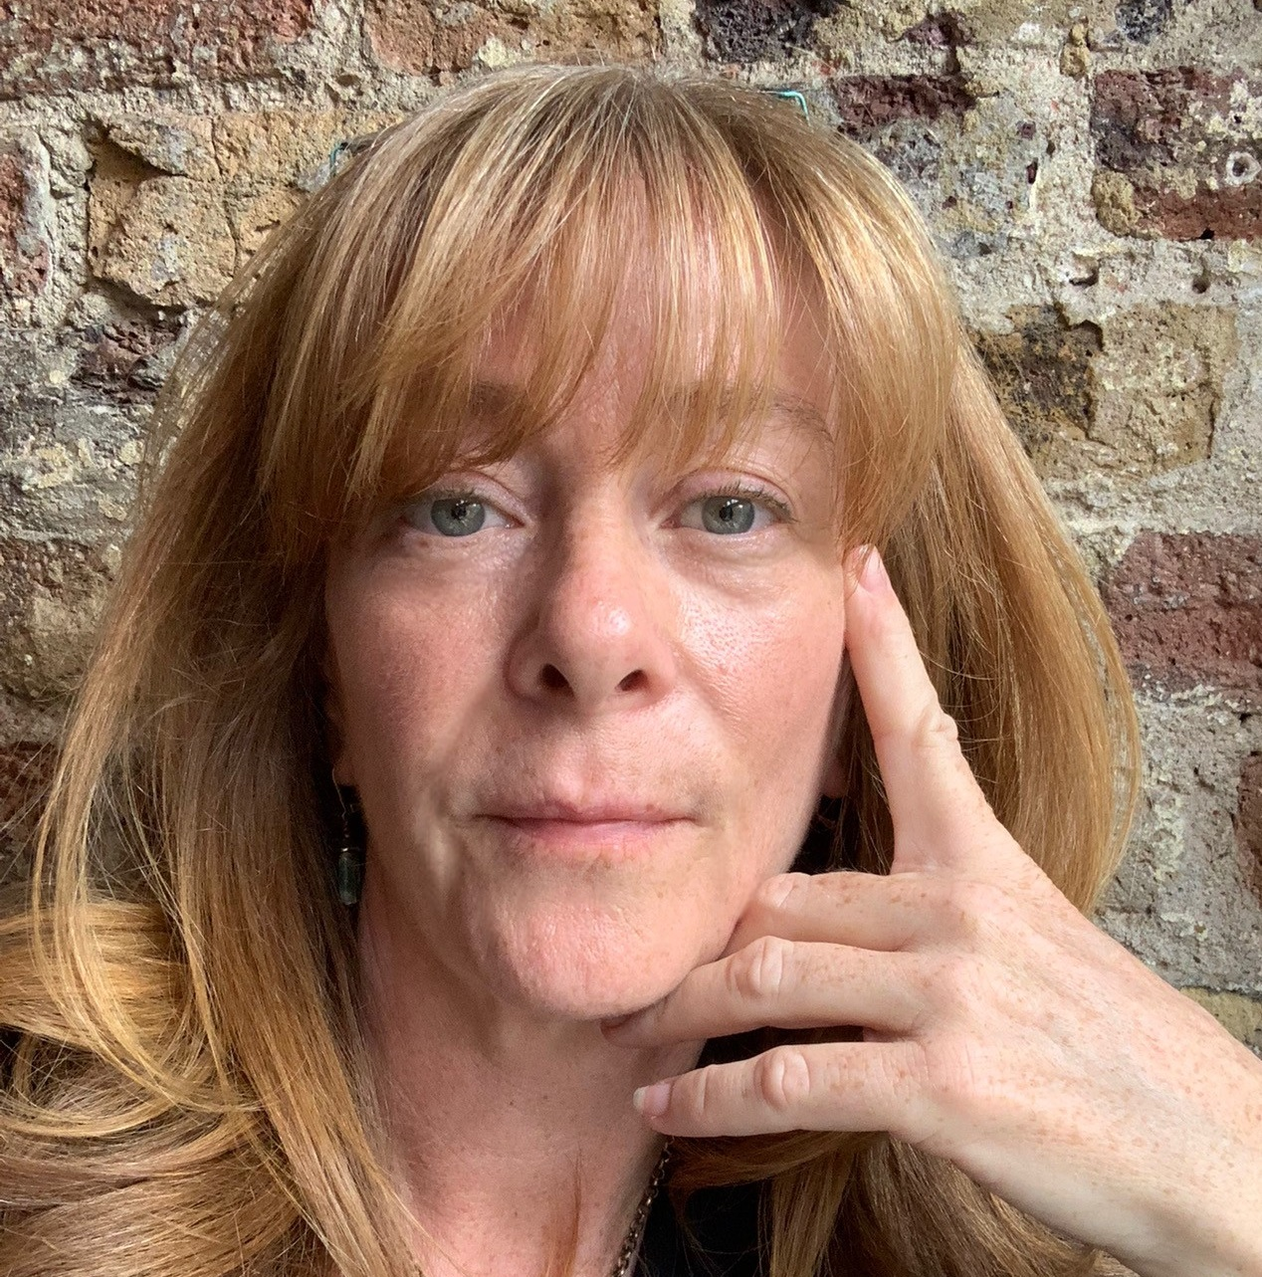
Global & Domestic Viewpoints and Alignment
2:00 PM - 2:30 PM
Moderated by
Phil Stone
Partner
PLURAL STRATEGY
Janice Rogers
Corporate Vice President, HR and ESG
DIVERSIFIED COMMUNICATIONS
Lisa Chamberlain
Business Development and Communications Specialist
WORLD ECONOMIC FORUM

Slide 18
Global & Domestic Viewpoints and Alignment
2:00 PM - 2:30 PM
Phil Stone
Partner
PLURAL STRATEGY
Phil is a co-founder of Plural, a strategy consultancy advising the Events, Media and Information industries on growth, new launches, performance improvement and pricing.
Clients include many of the leading Private Equity investors in the space.

Slide 19
Global & Domestic Viewpoints and Alignment
2:00 PM - 2:30 PM
Janice Rogers
Corporate Vice President, HR and ESG
DIVERSIFIED COMMUNICATIONS
As head of HR and ESG for Diversified Communications, Janice oversees their inclusive culture and their sustainability journey to net zero carbon emissions

Slide 20
Global & Domestic Viewpoints and Alignment
2:00 PM - 2:30 PM
Lisa Chamberlain
Business Development and Communications Specialist
WORLD ECONOMIC FORUM
Lisa is a communications strategist focused on cities. This work is based on 25 years of experience with the World Economic Forum, The New York Times, and the US House of Representatives.

Slide 21
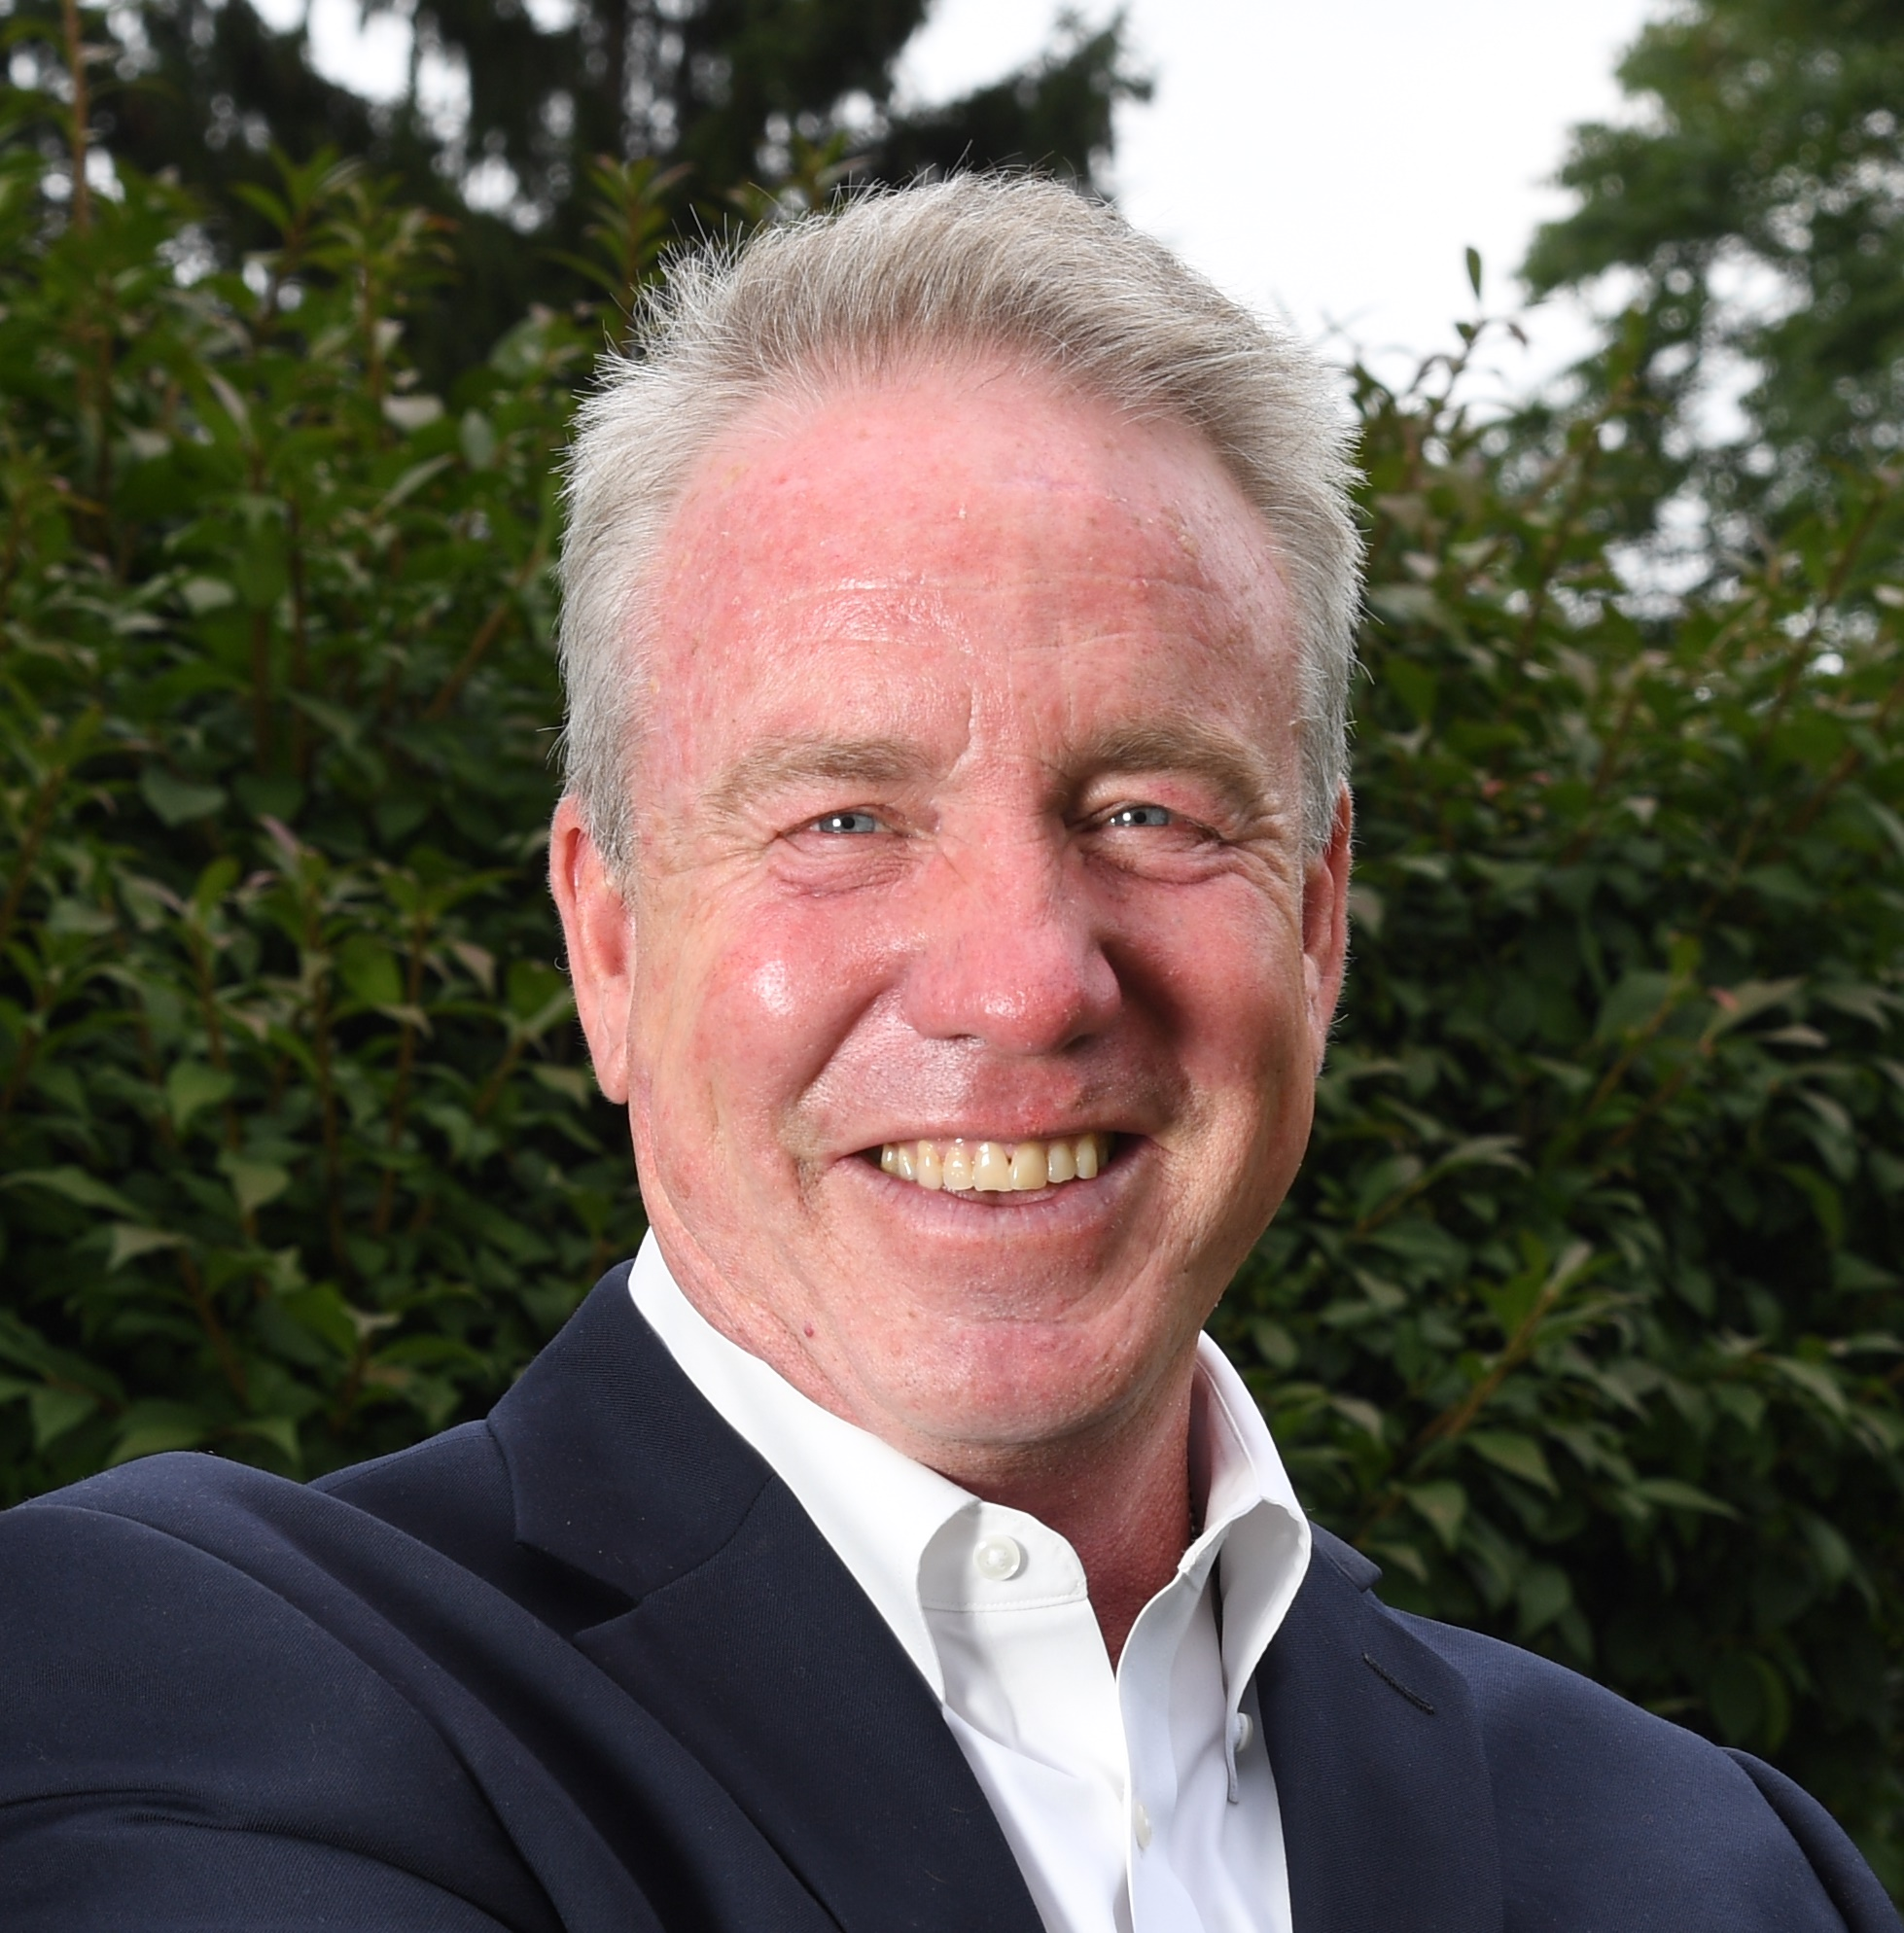
Facilitator
OPEN MIC -
Marty Glynn
CEO
MAD EVENT
MANAGEMENT

Slide 22
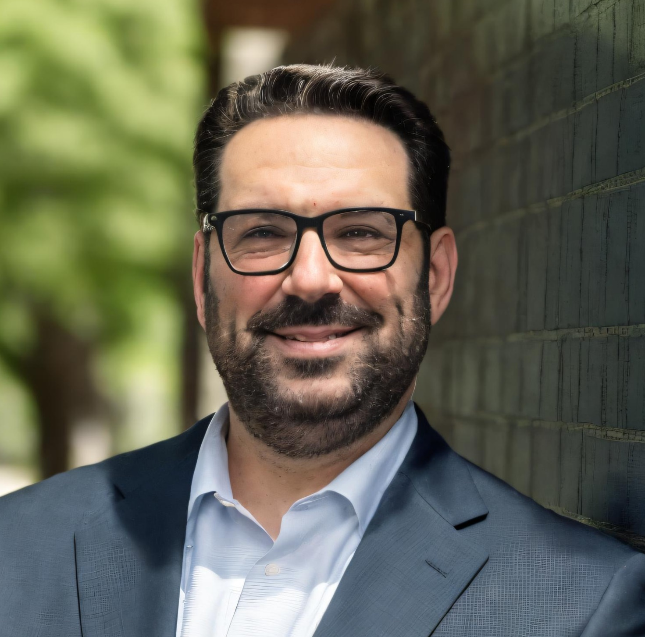

Case Studies in Sustainability:
How Show Organizers Are Leading the Way
2:30 PM - 3:00 PM
Moderated by
Mark Bogdansky
VP of Tradeshows and Community Engagement AUTOCARE ASSOCIATION
Marie Browne
Group Vice
President
RX
Lori Jenks
Senior Vice
President of Operations
ACCESS INTELLIGENCE
Martha Donato
President
MAD EVENT
MANAGEMENT

Slide 23
Case Studies in Sustainability:
How Show Organizers Are Leading the Way
2:30 PM - 3:00 PM
Mark Bogdansky
VP of Tradeshows and Community Engagement
AUTOCARE ASSOCIATION
Mark is an active member of multiple industry boards including IAEE, CEIR, ECA and MATSO.

Slide 24
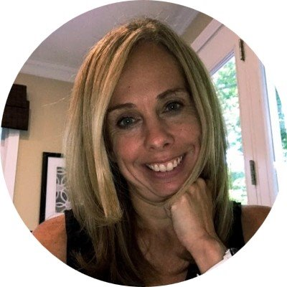
Case Studies in Sustainability:
How Show Organizers Are Leading the Way
2:30 PM - 3:00 PM
Marie Browne
Group Vice President
RX
Marie manages and grows a portfolio of industry leading events as Group Vice President at RX, a global company in the business of building businesses.

Slide 25
Case Studies in Sustainability:
How Show Organizers Are Leading the Way
2:30 PM - 3:00 PM
Lori Jenks
Senior Vice President of Operations
ACCESS INTELLIGENCE
Lori has over 20 years of event operations experience.

Slide 26
Case Studies in Sustainability:
How Show Organizers Are Leading the Way
2:30 PM - 3:00 PM
Martha Donato
President
MAD EVENT MANAGEMENT
Founder of MAD Event Management and UFI North America Director, Martha is a trailblazing event planner and respected thought leader, known for creating innovative and impactful experiences in the global event industry.

Slide 27
Facilitator
OPEN MIC -
Marty Glynn
CEO
MAD EVENT
MANAGEMENT

Slide 28

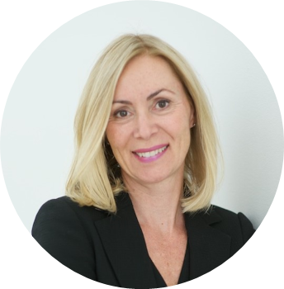
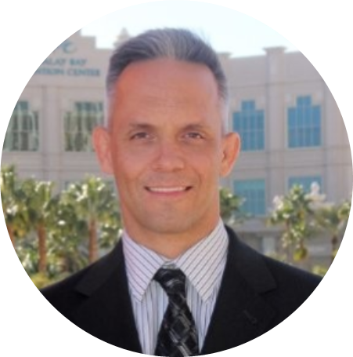
Strength in Collaboration: Uniting Venues,
Suppliers, and Organizers for Sustainable Success
3:00 PM - 3:30 PM
Moderated by
Jason Popp
President and CEO
MOSS INC.
Laura Purdy
General Manager
EXHIBITION PLACE
Steve Walker
Executive Director, Citywide Events
MGM
Martha Donato
President
MAD Event
Management

Slide 29
Strength in Collaboration: Uniting Venues,
Suppliers, and Organizers for Sustainable Success
3:00 PM - 3:30 PM
Jason Popp
President and CEO
MOSS INC.
Jason is the President and CEO of Moss Inc., a specialist production partner for the exhibit and event industry that focuses on sustainable materials and practices.

Slide 30
Strength in Collaboration: Uniting Venues,
Suppliers, and Organizers for Sustainable Success
3:00 PM - 3:30 PM
Laura Purdy
General Manager
EXHIBITION PLACE
Laura leads venue event operations, the development of international and domestic sales & marketing initiatives, site-wide transportation & security, and the delivery of venue services to support the convention center clients and permanent tenants at Exhibition Place.

Slide 31
Strength in Collaboration: Uniting Venues,
Suppliers, and Organizers for Sustainable Success
3:00 PM - 3:30 PM
Steve Walker
Executive Director, Citywide Events
MGM
Steve is the Executive Director of City-Wide Sales for MGM Resorts International, overseeing housing for major trade shows in Las Vegas. He holds a Hospitality Management degree from Drexel University.

Slide 32
Strength in Collaboration: Uniting Venues,
Suppliers, and Organizers for Sustainable Success
2:30 PM - 3:00 PM
Martha Donato
President
MAD EVENT MANAGEMENT
Founder of MAD Event Management and UFI North America Director, Martha is a trailblazing event planner and respected thought leader, known for creating innovative and impactful experiences in the global event industry.

Slide 33
Facilitator
OPEN MIC -
Marty Glynn
CEO
MAD EVENT
MANAGEMENT

Slide 34
Break
3:30 PM - 3:345PM

Slide 35
Industry Sector Breakout Discussions
3:45 PM - 4:15 PM Discussions | 4:15 - 4:45 pm Presentations
Roundtable 1
General Contractors
Sponsored by CSI Worldwide
Led by: Julie Kagy
Roundtable 4
Venues
Sponsored by Visit Atlantic City ​
Led by: Rebecca Bolton
Roundtable 2
Education ​
Sponsored by IAEE​
Led by: Hannah Deters ​
Roundtable 5
Industry Suppliers
Sponsored by AFR
Led by: Patrick Putzer​
Roundtable 3
Show Organizers ​
Sponsored by SISO​
Led by: Tommy Goodwin & Rachel Wimberly

Slide 36

Closing Statements & Recap
4:45 PM - 5:00 PM
Moderated by
Phil Stone
Partner
PLURAL STRATEGY
Gary Musich
Vice President Sales
VISIT ATLANTIC CITY
Martha Donato
President
MAD EVENT
MANAGEMENT

Slide 37
Group Photo
RIGHT AWAY, HERE AT THE STAGE!
Opening Night Social
5:15 PM - 7:00 PM
Toast to progress with fellow climate action leaders at
The Nest Climate Campus's opening night networking mixer!

Slide 38
The time to act is now
Partners​
Sponsors

