Slide 1

Friendship
Carmel Youth Fellowship- Character Study

Slide 2
Introductory Questions
What does it mean to be a friend? What characteristics define friendship?
How is friendship different than the other types of relationships that we have, say to our spouses/significant others, to our parents?
Think about the friendships you had 10 years ago, would you say how we make friends is a different process?
Would you lie for your friend?

Slide 3
Recap of Saul
Saul was the first King of Israel
He was chosen by God and anointed by Samuel (if you would like to recap his whole story please read1st Samuel Ch 9-10)
Saul was crowned the first king over Israel and under his rule Israel become a local power in the region. It was the beginning of the “golden years” for Israel.

Slide 4
Jonathan
Meaning of name: Jehovah’s Gift
He lived in Israel at about 1000 B.C.
We do not have much information of his youth, but we can assume that as a prince he was well taken care of, as he was the prince
He showed great leadership skills
He was rightfully next in line for the throne

Slide 5
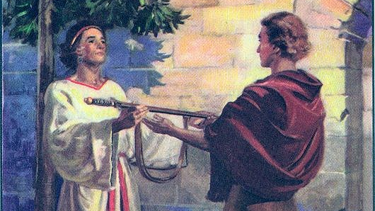
How David met Jonathan
After Saul’s disobedience, God had David installed to be the new king
Around this time David had defeated Goliath.
He rose to ranks in the military and was invited to the palace
It was there Jonathan and David met and started to form a close knit friendship
Their friendship, like all friendships were tested…

Slide 6

Great Friendship requires great commitment
David and Jonathan had an immediate bond
They pledged their friendship with each other
1st Samuel Ch 18:3
Jonathan was extremely loyal

Slide 7
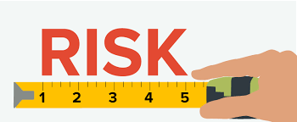
Great Friendships require great risk
Jonathan’s Birthright
His fathers mission
Commitment → Risk → Secrecy
Relationship with his father

Slide 8
Great Friendships require great faith
In everything David and Jonathan had included their deep faith in God.
Renewal of friendship
Jonathan’s courage

Slide 9

Great Friendships require Great love
Agape — Selfless Love.
Unselfish love (1 Sam 18:1-4)- Jonathan truly kept the command to “love thy neighbor” as yourself
Jonathan’s death
David’s pain
Agape → Philia

Slide 10
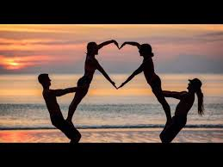
What can we learn
Friendship does not have to require a contract, but it does require commitment
Risk = Sacrifice
Friendship requires faith, it requires that you encourage your friend and you help them grow
Jonathan loved David as himself

Slide 11
