Slide 1
Carmel Mar Thoma Church
Preparation for the Lay Leaders

Slide 2
Preparation for Service
The person who does the Incense (D1) should be inside madbaha 40 mins before the service(by 9:20 am) to arrange the madbaha.
The person who reads the epistle (D2) should be inside madbaha by 9:45 am.
Both the lay leaders will be present with Achen for the tooyaba service and when he prays with Choir @ 9:55 am

Slide 3
Preparation
Get all the materials for worship and put these in their respective places.
  White cloth
  Virikkoottu
  Kappa
  Thaksa
  Wafer and Vine
  Incense Bowl
  Water, bowl and towels
  Offertory Baskets
  Light the charcoal and keep it ready before service.

Slide 4
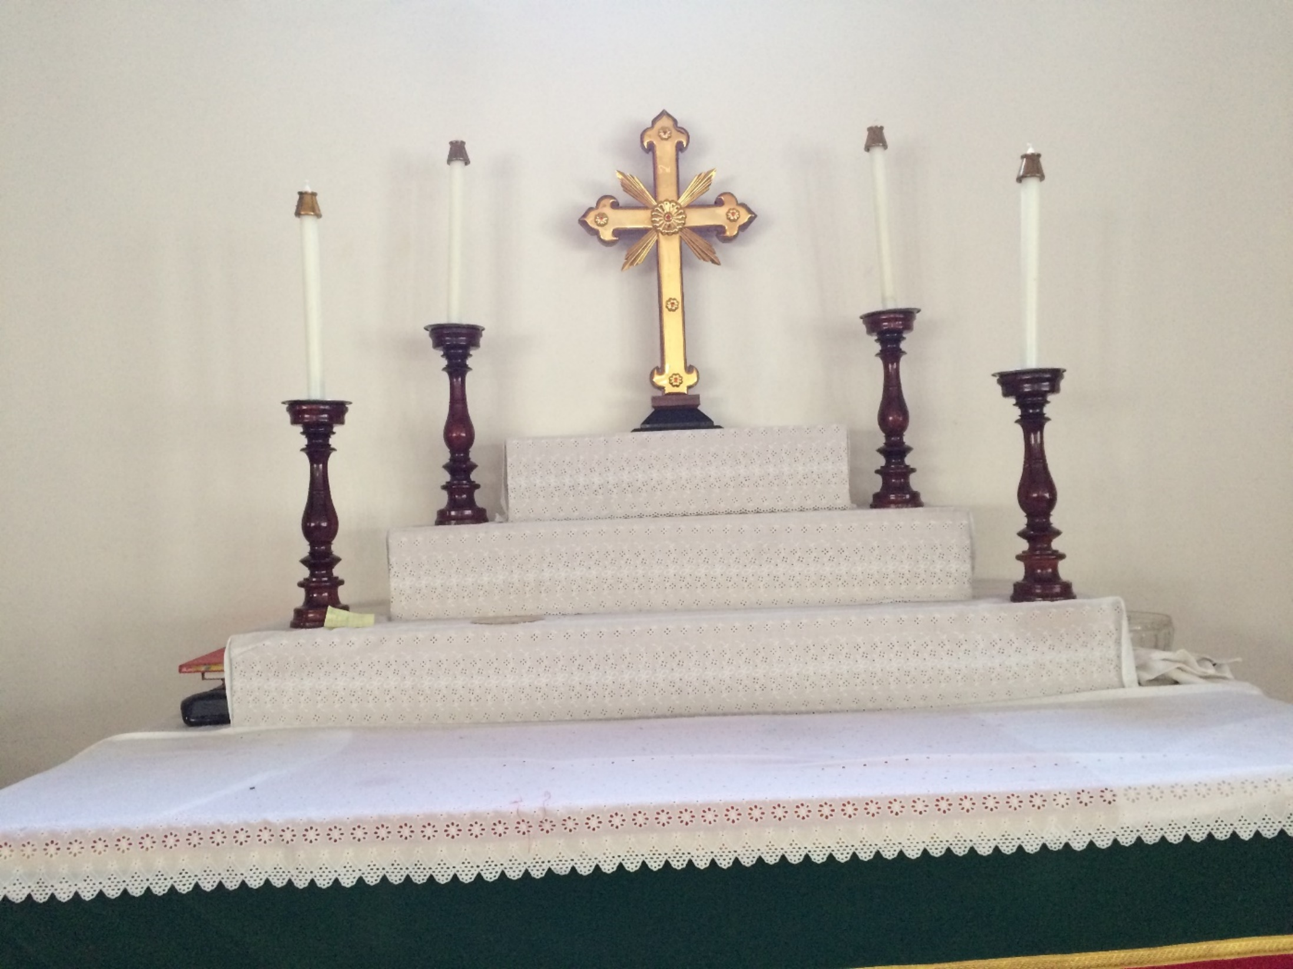

Slide 5
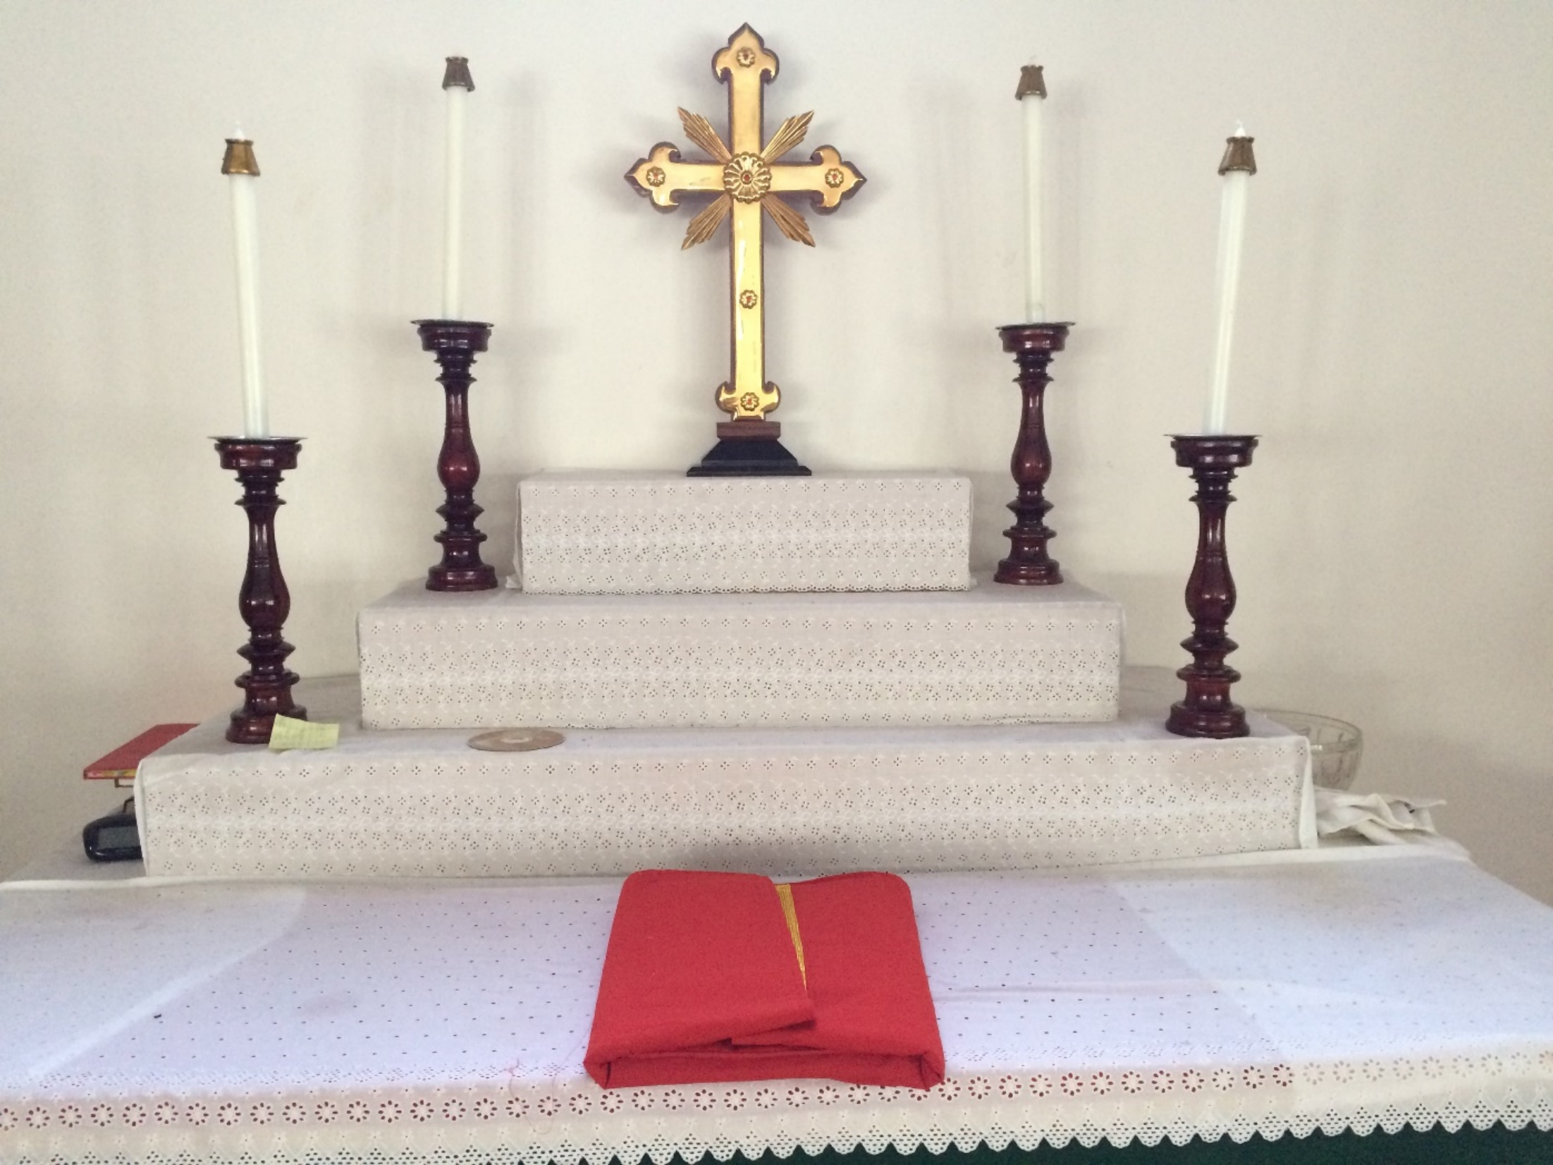

Slide 6
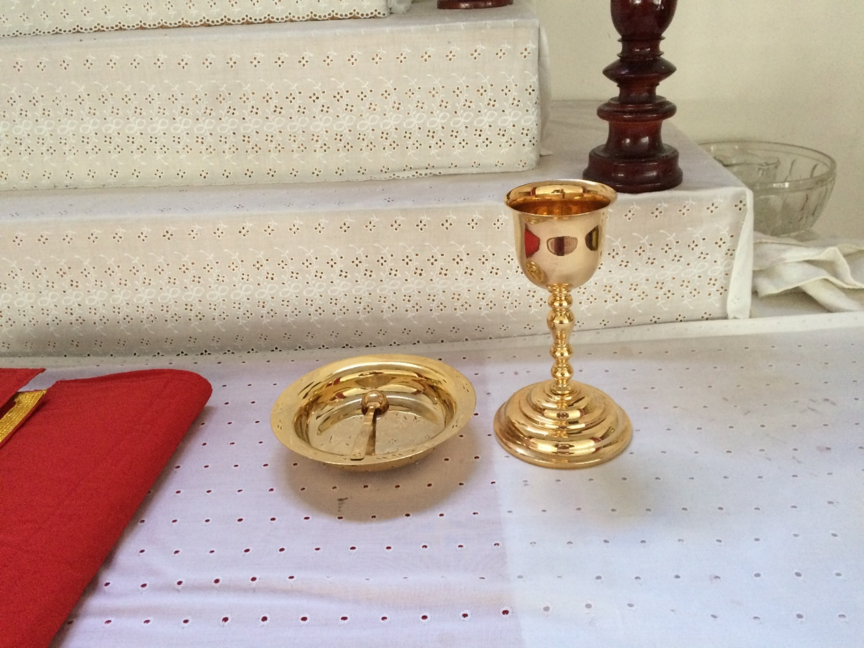

Slide 7
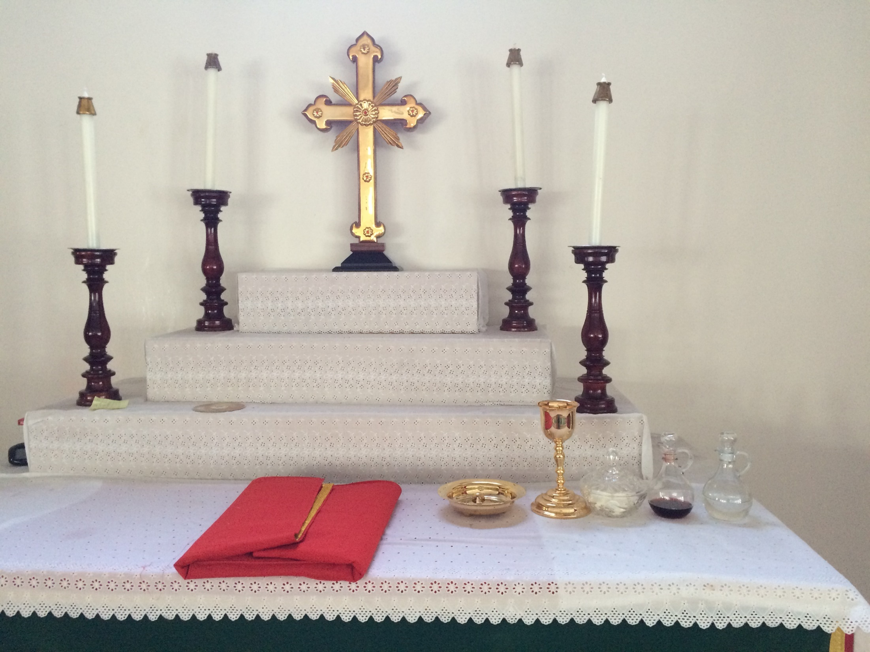
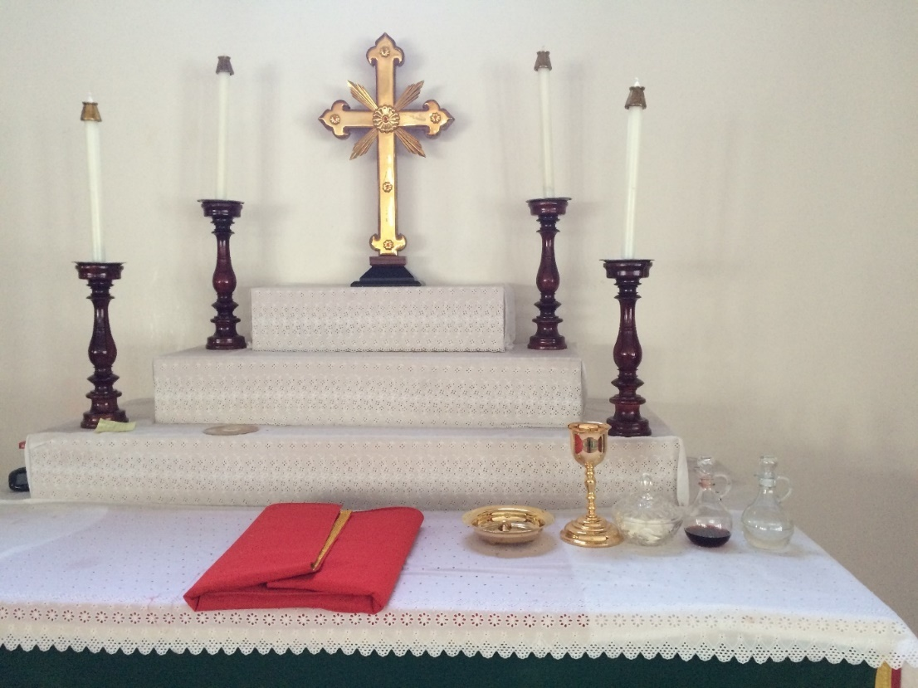

Slide 8
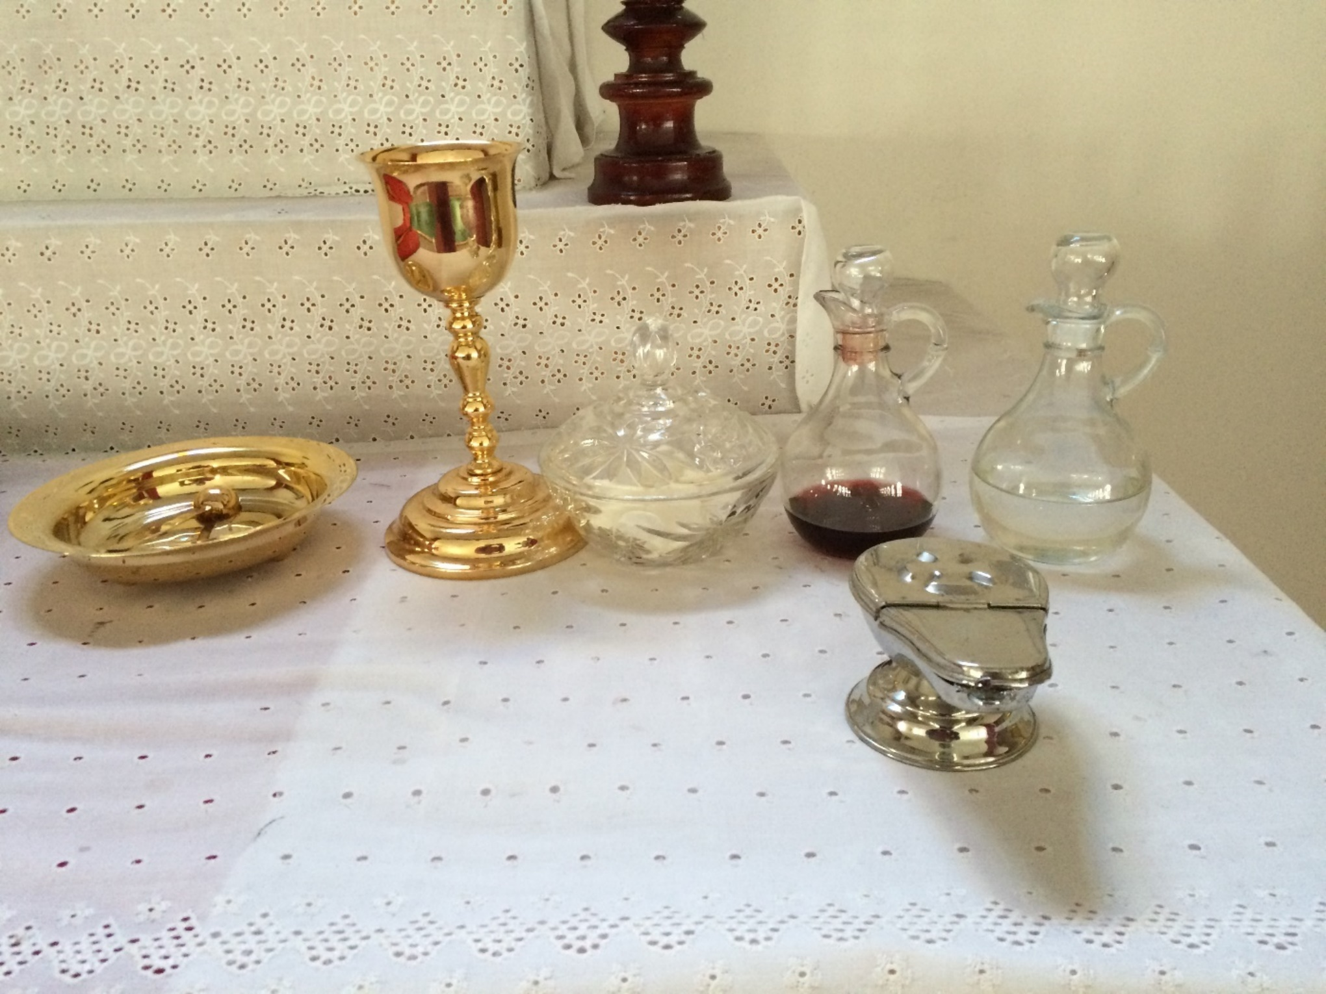

Slide 9
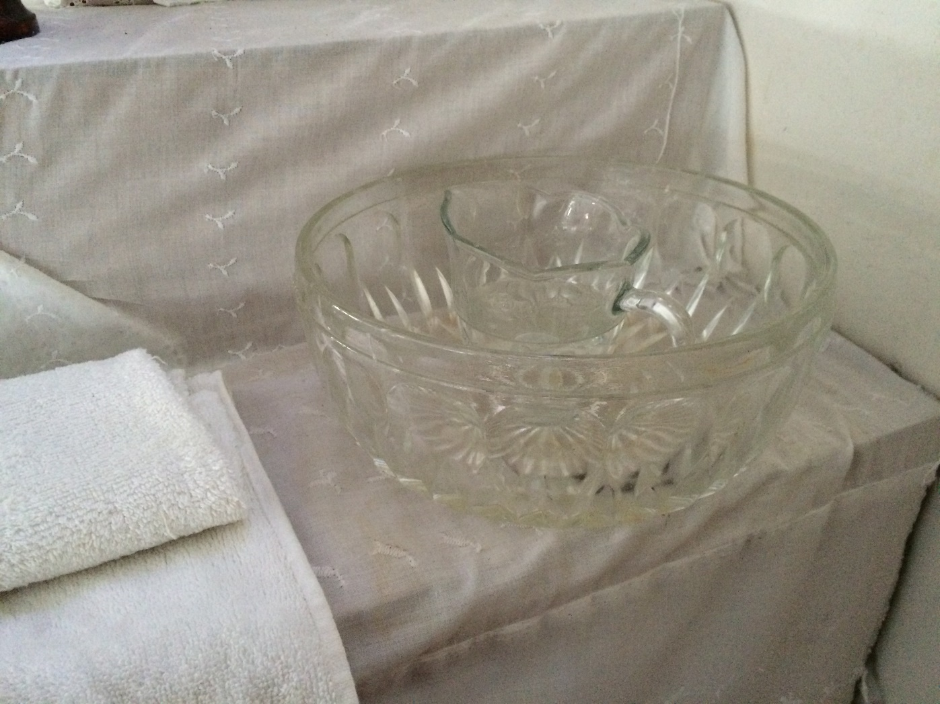

Slide 10
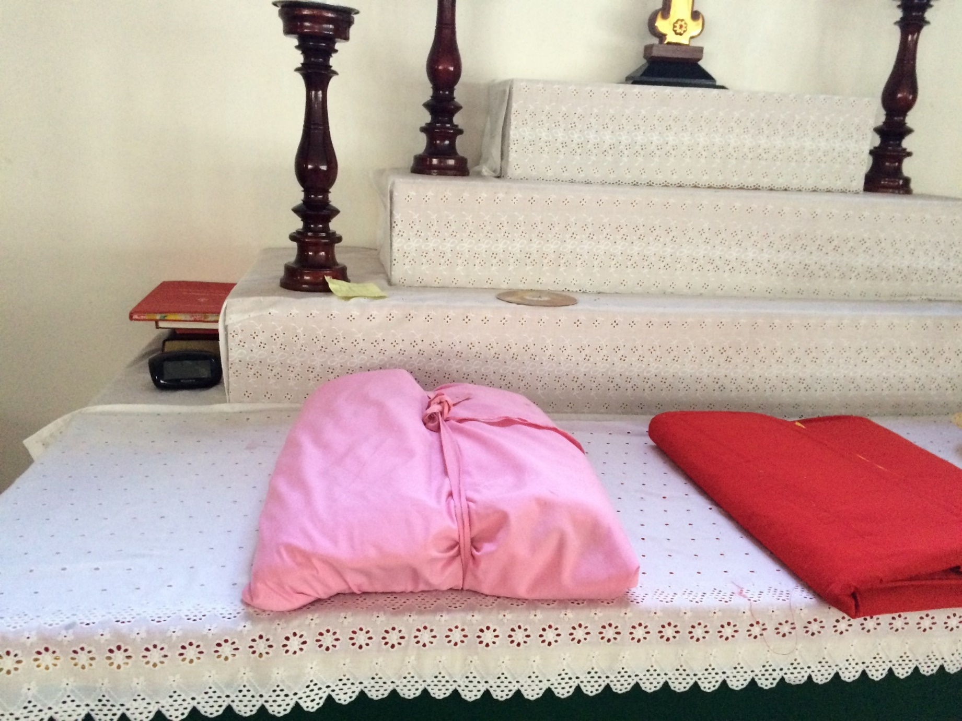

Slide 11
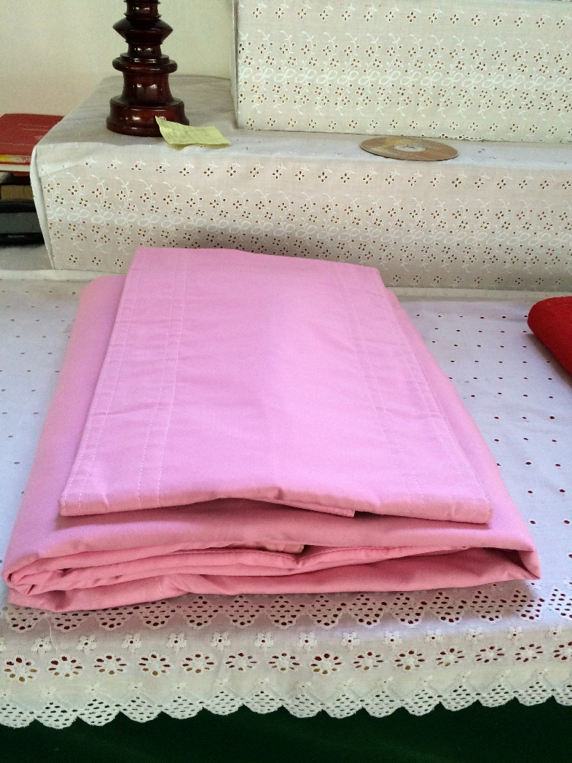

Slide 12
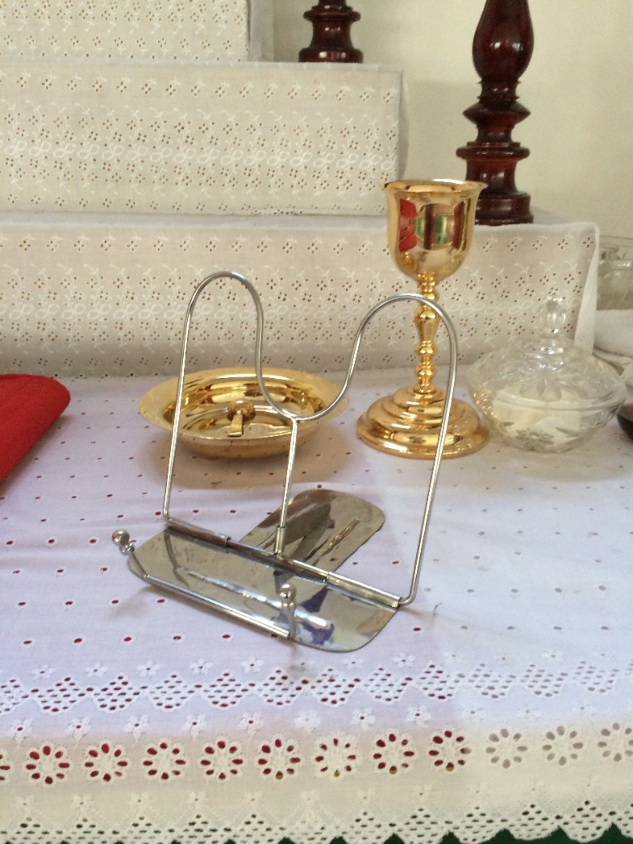
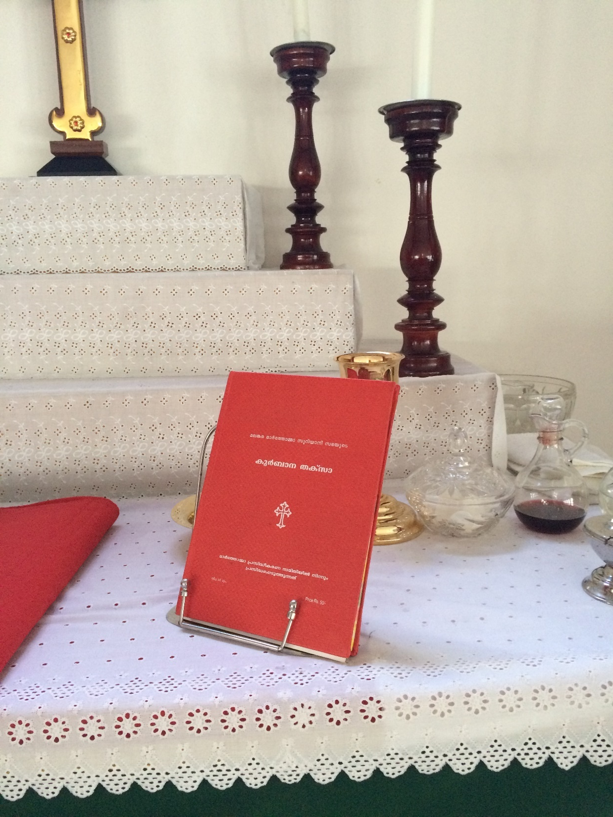

Slide 13
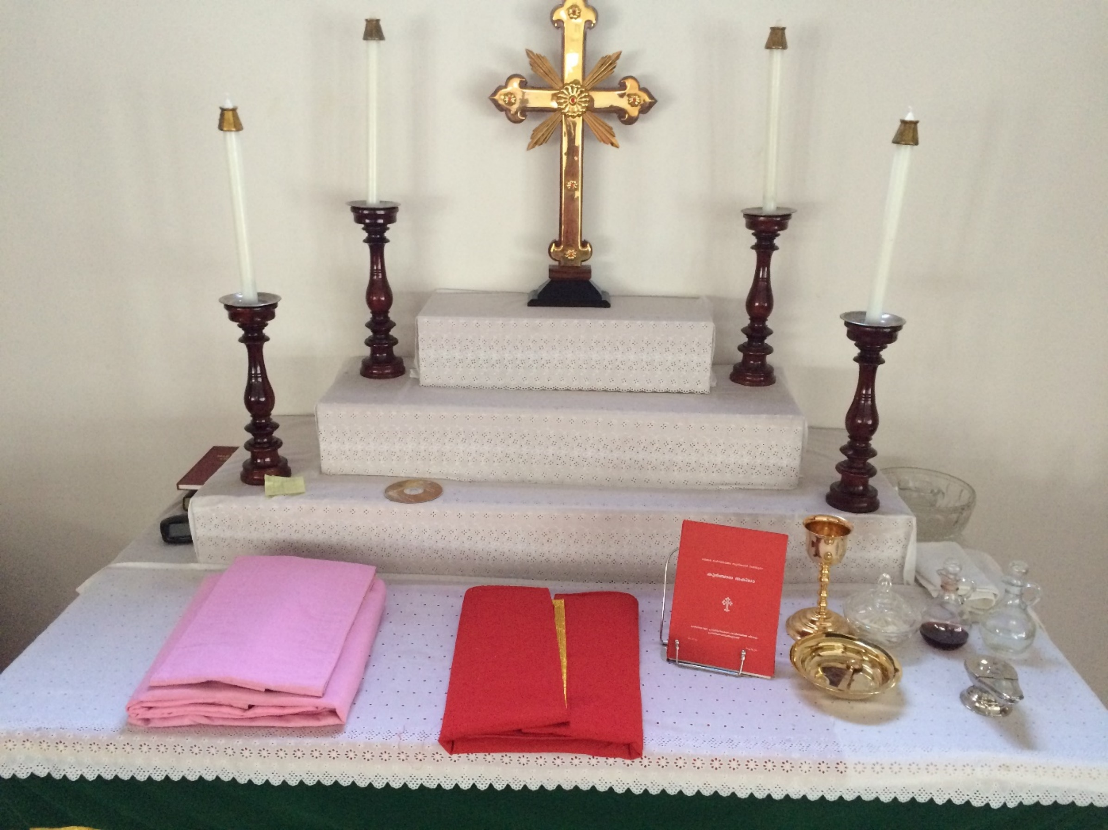
  White cloth
  Virikkoottu
  Kappa
  Stand, Thaksa
  Kassa Pilasa
  Wafer, Vine, Water
  Incense Bowl
  Water, bowl and towels
  Offertory Baskets
  Light the censer

Slide 14
Check
The gospel portion is book marked
Have updated names of the Bishops
Offertory Bags are ready
Mic is working, Lights are on
Song numbers are given to achen
Those who are assigned for Bible reading are ready

Slide 15
Preparatory (Tooyaba) Service
The service starts 15 mins before the HQ (9.45am)
Those who assists, the alter boys and covenant girls participate in it

Slide 16
The Preparatory Prayer
The achen, deacons, those who read the Bible joins the Choir for prayer.

Slide 17
Call to Worship
Achen makes the call and announces the song
Lessons

Slide 18
Meanwhile in the Madbaha
Celebrant puts incense in the censer
Censer is handed over to the achen
Candles are lit just before the chant “In your light”
  Deacon 2 will pull the curtain when the chant reaches the
  “Grant us purity of thought and mind…..”

Slide 19
In your light we see the light, Jesus, full of light
It’s your light that shines upon our world, light our minds
May your light reveal the sin in our hearts
As we humbly pray, in spirit and truth
Page 53

Slide 20
Pure and holy One who dwells on high, in mansions of light
Cleanse our hearts and souls, we lift them up, unto You
Grant us purity of thought and mind,
That our prayers may rise, up to You

Slide 21
P: O Lord Jesus Christ, born of Mary, baptized by John, have mercy on us.
Note: As Achen turns to face the congregation deacons face the achen (not the congregation)

Slide 22
C: We magnify You,
O Lord our king, only begotten Son,
Word of the Father,
Lord Jesus Christ,
Immortal in Your nature, who was born of the Virgin Mary, for the life and salvation of mankind.

Slide 23
Without change of nature
You became the Son of Man and were crucified for us, thus trampling death under foot, and destroying it for ever.

Slide 24
You are One in the Holy Trinity, and are worshipped and glorified equally with Your Father and Your Living and Holy Spirit.
Have mercy upon us.
Note: Achen hands the incense to Decon 1

Slide 25
Trisagion
Holy art thou, O God
Holy art thou, Almighty Lord.
Holy art thou, Immortal Lord.
O thou that was crucified for us, have mercy upon us. (3x)
Page 54

Slide 26

P: Lord have mercy (2)
C:Lord have mercy (2)
All: Lord have mercy

Slide 27
P: Lord God, fill us with essence of
Your holy Gospel, the teachings of the Apostles, the riches of Your divine wisdom, and the gift of Your
Holy Spirit.

Slide 28
Enable us to obey Your commands gladly and to fulfill
Your holy will perfectly.
C: Amen

Slide 29
Note: D 2 turn to face the congregation and reads the Epistle
D1 Remain facing East
D: From the epistle…
C: Praise to you,
O Lord of the apostles,
O Lord, grant us grace to discern your word.

Slide 30
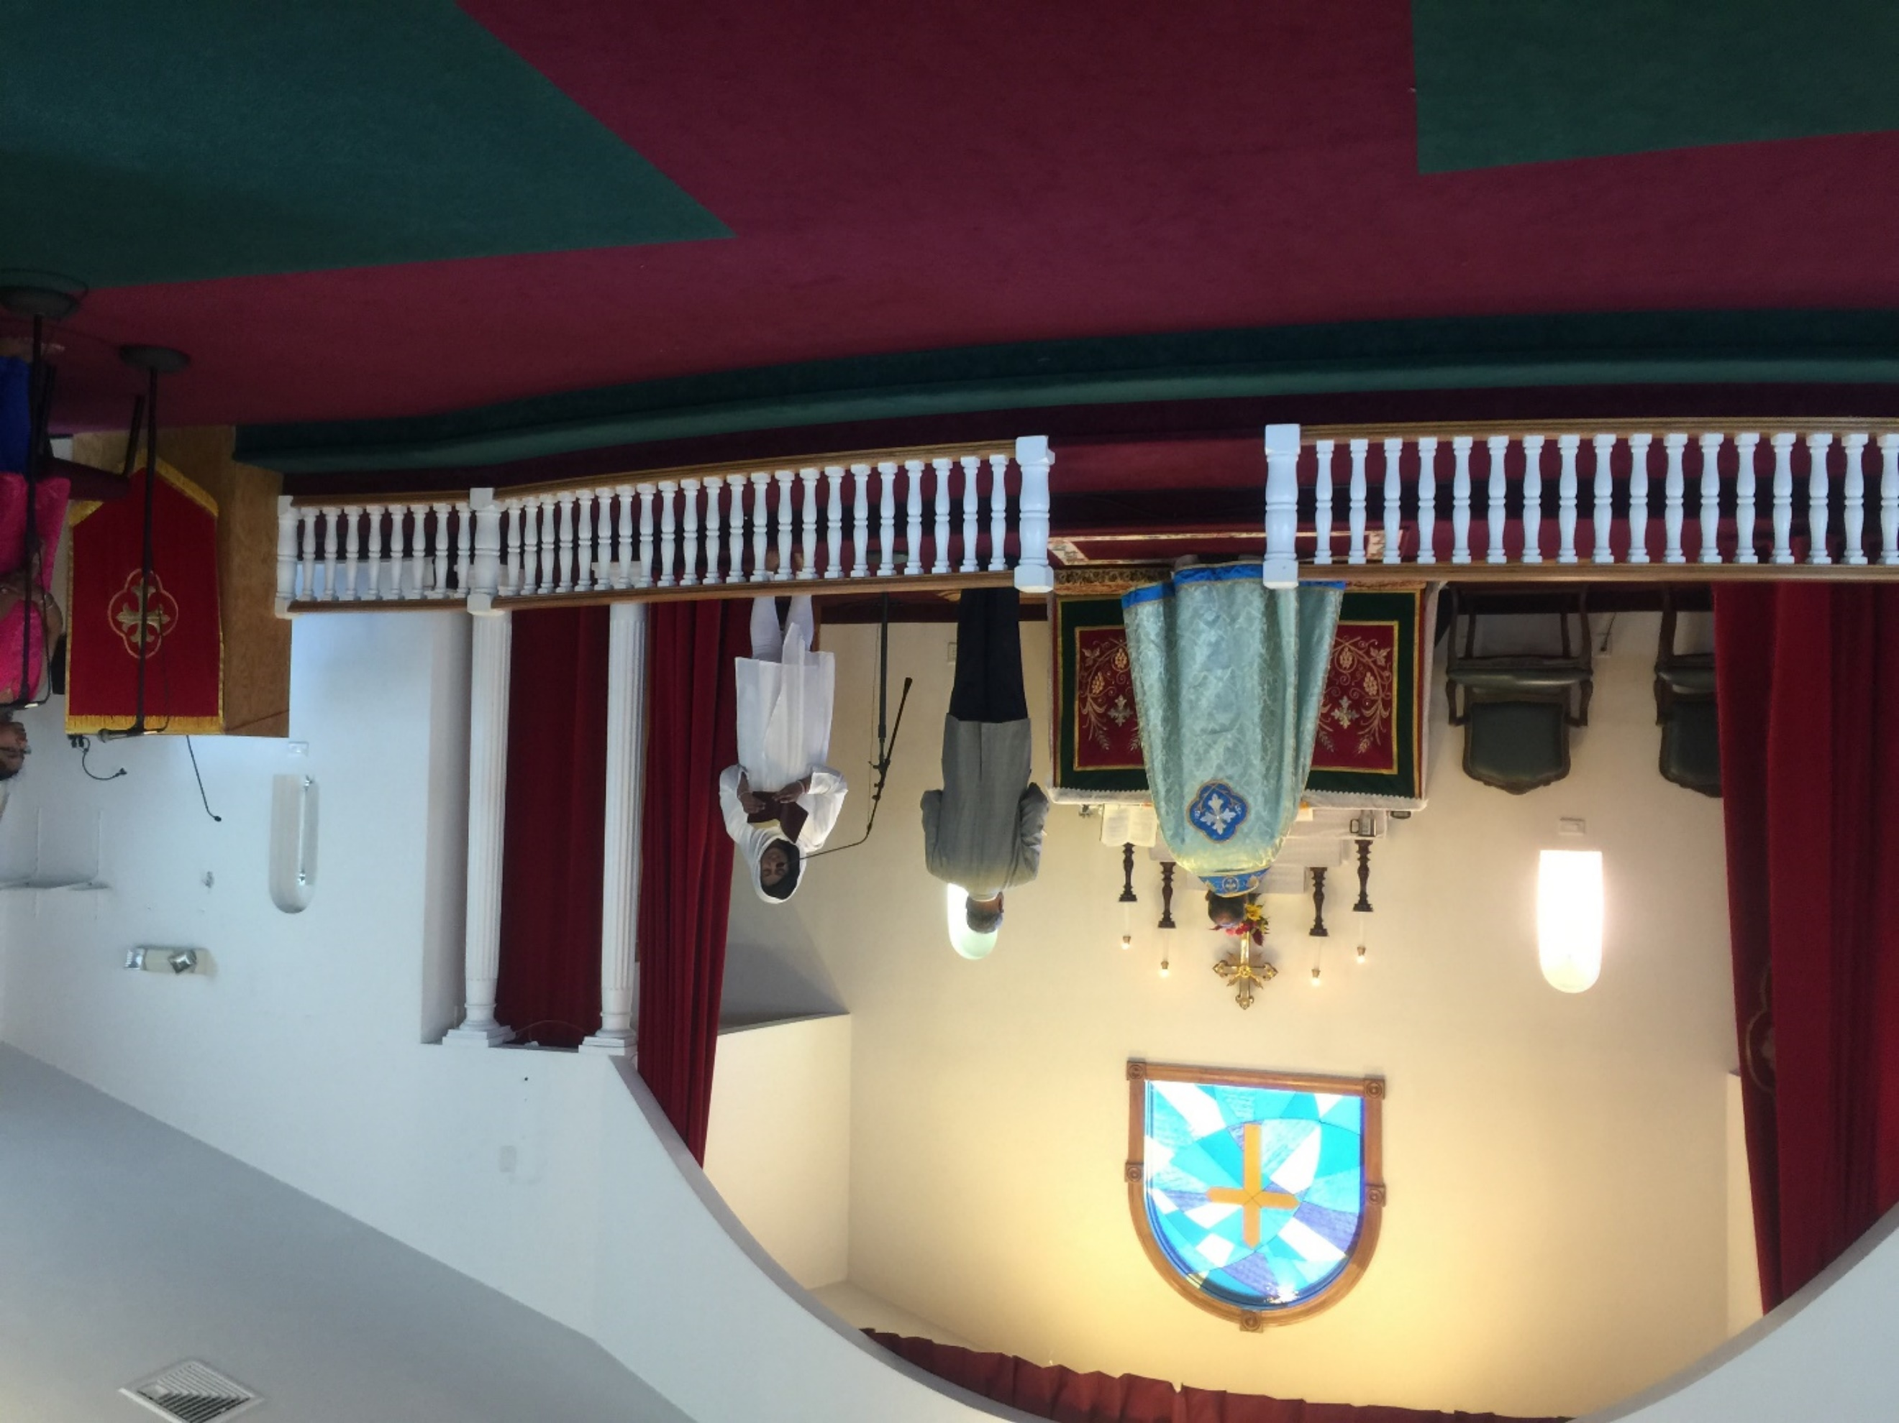

Slide 31
After the reading D2 turns around as he/she is saying the following:
D: Hallelujah, hallelujah.
Offer to the Lord sacrifices of praise; come and worship in his holy courts.
C: Hallelujah

Slide 32
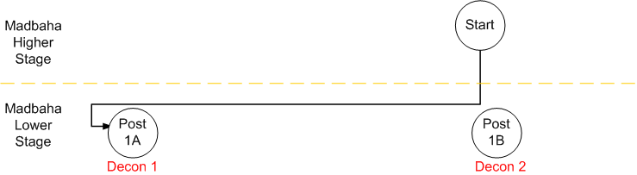
Note: Achen adds Incense. D1 moves to Post 1A of the Madbaha while reading the passage. D 2 moves to Post 1B. Remain at these posts until further notice.
D: Brothers and sisters, let us stand in silence awe and reverence and listen to the proclamation of the living Word of God from the Gospel of our Lord Jesus Christ.
C: Amen

Slide 33
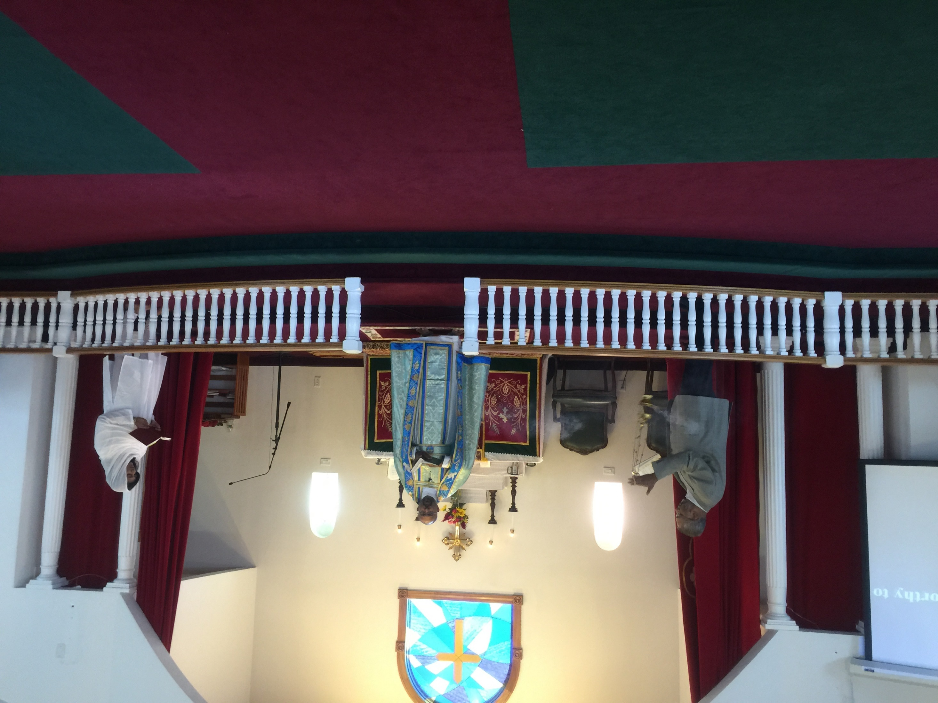

Slide 34
P: Peace be with you all
C: May the Lord make us all worthy to listen to His Word
Page 55

Slide 35
P: The Holy Gospel of our Lord Jesus Christ, which proclaims life and salvation to the world, as recorded by the by the
Evangelist Luke

Slide 36
C: Blessed is He that has come and will come again.
Praise to the Father who sent Him for our salvation.
May his blessings be ever upon us.

Slide 37
P: In the days of Jesus the Christ, our Lord and Savior, the Word of life,
God incarnate of the
Blessed Virgin Mary,
He taught in this manner / it happened in this way.
C: So we believe and affirm

Slide 38
Gospel reading
Page 55

Slide 39
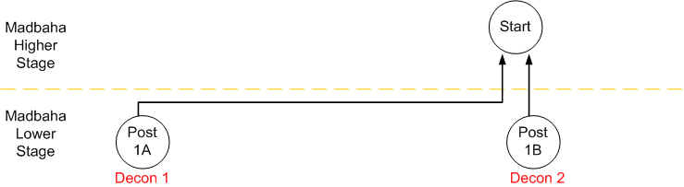
P: ‘Peace be with you all’
Achen turn around and Deacons move back to their position
C: And also with you.
We thank you, Lord, that you have given us your gospel which is indeed the light of the world, that we may be drawn closer to you.

Slide 40
Enable us by your grace to give praise to you through the living words from your gospel.

Slide 41
P: Let us pray to the Lord for His blessings and mercy
C: O Lord who is the source of all blessings, help us and bless us.

Slide 42
P: O Lord, help us continually to offer praise and thanksgiving to You. To Him who absolves us from our debts and pardons our sins. To Him who receives the

Slide 43
penitent and rejoices in the return of sinners;
To Him who has promised, “Call and I will answer; knock and I will open and stretch forth My hand to pardon your sins and iniquities”;

Slide 44
to Him belong glory and honor and worship at this time and all the days of our lives..
C: Amen.
Achen adds Incense
Note: D 1 bows to each of the four sides evenly
Page 56

Slide 45
P: Almighty and glorious Lord, save us from the vile of the evil one.
Lord, in Your grace and mercy,
You took flesh of the Blessed Virgin Mary and became human. Lord of Lords, do not banish us from Your presence and from the company of the angels who continually praise…

Slide 46
Your holy name and proclaim aloud that the Lord God is holy. Show us the way of life and salvation so that we may persevere to attain Your glorious kingdom.
Lord Jesus, look upon us with the eye of mercy. Save us from our enemies and all that would hurt us.
Protect us in the shadow of Your cross…

Slide 47
…Lord Jesus, save us from all deceit and greed. Save us from all evil thoughts, defilement and blasphemy. Lord Jesus, make us to rejoice with all the children of
Your Kingdom. To You and to the Father and to the Holy Spirit, we ascribe all praise and thanksgiving now and forever.
C: Amen.

Slide 48
P: O Lord God, who makes the sinner righteous, pardons our sins and makes us holy, blot out all my sins.
Through Your loving mercy, good
Lord wipe away the sins of all believers.
O Lord God, in Your mercy and goodness, remember us, our parents, brothers and sisters, our bishops, clergy, teachers of the faith…

Slide 49
…and all faithful children of Your holy and glorious church. Lord God, comfort us in body, mind and spirit.
Shower Your mercy upon us.
Be the remission of our sins.
Make us all worthy of the good end that is set for all children of peace.
To You, we offer praise and thanksgiving forever and ever.
C: Amen

Slide 50
Note: Achen adds Incense
P: Weak and sinful as we are, let us confess and together say,
P: Holy is the Holy Father.
C: Amen
Page 57

Slide 51
P: Holy is the Holy Son.
C: Amen
P: Holy is the living and Holy Spirit.
C: Amen
Hand over censer to the achen

Slide 52
P: We believe in one true God, the Father Almighty,
After receiving censer from achen
D 1 bows to each of the four sides evenly

Slide 53
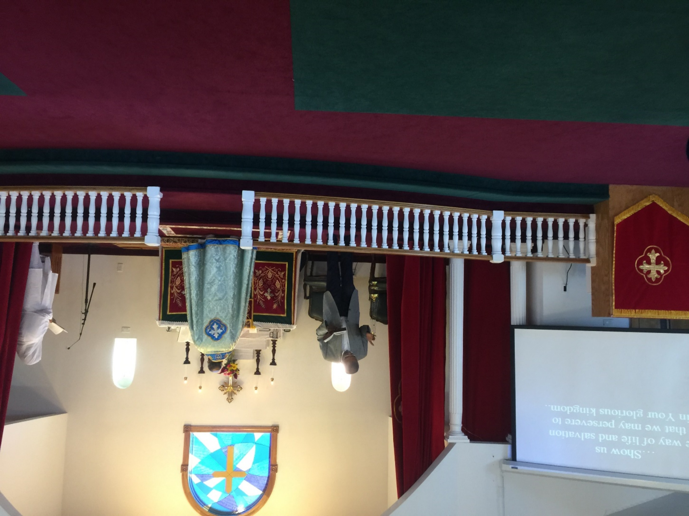

Slide 54
C: Maker of heaven and earth and all things visible and invisible.
We believe in one Lord Jesus Christ, the only begotten son of God, begotten of the Father before all the world.
Light of Light, very God of very God,

Slide 55
begotten not made, being of one substance with the Father, by whom all things were made; who for us and for our salvation came down from heaven and was incarnate by the
Holy Spirit of the Virgin Mary, and was made man.

Slide 56
He was crucified also for us in the days of Pontius Pilate, suffered and died and was buried.
The third day He rose again by his Father’s Holy will, ascended into heaven and sits at the right hand of the Father.

Slide 57
He will come again with glory to judge both the living and the dead and of his Kingdom there will be no end.
We believe in the Holy Spirit, the Lord and giver of Life, who proceeds from the Father,

Slide 58
who with the Father and the Son together is worshipped and glorified, who spoke by the prophets and apostles.

Slide 59
We believe in one, holy, catholic and apostolic Church; we acknowledge one baptism for the remission of sins and look forward to the resurrection of the dead and the new life of the world to come.
Amen.
Page 57

Slide 60
Before the Sermon
Give Achen the offertory basket for Birthdays and Wedding Anniversary
Give Achen the offertory bags in the basket for the congregation
Move the podium to the center

Slide 61
Confession
I confess that I have sinned against you, O Father, Son and Holy Spirt, in thought, word and deed. I am sorry with all my heart for these my sins. I believe in Your promise that you will receive all those who truly repent. O Lord, who is merciful an dfull of grace accept me, even as you accepted the publican, the woman who was a sinner, and the thief on the cross. Comfort me with the consolation of your word. O Lord, grant that your holy Body and Holy Blood, in which I now partake, may redeem me from judgement and condemnation and bring me to life and wholeness, Amen.

Slide 62
P: May God Almighty be compassionate to all of you, who have truly confessed your sins. God has freely forgiven your sins, to make you worthy to partake in this Holy Communion
C: Amen
Note: Deacon pours water for achen to wash hands and provide towel

Slide 63
Note: Turn to achen when Achen face the congregation
P: Dearly beloved , pray with me that this service may be acceptable to the Lord.

Slide 64
C: Lord, we humbly knock at Your door. We have come to Your house, and we pray for Your blessing. Sanctify Your servants by Your truth..

Slide 65
O Lord hear and answer the prayers of Your people. You have promised that where two or three are gathered in Your name, You will be in our midst. We pray that You send us the gift of Your Holy Spirit, to make His dwelling in us, Your people, as he dwelt in the Apostles.

Slide 66
P: O God and Lord of all, make us worthy to greet one another with the
Kiss of Peace, freed from insincerity and united in love.

Slide 67
To you, O Father, and to your only Son and to your Holy Spirit we give you praise and glory, now and for ever.
C: Amen

Slide 68
P: Peace be with you all.
C: And with you also.
D: In the love of our Lord, let us greet one another in Peace.
Note: Put the book on the shelf prior to receiving the kiss of peace. Receive the kiss of peace from Achen and share it with D 2 then with the congregation.
Receive and give the kiss of peace with one hand between the hand of the other.
Page 59

Slide 69
C: May the love and peace of our
Lord Jesus Christ abide with us for ever.

Slide 70
D: Brothers and sisters, having received this holy and divine peace, let us bow our heads before the merciful Lord.
C: Gracious Lord, we bow before you.

Slide 71
P: Merciful Lord, you dwell on high, yet condescend to look upon things that are lowly; bless now those who have bowed their heads in your presence

Slide 72
with the grace of your only Son – with whom and with the
Holy Spirit you are worthy of all praise and glory, now and for ever.
C: Amen

Slide 73
D: Brothers and sisters, let us participate in this Holy Qurbana which is now offered, with commitment, reverence, humility, purity of heart, love, true faith and devotion. To God the father, to whom all things belong, is offered this sacrifice of grace, peace and praise in a spirit of unity and concord

Slide 75
P: The Love of God the Father + the grace of the only begotten Son + and the communion and abiding presence of the Holy Spirit + be with you all, dearly beloved, forever.
C: And with you also.

Slide 76
P: May our hearts be with Christ on high.
C: Our hearts truly are with the Lord.
P: To sing praises and worship the Creator of all things.
C: Assuredly is good and right.

Slide 77
P: Who is adored by the heavenly hosts,
Sun and moon and all the stars, the earth and seas and all that dwell there,
Angels and archangels, thrones and powers, Cherubim and Seraphim, ever proclaiming;

Slide 78
C: Holy, Holy, Holy, is the Lord God Almighty,
Heaven and earth are full of His glory Hosanna in the highest!
Blessed is he who has come and is to come again in the name of the Lord;
Hosanna in the highest.

Slide 79
P: When the sinless One, of His own will, chose to suffer death for us sinners,
He took bread in His holy hands.
C: Bless, O Lord

Slide 80
P: He gave thanks, blessed, sanctified, and broke it and gave it o his apostles saying
‘Take, eat, this is my body given for you. This do in remembrance of me!’
C: Amen.

Slide 81
P: In the same way He took the cup.
C: Bless, O Lord.

Slide 82
P: He gave thanks, blessed, sanctified, and gave it to his apostles saying,
‘Drink this all of you, this is my blood of the new covenant which is shed for many for the forgiveness of sins!’
C: Amen.

Slide 83
P: Thus, as often as you eat this bread and drink this cup, you proclaim the Lord’s death until He comes.

Slide 84
C: O Lord, we remember Your death. We celebrate Your resurrection and we await Your second coming.
May your blessing rest upon us all.

Slide 85
P: O Lord, we remember your death, burial and resurrection, your ascension and look forward to Your second coming to judge the world in righteousness and truth, we offer this service and sacrifice entreating You, not to deal with us according to our sins, but according to Your own abundant mercy, and saying:

Slide 86
C: Have mercy upon us. O Lord our God, we give thanks to You, we glorify You, and we worship You. O Source of all goodness, have mercy on us and bless us.

Slide 87
P: Lord, have mercy (2)
C: Lord, have mercy (2)
All: Lord, have mercy

Slide 88
P: May the Holy Spirit sanctify this bread that it may be the body of our Lord Jesus Christ.
C: Amen

Slide 89
P: May the Holy Spirit sanctify the wine in this chalice that it may be the blood of our Lord Jesus Christ.
C: Amen

Slide 90
P: O Lord, sanctify the bodies and souls of those who receive these gifts that they may bear fruit for the stability of your holy Church.
Establish ever firmly your holy Church founded on the rock of faith, against which the gates of hell shall not prevail,

Slide 91
and preserve her to the end from strife and error.
To you, with the Son and the Holy Spirit, we will offer praise and thanksgiving both now and for ever.
C: Amen

Slide 92
D: Look with mercy, O Lord, on your holy Church throughout the world, on all bishops who bear burden of leading and guiding her,

Slide 93
especially our father in , the Valiya Metropolitan,The metropolitan, the moderators of CSI and CNI, Archbishop
of the Anglican Church, our Diocesan Episcopa, other bishops, [add names of the bishops] priests, deacons, evangelists, faithful members of our church and seekers of the faith.

Slide 94
Lord, we remember all who exercise authority in various countries, especially in this country. Give to each one Your Holy Spirit that they may diligently work in your vineyard.
C: Lord, have mercy.

Slide 95
D: Lord, we remember the mother of our Lord, the Blessed Virgin Mary, the holy Apostles, the Prophets, the preachers, the evangelists, the martyrs, the confessors and all the saints.
Lord, we remember the three

Slide 96
councils of Nicea, Constantinople and Ephesus and all the holy fathers who participated in them. Make us worthy to follow in their footsteps. Lord, we also remember all the faithful who are departed and fallen asleep in

Slide 97
the true faith, grant that we also may with them be counted worthy of the remission of our sins and be gathered into Your heavenly kingdom.
C: Lord have mercy

Slide 98
D: Lord, we thank You for the beautiful universe You have created and the life and the possibilities of it. Forgive us O Lord, for we have distorted the universe for our greed and selfishness.

Slide 99
Help us O Lord, to be good and faithful stewards for the fulfillment of Your will.

Slide 100
P: Lord, have mercy (2)
C: Lord, have mercy (2)
All: Lord, have mercy

Slide 101
P: The blessing of our great God and Savior
Jesus Christ + be with you all,forever.
C: And be with you also.

Slide 102
Note: Litany section will be read by convent girls
D: Brothers and sisters we must pray to the Lord always, reconciliation and peace and for His Blessings and mercy.
C: Lord in your mercy hear our prayers.

Slide 103
D: Let us pray to the Lord for unity in the church and harmony between all people and communities.
C: Lord in your mercy hear our prayers.

Slide 104
D: For peace in our families and grace in our hearts, that we may be strengthened in faith.
C: Lord in your mercy hear our prayers.

Slide 105
D: For recovery of health for the sick, comfort for the distressed, deliverance for prisoners, safety for travellers, unity and love for those who are estranged.
C: Lord in your mercy hear our prayers.

Slide 106
D: Let us give glory to
God the Father, Lord of all, and worship his only begotten Son and Praise his holy and life-giving Spirit.

Slide 107
C: O Lord of all blessings, we commit our lives into your keeping and pray for your blessings.
Gracious God, have mercy upon us and bless us.

Slide 108
P: O God, the Father of our
Lord Jesus Christ, make perfect the offerings and oblations presented before You. Sanctify our bodies, souls and spirits,

Slide 109
so that with pure and confident hearts we may address You as God and Father and pray: ‘Our Father in heaven’

Slide 110
C: Hallowed be Your name.
Your kingdom come,
Your will be done on earth as in heaven.
Give us today our daily bread,
Forgive us our sins, as we forgive those who sin against us.

Slide 111
Lead us not into temptation, but deliver us from all evil
For the kingdom, the power and the glory are Yours now and forever.
Amen.

Slide 112
P: May the grace and mercy of the holy and glorious trinity, + uncreated, self-existent,
+ eternal, adorable and one in essence
+ be with you all for ever.
C: And with you also. O holy and glorious Trinity, have mercy on us.

Slide 113
P: Holy things for holy people.
C: Holy is the one Father, holy is the one Son, holy is the one Spirit.

Slide 114
P: Glory be to the Father and to the Son and to the Holy Spirit.
C: One from the beginning and for ever and ever. Amen.

Slide 115
P: The one Holy Father, who created the world in His mercy, is with us.
C: Amen

Slide 116
P: The one Holy Son, who saved it by His precious Passion is with us.
C: Amen

Slide 117
P: The one living Holy Spirit, who perfects and fulfils all that is and that has been, is with us. May the name of the Lord be blessed as in the beginning, both now and for ever.
C: Amen

Slide 118
Now as we come to Your table
We recall those gone before us
Grant their lives be an example
May we use their teaching as our guide

Slide 119
Lord You've prepared this communion
You are our hope and salvation
We bow our heads in Your presence
As we share in Your Body and Blood
May we find renewal of life in You.

Slide 120
P: Lord Have Mercy (2)
C: Lord Have Mercy (2)
All: Lord Have Mercy

Slide 121
P: Dearly beloved , pray for me.
C: As for us, our days are like grass. We bloom like the flowers of the field. Bless us, O Lord.

Slide 122
P: Glory be to the Father and to the Son and the Holy Spirit.
C: As it was in the beginning, is now and ever shall be. Amen.

Slide 123
D: O Lord, at your command death held its sway. You abolished death through
Your resurrection from the dead. Therefore, we praise and exalt you.

Slide 124
O Lord, every mouth shall sing Your praise.
O Lord who gathers up the children of Adam from everywhere, bless us and help us.

Slide 125
C: O Son of God, Your death has changed our death into life.
Raise us from the dust so that we may ever praise You. God the
Father, the Son and the Holy
Spirit is worthy of glory and worship forever.

Slide 126
From the beginning and from generation to generation, may He be praised. Hallelujah.

Slide 127
P: O Son of God who came for our salvation and will come again for our resurrection and for the renewal of our race, grant, we pray, forgiveness of sins to your servants through your own atoning sacrifice.
C: Amen

Slide 128
P: O Lord God, graciously bless these your children who partake of your most precious Body and Blood which was given on Calvary for the forgiveness of sins, that they may abide in your presence for ever.
C: Amen.

Slide 129
Note: Achen turns around to face the congregation. Deacons should face Achen
P: The blessing of Jesus Christ our great God and Savior be on those who bear these sacred mysteries, on those who dispense them on those who receive them, and on all those who have participated

Slide 130
and who shall participate in them.
The grace of God be on us all, both now and for ever.
Note: Achen Turns back to face the Madbaha.
C: Amen. Lord, have mercy and bless us.
Glory and praise be to You, our Lord and our everlasting Refuge.

Slide 131
Note: Achen turns around with the bread and faces the congregation. Decons should face bread. Decons should keep a tally of the number people received holy communion.
Keep an eye on the supply of bread and wine.
P: The Holy Body and Blood of our Lord Jesus Christ, broken and shed on Calvary for the forgiveness of sins, are given to you for the health of your body and soul.
C: Amen.

Slide 132
Note: Decons should receive the holy communion at the end. This will indicate to Achen that all the general public received holy communion.
Note: The last persons who receives the holy communion remains kneeling at the alter until the congregation starts the verse: “C: All the earth shall bow down”

Slide 133
P: Praise be to you,
O Lord, our God, for ever.
Praise be to you, O Lord Jesus Christ.
May your holy Body and Blood of which we have partaken be not for our condemnation, but for life and salvation to us all.
O God grant us your blessing.

Slide 134
C: All the earth shall bow down before you and every tongue shall praise your holy name, for you give life to the dead and you are the hope of all who lie in the grave.

Slide 135
We praise you, O Lord, and give you thanks for your mercy towards us.

Slide 136
P: We praise you, O Lord, because in your abundant mercy you have fed and strengthened us with the precious Body and Blood of your Son our Savior Jesus Christ, and you have thereby made us one with all the members of his mystical Body.

Slide 137
We pray you to give us grace to continue in that holy fellowship and for ever to offer glory and praise to you and to your only begotten Son and to your Holy Spirit.
C: Amen.

Slide 138
P: Bless us O Lord, Almighty,
You are our God the Creator.
Show to us ever the way of salvation,
Our God, Helper of all.

Slide 139
C: Accept O Lord ,this our prayer, Pardon our sins , receive our praise,
Bless this your servant who’s served in your presence
Dismiss us with your peace.

Slide 140
P: My beloved brothers and sisters, I commend you to the grace and blessings of the Holy and Glorious Trinity. Go now in peace and serve the Lord + with the gifts and blessings that you have received from the atoning sacrifice of the Lord.
C: Amen

Slide 141
P: You, both near and far, who are saved by the victorious cross of the Lord + and sealed with the seal of holy baptism, this holy trinity will forgive your sins and comfort your souls.
C: Amen

Slide 142
P: Pray for me my brothers and sisters, weak and sinful as I am, that I may obtain mercy and help.
Depart in peace, filled with gladness and rejoicing. +

Slide 143
C:May the Lord accept your ministration and help us by your prayers. Amen
Note: close the curtain. Make sure the cross on the curtain is centered

Slide 144
Doxology
Announcements
Doxology continues
Benediction

Slide 145

In The Madbaha
Wash the Kassa and Peelasa
Fold the Kappa
Put everything back in position
Take the battery off from the cordless mike.
Check bread, Wine, Candles, incense… for the next service
See that the lights are off.
Pray thanking God and leave
Lay leader Please check

