Slide 1
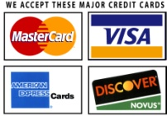
Questionnaire
Event guest count ___________
What is the date of the event? ___ / ____ / 20
What is the Name & Address of the location ?
____________________________________________________________
What are the hours of the party? ___ till ____
What time do the guests begin to arrive ? _______
How many people will be attending? _______ Adults ______ Children
What will we be serving?
Beer ___ Wine ___ Mixed Drinks ___ Soda-Pop___ Water___
Are you purchasing the drinks? Yes or No
Type of Event_________________________
Is there a theme to your event or special details we need to know ?
Contact Information
Name(s) _____________________________ Host ________________________________
Address ________________________ City______________ State___________ Zip__________
Email : Mobile #
Policy to secure your date needed a 50% nonrefundable deposit will be needed in order to hold your date the balance is then due 30 days before the event

