Slide 1

FIX & FLIP HOUSE’S
Create passive income, Buying and Holding multi unit properties & Flipping Houses

Slide 2
FIX & FLIP HOUSE’S
Create Passive Income, Buying And Holding Multi Unit Properties & Flipping Houses

Slide 3

GET STARTED TODAY
FLIPPING HOUSE’S

Slide 4
ALL REAL ESTATE OWNED
Property Address Purchased Price Sold Price
30 Glen Brook Drive $81,000 $117,000
161 Central Ave $72,000 $195,000
1608 3rd Ave $68,000 $108,000
1410 1st Ave $37,000 $159,000
1432 1st Ave $43,000 $62,000
908 24th Street $52,000 $130,000
907 23rd Street $95,000 $185,000
17-19 Strong Pl. $64,000 $225,000
1819 7th Ave $14,000 $135,000
6 McelWain Ave $80,000 $153,000
29 Valedepenas Ln $165,000 $260,000
84 Old Loudon Rd $230,000 $350,000
79 Blue Jay Way $329,000 $435,000
Real Estate Owed $1,330,000 Net 1,184,000
Total $2,514,000

Slide 5
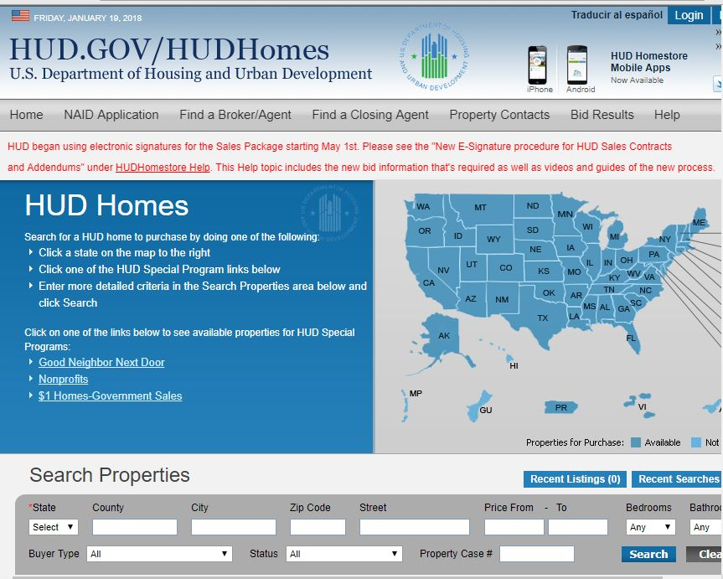
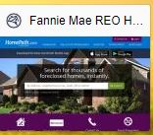

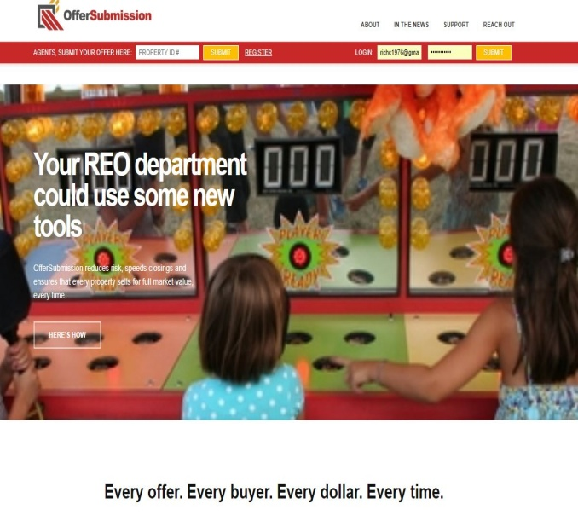

ACQUIRING PROPERTIES

Slide 6
WHAT IS A
BANK OWNED PROPERTY?
A bank-owned or real estate owned (REO) property:
  has reverted to the mortgage lender after the home fails to sell in a foreclosure auction.
We will be referencing my personal experience with this from my project at 6 McelWain Ave in Cohoes, N.Y.

Slide 7
BANK OWNED
PROPERTY WEBSITES
Local ENYR MLS
Hudhomestore.com
Homepath.com
Auction.co
Xhome.com
Hubzu.com
Reo.wellsfargo.com
offersubmission.com.
This is just a few that exists. There are many to choose from.

Slide 8
WHAT IS A
BANK OWNED PROPERTY?
Either sales or fails to sell in a foreclosure auction.
Bank owns the property, handles eviction, pay ‘s off tax liens, may be some repairs.
Bank will contract with local agent to list the property on the market.
Property reverted to the mortgage lender after the property fails to sell at auction.

Slide 9
6 MCELWAIN AVE COHOES
Prep Work Of Purchasing Bank Owned Property.
Check all taxes to make sure their paid and current.
Check for any liens.
Walk through property to:
  Determine repair cost.
  Figure out what will be replaced, fixed and rehabbed.
Remember to always estimate repair cost higher, on average 20% higher. Don’t discount other peoples labor and time, like you would for yourself.

Slide 10
6 MCELWAIN AVE COHOES
The Scope Of Work
Determine your order of repairs, (very crucial).
  Repairs have to be made in a timely fashion, so one thing does not get ahead of the other.
  Example (re-sheet rocking a interior wall before you decide if there will be plumbing or electricity running through, deciding on floor plan and bath, and kitchen layout yearly in the planning stage is crucial.
Determine timeline and expected completion date. Absolutely a MUST.
Market analysis to see what the value would be once property is rehabbed. Also called AVR (after repair value).

Slide 11
DOING YOUR HOMEWORK ON A PROPERTY
Once You Find A Property You Would Like To Invest In (Fix & Flip)
Compare the neighborhood location
  All real estate is about location, location, LOCATION!
You want to look for the worst house on the street
  Ideally there is only one on the street that needs rehab
  If there is more than one property that needs repair, that falls in the category of possibly a BAD LOCATION.
Pick your location wisely or you might find it difficult to sell once all the repairs are completed.
Your ARV (After Repair Value) MUST be determined before you purchase any property.

Slide 12
AFTER REPAIR VALUE (ARV)
AVR on 6 McelWain Ave Cohoes was $150,000.
  That was what I thought the property to be worth once all work was completed.
  You figure this out by the comparable sales of the houses in the area.
Once you know the AVR, you can begin to calculate cost of repair, as well as holding cost.
  Take purchase price, repair cost, holding cost, Minus AVR and that net figure must be attractive enough to take all the risk. Every flip is unique.

Slide 13
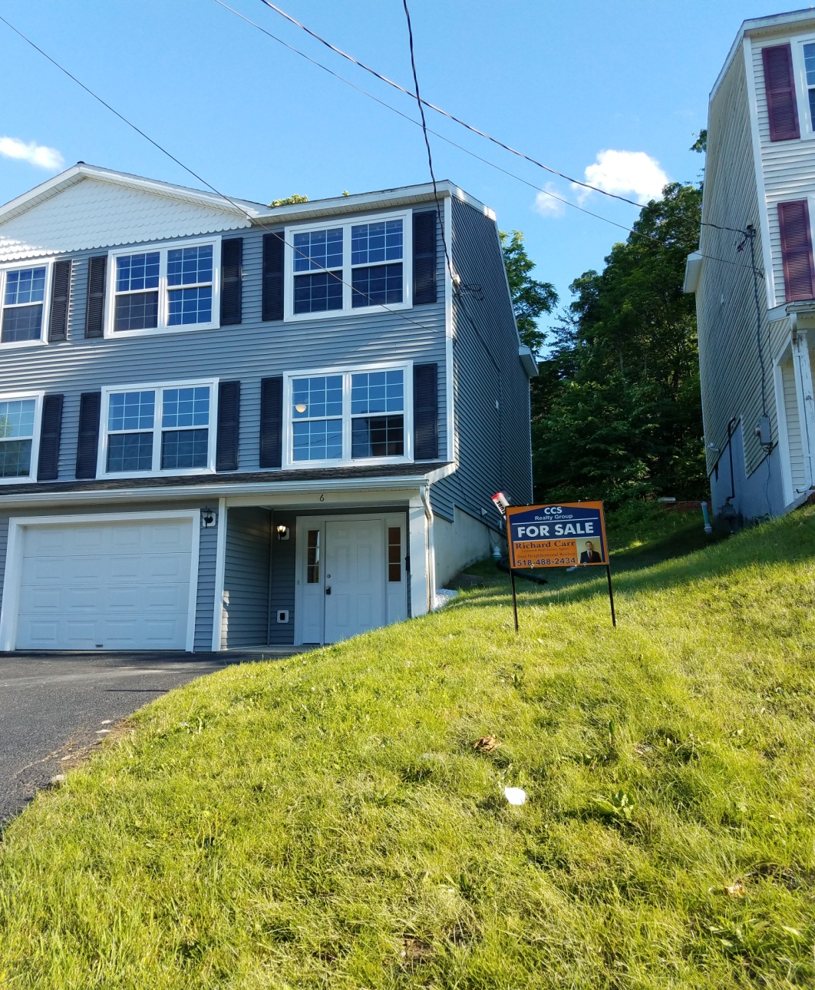
6 MCELWAIN AVE COHOES

Slide 14
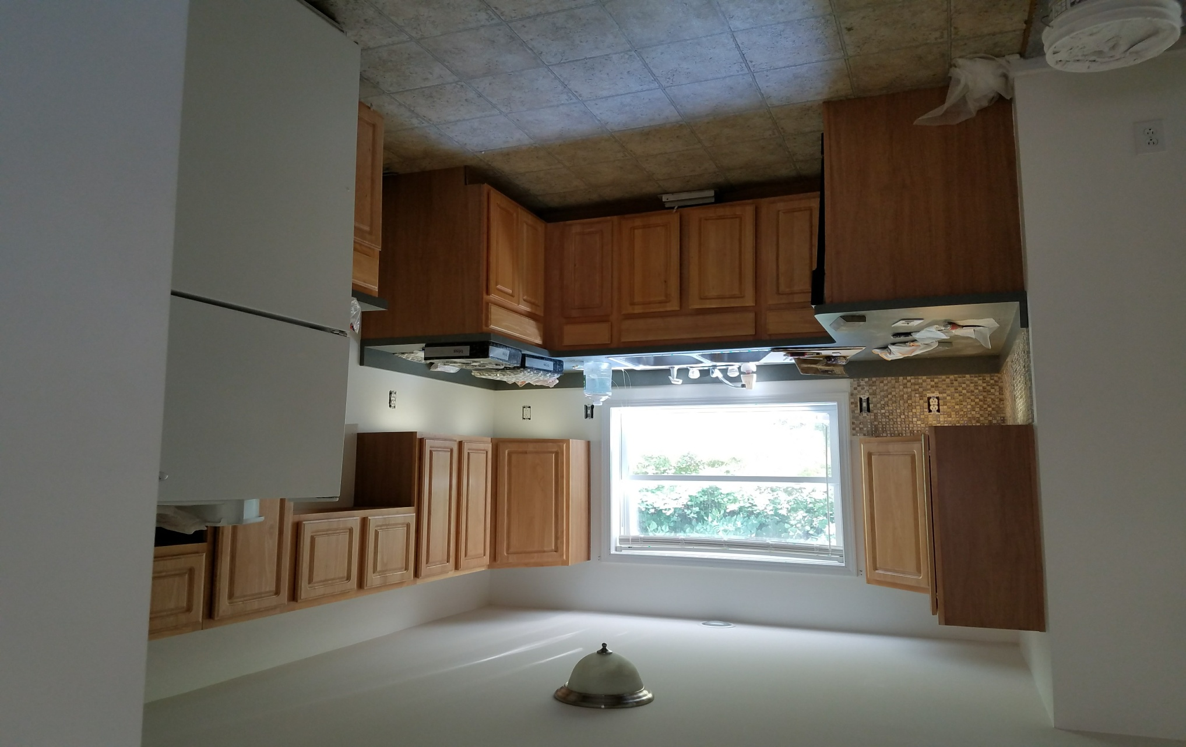
KITCHEN (IN PROGRESS)

Slide 15
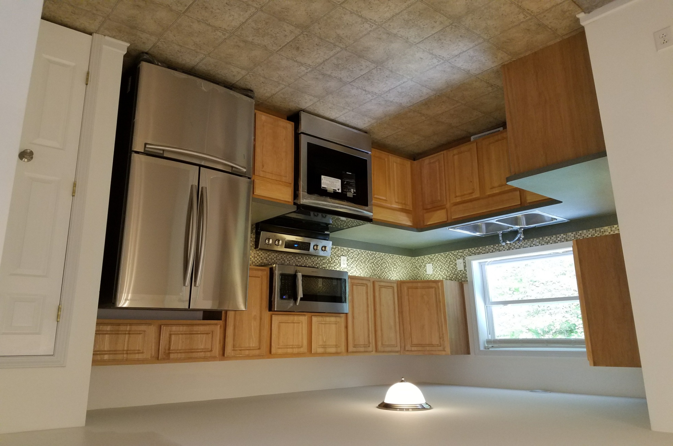
KITCHEN ( AFTER)

Slide 16
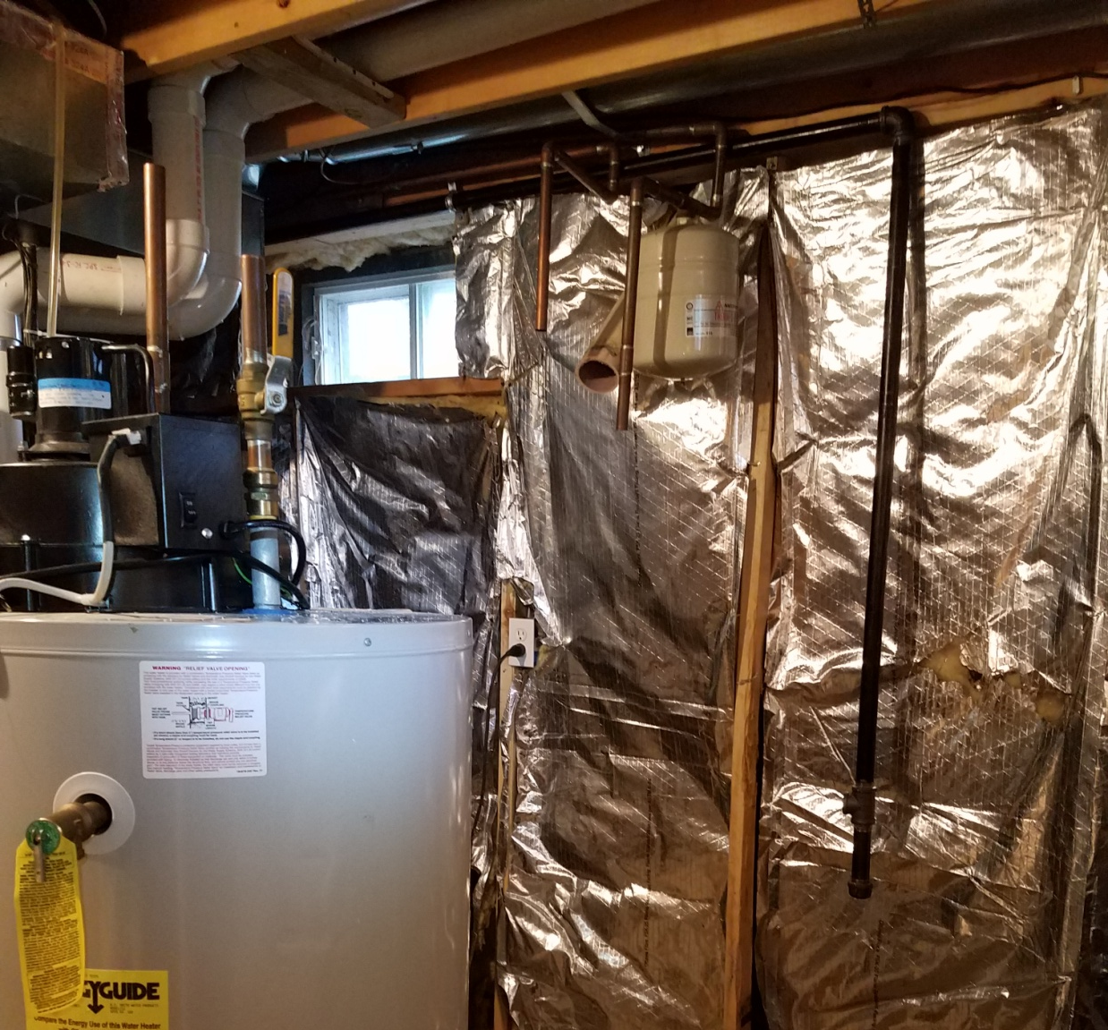
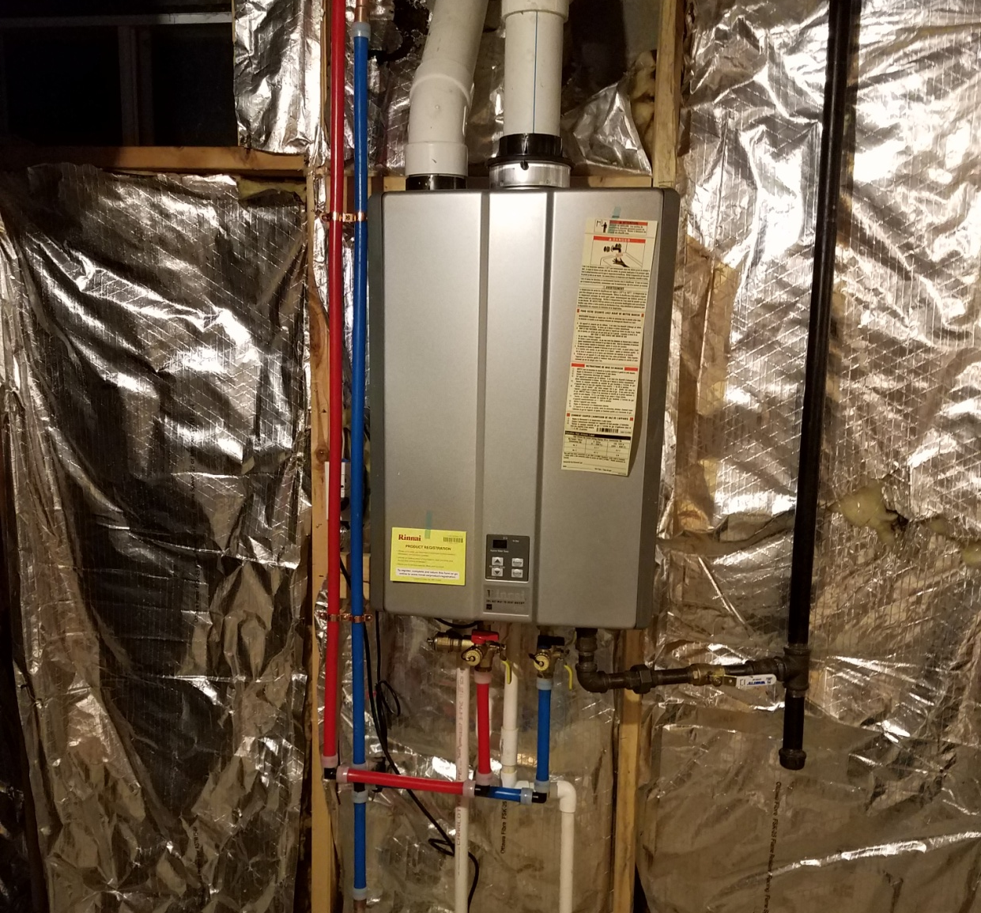
Tankless Water heater install

Slide 17
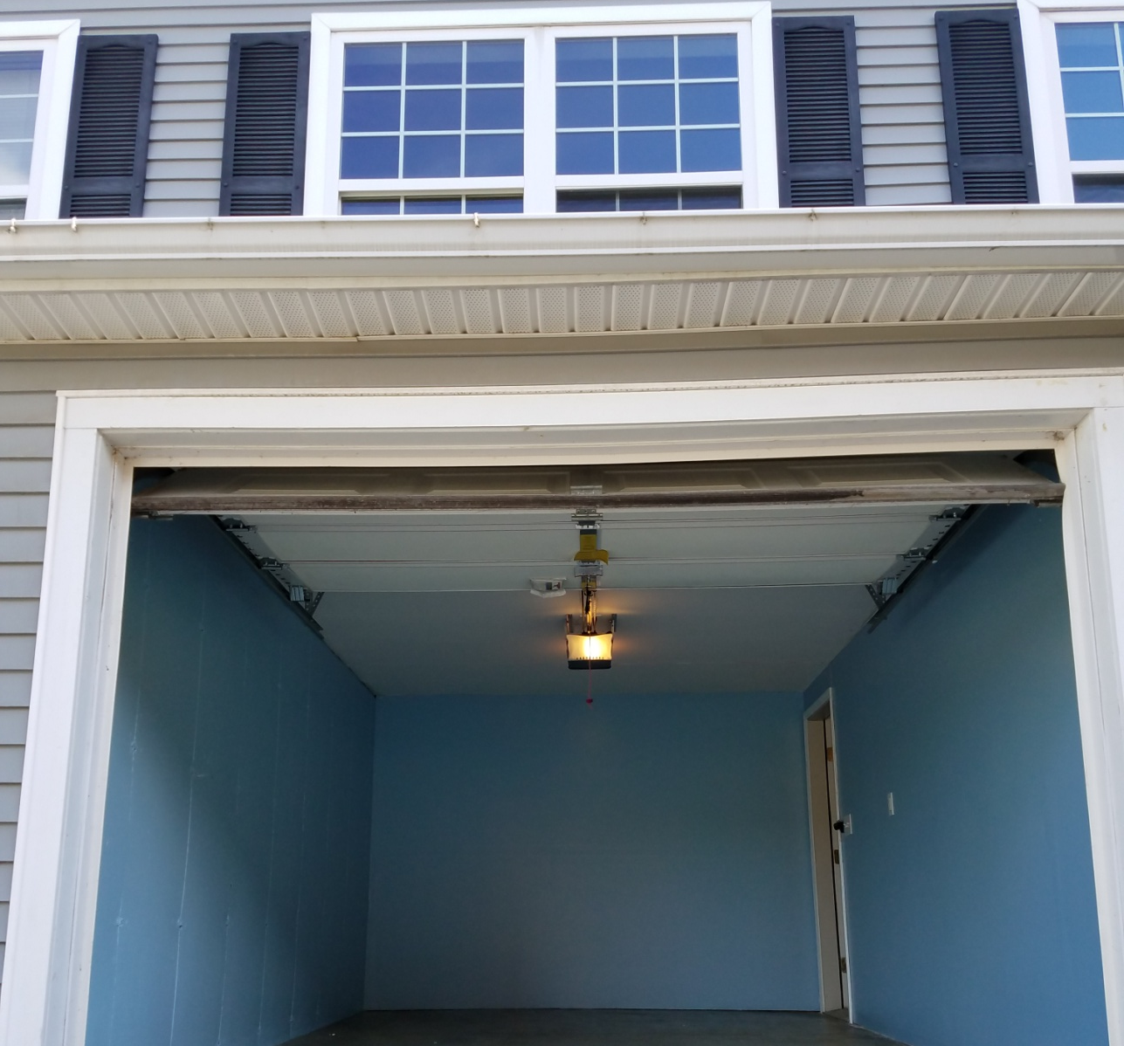
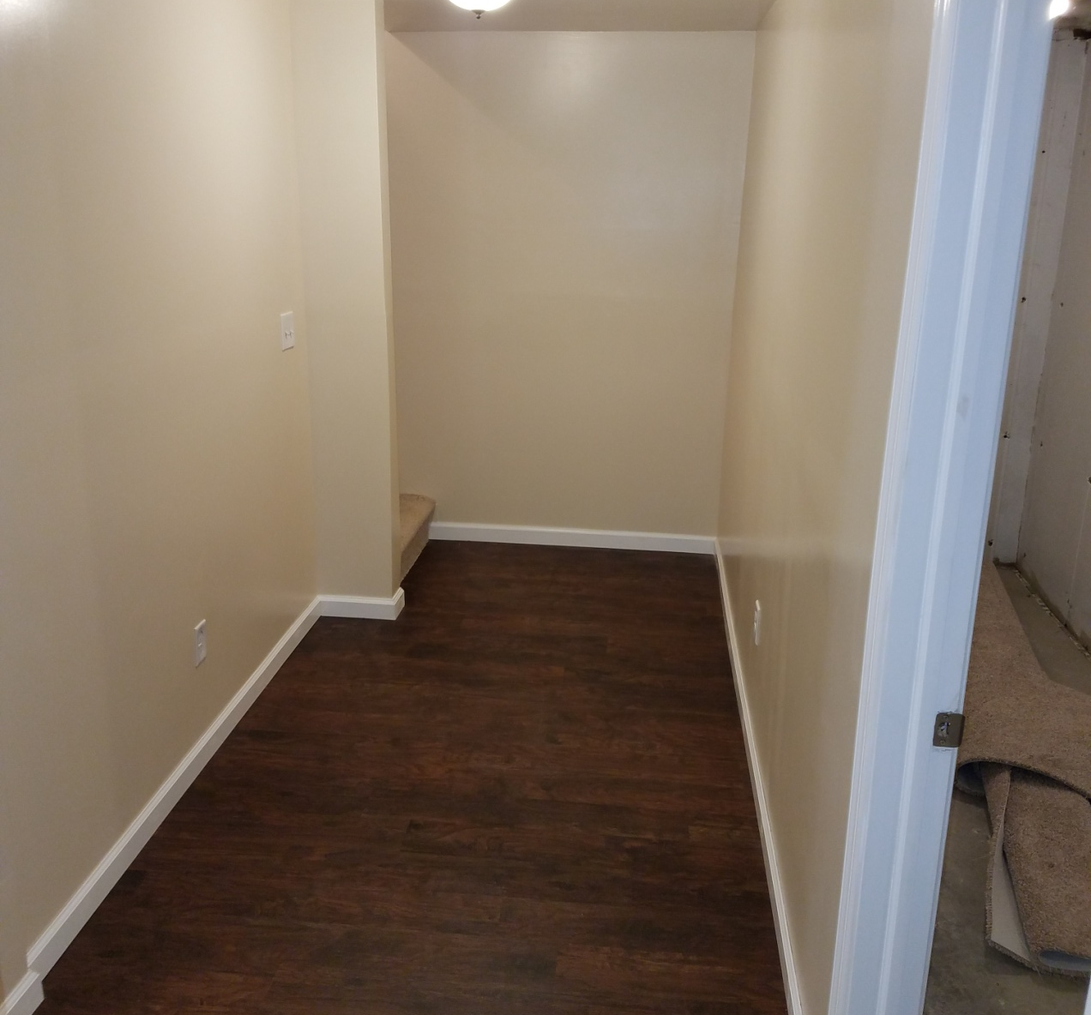
Garage & Basement Finished

Slide 18
6 MCELWAIN AVE COHOES
Purchased Property for $80,000
Repair cost $8,500
School and Property taxes prorated 3 months were $1,400 , Additional holding cost $300.00
Remodeled Kitchen, bathrooms, basement, electrical, garage, landscaping, and plumbing.
Listed the property for $149,000
Sold multiple offers $153,000
Net proceeds
$62,600

Slide 19
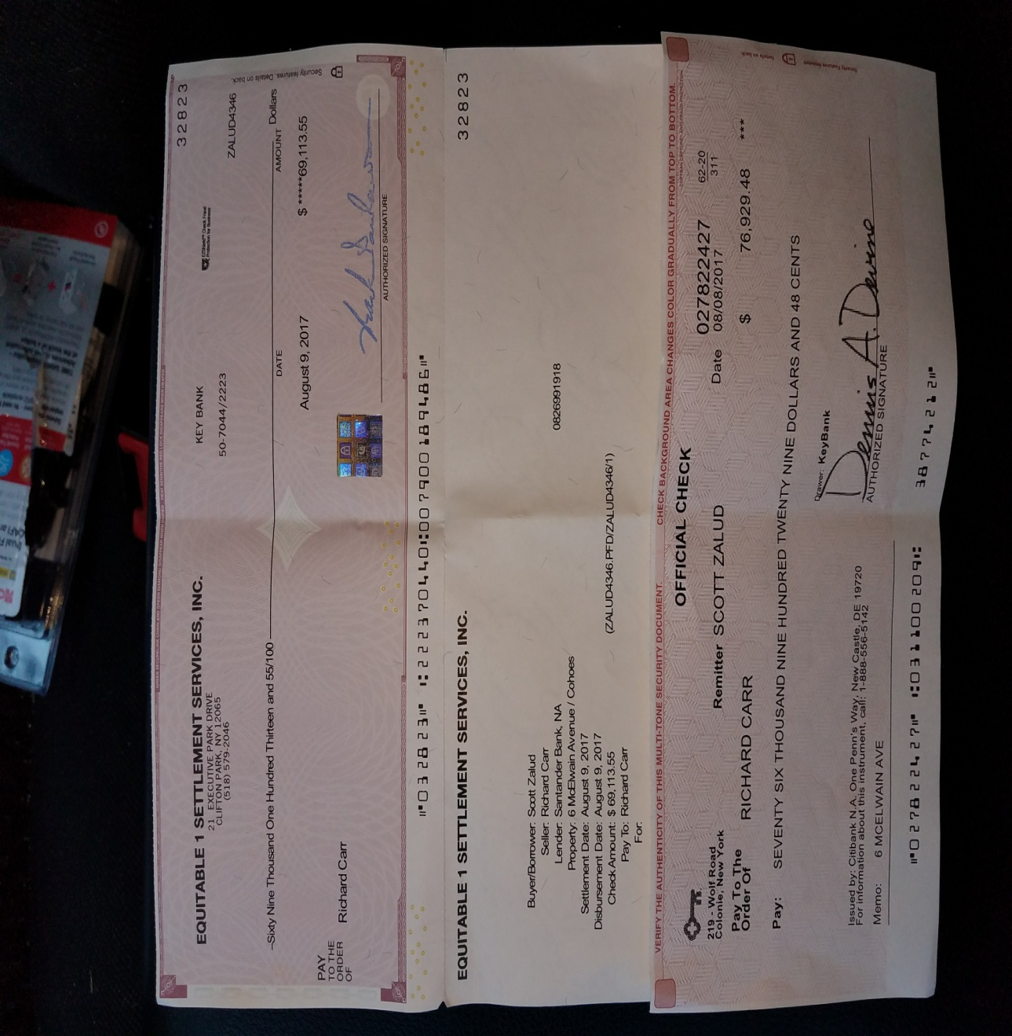
CLOSING CHECKS

Slide 20
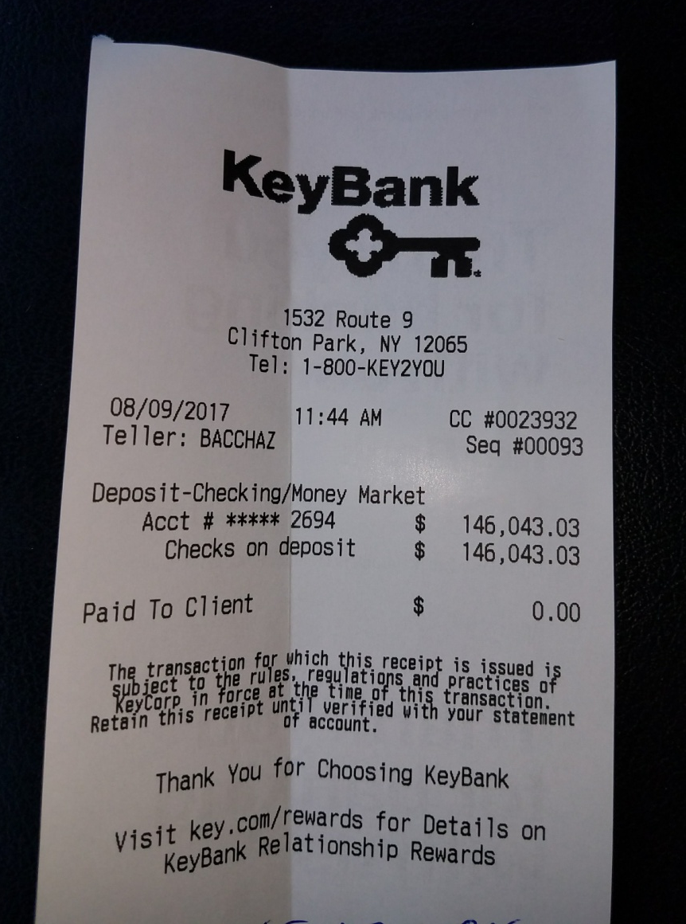
KEY BANK RECEIPT

Slide 21
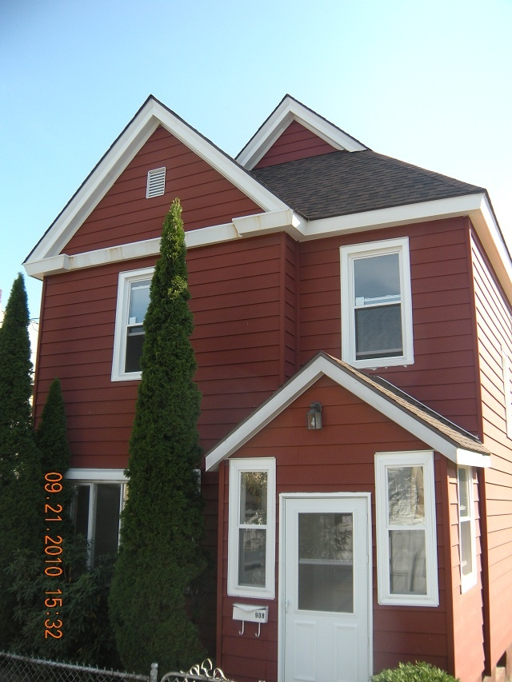
908 24TH STREET, WATERVLIET

Slide 22
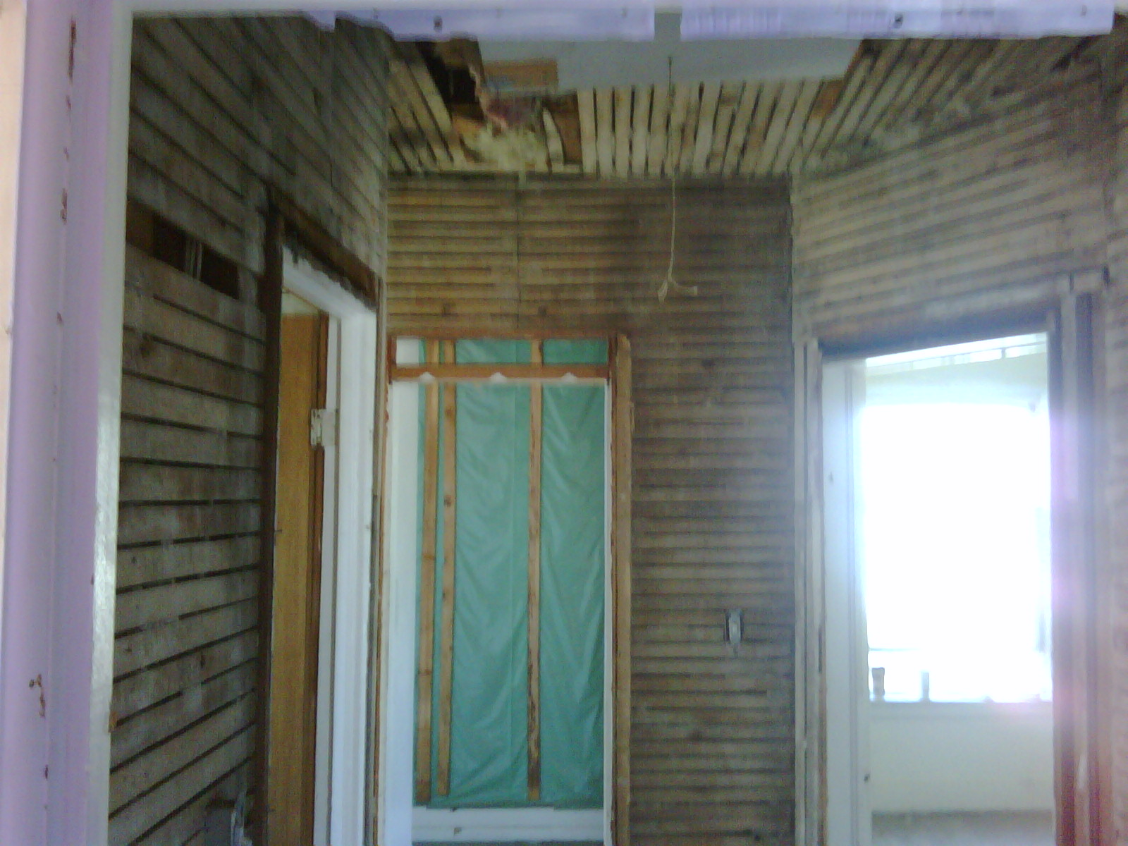
UPSTAIRS HALL WAY GUTTED

Slide 23
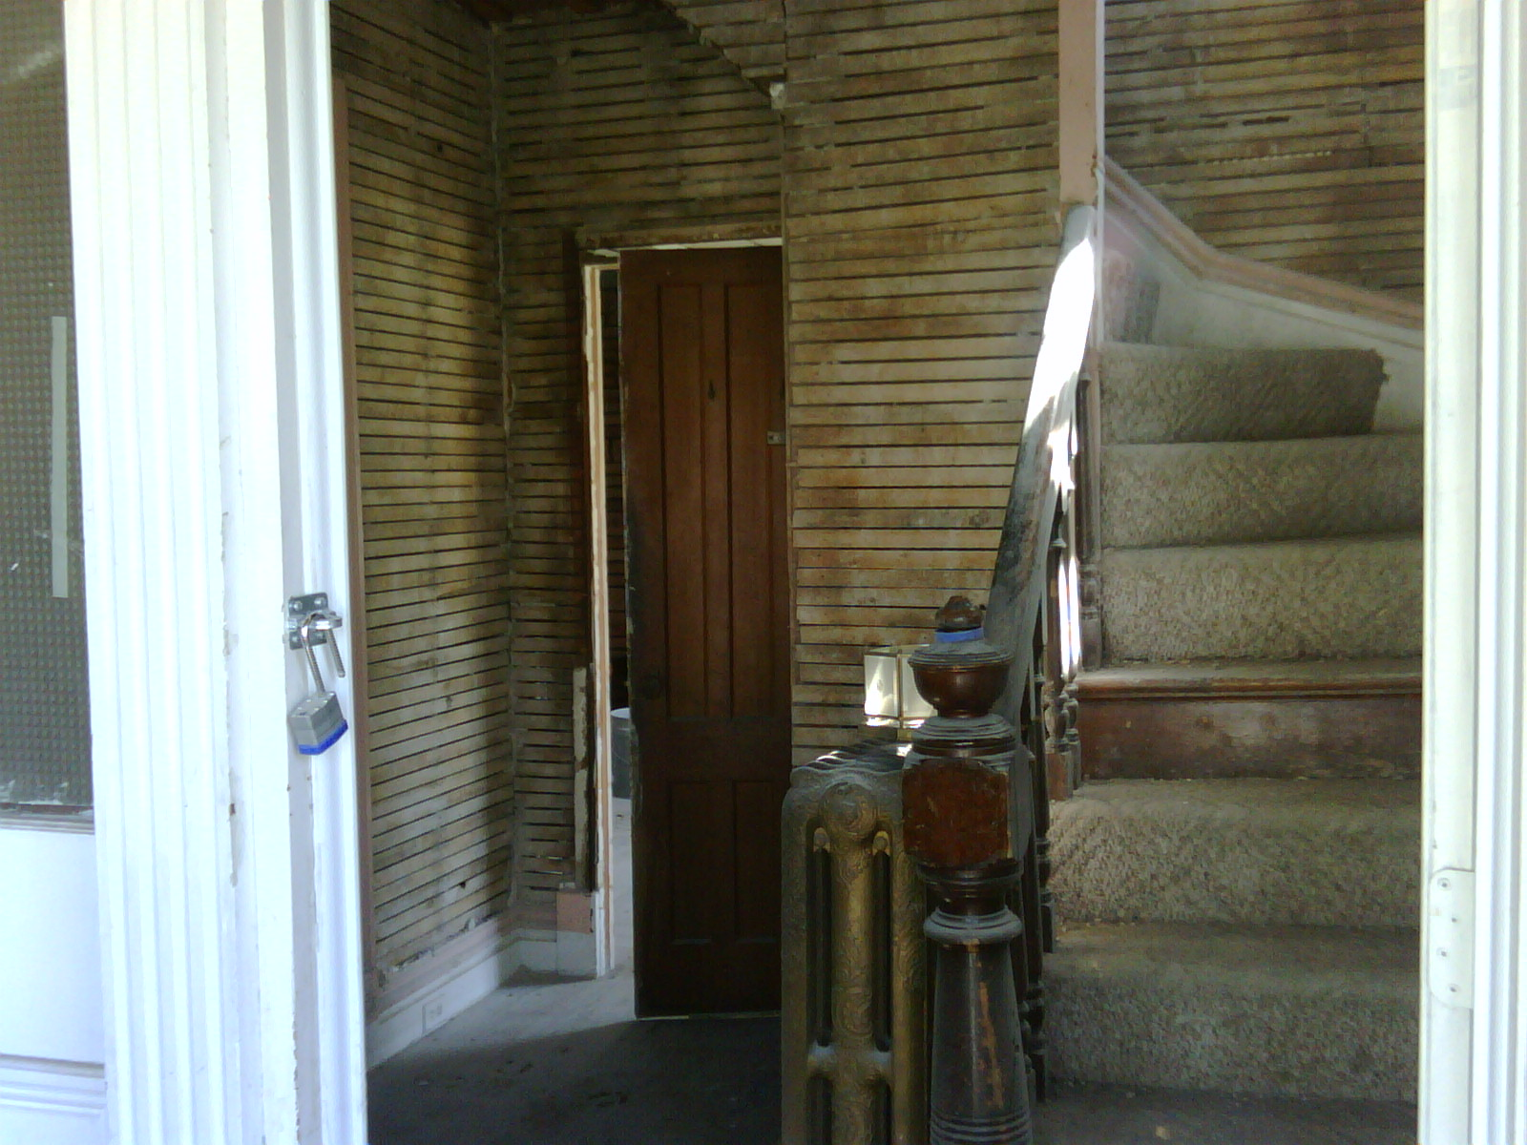
Stair Way /Foyer

Slide 24
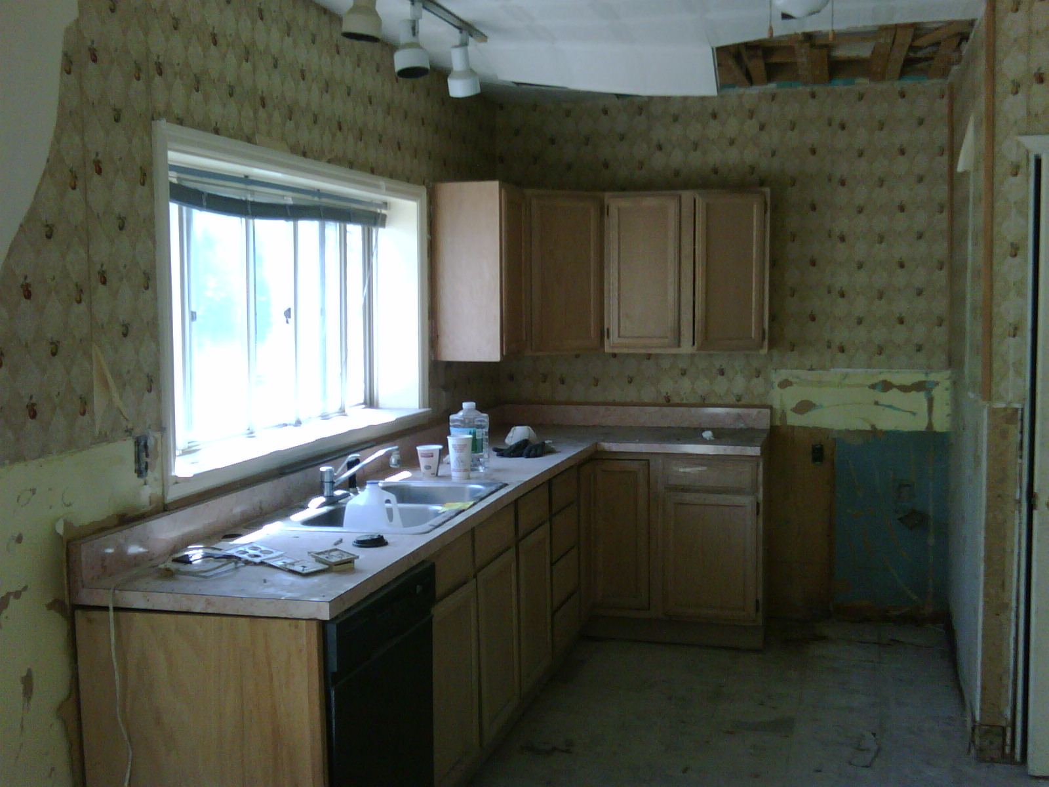
Kitchen ( before)

Slide 25
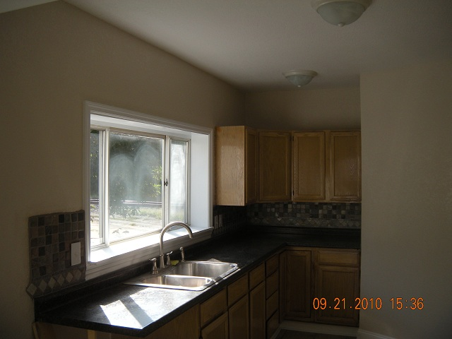
Kitchen
(after)

Slide 26
REPAIRS
Before you start any fix & flip project:
  Walk through property multiple times.
  Figure out what you can save from the materials and features that already exist in the house.
Try to save kitchens, bathrooms, doors, and moldings on most projects.
  Very costly to replace.
  These items can be fixed or enhanced in some way to make them look better than they once appeared.
  Saving these items can mean staying within budget.

Slide 27
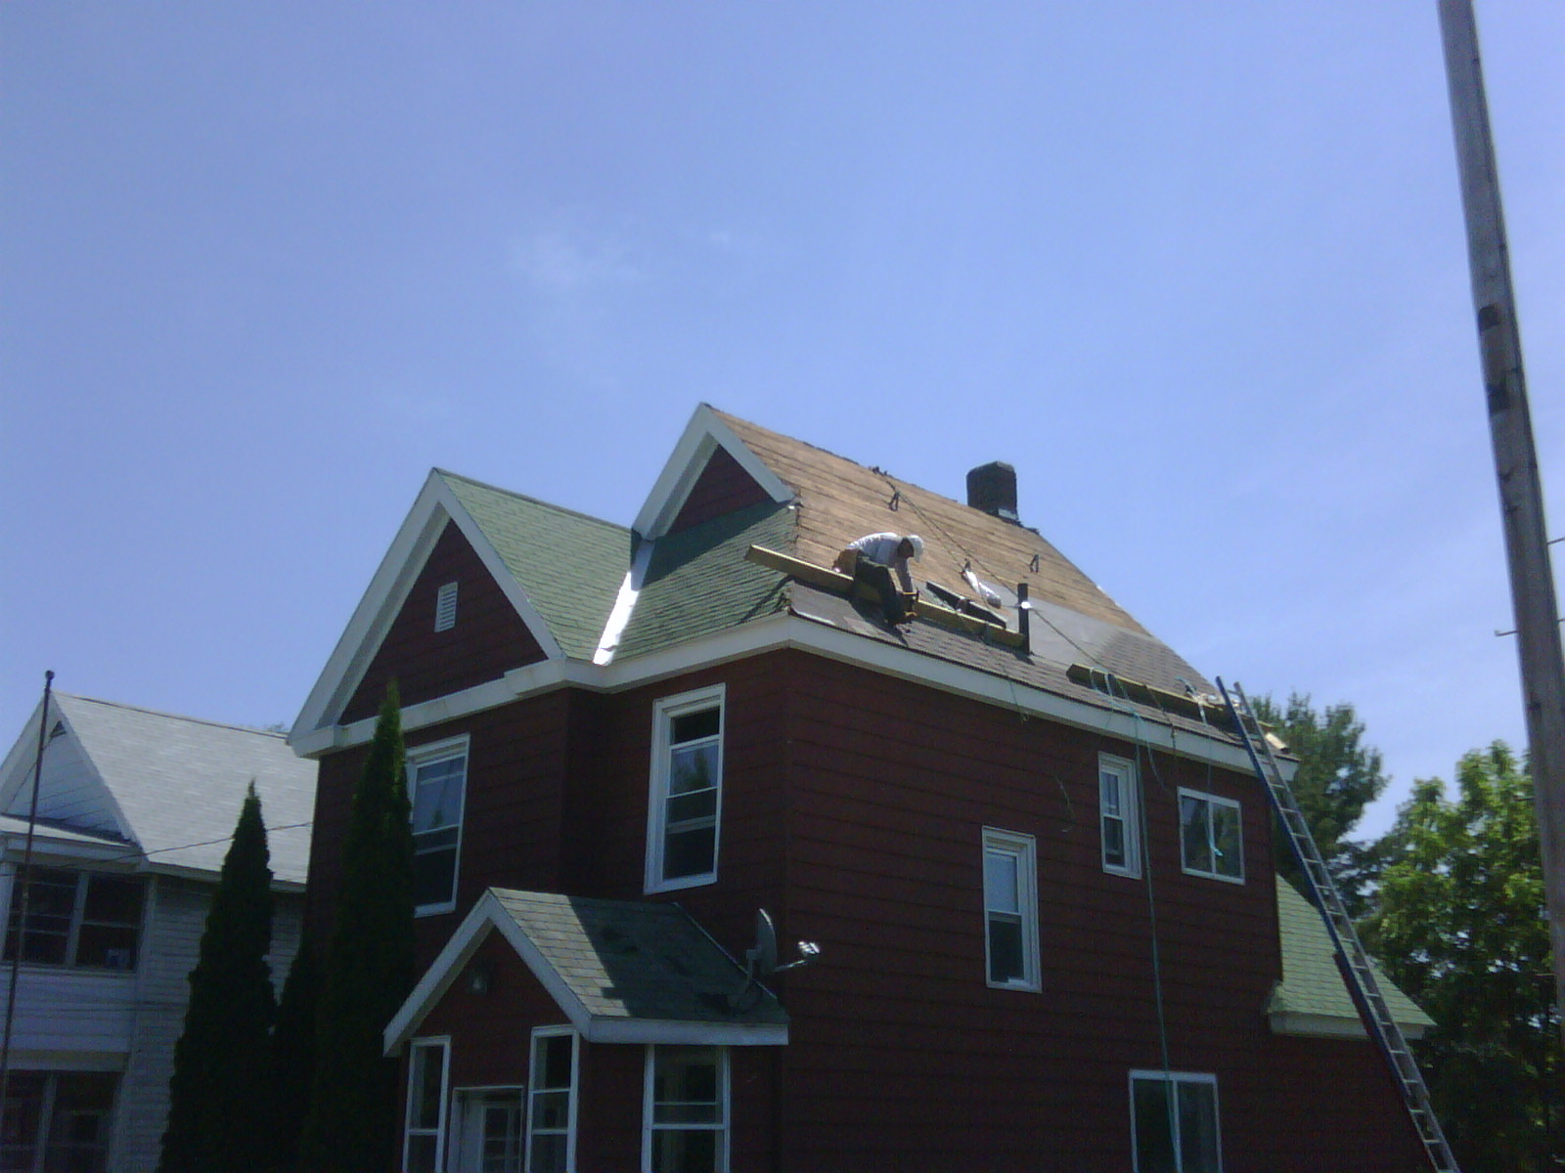
Roof (before)

Slide 28
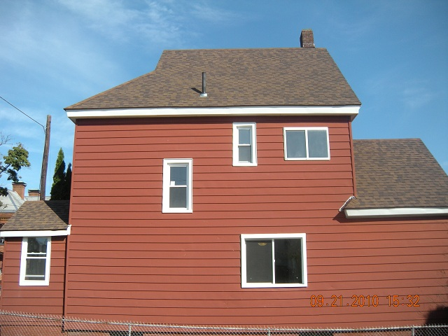
Roof (after)

Slide 29
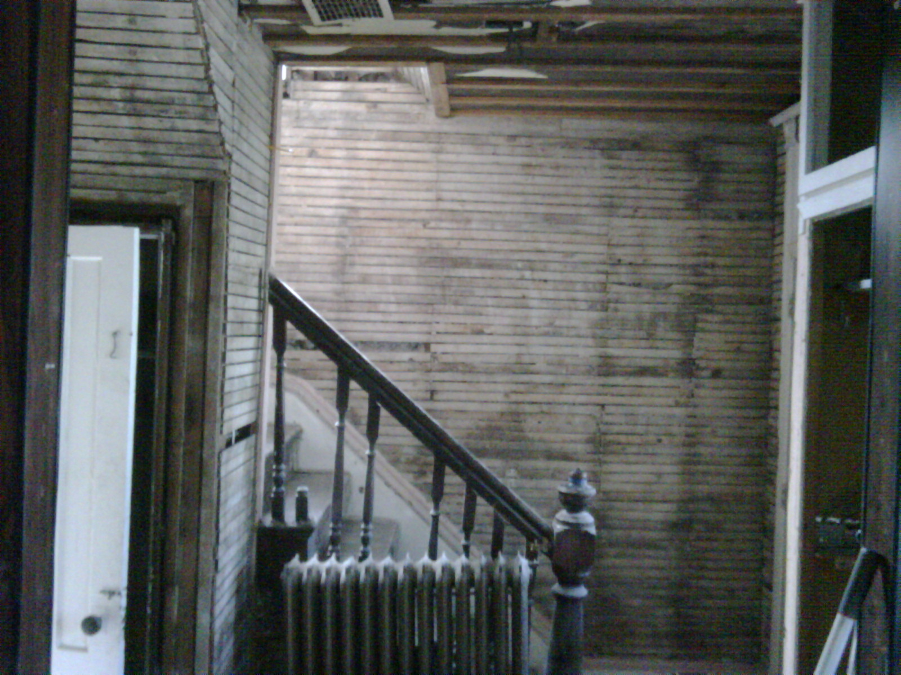
Stair way (before)

Slide 30
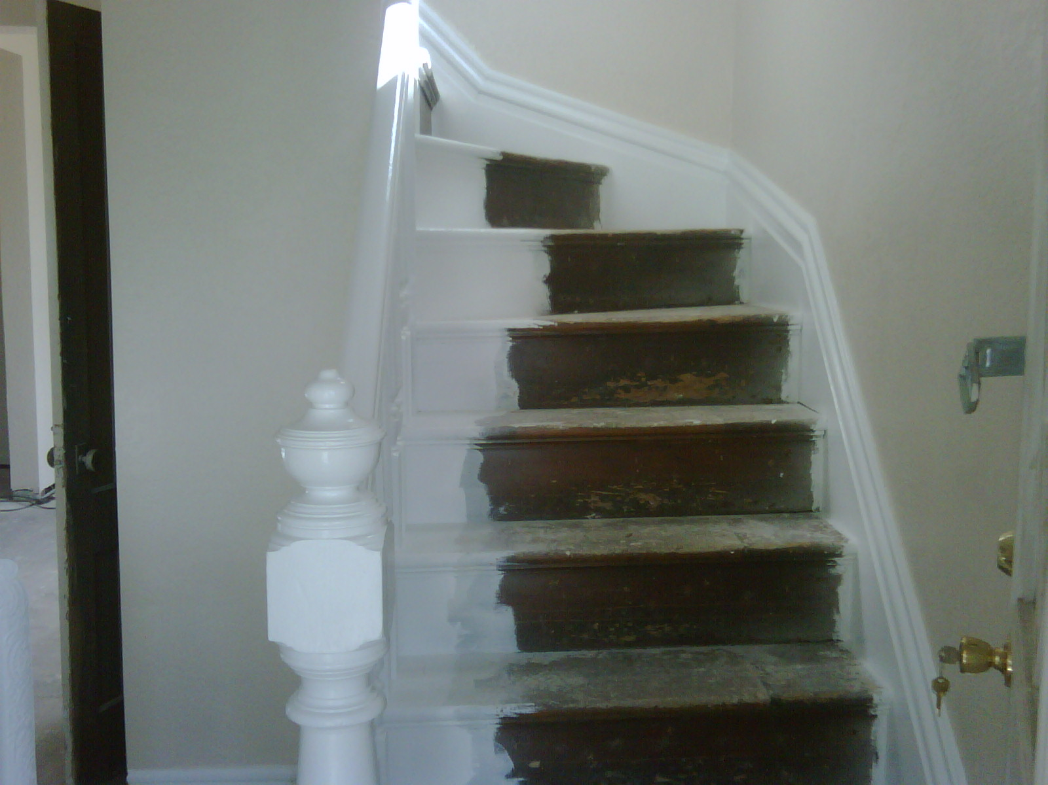
Stairway (after)

Slide 31
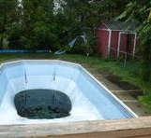
POOL (BEFORE)

Slide 32
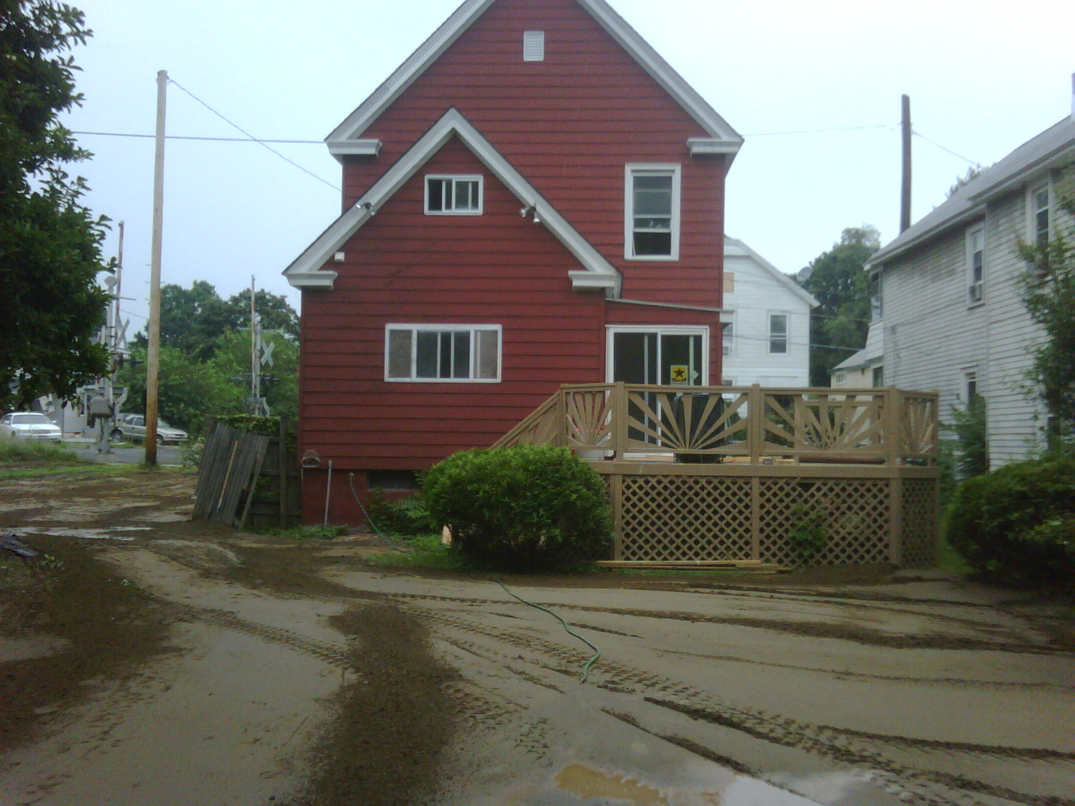
POOL FILLED IN (AFTER)

Slide 33
908 24TH STREET
Purchased property for $52,000
Totally gutted property down to studs
Total rehab cost $32,000
Total cost to hold property for 14 months $5,400, Including taxes,insurance,utilities.
Entire inside of building brand new
Sold property For $130,000
Net proceeds
$40,600

Slide 34
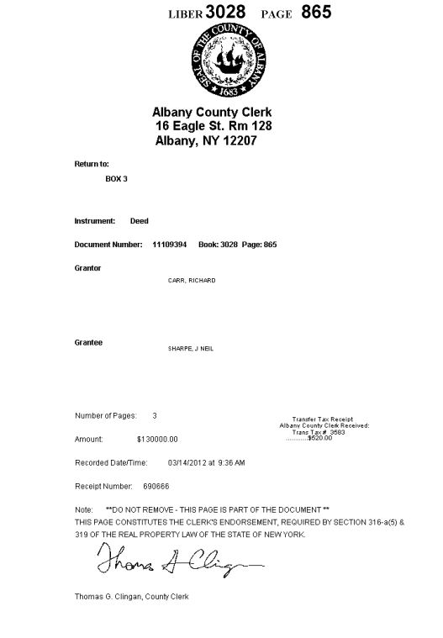
908 24TH STREET DEED

Slide 35
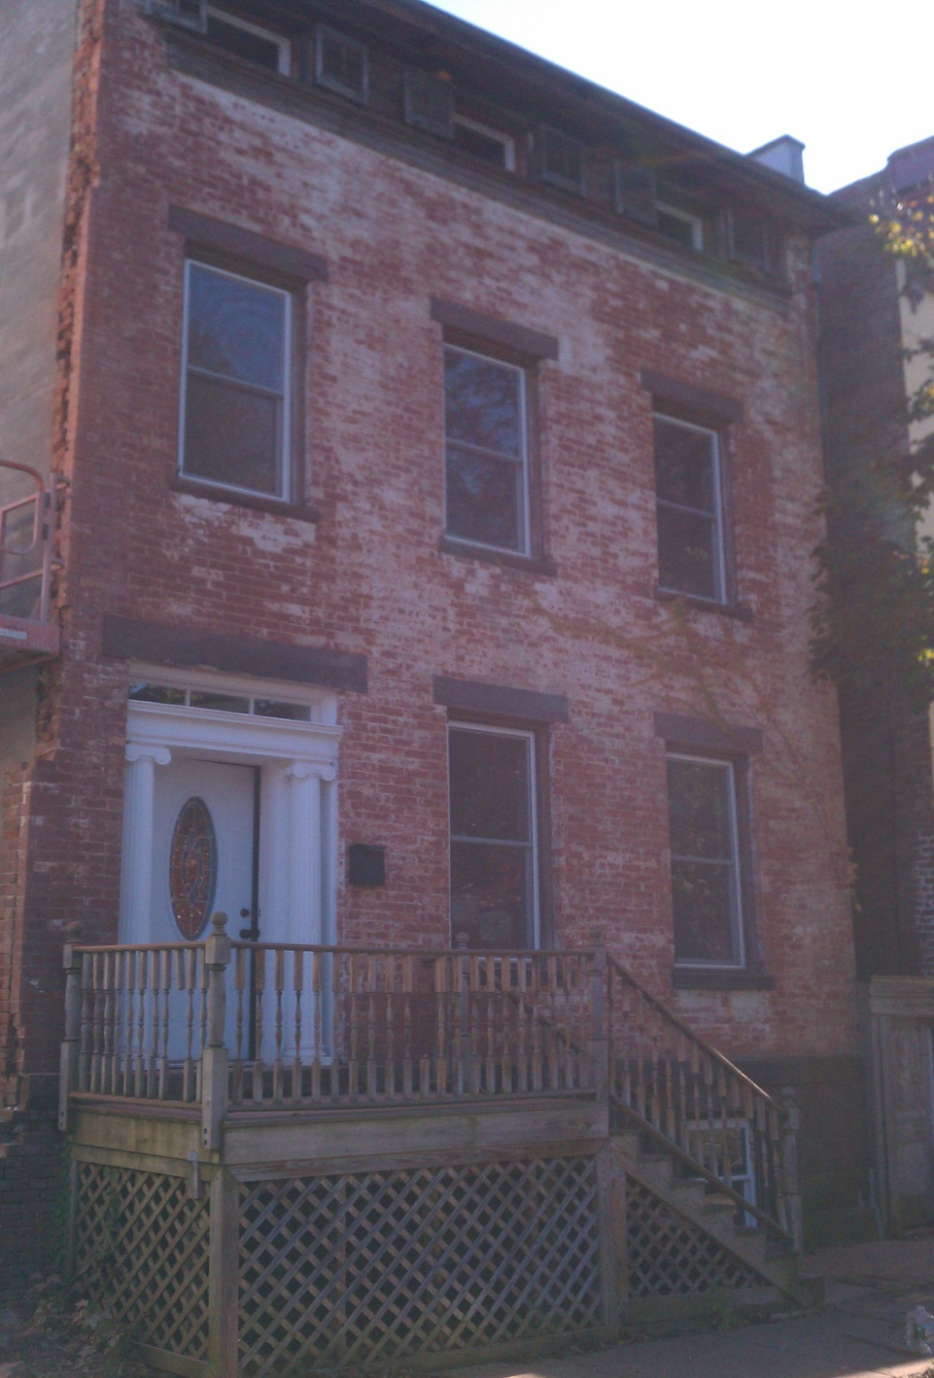
1410 1ST AVE WATERVLIET (BEFORE)

Slide 36
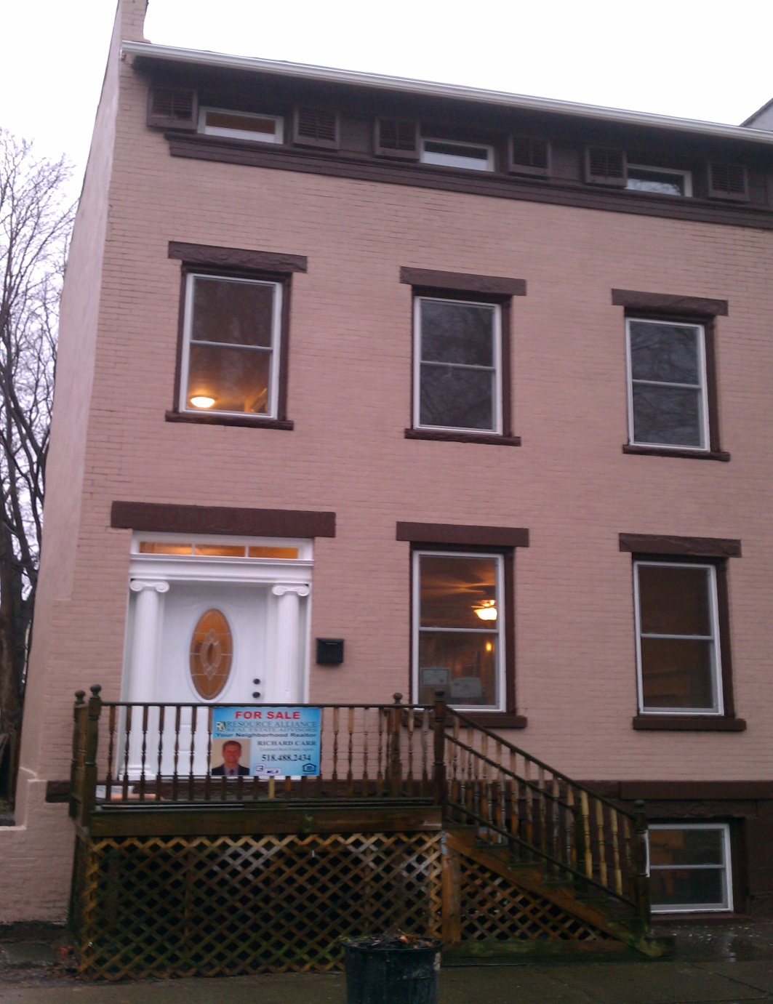
1410 1st Ave (After)

Slide 37
1410 1ST AVE WATERVLIET
Purchased property for $37,000
Total all repairs cost $ 45,000
Rehabbed 90% of entire 4 store building
Additional holding cost for 13 months $4,500
Taxes & utilities
Sold property for $159,000
Net proceeds
$64,500

Slide 38
SCOPE OF WORK
1410 1st Ave
Needed extensive brick foundation work, Over 2 months full time with a mason.
I found a mason on craigslist, He (Tony) was laid off from his union job, and he worked for me for $12.00 per hour.
When you are buying and selling properties you must try and find quality cheap labor (It does exist)! Tony ended up working for me for an additional 8 months until he went back to his previous job.

Slide 39
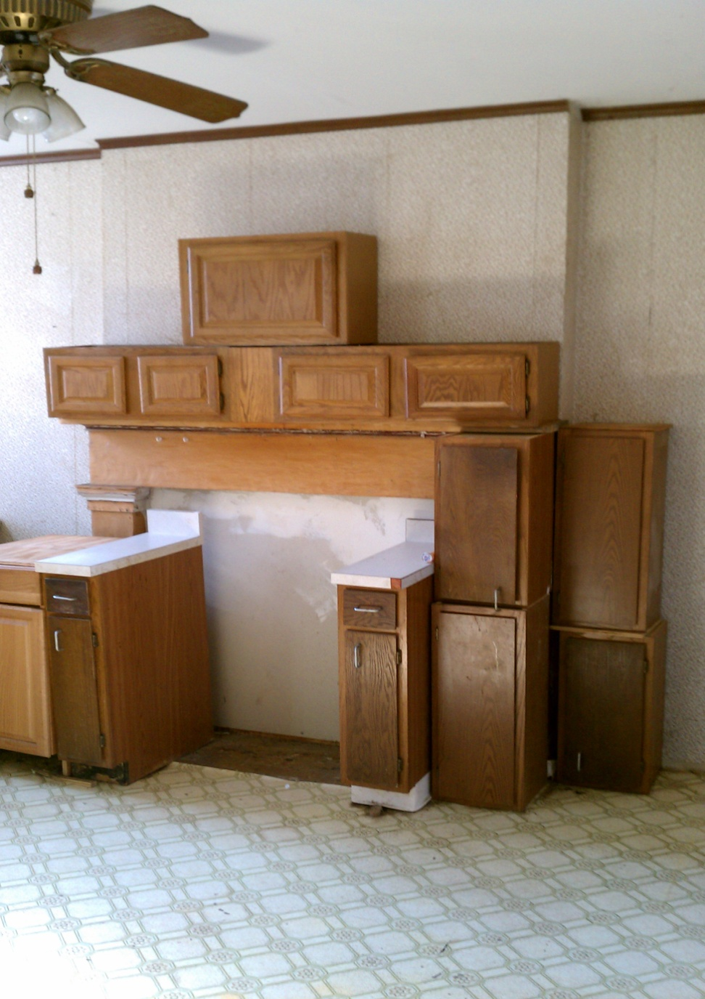
OLD KITCHEN

Slide 40
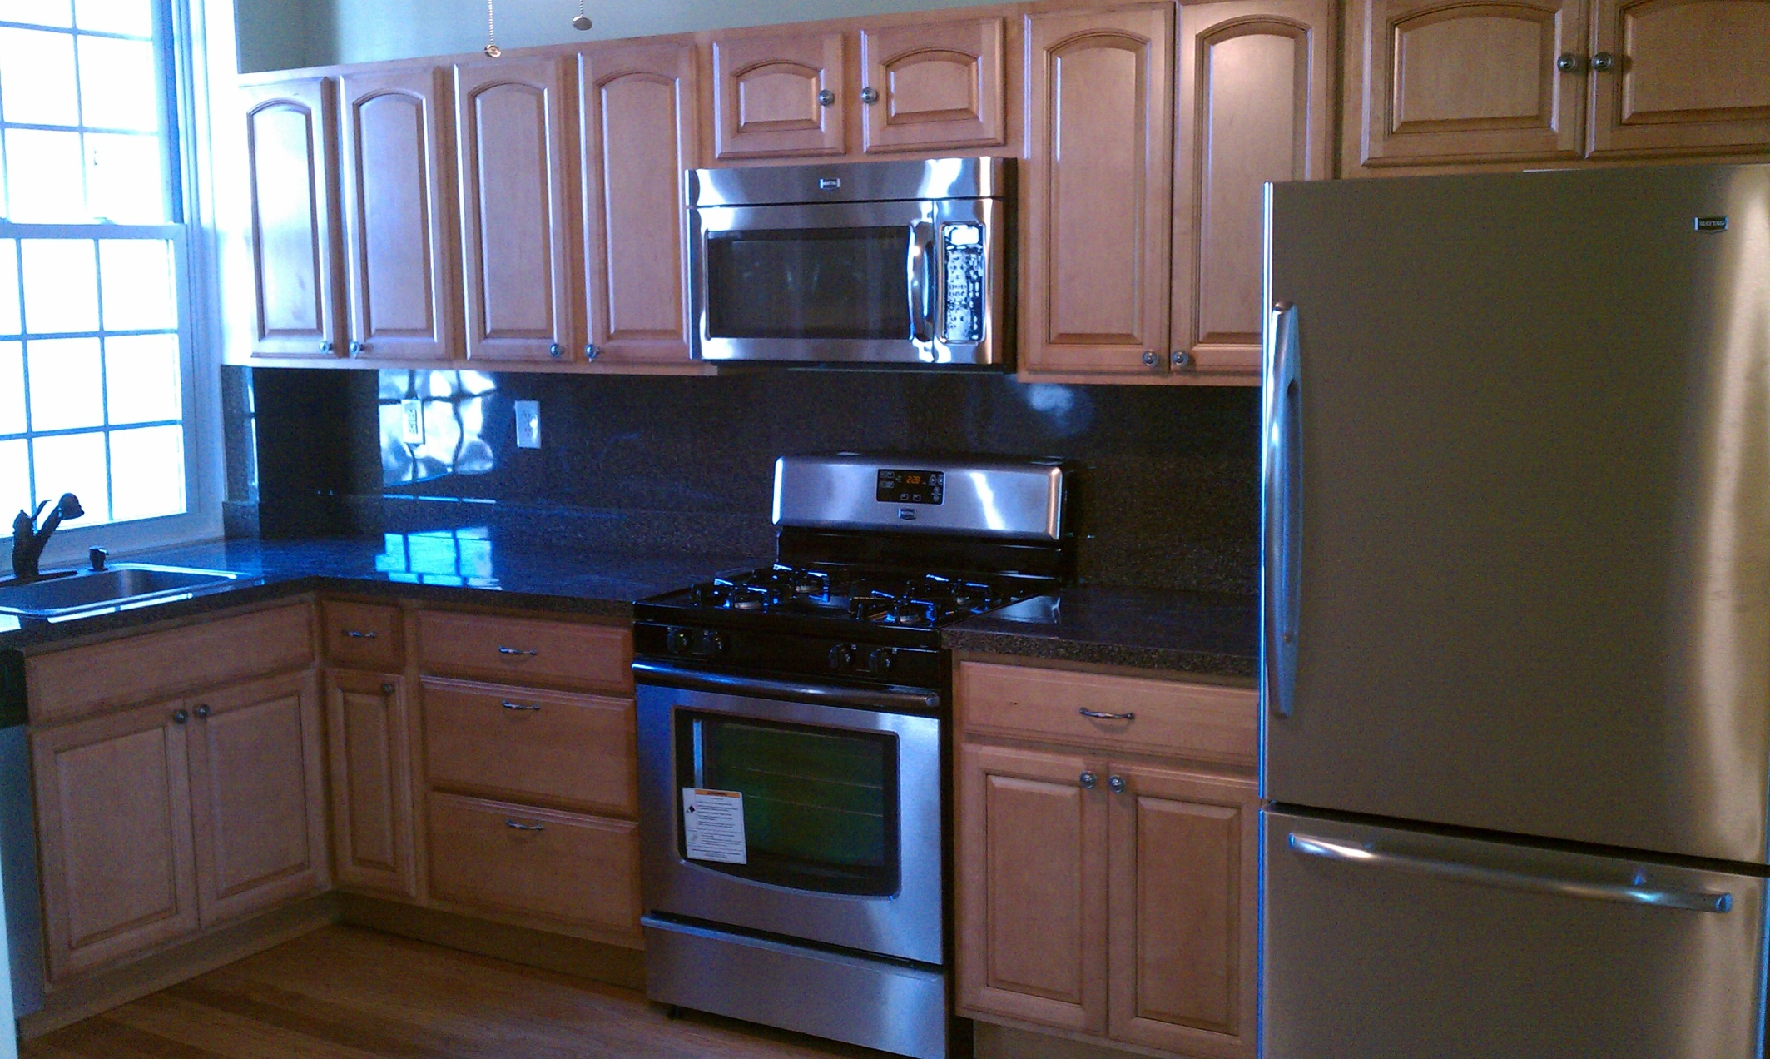
NEW KITCHEN

Slide 41
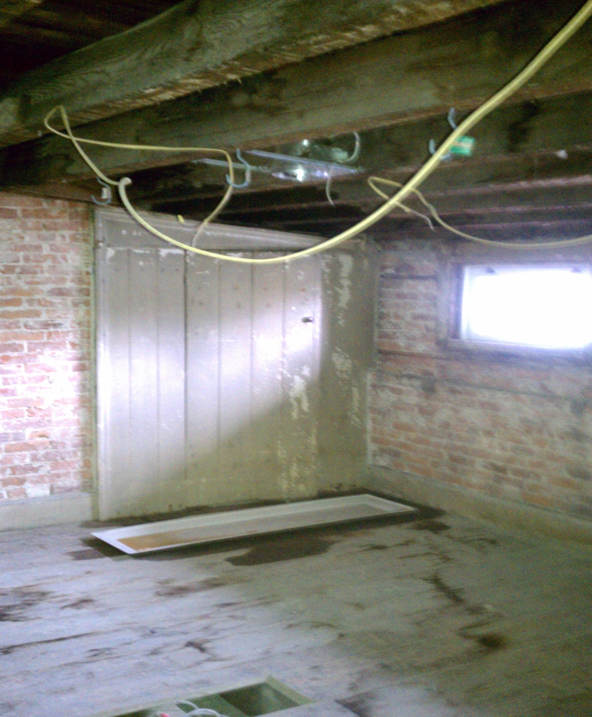
3RD FLOOR OFFICE (BEFORE)

Slide 42
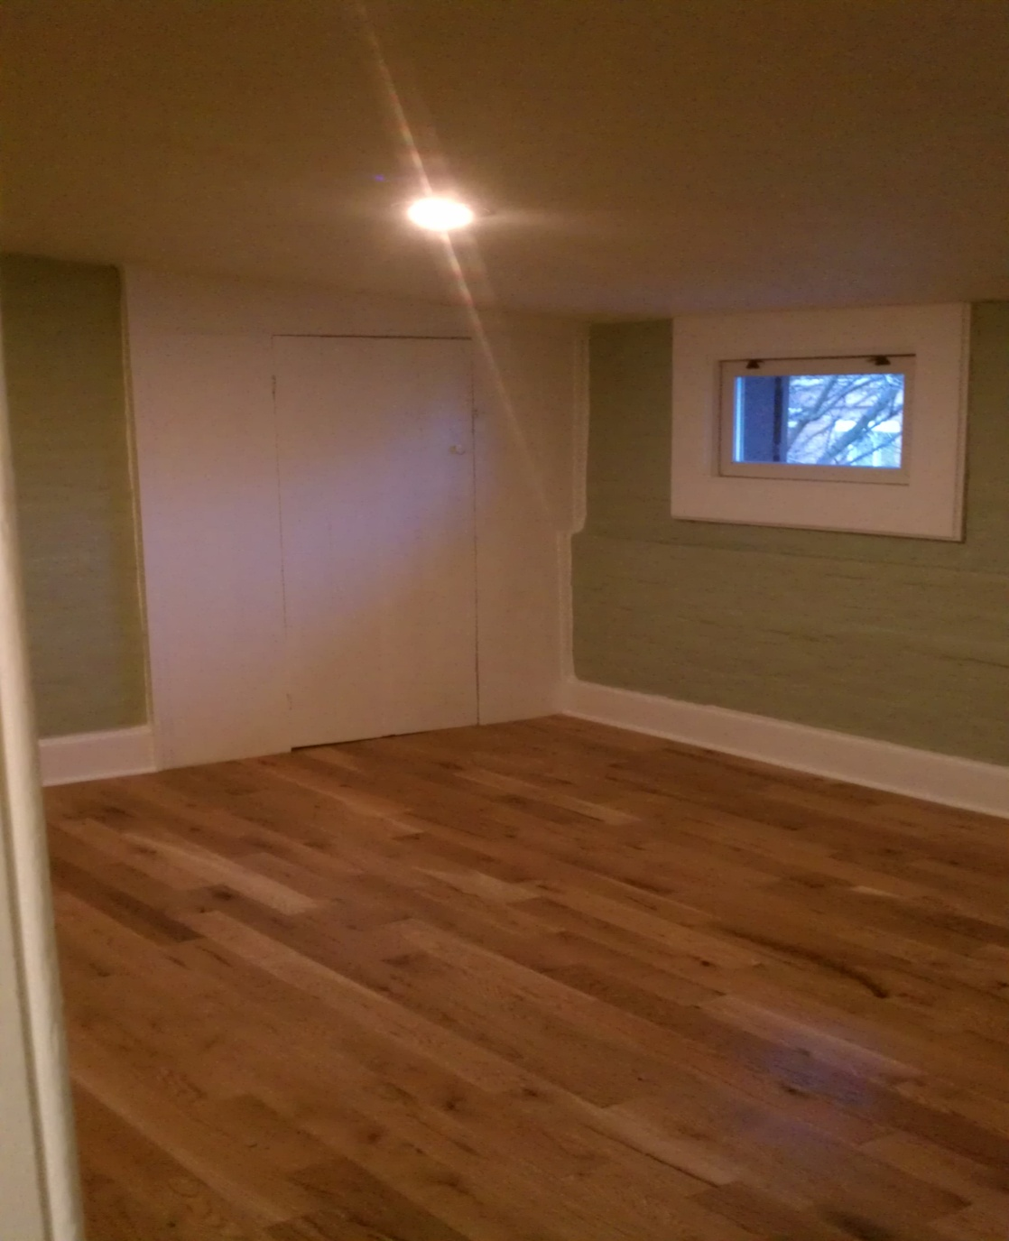
3rd floor office (After)

Slide 43
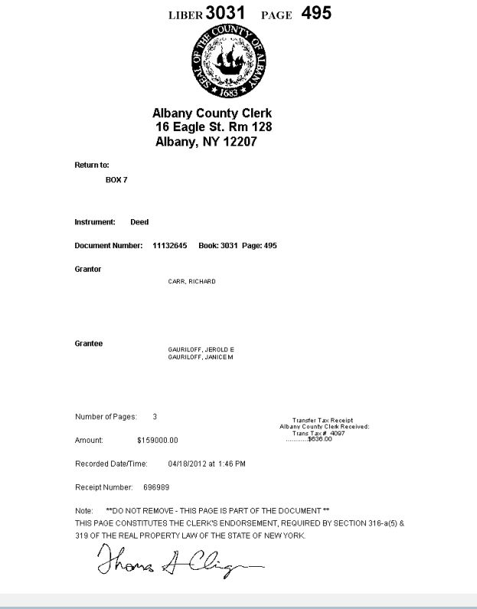
1410 1ST AVE DEED

Slide 44
MUNICIPALITIES PERMITS
Permits are needed on all major changes that are made to the property. Individual permits are needed for:
Major construction floor plan change
Insulation (new walls)
All electrical
Water heaters
HVACs
All roofing
All siding
All foundation work
These permits are necessary at all stages of completion. Without permits it would be very difficult to obtain a COC, (Certificate of Occupancy).

Slide 45
MUNICIPALITIES PERMITS
Certificate of Occupancy
CO is needed to sell the home once it is completed.
CO, states to the consumer (home owner) the property is free and clear of defects and is safe and up to code to occupy.
Most home owners will get a home inspection as well.
Check with you local municipality to determine what permits are necessary for you to obtain and at what stages to apply.

Slide 46
PERSONAL FIX AND FLIPS
79 Blue Jay Way
Intended to be a Fix and Flip project.
Purchased 12/03/2015 at Saratoga County Court House.
I was the only bidder, Bidding started at $328,000
  The attorney conducting the auction excepted my bid of $329,000.
  I also negotiated to finance the property with her and the bank right at the same location. They accepted.
Normally all auctions are paid in cash within 30 days of Auction being completed. Or you forfeit your 10% deposit.
After showing the property to my wife two days later we decided to make the property our personal home instead of flipping it.

Slide 47
79 BLUE JAY WAY
REPAIR COST
New hardwood floors entire first floor $5,400
Granite counters Kitchen and Bathroom $5,100
Kitchen back splash Tile $2,000
Custom paint job entire inside materials $1,500
All appliances $6,500
Pool liner and repair $4,500
Landscaping $2,000
New deck $7,200
New driveway $5,200
All Repairs cost $39,400

Slide 48
79 BLUE JAY WAY
Acquired property for $329,000
All repairs cost $39,400
After market value $425,000
If property sold, estimated Net return $56,600
All repairs took 2 months to complete part time.
Estimated Net Return $56,600

Slide 49
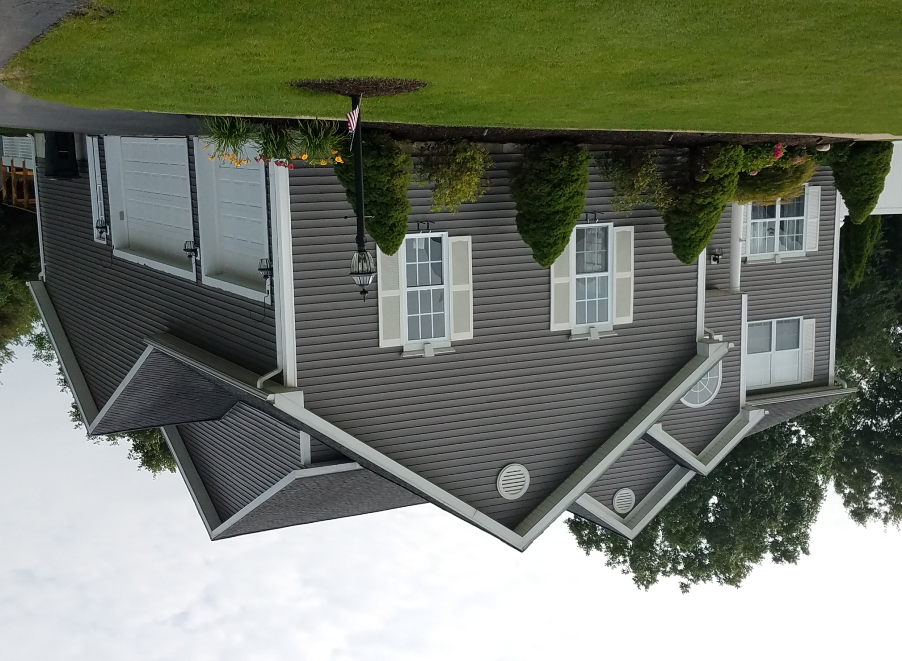
79 BLUE JAY WAY

Slide 50
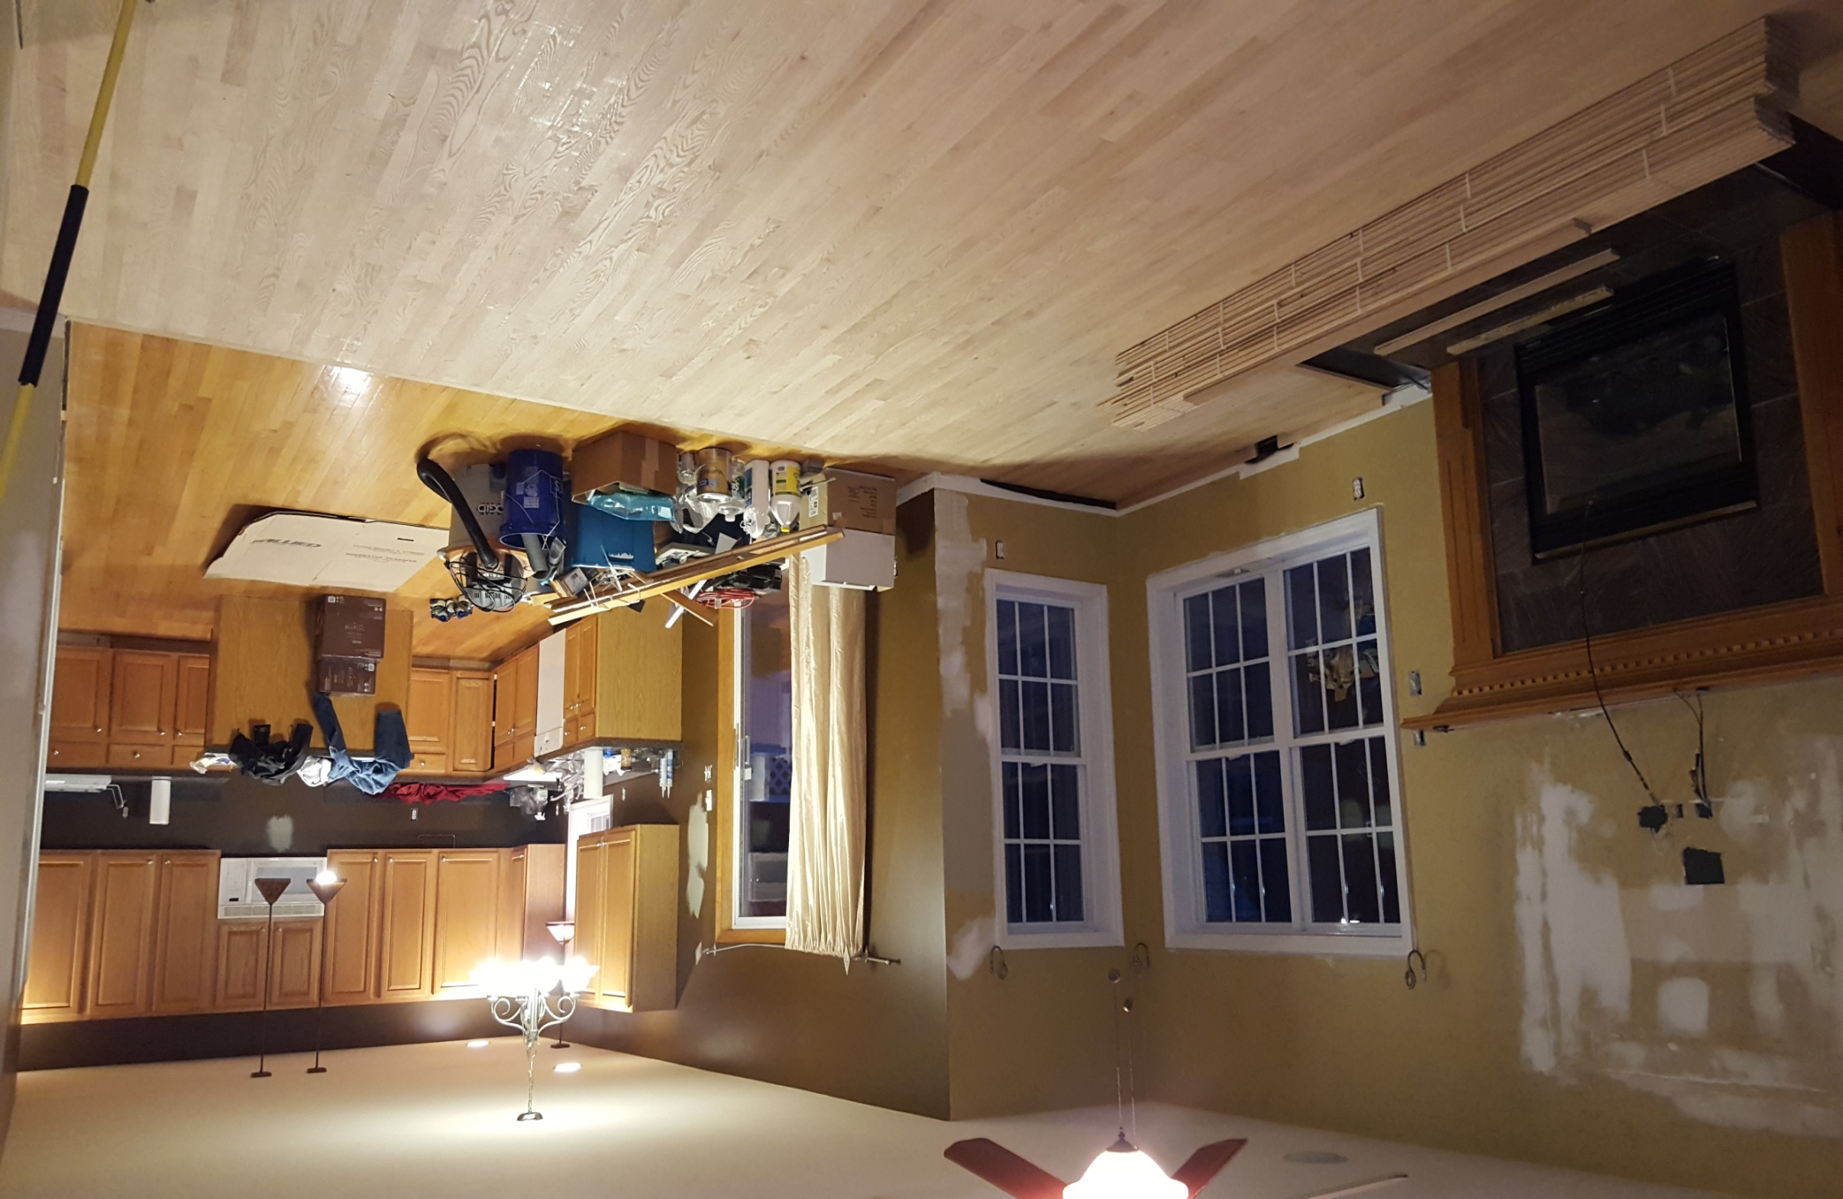
FAMILY ROOM INTO KITCHEN

Slide 51
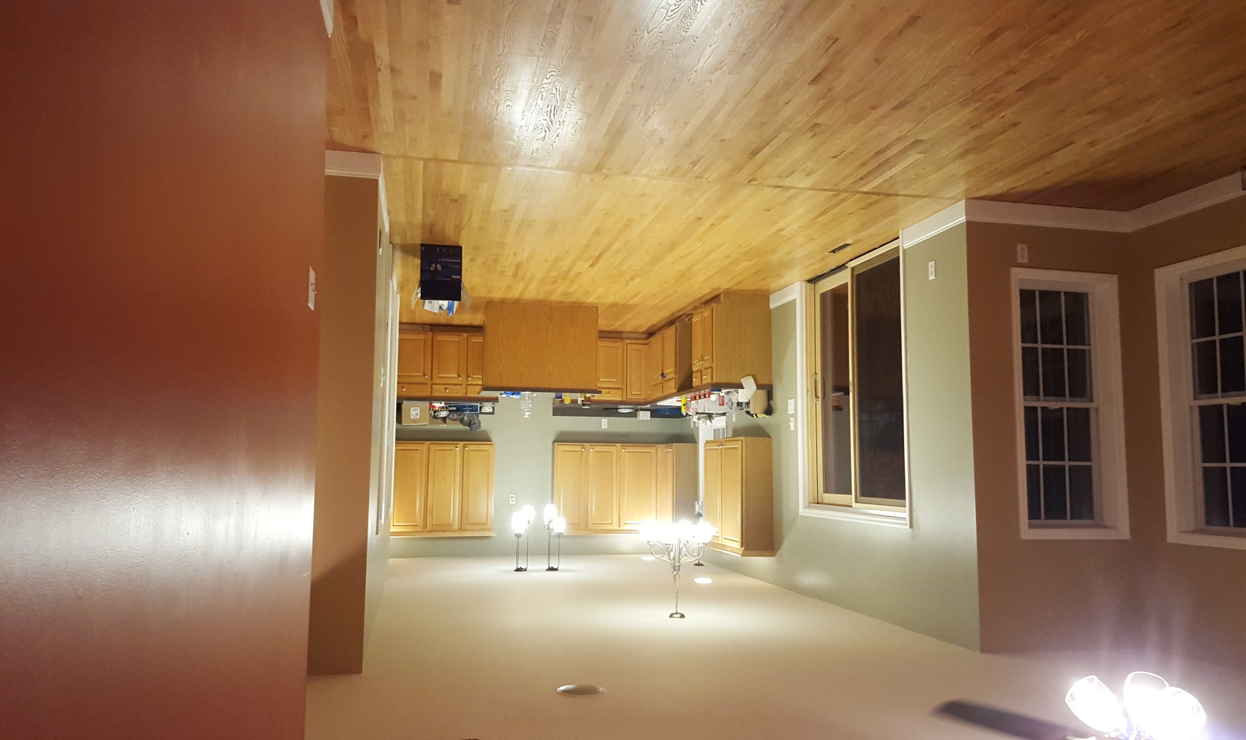
AFTER

Slide 52
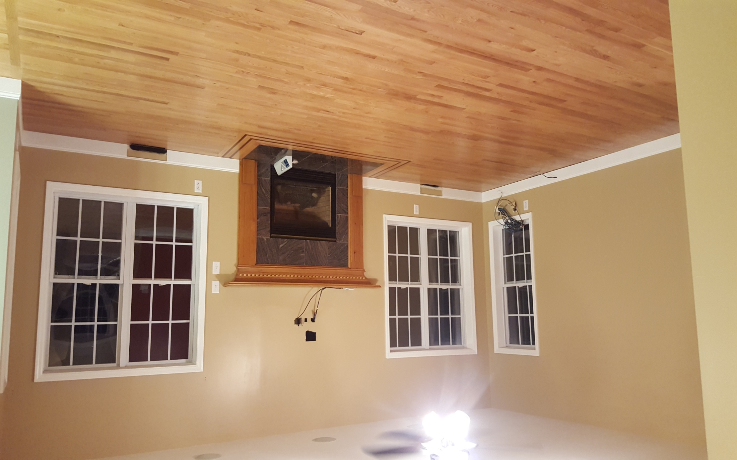

Slide 53
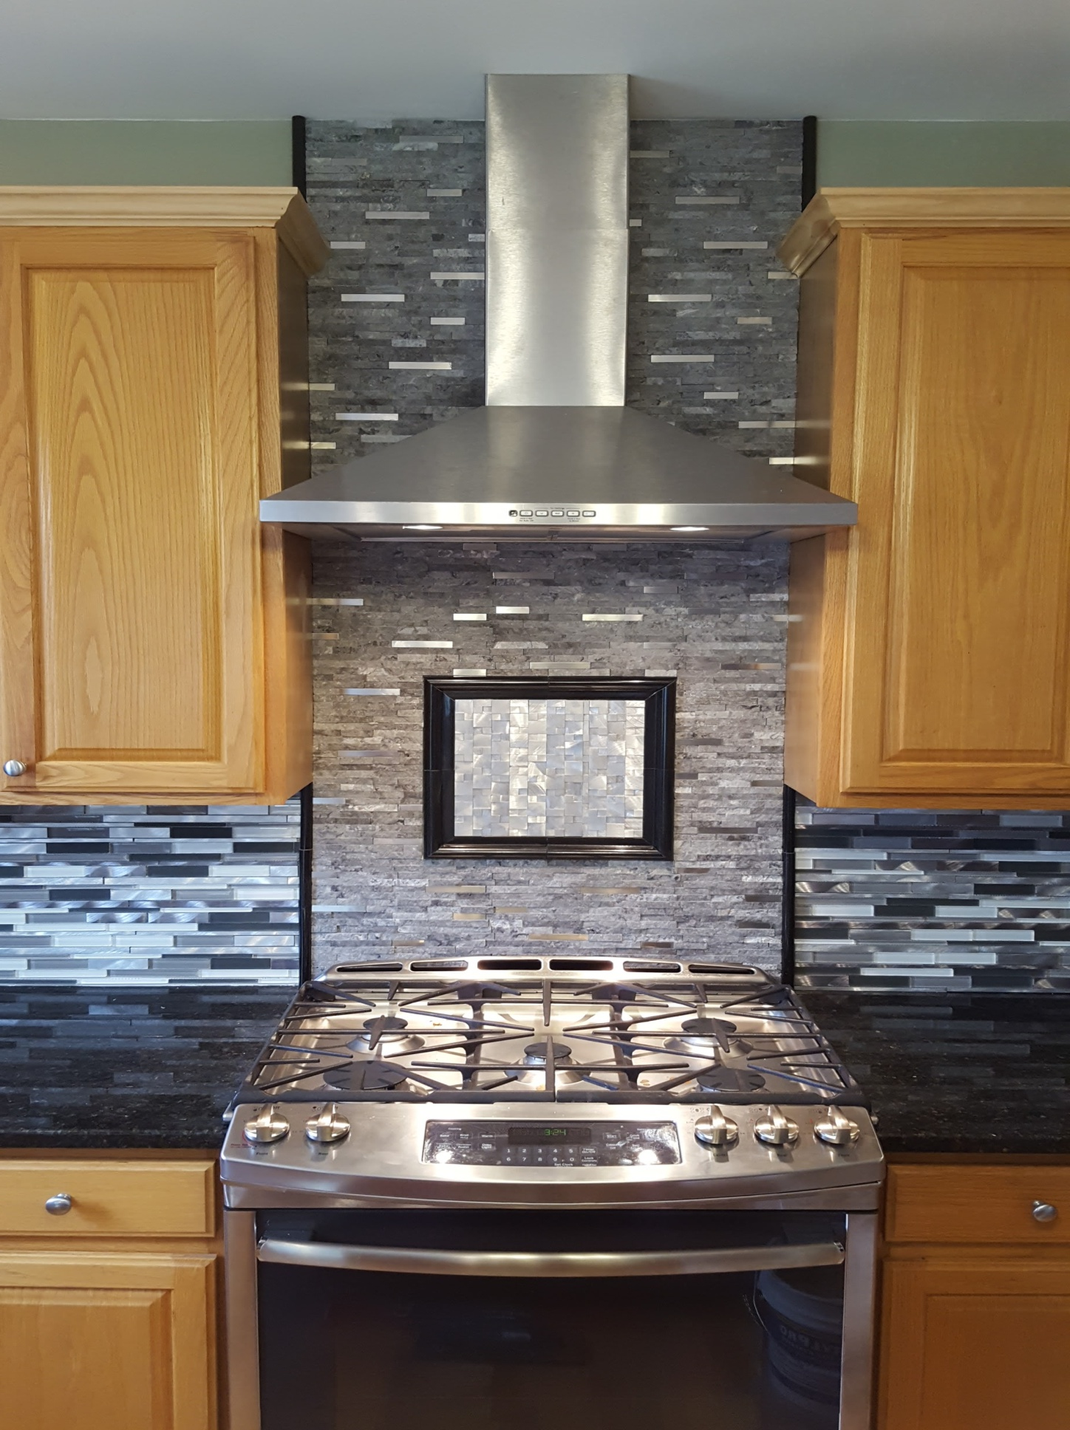
KITCHEN

Slide 54
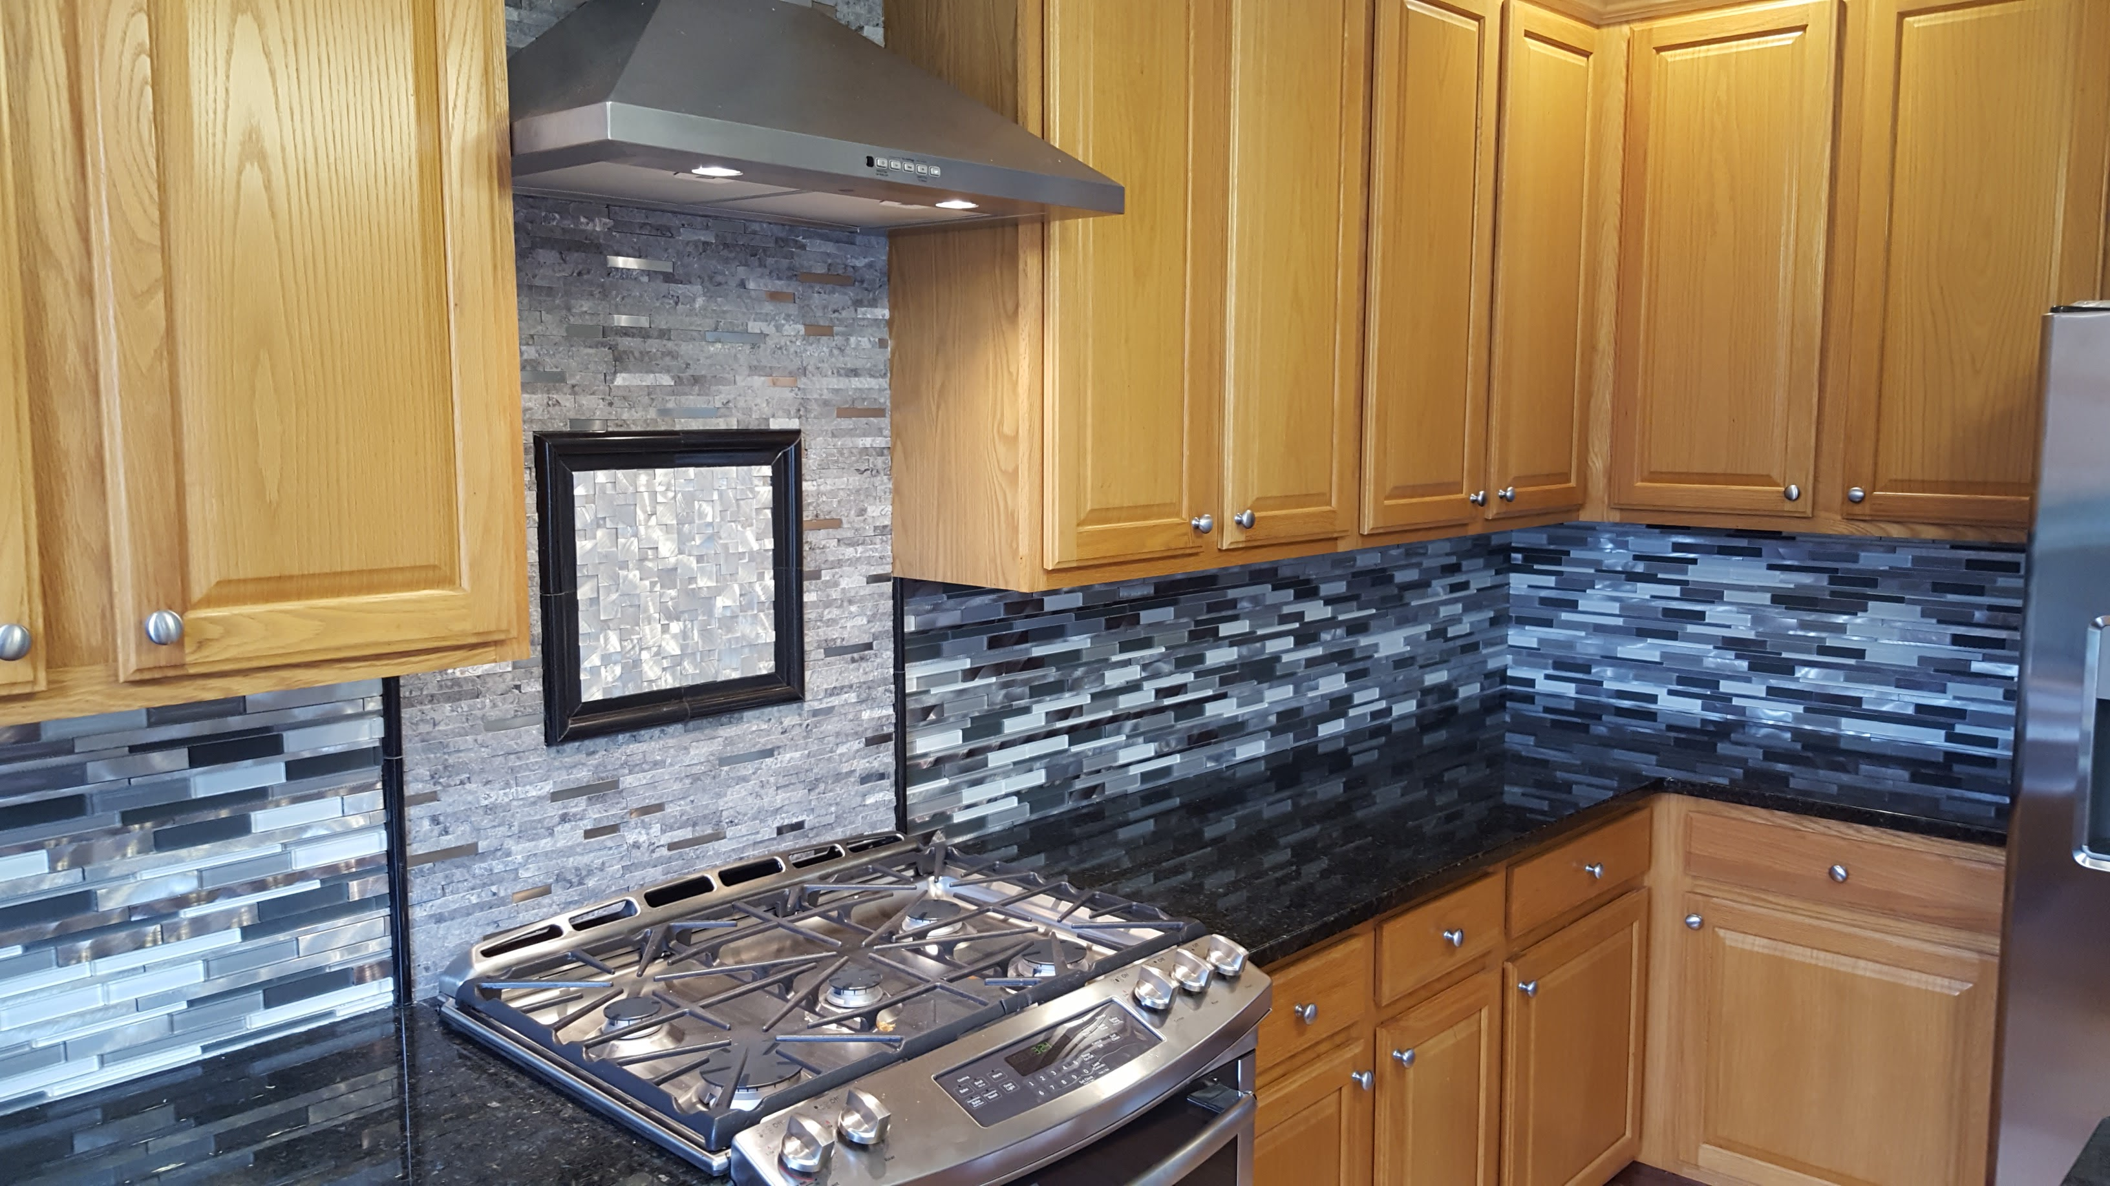

Slide 55
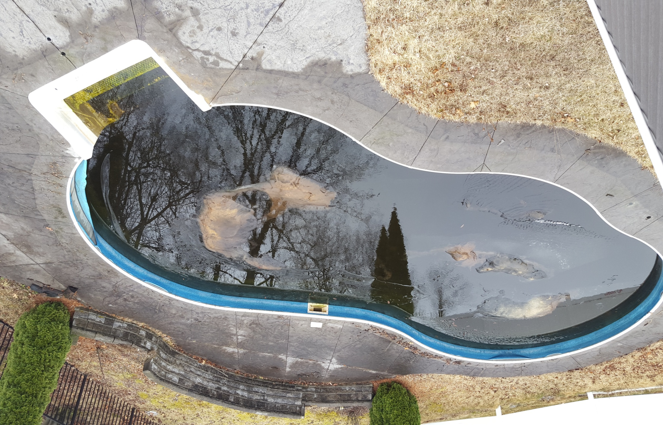

Slide 56
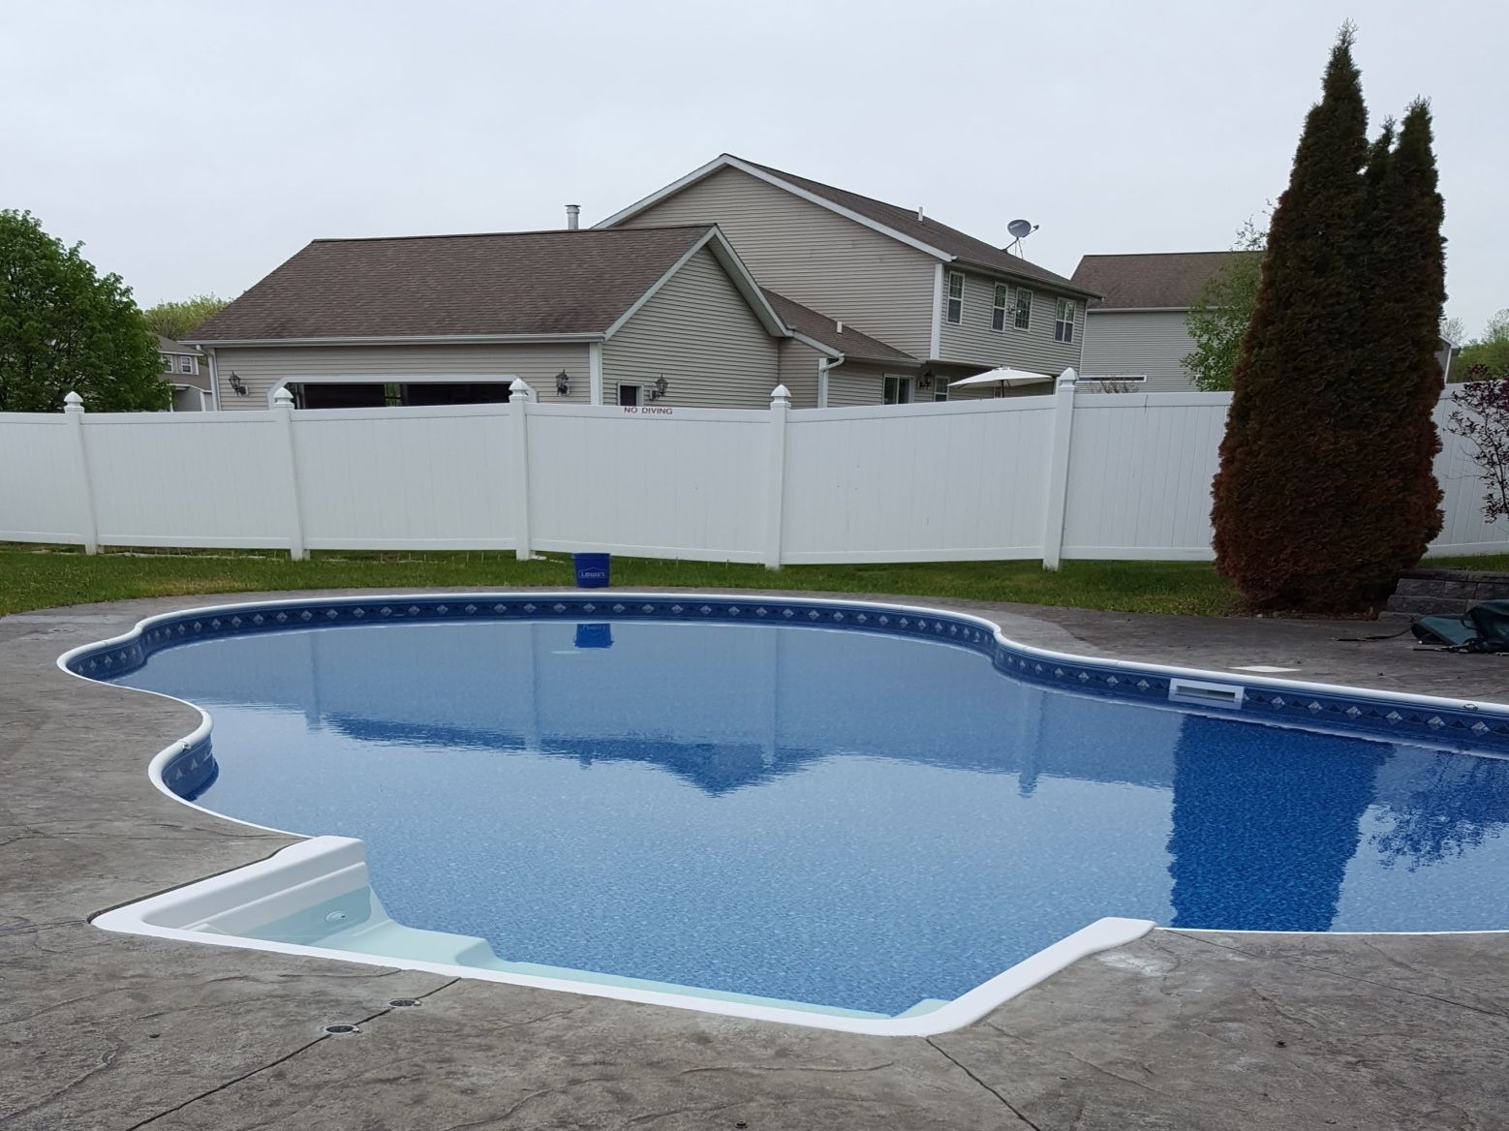

Slide 57
SUMMARY
Bank Owned (REO) Properties
  Check all taxes and liens.
Determine Repair Cost
  Figure out what will be replaced, fixed and rehabbed.
  Remember to always estimate repair cost higher.
Determine the Scope Of Work
  Determine your order of repairs.
  Determine timeline and expected completion date.
Your ARV (After Repair Value) MUST be Determined Before You Purchase Any Property

Slide 58
SUMMARY
Once You Find A Property You Would Like To Invest In (Fix & Flip)
  Compare the neighborhood location.
  Pick your location wisely.
  Once you know the AVR, you can begin to calculate cost of repair, as well as holding cost.
Before You Start Any Fix & Flip Project
  Figure out what you can save from the materials and features that already exist in the house.
  You must try and find quality cheap labor.

Slide 59
SUMMARY
Permits are needed on all major changes that are made to the property
Certificate Of Occupancy (COC) is needed to sell the home once it is completed
  Most homeowners will want an inspection as well.
Auctions
  Normally all auctions are paid in cash within 30 days of Auction being completed. Or you forfeit your 10% deposit.

Slide 60
GET STARTED TODAY FLIPPING HOUSES

