Slide 1
Find, Fund, Fix & Flip LLc

Slide 2
Find, Fund, Fix & Flip
Create Passive Income, Buying And Holding Multi Unit Properties &
Find, Fund, Fix and Flip Houses

Slide 3
How to Find Properties
Public notices - Notice of Sale Description in the newspapers and City, County, State Court Houses, Libraries, Sheriffs offices, and other city, state and county offices.
Below are some of the due diligence buyers should be prepared to do.
Current and overdue Water and Sewer Bills.
Past Codes Violations.
Current Year Tax Bill (will be pro-rated at closing)
Check county for all past due or delinquent taxes.
Zoning and Planning Allowed uses after closing.
Prior use does not guarantee future zoning.

Slide 4
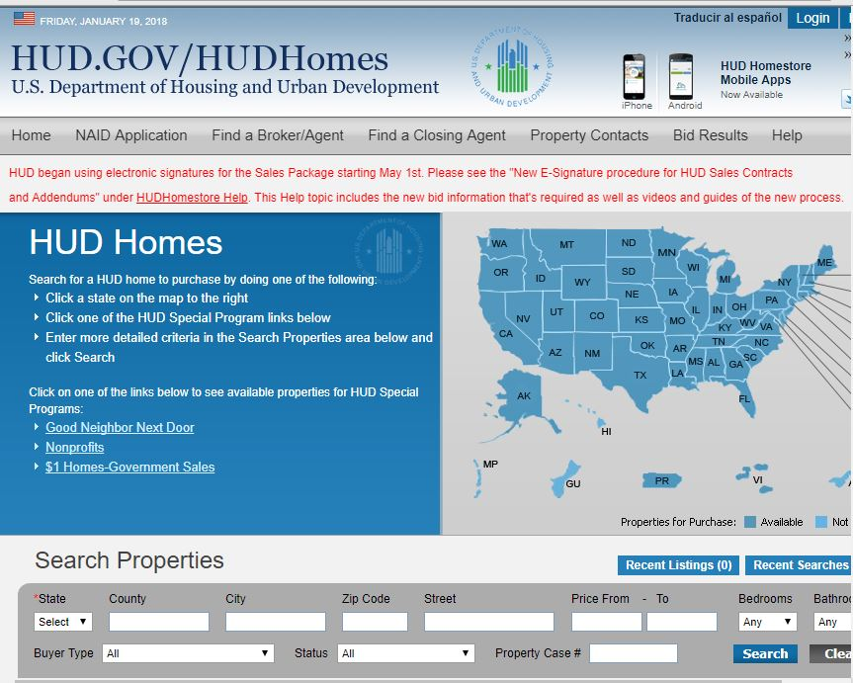
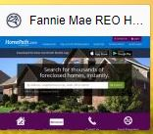
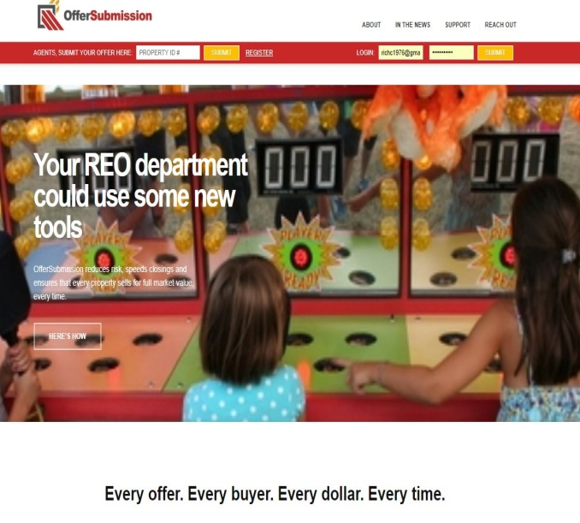
ACQUIRING PROPERTIES (Find Below Market Houses)

Slide 5
BANK OWNED PROPERTY WEBSITES
Local ENYR MLS
Hudhomestore.com
Homepath.com
Auction.com
Xhome.com
Hubzu.com
Reo.wellsfargo.com
offersubmission.com
Res.Net
A-1Reo
Craigslist.com
This is just a few that exist. There are many to choose from.

Slide 6
Albany County Court Auction

Slide 7
WHAT IS A BANK OWNED PROPERTY?
A bank-owned or real estate owned (REO) property:
Individual loses title possession through foreclosure process.
Bank regains title possession.
Promissory note is the legal instrument lost by owner through completion of foreclosure process.
Property is publicly auctioned at the county or listed by the bank on the MLS.
This process could take up to 3 years or more.
We will be referencing my personal experience with this from my project at 6 McelWain Ave in Cohoes, N.Y.

Slide 8
WHAT IS A BANK OWNED PROPERTY?
Either sells or fails to sell in a foreclosure auction, due to bank or county .
Bank owns the property, handles eviction, pay ‘s off tax liens, may be some repairs.
Bank will contract with local agent to list the property on the market.
Property reverted, to the mortgage lender after the property fails to sell at auction.

Slide 9
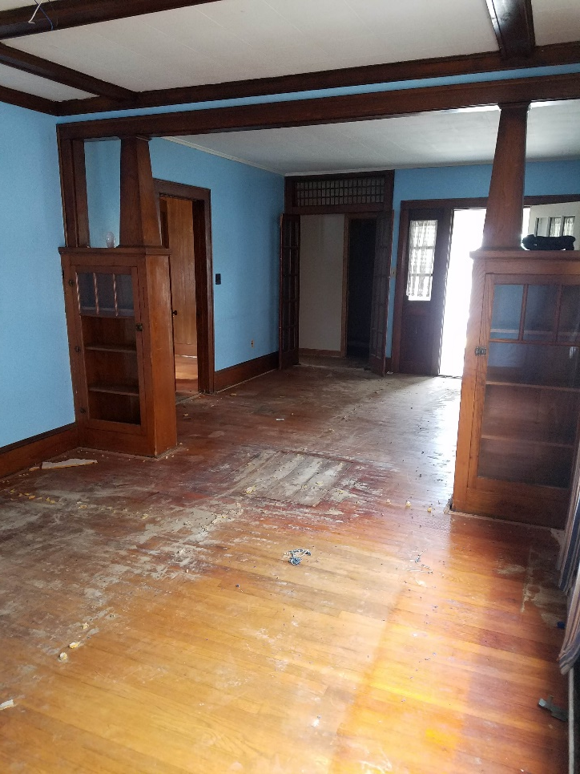
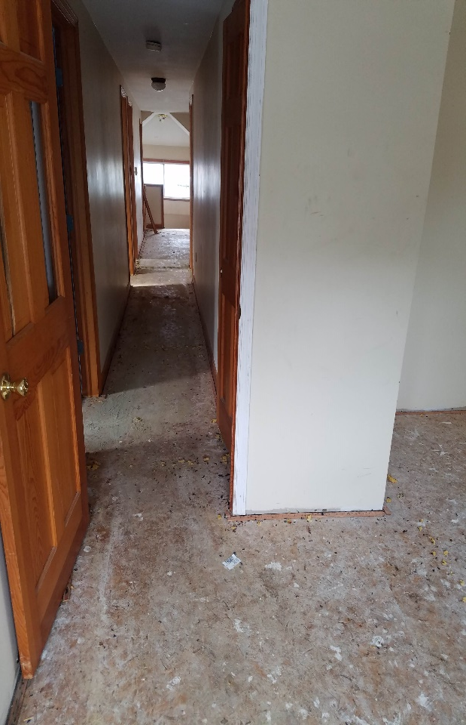
892 6th Ave, Lansingburgh
Bank Foreclosure
4 Bedroom 2 full bath bungalow 2,000 square feet.
This property was bid on during the last Find, Fund, Fix, And Flip class on 10/04/2018.
First initial bid was $25,000
With a $2,500 credit card deposit submitted online, at Auction.com.
Final bid price was $55,499
Total purchase price was $58,273.95
Contracts signed on 10/10/18
EMD $2,913.00
Total closing cost $3,092.00

Slide 10
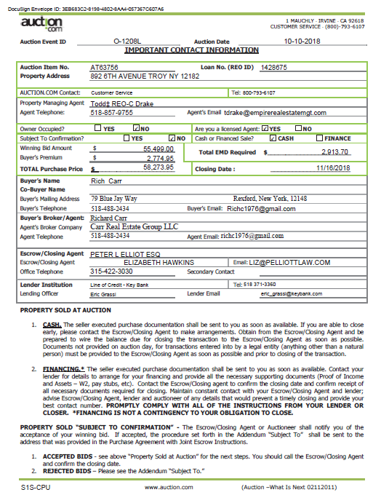
Auction.com Contracts

Slide 11
892 6th Ave Lansingburgh
Purchase price $60,000
Repair cost $35,000
Holding cost $3,500
Utilities +/- $950.00
ARV Market price
$179,000
Estimated net profits
$80,500
Minus buyer agent 2.5%
Of the sale price
After placing a bid on this property, I scheduled a showing. I also did a market analysis to determined ARV. I drove around the area and determined location was marketable.
While at the showing I measured the property square footage and began to determined the repair cost.
Repairs consist of New roof, new furnace, all plumbing replaced, New carpeting upstairs, windows, refinishing Hardwood floors downstairs, New painting all throughout, vanity’s, toilets, kitchen counters, appliances, upgraded electrical panel, new electrical wiring on the first floor. Sheetrock replacement, sheetrock repairs, new doors, new vinyl flooring.
All repairs estimated to be $35,000

Slide 12
County Tax Lien Auctions
Albany County Auctions & Capital Region
Town of Colonie, City of Cohoes, City of Watervliet, City of Albany.
If the properties on the list remain unpaid after 4 years of collection efforts Albany County is now proceeding with foreclosure and will take title to any that remain unpaid. Once taken, County-owned parcels are transferred per the conditions set forth in the County Disposition Plan.
Albany, Rensselaer, Schenectady, and Saratoga Counties are very similar when it comes to handling tax lien collection.

Slide 13
Auctioned properties & Tax Liens
Most liens are removed after a foreclosure property sale, but certain liens may remain.
Here are some examples:
Any lien recorded on title prior in time to the foreclosing mortgage.
First Mortgage (if the foreclosing mortgage is a second or third mortgage)
HOA or COA assessment liens (in certain states)
Mechanic’s Liens (in some states)
Government liens such as state and federal tax liens, city or county liens, US Government liens.
IRS liens (IRS may buy the property within 120 days after sale at the price paid at foreclosure sale)
Code Enforcement Liens, Environmental Liens, and Utility Liens
Child Support Liens, Etc..
I always recommend owner’s title insurance policy, based on ARV.

Slide 14
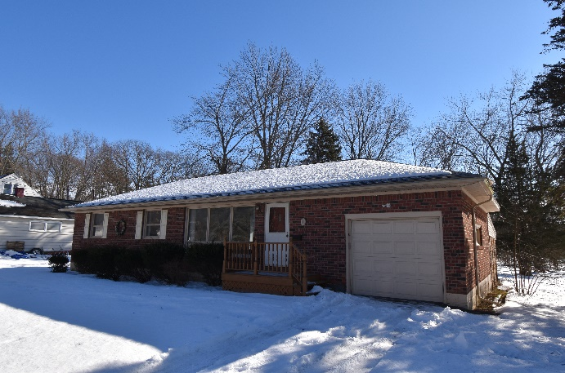
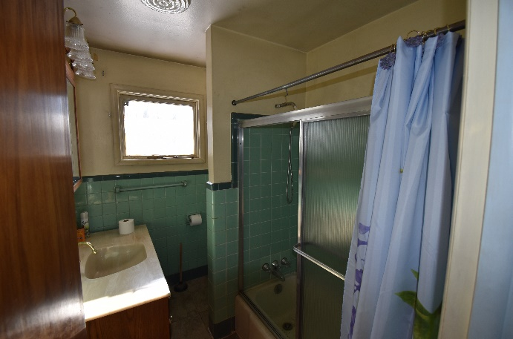
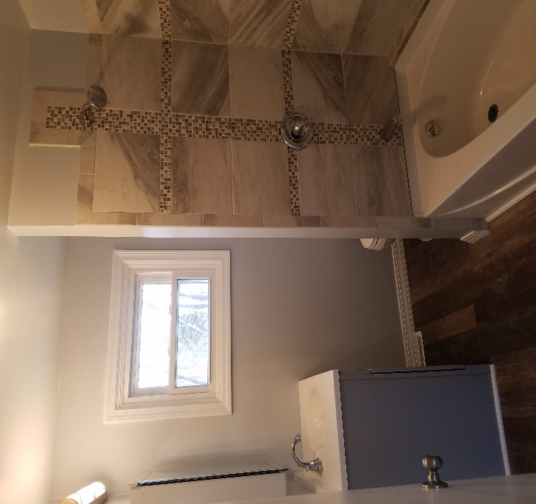
Off The Market Homes
1 Overidge Rd Latham
Another way to purchase property is by buying from an owner that does NOT have a mortgage.
The seller may have a property that needs extensive repairs before it could be sold. You can acquire these property sometimes by the owner holding paper (promissory note). This is an option when the property is not well marketable. When the owner holds paper meaning the promissory note.
The owner now acts as the bank, you gain title to the property, and the deed is filed and recorded in your name with terms and conditions you and the owner set forth. All property payments are made directly to the owner, all taxes are paid by you, (the new owner) directly to the municipality, according to the local tax map. In some cases this may be a less expensive way to acquire property. Once the property is repaired, you can now borrow against the property and payoff the owner.

Slide 15
1 Overidge Rd, Latham
Purchase Price- $150,000
Property & School Taxes- $4,015
Insurance ( Hazard)- $850
Water & Sewer Bill (Quarterly) $285
National Grid Monthly Utilities $110
Owned Property for 6 months.
Repairs include, Replaced furnace & A/C, Rehabbed bathroom
Replaced all plumbing, New granite in kitchen, refinished hardwood floors & kitchen cabinets, New windows, new electrical panel, meter can and weather head.

Slide 16
1 Overidge Rd, Latham
This property was purchased off the market for $150,000, extensive repairs made over 6 months totaling $28k. Total holding cost ($3,200, taxes, utilities, insurance). Buyer agent commission $5,850 on the sale. Sold for $234,000, Net profits proceeds $46,000.
This property would have made a great wholesale opportunity, I could have sold this property within 24 hrs. for $175,000 without repairing anything.

Slide 17
1 Overidge Rd Latham

Slide 18
1 Overidge Rd Before & After
Kitchen before
Kitchen After

Slide 19
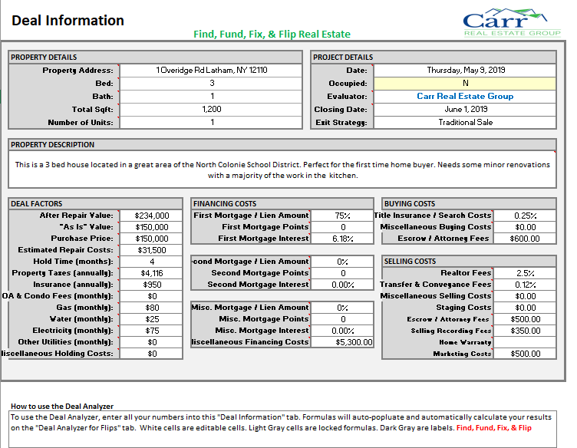

Slide 20
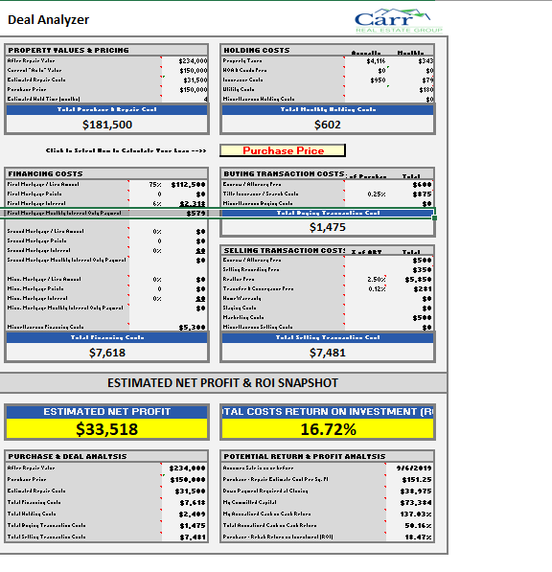

Slide 21
$$ Funding Your Flip $$
Types of lending available
FHA 203k Rehab Loan, Finance the property and cost of repairs. Rules do apply.
Conventional mortgage, can sometimes be utilized if the property needs TLC. Conv. Mortgage will not qualify if the property is a rehab.
Line of credit, on residential primary, or income property, Commercial, and some SBA loans
Utilizing lines of credit to purchase homes is one of the best ways, you are consider a cash buyer.
Off the market real estate purchases?
Holding paper on the real estate purchase?

Slide 22
Search Properties MLS
Take 45 min
Find, Evaluate, Determine ARV, Market Analysis report. Compare current sale price to ARV market price.
Research property taxes.
https://egov.basgov.com
http://tax.neric.org/Search.aspx?district=412402
http://www.infotaxonline.com/
https://www.taxlookup.net/ https://publicrecords.netronline.com/state/NY/county/albany/
https://pacer.login.uscourts.gov/csologin/login.jsf?appurl=pcl.uscourts.gov/search
Break up in groups of 3 people.

Slide 23
Find, Fund, Fix, & Flip
The Scope Of Work
Determine your order of repairs, (very crucial).
Repairs have to be made in a timely fashion, so one thing does not get ahead of the other.
Example (re-sheet rocking a interior wall before you decide if there will be plumbing or electricity running through, deciding on floor plan and bath, and kitchen layout yearly in the planning stage is crucial.
Determining a timeline and expected completion date, is absolutely a MUST.
Market analysis to see what the value would be once property is rehabbed. Also called ARV (after repair value).

Slide 24
Doing your homework
Prep Work Of Purchasing Bank Owned Property.
Check all taxes to make sure their paid and current, title search, purchase ( home owners title policy)
Check for any liens.
Check local code enforcement for violations.
Walk through property to:
Determine repair cost.
Figure out what will be replaced, fixed and rehabbed.
Remember to always estimate repair cost higher, on average 20% higher. Don’t discount other peoples labor and time, like you would for yourself.

Slide 25
DOING YOUR HOMEWORK ON A PROPERTY
Once You Find A Property You Would Like To Invest In (Fix & Flip)
Compare the neighborhood location
All real estate is about location, location, LOCATION!
You want to look for the worst house on the street
Ideally there is only one on the street that needs rehab
If there is more than one property that needs repair, that falls in the category of possibly a BAD LOCATION.
Pick your location wisely or you might find it difficult to sell once all the repairs are completed.
Your ARV (After Repair Value) MUST be determined before you purchase any property.

Slide 26
AFTER REPAIR VALUE (ARV)
ARV on 6 McelWain Ave Cohoes was $150,000.
That was my opinion of the property value once all the work was completed.
You figure this out by the comparable sales of the houses in the area / neighborhood.
Once you know the ARV, you can begin to calculate cost of repair, as well as holding cost.
Take purchase price, repair cost, holding cost, Minus ARV and that net figure must be attractive enough to take all the risk. Every flip is unique.

Slide 27
6 MCELWAIN AVE COHOES

Slide 28
KITCHEN (IN PROGRESS)

Slide 29
KITCHEN ( AFTER)

Slide 30
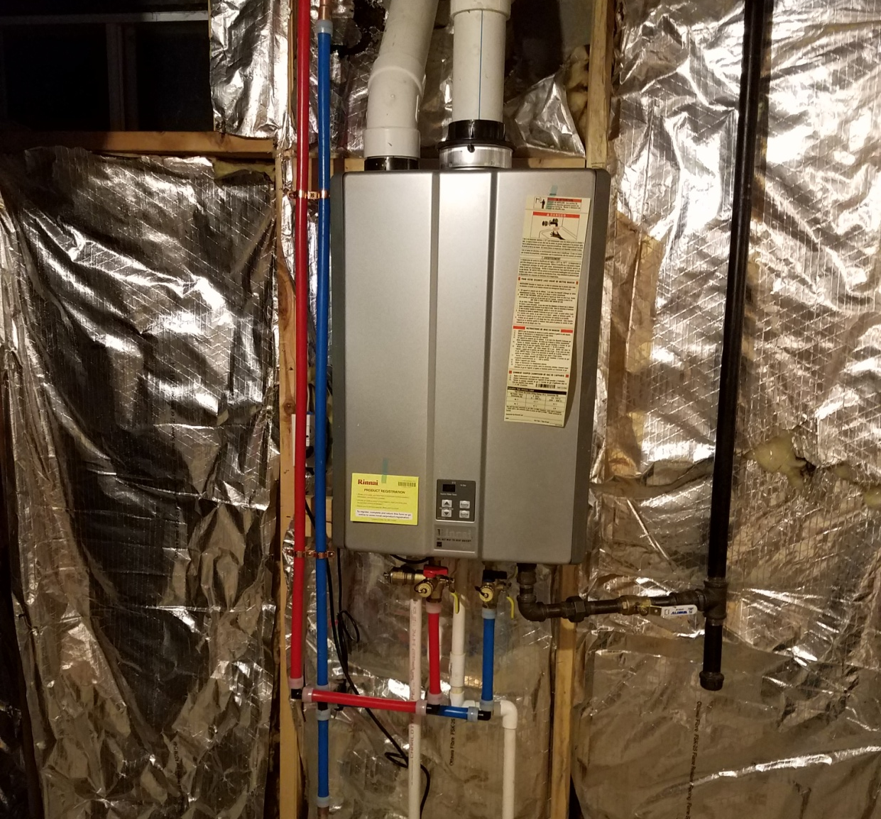
Tankless Water heater install

Slide 31
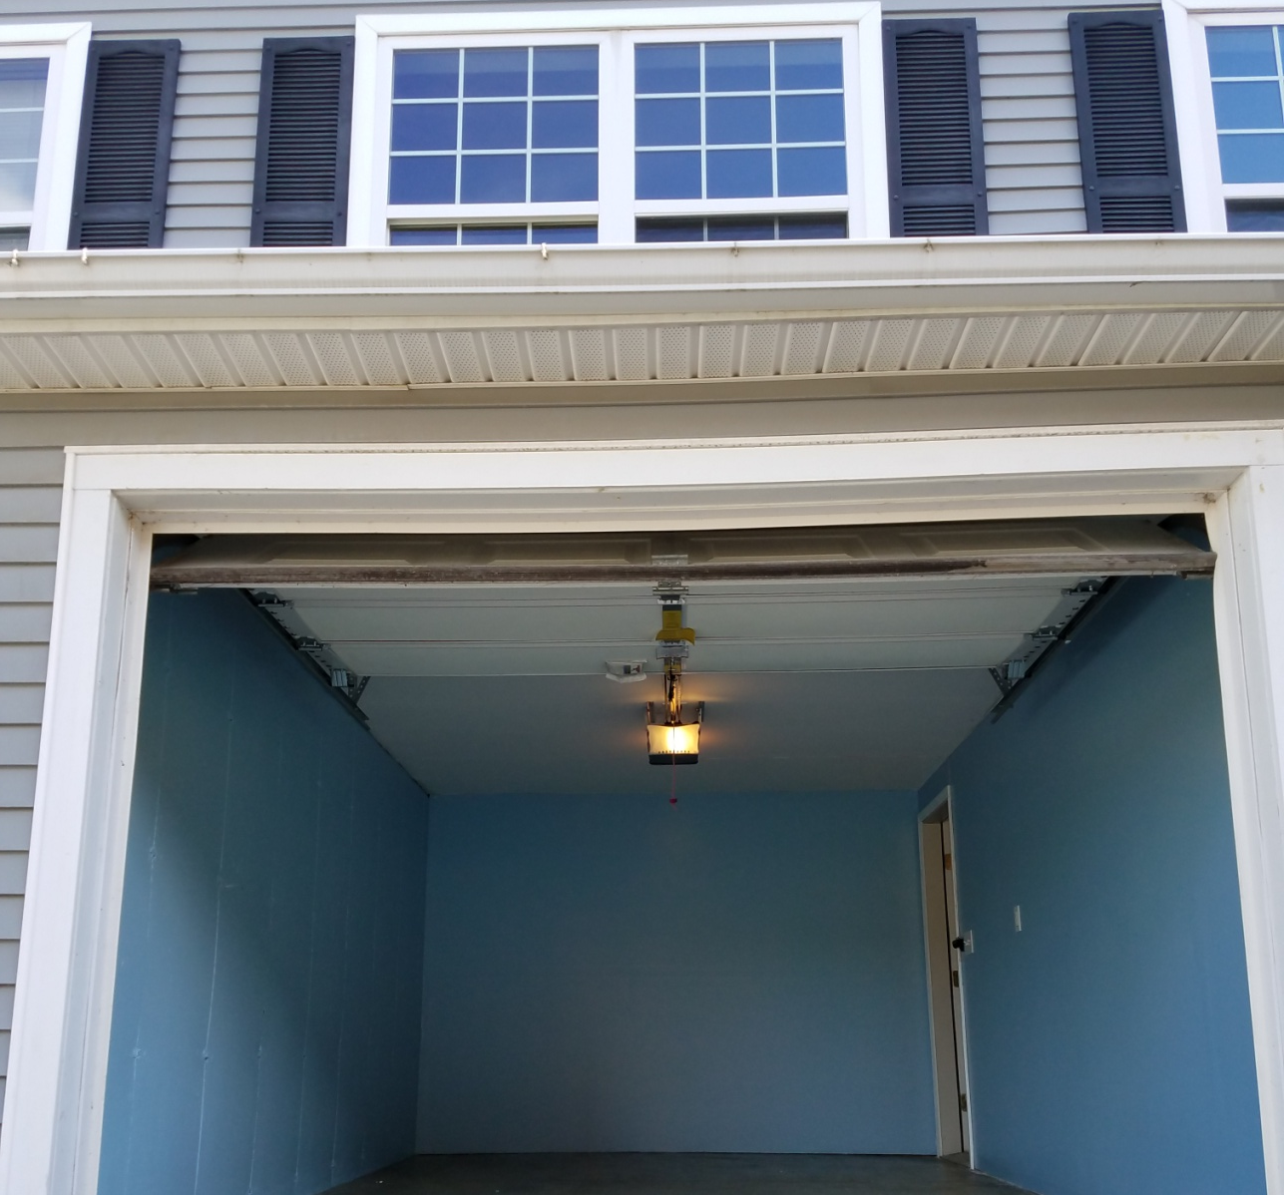
Garage & Basement Finished

Slide 32
6 MCELWAIN AVE COHOES
Purchased Property for $80,000 ( homepath)
Repair cost $8,500
School and Property taxes prorated 3 months were $1,400 , Additional holding cost $300.00
Remodeled Kitchen, bathrooms, basement, electrical, garage, landscaping, and plumbing.
Listed the property for $149,000
Sold multiple offers $153,000
Minus buyer agent commission 2.5% $3,825
Net proceeds
$58,675

Slide 33
CLOSING CHECKS

Slide 34
KEY BANK RECEIPT

Slide 35
Trusted Vendors Wholesale
Kamco Supply Corp. - Drywall & supply, molding’s
Bryant Northeast - Tankless water heaters, HVAC
Prosource of Albany - Flooring, kitchen cabinets
Ral-Supply - HVAC equipment
Alside Albany - Windows, siding
ABC Supply - Siding, roofing
City Electric - Electrical supplies
Appliance Giant - Appliances

Slide 36
908 24TH STREET
Purchased property for $52,000
Totally gutted property down to studs
Total rehab cost $32,000
Total cost to hold property for 14 months $5,400, Including taxes, insurance, utilities.
Entire inside of building brand new
Sold property For $130,000
No commission
Net proceeds
$40,600

Slide 37
908 24TH STREET, WATERVLIET A-1Reo.com ( Selling broker)

Slide 38
UPSTAIRS HALL WAY GUTTED

Slide 39
Stair Way /Foyer

Slide 40
Kitchen ( before)

Slide 41
Kitchen (after)

Slide 42
REPAIRS
Before you start any fix & flip project:
Walk through property multiple times.
Figure out what you can save from the materials and features that already exist in the house.
Try to save kitchens, bathrooms, doors, and moldings on most projects.
Very costly to replace.
These items can be fixed or enhanced in some way to make them look better than they once appeared.
Saving these items can mean staying within budget.

Slide 43
Roof (before)

Slide 44
Roof (after)

Slide 45
Stair way (before)

Slide 46
Stairway (after)

Slide 47
POOL FILLED IN (AFTER)

Slide 48
908 24TH STREET DEED

Slide 49
1410 1ST AVE WATERVLIET (BEFORE)

Slide 50
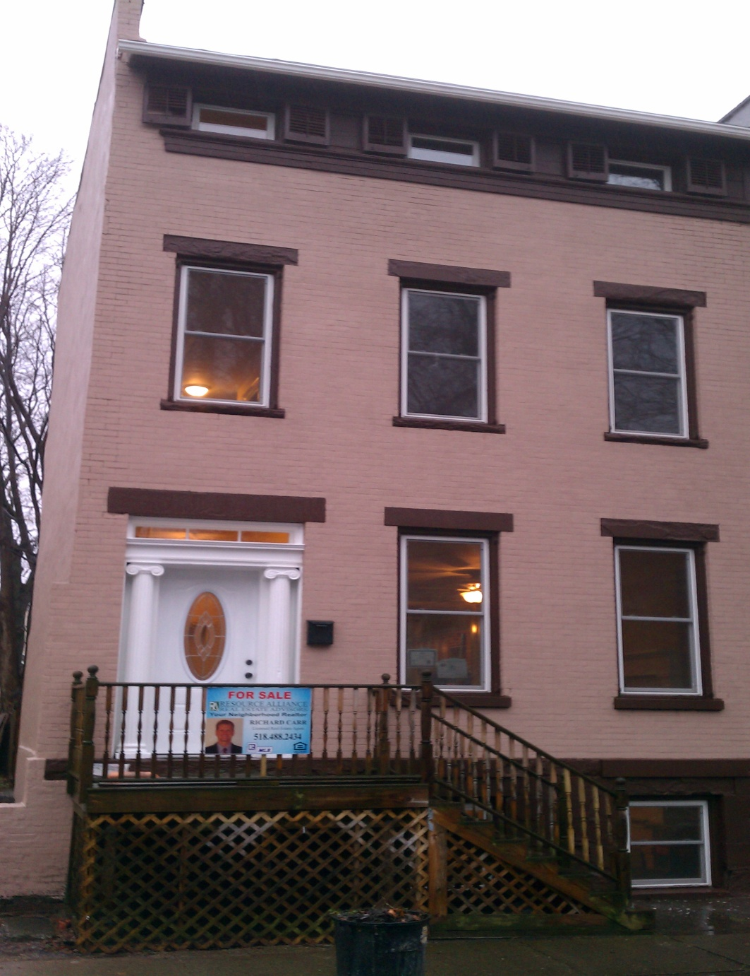
1410 1st Ave (After)

Slide 51
1410 1ST AVE WATERVLIET
Purchased property for $37,000 (2 offers)
Total all repairs cost $ 45,000
Rehabbed 90% of entire 4 store building
Additional holding cost for 13 months $4,500
Taxes & utilities
Sold property for $159,000
Minus $3,975 Buyer agent commission
Net proceeds
$60,525

Slide 52
SCOPE OF WORK
1410 1st Ave
Needed extensive brick foundation work, over 2 months full time with a mason.
I found a mason on craigslist, He (Tony) was laid off from his union job, and he worked for me for $12.00 per hour, as a misc. 1099 employee.
When you are buying and selling properties you must try and find quality cheap labor (It does exist)! Tony ended up working for me for an additional 8 months until he went back to his previous job.

Slide 53
OLD KITCHEN
Actual kitchen

Slide 54
NEW KITCHEN

Slide 55
3rd FLOOR OFFICE (BEFORE)

Slide 56
3rd floor office (After)

Slide 57
1410 1ST AVE DEED

Slide 58
17 Idlewild Park Watervliet - 3 Unit

Slide 59
17 Idlewild Park 3 Family ( Actual Class code 220)
I bought this property on HUBZU in 6/2016 For $29,559
Seller was Wells Fargo mortgage company, Ocwen Loan Servicing.
This property was bid on 3 times before the bank accepted my offer. First offer started at $70,000, then final offer $28,000
All repair cost were $55,000
Holding cost for 3 years were $12,800 ( Taxes, Utilities, Water & Sewer)
Sold property 12/2019 for $218,900

Slide 60
17 Idlewild Park- 3 Family Investment
1st Floor apt. 2 bedroom 1 bath estimated monthly rent $1,250
2nd Floor apt. 2 bedroom 1 bath estimated monthly rent $1,400
1st Floor rear studio apt. 450 sq. ft estimated monthly rent $650
Total rent roll $3,300 per month.
Estimated market value $214,900.
Estimated mortgage $180,000 FHA or Conventional.
Estimated mortgage payment $1,280.00 Escrowed.
Estimate water & sewer bill $980.00 per year.
Total estimate net income per-month $1,950.

Slide 61
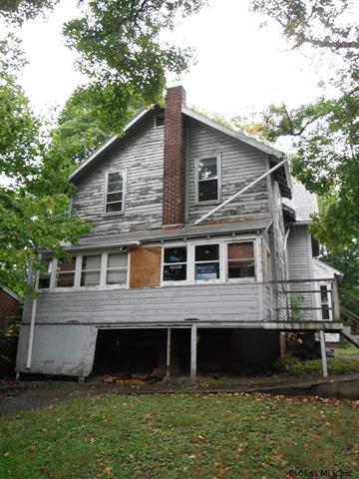
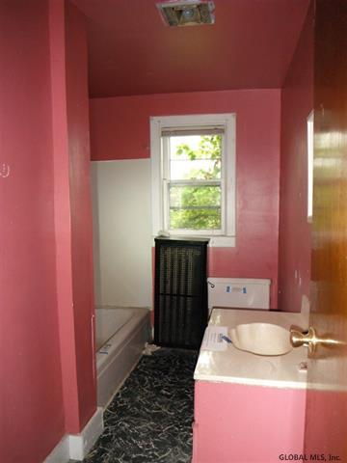
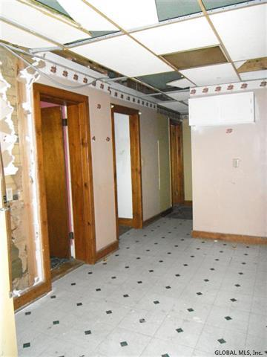
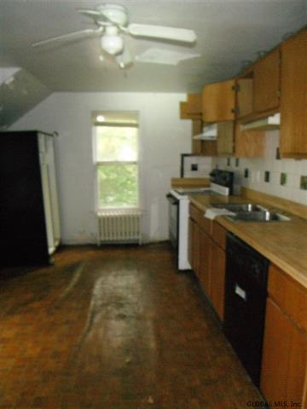
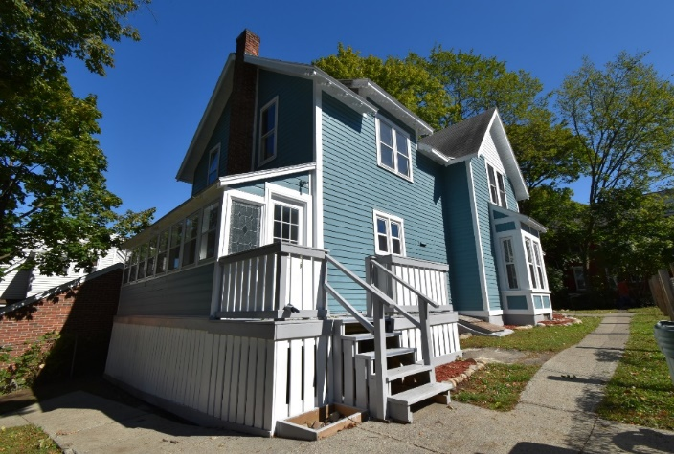
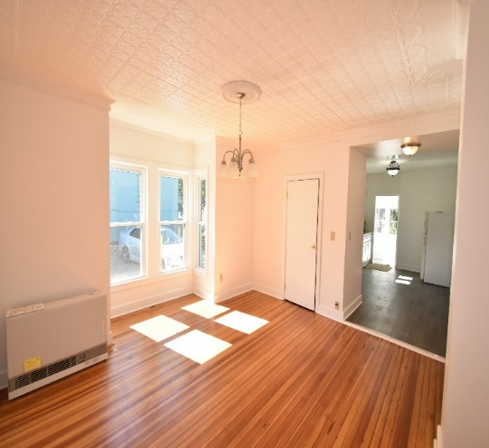
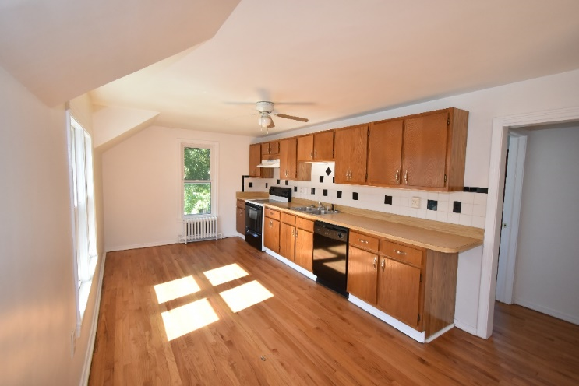
Before and After photo’s
17 Idlewild Park

Slide 62
17 Idlewild park SOS

Slide 63
Class exercise Investment properties Versus 401K plans or the stock market
Stocks, mutual fund, IRA’s, or 401K’s investment plans have the ability to compound the interest of an investment, were on the investment properties do NOT compound the net income or the interest. Both forms of investments have there share of pro’s and con’s.
Compound interest is the addition of interest to the principal sum of a loan or deposit, or in other words, interest on interest. It is the result of reinvesting interest, rather than paying it out, so that interest in the next period is then earned on the principal sum plus previously accumulated interest.

Slide 64
Stock Market –Versus- Real Estate Investment properties
Like I mentioned in the previous slide stocks or 401K plans have the ability to compound the interest in any individual stock or 401K plan can generate.
Example
In the previous slide I mentioned, 17 Idlewild Park, 3 family in Watervliet, nets $1,950 per month in income, with that income you could invest in 401K plan or solo 401K plan. You well still have positive cash flow, but, now you will create another source for investing.
This property can generate enough income per month to live and pay bills on, and also offer to invest some of the proceeds in the stock market or other investment options.

Slide 65
This calculator shows that investing $5,000 per year, which is around $450.00 per month out of the net income from any investment property that you purchase, this is what we call diversified assets. https://www.calculator.net/401k-calculator.html?age=25&income=50000&balance=5000&contribution=10&ematch=50&ematchend=3&retirementage=65&lifeexpectancy=85&incomeincrease=3&rate=6&inflation=3&hideirslimit=0&type=1&x=63&y=20#top
Stocks – Versus investment properties

Slide 66
*MUNICIPALITIES PERMITS*
Permits are needed on all major changes that are made to the property. Individual permits are needed for:
Major construction floor plan change
Insulation (new walls)
All electrical
Water heaters
HVACs
All roofing
All siding
All foundation work
These permits are necessary at all stages of completion. Without permits it would be very difficult to obtain a COC, (Certificate of Occupancy).

Slide 67
MUNICIPALITIES PERMITS
Certificate of Occupancy
CO is needed to sell the home once it is completed.
CO, states to the consumer (home owner) the property is free and clear of defects and is safe and up to code to occupy.
Most buyers will get a home inspection as well, its up to the home owner ( buyer) to complete their due diligence.
Check with you local municipality to determine what permits are necessary for you to obtain and at what stages to apply.

Slide 68
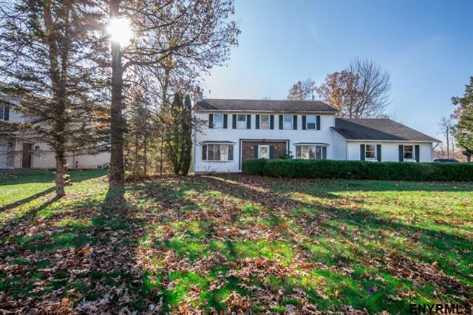
1 Mates Way ( Before )

Slide 69
Mates Way ( After )

Slide 70
Mates Way ( Before )

Slide 71
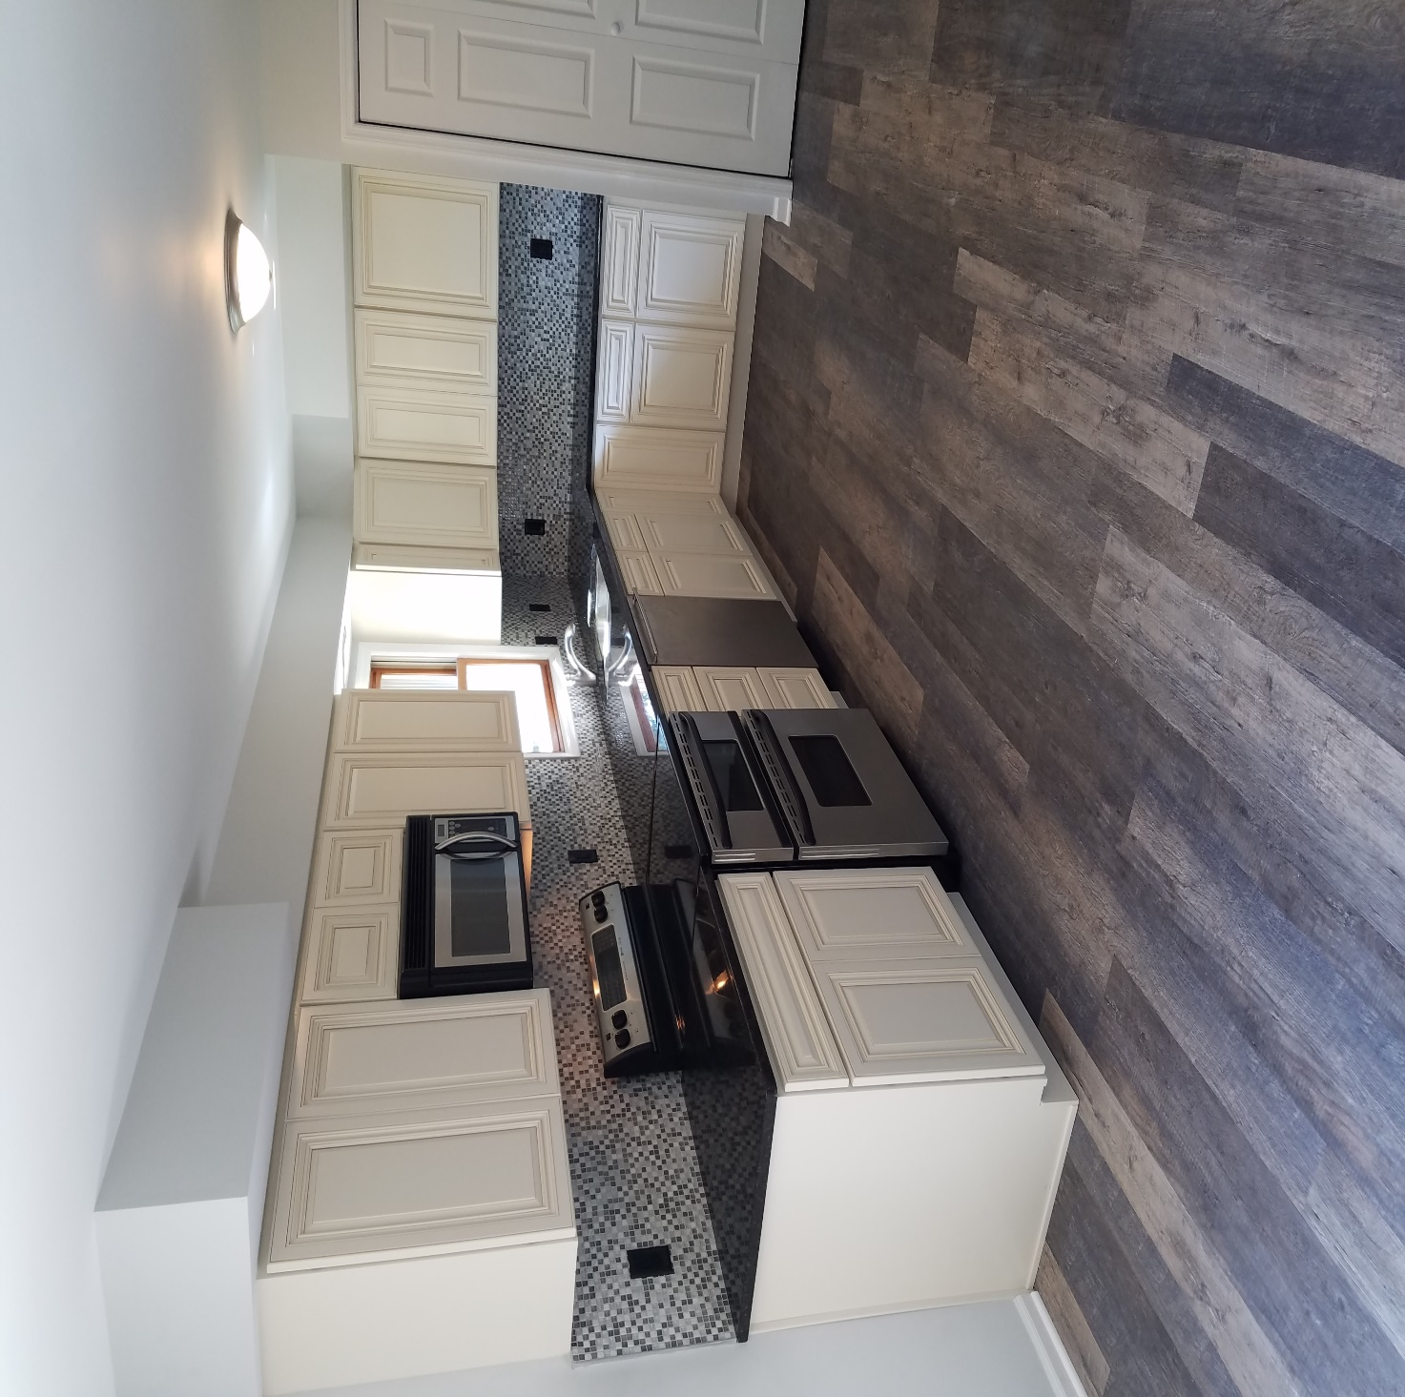
Mates Way ( After )

Slide 72
Mates Way Purchase Price
Purchased property for $232,000
Holding cost include All taxes per month $590
Utilities per month $80.00
Closing cost $2,400
Rehab cost $52,000
Replaced, Roof, Furnace & A/C, Water heater, Bay windows, Entire kitchen, appliances, All flooring, All vanity’s, all toilets, entire inside painted, All plumbing fixtures & plumbing, All lighting fixtures, garage doors, All door hinges and locks.

Slide 73
Mates Way
Joint venture with another locale brokerage company.
AVR ( After Repair Value ) $305,000-$325,000
Actual sale price $287,500 SOLD
Acquired property $232,000
All holding cost $2,800
Repaired cost $52,000
Total $286,800
Approx. NET $-700.00
Minus 2.5% buyer agent
This flip was in the Red, * WE over PAID*

Slide 74
County Court Auction PERSONAL Owner Occupied FIX AND HOLD
Blue Jay Way- 2,800 Sq. Ft 4 Bed 3 Bath, 3 car garage colonial.
Intended to be a Fix and Flip project.
Purchased 12/03/2015 at Saratoga County Court House.
I was the only bidder, Bidding started at $328,000 – previous owner owed $472,850
The attorney conducting the auction excepted my bid of $329,000.
I also negotiated to finance the property with her and the bank right at the same location. They accepted.
Normally all auctions are paid in cash within 30 days of Auction being completed. Or you forfeit your 10% deposit.
After showing the property to my wife two days later we decided to make the property our personal home instead of flipping.

Slide 75
BLUE JAY WAY REPAIR COST
New hardwood floors entire first floor $5,400
Granite counters Kitchen and Bathroom $5,100
Kitchen back splash Tile $2,000
Custom paint job entire inside materials $1,500
All appliances $6,500
Pool liner and repair $4,500
Landscaping $2,000
New deck $7,200
New driveway $5,200
Sauna
All Repairs cost $39,400

Slide 76
BLUE JAY WAY
Acquired property for $329,000
All repairs cost $39,400
After Repair value $425,000
If property sold, estimated Net return $56,600
All repairs took 2 months to complete part time.
Estimated Net Return $56,600

Slide 77
BLUE JAY WAY

Slide 78
FAMILY ROOM INTO KITCHEN

Slide 79
AFTER

Slide 81
KITCHEN

Slide 85
IRS Tax on Capital Gains
Be mindful of your tax liability, and factor in your tax liability on all flips. Your rate will be determined by whether you occupied the property for at least 2 years or more within a 5 year period, or if you held the property for 1 year or more.
In 2018 and 2019 the capital gains tax rates are either 0%, 15% or 20% for most assets held for more than a year. Capital gains tax rates on most assets held for less than a year correspond to ordinary income tax brackets (10%, 12%, 22%, 24%, 32%, 35% or 37%).

Slide 86
SUMMARY
Bank Owned (REO) Properties
Check all taxes and liens.
Determine Repair Cost
Figure out what will be replaced, fixed and rehabbed.
Remember to always estimate repair cost higher.
Determine the Scope Of Work
Determine your order of repairs.
Determine timeline and expected completion date.
Your ARV (After Repair Value) MUST be Determined Before You Purchase Any Property
Determine your tax liability, (capital gains tax)

Slide 87
SUMMARY
Once You Find A Property You Would Like To Invest In (Fix & Flip)
Compare the neighborhood location.
Pick your location wisely.
Once you know the ARV, you can begin to calculate cost of repair, as well as holding cost.
Before You Start Any Fix & Flip Project
Figure out what you can save from the materials and features that already exist in the house.
You must try and find quality inexpensive labor.

Slide 88
SUMMARY
Permits are needed on all major changes that are made to the property
Certificate Of Occupancy (CO) is needed to sell the home once it is completed
Most homeowners will want an inspection as well.
It’s the buyer / home owners job to complete their due diligence.
Auctions
Normally all auctions are paid in cash within 30 days of Auction being completed. Or you forfeit your 10% deposit.

Slide 89
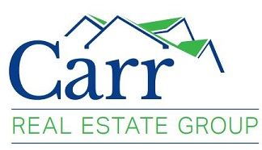
Find, Fund, Fix, & Flip
Thank you for participating in today’s class!
Find FREE downloads at
www.CarrRealEstateGroupllc.com

