Slide 1

HCGOP
May 19, 2025
Refuge Assembly, Soddy Daisy
MONTHLY MEETING - EVERY 3RD MONDAY

Slide 2
Prayer (Pastor Dennis)
Pledge (Steve Slater)
Elected Officials (Gene O’Shipley)

Slide 3
April/May Recap:
Choices Walk for Life (April 5th)
Republican Women’s Legislative Day on the Hill (April 14th)
State of the County (April 15th)
HCGOP Monthly Meeting (April 21st)
Armed Forces Day Parade & Luncheon (May 2nd)
School Board Budget Vote (May 8th)
HCGOP at J-Fest (May 17th)

Slide 4
Upcoming Opportunities:
Volunteers needed to place and retire flags at Chattanooga National Cemetery on May 24th and 31st (contact Mickey McCamish at 423-756-2212)
Precinct Strategy - where do YOU fit in? (email me - chair@hcgop.com)
Republican-owned business? Let’s support each other!
Committee Assignments - Please go to www.hcgop.com and complete the “committee” survey to get involved in what YOU care about…

Slide 5
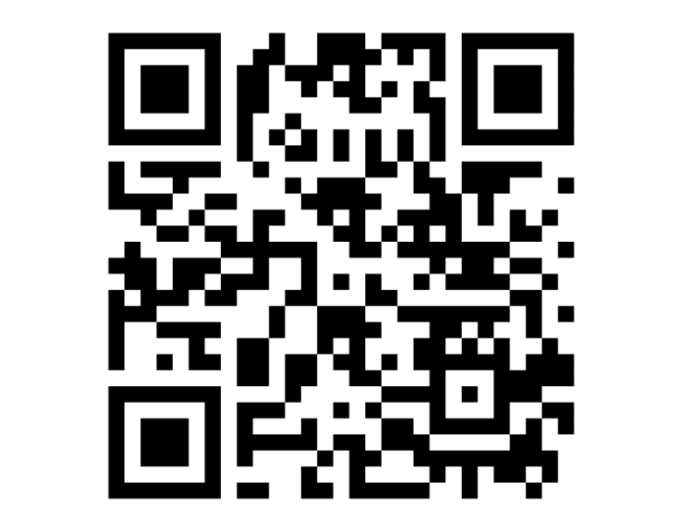
Committee Interest Survey
https://hcgop.com/committees-1

Slide 6
Lincoln Day Dinner
Purchase tables and tickets at hcgop.com
All of our Providence Tables ($5,000) are sold out!
Ticket Spotlight: Business Booster Bundle for $530
Two tickets and a Full Page Advertisement

Slide 7
HCGOP Headquarters Exit Strategy
Communication
Duration
Logistics
Disposition

Slide 8
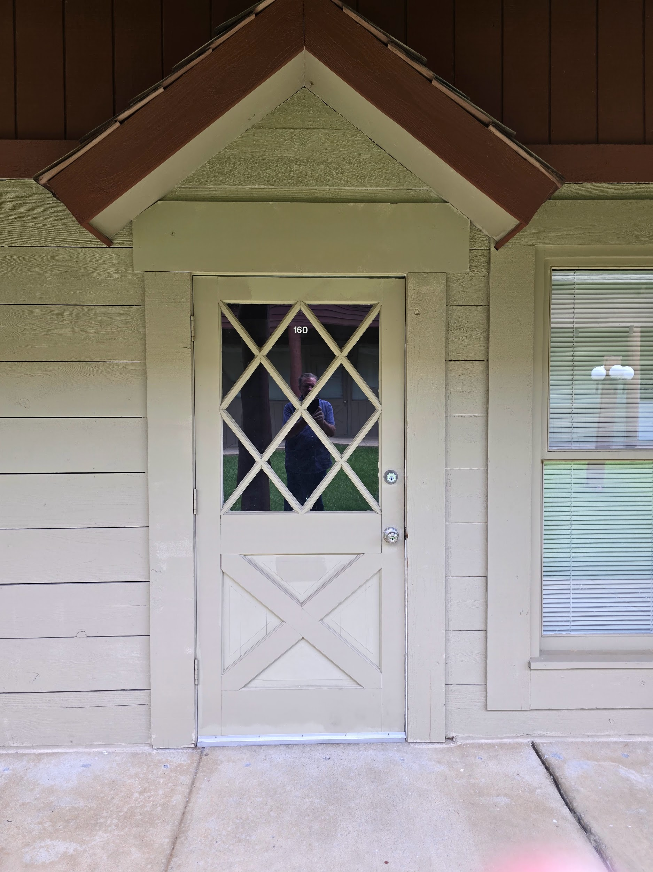
HCGOP Headquarters Exit Strategy

Slide 9
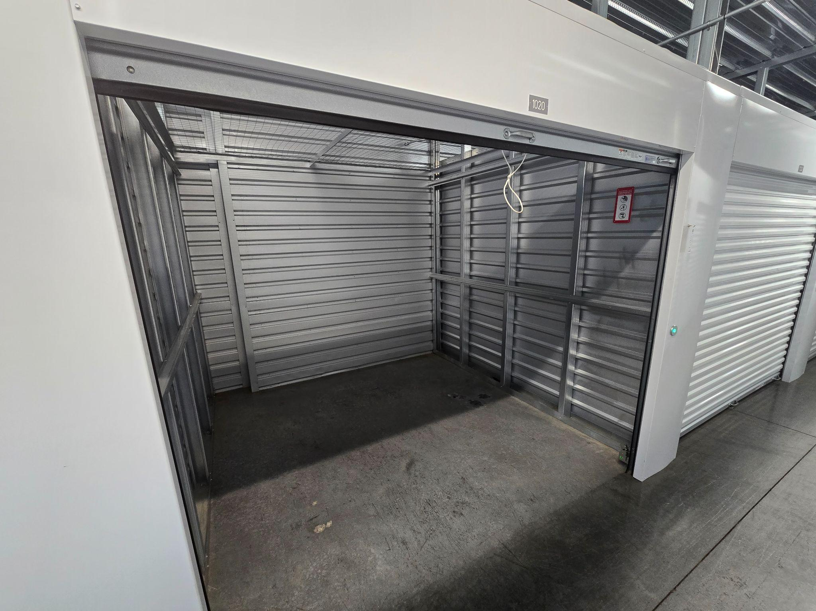

Slide 10
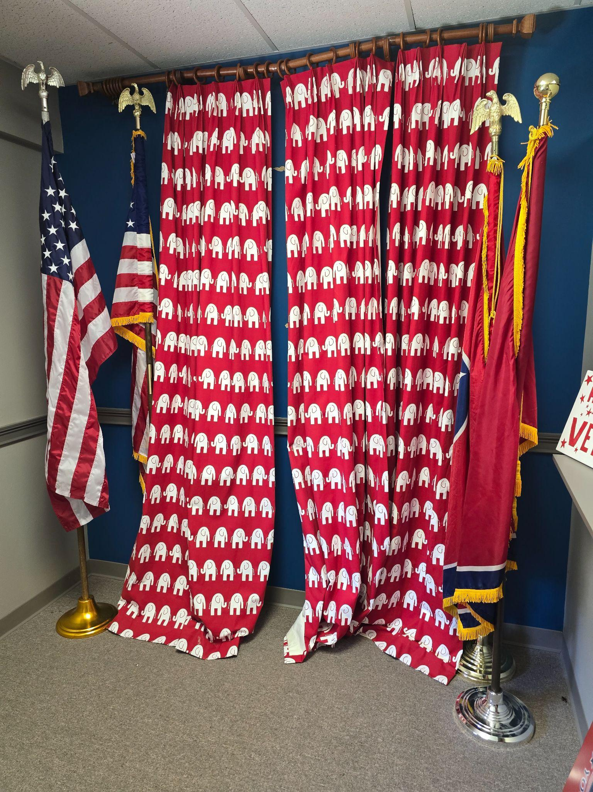

Slide 11
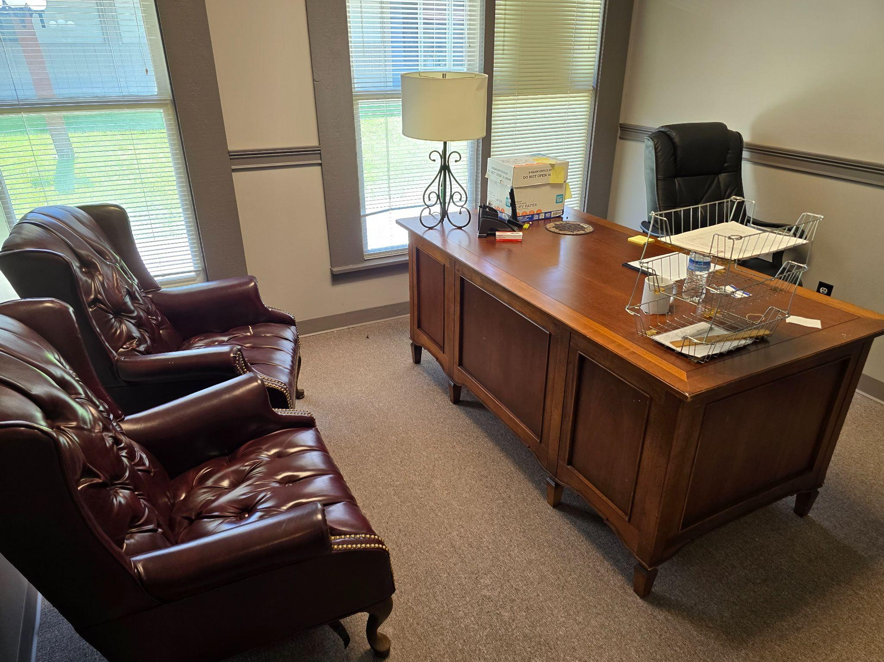

Slide 12
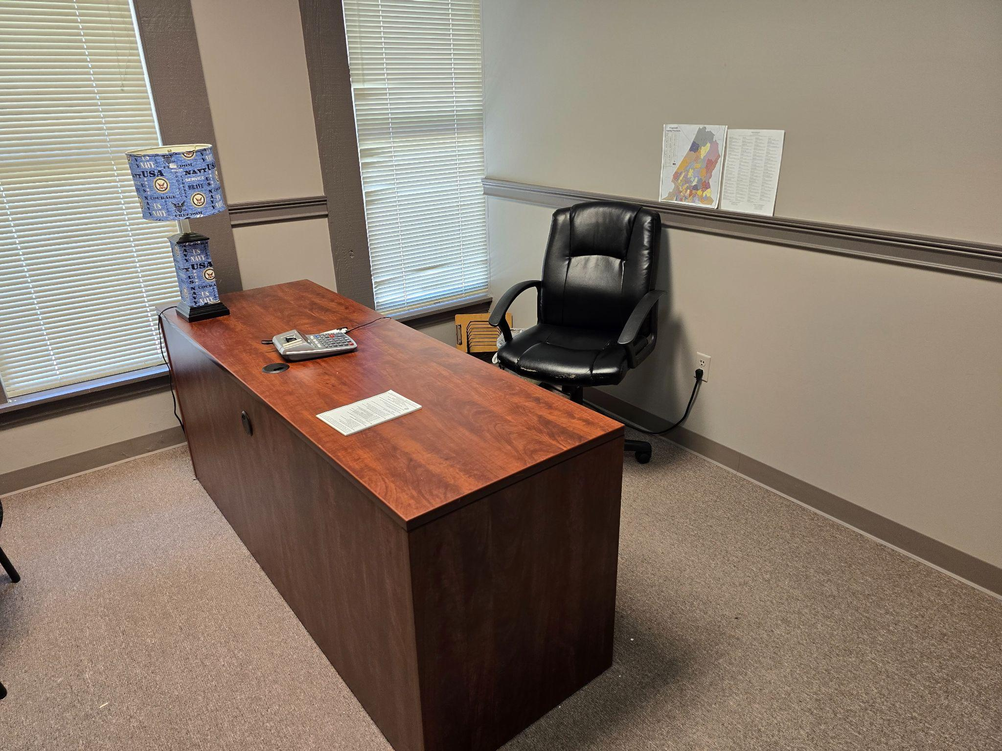

Slide 13
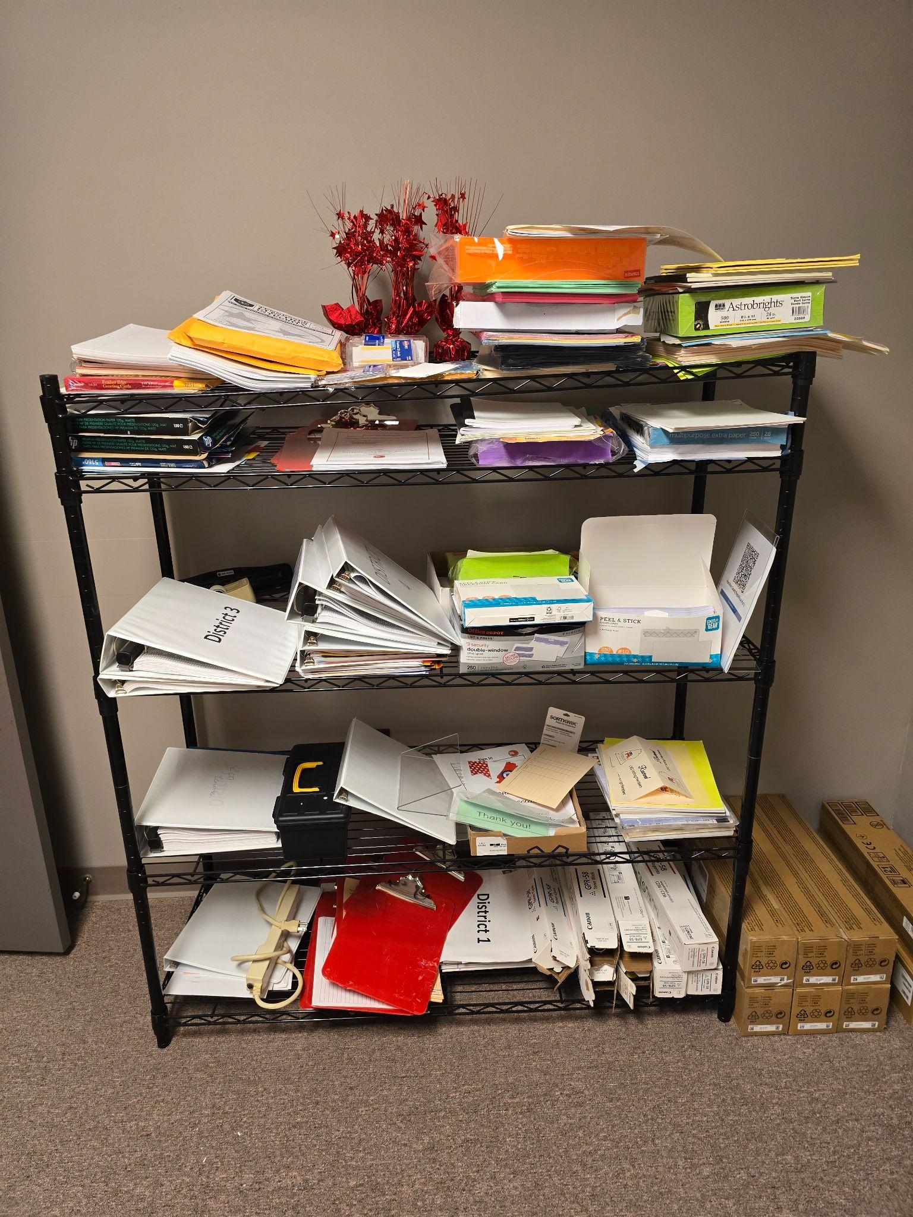

Slide 14
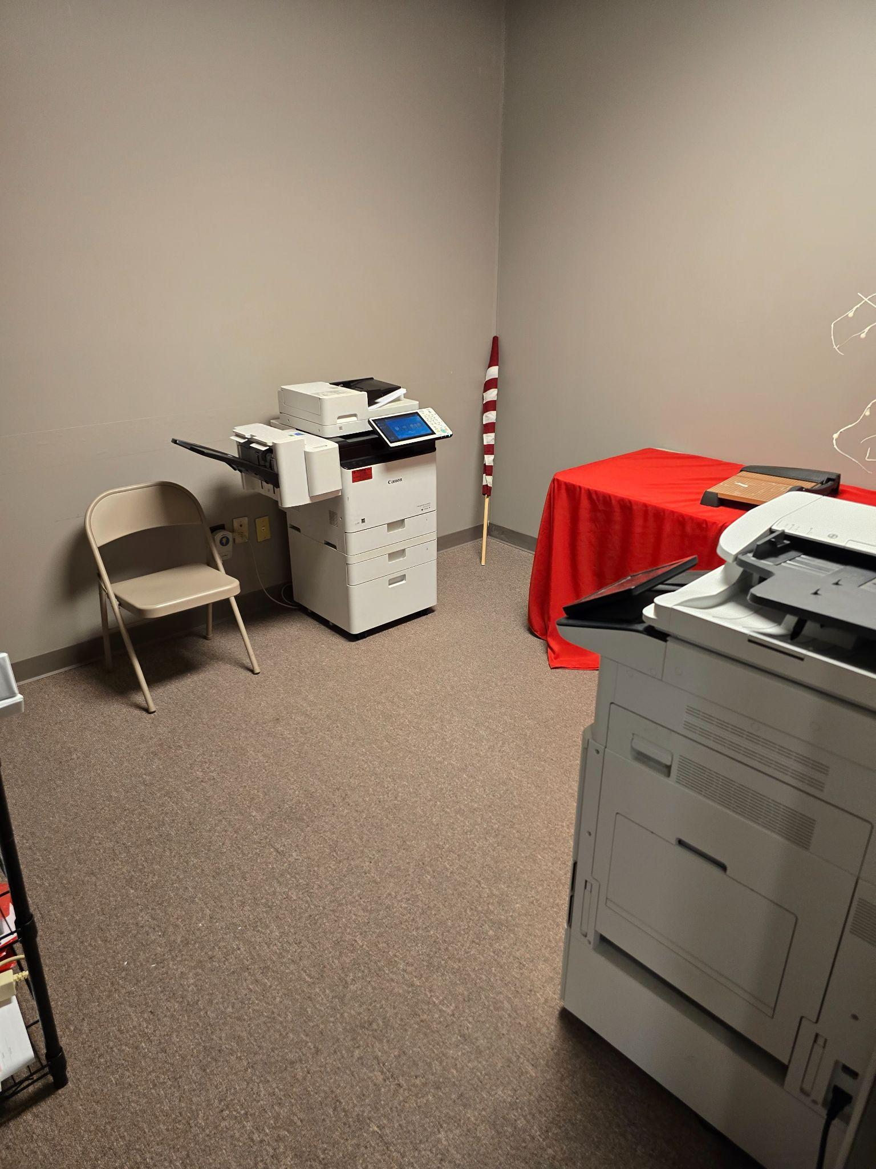

Slide 15
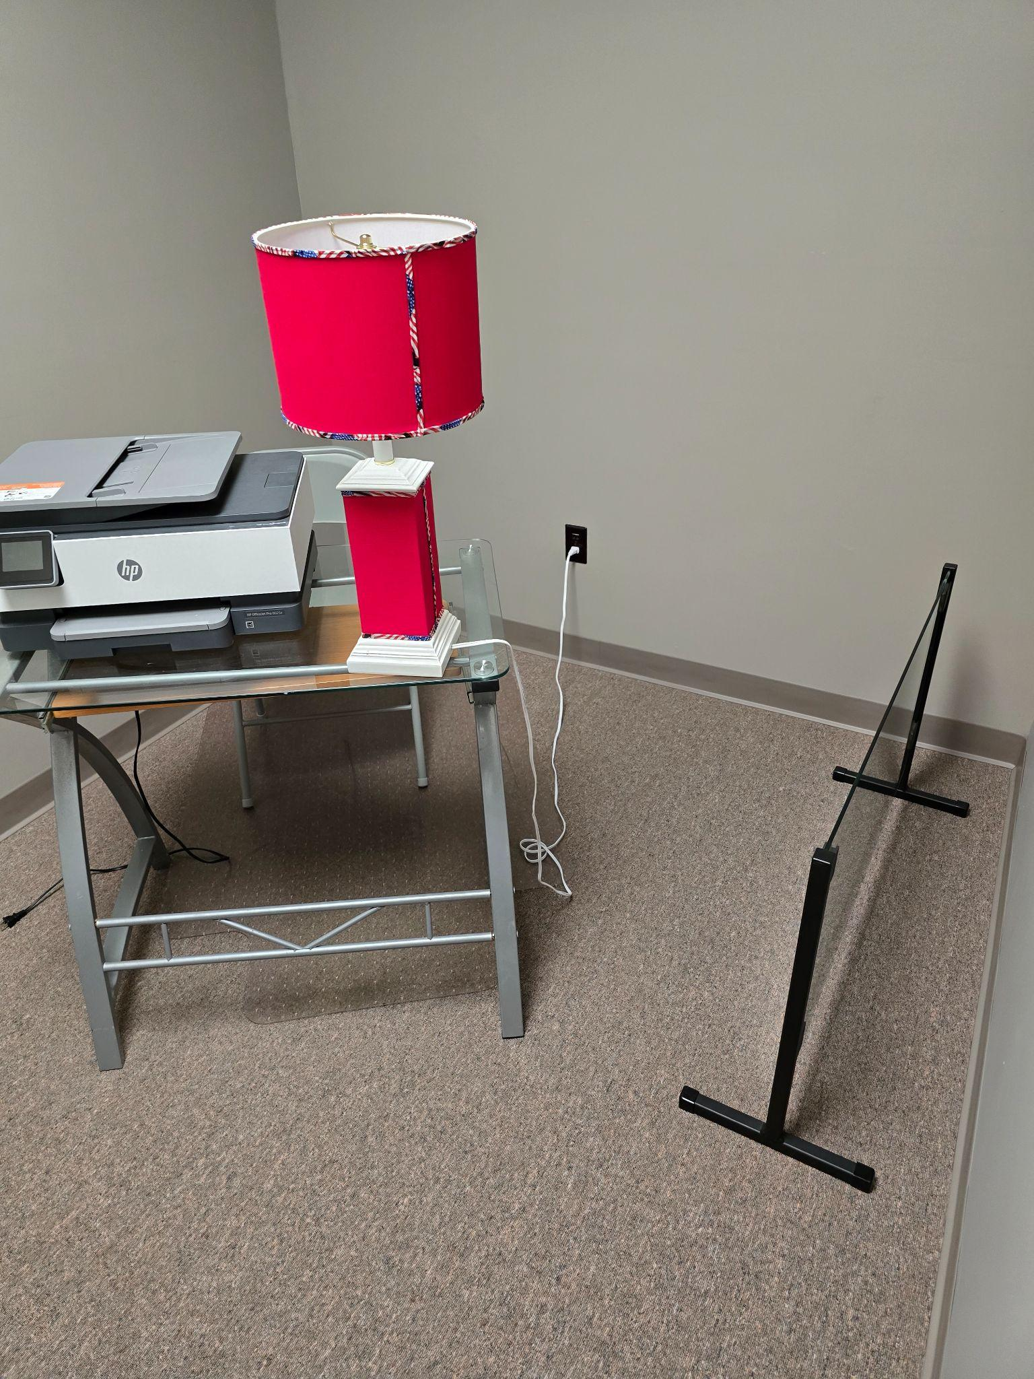

Slide 16
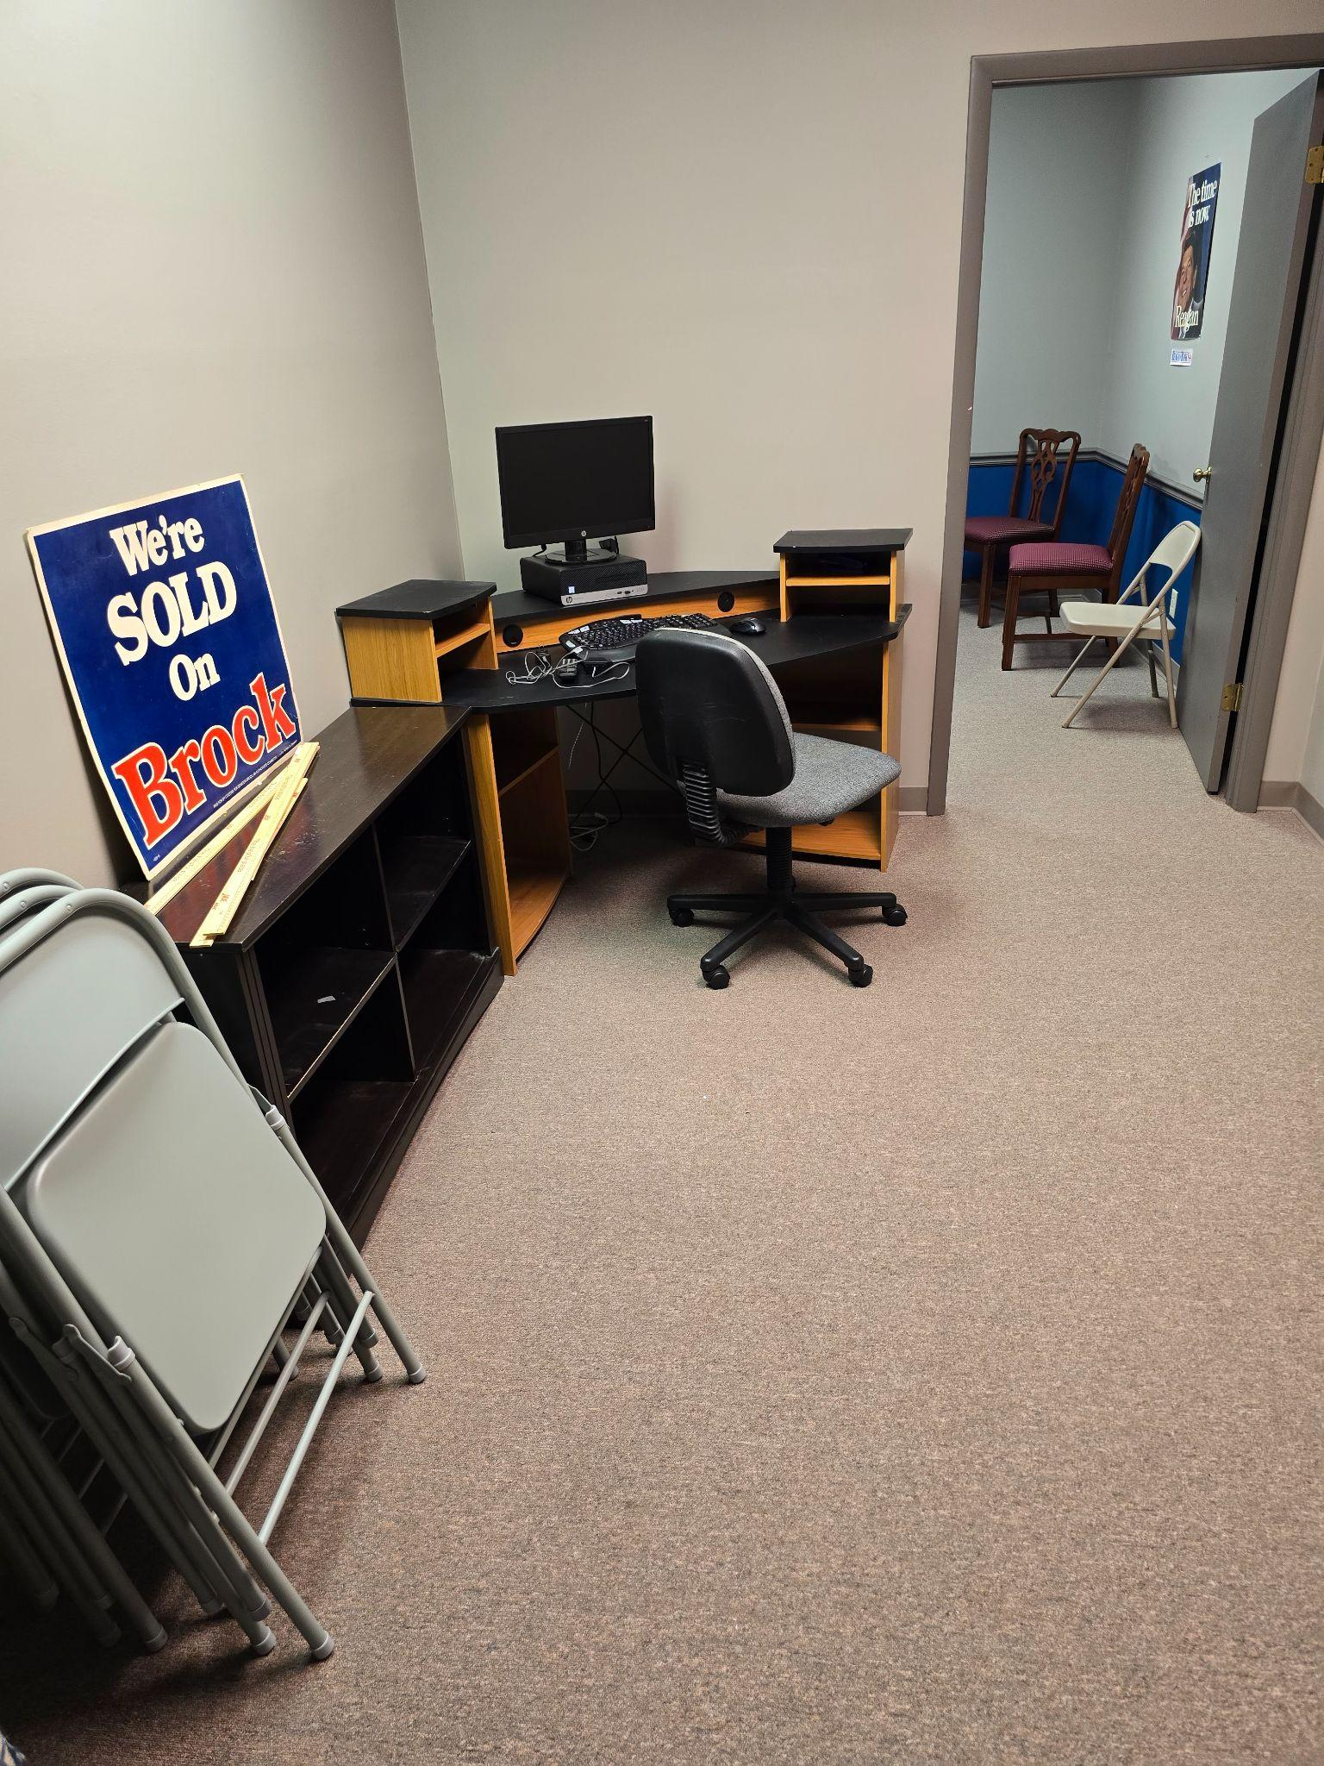

Slide 17
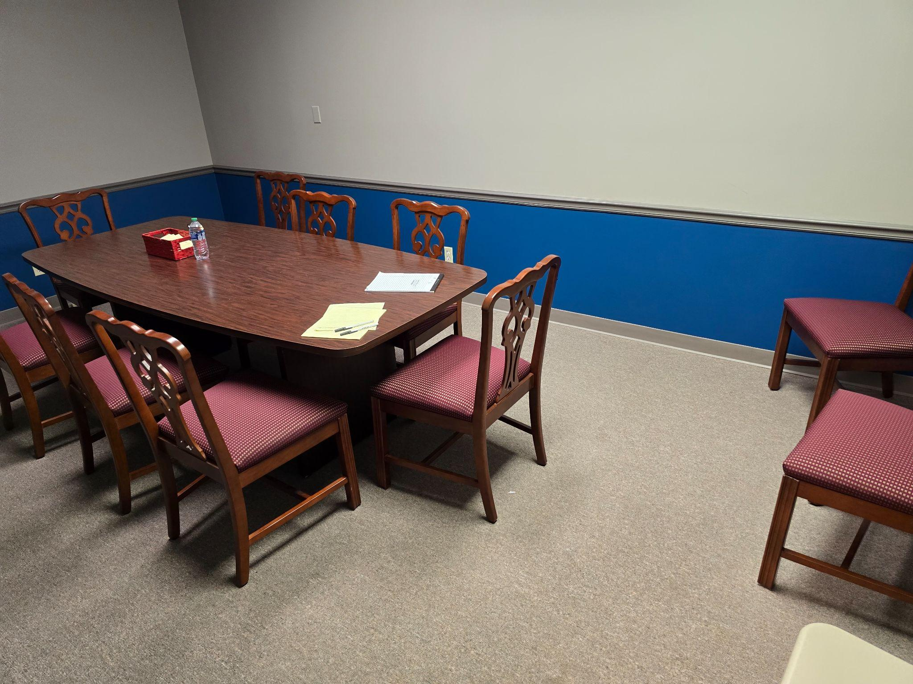

Slide 18
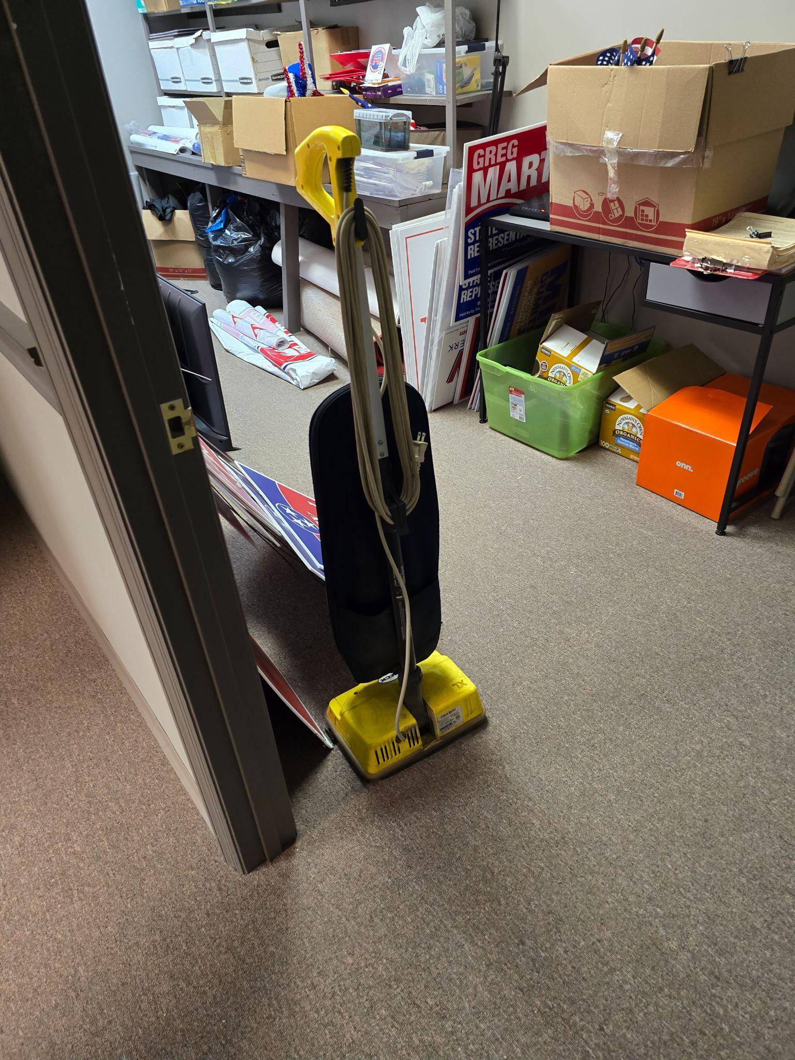

Slide 19
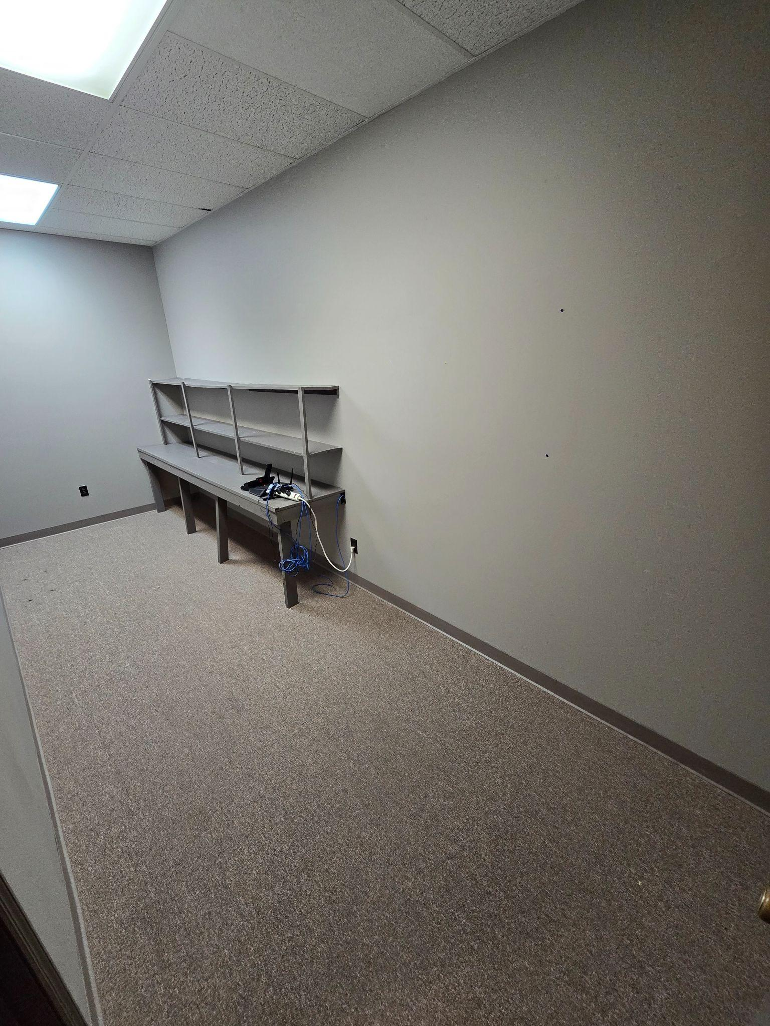

Slide 20
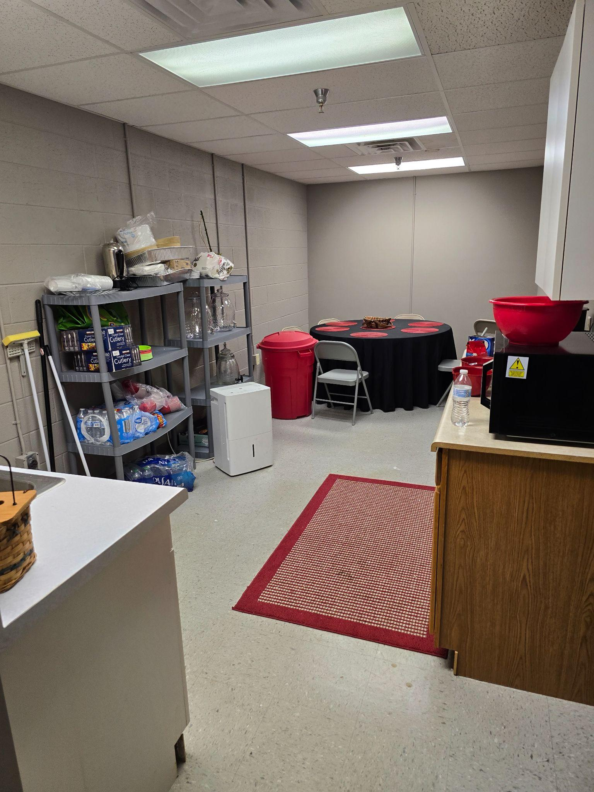

Slide 21
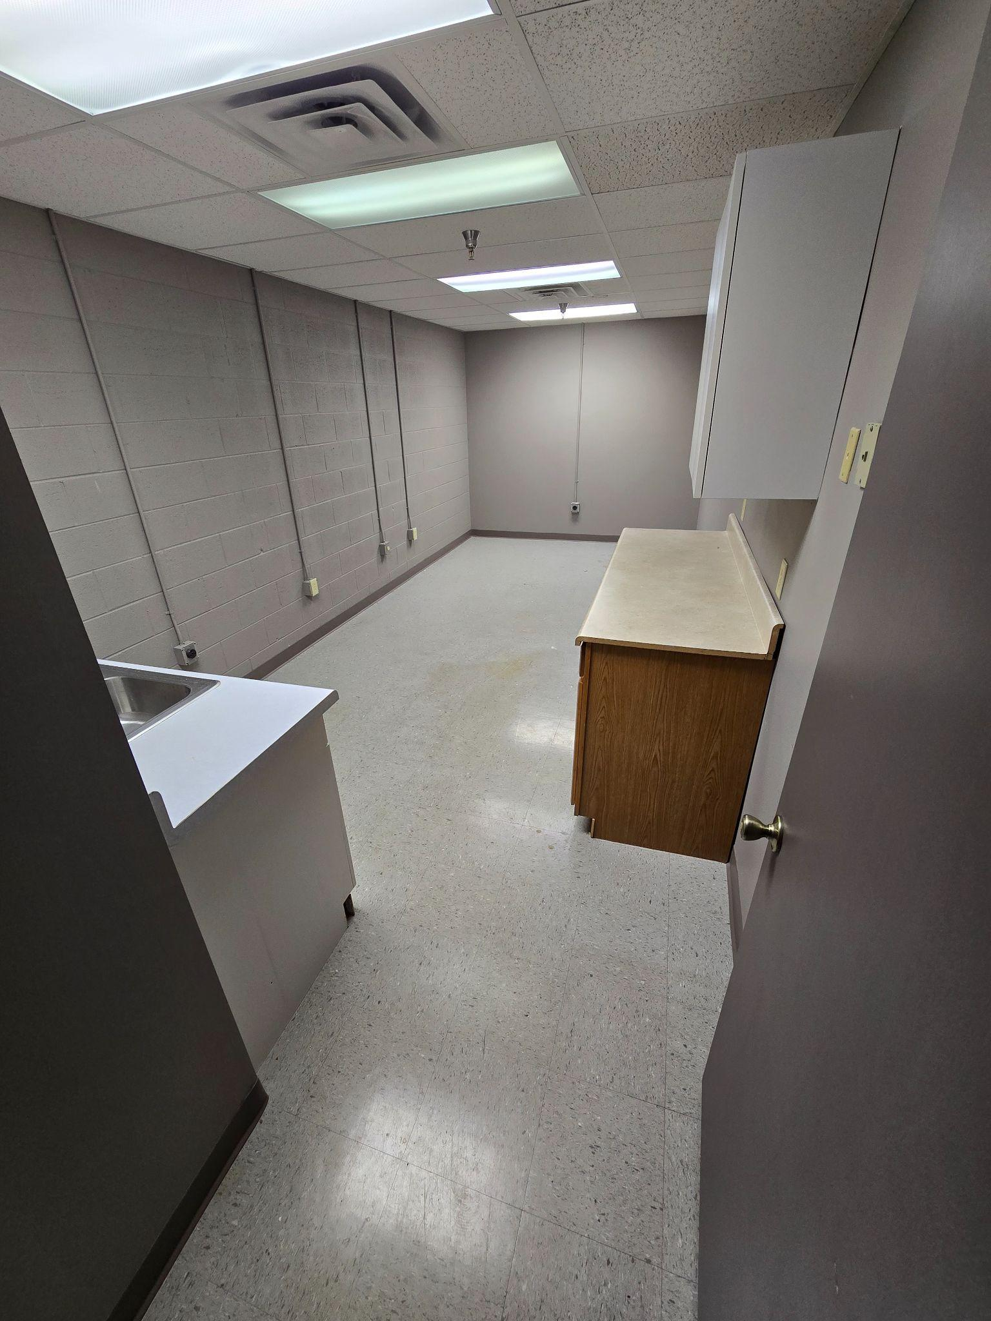

Slide 22
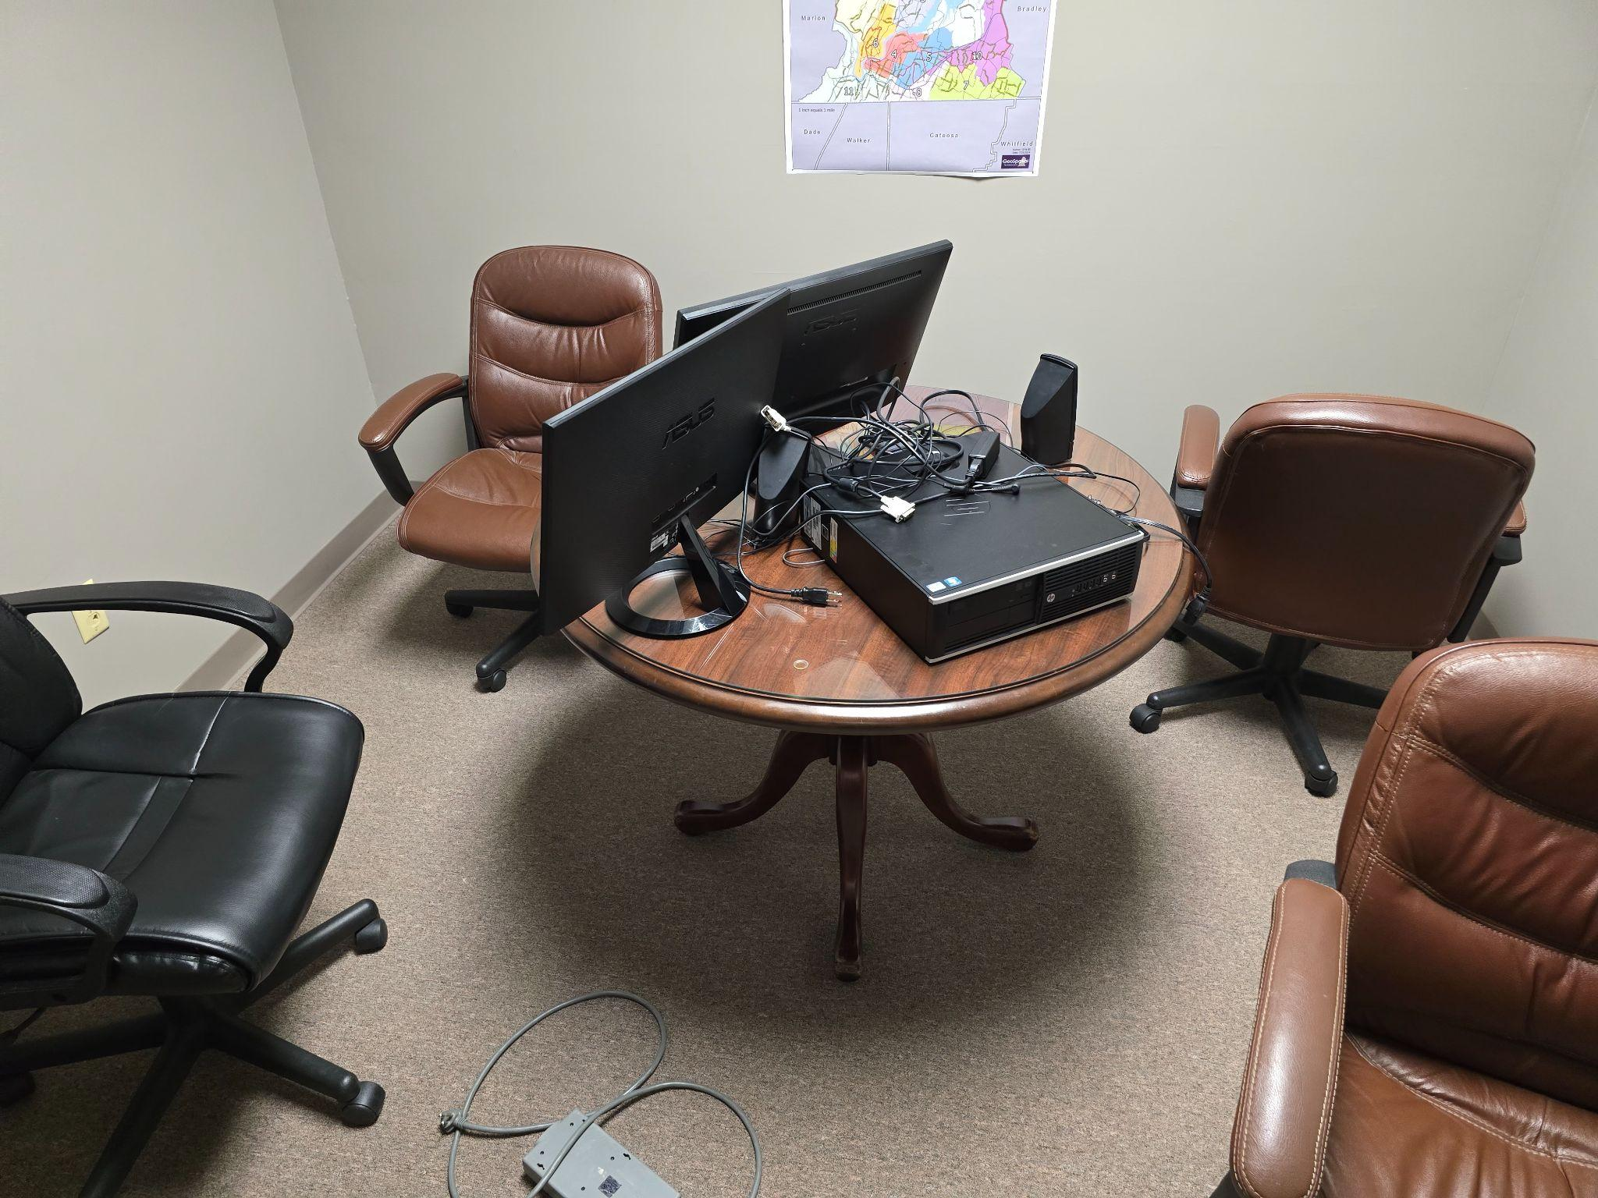

Slide 23
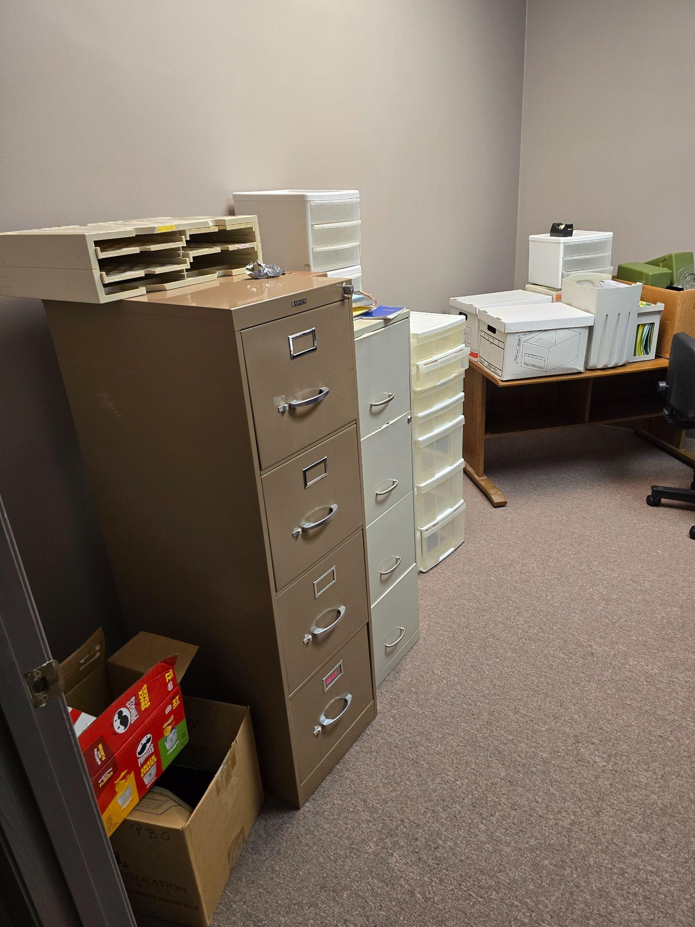

Slide 24
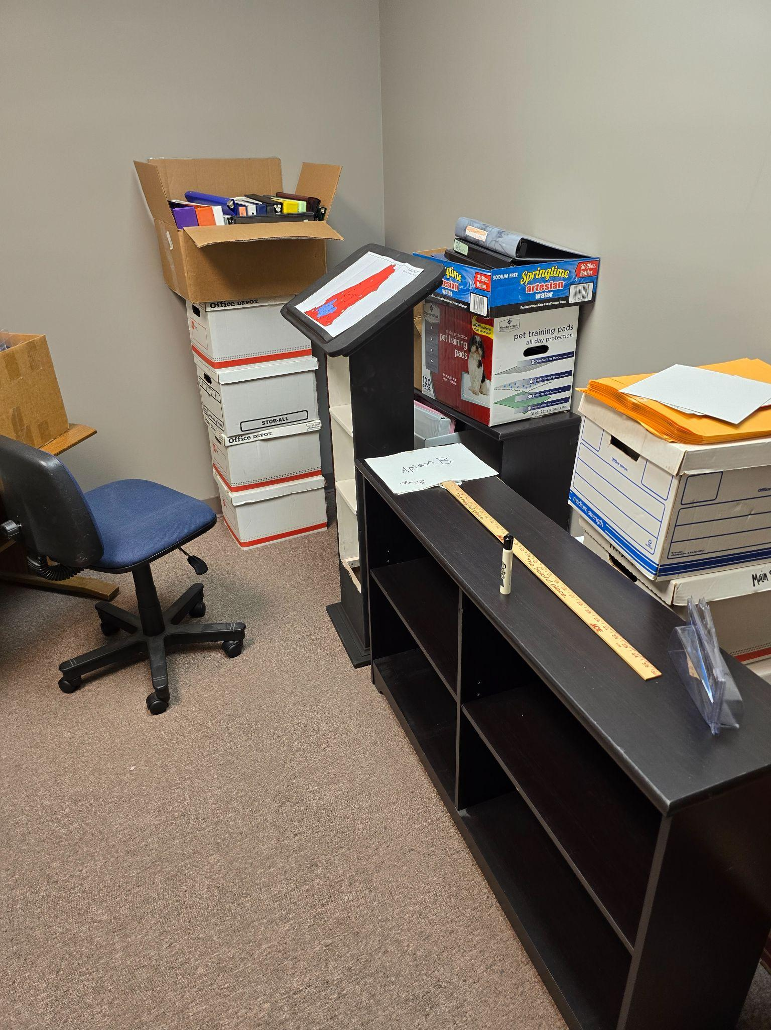

Slide 25
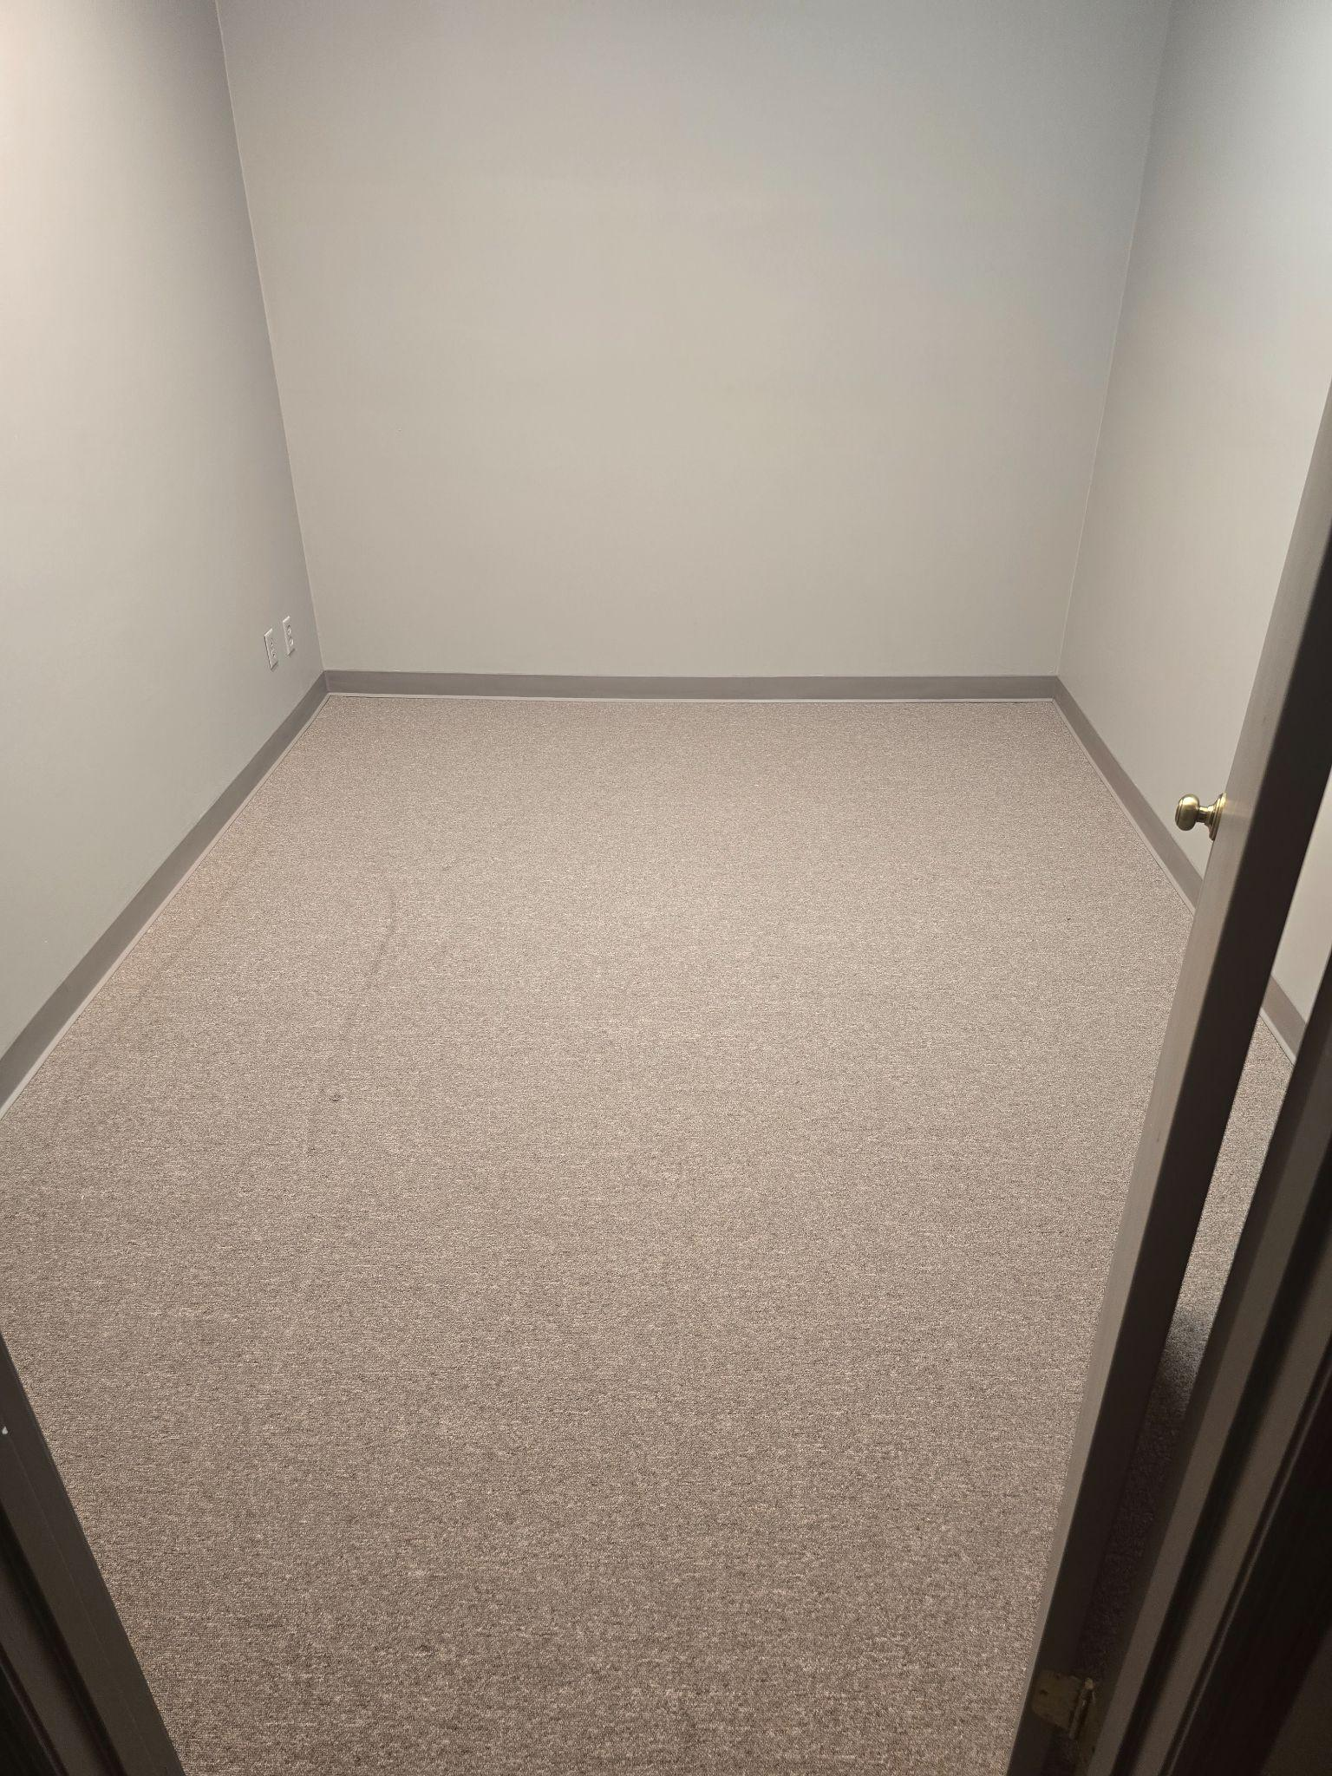

Slide 27
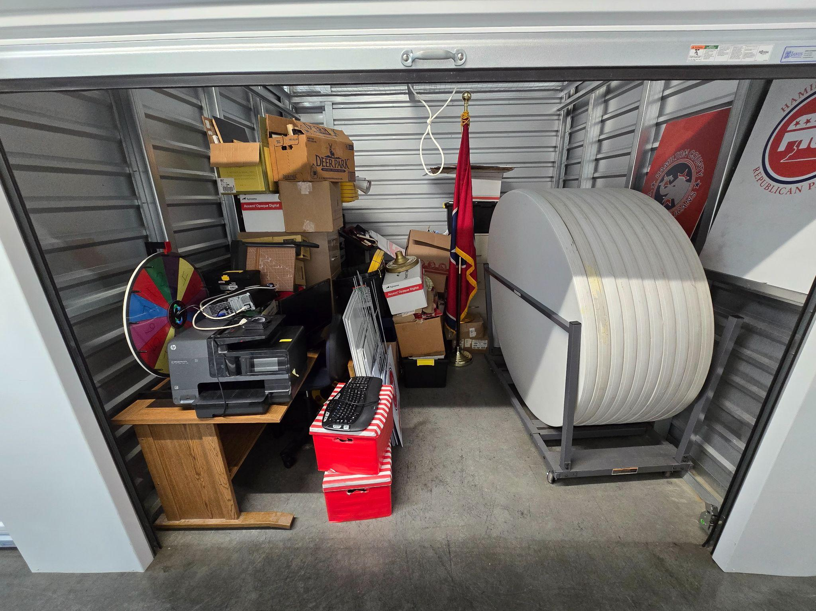

Slide 28
TREASURER’S REPORT
Strengthening Revenues,
Strategic Cuts,
Mission First

Slide 29

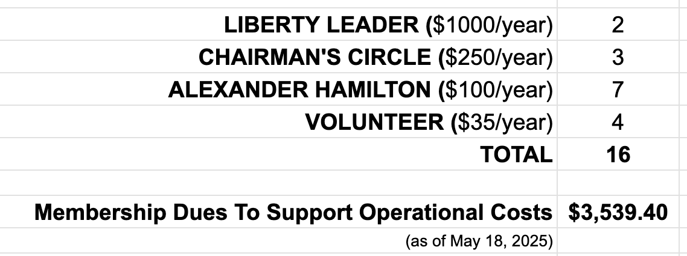
REVENUE: MEMBERSHIP
Membership has its privileges!
Yes, you can renew each year automatically.
Yes, you can do monthly installments at all levels.
On a monthly basis, these memberships give us $294.95 to build our team.

Slide 30
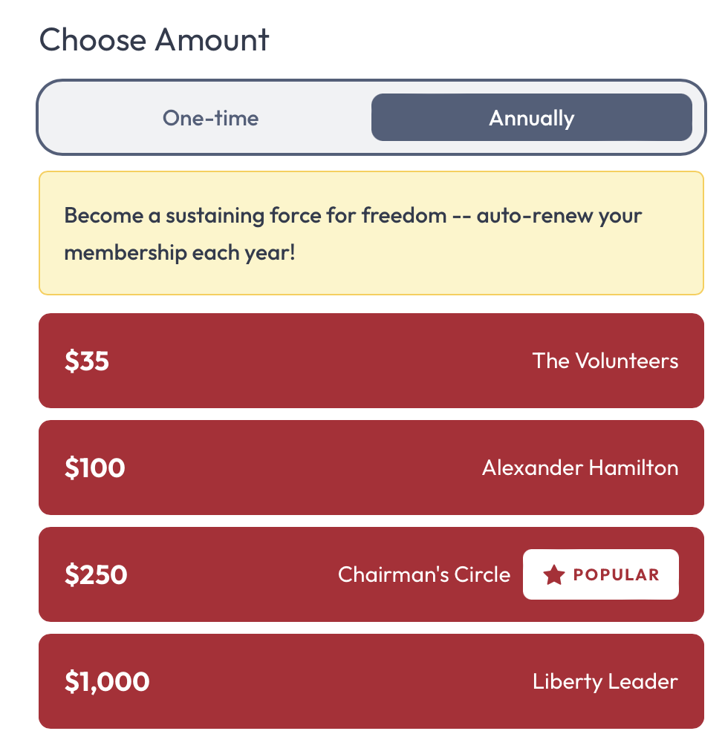

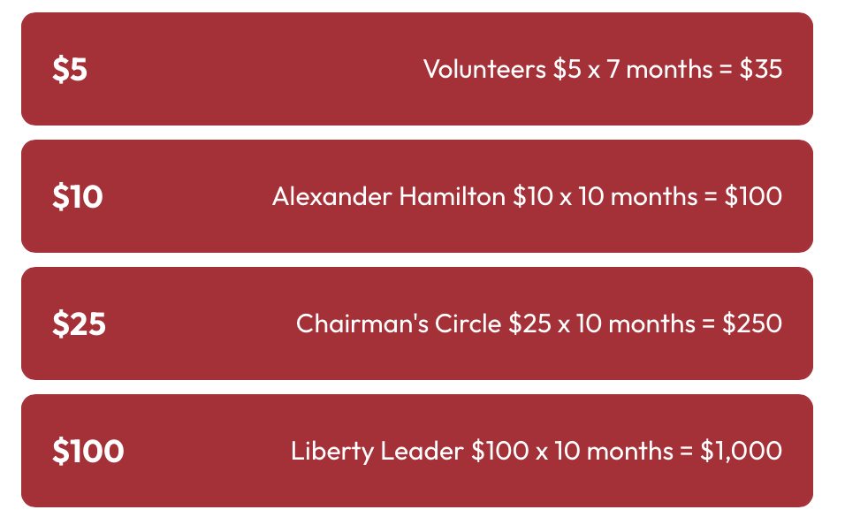
REVENUE: MEMBERSHIP
JOIN US!! Depending on your membership level, you get things like: Decal, Nametag, Access to Members Portal for Meeting Minutes and Treasurer’s Report, Invitation to a Chairman’s Event, and a surprise gift to be revealed at the Lincoln Day Dinner!

Slide 31
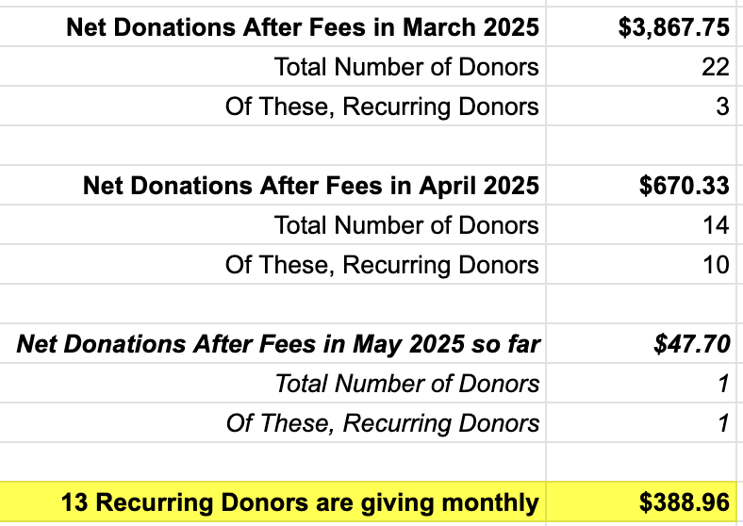
REVENUE: DONATIONS
Recurring Donations = Reliable Support
March-May Snapshot Shows Steady Growth
Enthusiastic support in March.
Steady support in April.
More recurring donors!
$10 to $100/month adds up for BIG impact!
13 monthly donors give us $388.96 we can count on and plan around.

Slide 32

REVENUE: EVENTS
LINCOLN DAY DINNER 2025
“For God, County, and Country!!”

Slide 33
EXPENSES: OFFICE
3-YEAR RENTAL CONTRACT
On January 22, 2024, the previous HCGOP signed a 3-year contract committing the organization to pay rent thru December 31,2026.
The office space incurred the following expenses:
Rent 2024 $935/month, 2025 $963/month, and 2026 $992/month
Tenant liability insurance
Share of common area maintenance, real estate tax & building insurance
Internet
Electricity
Phone line
Printer rental and usage
One employee ($18/hour, 35-50 hours per month)

Slide 34
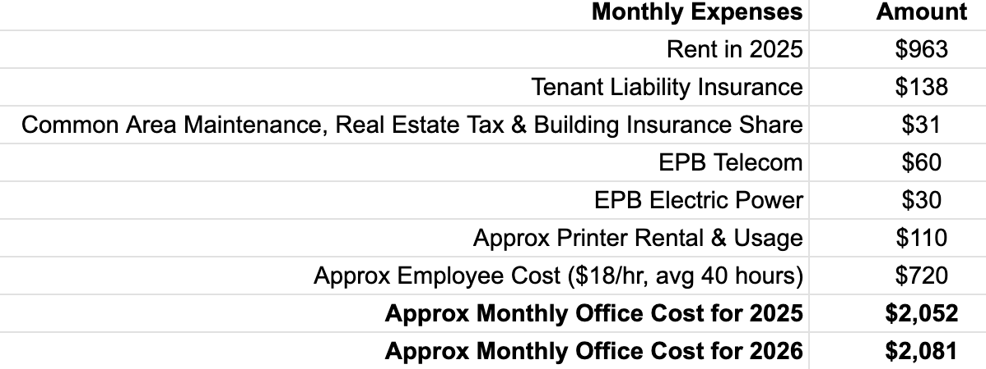
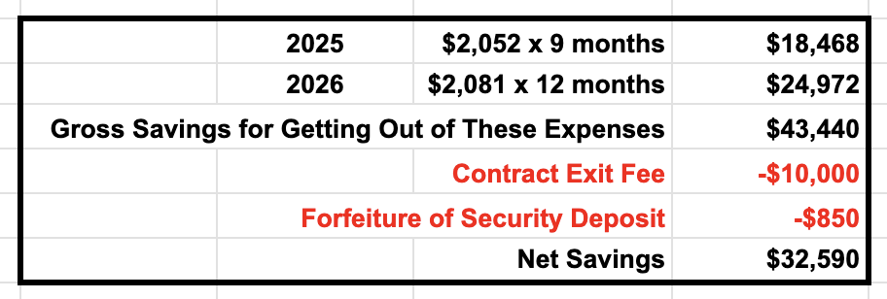
EXPENSES: OFFICE
Two years left on 3-year rental contract

Slide 35
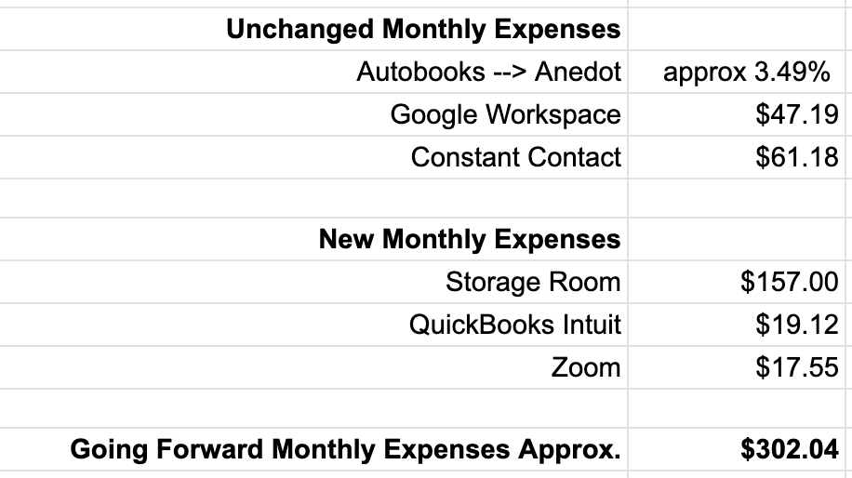
EXPENSES: GOING FORWARD
Shifting from Overhead to Outreach
Plus, each month our new HCGOP Community Meetings will incur a rental fee depending on the location. Each month we will meet in a different part of our county.

Slide 36
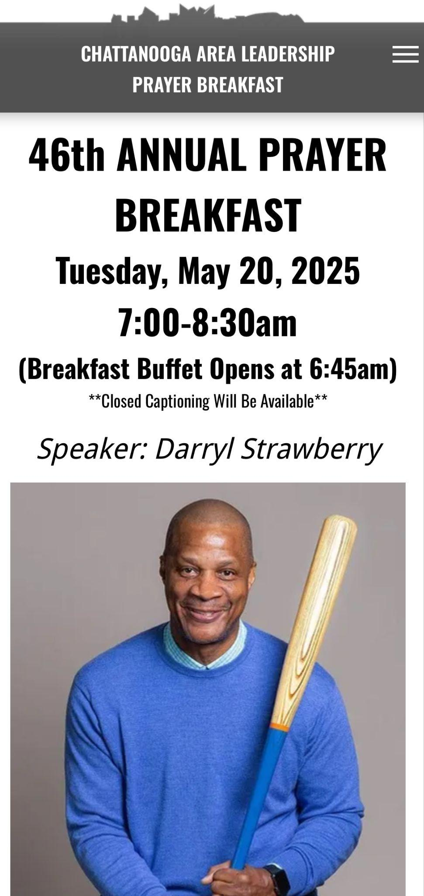


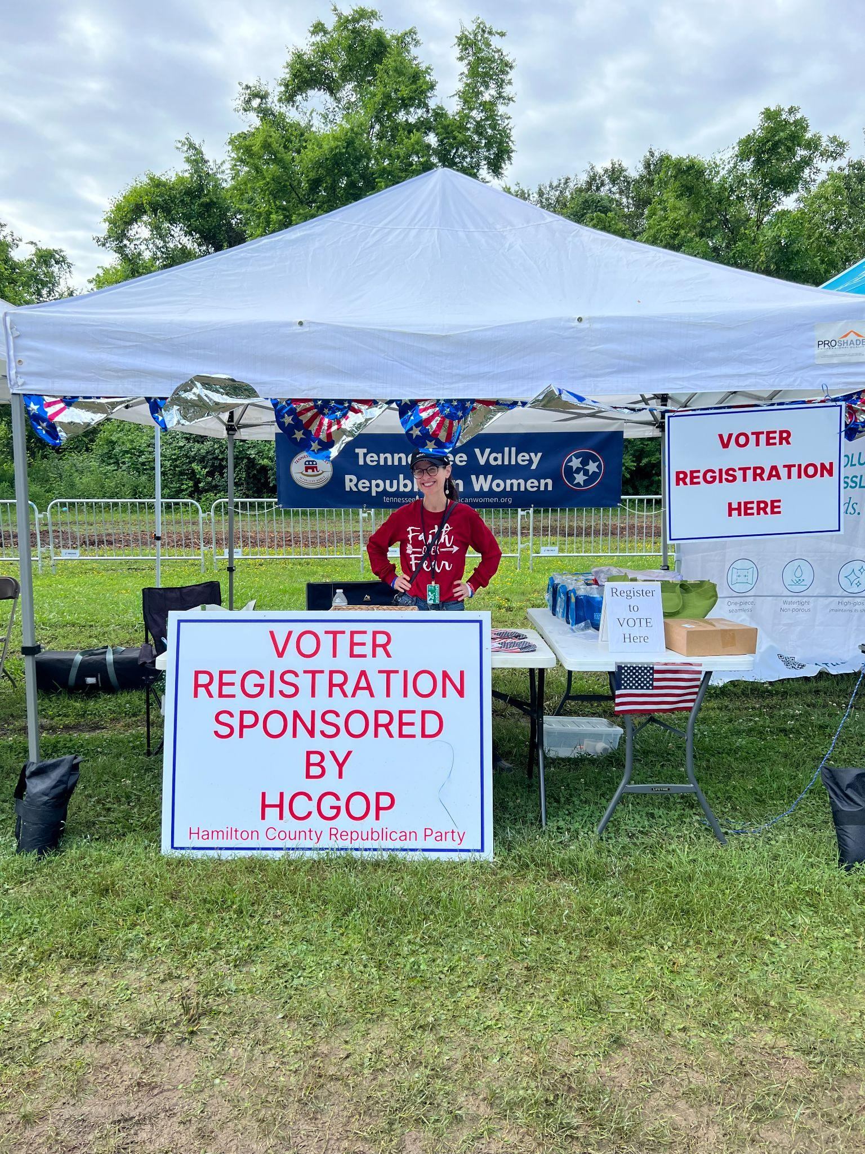
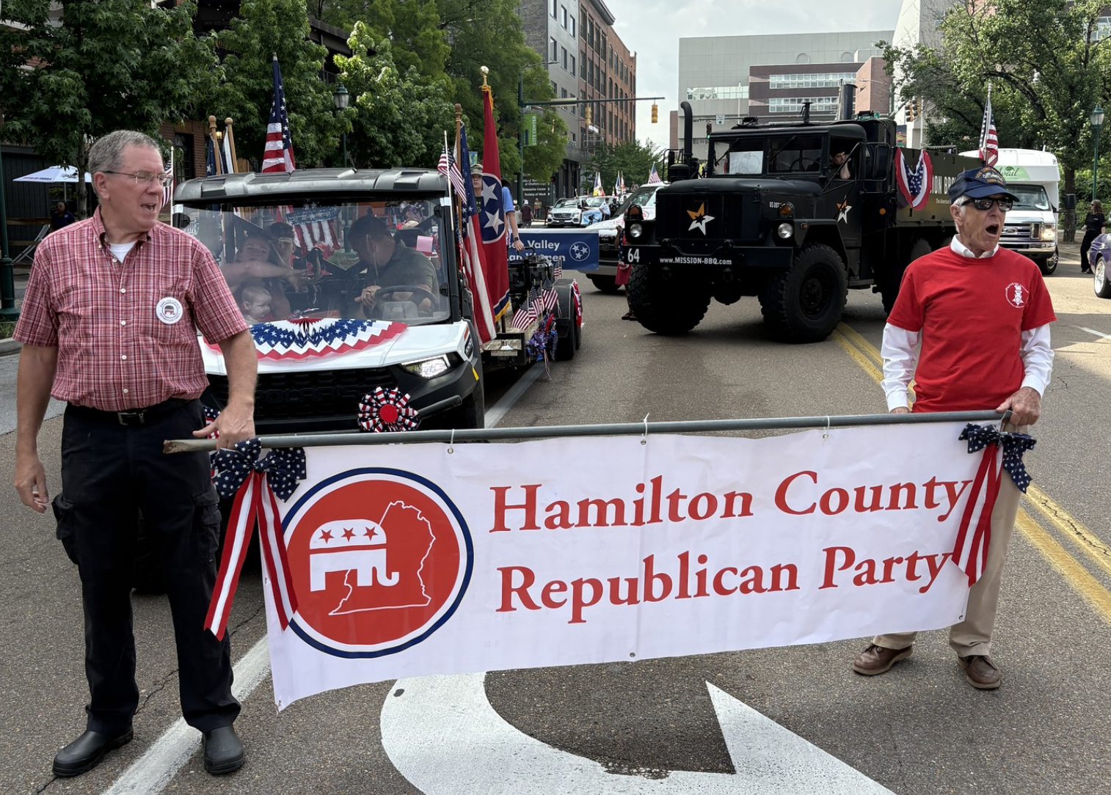
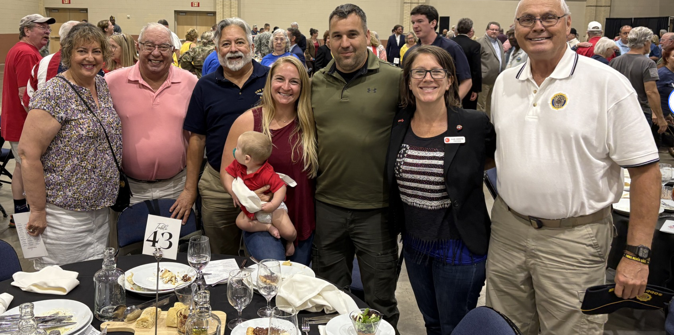
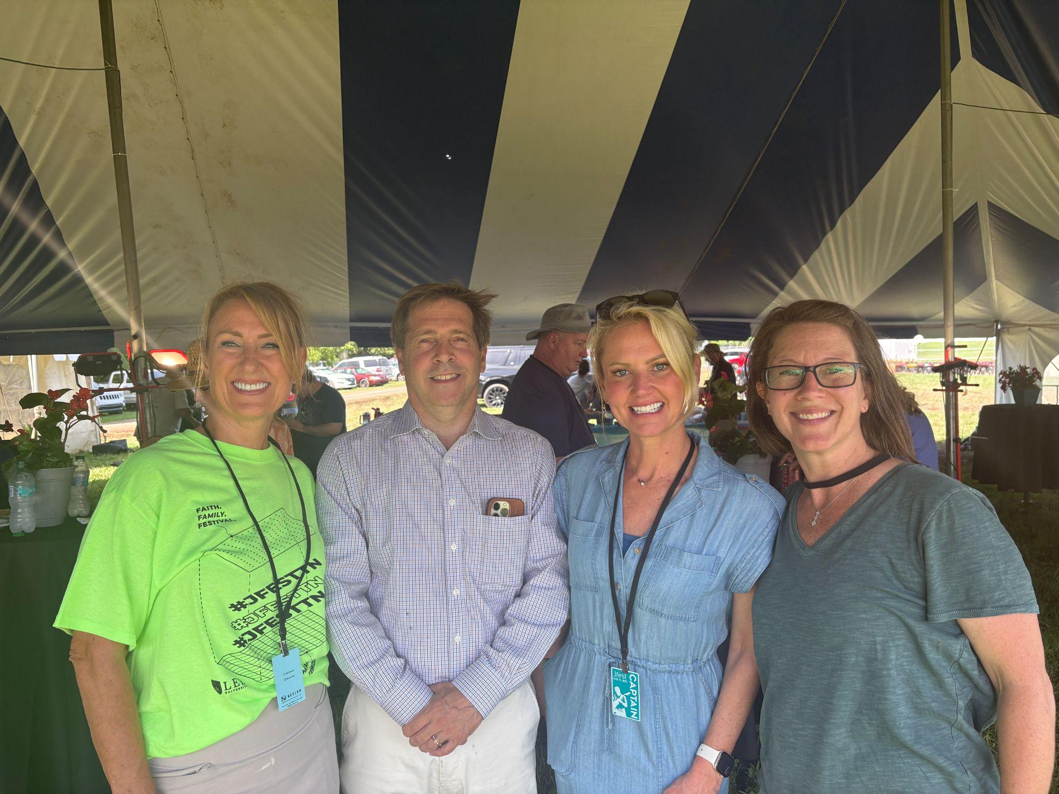
EXPENSES: GOING FORWARD
Shifting from Overhead to Outreach
$250 Support for
New T-shirts!
Armed Forces Day Parade & Luncheon $350 with Veterans at our table
JFest Booth $250 HCGOP + TN Valley Republican Women
Table for GOP Men $240

Slide 37

FINANCIAL SNAPSHOT
As of May 19, 2025
Bank Account Balance: $27,046.09 (RockPoint Bank)
Transitioning to Anedot
No outstanding debts
Lincoln Day Dinner fundraising in motion
JOIN AS A MEMBER – It’s your backstage pass to exclusive updates, events and impact!
BECOME A MONTHLY DONOR – Fuel the mission, month after month!

Slide 38
Announcements
46th Annual Prayer Breakfast
  3 spots available - Text 615-525-5686
  Darryl Strawberry - May 20th - 7:00am - Convention Center
Memorial Day: Chattanooga National Cemetery @ 11:00am
  Park at National Guard Armory on South Holtzclaw, shuttles start at 9:30am
  Comments by Congressman Fleischmann & Mayor Wamp
Lincoln Day Dinner - July 12th
Club announcements
Elected Official announcements

Slide 39
Closing Remarks
Please continue showing up!
Please give!
Please reach out if you’re interested in running for office…2026 is right around the corner!
Next Meeting
Harrison Community Center Auditorium
(5637 Hwy 58, Harrison, 37341)
June 16th - 6:30pm

