Slide 1
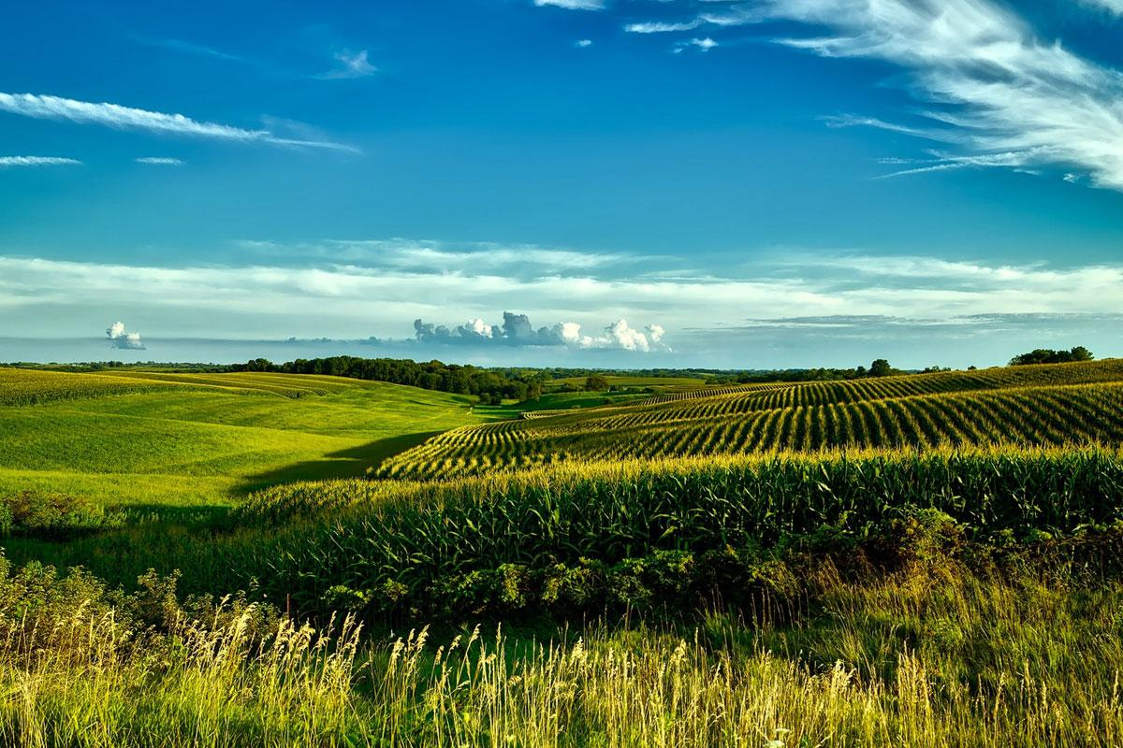
Remediation of
“Seeds of Controversy”
By Hugo Arturo Verduzco

Slide 2
What topics did I discuss within my Essay?
Definition and History of GMOs
What GMOs are and how they are created. The historical development of GMOs, including the use of Agrobacterium tumefaciens and the creation of the first genetically modified crops like the FLAVR SAVR™ tomato.
Benefits of GMOs
Increased crop yields, particularly in challenging environments.
Reduction in pesticide use and associated environmental benefits.
Improved food security, especially in regions prone to hunger and environmental stressors.
Economic benefits for large-scale farmers and agribusinesses.
Concerns About GMOs
Potential health risks and public skepticism regarding their safety and "unnatural" nature.
Environmental risks, including biodiversity loss and soil degradation caused by monoculture farming.
Ethical and societal concerns, particularly around corporate control.

Slide 3
Corporate Control and Seed Ownership
The role of patents in restricting farmers from saving seeds. Financial dependency created by the patent system, forcing farmers to buy new seeds annually.
Case study of Percy Schmeiser vs. Monsanto, highlighting the legal and ethical issues around seed patents.
Economic and Socioeconomic Impacts
The financial burden of GMO seeds on small-scale/traditional farmers.
Disparities between developed countries (e.g., U.S.,India, Argentina) in GMO adoption and its consequences.
The role of GMOs in exacerbating or alleviating global food inequality.
Biodiversity and Environmental Impact
Risks of biodiversity loss due to GMO-driven monoculture practices.
Case examples like Argentina’s soybean industry, showing how GMOs can harm ecosystems.
The importance of balancing GMO use with sustainable farming practices, such as intercropping and crop rotation.
Survey Results and Public Perception
Insights from your survey showing public skepticism toward GMOs, concerns over corporate control, and economic challenges faced by farmers.

Slide 4
Why I picked the topic
I have recently become interested in this topic as of a few years ago, I am majoring in Bio-Chemistry, may switch to Bio-tech to focus primarily on GMO’s and I saw this as a great opportunity to educate myself further to determine if this is a path I would like to take.
Ideal goal :
Career: Product Manager for Biotech Products
Hobby: Work/create a healthy GMO that help farmers and mankind.

Slide 5
What I Changed and How My Website is Organized:
I transformed my essay into an engaging website by adding visuals, multimedia, and simplified language for a broader audience. I broke down dense paragraphs into sections and incorporated headers, bullet points, and interactive elements to enhance readability.
My website is structured with clear tabs:
What Are GMOs? – An overview of GMOs’ history, science, and core benefits.
The Pros of GMOs – A breakdown of advantages in agricultural contexts.
The Cons of GMOs – A breakdown of disadvantages in agricultural contexts.
Corporate Control and Seed Ownership – Overview of Monsanto and a legal case.
Survey Results and Public Opinion – Insights from public responses and opinions gathered through a survey.
Each section flows logically, guiding readers through the topic while connecting key arguments and evidence.

Slide 6
Audience:
Primary Audience: Consumers curious about GMOs, including those wanting to make informed choices about food and sustainability.
Secondary Audience: Educators, students, and advocates or skeptics seeking balanced perspectives and credible information on the GMO debate.

Slide 7
What I Learned:
Through this process, I learned how to adapt my writing to different mediums and audiences.
Translating my essay into a website taught me the importance of visual storytelling, simplifying complex ideas, and organizing content for clarity and engagement.
I also realized how multimedia can enhance arguments and make topics like GMOs digestible.

Slide 8
How I Made My Essay More Friendly:
I simplified the language to make it easier to understand and avoided technical lingo when possible.
I used visuals like images, videos, and infographics to break up the text and added clear headers to guide readers.
By presenting balanced perspectives and engaging multimedia, I made the content more approachable and relatable.

Slide 9
Main Concerns When Remediating My Essay:
I focused on keeping the content engaging while maintaining accuracy and balance.
I wanted to simplify complex ideas without losing depth and ensure the visuals supported the argument. I still felt as if the paragraphs were to large but couldn’t simplify my topics further.
Organizing the site in a way that was easy to navigate.

Slide 10
How I Found Additional Media:
I searched for credible and relevant images, infographics, and videos that aligned with my essay’s themes. I used academic databases, reputable websites, and creative commons resources to ensure high-quality and properly licensed content to the best of my ability.
Youtube had many condensed educational videos

