Slide 2
Welcome Back to School 2024-25
Principal
Kate Flanaghan
Assistant Principal
Jason La Mesa

Slide 3
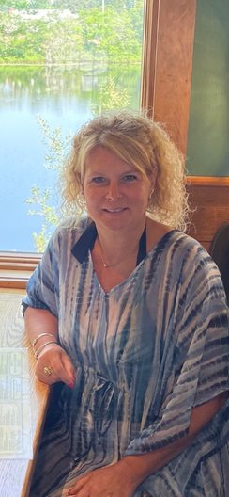
Pupil Services
Lauren Andrews
Special Education Coordinator
Landrews@enfieldschools.org
Kellie Chenevert
Special Education Teacher
kchenevert@enfieldschools.org

Slide 4
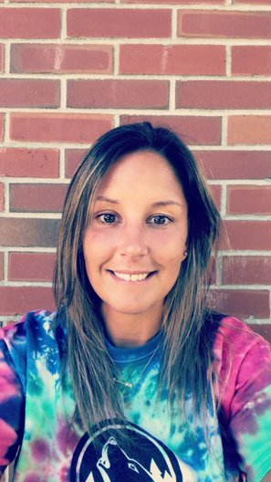
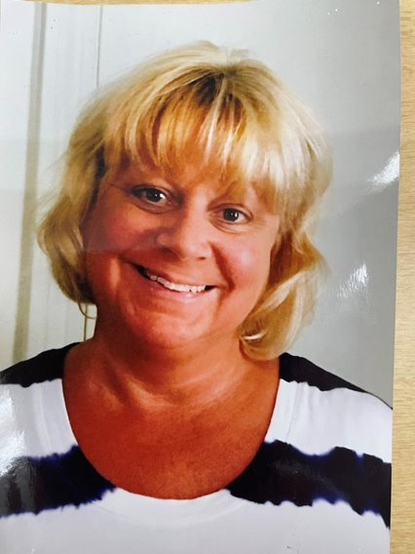
Teachers
Andrea Silva
3rd Grade Teacher, Room 10
asliva@enfieldschools.org
Kim Muggleton
3rd Grade Teacher, Room 11
kmuggleton@enfieldschools.org

Slide 5
Teachers
Kathleen Martin
3rd Grade Teacher, Room 13
Kmartin@enfieldschools.org
Kelly Chenevert
3rd Grade Special Education Teacher, Room 12
Kchenevert@Enfieldschools.org

Slide 6
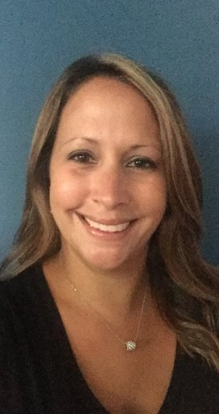
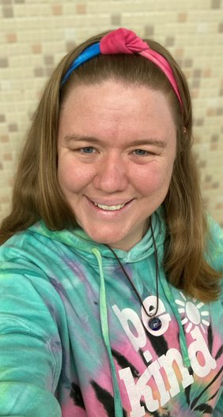
Teachers
Kim Harmon
3rd Grade Teacher, Room 14
kiharmon@enfieldschools.org
Cortney Sorenson
3rd Grade Teacher, Room 15
csorenson@enfieldschools.org

Slide 7
Collaborative Relationships
We look forward to building a collaborative relationship with all our Whitney families. We all feel that it is important to keep open dialogue between home and school.
Working together shows your child that their education is important to both you and their teacher.

Slide 8
Whitney Wolves Newsletter = SMORES
The Whitney Wolves Newsletter will be sent home weekly via email and accessible on the Eli Whitney website and Facebook page. Please complete all student information forms online through the Parent Portal or call or email the school and be sure to include your email to ensure that you receive school communication in a timely manner. Important information and community flyers will be included in each newsletter.

Slide 9
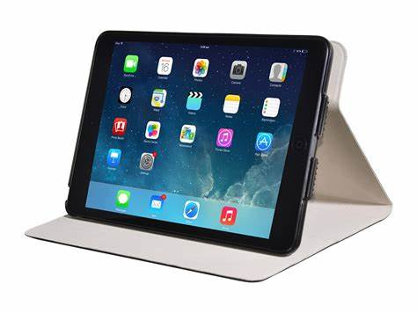
First Week of School
We encourage parents to take photos at home.
Staff will be available outside the building to help.
Staff will be available to assist your child and answer any questions.
Students will not have access to a water fountain. You may want to send a water bottle or your child’s use.
Please limit backpacks to lunch bags, water bottles, and iPads only.

Slide 10
Procedures: Staff is always on duty to greet your child and assist as needed.
Arrivals
Walker/Parent Drop-Off: (Exceptions must be preapproved by building principal) 8:25-8:40
NOTE: Entrance to Drop Off is from South Rd. There is no left turn off Olmstead Rd. into the drop off area.
Students should not arrive before 8:25. Staff will not be available for supervision before this time. Please do your best to arrive prior to the bell ringing. This will support your child’s engagement in morning activities.
Students arriving late must enter the building through the front door. An adult must accompany and remain with the student at the front door until the student is let into the building by a staff member. The parent must sign the student into the attendance book provided outside the front office.

Slide 11
Drop Off Procedures: Staff is always on duty to greet your child and assist as needed.
Drive into the pick-up/drop off area (do not park) and have your child quickly exit out of the passenger side of the vehicle.
Pull away from the area as soon as your child leaves your car.
There is always a teacher on duty to watch the students as they exit your car and walk to the school.
Teachers will assist your child with any directions or supports needed.
** NO drop-off of students at the main door during drop off time to ensure safety for all.

Slide 12
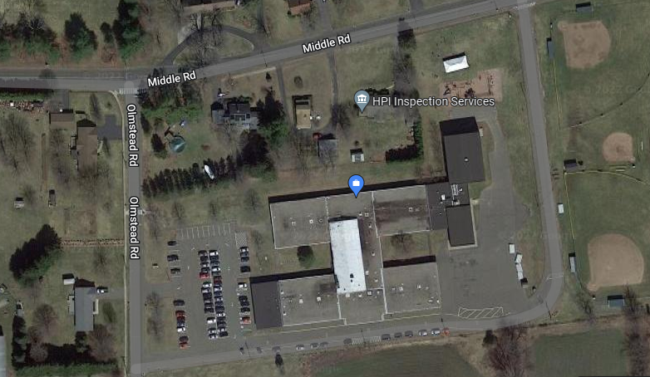
DROP OFF
Whitney
No Left turn
Buses only

Slide 13
Procedures
Dismissal:
Walker/Parent Pick-up: (Exceptions must be pre-approved by building principal) 3:06, busses: 3:10.
NOTE: Entrance to Pick up is from South Rd. There is no left turn off Olmstead Rd. into the pick-up area.
If your student needs to be dismissed early or the method of dismissal changes, a parent/guardian must contact the office with a letter or a phone call prior to 2:30. To limit exposure, students will be picked up at the front door after parent signs the dismissal book and shows identification. If no notification is received, student will be dismissed their usual way.

Slide 14
Dismissal Procedure
At 3:06 walkers and pick-ups are called to the back of the building. Staff facilitates the pick-up process.
Children being picked up wait in the designated area until staff directs them to enter the car. No children will be allowed to enter the parking lot by themselves.

Slide 15
PICK UP
Whitney
No Left Turn
Buses only

Slide 16
Procedures
Transportation & Drop-Off/Dismissal Procedures
Walker 2. Pick-Up/Drop-Off 3. Bus
Student must always go home to primary residence, or afterschool care as set up at beginning of school year.
Bus Transportation: All students will go home unless a different drop-off is necessary (in-district daycare). Office must be notified in writing prior to changes.
Students cannot ride home with another student, on a bus other than their own, per the bus company.
**Exceptions to ride another bus must be requested in writing and approved by administration ahead of time.

Slide 17
Bus Dismissal Procedure
Bus students exit out the front doors.
Students waiting or their bus to called remain in their classrooms until called to a bus station.
Students are released from their classrooms by their teachers when their bus number is called.

Slide 18
Whitney
Buses only

Slide 19
Breakfast and Lunch
Breakfast
8:25-8:40
Breakfast is available to all students. Cost for breakfast is to be determined.
Students arriving to school late can pick up breakfast and take it to their room, but it will be eaten as snack.
Lunch
Lunch is provided to all students. Cost for lunch is to be determined.
The lunch menu is on the district's website and is sent home in the Whitney Wolves Newsletter.
There are typically 3 choices students can choose from.

Slide 20
Whitney Office and Special Services Staff 860-763-7540 Emails: first initial last name @ enfieldschools.org
Office Staff Mrs. D. Souer Mrs. L. Lawler Nurse Mrs. J. Rustic Counselor Mrs. L. Short Special Education Mrs. K. Chenevert-3rd Mrs. D. Wagner-4th Mrs. S. Perez-5th Mrs. J. Cahillane-Speech Ms. D. Del Coro-OT Ms. C. D'Agostino-PT | Assistant Principal Mr. J. La Mesa Principal Mrs. K. Flanaghan Special Education Coordinator Mrs. Lauren Andrews Custodians Mr. Mejia Mr. Bowling Mr. Craig

Slide 21
Eli Whitney Teaching Staff
3rd Grade Mrs. A. Silva Mrs. K. Muggleton Mrs. Martin Mrs. Ki. Harmon Mrs. C. Sorenson Mrs. K. Chenevert | 4th Grade Ms. J. Stolar Ms. K. Suleski Ms. N. Ricci Mrs. M. Linehan Mrs. D. Wagner 3rd – 5th Mrs. E. Ziba, and Mrs. Puttick | 5th Grade Mrs. C. Zenzick Mrs. J. Horton Mrs. M. Lindeland Ms. C. Polmatier Mrs. K. Foy Mrs. S. Perez
Grade Level Teachers:
Emails: first initial last name @ enfieldschools.org

Slide 22
Specialists & Support Teachers Emails: first initial last name @ enfieldschools.org
TBD, Music Ms. M. Santarpia, Art Mr. J. Crandall, PE Ms. S. Wolf, Library Ms. Aloisa, TECH Mrs. D. Klapproth, Reading Ms. C. Maggio, Reading Consultant Mrs. M. Bellafronte, Math Mrs. J. Edelstein, Math Mr. B. Moore-Manwaring, MLL/TESOL

Slide 23
Support Staff Paraprofessionals Behavior Techs Tutors
Behavior Techs Ms. Nugent Paraprofessionals Ms. Burke Mr. Taylor Ms. Alaimo Ms. Viveiros Ms. Creanza Ms. Cressotti Ms. Alexander Erin Maggio | Tutors Ms. Fortuna Mrs. Bourcier Ms. Hillis Ms. Maddeaux Lunch Staff Ms. Delorge Ms. Thibodeau Ms. Ruggieri Ms. Bourcier Ms. Jessica Ms. O'Regan

Slide 24
Technology Insurance Application
Student/Parent Technology
Loss/Damage – Waiver
The replacement cost of lost devise is based on the cost of the replacement of the device lost while in their possession. Replacement costs for accessories including but not limited to, cases, charging cords, etc. will be based on the cost at the time of replacement. See comparison chart:
Please Confirm:
___ I understand any violation of the terms of this agreement may subject me to disciplinary action.
For the Damage Waiver Program: This payment will cover my student’s iPad for one occurrence during the current school year. This coverage may be renewed after use for same fee.
___I have paid online through myschoolbucks.com
___I have included a check made Payable to Enfield Public Schools with my child’s name on the check.
___I do NOT want to participate in the Loss/Damage Waiver for my child’s iPad. I understand I am responsible for the replacement cost of the device should it get broken, stolen or lost.
___I have read, understand and accept the parent/student responsibilities enclosed in this EPS Technology Handbook.
Per Occurrence/Without Waiver | Cost
Lost/Damaged iPad | $400
Replacement Charger/Accessories/Keyboard | $40

Slide 25
Parent Responsibilities
I will supervise my child’s use of the iPad at home and promote digital wellness through monitoring screen time.
I will make sure my child recharges the iPad battery nightly.
I will make sure my child brings the iPad to school every day.
I will discuss the Enfield Public Schools’ expectations regarding the use of the internet and email at home.
I will not attempt to repair the iPad or attempt to clean it with anything other than a soft, dry cloth.
I will report, to the school, any problems with the iPad, as outlined in the Handbook.
I will not load or delete any software rom the iPad.
I agree to return the iPad to school when requested and/or upon my child’s withdrawal from Enfield Public Schools.

Slide 26
Student Responsibilities
Your iPad is an important learning tool and is to be used to educational purposes. In order to take your iPad home each day, you must be willing to accept the following responsibilities:
I will bring my iPad to school every day.
I will keep the iPad in its protective case at all times.
I will recharge the iPad battery each night.
I will trat the iPad with care by not dropping it, getting it wet, leaving it outdoors, exposing it to extreme temperatures, or using it with food and drink nearby.
I will not lend the iPad to anyone, not even my friends or siblings; it will stay in my possession at all times.
I will not use my iPad with personal email accounts other than those assigned by school.
I will remove programs or files from the iPad.
I will not give out personal information while using the iPad.
I agree that any other electronic communication should be used only for appropriate, legitimate responsible communication. I will practice good Digital Citizenship skills.
I will keep all accounts and passwords assigned to me secure and will not share these with any other students.

Slide 27
Student Responsibilities, Cont.
I will not attempt to repair the iPad
I will return the iPad when requested and/or upon my withdrawal from Enfield Public Schools.
When using the iPad at home, at school, and anywhere else I may take it, I will follow the policies of Enfield Public Schools. Especially the Student Handbook and Acceptable Use Policy, and abide by all local, state, and federal laws.
In the event that the iPad is damaged, lost, or stolen under this plan, restitution will be expected. It is important to remember that our Mobile Devise Management Tool, Mosyle, us used on the device and has the ability to track the location of the iPad (location will be indicated on the map), as well as remotely control a sound notification on each device. In the event of loss or theft, it is important to notify school personnel quickly (before the battery drains). The school district will treat it a lost iPad as stolen and support law enforcement/authorities in tracking the device.
I have read, understand and accept the parent/student responsibilities enclosed in this EPS Technology Handbook.
Parent Signature_____________________________________________________
Student Signature____________________________________________________

Slide 28
We at Whitney feel honored to work with you and your children. We take pride in our community. Thank you for being a part of that community.
Welcome!

