Slide 1
Introduction to the G4 Bicycle
To finish this talk in a reasonable time, I had to limit the message, and focus…
Who am I?
The Five G4 Bikes
What is a G4 Bike?
Why is it different?
How does it work?
More on the 5 Prototypes
25,000 Miles of Riding, Touring and Racing
Where to from Here?
Does History Repeat Itself?
Summary, Q & A
Potential Follow-on Topics
(Too much for today…)
Build Process and the Shop
G4 Fairings, Aerodynamics and Sailing
System Engineering and Patent Processes
G4 in Mixed Group Rides
G4 “Road Racer” (vice current “Sport Tour”)
G4 Travel Bike
G4 Delta Trikes
G4 vice Upright vice Recumbent
The G4 Uses a New Principle of Operation, Based on Standing to Pedal an Upright,
To Better Integrate and Engage the Rider, Result is a New Type of Bicycle.
1
Notes:
This is an introduction to the G4 Bike
G4 is a new type of high-performance bicycle that is a lot more fun to ride.
There is a lot more to say, but that will have to wait until another time.

Slide 2
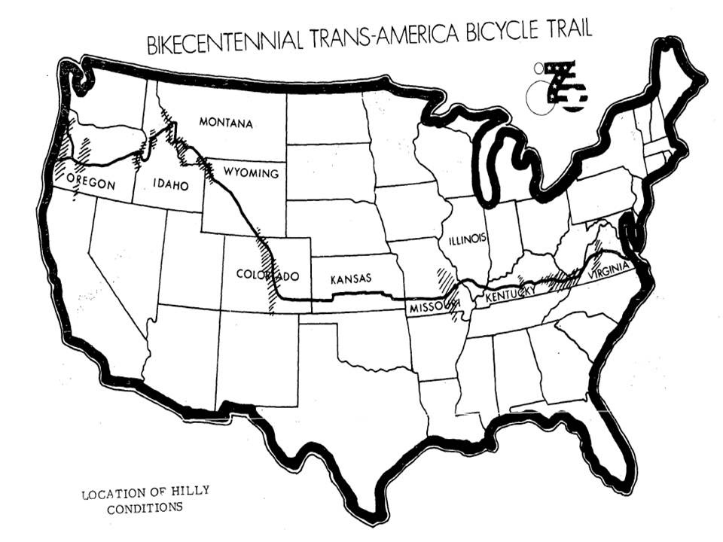
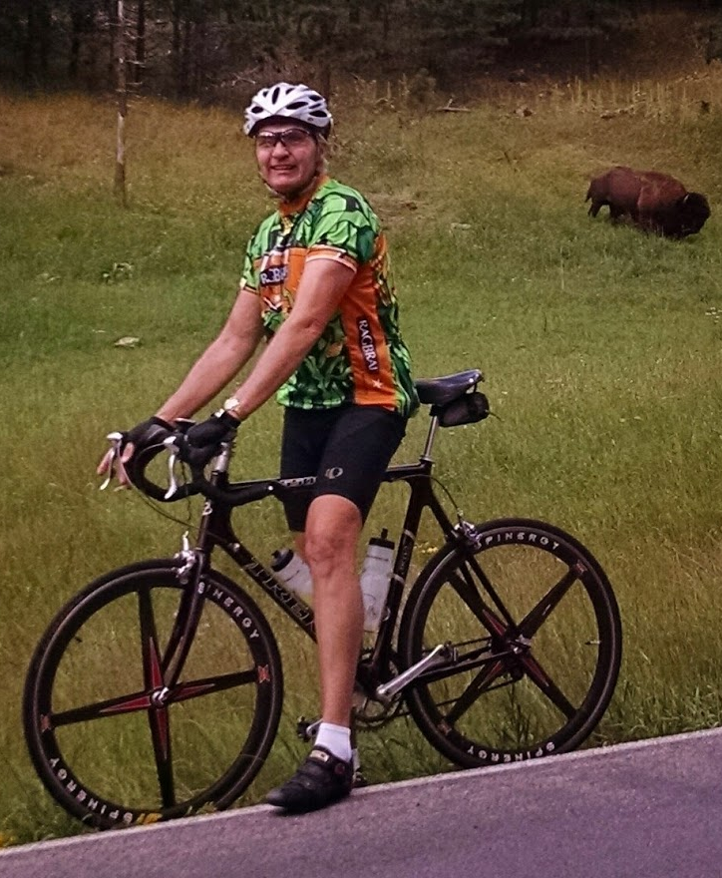
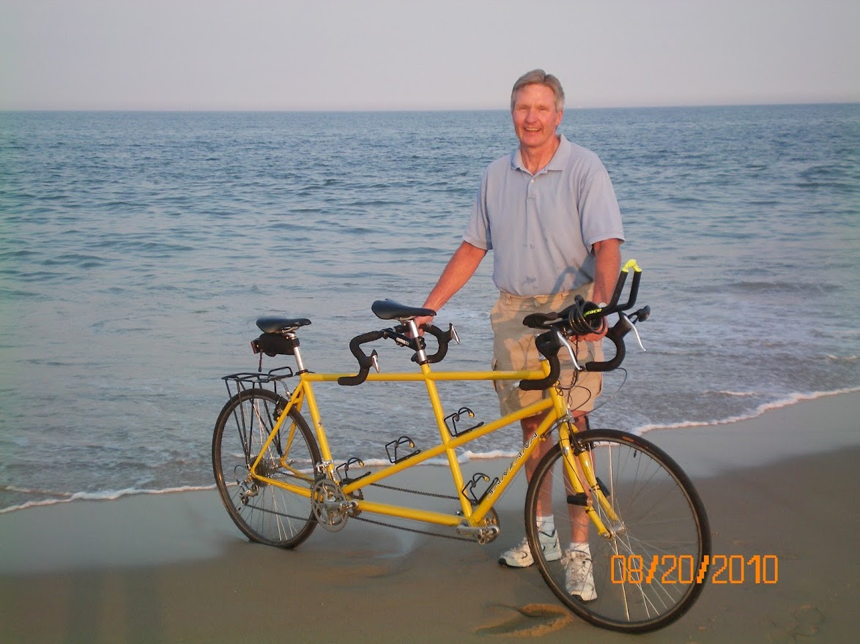
Who Am I?
Retired in 2014 to develop bikes!
Professional Engineer and Systems Analyst
DoD Career: System Development, Test and Evaluation
Conventional Bike History
Biked to work
Peggy (wife), kids, friends and vacation rides
Harford Velo Club - Founding Member
Tandem
Trans-Am in 2011
Building – My shops have been a lifelong passion
My “Dream Shop” built in 2009
Started with Wood, added Machine, Welding, Composites
Recumbent Research – I needed to understand…
Wanted to Buy Current and Build New
Studied, Traveled, Shopped, Tested, Documented
First ride in 2014
I did not buy…
Peggy fell and was kinda done with recumbents…
Ron Thompson
ronaldathompson7641@gmail.com
(410) 734-7528 (Landline)
Harford County, Maryland
2
Notes:
As I think about it, seems my entire life, personally and professionally has been in preparation for G4 Bike development.
I started dedicated development in 2014.
And have continued to work the G4 full time since then.

Slide 3
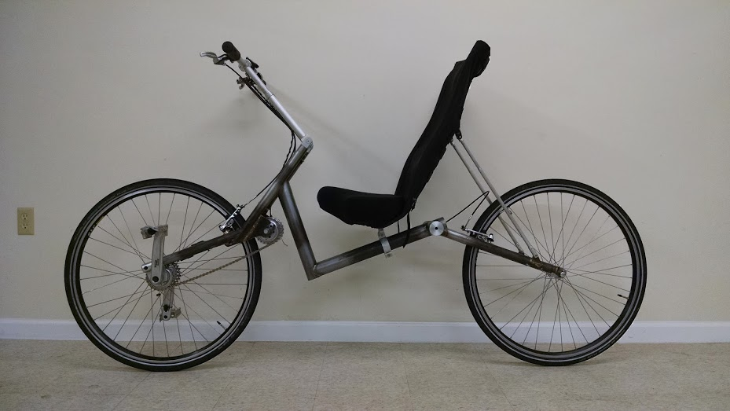
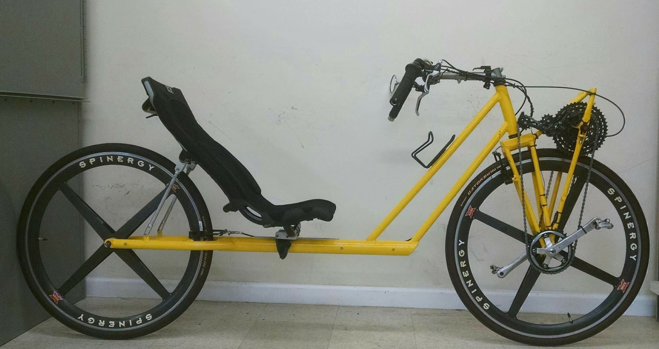
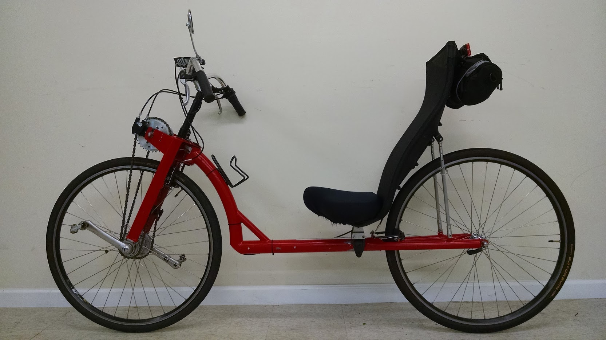
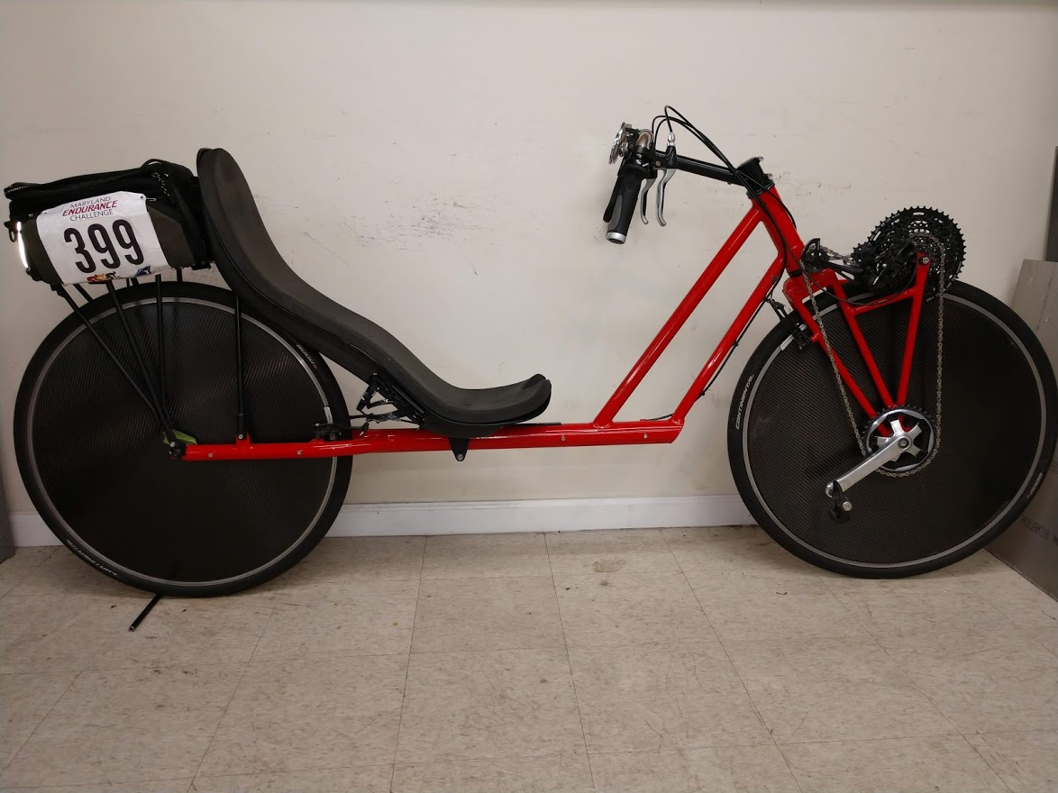
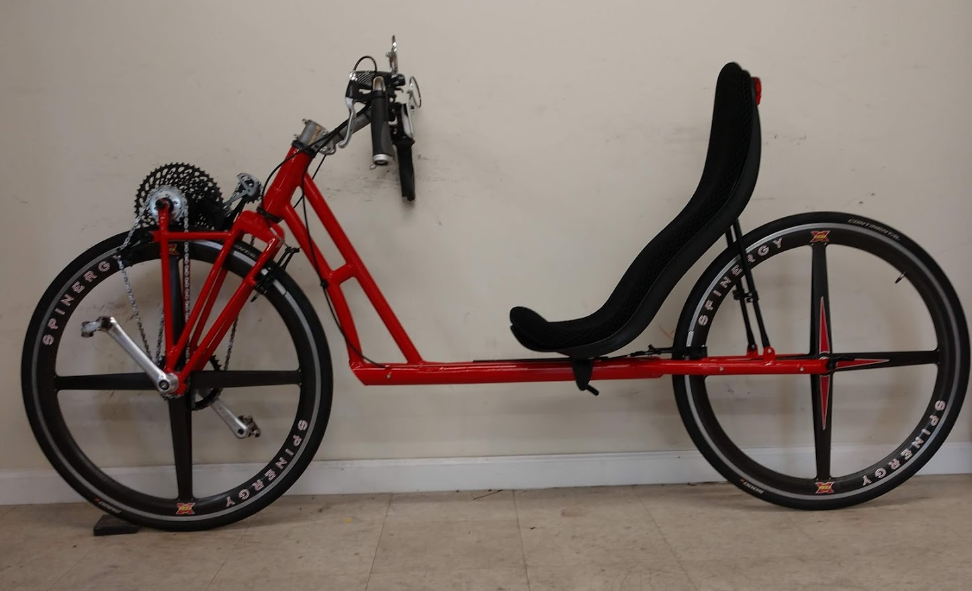
P-1
The Five G4 Bikes
P-3
Started building Bikes in 2014
Wanted comfort, speed, & safety for “Road Touring”. Also wanted fairings for speed, protection and cargo.
Had no thought of hand power input…
“Developmental Prototypes” P1 to P5
P1 - Spring 2015 – Manage PFF!
P2 - Spring 2016 – Manage PFF??
P3 - Spring 2018 – Hand Power!
P4 - Spring 2019 - Refinements
P5 - Spring 2020 – Peggy’s Bike
P-2
P-4
P3 was the first to allow effective and substantial hand power input!
P-5
Have kept quiet about the bikes,
until now.
3
Notes:
This is an overview of the result.
The bikes have gotten good.
But they work better than I ever could have hoped.
I am excited to start talking about them.

Slide 4
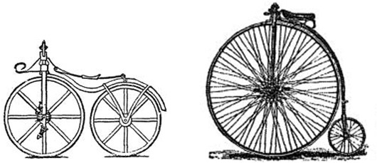
What is a G4 Bike?
Defined by ~Three Prior Generations of Bicycle Function
Generation 1 - Draisene - 1818
Two wheels can be balanced by steering the front!
“Scooter” propulsion
Generation 2 - Boneshakers and High Wheelers - Circa 1860
Pedal-Crank front wheel propulsion
Pedal force input is ~ parallel to the steering axis
Generation 3
“Safety Bike” which is the current “Upright” - Circa 1885
Drive to rear wheel separated steering and propulsion
Can stand, pedal and provide hand power!*
Recumbents – Circa 1896
Bents Are a subset of G3, because they are concurrent
(arguably, could be G4, and then G4 is G5…)
Pedal force input is ~ perpendicular to the steering axis
Reclined rider, for aerodynamics, comfort and safety
G1
G2
* Safety Bike ~inventor said the big advantage was being able to stand and pedal!
G3
4
The “Generation Four Bicycle”
Provides the Best of the G3 Upright and Recumbents.
Notes:
200 years of bicycles are summarized in three generations.
The current Generation 3 bikes have existed for over a 100 years.
Includes both upright and recumbents.
They have very different advantages.
The G4 provides the best of both.

Slide 5
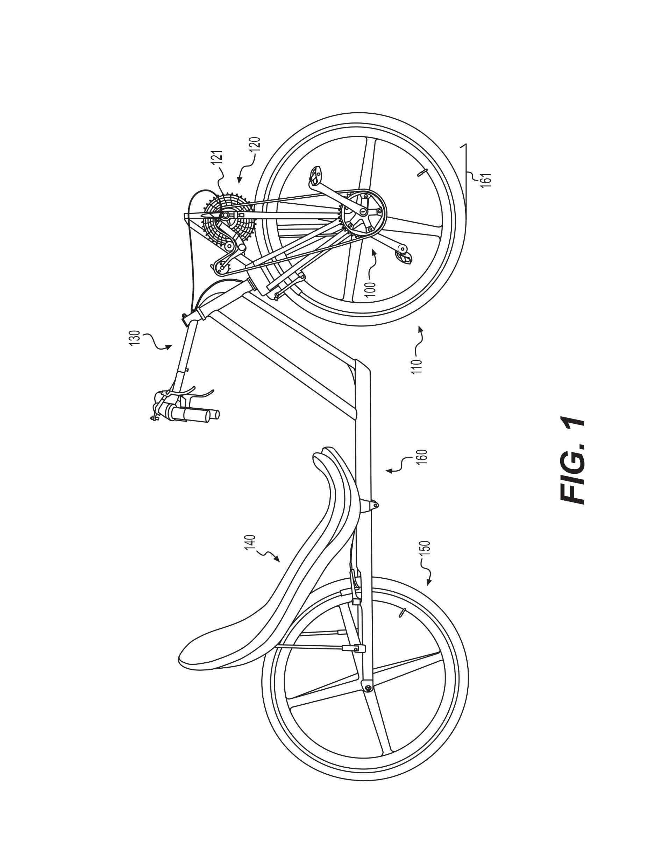
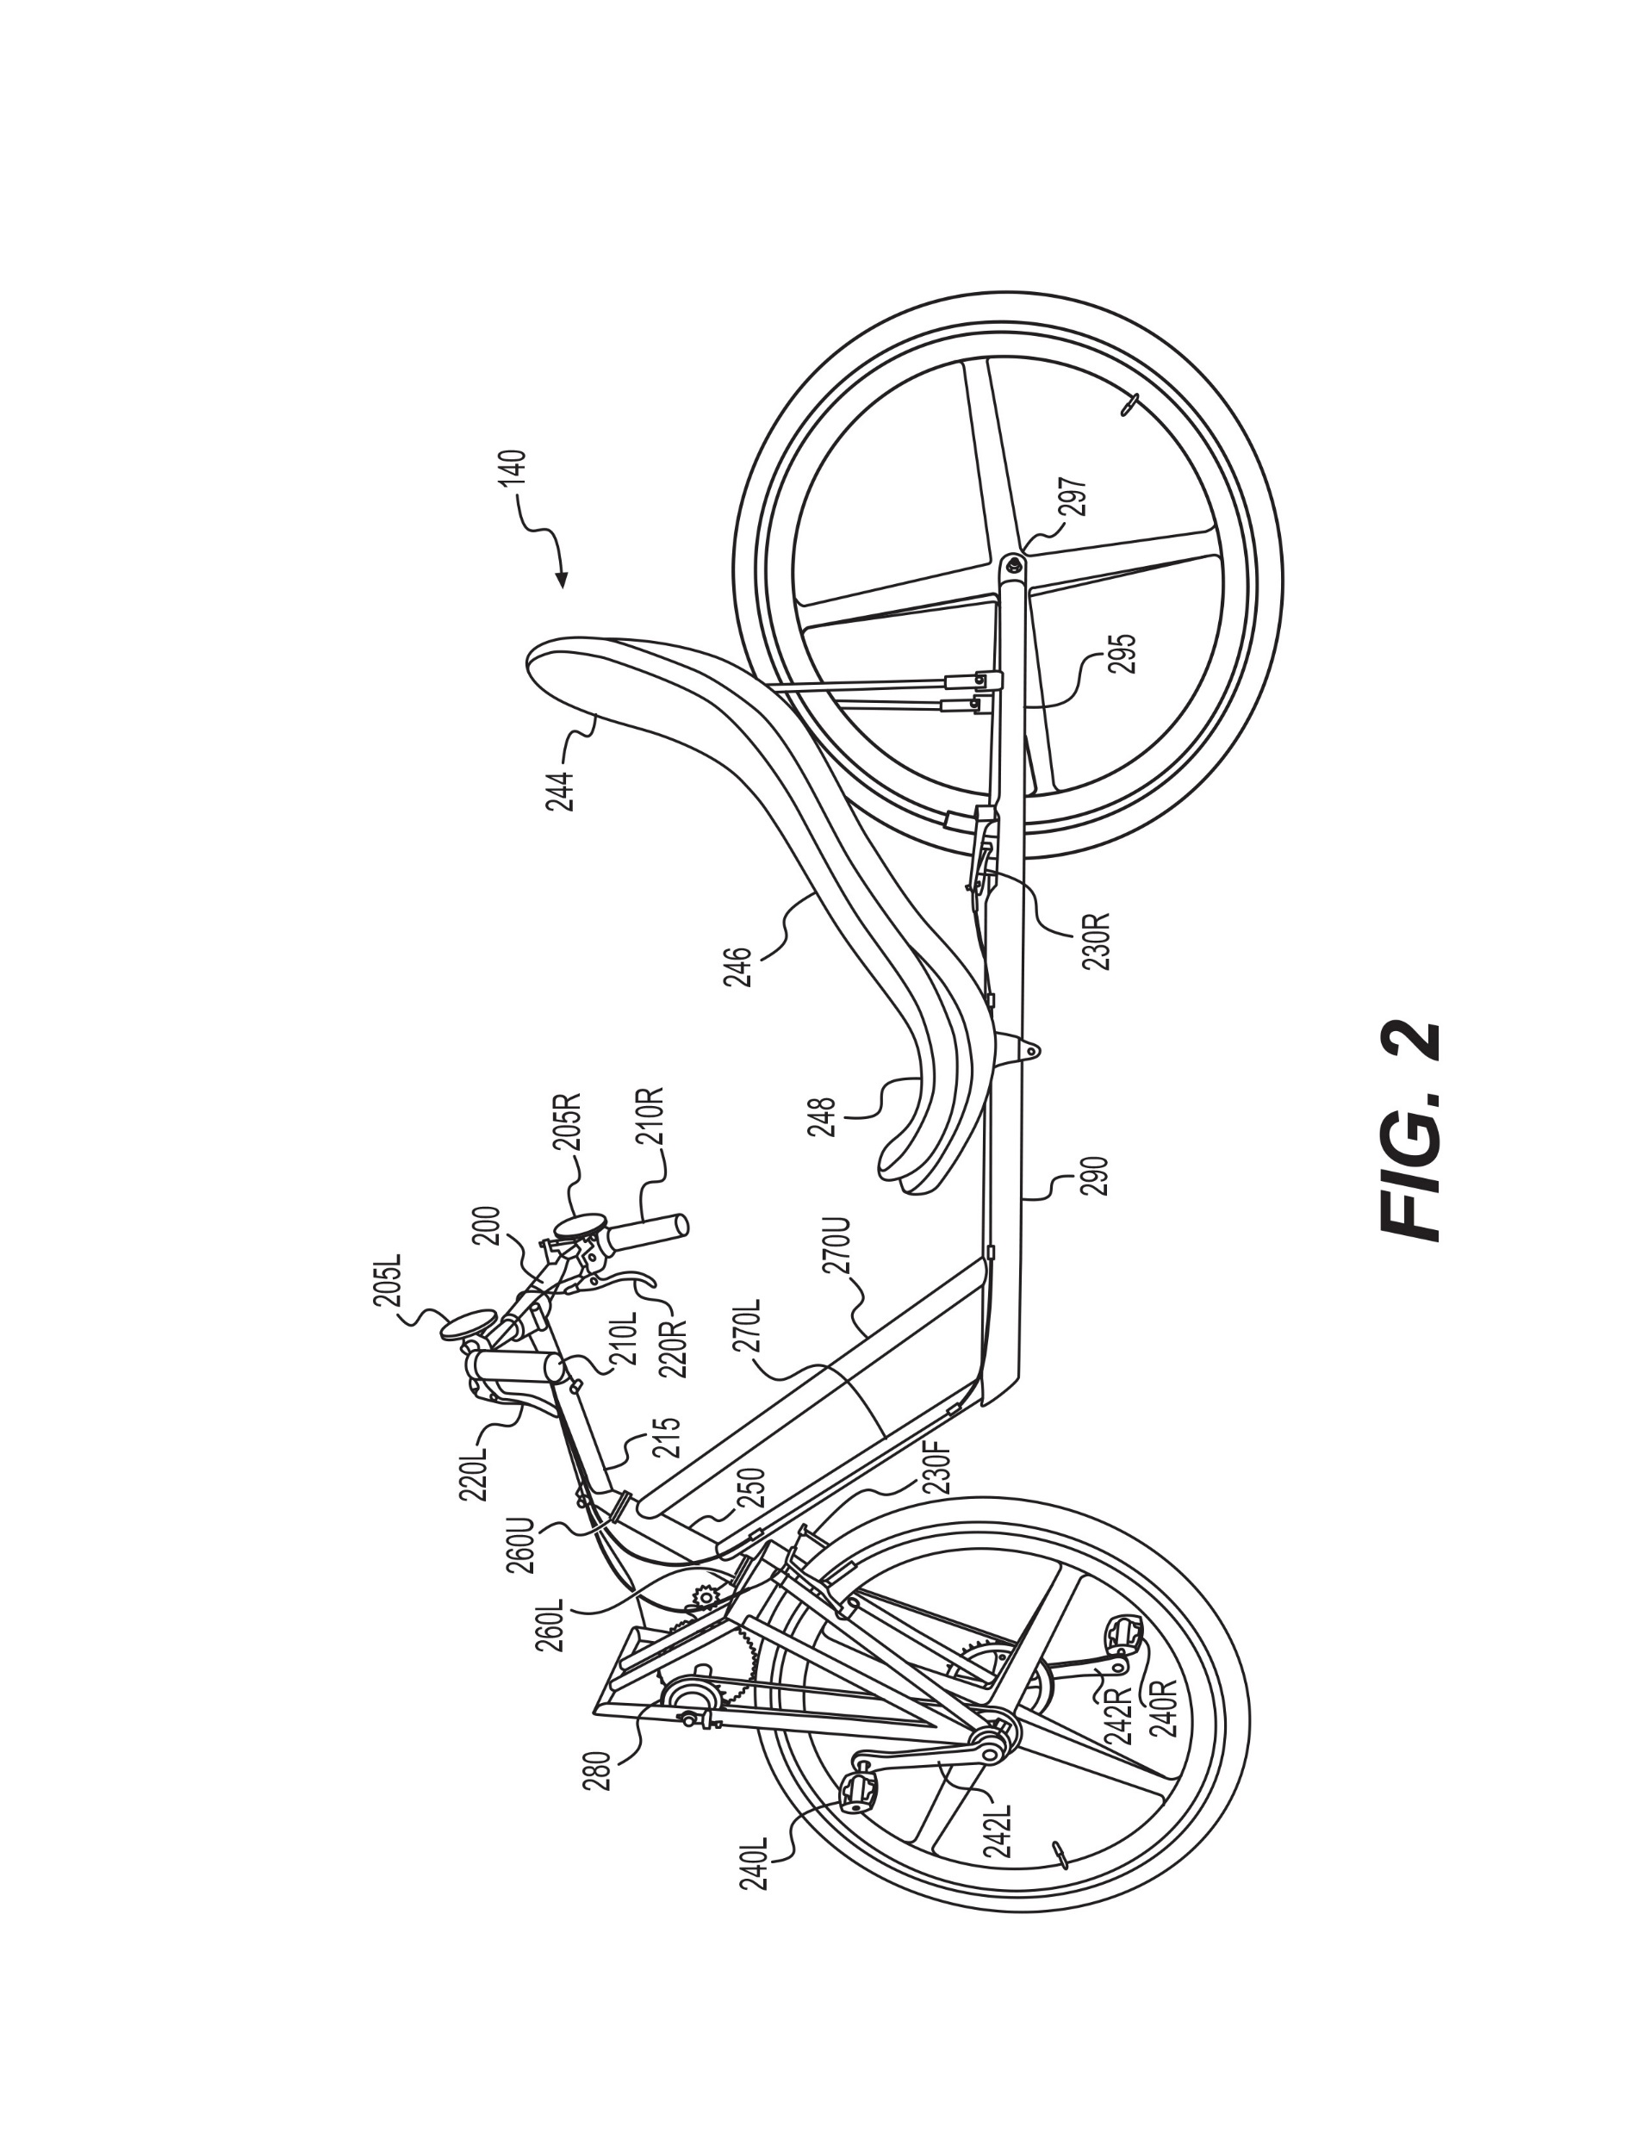
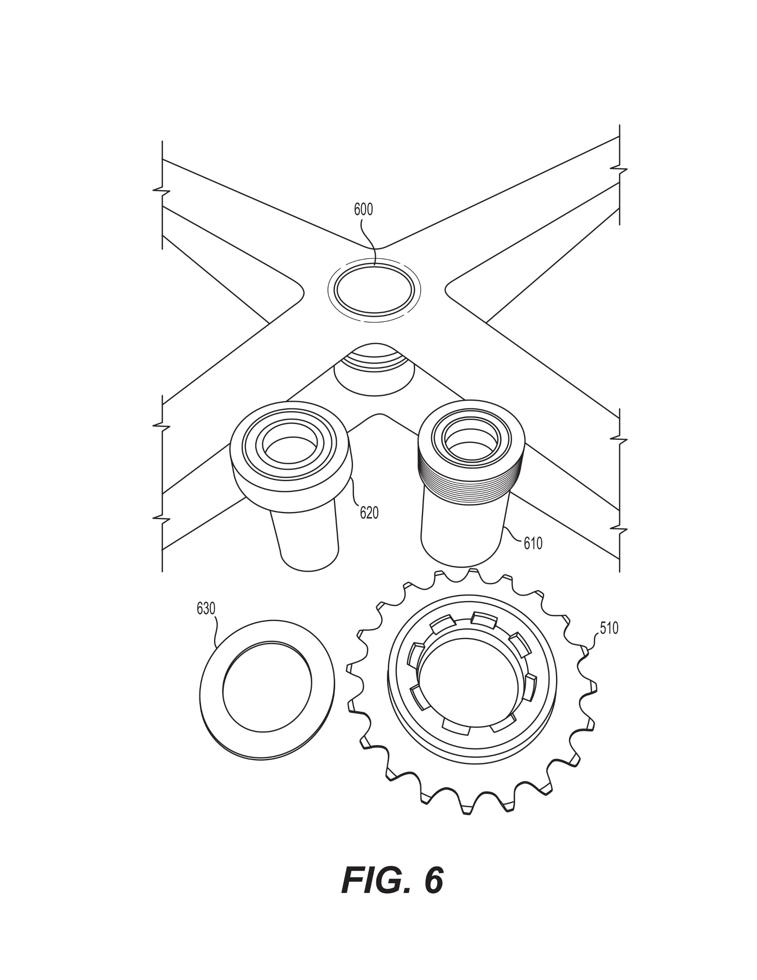
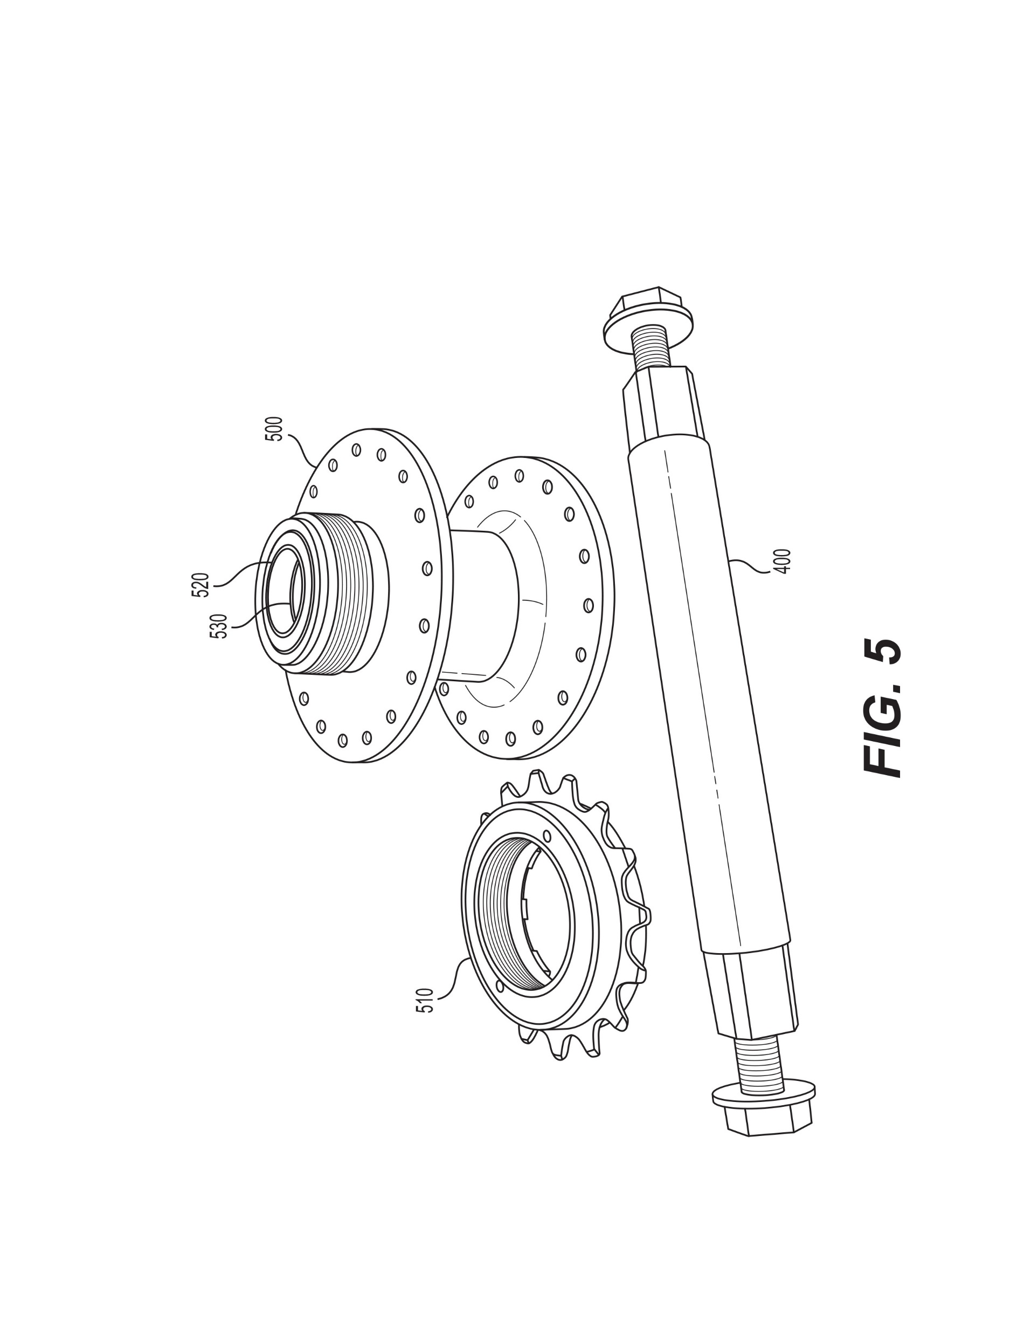
The Generation Four Bicycle
Front wheel driven and steered
Crankset is on the fork near the steering axis
Hand leverage controls foot forces
Fork is rigid in torsion to hand and foot forces, applied in opposition, about the steering axis
Uses extended steering trail
Dual chain derailleur transmission
Low step over, feet easily reach ground
Natural head up position
Intermediate length wheelbase, and
Rider seating is ~centered on the wheelbase for balanced handling and a smooth ride.
Hand power application is by rhythmically pulling the crankset into the pedal thrust.
Application is directly to the hand grips. There is no need for supplemental mechanism.
I think this new principle of operation,
makes the G4 a new type of bicycle.
5
“Recumbent Bicycle and Methods of Riding Employing Supplemental Upper Body Power, Enhanced Aerodynamics, Stability and Control” Utility Patent Publication is Expected in Fall 2021.
Notes:
A good bike must be simple.
The G4 integrates and allows the rider to power this recumbent like an upright.
Balance, full engagement and high-performance results in satisfying capability.
Patents are pending.

Slide 6
G4 Bike Dual-Chain Drive
No special coaxial hub gear is needed.
The coaxial crankshaft and front wheel rotate independently.
Chain 1 provides pedal input to the secondary shaft.
Secondary shaft has a derailleur & cassette, or gear hub, and secondary drive cog.
Chain 2 drives the front wheel at the speed from secondary shaft transmission.
6
Notes:
Dual chain, coaxial crank, front wheel drive works well.
The long-sought development of a coaxial gear hub is not necessary.

Slide 7
Why is the G4 Bike Different?
Many patented mechanisms show the need for recumbent hand power. They are not used, because bicycles also need to be simple.
G4 is a Moving Bottom Bracket (MBB) bike.
Prior MBB, from Boneshakers and High-Wheelers to
Kervelo and Cruzbike, are designed to limit Pedal Force Feedback (PFF).
PFF is controlled by:
Aligning foot force input with the steering axis, or
Offsetting the crankset far forward of the steering axis
The G4 bike uses this “Pedal Steering Interaction” as the mechanism for hand power input!
Hand Power Input
Aerodynamic Stability and Control
Trail Dynamic Effects
Trail increasingly controls PFF with groundspeed.
Hand power input is most important at lower speeds for acceleration and climbing.
Cruise at speed is relaxed because trail controls PFF.
Hand and foot forces about the steering axis provide powerful stability and control.
Allows routine use of a full disk front wheel.
Even in blustery wind conditions.
Serendipity
Hand Power Engagement Creates a Better Ride Experience!
7
Notes:
Achieving G4 capability required an extended engineering development program.
I don’t think the G4 could have been developed any other way.
The key is that the G4 turns what had been considered a flaw with this type bicycle into a feature. “Turns lemons into lemonade".
Hand power application results in exceptional acceleration and climbing.
The G4 is responsive, high performance and a lot of fun to ride.

Slide 8
G4 Bike – How Hand Power Input Works
Standing to pedal is familiar, but often not well understood. David Gordon Wilson explains:
“in conventional upright bicycles … substantial arm work is easily performed by tilting the bicycle away from the descending pedal … the legs can then push harder or move faster for an overall increase in power output.
Recumbents … do not permit the rider to use additional muscles in this way.”
Is this a reason recumbents have never achieved upright bike popularity?
The G4 solves this problem - The rider forces the crankset into the foot pedal thrust!
I was not convinced this really worked until Prototype 3!
G4 hand power input is a result of complex geometry, in three dimensions, with rotation in two directions. I am certain that I can not do that math…
Also, I believe G4 hand power input mechanisms are more effective than on an upright! I need to work this…
Innovation often
precedes theory…
Airplanes before aerodynamics…
Steam engines before thermodynamics…
I can tell you that it works. And how to work it.
But maybe not exactly why it works…
8
Notes:
This book is my bike system bible. Wilson is my hero. He explains the problem with recumbents. Defining the problem is a first big step in solving it.
Detailed mechanics of G4 power input are complex...
I think explicit quantification would show that it works even better than on an upright!

Slide 9
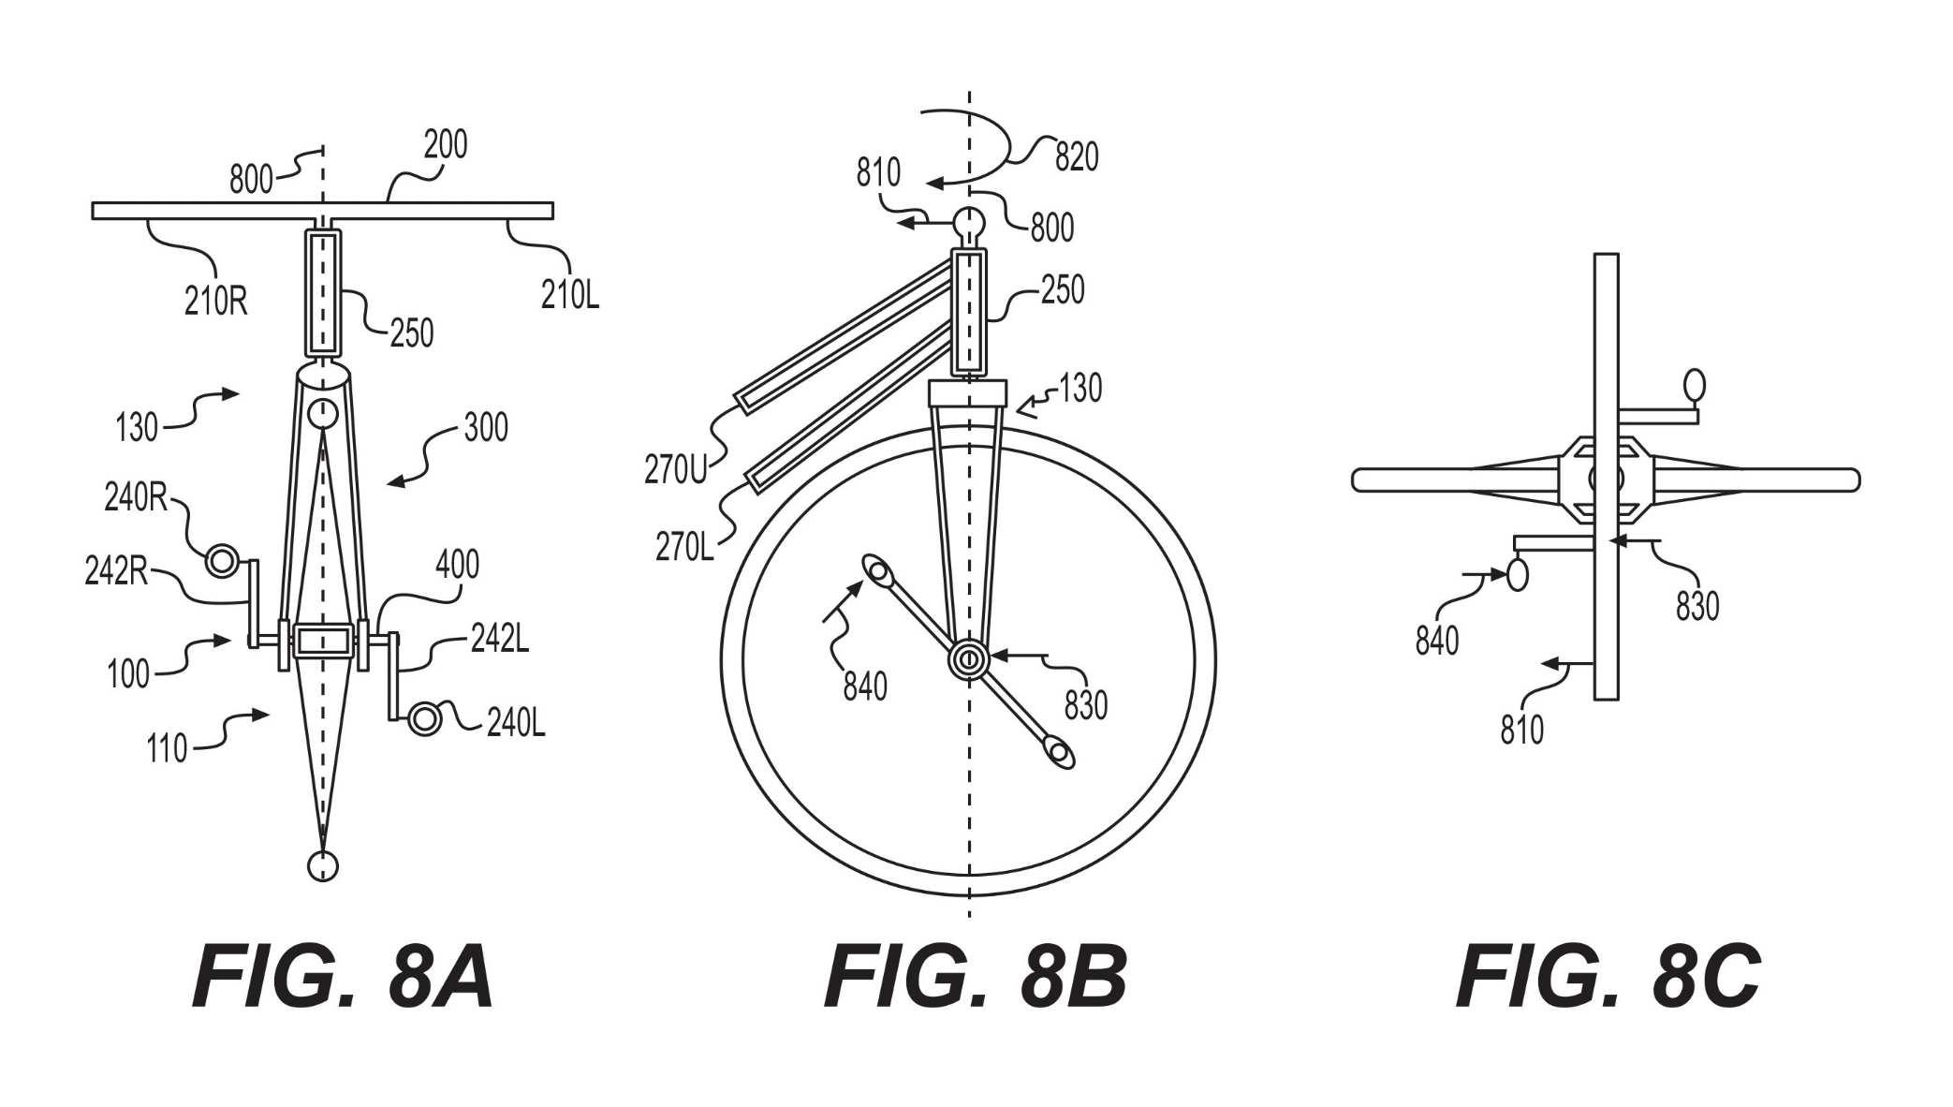
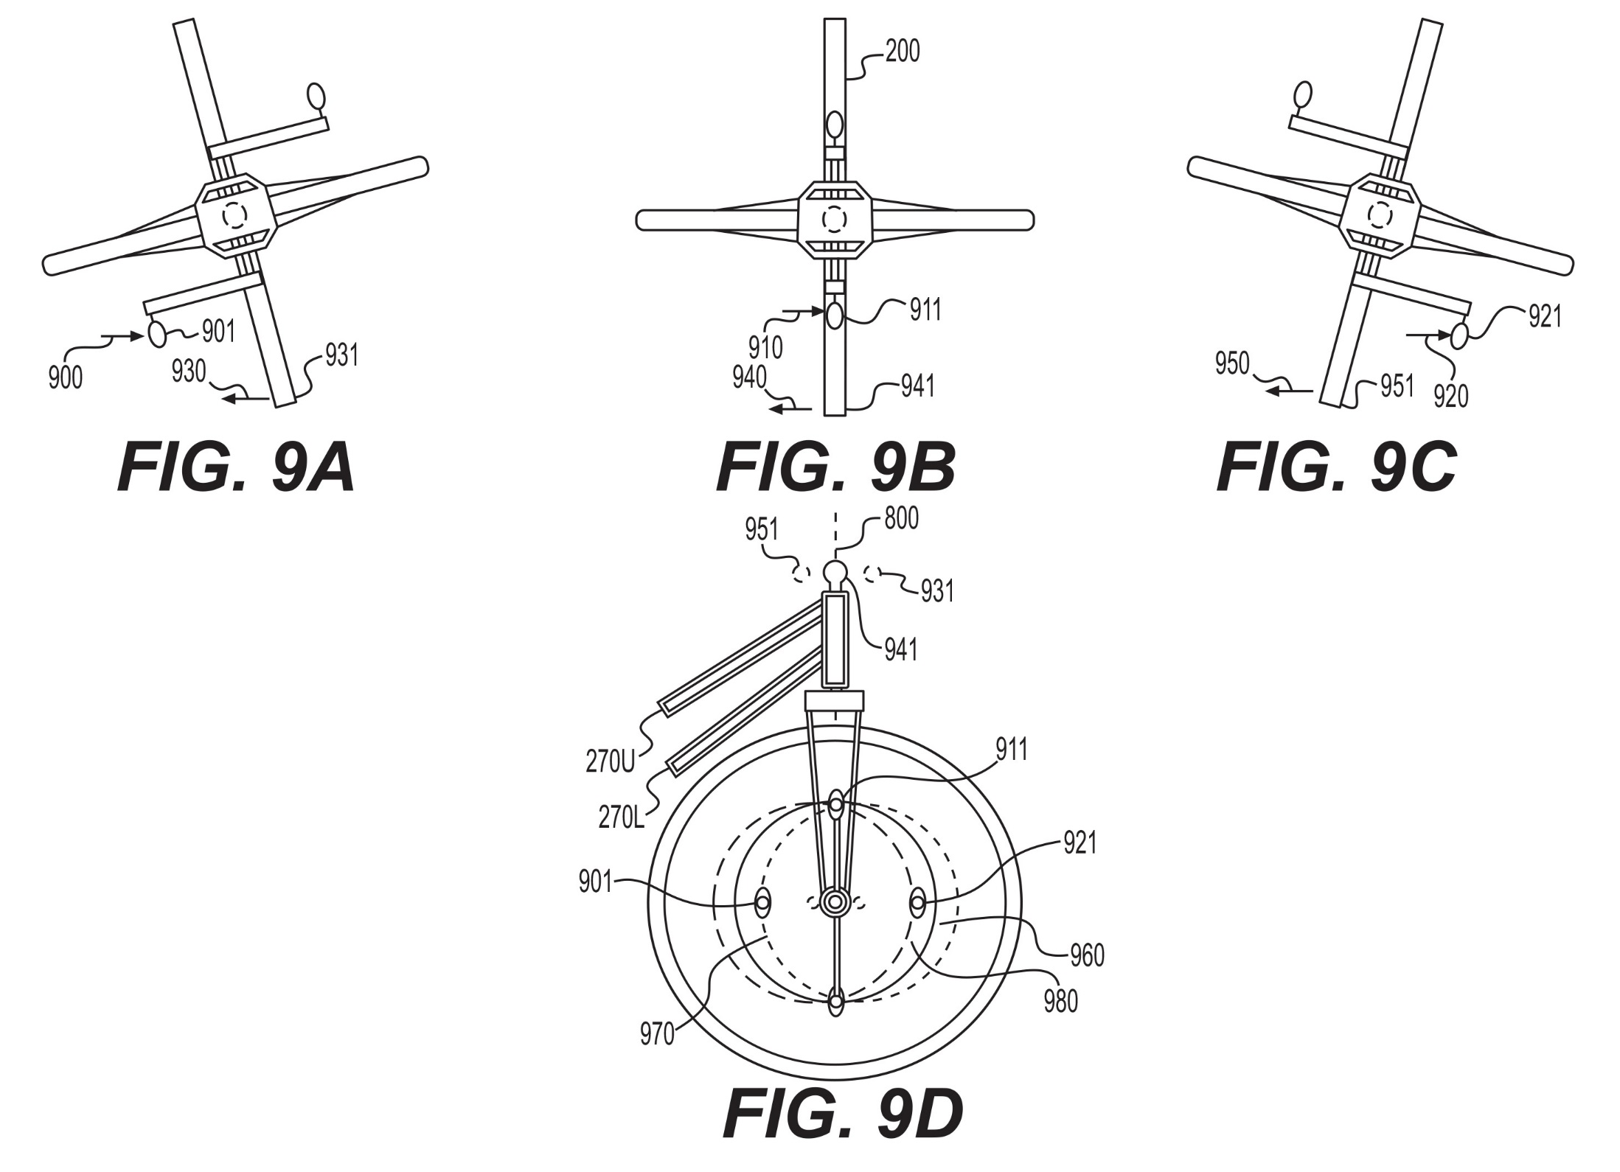
G4 Bike – How it Works
Hands control foot forces about the steering axis using leverage
Hand reaction balances foot pedal input.
Hand force adds crankshaft torque. Crankshaft lateral force is applied to the crankarm. “push harder”
Hand motion adds both torque and “work”. Foot perimeter distance traveled is reduced. “move faster”
Empirically, hand power input may be ~50% of foot power input.
Hand power input is limited by rider cardiovascular capacity.
Hand Torque Input to Crankshaft
Hand Torque and “Work” Input
Play Video Demonstrations 1 and 2
9
Notes:
All six lines of this chart are important and need to be discussed.
The hand over foot leverage ratio lets it all happen
Pedal force reaction – in addition to seat back reaction
Hand torque input
Hand work input
Substantial hand power is obvious, exact quantification is difficult
Key is that use of additional muscles allows the rider to add power limited only by their heart rate.
Additionally, there is some evidence that this use of additional muscle groups also increases the longer-term aerobic power that can be applied
The graphics explain hand torque and work input.
But it might be best just watch a video demonstration.

Slide 10
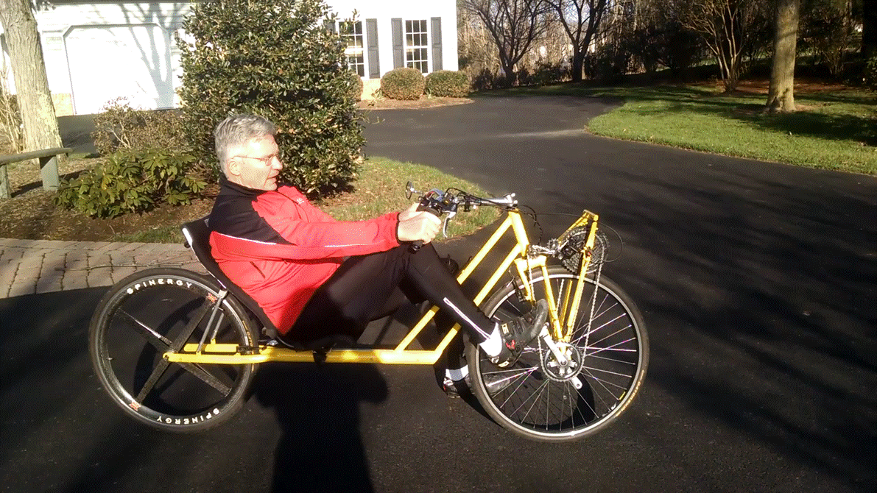
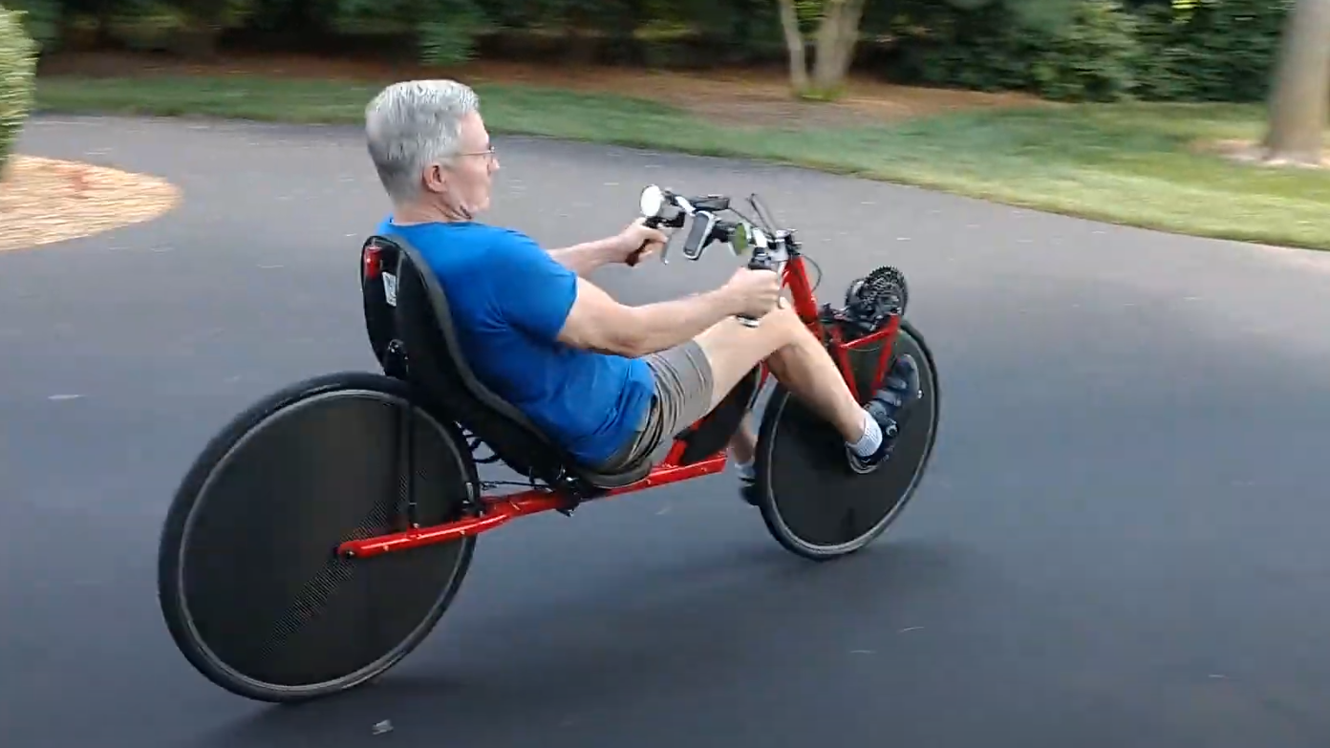
VID_03 hand power
VID_01 hand input
10
Notes:
First video was taken in 2018. On P3 before I had the nerve to machine that very Spinergy expensive hub…
The second video was taken last week before heading out on a 4th of July ride.

Slide 11
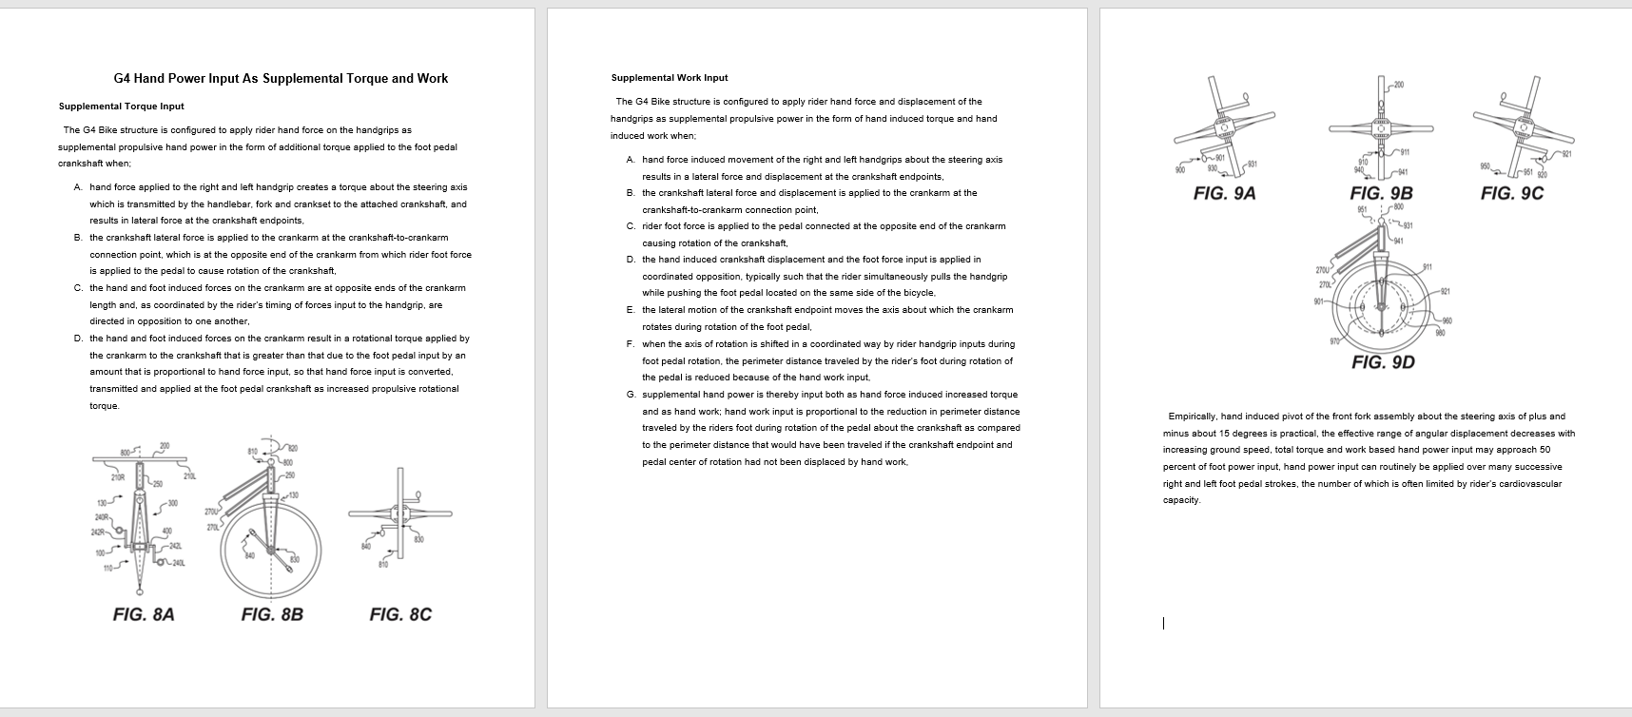
How G4 Hand Power Input Works
Its complicated. And hard to explain. If it needs to be studied, this write up is available.
Gary has a link to this file in the video description below.
11
Notes:
Graphics and explanatory text are provided so the complex mechanics can be studied.
Gary has the document available.
And I put it on the g4bikes.com web site I just brought on-line.
If anyone can do the math to characterize both the G4 and the conventional upright, I’d sure like to talk.

Slide 12
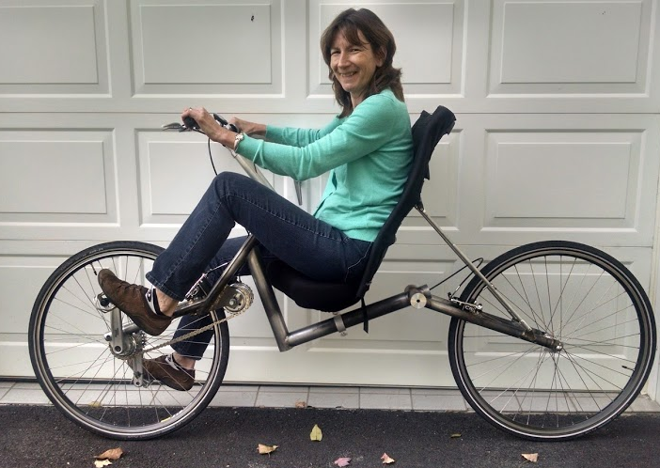
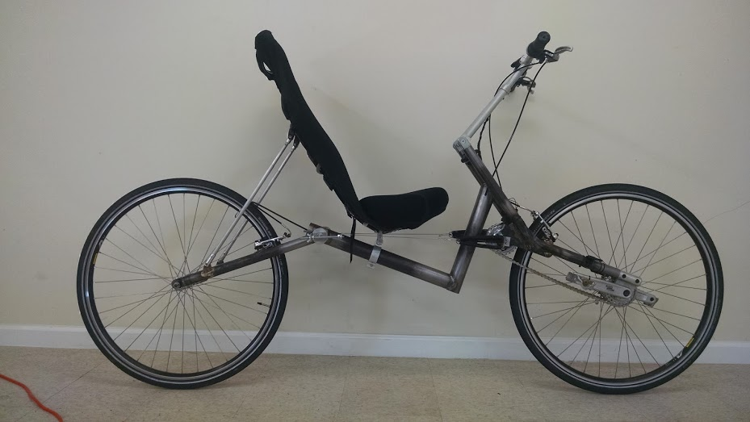
More on the 5 Prototypes - P1
A better commuting bike?
Designed to control PFF.
Did not work very well.
I only rode it ~200 miles.
Was fun. I learned a lot. But P1 was not a good bicycle.
Peggy could ride it!
12
Notes:
Now for more on the actual bikes...
In retrospect, P1 was a great bike because it demonstrated that the basic configuration was easy to ride.

Slide 13
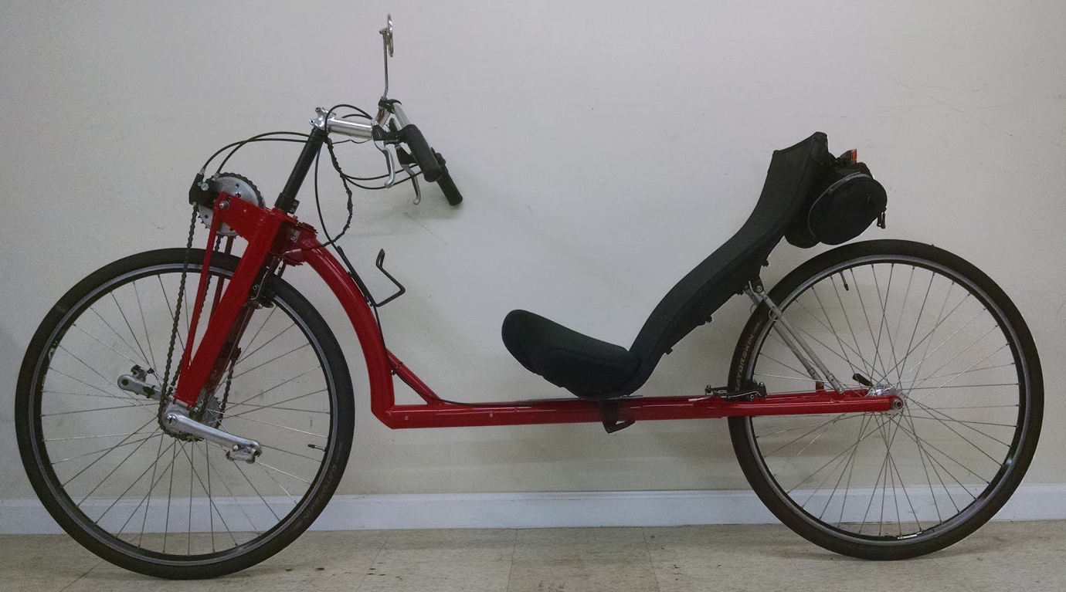
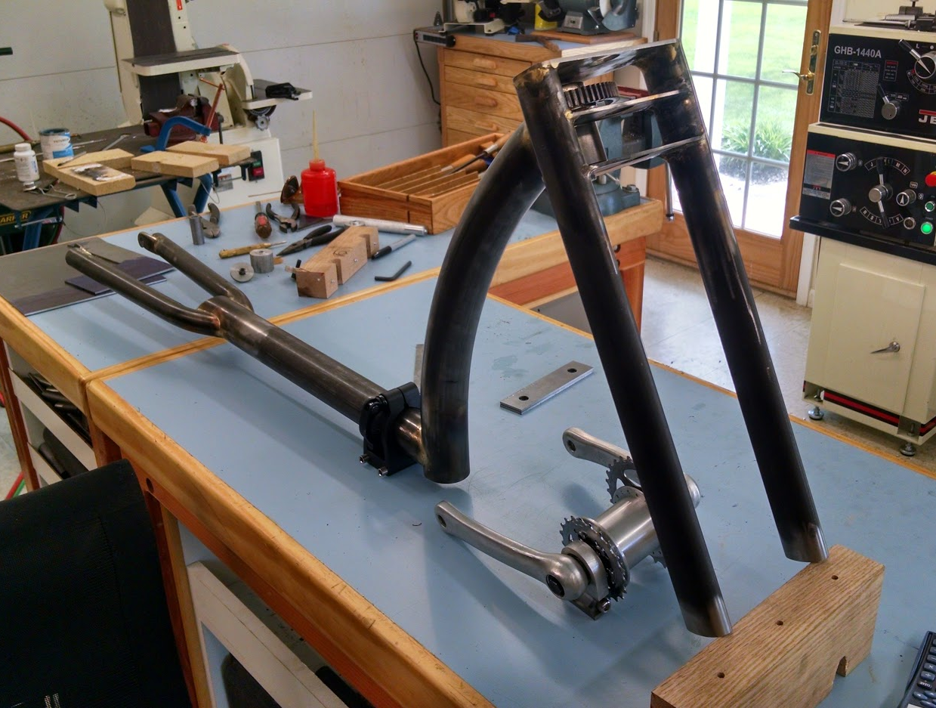
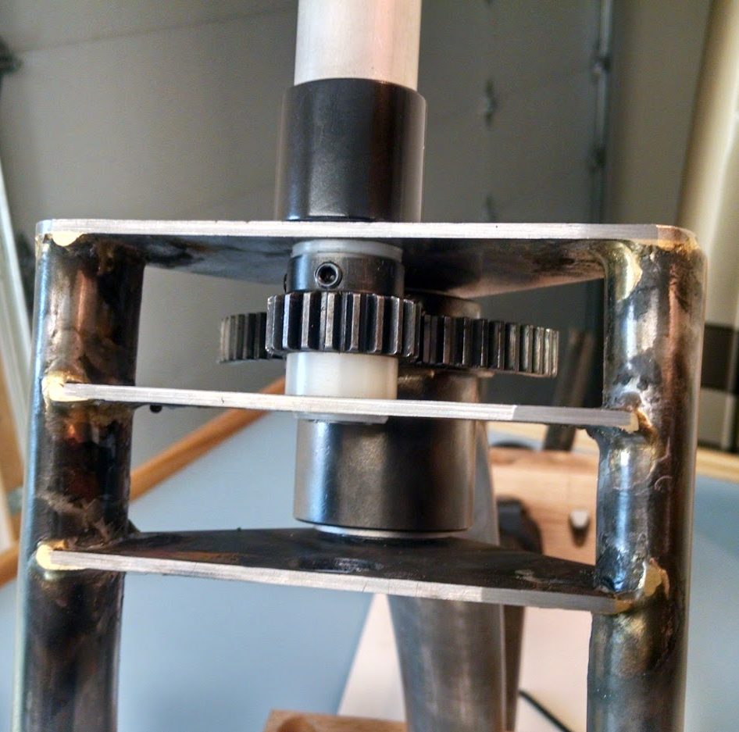
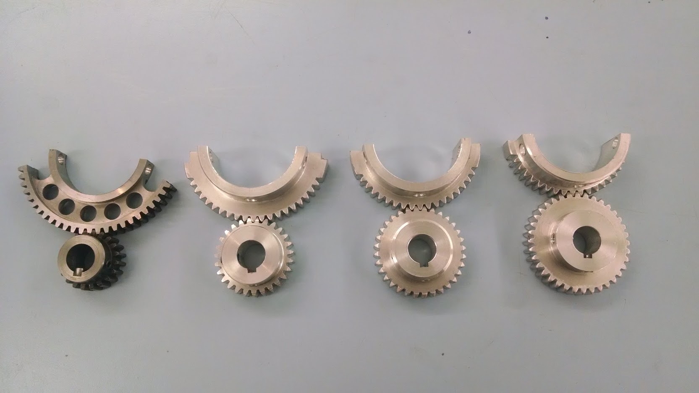
Prototype 2 - P2
Based on P1 lessons. Extensively modified and developed.
Started with geared steering to completely control PFF…
Before I understood!
Rode it ~8-10K miles over 2+ years.
Indicated effective hand power input was possible!
13
Notes:
P2 was the bike I worked on the longest.
P2 was probably the most important.
It helped me understand the opportunity and approach for use of hand power on a recumbent.
That the G4 could take advantage of Pedal Steering Interaction!

Slide 14
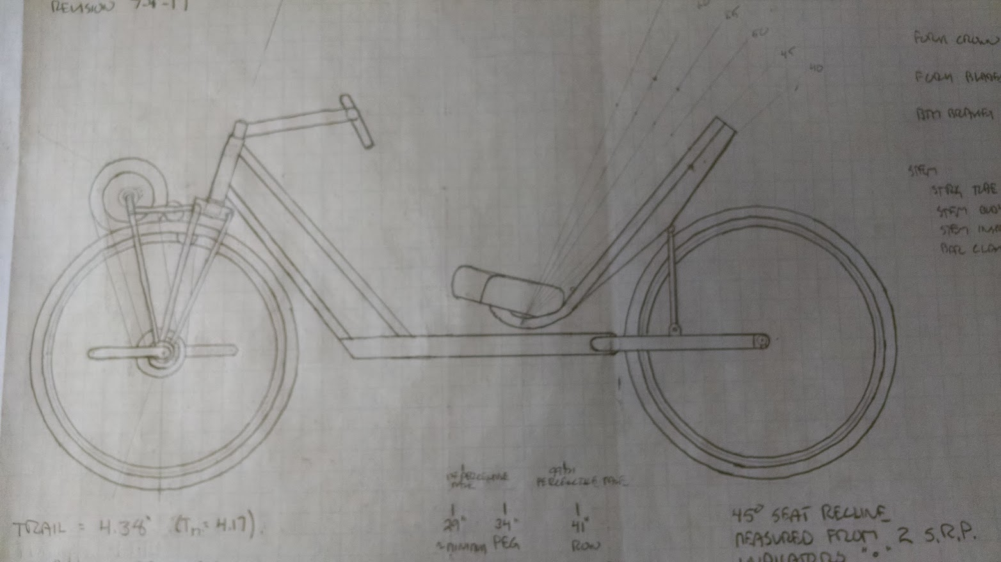
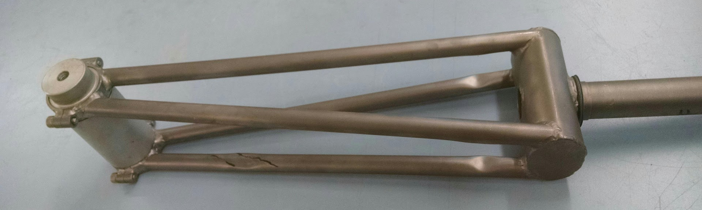
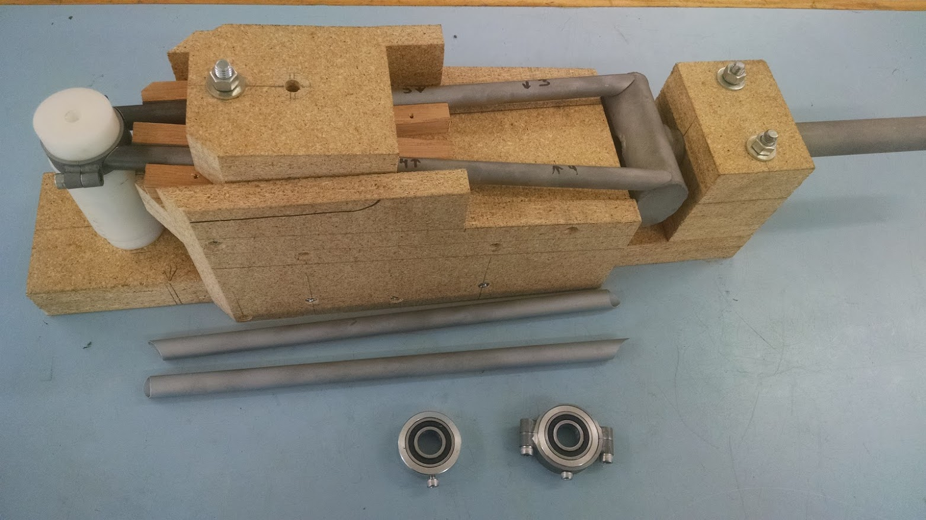
Prototype 3 - P3
Hand power works!
Was also extensively modified and developed.
Is now my, “Big Tire Gravel Bike”.
Friends in the club call it the “Do Anything Bike”.
~10k miles and going strong.
14
Notes:
P3 was the breakthrough.
Although I also needed to make extensive changes to the P3 configuration that are not shown in this photo. Both the fork and the frame evolved.
The result is still a great bike.

Slide 15
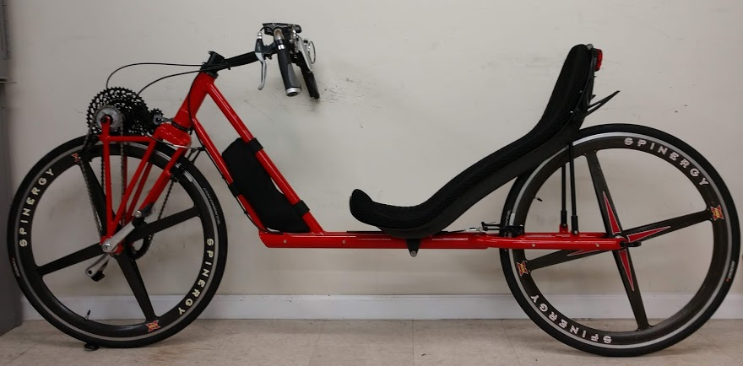
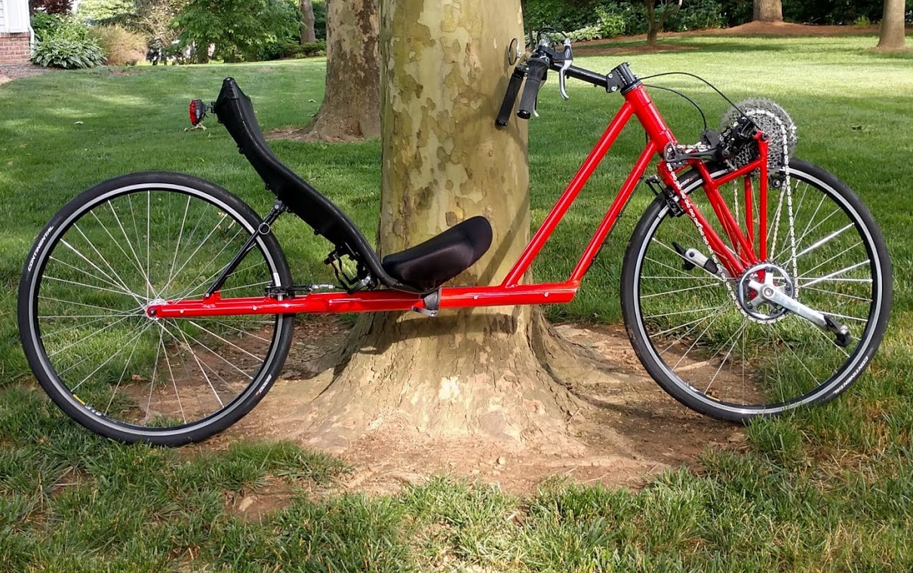
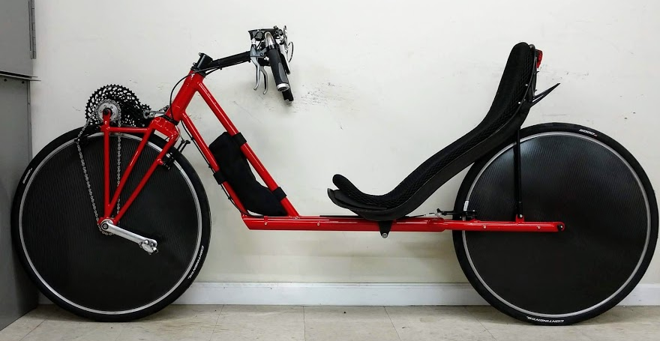
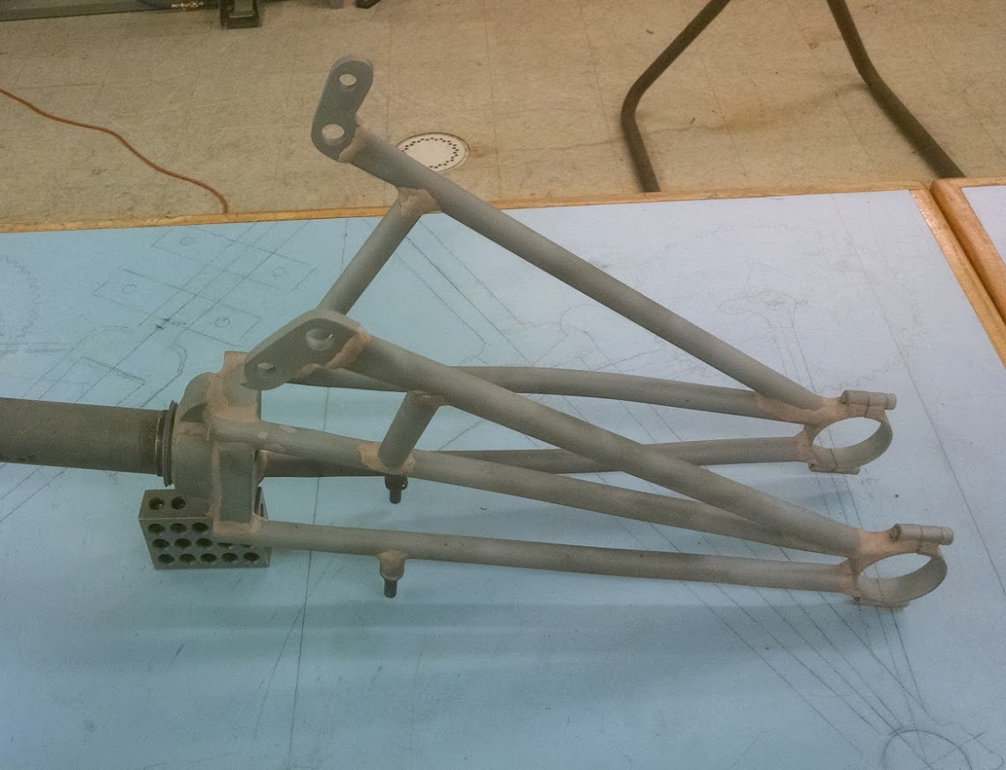
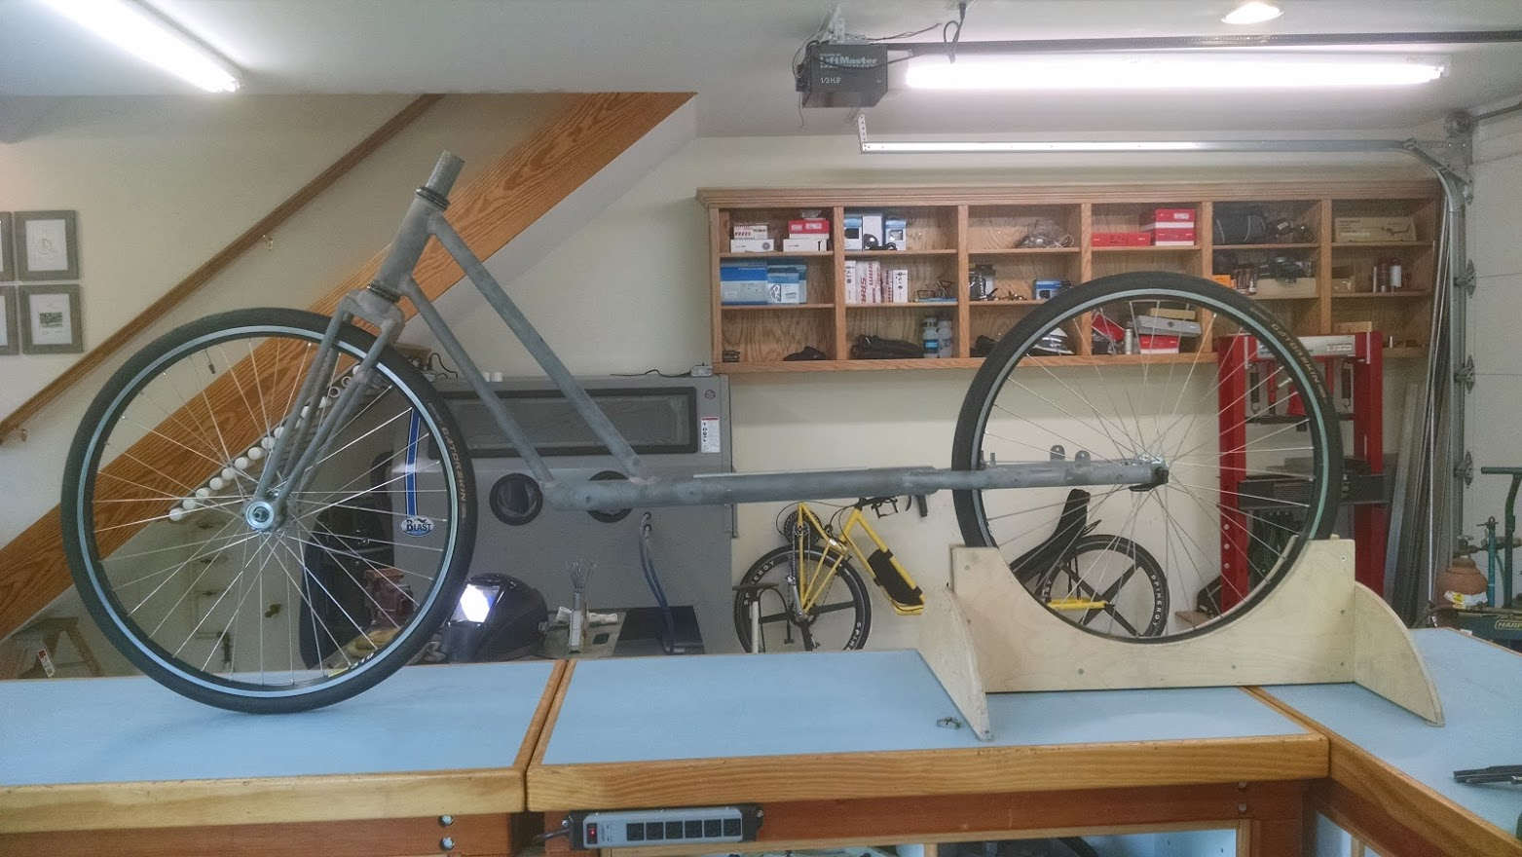
Prototype 4 - P4
Simplified secondary drive support, 1.5” steerer, new crown, secondary chain tension idler
My current racer, club bike and cruiser.
Routine use of disk front and rear wheels.
15
15
Notes:
P4 is a refined version of the final P3.
Note the ability to use both front and rear disk wheels is a direct result of G4 stability and control.
In addition to being low drag, with the right side or head wind, I believe these wheels can actually add thrust. They act as “sails”.

Slide 16
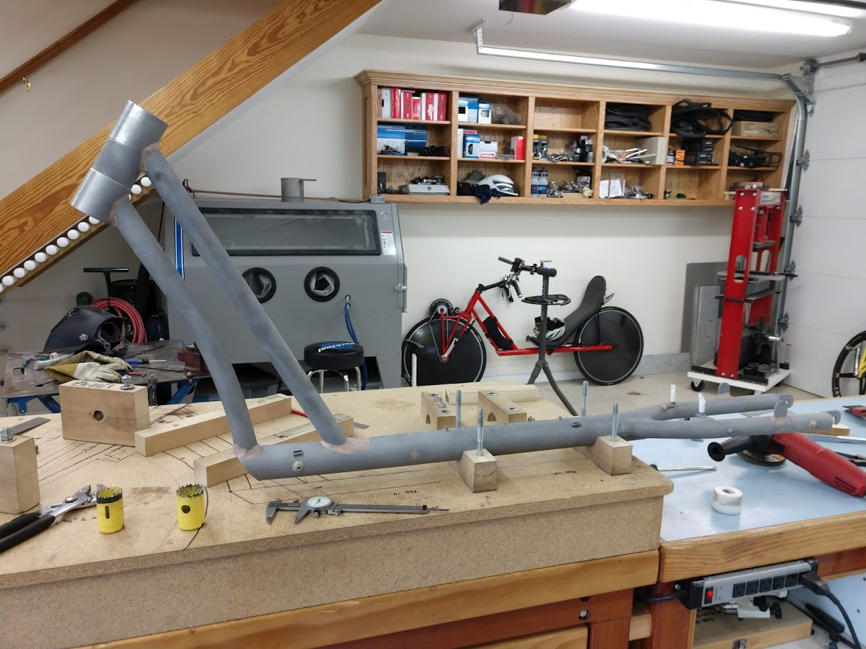
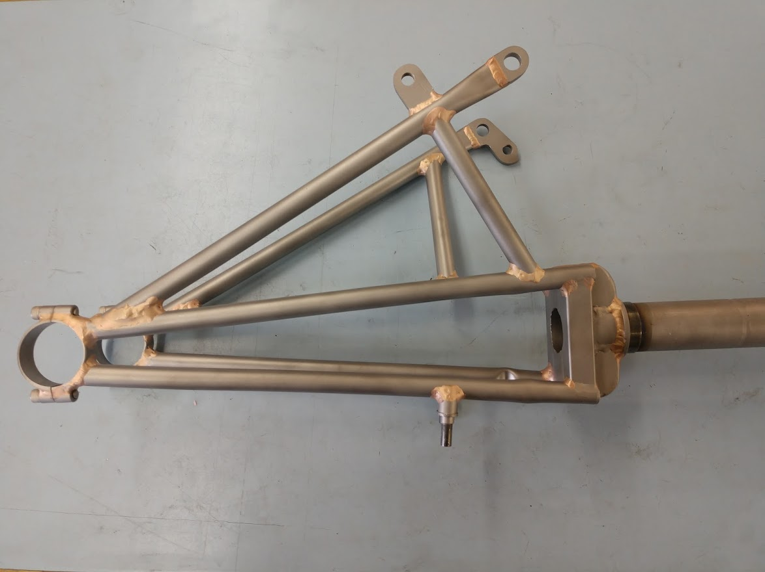
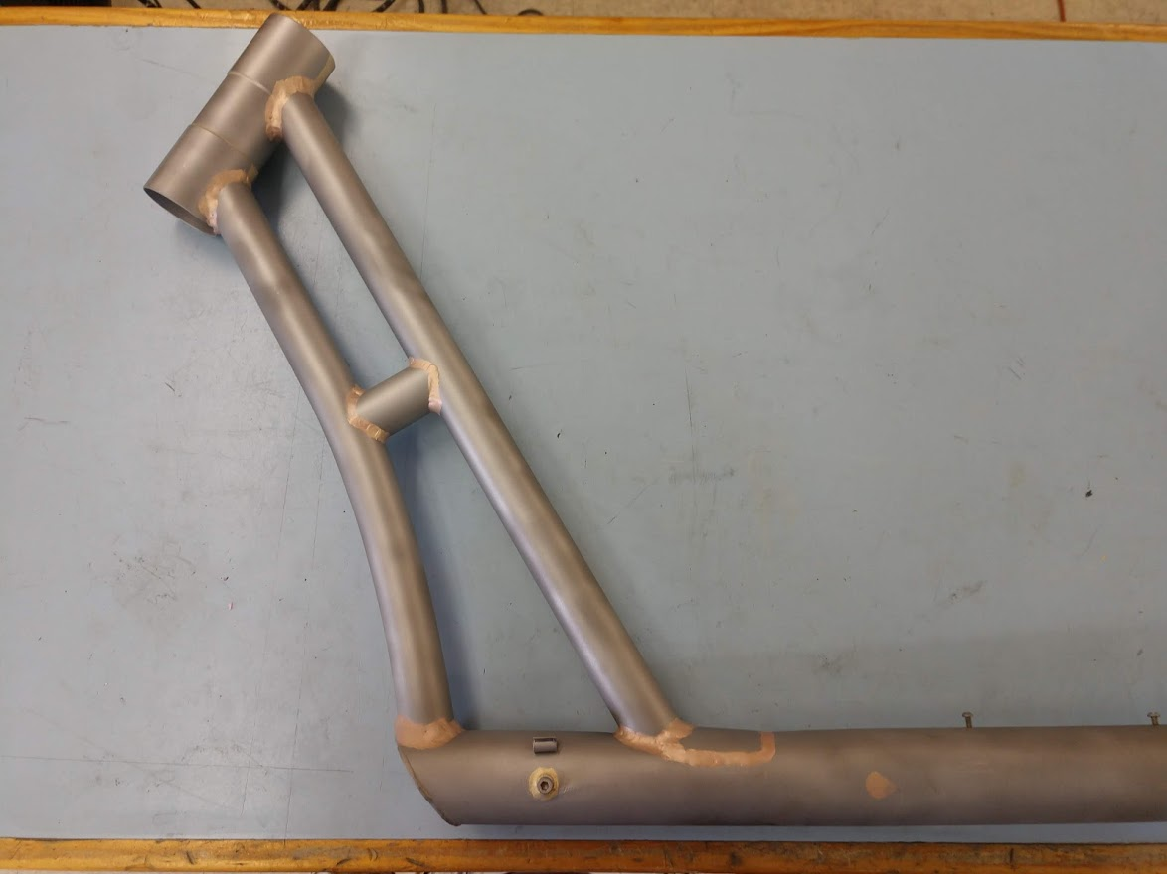
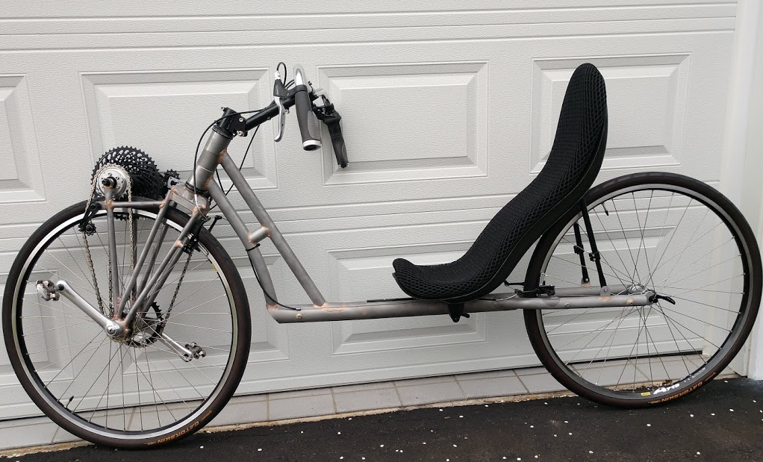
Prototype 5 - P5
Peggy’s bike
Easily adjustable for rider size
Close reach down tubes
~ 5k miles so far
Peggy quit riding her upright bikes!
16
Notes:
P5 is the same as P4 except smaller and more easily adjusted.
It is Peggy's bike.
The Spinergy wheels are about 40 ounces lighter than the 36 spoke touring wheels with carbon disk covers on P4.

Slide 17
~ 25K Miles of Riding, Touring and Racing
In 2 videos and 2 pages of photos
It is all about the magic of riding a bike.
Rider is fully engaged, feet, hands, seat, head and heart, as an integrated part of a high-performance machine.
Performance and efficiency with comfort and safety.
A joy to ride. It moves well. People smile seeing it pass.
Building P5 Peg First Ride
Peg Close at Beach
17
Notes:
This is the pay off.
The bikes work and are great fun.

Slide 18
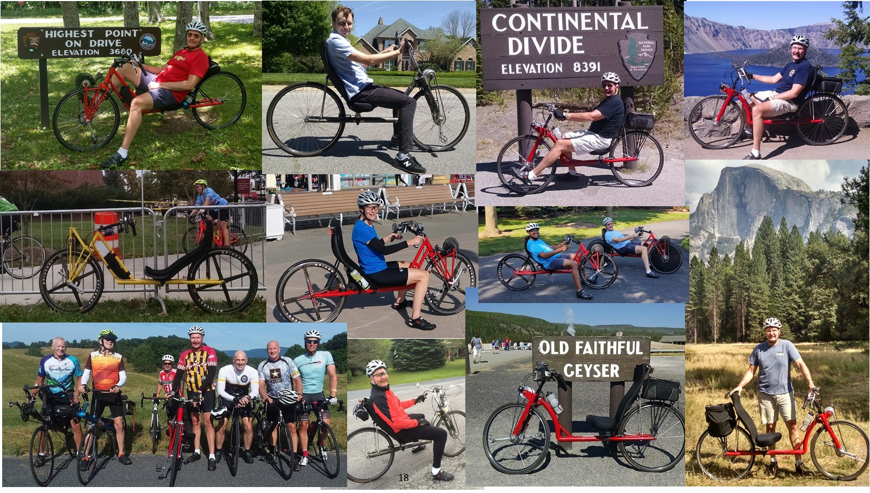
Notes:
Pictures of good times on P2 to P5.
The bikes just do everything well.

Slide 19
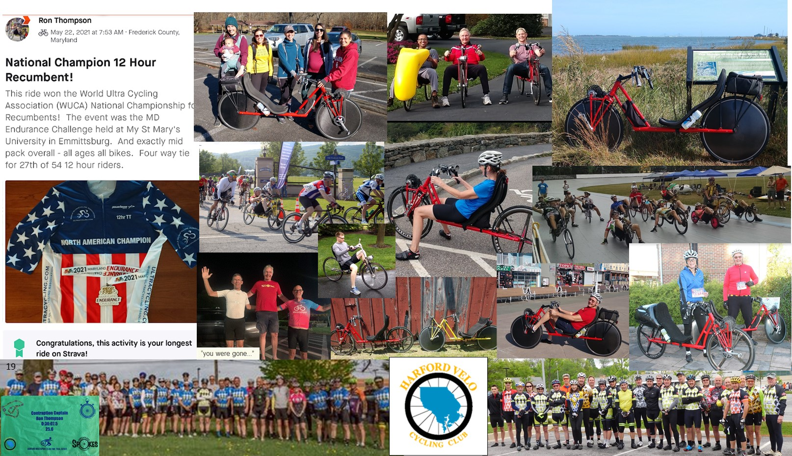
Notes:
Including club rides, racing and time trialing.
Shout out to my Harford Velo Club for patience while I learned to group ride.
And to WUCA for upright and recumbent National Championship Events.

Slide 20
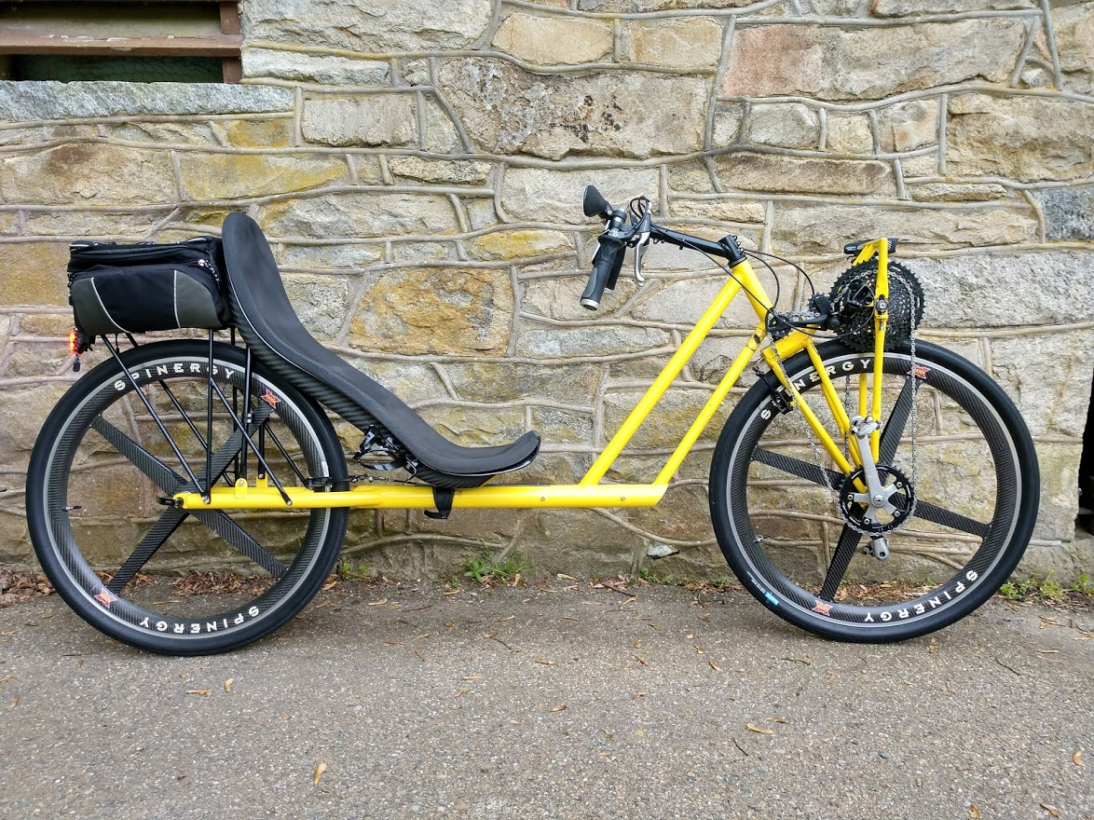
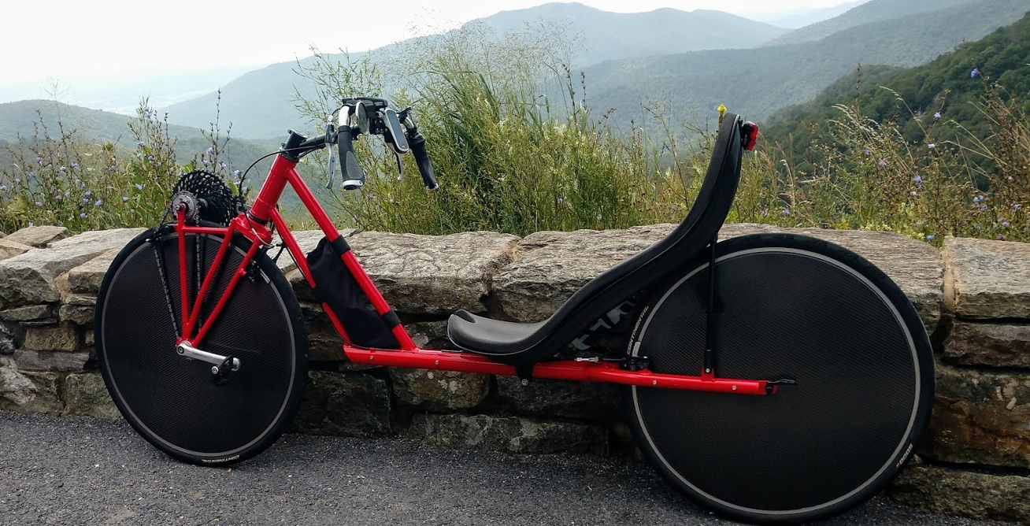
What’s Next?
Can the G4 become the next mainstream bicycle?
Riding the G4 is great fun. People see that it is. They ask to buy one.
Easily the best Bicycle I’ve ever ridden.
I think the G4 could ultimately sell in upright bike quantities.
Making it available will take a team.
My objectives:
Be happy! Enjoy the prototype bikes.
Continue my “G4 System” development.
A long list of projects I want to do…
Race, Travel and Trike prototypes; Aerodynamics, Sailing, Protective and Cargo Fairings, Composites, and more…
Be part of the team to make the G4 available.
Recover my investment and fund future work.
Help build a G4 Bike Community.
I do want the G4 to be commercially available.
Please contact me if you can help make that happen!
20
Notes:
Clearly, I am biased, but I think everyone is going to want a G4.
I think the US bike market amounts to several billion dollars annually...
Providing them is more than I can or want to do alone.
Though I would like to work with the right people to make them available.
Until then, I'm going to continue doing what I've been enjoying!

Slide 21
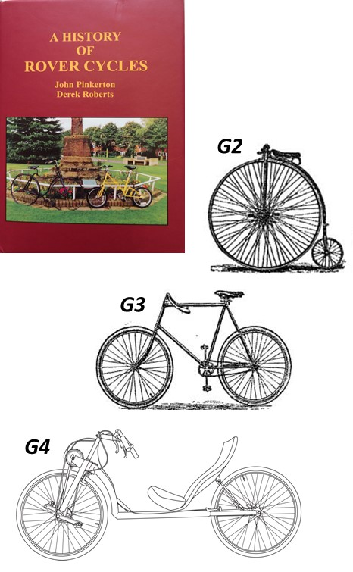
Will History Repeat Itself?
J.K. Starley Letter Circa 1885, on the Rover “G3-Safety Bicycle” vs. “G2-High Wheeler”
“The Rover is absolutely the outcome of a determination to obtain advantage previously unknown in a bicycle. We felt confident that a large percentage of unused power could be utilized if the rider were properly placed, particularly with regard to hill climbing. In this we were not mistaken, as the enormous success of the Rover undoubtedly proves.”
G4 has the same, “advantage previously unknown”
and
“a large percentage of unused power could be utilized”
Could G4 have the same “enormous success”?
21
Notes:
In closing, this chart provides some interesting history that I just discovered...
The advantages of the G4 Bike are really very close to those claimed 135 years ago for the upright over the high wheeler!
Will the G4 be the bike of the future?

Slide 22
Summary & Questions?
Current bikes are not the right machines for what I want to do.
Upright bike development has been constrained by professional racing,
which has kept bikes the same, to compare riders and keep competition fair.
Important and worth doing. But not what I want...
I want full engagement, integrated as part of an efficient, high-performance machine, with comfort and safety.
I want the best machine for Sport Touring. Even if it is different. Sometimes different is better.
The G4 is a better bicycle for people like me.
And, in this respect, I don’t think I’m unusual.
The world is better when more people ride bikes.
Ron Thompson
ronaldathompson7641@gmail.com
(410) 734-7528 (Landline)
Harford County, Maryland
22
Notes:
Sport and commercial organizations have super optimized the upright bicycle configuration.
But it is not the right solution for what I want to do.
The G4 is.

Slide 23
Potential Follow-on Topics
(Too much for today…)
Build Process and the Shop
G4 Fairings, Aerodynamics and Sailing
System Engineering and Patent Processes
G4 in Mixed Group Rides
G4 “Road Racer” (vice current “Sport Tour”)
G4 Travel Bike
G4 Delta Trikes
G4 vice Upright vice Recumbent
23
Notes:
A preview of some potential future discussions...

