Slide 1
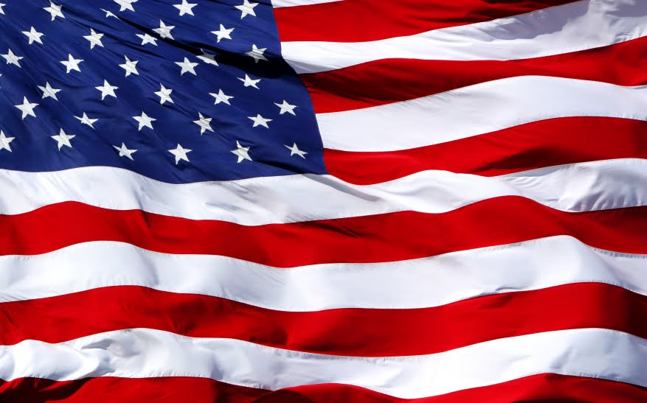


Should Christians be involved in politics?

Slide 2
"We hold these truths to be self-evident, that all men are created equal, that they are endowed by their Creator with certain unalienable rights, that among these are life, liberty and the pursuit of happiness."

Slide 3


The right to life, liberty,
and the
pursuit of happiness.

Slide 4
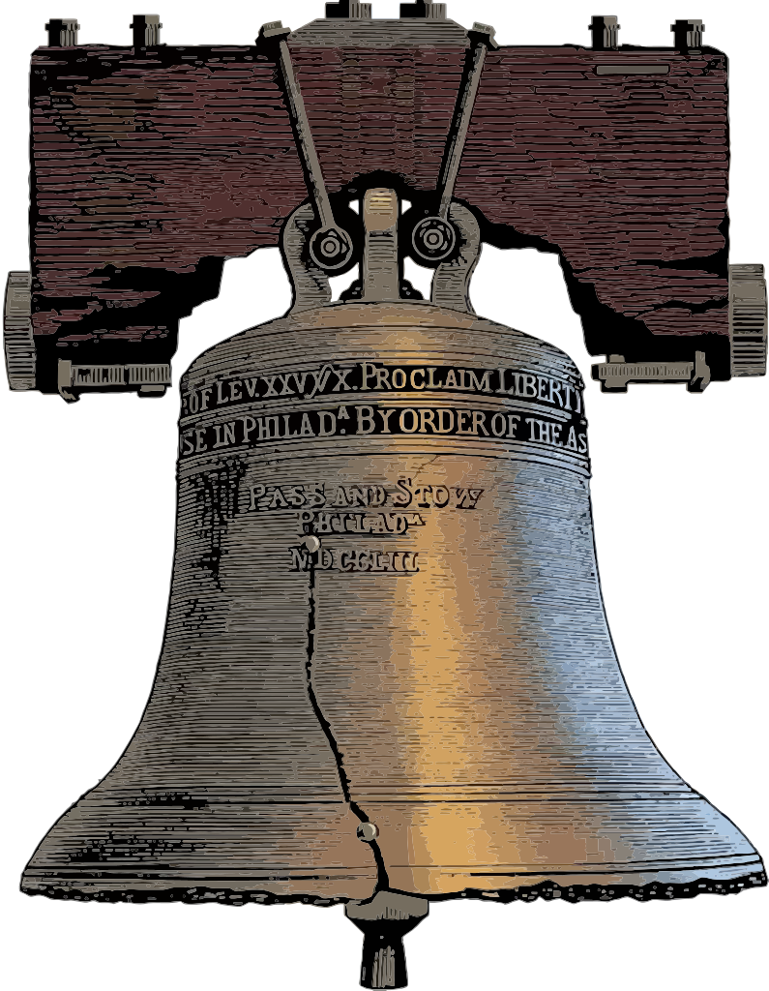

Slide 5
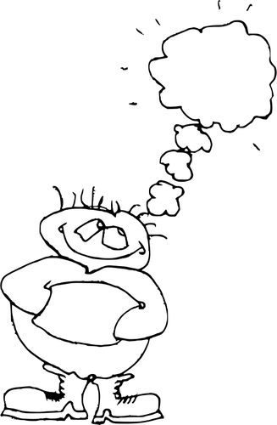
The freedom to think or act without being constrained by necessity or force; freedom from captivity or slavery.

Slide 6

"Where the Spirit of the Lord is, there is liberty."

Slide 7
Proverbs 14:12.
"There is a way that seems right to a man,
But its end is the way of death."

Slide 8
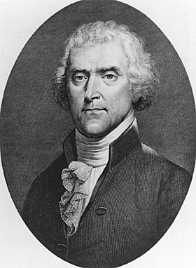
"God who gave us life gave us liberty. And can the liberties of a nation be thought secure when we have removed their only firm basis, a conviction in the minds of the people that these liberties are a gift of God?"

Slide 9
"But one who looks intently at the perfect law, the law of liberty, and abides by it not having become a forgetful hearer but an effectual doer; this man shall be blessed in what he does.“
James 1:25

Slide 10
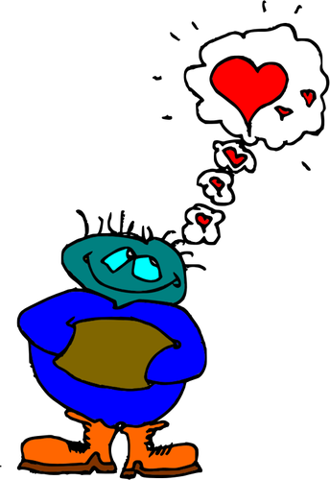
"He answered, "'Love the Lord your God with all your heart and with all your soul and with all your strength and with all your mind'; and, 'Love your neighbor as yourself.'“
Luke 10:27

Slide 11

“If men were angels, we would have no need of government."

