Slide 1

Three Lies of the Devil

Slide 2
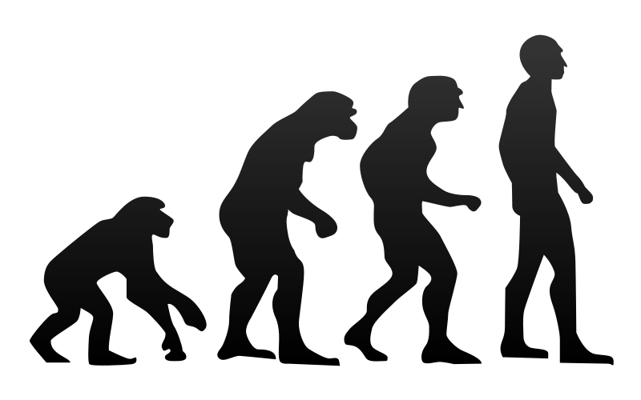
Everything evolved through natural processes = NO GOD!

Slide 3


You
Can
Be
Like
God

Slide 4
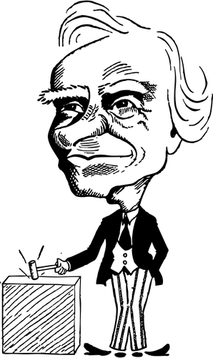
Christians shouldn’t be
involved in politics – or government.

Slide 5

It’s
Just
business

Slide 6



Republican
Democrat
Politician

Slide 8
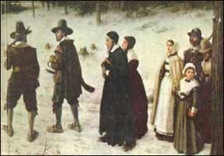

Slide 9
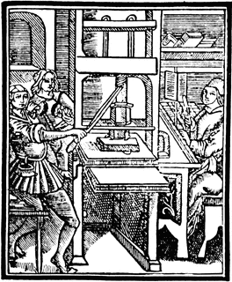

Slide 10

The lens through which we view the world

Slide 11

A Biblical Worldview is how you view the world if you believe in the Bible.
-or-

Slide 12
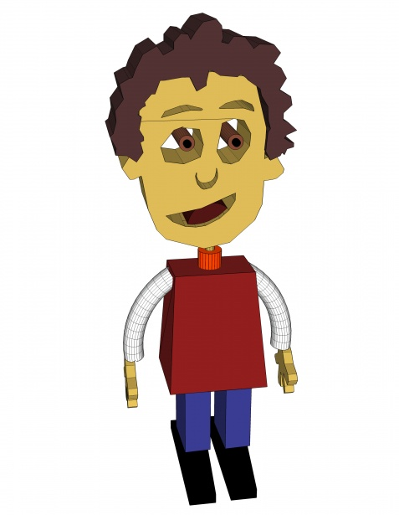
A Humanistic Worldview is how you view the world if you don't believe God exists and your faith is in human kind instead.

Slide 13
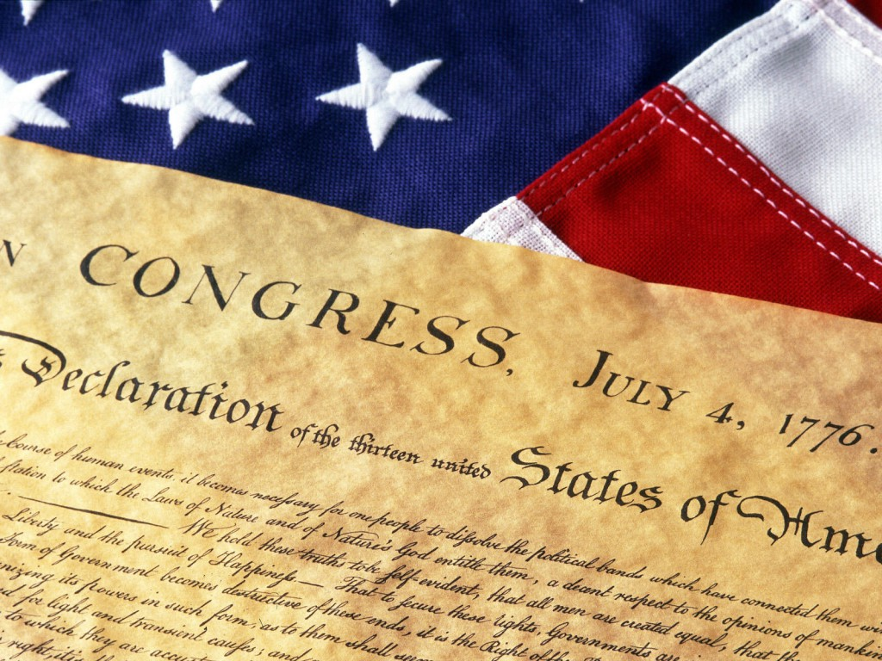
"We hold these truths to be self-evident, that all men are created equal, that they are endowed by their Creator with certain unalienable rights, that among these are life, liberty and the pursuit of happiness."

Slide 14
"That to secure these rights (those that we stated come from God), governments are instituted among them, deriving their just powers from the consent of the governed..."

Slide 15
The right to life, liberty
and the
pursuit of happiness.

