Slide 1
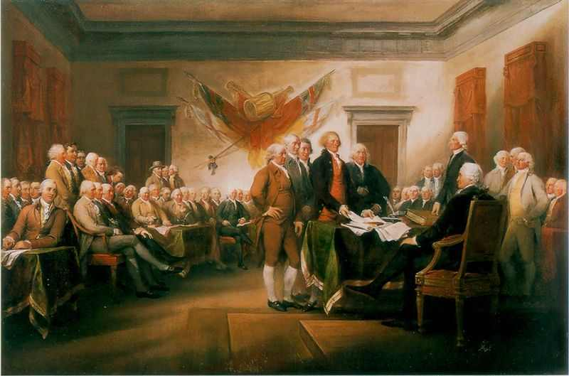
The American Revolution…
to fight or not to fight?

Slide 2
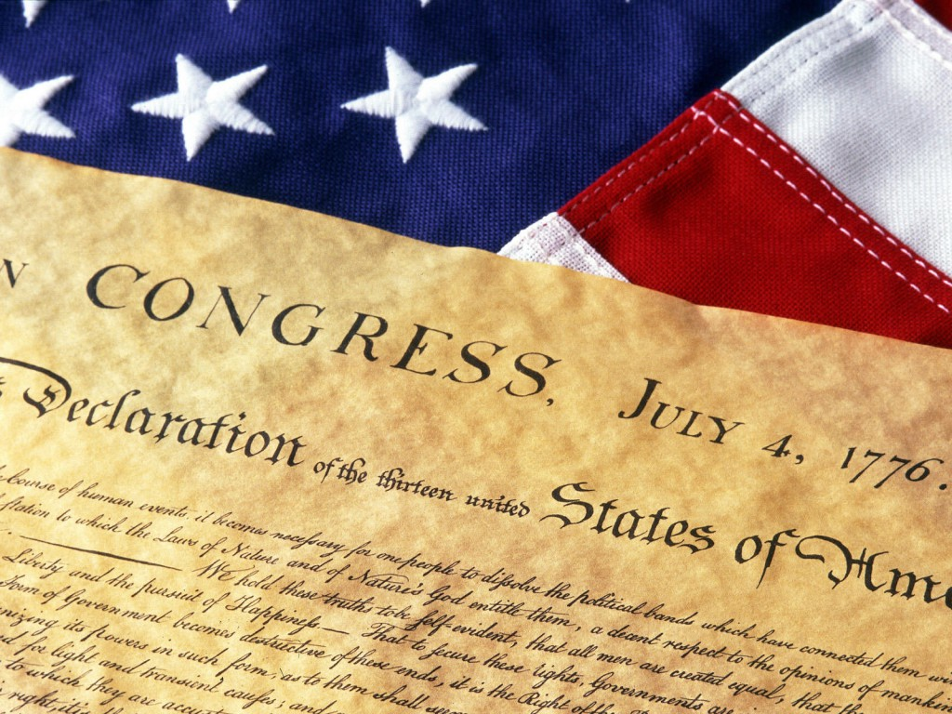
“He has refused his Assent to Laws, the most wholesome and necessary for the public good.”
“He has forbidden his Governors to pass Laws of immediate and pressing importance, unless suspended in their operation till his Assent should be obtained; and when so suspended, he has utterly neglected to attend to them.”
“He has refused to pass other Laws for the accommodation of large districts of people, unless those people would relinquish the right of Representation in the Legislature, a right inestimable to them and formidable to tyrants only.”
“He has called together legislative bodies at places unusual, uncomfortable, and distant from the depository of their public Records, for the sole purpose of fatiguing them into compliance with his measures.”
“He has dissolved Representative Houses repeatedly, for opposing with manly firmness his invasions on the rights of the people.”
“He has refused for a long time, after such dissolutions to cause others to be elected; whereby the Legislative powers, incapable of Annihilation, have returned to the People at large for their exercise; the State remaining in the mean time exposed to all the dangers of invasion from without, and convulsions within.”
“He has endeavored to prevent the population of these States; for that purpose obstructing the Laws for Naturalization of Foreigners; refusing to pass others to encourage their migration hither, and raising the conditions of new Appropriations of Lands.”
“He has obstructed the Administration of Justice, by refusing his Assent to Laws for establishing Judiciary powers.”
“He has made Judges dependent on his Will alone, for the tenure of their offices, and the amount and payment of their salaries.”
“He has erected a multitude of New Offices, and sent hither swarms of Officers to harass our people, and eat out their substance.”
“He has refused his Assent to Laws, the most wholesome and necessary for the public good.”
“He has forbidden his Governors to pass Laws of immediate and pressing importance, unless suspended in their operation till his Assent should be obtained; and when so suspended, he has utterly neglected to attend to them.”
“He has refused to pass other Laws for the accommodation of large districts of people, unless those people would relinquish the right of Representation in the Legislature, a right inestimable to them and formidable to tyrants only.”
“He has called together legislative bodies at places unusual, uncomfortable, and distant from the depository of their public Records, for the sole purpose of fatiguing them into compliance with his measures.”
“He has dissolved Representative Houses repeatedly, for opposing with manly firmness his invasions on the rights of the people.” “He has refused for a long time, after such dissolutions to cause others to be elected; whereby the Legislative powers, incapable of Annihilation, have returned to the People at large for their exercise; the State remaining in the mean “He has kept among us, in times of peace, Standing Armies without the Consent of our legislatures.”
“He has affected to render the Military independent of and superior to the Civil power.”
“He has combined with others to subject us to a jurisdiction foreign to our constitution, and unacknowledged by our laws; giving his Assent to their acts of pretended legislation:”
“He has abdicated Government here, by declaring us out of his Protection and waging War against us”
“He has plundered our seas, ravaged our Coasts, burnt our towns, and destroyed the lives of our people”
“He is at this time transporting large Armies of foreign Mercenaries to complete the works of death, desolation and tyranny, already begun with circumstances of Cruelty & perfidy scarcely paralleled in the most barbarous ages, and totally unworthy the Head of a civilized nation.”
“He has constrained our fellow Citizens taken Captive on the high Seas to bear Arms against their Country, to become the executioners of their friends and Brethren, or to fall themselves by their Hands.”
“He has excited domestic insurrections amongst us, and has endeavoured to bring on the inhabitants of our frontiers, the merciless Indian Savages, whose known rule of warfare, is an undistinguished destruction of all ages, sexes and conditions.”

Slide 3

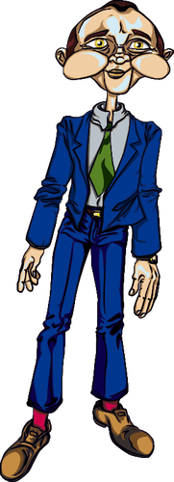
Tyranny - cruelty and injustice in the exercise of power or authority over others; oppressive government by one or more people who exercise absolute power cruelly and unjustly.

Slide 4
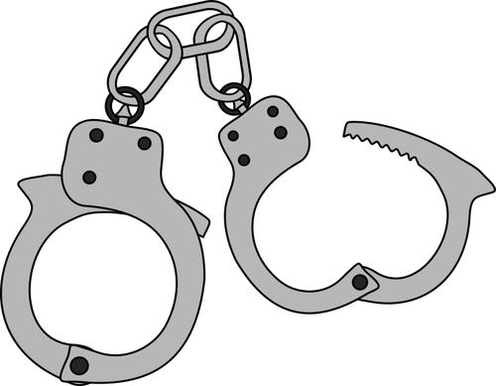
"For freedom Christ has set us free; stand fast therefore, and do not submit again to a yoke of slavery.“ Galatians 5:1

Slide 5
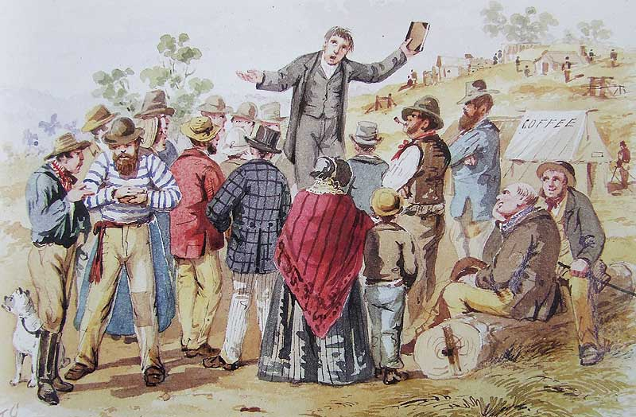

Slide 6
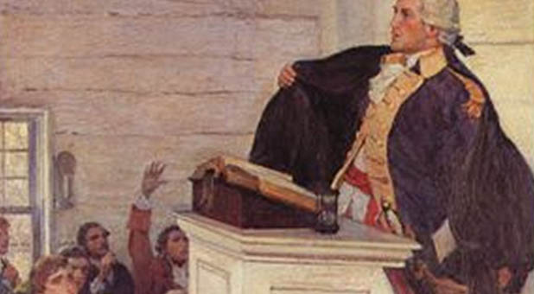

Slide 7
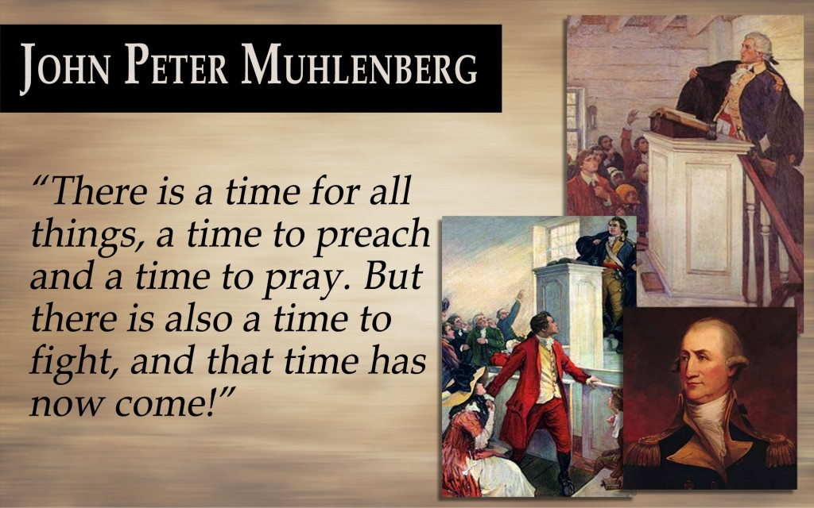

Slide 8
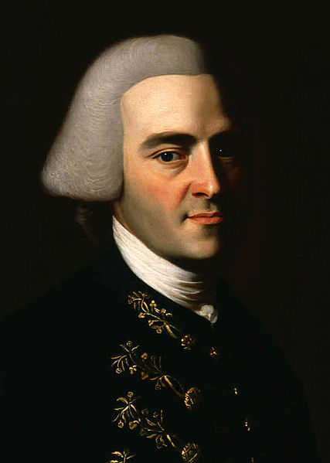
"Resistance to tyranny becomes the Christian and social duty of each individual...continue steadfast, and with a proper sense of your dependence on God, nobly defend those rights which heaven gave, and no man ought to take from you.“
John Hancock

Slide 9
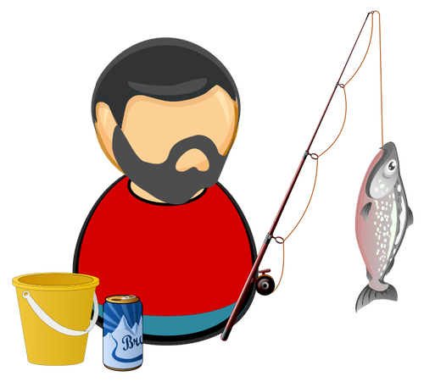
"And when they had brought them, they set them before the council. And the high priest asked them, saying: 'Did we not strictly command you not to teach in this name? (The name of Jesus) And look, you have filled Jerusalem with your doctrine, and intend to bring this Man's blood on us!' Then Peter and the other apostles answered and said: 'We must obey God rather than men.“ Acts 5:27-29

Slide 10
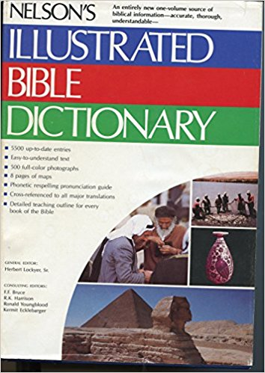
"The continuous activity of God in HIs creation by which He preserves and governs...it is the denial of the idea that the universe is governed by chance or by fate."
In other words, it is the will of God and His action to carry out that will as it applies to our lives, including government.

Slide 11
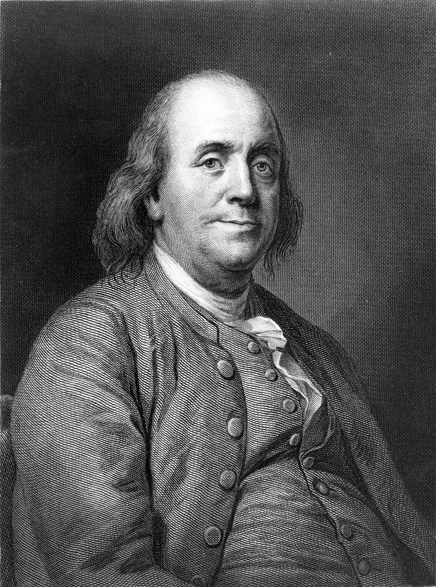
We must indeed all hang together, or most assuredly we will all hang separately."

Slide 12

"In Germany they came first for the Communists, and I didn't speak up because
I wasn't a Communist.
Then they came for the Jews, and I didn't speak up because
I wasn't a Jew.
Then they came for the trade unionists, and I didn't speak up because
I wasn't a trade unionist.
Then they came for the Catholics, and I didn't speak up because
I was a Protestant.
Then they came for me, and by that time no one was left to speak up.“ Rev. Martin Niemoller

Slide 13

“Silence in the face of evil is itself evil: God will not hold us guiltless.
Not to speak is to speak. Not to act is to act.” Dietrich Bonhoeffer

Slide 14
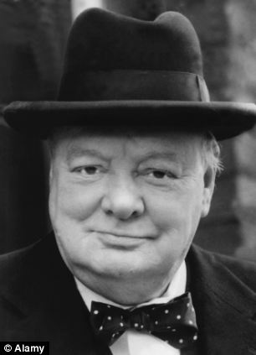
“If you will not fight for right when you can easily win without bloodshed;
if you will not fight when your victory is sure and not too costly;
you may come to the moment when you will have to fight with all the odds against you
and only a precarious chance of survival.
There may even be a worse case.
You may have to fight when there is no hope of victory, because it is better to perish than to live as slaves.”Winston Churchill

