Slide 1

“…All men are created equal…”

Slide 2
“We hold these truths to be self-evident, that all men are created equal, that they are endowed by their Creator with certain unalienable rights, that among these are life, liberty, and the pursuit of happiness...”

Slide 3
Hyp – o – crite
(hip’e krit)
Function: noun
Meaning:
A person who puts on a false appearance of virtue or religion.
A person who acts in contradiction to his or her stated beliefs or feelings.

Slide 4
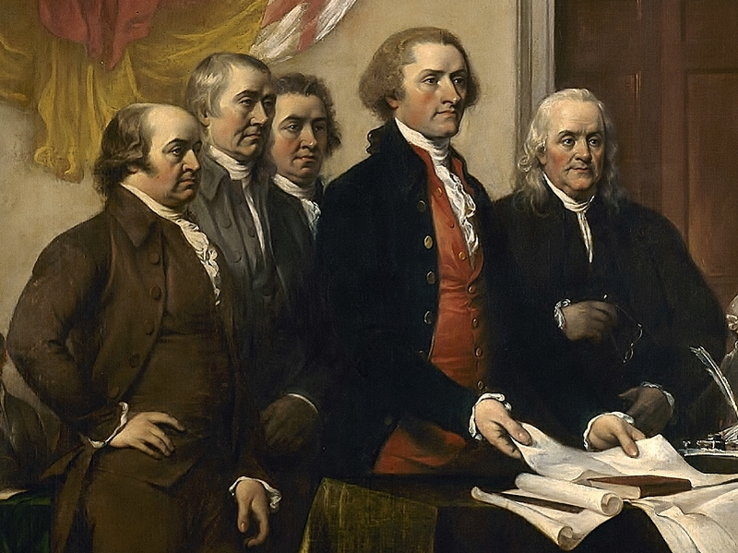

Slide 5



Slide 6
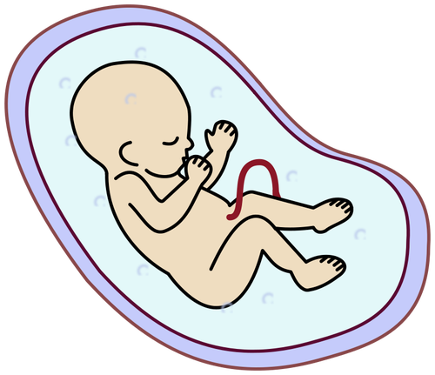

Slide 7

"If men were angels, we would have no need of government.“
James Madison

Slide 8
Equality
Ethnicity
Age
Disability
Religion
Sexuality
Gender
Marital Status

Slide 9
“We hold these truths to be self-evident, that all men are created equal, that they are endowed by their Creator with certain unalienable rights, that among these are life, liberty, and the pursuit of happiness...”

Slide 10

“…That to secure these, governments are instituted among men, deriving their
just powers from the consent of the governed…”

Slide 11
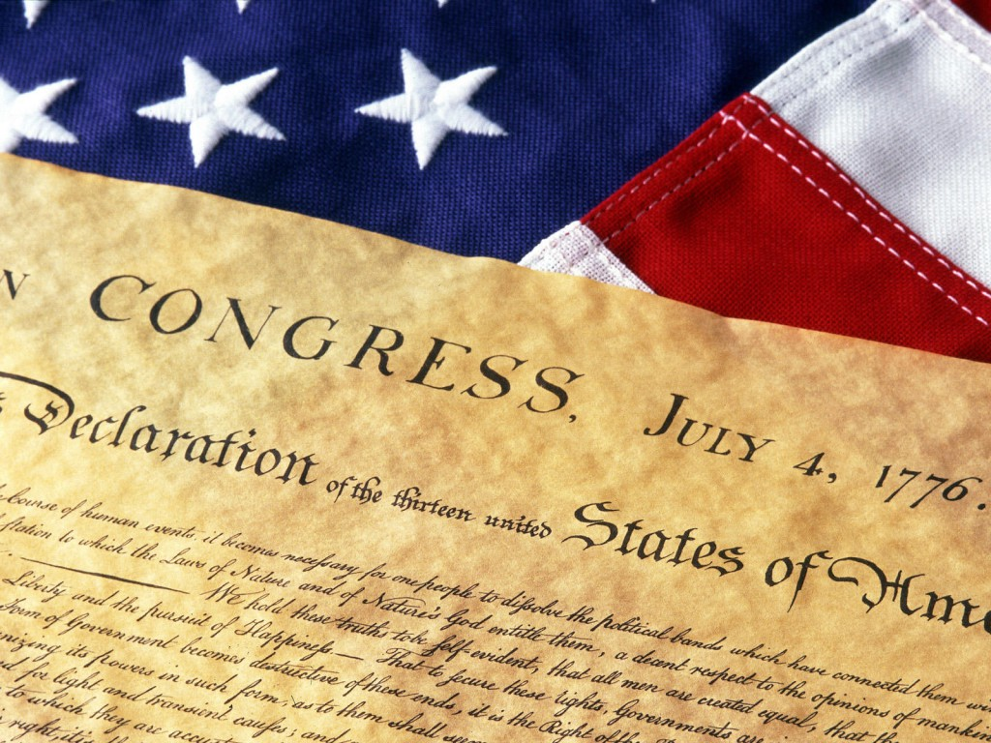
“He has refused his Assent to Laws, the most wholesome and necessary for the public good.”
“He has forbidden his Governors to pass Laws of immediate and pressing importance, unless suspended in their operation till his Assent should be obtained; and when so suspended, he has utterly neglected to attend to them.”
“He has refused to pass other Laws for the accommodation of large districts of people, unless those people would relinquish the right of Representation in the Legislature, a right inestimable to them and formidable to tyrants only.”
“He has called together legislative bodies at places unusual, uncomfortable, and distant from the depository of their public Records, for the sole purpose of fatiguing them into compliance with his measures.”
“He has dissolved Representative Houses repeatedly, for opposing with manly firmness his invasions on the rights of the people.”
“He has refused for a long time, after such dissolutions to cause others to be elected; whereby the Legislative powers, incapable of Annihilation, have returned to the People at large for their exercise; the State remaining in the mean time exposed to all the dangers of invasion from without, and convulsions within.”
“He has endeavored to prevent the population of these States; for that purpose obstructing the Laws for Naturalization of Foreigners; refusing to pass others to encourage their migration hither, and raising the conditions of new Appropriations of Lands.”
“He has obstructed the Administration of Justice, by refusing his Assent to Laws for establishing Judiciary powers.”
“He has made Judges dependent on his Will alone, for the tenure of their offices, and the amount and payment of their salaries.”
“He has erected a multitude of New Offices, and sent hither swarms of Officers to harass our people, and eat out their substance.”
“He has refused his Assent to Laws, the most wholesome and necessary for the public good.”
“He has forbidden his Governors to pass Laws of immediate and pressing importance, unless suspended in their operation till his Assent should be obtained; and when so suspended, he has utterly neglected to attend to them.”
“He has refused to pass other Laws for the accommodation of large districts of people, unless those people would relinquish the right of Representation in the Legislature, a right inestimable to them and formidable to tyrants only.”
“He has called together legislative bodies at places unusual, uncomfortable, and distant from the depository of their public Records, for the sole purpose of fatiguing them into compliance with his measures.”
“He has dissolved Representative Houses repeatedly, for opposing with manly firmness his invasions on the rights of the people.” “He has refused for a long time, after such dissolutions to cause others to be elected; whereby the Legislative powers, incapable of Annihilation, have returned to the People at large for their exercise; the State remaining in the mean “He has kept among us, in times of peace, Standing Armies without the Consent of our legislatures.”
“He has affected to render the Military independent of and superior to the Civil power.”
“He has combined with others to subject us to a jurisdiction foreign to our constitution, and unacknowledged by our laws; giving his Assent to their acts of pretended legislation:”
“He has abdicated Government here, by declaring us out of his Protection and waging War against us”
“He has plundered our seas, ravaged our Coasts, burnt our towns, and destroyed the lives of our people”
“He is at this time transporting large Armies of foreign Mercenaries to complete the works of death, desolation and tyranny, already begun with circumstances of Cruelty & perfidy scarcely paralleled in the most barbarous ages, and totally unworthy the Head of a civilized nation.”
“He has constrained our fellow Citizens taken Captive on the high Seas to bear Arms against their Country, to become the executioners of their friends and Brethren, or to fall themselves by their Hands.”
“He has excited domestic insurrections amongst us, and has endeavoured to bring on the inhabitants of our frontiers, the merciless Indian Savages, whose known rule of warfare, is an undistinguished destruction of all ages, sexes and conditions.”

Slide 12
The Massachusetts Constitution of 1780
“…All men are born free and equal, and have certain natural, essential, and unalienable rights; among which may be reckoned the right of enjoying and defending their Lives and Liberties; that of acquiring, possessing, and protecting property; in fine, that of seeking and obtaining their safety and happiness…”

Slide 13


OR
No one can serve two masters. Either you will hate the one and love the other, or you will be devoted to the one and despise the other. You cannot serve both God and money.“ Luke 16:13

Slide 14
Louisiana
Purchase

