Slide 1
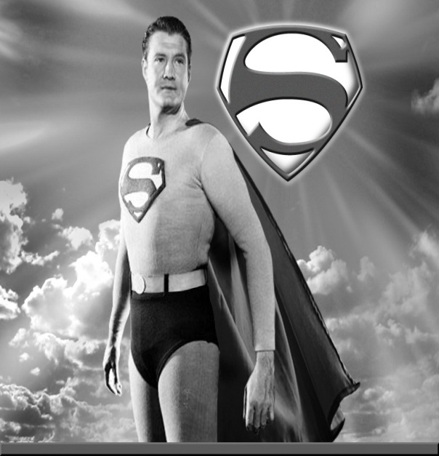
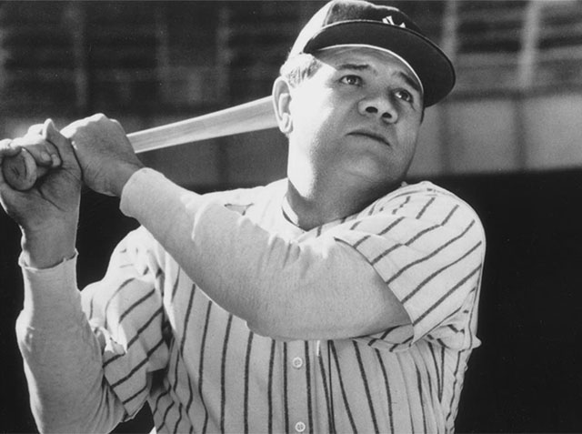
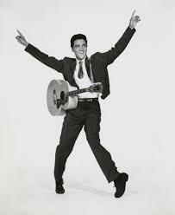
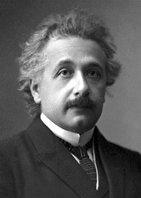
Who’s
Your
Hero?

Slide 2
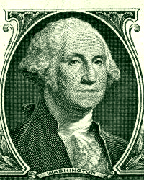

Slide 3
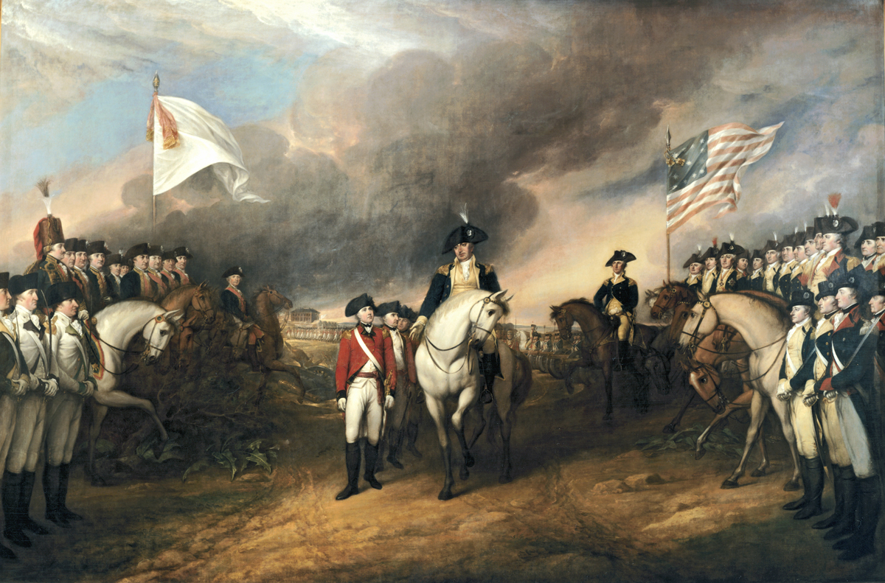
The surrender of the British forces at Yorktown. Painting by John Trumbull (US Capitol)

Slide 4
Providence:
Care and guidance provided by God to accomplish His will

Slide 5
“But by the all-powerful dispensations of Providence, I have been protected
beyond all human probability or expectation; for I had four bullets through my coat,
and two horses shot under me, yet escaped unhurt, although death was leveling
my companions on every side of me.”

Slide 6
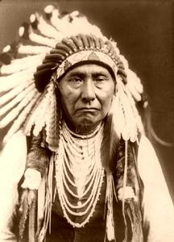

Slide 7
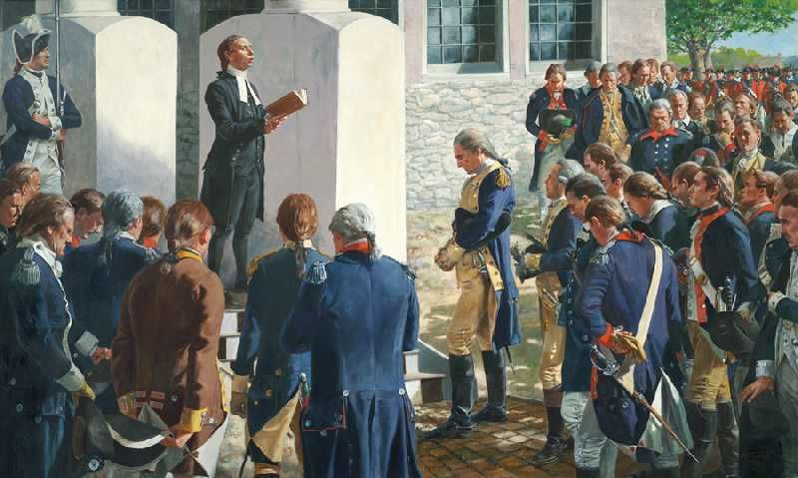

Slide 8
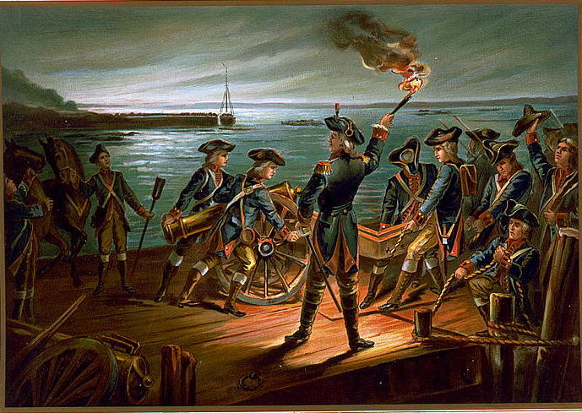

Slide 9
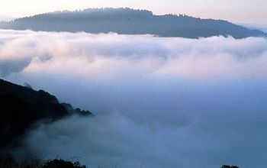

Slide 10
"No people can be bound to acknowledge and adore the Invisible Hand which conducts the affairs of men more than the people of the United States. Every step by which they have advanced to the character of an independent nation seems to have been distinguished by some token of providential agency... We ought to be no less persuaded that the propitious smiles of Heaven can never be expected on a nation that disregards the eternal rules of order and right which Heaven itself has ordained."

