Slide 1
The Fallen Nature of Man

Slide 2

The lens through which we view the world

Slide 3
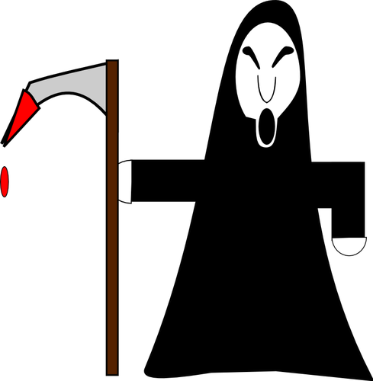

"There is a way that seems right to man but in the end, it leads to death.“
Prov. 14:12

Slide 4
"Without a firm moral foundation, freedom degenerates quickly into selfishness ... Unless men exercise their freedom ... without moral restraints, a free society can degenerate into anarchy.” President Harry S. Truman, April 3, 1951

Slide 5
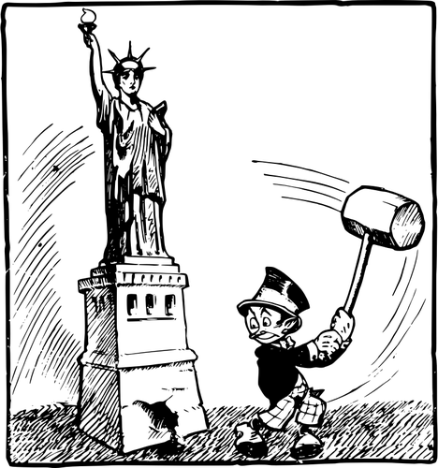
“Liberty becomes a question of morals more than of politics.”Lord Acton

Slide 6


"All of us have become like one who is unclean, and all our righteous acts are like filthy rags; we all shrivel up like a leaf, and like the wind our sins sweep us away.“ Isaiah 64:6

Slide 7

"The heart is deceitful above all things, and desperately wicked: who can know it?”
Jeremiah 17:9

Slide 8

“Power tends to corrupt and absolute power corrupts absolutely…” Lord Acton

Slide 9
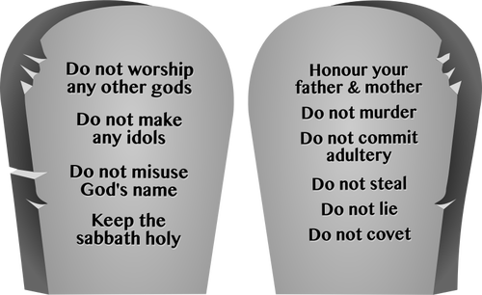
DO NOT STEAL…DO NOT COVET

Slide 10
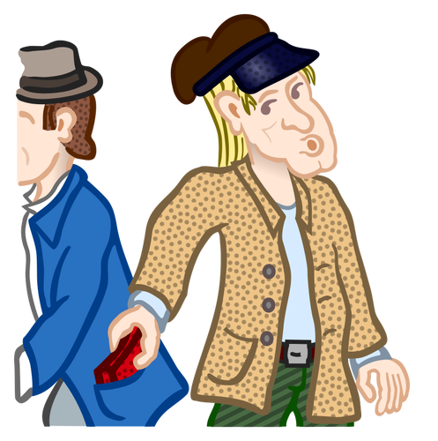

Slide 11

"But if anyone does not provide for his own, and especially for those of his household, he has denied the faith and is worse than an unbeliever." 1 Tim. 5:8

Slide 12

"If anyone is not willing to work, then he is not to eat.“ 1 Thess. 3:30

Slide 13

"We hold these truths to be self-evident, that all men are created equal, that they are endowed by their Creator with certain unalienable Rights, that among these are Life, Liberty and the pursuit of Happiness."

Slide 14
"That to secure these rights, Governments are instituted among Men, deriving their just powers from the consent of the governed"

Slide 15
“Authority that does not exist for liberty is not authority but force.” Lord Acton

Slide 16
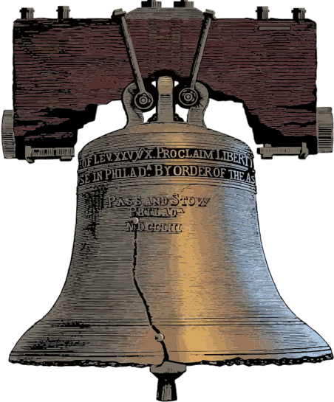
"Proclaim liberty throughout all the land all the inhabitants thereof.“ Leviticus 25:5

Slide 17

"Now the Lord is the Spirit; and where the Spirit of the Lord is, there is liberty."

Slide 18
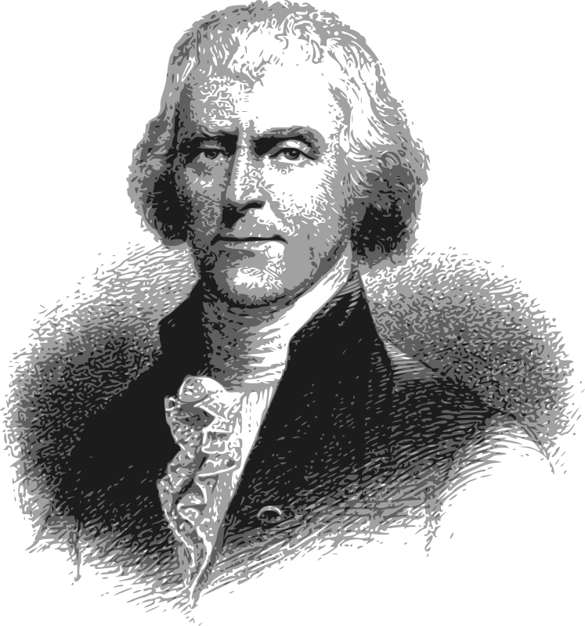
"Can the liberties of a nation be secure when we have removed the conviction that these liberties are the gift of God?"

Slide 19
1. Freedom from a corrupt government
2. Freedom from foreign rule and national independence or sovereignty; and
3. The power or right to think, speak or believe according to your personal choice.

Slide 20
“The fear of the Lord is the beginning of wisdom, and knowledge of the Holy One is understanding.” Proverbs 9:10

Slide 21
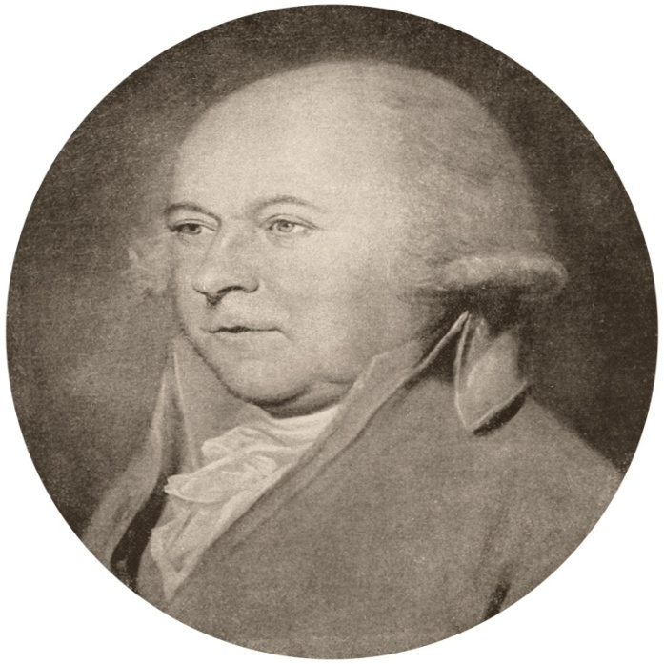
"Our Constitution was designed for a moral and religious people...it is wholly inadequate to govern any other.“John Adams

Slide 22
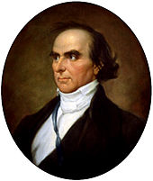
"Whatever makes men good Christians, makes them good citizens.“ Daniel Webster

