Slide 1
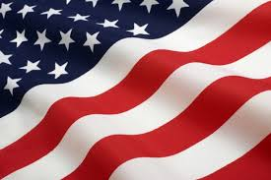
Defending its citizens against foreign powers;
Where the citizens were the sovereigns as opposed to a king;
Where the rights of individuals were protected;
Where the government's powers were limited and specifically listed or "enumerated"; and
Where liberty was protected by curtailing power grabs through a system of checks and balances. The Preamble of our Constitution states it well.

Slide 2
“We the People of the United States, in Order to form a more perfect Union, establish justice, insure domestic Tranquility, provide for the common defense, promote the general Welfare, and secure the Blessings of Liberty to ourselves and our Posterity, do ordain and establish this Constitution for the United States of America …”

Slide 3
“The best way to take control over a people and control them utterly is to take a little of their freedom at a time, to erode rights by a thousand tiny and almost imperceptible reductions. In this way, the people will not see those rights and freedoms being removed until past the point at which these changes cannot be reversed.” Pat Miller

Slide 4
"Many features we have long criticized in tyrannical governments around the world are becoming standard practice across America, even tainting our foreign policy."
William H. Huff, on pp xiv

Slide 5
Nazi, Germany that killed over 6,000,000 Jews as well as many others;
Joseph Stalin of the Soviet Union killed millions and millions with the exact number being unknown;
Mao Zedong - or Chairman Mao, as he was known - of Communist China killed between 45,000,000 and 78,000,000.
Others worth mentioning are:
Fidel Castro, the founder of Communist Cuba;
Muomar el-Gadhafi of Libya; and
Saddam Hussein of Iraq.
All of these tyrants killed mostly their own people in order to maintain their power.

