Slide 1
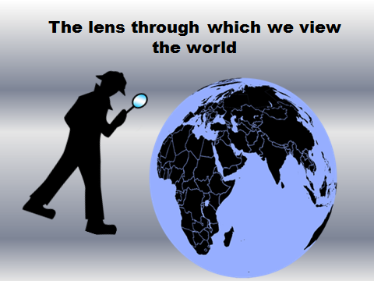


The lens through which we view the world

Slide 2
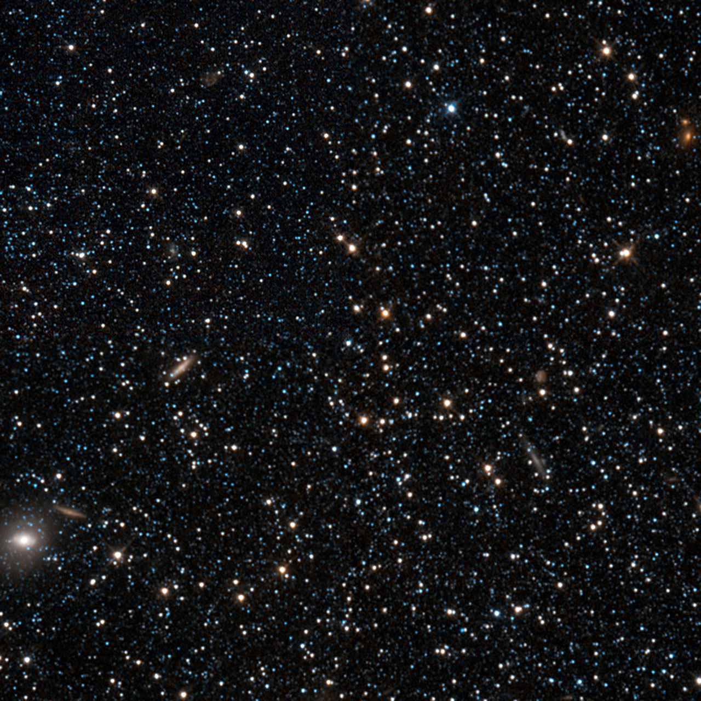
The wrath of God is being revealed from heaven against al the godlessness and wickedness of people, who suppress the truth by their wickedness, since what may be known abut God is plain to them, because God has made it plain to them. For since the creation of the world God’s invisible qualities – his eternal power and divine nature – have been clearly seen, being understood fro what has been made, so that people are without excuse. Romans 1:18-20

Slide 3
For although they knew God, they neither glorified him as God nor gave thanks to him, but their thinking became futile and their foolish hearts were darkened. Although they claimed to be wise, they became fools and exchanged the glory of the immortal God for images made to look like a mortal human beings and birds and animals and reptiles. Romans 1:21-23

Slide 4
Therefore God gave them over in the sinful desires of their hearts to sexual impurity for the degrading of their bodies with one another. They exchanged the truth about God for a lie, and worshiped and served created things rather than the Creator—who is forever praised. Amen. Romans 1:24-25

Slide 5
Because of this, God gave them over to shameful lusts. Even their women exchanged natural sexual relations for unnatural ones. ²⁷ In the same way the men also abandoned natural relations with women and were inflamed with lust for one another. Men committed shameful acts with other men, and received in themselves the due penalty for their error. Romans 1:26-27

Slide 6
Furthermore, just as they did not think it worthwhile to retain the knowledge of God, so God gave them over to a depraved mind, so that they do what ought not to be done. They have become filled with every kind of wickedness, evil, greed and depravity. They are full of envy, murder, strife, deceit and malice. They are gossips, slanderers, God-haters, insolent, arrogant and boastful; they invent ways of doing evil; they disobey their parents; they have no understanding, no fidelity, no love, no mercy. Although they know God’s righteous decree that those who do such things deserve death, they not only continue to do these very things but also approve of those who practice them. Romans 1:28-32

