Slide 1
Find Data
Enter Data Into a Computer
Computer Processes Data
Data is Accessible for Use & Interpretation
Data is Stored in Computer

Slide 2
Data
Information
Knowledge

Slide 3

Hypothesis
Data
Possibilities
Conclusion

Slide 4
On the Origin of Species by Means of Natural Selection, or the Preservation of Favored Races in the Struggle for Life.

Slide 5
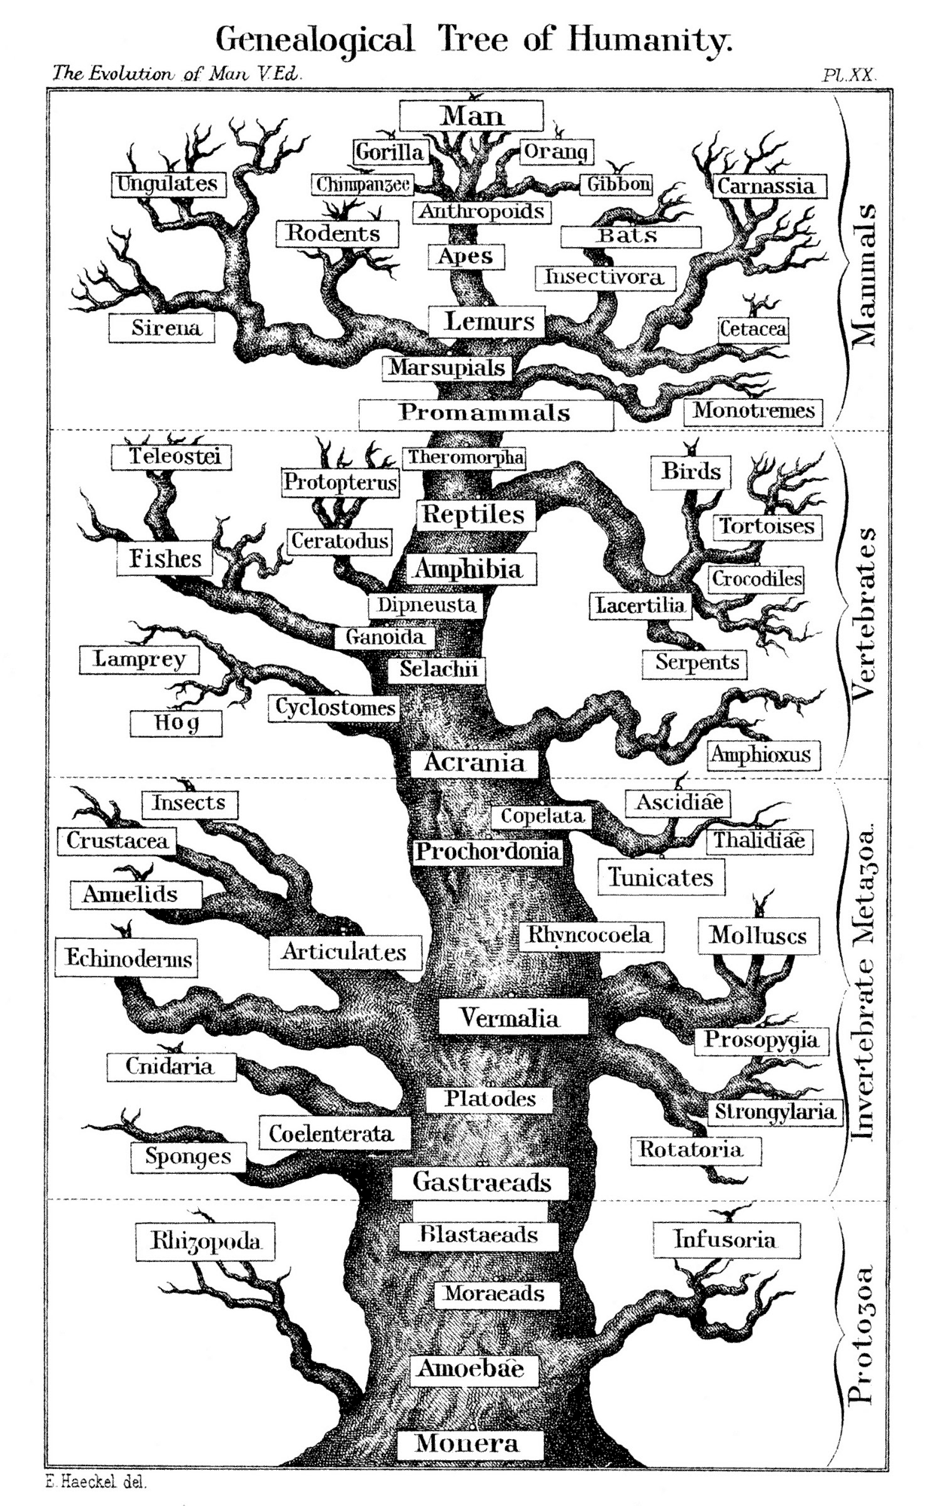
Haeckel’s
Tree
Of
Life

Slide 7

The Bible
Says

Slide 8
The Bible
Says

Slide 9
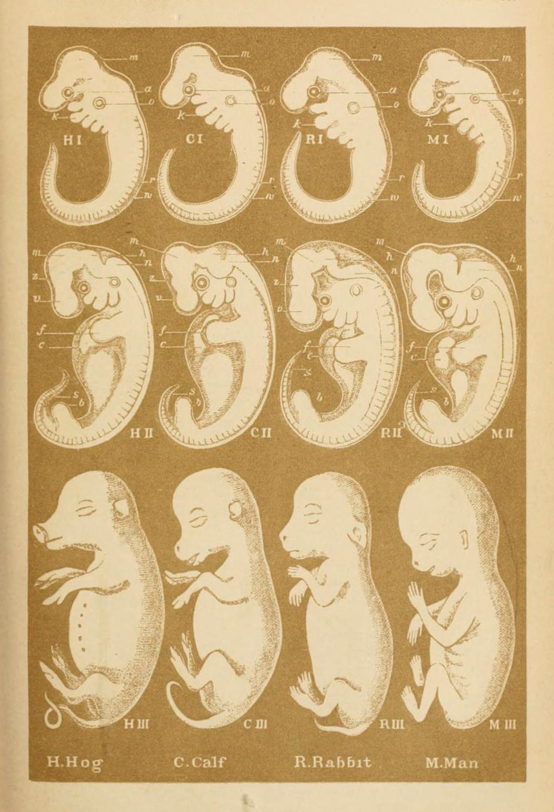
Haeckel’s Embryos

Slide 10
"Ontogeny recapitulates phylogeny."

Slide 11
Hog Calf Rabbit Human
The embryos Haeckel drew
How the embryos actually look
Hog Calf Rabbit Human

Slide 12
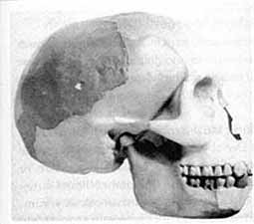
Piltdown Man

Slide 13
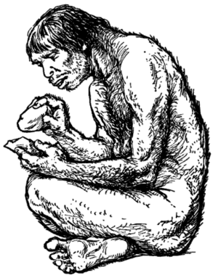

Slide 14
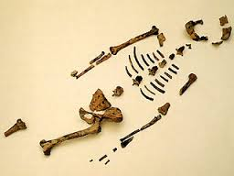

Slide 15
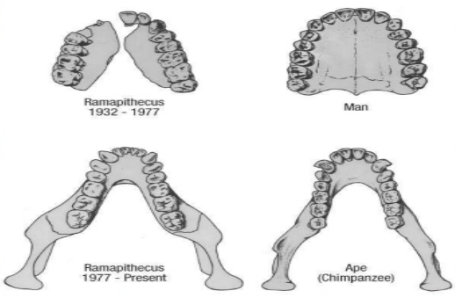
Credit: In the Beginning: Compelling Evidence for Creation and the Flood by Walt Brown, Page 10

Slide 16
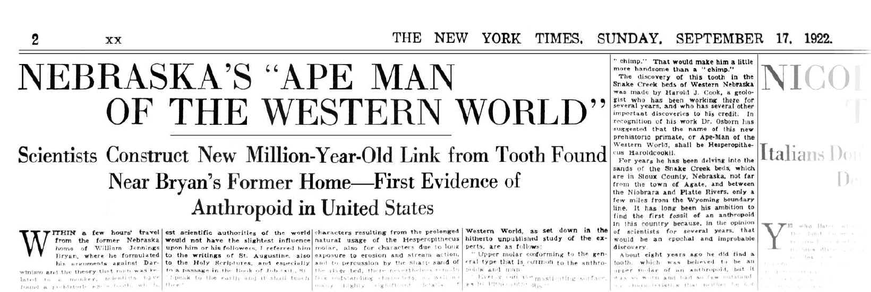

Slide 17
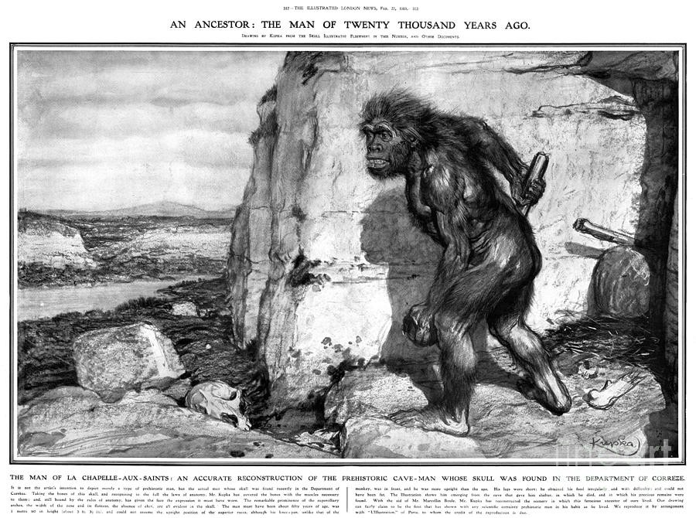

Slide 18
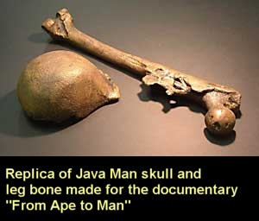

Slide 19
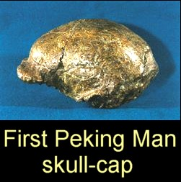

Slide 21
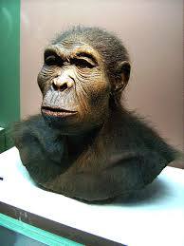
By Author of reconstruction unknown (klimaundmensch.de)Photographed by User:Lillyundfreya - Photographed at Westfälisches Museum für Archäologie, Herne, CC BY-SA 3.0, https://commons.wikimedia.org/w/index.php?curid=1843470

Slide 22
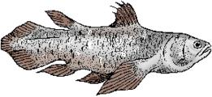
Coelacanth
Illustration from www.Merriam-Webster.com/dictionary/coelacanth

Slide 23
