Slide 1
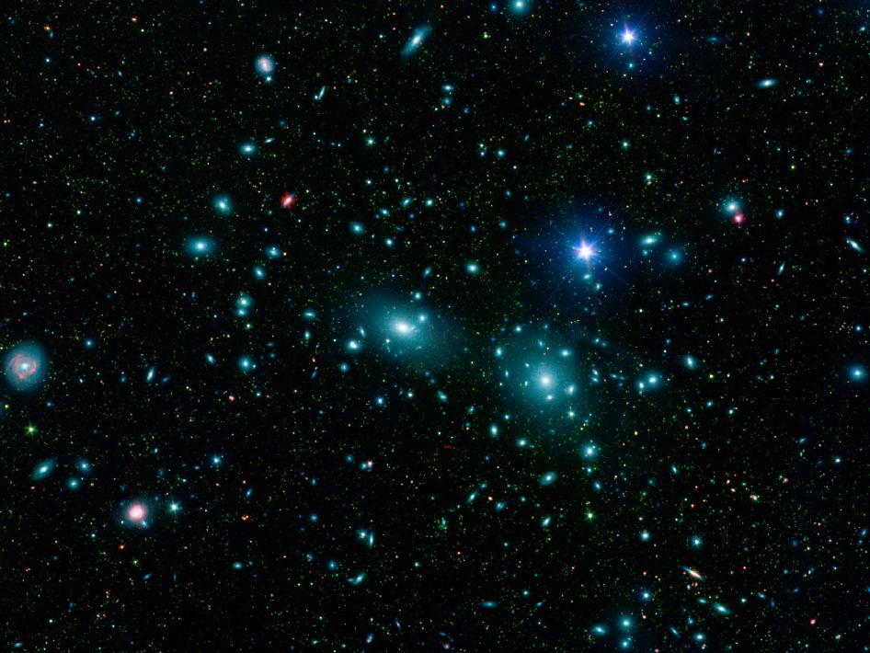


Science and the Bible –
Perfect Together

Slide 2

“For the weapons of our warfare are not carnal but mighty in God for pulling down strongholds, casting down arguments and every high thing that exalts itself against the knowledge of God…”
2Cor.10:4-5a

Slide 3
The Devil’s
Biggest Lies
You can be like God
2. Christian’s shouldn’t be involved in politics
3. Everything evolved through natural causes

Slide 4
“However, when the Son of Man comes, will he find faith on the earth?” Luke 18:8b spoken by Jesus.
“…for that Day will not come unless the falling away
comes first…
1Thess.2:3 spoken by the Apostle Paul

Slide 5
Barna Research Poll:
70%
of students in Christian homes intend to leave the church after graduation directly due to teachings on Evolution.

Slide 6

“In the beginning God created the heavens and
the earth.” Genesis 1:1

Slide 7
Since 1859, when Darwin wrote his famous Origins of Species, men who don’t believe or don’t want to believe in God, have been determined to prove that everything evolved as opposed to being created. They have literally been looking under every rock to find proof of their hypothesis.

Slide 8
As a result, people looking for another explanation for the things we see have fallen for every hoax or wild explanation, such as:
Haeckel’s Embryos
Archaeopteryx
Java Man
Piltdown Man
Nebraska Man
The Peppered Moth
Neanderthal Man
Punctuated Equilibrium
Lucy (Australopithecus)
The Miller-Urey Experiment

Slide 9
Scientific Method:
Observable
Repeatable
Predictable
Falsifiable

Slide 10
Darwin predicted:
“If my theory be true, numberless varieties, linking closely together all the species of the same group, must assuredly have existed…
“The number of intermediate and transitional links between all living and extinct species, must have been inconceivably great…
“An interminable number of intermediate forms must have existed…”
Origin of Species, 6th edition, chapters 6, 10, 15

Slide 11
One of the many tree of life possibilities based on Darwin’s predictions that evolutionists propose.

Slide 12
Genesis 1:24, 25 (The 6th Day of Creation)
“And God said, ‘Let the land produce living creatures according to their kinds: livestock, creatures that move along the ground, and wild animals according to its kind.’ And it was so. God made the wild animals according to their kinds…”

Slide 14

DNA and RNAI confirms Genesis that all animals reproduce after their
own kind.

Slide 15
The 2nd Law of Thermodynamics states:
The Second Law of Thermodynamics simply tells us that life systems that require energy go from an organized state to a disorganized state if the energy isn’t maintained. The process of going from organization to disorganization in life systems is commonly referred to as decay.

Slide 16
The first two laws of Thermodynamics were first were credited to Sadi Carnot in 1824, elaborated upon by Rudolf Clausius and William Thomson
in 1860, and credited as laws by Willard Gibbs in 1873.

Slide 17
“For the creation was subjected to futility, not of its own will, but because of Him who subjected it, in hope that the creation itself also will be set free from its slavery to corruption into the freedom of the glory of the children of God. For we know that the whole creation groans and suffers the pains of childbirth together until now.”
The Apostle Paul, Romans 8:20-22

Slide 18
According to Strong’s Concordance
#5356 phthora (fthor-ah’):
Corruption = decay

Slide 19
The Apostle Paul wrote the Book of Romans a little more than
2000 years
before Sadi Carnot!!!

Slide 20
The prophet Isaiah lived
around 681 B.C.
or 2,681 years ago
Isaiah 40:22a, states:
“He (God) sits enthroned above the circle of the earth, and its people are like grasshoppers”.

Slide 21
In 330 B.C.
(Approximately 350 years after Isaiah)
Aristotle argued that the world must be round. The idea first spread throughout Greece and then throughout the rest of the world.

Slide 22

Job 38:16a states:
“Have you entered into the springs of the sea…”

Slide 23
The existence of water springs in the oceans were predicted in the early 1970s but were not actually discovered until 1977 A.D. in the Galapagos Rift.

Slide 24
These predictions were made by oceanographers approximately 3978 years after Job first wrote about them!

Slide 25

Job 38:16 b states:
“…Or have you walked in the recesses of the sea?”

Slide 26
The recesses of the deep were first discovered by a team of British scientists in the Pacific ocean in 1873.
3871 years
after Job!!!

Slide 27
Job 38:7a states:
“…When the morning stars
sang
together”

Slide 28
As recently as September 5, 2012, NASA reported on the
“song”
the earth was singing.
Yes, that is an actual musical interlude.

Slide 29
NASA also reported that black holes sing as well. You can read more about it on the links below:
http://www.nasa.gov/centers/goddard/universe/black_hole_sound.html
http://www.nasa.gov/mission_pages/rbsp/news/emfisis-chorus.html

Slide 30
“Soaring to the depths of our universe, gallant spacecraft roam the cosmos, snapping images of celestial wonders. Some spacecraft have instruments capable of capturing radio emissions. When scientists convert these to sound waves, the results are eerie to hear. In time for Halloween, we've put together a compilation of elusive "sounds" of howling planets and whistling helium that is sure to make your skin crawl.”
On the website below you will be able to hear the recordings from Jupiter, Earth and Uranus:
http://www.nasa.gov/vision/universe/features/halloween_sounds.html

Slide 31
These discoveries were made approximately 4020 years after Job’s statements.

Slide 32
The Big Bang Theory states:
The universe originally existed in an extremely dense and compact state called a singularity.
A cosmic explosion caused expansion.
The universe has continued to expand and cool.
After the bang, the universe developed hydrogen and other elements.
The hydrogen produced light, which was the vehicle that enabled further expansion.
General Relativity requires that the structure of the cosmos had to be in existence before the celestial bodies formed.
Notes:
This is how the Big Bang Theory looks today

Slide 33
Jer. 51:15“He made the earth by his power; He founded the world by his wisdom
and stretched out the heavens by His understanding.”
Jer. 10:12 “But God made the earth by his power; He founded the world by His wisdom and stretched out the heavens by His understanding.”
Isa. 40:22b “He stretches out the heavens like a canopy, and spreads them out like a tent to live in.”
Isa. 42:5a “This is what God the Lord says—the Creator of the heavens, who stretches them out,…”
Isa. 51:13a “…that you forget the Lord your Maker, who stretches out the heavens
and who lays the foundations of the earth,…”
Zech. 12:1 “A prophecy: The word of the Lord concerning Israel. The Lord, who stretches out the heavens, who lays the foundation of the earth, and who forms the human spirit within a person, declares…”
Notes:
This is how the Big Bang Theory looks today

Slide 34
Hebrews 11:3
“By faith we understand that the worlds were prepared by the word of God, so that what is seen was not made out of things which are visible.
2 Peter 3:5
“For when they maintain this, it escapes their notice that by the word of God the heavens existed long ago and the earth was formed out of water and by water.”

Slide 35
“In the beginning God created the heavens and the earth.
And the earth was formless and void, and darkness was over the surface of the deep; and the Spirit of God was moving over the surface of the waters.
Then God said, ‘Let there be light’; and there was light.”
Genesis 1:1-3

Slide 36
The scientific disciplines covered in these 3 verses:
Vacuum physics
Sono luminescence
Cosmogony
Theory of Relativity
Quantum Mechanics
Harmonics
Wave Physics
Astrophysics
The Inflationary Theory

Slide 37
“Much of what WMAP (Wilkinson Microwave Anisotropy Probe) reveals about the universe is because of the patterns in its sky maps. The patterns arise from sound waves in the early universe. As with the sound from a plucked guitar string, there is a primary note and a series of harmonics, or overtones. “
map.gsfc.nasa.gov/news/index.html

Slide 38
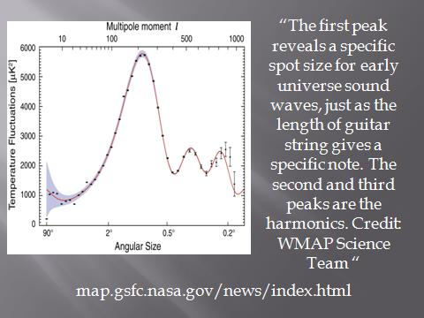

Slide 39
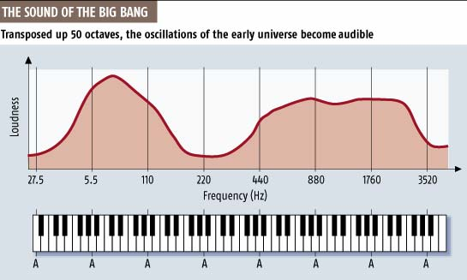

Slide 40
NASA launched WMAP in
June of 2001 –
Approximately
3400 years after
Moses wrote Genesis!!!

Slide 41
“And the earth was
Formless & void…”
Genesis 1:2a

Slide 42
The word for formless in Hebrew is tohuw (to’-hoo).
It is translated as:
confusion
empty place
without form
and chaos.

Slide 43
The word void in Hebrew is Bohuw (bo’-hoo)
This is translated as:
empty
vacuum
primeval

Slide 44
The word vacuum in English means a space entirely devoid of matter, or a space not filled or occupied.

Slide 45
Putting these two words together, we have an empty space not filled with matter, or a vacuum that is chaotic.

Slide 46
How does Cosmogony –
(the study of the history of the Cosmos) along with Astrophysics and Vacuum physics describe the primeval universe before the Big Bang?

Slide 47
Vacuum is space that is empty of matter. The word stems from the Latin adjective vacuus for "empty" or "void".

Slide 48
Characteristics of a Vacuum (according to physics):
Within a vacuum energy can spontaneously appear from no where so long as it does not last too long. Particles can "pop up" out of a vacuum so long as they do not have too large a mass or do not last too long.

Slide 49
Quantum Mechanics refers to these chaotic bursts of energy and minute particles as quantum fluctuations and they exist within a vacuum.

Slide 50
The Bible refers to this primeval time as a formless void, which also translates to a vacuum, with chaos.
Science refers to this primeval time as a vacuum with quantum fluctuations or chaotic bursts of energy.

Slide 51
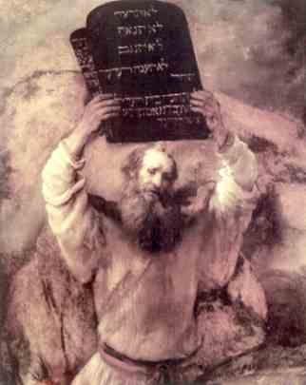
- Remember –
Moses wrote Genesis approximately 3400 years ago.
The hypothesis of vacuum physics was first proposed by Amadeo Avogardo in 1811.

Slide 52
For the mathematically challenged –
Moses wrote about the dynamics of the primeval creation being a vacuum that is void of matter but filled with chaos approximately 3400 years ago.
That’s approximately 3200 years before Amadeo Avogardo!!!

