Slide 1

https://www.usgs.gov/media/images/pangea

Slide 2

https://images.nasa.gov/search-results?q=earth&keywords=&page=2&media=image,video,audio&yearStart=1920&yearEnd=2017

Slide 3
Notes:
Obviously something must have happened to turn this into this.
Can anyone guess what that might have been?

Slide 5
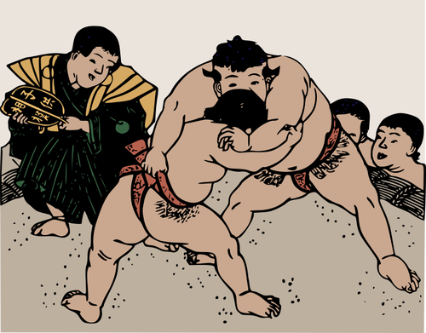

Slide 6

Notes:
God gives us clues about how all of this evil affected the earth.

Slide 7
Names in the Bible
Isaac means “laughter”
Moses means “drawn from the water”
Jesus means “Jehovah saves”

Slide 8
Jesus means
“Jehovah Saves”
Notes:
Does anyone know what the name Jesus means?
Of course I hope you know that Jehovah is the Hebrew way of saying “God”.

Slide 9
The name “Noah” means something too.
Can anyone guess what the name Noah means?
Remember, it’s a clue to what was happening to the earth at that time as a result of all of the sin and evil.

Slide 10


Lamech named his son
Noah
Lamech said, ‘Noah will comfort
us from the pain of our work. The pain is because God
has cursed the
ground.’” Genesis 5:29

Slide 11
Two Reasons
Why the Lord will curse the ground:
#1 – as judgment for evil
#2 – to bring us to repentance

Slide 12

Why did God
curse the ground in Noah’s time?

Slide 13
“People on earth did what God said was evil. Violence was everywhere.”
Genesis 6:11

Slide 14

Genesis 6:5 says, “Then the Lord saw that the wickedness of man was great in the earth, and that every intent of the thoughts of his heart was only evil continually.”

Slide 15

“So, God said to Noah, ‘People have made the earth full of violence. So I will destroy all people from the earth.’”
Genesis 6:13

Slide 16
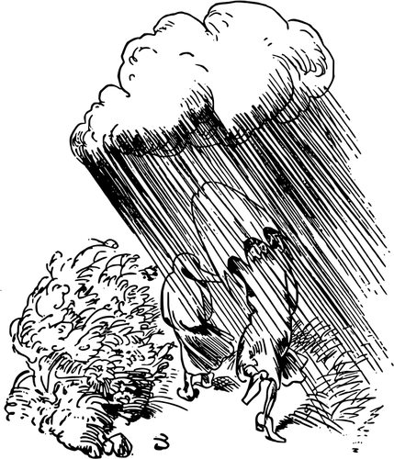
“I will bring a flood of water on the earth. I will destroy all living things that live under the sky. This includes everything that has the breath of life. Everything on the earth will die.” Genesis 6:17

Slide 17

“All living things that moved on the earth died. This included all the birds, tame animals, wild animals and creatures that swarm on the earth. And all human beings died. So everything on dry land died. This means everything that had the breath of life in its nose.” Genesis 7:21-22

Slide 18




Notes:
But some things didn’t die. Can you name a few that living creatures that didn’t have the breath of life in them?

Slide 19
The Bible says:
All animals that had the breath of life in them died.
Science says that there is a record in the earth that there were mass extinctions of animals.

Slide 20
What is “Theory?”

Slide 21

Ideas that explain
data

Slide 22
What is “Data?”

Slide 23
Known facts

Slide 24
What is the
Scientific Method?

Slide 25

Observable

Slide 26

Repeatable

Slide 27

Testable

Slide 28

Falsifiable

Slide 29

There are a lot of ways to test data. In the laboratory is one of them.

Slide 30

Cross section of a tree
Bark
Annual
Rings
Pith

Slide 31

Whether
you’re a creationist
or
an evolutionist,
we all look at
the
same data

Slide 32

But we think different things about what we see

Slide 33

Remember, we all have
different worldviews,
or opinions, about how
we view the world that
are affected by the things
we believe

Slide 34


Supernatural Vs.
Some force that is
able to work above
the laws of nature
and is not limited to
nature and its laws.
Natural
Existing in or caused by nature; not made by humans or anything that is supernatural.
Notes:
There are two different views about the world.

Slide 35
Is there data to support what the Bible says about the Flood?

Slide 36




Slide 37
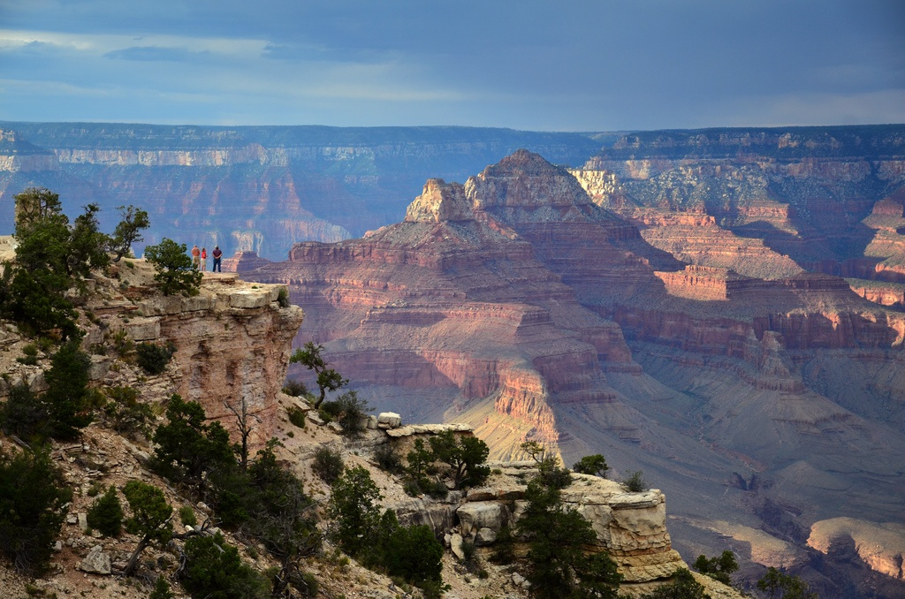
Credit: NPS

Slide 39
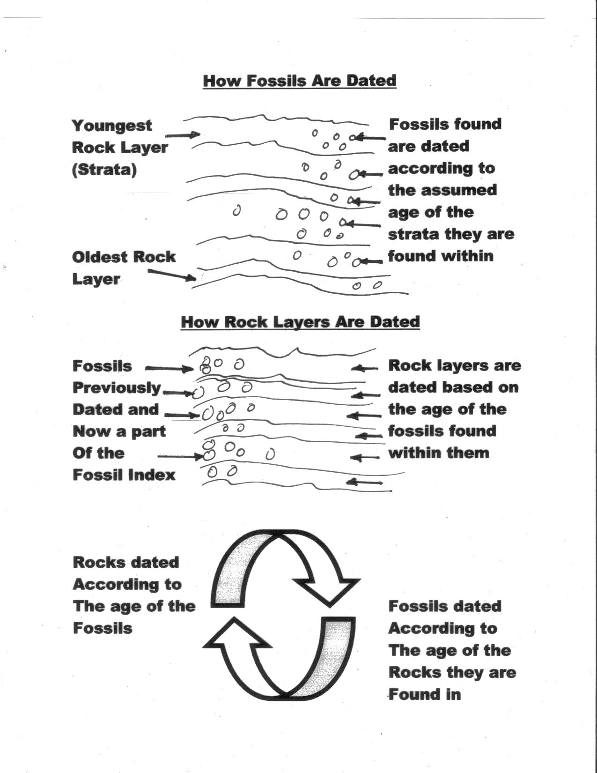

Slide 40
Are there facts
that contradict
what the evolutionists believe and teach?

Slide 43
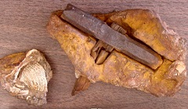
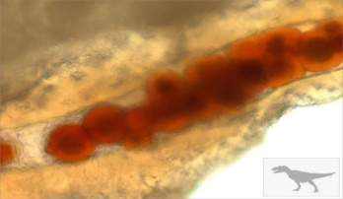
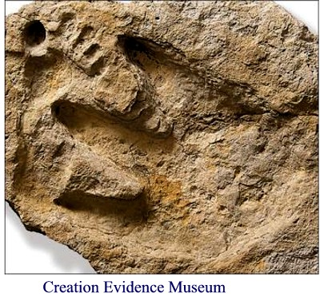

Other Contradictions
Iron hammer found in 100 million year old rock layer, 98 million years before humans were supposed to have evolved. By Source (WP:NFCC#4), Fair use, https://en.wikipedia.org/w/index.php?curid=41582407
Blood found in T-Rex femur by Dr. Mary in 2005. According to evolution, T-Rexes went extinct 70 million years ago, but the blood cells were still viable and liquid and had not disintegrated over time as they should have.
Human footprints found along side dinosaur tracks in the Paluxy River in Glen Rose, Texas. Dinosaurs supposedly went extinct over 60 million years before man evolved.
Human femur found in Shenandoah region of Pennsylvania by Ed Conrad in rock layer designated to be 307 million years old, over 250 million years before man was supposed to have evolved.

