Slide 1

What do you think about when you think about
Noah’s Ark?

Slide 2


Slide 3

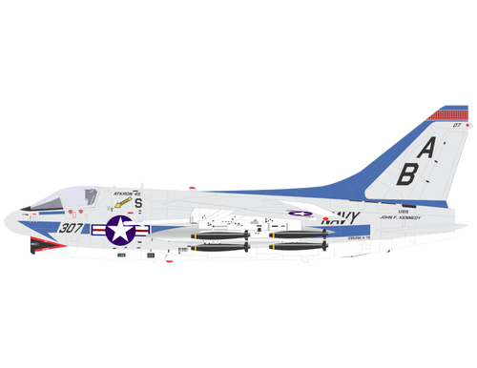




44 feet high
437 feet long
44 feet high

Slide 4


Slide 5

" Every living thing that moved on land perished—birds, livestock, wild animals, all the creatures that swarm over the earth, and all mankind. Everything on dry land that had the breath of life in its nostrils died. Every living thing on the face of the earth was wiped out; people and animals and the creatures that move along the ground and the birds were wiped from the face of the earth. Only Noah was let, and those with him in the Ark.” Genesis 7:21-23

Slide 6
The Bible says:
All animals that had the breath of life in them died.
Science says that there is a record in the earth that there were mass extinctions of animals.
Notes:
Mass extinctions is a fancy way of saying many, many animals died at the same time and some never multiplied again on the earth. They became extinct – or they no longer live.

Slide 7
Are there facts that support what the Bible says about the flood?

Slide 8
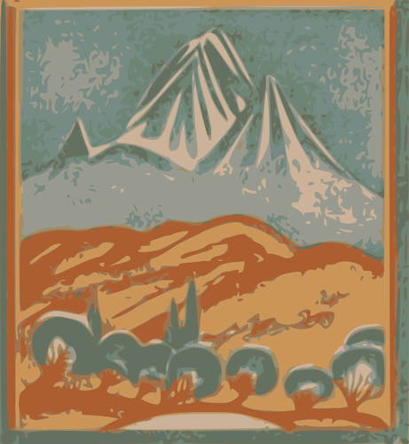



Slide 9

Here’s a picture of the Grand Canyon. Notice all the layers. Geologists call these layers “strata”

Slide 10
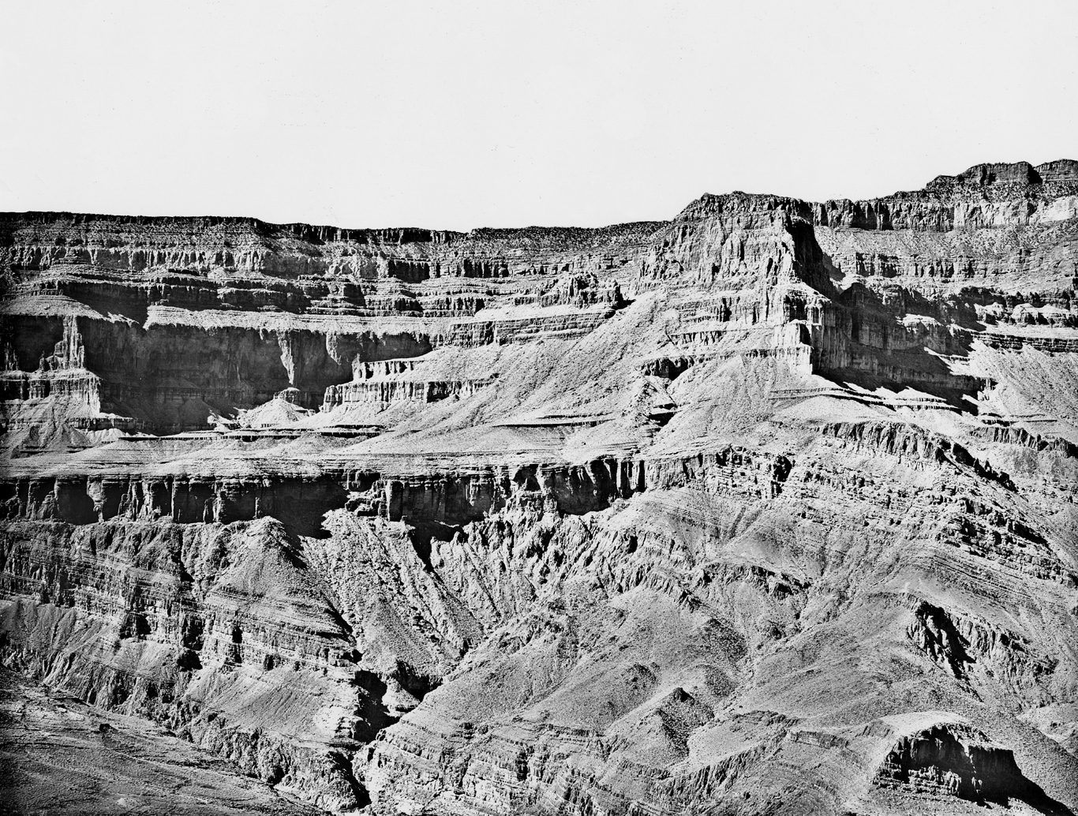
https://education.usgs.gov/images/schoolyard/GrandCanyon.jpg

Slide 11
Here’s how they use these layers to prove their theory that the earth is over 4,000,000,000 years-old.

Slide 12
“Newer rocks are deposited on top of older rocks. The newer rocks cover up the older rocks.
For sedimentary or volcanic rocks, the oldest layers are therefore on the bottom and the youngest layers are on the top. We call this "The Principle of Superposition" (super = top).
Erosion can help expose older layers that were once buried.
Geologists reconstruct the order in which layers were deposited by their relative position (which ones are on top of which). We call this a "relative dating" because we don't know the exact date and time of the event, but only what happened before or after it. Detectives also use relative dates when they reconstruct a sequence of events to help solve mysteries.
While the Principle of Superposition is true to some extent, think about cases when it might not be true. For example, plate tectonic forces can deform and contort rock sequences so much that they sometimes get turned upside down. Or, sometimes underground magma rises upward from the earth's interior and gets deposited beneath other rock layers (we call these rocks "intrusive igneous" rocks because they intrude into the existing rocks, and granite is a common example).:

Slide 13

There’s
A
Problem

Slide 14

Why is having long
periods of time important
to evolutionists?

Slide 15

Changes Needed for Changing Reptiles into Birds
Feathers have to develop from scales
The respiratory system has to change dramatically
The skeletal system and bones must go from dense to hollow for flight
The digestive system needs to re-develop
The nervous system needs to reform
Bills and beaks have to develop
The new creature needs to learn how to fly
Sound producing organs need to develop

Slide 16

The Feather
Primary Feathers
Secondary Feathers
Barbule
Barb
Shaft

Slide 17
So…
what happened to the earth at the time of the Flood?

Slide 18

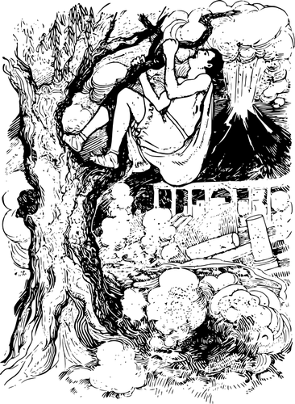
“Noah was now 600 years old. The flood started on the 17th day of the second month of that year. That day the underground springs (the fountains of the deep) split open. And the clouds (the windows of heaven)in the sky poured out rain.”Genesis 7:11

Slide 19
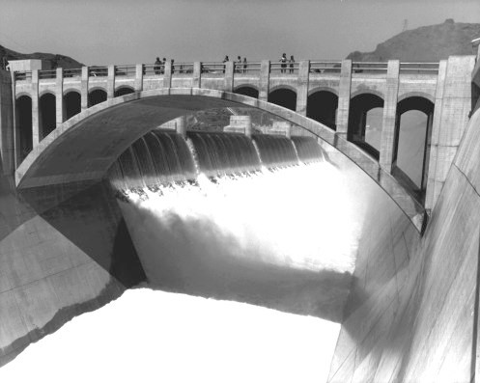
“Window” in Genesis 1:6-8 and 7:11
Window – a lattice, a window, dove-cot (because of the pigeon holes), chimney; sluice (with openings for water). Strong’s #699.
“A lattice opening, where smoke escaped; where sluices in sky (were), opened by (and), through which rain pours destructively.” Brown-Driver-Briggs Hebrew and English Lexicon
“…an artificial channel for conducting water, fitted with a gate at the upper end for regulating the flow…” Webster’s Dictionary.
Photo Credit: USBR.gov

Slide 20
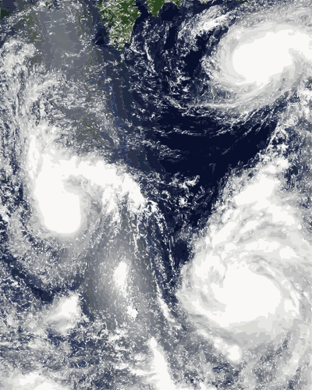
“…the underground springs split open. And the clouds in the sky poured out rain.”Genesis 7:11

Slide 21
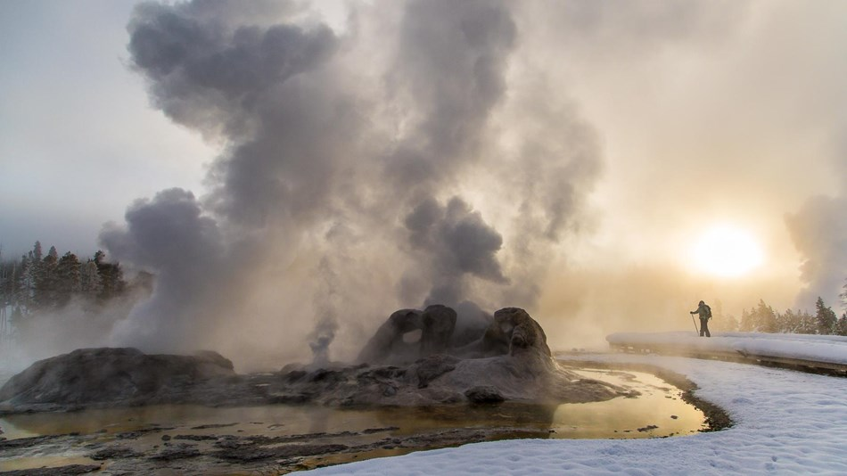
Photo Credit: nps.gov

Slide 22

What were the “springs” of the deep?
“A spring, a fountain, a source, well.”
From Strong’s # 4599.
…In other words…Today we would call
this water that gushed out of the
earth a geyser or possibly a volcano

Slide 23

Notes:
This is a picture of a volcano. We know that the lava that flows out of a volcano from beneath the earth is very very hot. So is the water beneath the earth.

Slide 24

What about
The sky?
Were there any changes in the sky?

Slide 26
In other words…
The firmament had a hammered metal-like quality.

Slide 27

Notes:
This is what hydrogen looks like if you blow it up many many times larger than it actually is.
Draw their attention to the shape of the lattice work.
Today we also know that frozen hydrogen, which is 2/3 of water, seems like a metal.
The Bible says that when God separated the layers of the sky and atmosphere, they were like metal layers.

Slide 28
And…
it had layers!!!

Slide 29
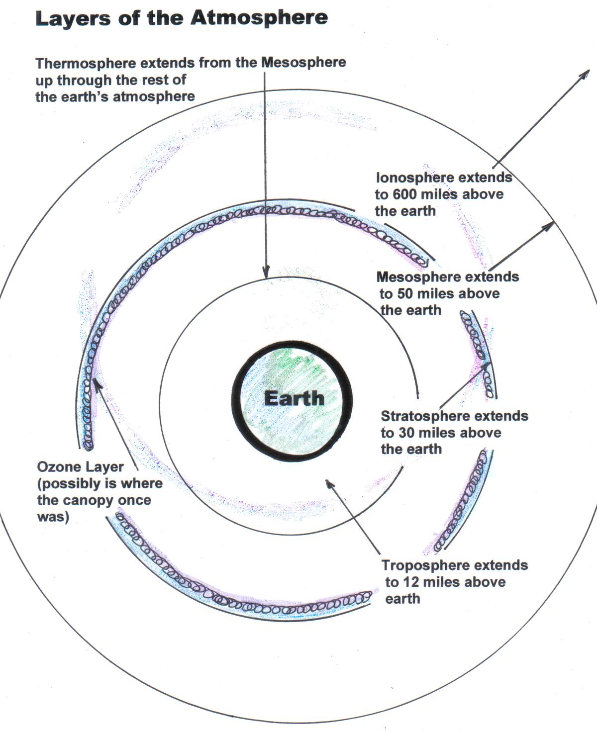

Slide 30
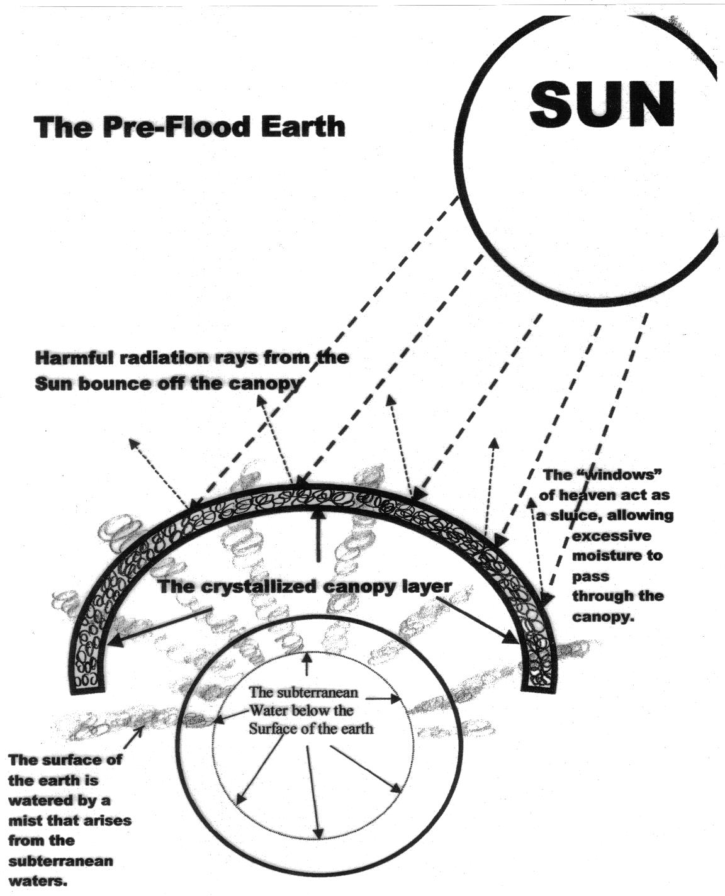

Slide 31
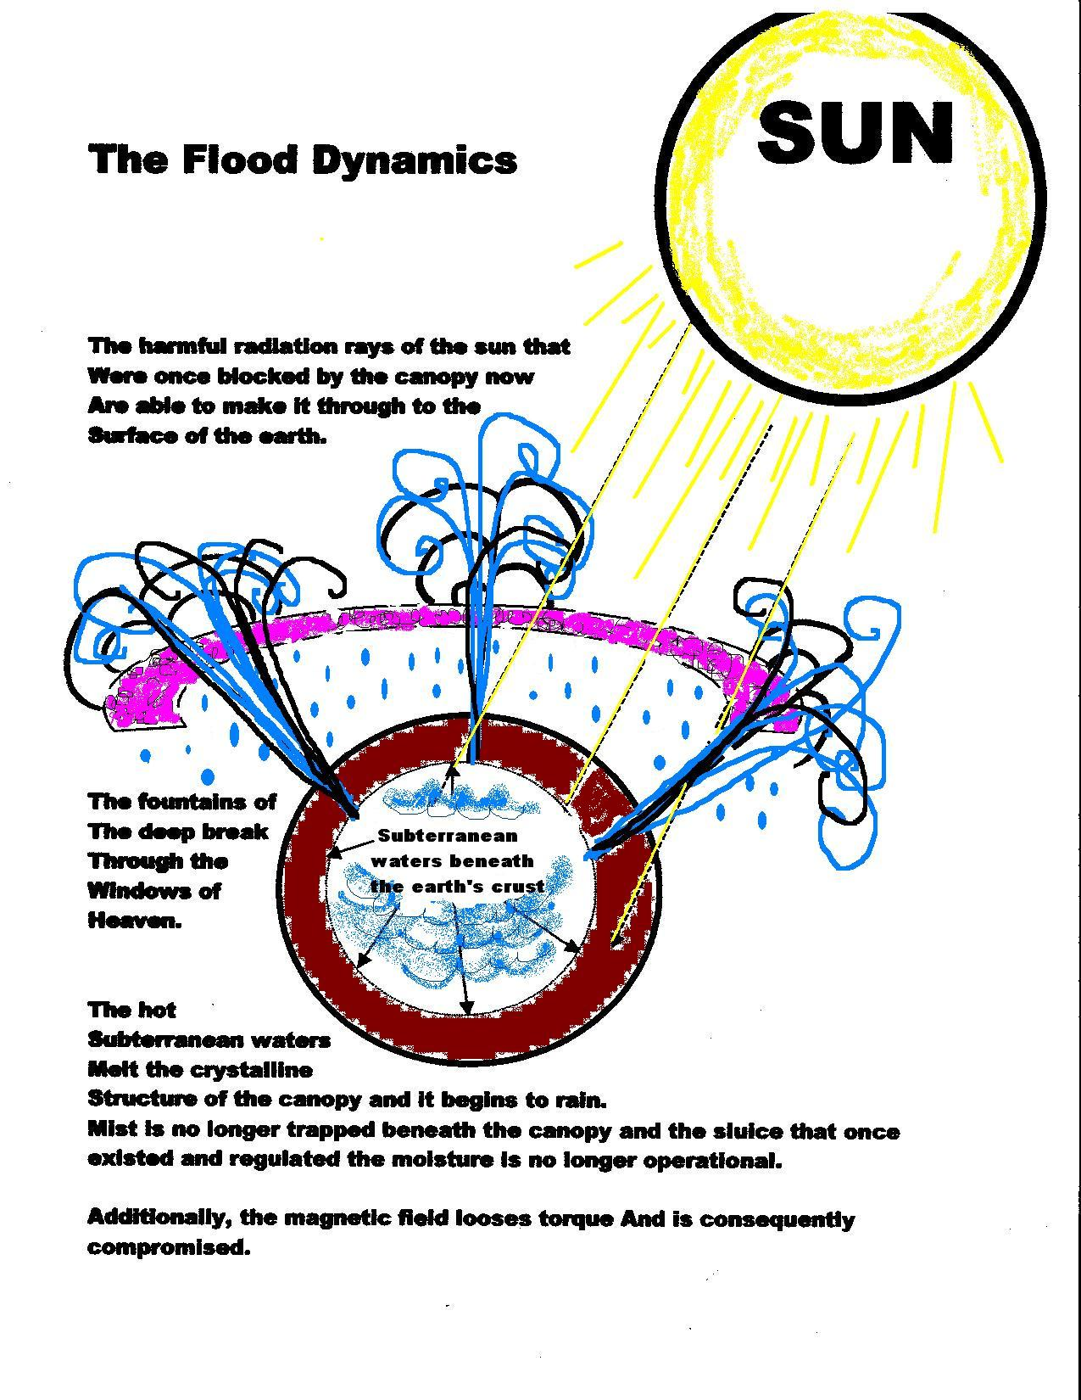

Slide 32
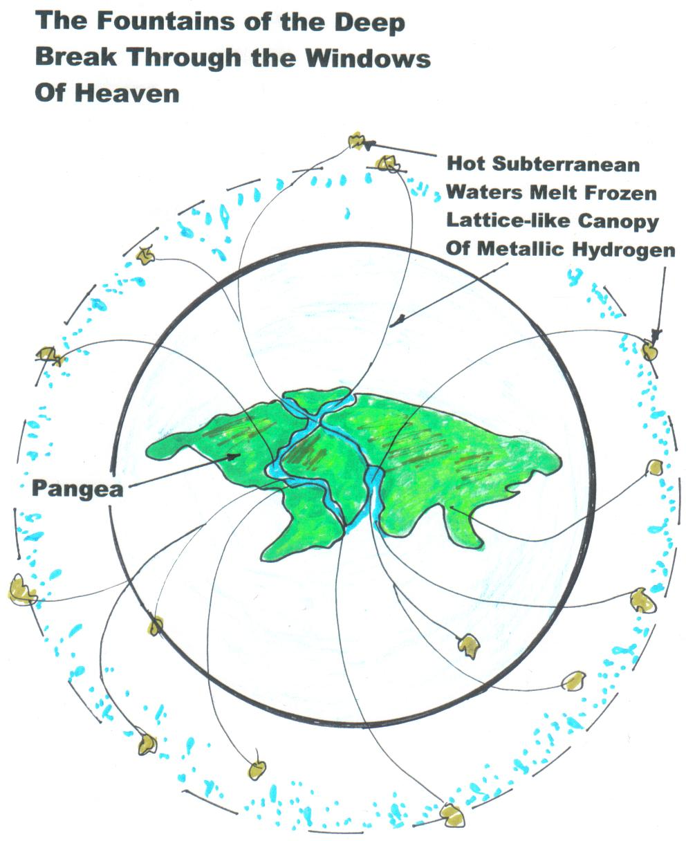

Slide 33

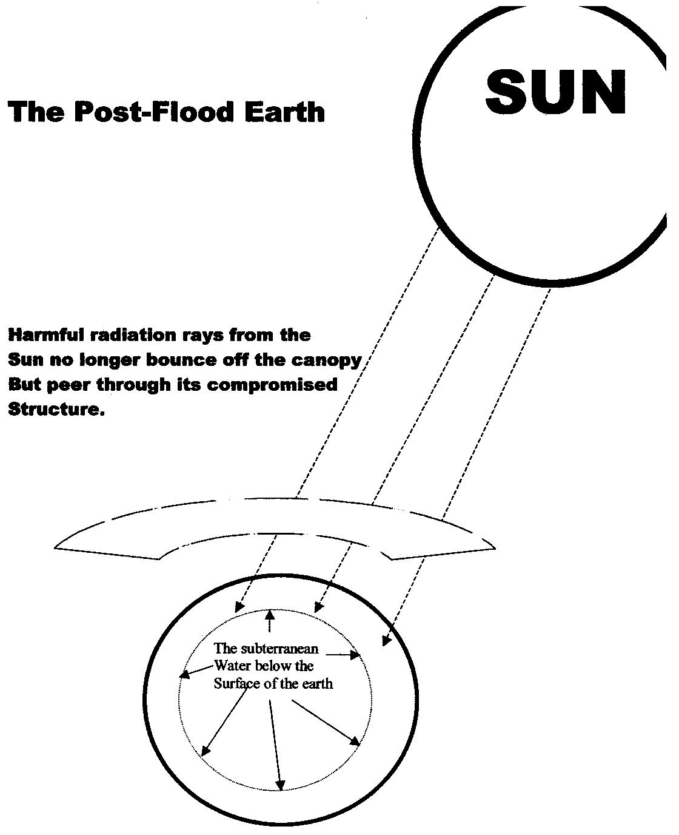

Notes:
After the Flood was over, the layer above the earth must have been quite different than it was before the Flood.
This would have affected life on the earth in many ways. Today we always hear that we shouldn’t spend too much time in the sun. It can be harmful. I don’t think that was the case before the Flood when the layer above the earth protected everything.
I think this also is why the Bible tells us that before the Flood men lived a very long time and after the Flood, that began to change.
The next chart shows us some of those changes.

Slide 34
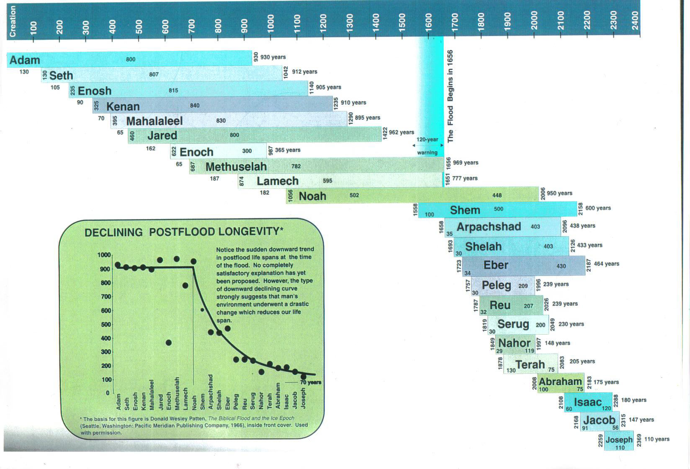

Slide 35
Some important
things to remember
about the flood:

Slide 36
#1
The ark was a HUGE ship:
437 feet long
73 feet wide
44 feet high

Slide 37
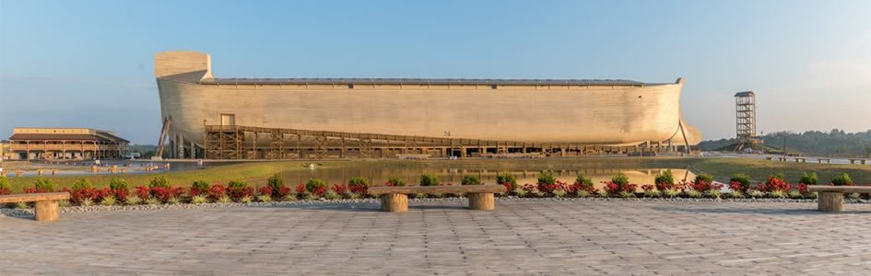

Slide 38
#5

Slide 39

#3
The Bible gives us a lot of information about the flood

Slide 40
And

Slide 41

#4
There are a lot of
Theories
about the flood

Slide 42

Think

Slide 43
Think about who
You should believe..

Slide 44

Should you believe the Evolutionists’
Theory with all its contradictions?

Slide 45
OR…

Slide 46

Should you believe
what God tells us
in the Bible?

