Slide 1
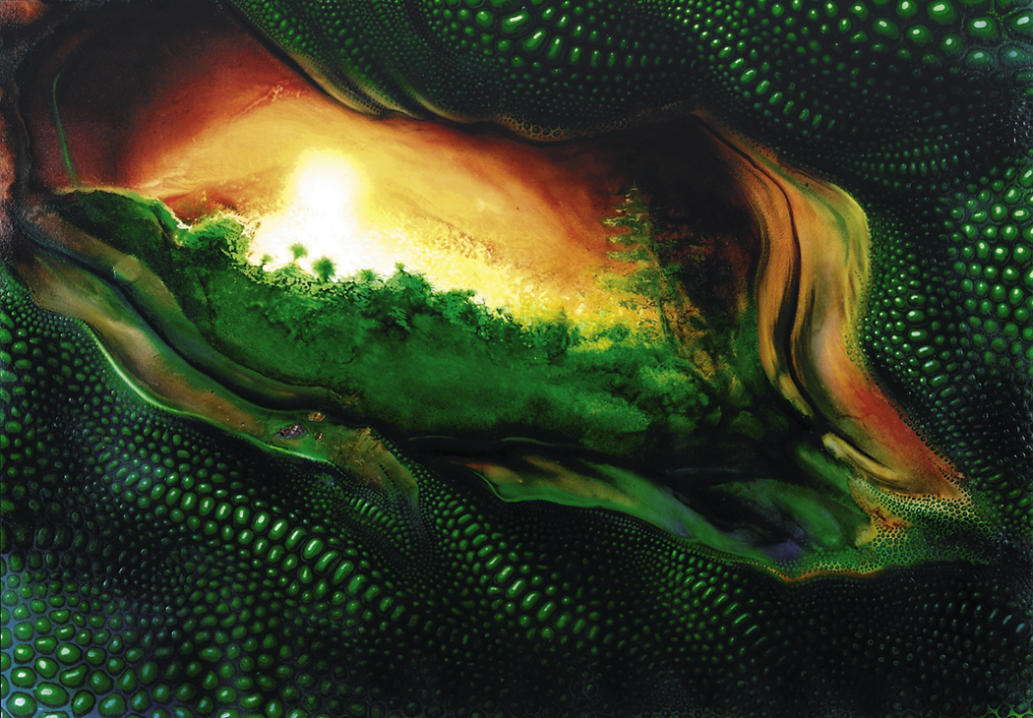
Dinosaurs are
AWESOME creatures

Slide 2


When you think
about
“dinosaurs”
What do you
think about?

Slide 3
If you lived in ancient
China, you might think
of this:

Slide 4


Slide 5


Slide 6


Slide 7


Slide 8
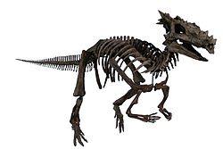
The Childrens Museum of Indianapolis –
Dracorex skeletal reconstruction

Slide 10
If you lived in England
during the middle ages, you might think of this:

Slide 11


Slide 12
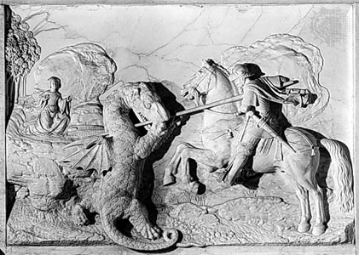
St. George & the Dragon
By Michael Colombe, 1508-09, the Louvre, Paris

Slide 13
If you lived in Cambodia, around eight hundred years ago, this is what you might think a dinosaur looked like

Slide 14


Slide 15
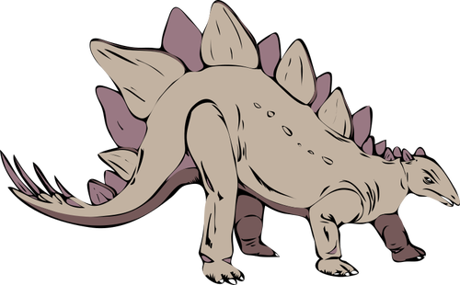

Slide 17
There are many,
many kinds of dinosaurs

Slide 19
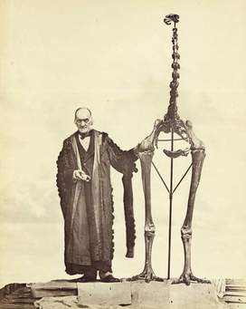
In the early 1800’s, people began discovering large bones that they thought belonged to other animals. It wasn’t until 1841 that British scientist Richard Owen realized that they were actually discovering fossils for another type of animal he called “Dinosauria” meaning “terrible lizards.” This earned him the name of “the man who invented the dinosaur.”

Slide 20
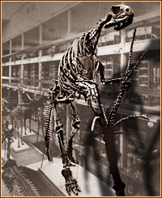
In 1868 this three story high Hadrosaurus foulkii dinosaur was the first dinosaur fossil to be mounted in a museum
Photo Credit: Academy of Natural Sciences

Slide 21

Until museums started putting together pieces of dinosaur fossils being excavated and then displaying them in museums, the average person had no idea what these creatures actually looked like…or did they???

Slide 22
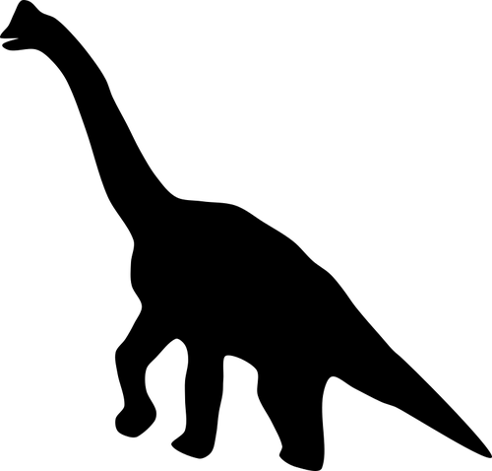
Tenontosaurus
Tenontosaurus tilletti
Pronunciation: teh-NON-toe_SORE-us, TILL-et-eye
Meaning of name: Tillett's tendon lizard
Length: 23 feet (7 meters) for adults. The larger skeleton in the museum is a juvenile (13 feet or 4 meters). The smaller ones are young.
Weight: Estimated 1,500 pounds (680 kg)
Diet: Plants
Range: North America (Montana, Utah, Wyoming)
Age: Early Cretaceous, 115-105 million years ago
What is it?: Tenontosaurus is a dinosaur that is probably related to Iguanodon.

Slide 23
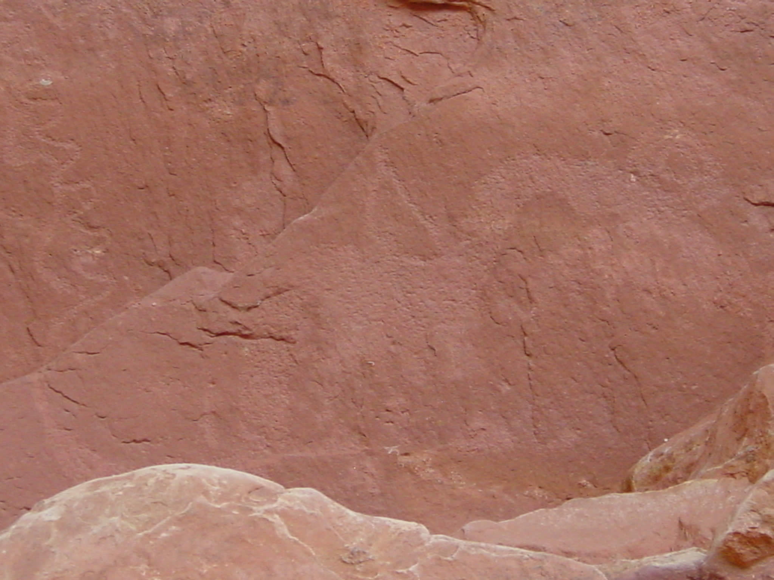

Slide 24
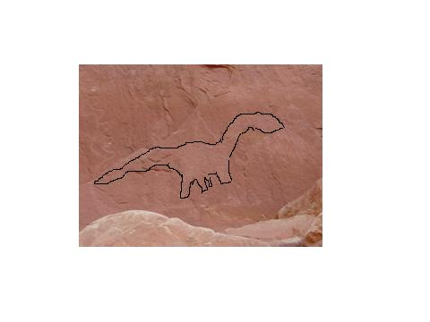

Slide 25
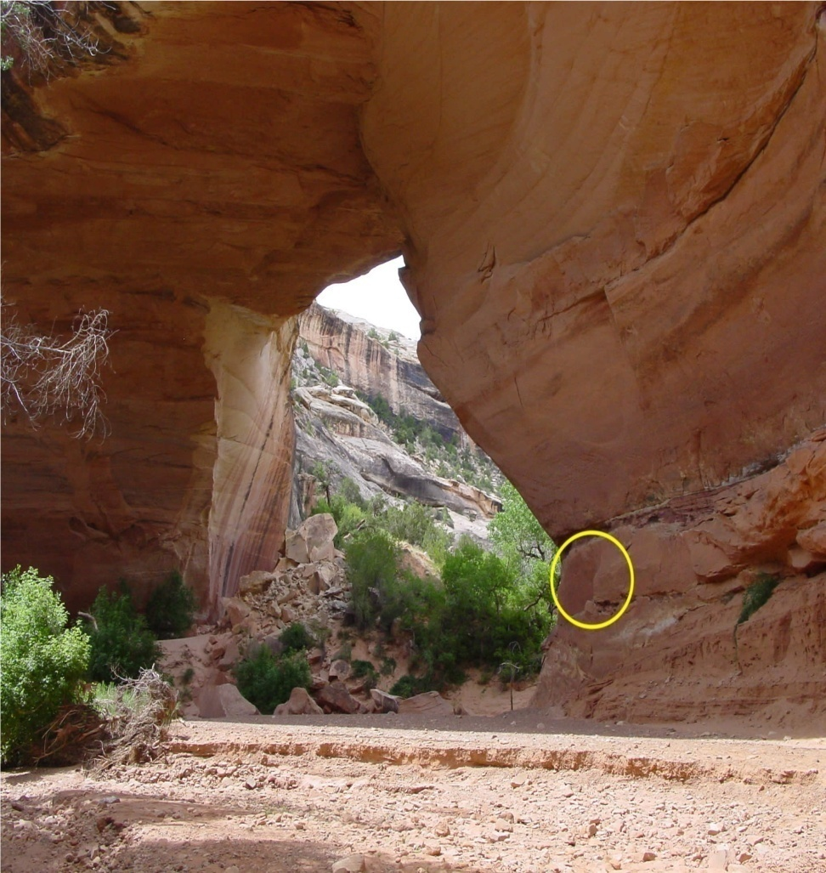
This drawing was found under the Kachina Bridge, a geological formation that is part of National Bridges National Monument in Utah. Thought to have been drawn by the Anasazi Indians, who deserted the area around 1300 AD.

Slide 26

So…how did the Anasazi Indians, who stopped living in this area around 1300 AD, know what a tenontosaurus looked like if the first dinosaur wasn’t put together for a display until 1868 AD – over 500 years after the petrogylph in Utah had been drawn?

Slide 27

Here’s a question those who believe in Bible are often asked about the Flood…

Slide 28
How did
Dinosaurs
fit on the ark?

Slide 29


Did you know that
Baby dinosaur eggs
Weren’t bigger than
The size of a football?

Slide 30

…which means that when dinosaurs were born, they would have had to have been small enough to fit inside a football.

Slide 31
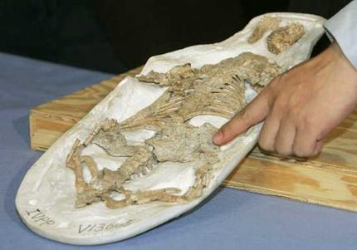
“Scientists have long thought mammals did not begin a true growth spurt until after dinosaurs were wiped out 65 million years ago.”The Boston Globe 1/13/2005
This fossil was found in China’s north-eastern region.
The fossilized remains of a juvenile dinosaur found in the remains of 130-million-year-old cat-sized mammal. Photo: Reuters

Slide 32


Slide 33
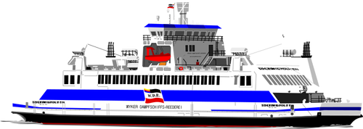


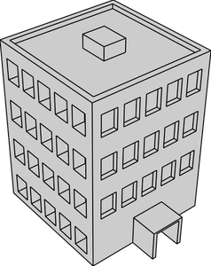


44 feet high
437 feet long
44 feet high
The ark was BIG – HUGE – REALLY, REALLY BIG!

Slide 34
…and baby dinosaurs were
small

Slide 35

A lot of what we think comes from our worldview

Slide 36
OR…

Slide 37

The lens through which we view the world

Slide 38
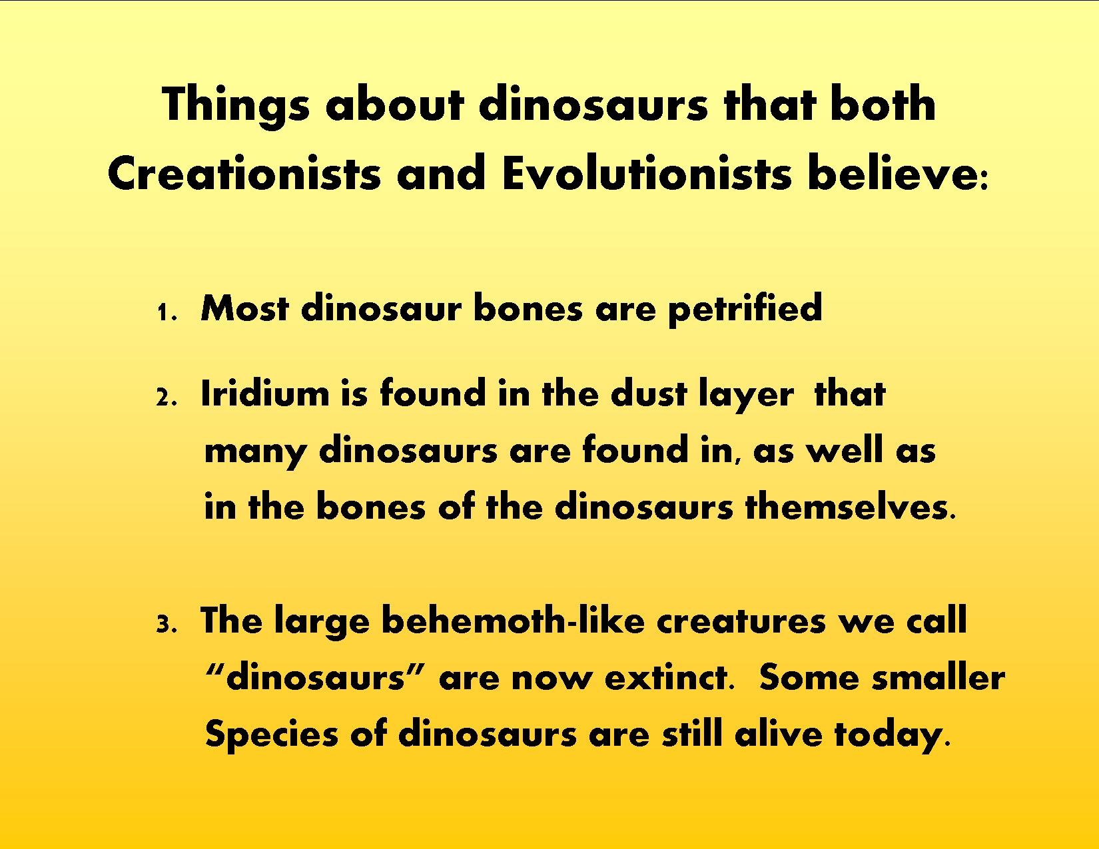

Slide 40


Slide 41
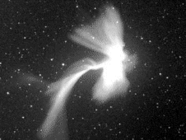
A Leonids meteor explodes in Earth's upper atmosphere on Nov. 23, 1998. (Robotic Optical Transient Search Experiment (ROTSE) team.)
https://www.nasa.gov/connect/chat/comet_chat.html

Slide 42

https://www.usgs.gov/products/data-and-tools/real-time-data/volcanoes

Slide 43
Job:40:15-17 “Look at the behemoth. I made him just as I made you. He eats grass like an ox. Look at the strength he has in his body. The muscles of his stomach are powerful! His tail extends like a cedar tree.”

Slide 44



Slide 46
Evolutionists believe dinosaurs went extinct million years ago
65

Slide 47
They have a lot of theories of how this might have happened

Slide 48
Theory?
What is a

Slide 49

A theory
is an idea that explains data

Slide 51

Here’s another problem with their timeline

Slide 52





“Science shows that dinosaur fossils are found with plants that are very familiar to us, such as sassafras, oak, magnolia, palm, willow, and grasses. But according to evolutionary theory, these should not be found with dinosaurs because these plants did not evolve until millions of years after dinosaurs went extinct.”

Slide 53

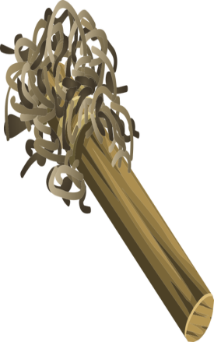

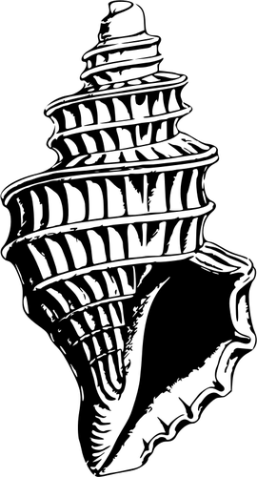


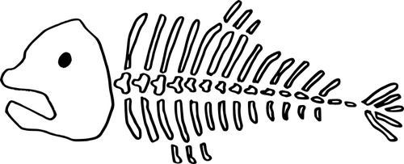
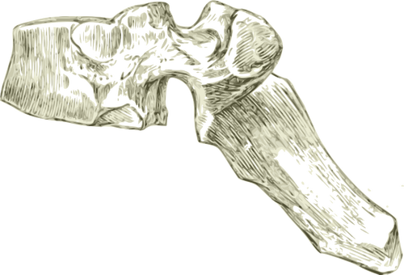

Slide 54


Time to stop and think.

Slide 55
Paleontology is a field of biology that developed in the 19th century.
“(it) was intended by the editor of a French scientific journal to refer to the study of ancient living organisms through fossils.”
Wikipedia: History of Paleontology

Slide 56
So…how did the Anasazi Indians know how to draw a picture of these creatures in
1300 AD that went extinct over millions of years ago if they never saw one?

Slide 57
Paleontology is a field of biology that developed in the 19th century.
“(it) was intended by the editor of a French scientific journal to refer to the study of ancient living organisms through fossils.”
Wikipedia: History of Paleontology

Slide 58
So, how did the Anasazi Indians, who lived 600 years before the paleontologists began digging up fossils, know how to draw an anatomically correct Tenontosaurus if such an animal had not been excavated by paleontologists during the time the Indians lived?

Slide 59
OR…

Slide 60
How did the ancient Chinese know how to create artwork that looks just like Dracorex, which had supposedly gone extinct millions of years ago if they never saw one?

Slide 61
OR…

Slide 62
How did the ancient Cambodians know how to carve an anatomically correct image of a Stegosaurus on their temple if they never saw one because they had gone extinct so many of millions of years ago?

Slide 63
And isn’t it strange that Dracorex and Tenontosaurus fossils were found in the areas where there is ancient artwork that depicts them accurately anatomically?

Slide 64

Yes, it would be more than strange if these animals went extinct before the artists were able to see them!

Slide 65
AND…
Does “science” ever get it wrong?

Slide 66

Ever hear of the
Brontosaurus?

Slide 67


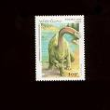
The Brontosaurus was discovered in 1879. Its name means “Thunder Lizard”. It walked on four legs and had a long neck and a long tail. It was one of the most famous dinosaurs of all times. It was later discovered in 1970 that it had the head of a Camarasaurus.
1995
Dinosaur Stamps
1991

Slide 68
The appearance of different life forms in the geologic record
MARY HIGBY SCHWEITZER: I was working on the leg bones. And as I worked, I noticed a bunch of stuff. It was like, you know, "This bone, it's hollow inside." And I was looking at this thing thinking, "This is really interesting.“ (Paleobiologist at North Carolina State University)
PETER STANDRING: It was the inside of the T. rex bone that fascinated Schweitzer, who made thin sections out of it. And in these cross-sections of fossilized bone, she saw something that she and everyone else had thought was impossible: round structures that looked like red blood cells, dinosaur blood cells. (Correspondent for NOVA)
DEREK BRIGGS: Because we have this clear understanding that part of all biological cycles involves decay. I mean, nature is set up to break down that material and recycle it. So it's just improbable that those kinds of very delicate structures would survive, particularly for millions of years.(Curator of invertebrate paleontology at Peabody Museum at Yale University)
MARY HIGBY SCHWEITZER: When you think about it, the laws of chemistry and biology and everything else that we know say that it should be gone. It should be degraded completely.
PETER STANDRING: Flexible tissue? From a 68-million-year-old dinosaur?
MARY HIGBY SCHWEITZER: Blood vessels, transparent, hollow, pliable, flexible branching blood vessels that contained small, round, red microstructures floating in the vessels. I said, "This is not possible. Do it again.“ (Schweitzer speaking to lab assistant at NC State University)
We got another piece of bone, we put it in the solution, we waited two or three or four weeks, looked again...more blood vessels. We must have repeated that with probably 17 or 18 different fragments of bone.
NOTE: These excerpts were taken from a NOVA interview conducted on July 24, 2007.

Slide 69


Slide 70
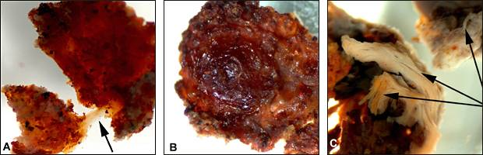
Elastic tissue fragment
Fresh looking sample
Fibrous structure still visible in bones

Slide 71

If you’re thinking “Jurassic Park”…sorry, not enough DNA

