Slide 1
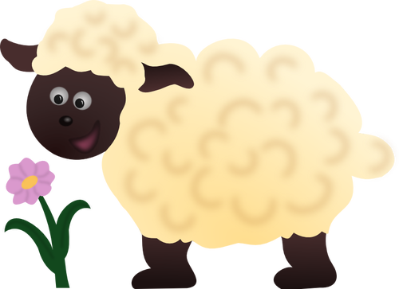
Behold the Lamb of God

Slide 2
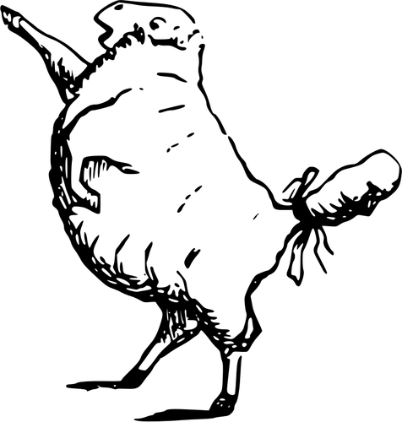
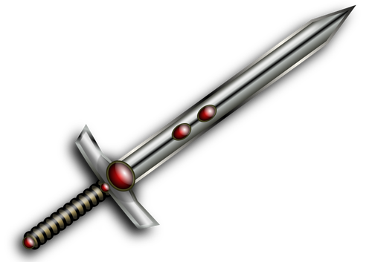
Sin
“…Behold the Lamb of God
who takes away
the sins of the world.”

Slide 3
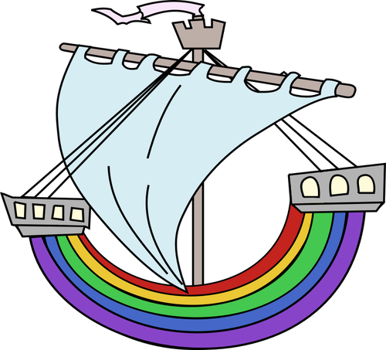
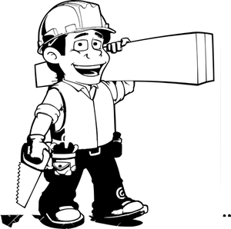

Slide 4


“ And Abraham lifted up his eyes and looked, and behold, behind him was a ram, caught in a thicket by his horns. And Abraham went and took the ram and offered it up as a burnt offering instead of his son. ¹⁴ So Abraham called the name of that place, ’The Lord will provide'; as it is said to this day, ‘On the mount of the Lord it shall be provided’.” Genesis 22:13-14

Slide 5
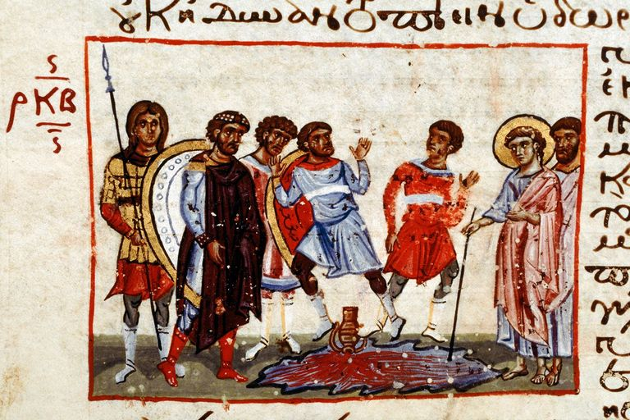
Moses turns the water into blood.

Slide 6

Next, he brings an infestation of frogs onto the land.

Slide 7
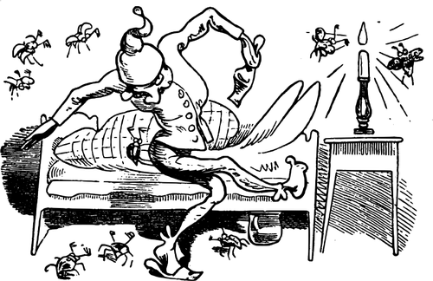
Then he brings gnats or lice on the land – on all the people
and on all the livestock.

Slide 8
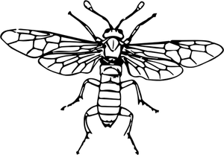

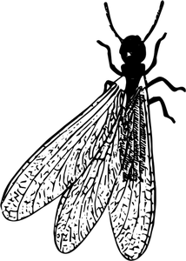
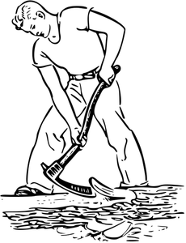
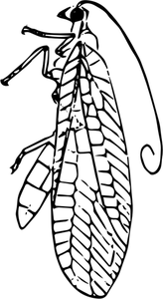
Next, Moses sent flies on the land – lots and lots of flies.

Slide 9

Next, all the livestock was struck dead.

Slide 10
Next, Moses brought boils on all the Egyptians and their animals.

Slide 11
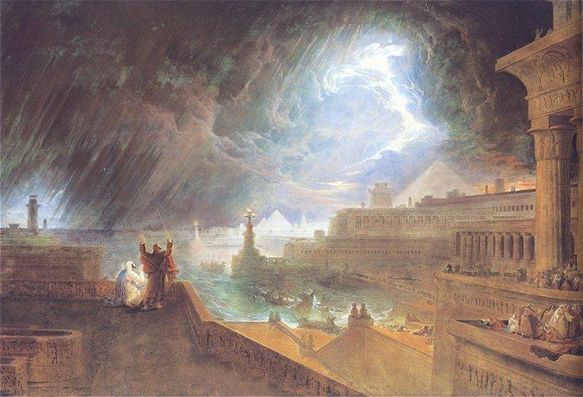
Next, it rained hail and fire!

Slide 12
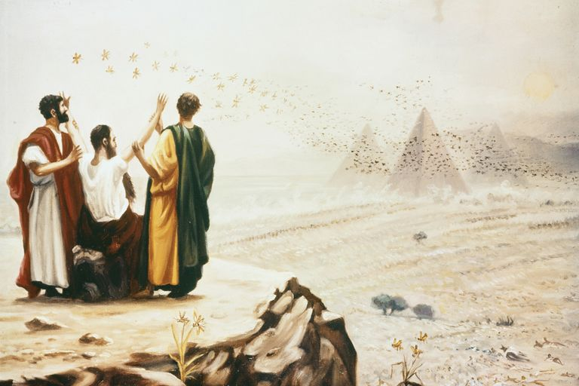
Then, the locusts were sent to devour everything that was left.

Slide 13
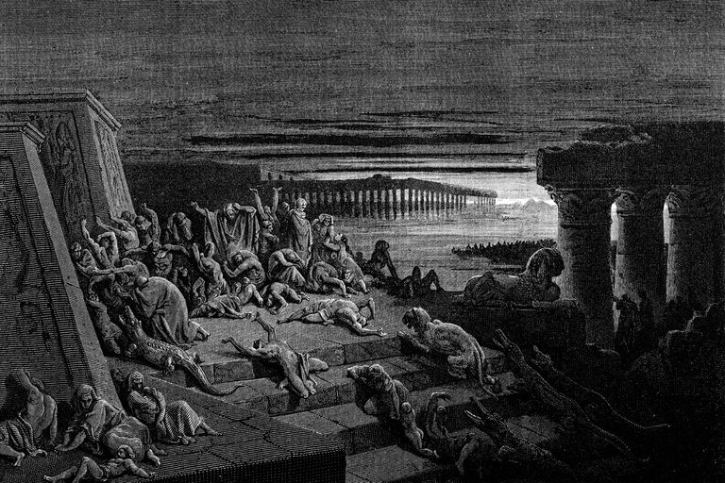
Then, there was darkness on the land for three days.

Slide 14
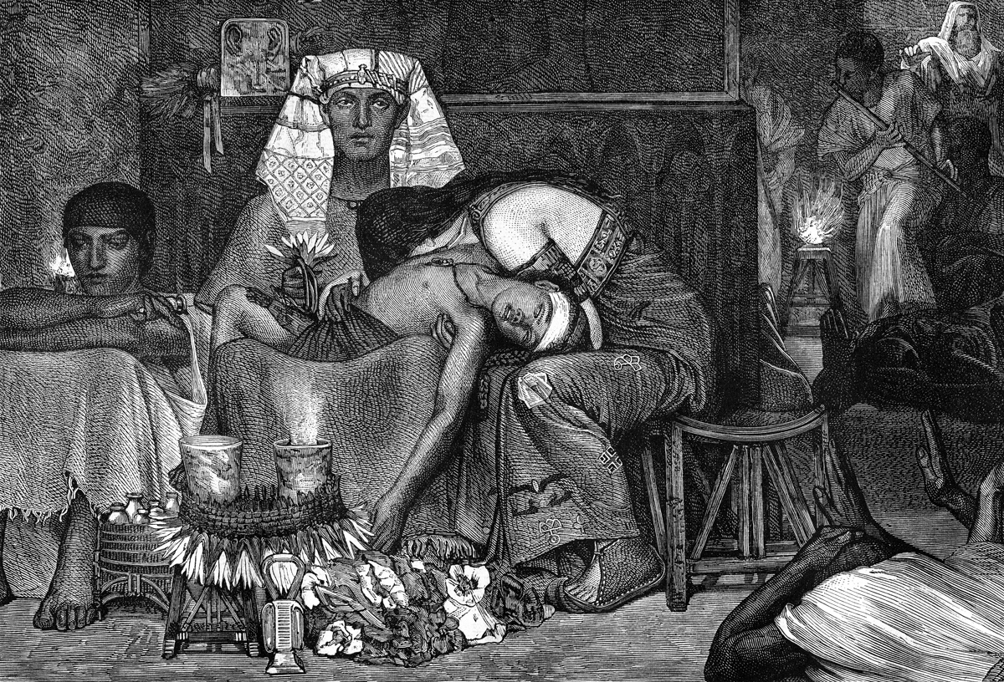
Finally, the last plague that was just too much for Pharaoh and his people to bear, the death of the firstborn of Pharaoh and everyone – including the firstborn of the livestock.

Slide 15
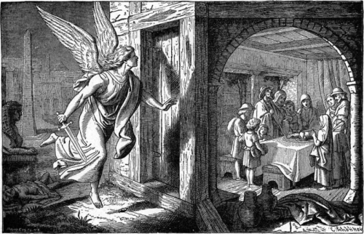

Slide 16
