Slide 2
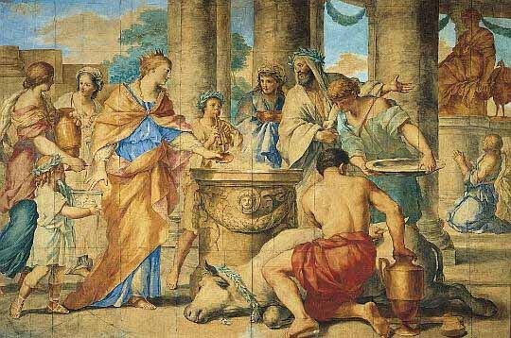
The Romans also practiced animal sacrifice.

Slide 3


Slide 4
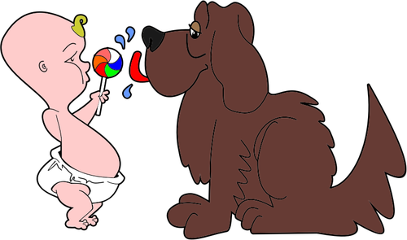
“…for it is the life of all flesh.
Its blood sustains life.” Leviticus 17:14

Slide 6

“And they sang a new song saying, ‘You are worthy to take the scroll and open its seals, because you were slain, and with your blood you purchased for God persons from every tribe and language and people and nation.’” Revelation 5:9

Slide 9



S
I
X
S
T
O
R I
E
S
4 “

Slide 10
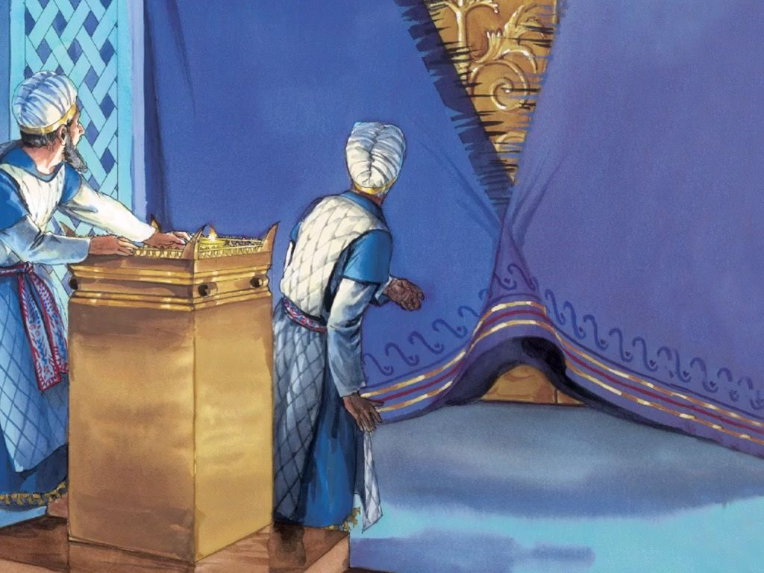

Slide 11
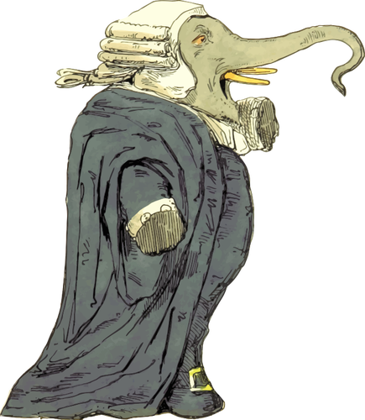


Slide 12

“And by that will, we have been made holy through the sacrifice of the body of Jesus Christ once for all.” Hebrews 10:10

Slide 14
