Slide 1


The lens through which we view the world

Slide 3

Whether
you’re a creationist
or
an evolutionist,
we all look at
the
same data

Slide 10
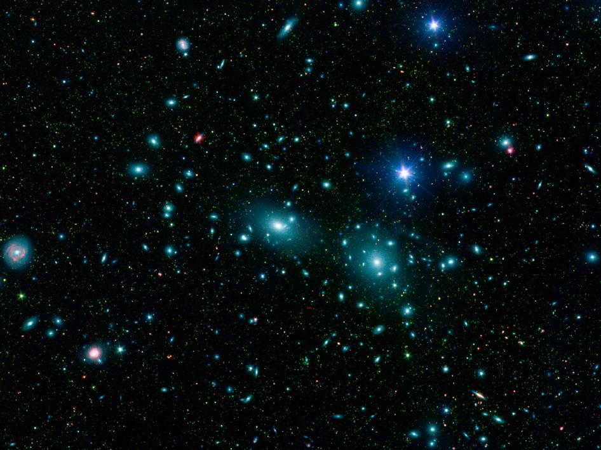

DNA and RNAI confirms Genesis that all animals reproduce after their
own kind.

Slide 14


“People on earth did what God said was evil. Violence was everywhere.” Genesis 6:11

Slide 15




Slide 16
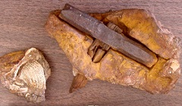
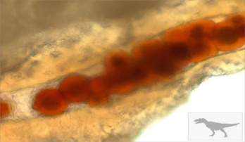
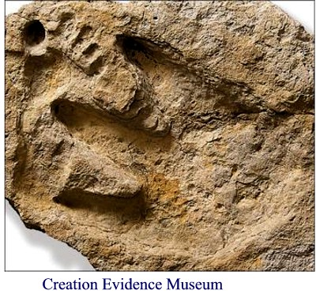

Other Contradictions
Iron hammer found in 100 million year old rock layer, 98 million years before humans were supposed to have evolved. By Source (WP:NFCC#4), Fair use, https://en.wikipedia.org/w/index.php?curid=41582407
Blood found in T-Rex femur by Dr. Mary in 2005. According to evolution, T-Rexes went extinct 70 million years ago, but the blood cells were still viable and liquid and had not disintegrated over time as they should have.
Human footprints found along side dinosaur tracks in the Paluxy River in Glen Rose, Texas. Dinosaurs supposedly went extinct over 60 million years before man evolved.
Human femur found in Shenandoah region of Pennsylvania by Ed Conrad in rock layer designated to be 307 million years old, over 250 million years before man was supposed to have evolved.

Slide 17

What do you think about when you think about Noah’s Ark?

Slide 18


Slide 19
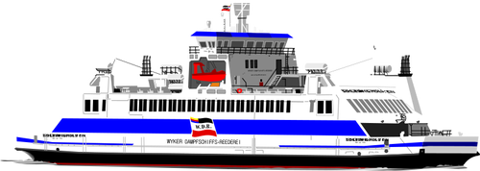





44 feet high
437 feet long
44 feet high

Slide 25


Slide 26


Did you know that baby dinosaur eggs weren’t bigger than the size of a football?

Slide 29

You can be like God

Slide 30

Should
Christians be involved in politics?

