Slide 4
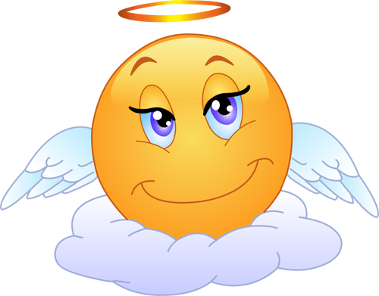
“If men were angels, we would have no need of government.”

Slide 5
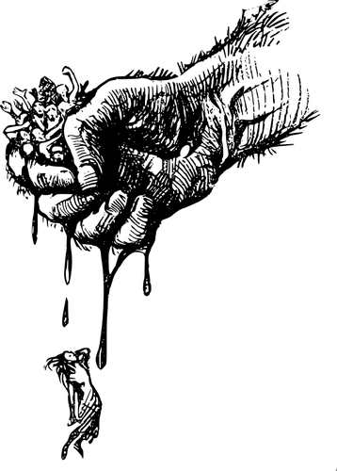
Tyranny – cruelty and injustice in the exercise of power or authority over others, oppressive government by one or more people who exercise absolute power cruelly and unjustly.

Slide 6
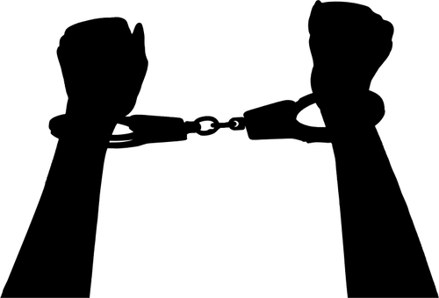
“For freedom Christ has set us free; stand fast, therefore, and do not submit again to a yoke of slavery.” Galatians 5:1

Slide 8


“And when they had brought them, they set them before the council. And the high priest asked them saying, ‘Did we not strictly command you not to teach in this name (the name of Jesus)? And look, you have filled Jerusalem with your doctrine, and intend to bring this Man’s blood on us!’ Then Peter and the other apostles answered and said: ‘We must obey God rather than men.’” Acts 5:27-29

Slide 10
"Without a firm moral foundation, freedom degenerates quickly into selfishness...Unless men exercise their freedom...within moral restraints, a free society can degenerate into anarchy." President Harry S. Truman, April 3, 1951

Slide 11
"Liberty becomes a question of morals more than of politics." Lord Acton

Slide 12
"Power tends to corrupt and absolute power corrupts absolutely..." Lord Acton

Slide 13
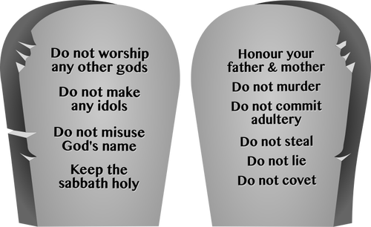
Do not steal…Do not covet

Slide 14
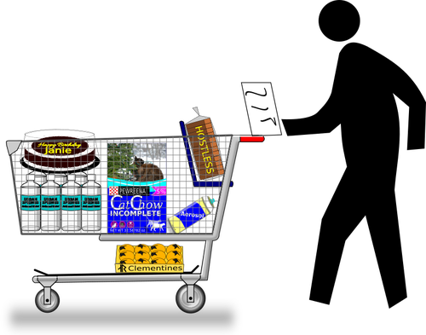
"But if anyone does not provide for his own, and especially for those of his household, he has denied the faith and is worse than an unbeliever." 1 Tim. 5:8

Slide 15
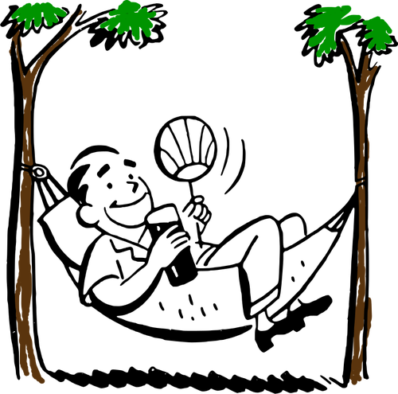
"If anyone is not willing to work, then he is not to eat." 1 Thess. 3:30

Slide 16

."We hold these truths to be self-evident, that all men are created equal, that they are endowed by their Creator with certain unalienable Rights, that among these are Life, Liberty and the pursuit of Happiness."

